Slide 1
Utilizing AIRS for Research COI Assessment
12/2013

Slide 2
Revised COI policy
Why has the COI process and reporting changed?
Public Health Service (PHS) Final Rule
Published in Federal Register August 25, 2011
Implementation August 24, 2012
Virginia State and Local Government Conflict of Interests Act
Section 2.2-3100.
Specifically restricts the ability of employees to have personal interests in certain contracts with their own or other governmental agencies
Increased public demand for transparency

Slide 3
Financial Conflicts of Interest
Financial Conflicts of Interest in research occur when the Investigator, or any member of that person’s immediate family (spouse and any other person residing in the same household as the researcher, who is a dependent of the researcher or of whom the researcher is a dependent), possesses a Significant Financial Interest (SFI) that is in conflict with his or her institutional responsibilities, such as the design, conduct, or reporting of research.
From VCU policy: Research Conflict of Interests
Reported Financial Interests include:
salary or other payments for services (e.g., consulting fees, honoraria, or payments for serving on a corporate Board of Directors, Scientific Advisory Board, or holding a position in a company) from an entity(ies) other than VCU;
income from seminars, lectures, service or teaching engagements sponsored by for-profit entities, federal, state, or local agencies or public or non-profit entities;
equity interests (e.g., stocks, stock options, or other ownership interests);
income related to intellectual property rights (e.g., patents, copyrights, and royalties from such rights,); and
travel that is reimbursed or paid by a third party (i.e., travel that is arranged and paid for directly by an organization so that the exact monetary value may not be readily available) related to an Investigator’s Institutional Responsibilities.
Financial Interest does not include salary, reimbursement or travel payment originating from VCU, VCUHS, or MCVP, with the exception of royalties/ payments from VCU IP Foundation.

Slide 4
Significant Financial Interests (SFIs)
SFIs include the following:
financial interest in a publicly traded entity that, individually or in aggregate, exceeds $5,000 on the date of disclosure or during the 12 months preceding an investigator’s report (e.g. consulting, honoraria; equity or ownership interest including stock, stock options).
any financial interest, or ownership interest, in a non-publicly traded entity, eg. a start up company.
income related to intellectual property rights and interests (e.g., patents, copyrights), upon receipt of income, such as royalty payments, related to such rights and interests.
Travel, by itself or in combination with other Financial Interests, may be SFI.
SFI exclusions:
Salary or reimbursements paid by VCU, with the exception of payment from the VCU Intellectual Property Foundation.
Income from investment vehicles, such as mutual funds and retirement accounts, as long as the investigator does not directly control the investment.

Slide 5
‘COI investigators’
‘Investigator’ describes any individual, regardless of title, role or position, who is responsible for the design, conduct, or reporting of research. By considering an individual’s degree of independence relative to the research, the Principal Investigator on the proposal or protocol designates the individuals who meet the definition of ‘Investigator.’
Consider: When designating ‘COI Investigator,’ independence and responsibility should be comparable/near comparable to PI.
Designated ‘investigators’ enter the AIRS to complete a Financial Interest Report(FIR).
‘Investigators’ report Financial Interests, regardless of research funding, in the AIRS.
Each Investigator reports requested Financial Interests held by himself or herself, or any member of his or her immediate family (spouse and any other person residing in the same household as the researcher, who is a dependent of the researcher or of whom the researcher is a dependent).

Slide 6
Who is a ‘COI investigator’? (not all individuals on a proposal/protocol are ‘COI investigators’!)
Might be a ‘COI investigator’
Probably NOT a ‘COI investigator’
PI on proposal/protocol **
Co-PI **
Co- or sub-Investigators *
Key/Senior Personnel on proposal *
Project manager/director *
Student (usually graduate/trainee) who is ‘functional’ PI on protocol *
Medical investigator *
Research staff authorized to make independent decisions without PI consultation *
Consultant who will make decisions about design, conduct, or analysis/reporting *
** always * very likely
Students under the direct supervision of PI/Co-PI/Co-I
Research staff, including engaged community members, under direct supervision (i.e., they must consult with PI, have no/limited independent decision making authority)
Research-related personnel whose jobs support the research enterprise, eg. Investigational pharmacists, lab technicians, CRSU staff
Anyone other than the PI on a training , practice, resource grant

Slide 7
What do PIs need to do?
Determine which individuals listed on OSP application, IRB, or IACUC protocol are ‘COI investigators’.
Notify all designated ‘COI investigators’ on the pending proposal/protocol submission to enter the AIRS to report/update FIs and research relatedness, if any.
Work with OSP or IRB, re: Non-VCU collaborators
Pertains to PHS or other adherent entities for OSP.
Pertains to any non-VCU investigator who is designated as ‘COI investigator’ on an IRB application.

Slide 8
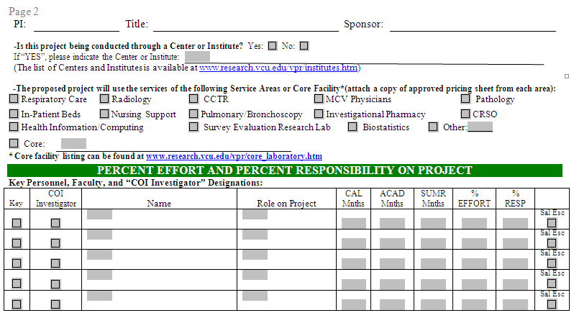
PI designates an ‘investigator’ on IAF

Slide 9

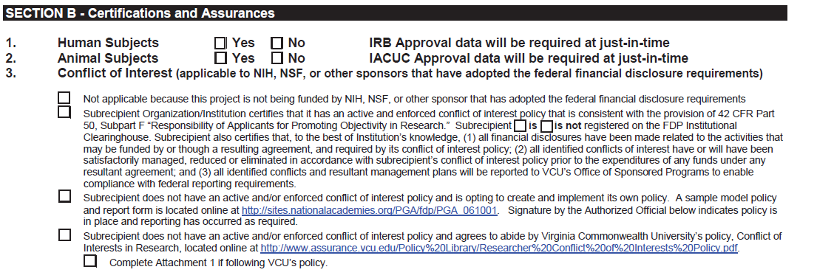
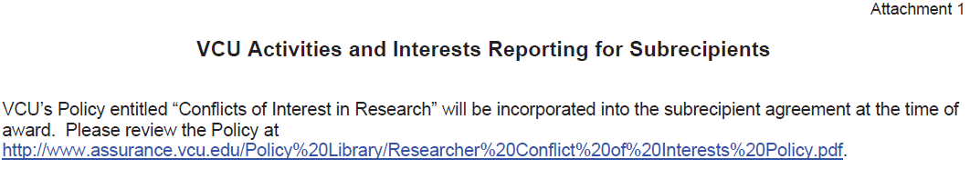
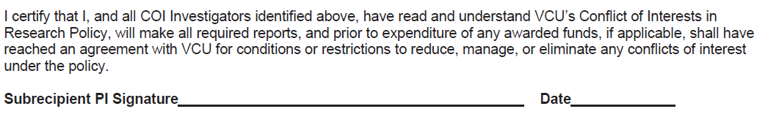

Slide 10
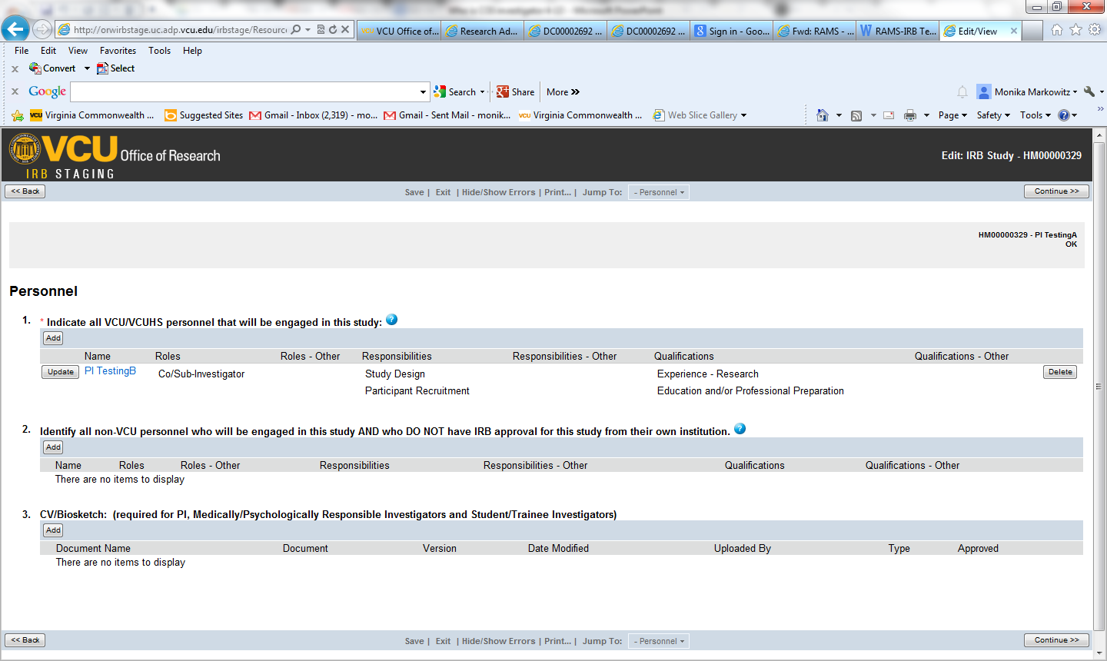
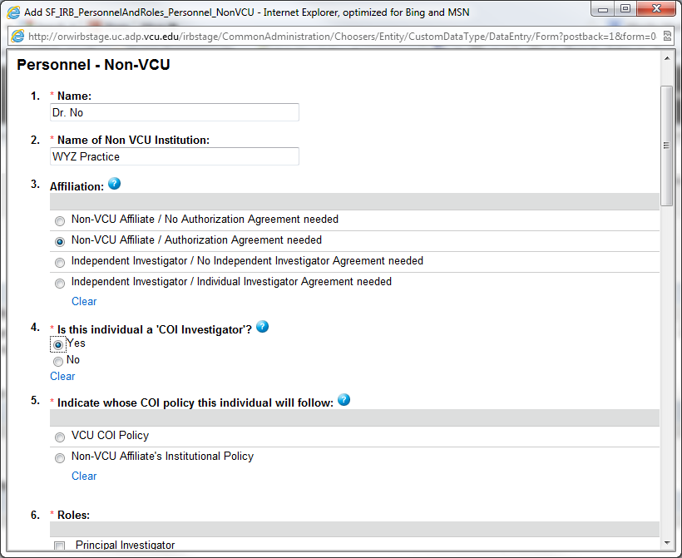
Indicate non-VCU collaborators and ‘COI Investigators’ in RAMS-IRB(and IACUC)

Slide 11
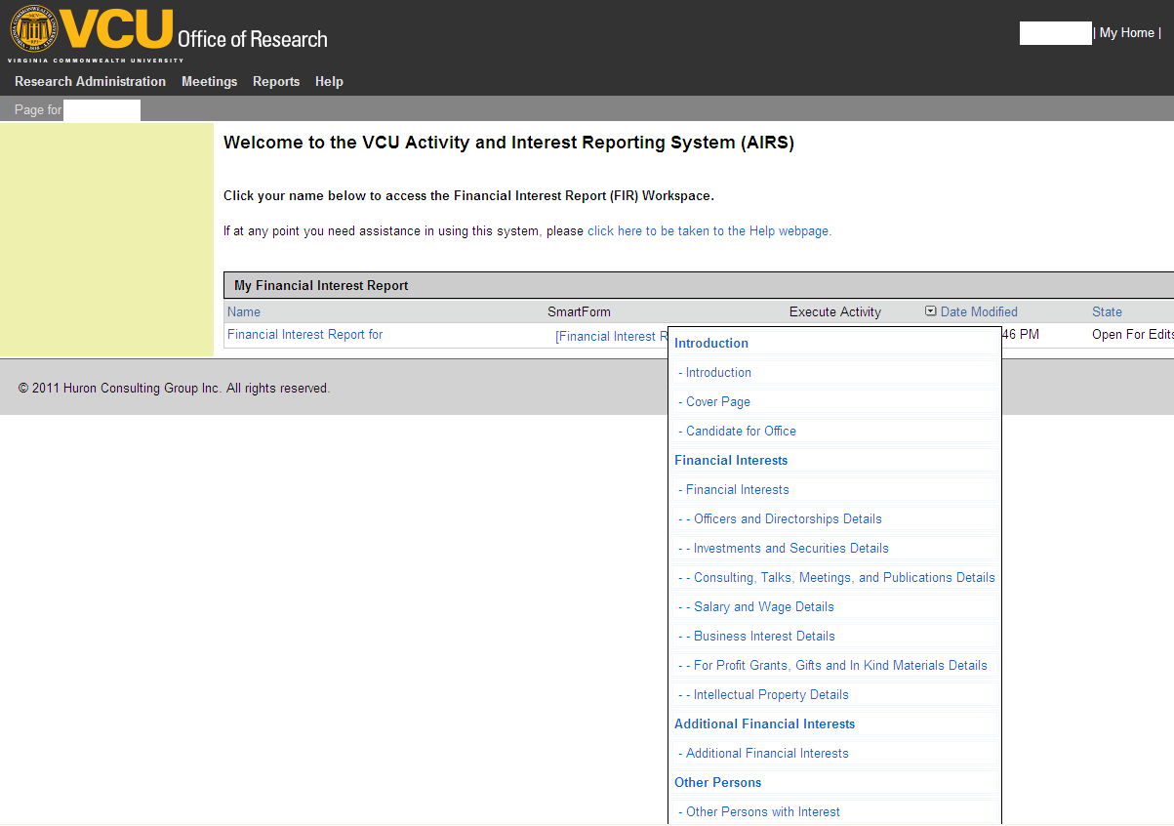
Activity and Interest Reporting System (AIRS)
http://airs.research.vcu.edu/ | Use VPN to access outside of VCU - https://vpn.vcu.edu Each ‘investigator’ enters own FIs into the AIRS – login with eID & password

Slide 12
Mandatory Training
Training precedes initial FI reporting in the AIRS
PHS regulations require investigator training:
initially,
every 4 years, and
immediately under the following circumstances
Institutional Financial Conflict of Interests policies change in a manner that affect Investigator requirements
An Investigator is new to the Institution
Institution finds that an Investigator is not in compliance with the Institution’s Financial Conflict of Interests policy or management plan.
Included in training is Read-only Content (no quiz):
PHS Rule on “Promoting Objectivity”
VCU Policy on Research COI, including Procedures

Slide 13
‘Investigator’ reporting in the AIRS
Initial/annual – Report for ‘now’ and last 12 months:
Financial Interests (FI) for self and immediate family
Research relatedness, if any, to all proposed or ongoing research
Annually affirm/update accuracy of reported FIs for ‘now’ and last 12 months.
Update – Report:
FI within 30 days of discovery/acquisition of a new entity OR if same entity but new interests are >$5000 in aggregate.
Travel update ONLY if new entity is paying
updated research-relatedness, if applicable
May need to update research relatedness for new proposal/protocol based on existing FIs
Nothing to update? No relatedness? If entered/updated in last 12 months, no need to re-enter AIRS for specific proposal/protocol submission unless there’s a change!

Slide 14
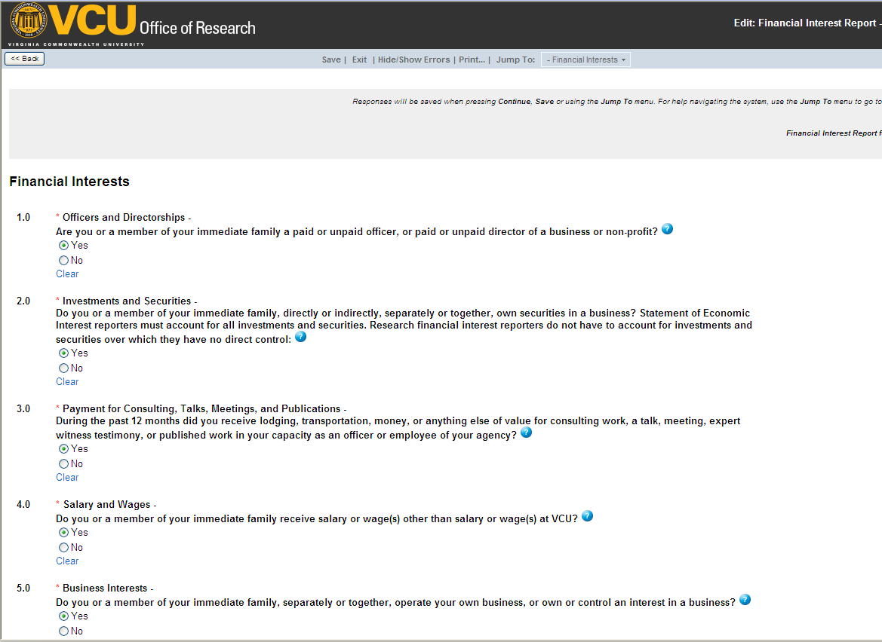
Financial Interests Questions [yes/no; if yes, directed to more questions; blue circle – Help]

Slide 15
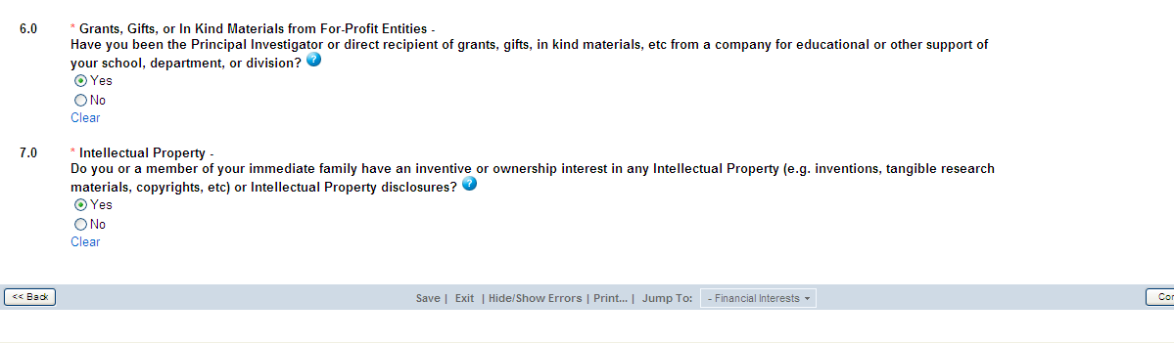
FI Questions (cont’d)

Slide 16
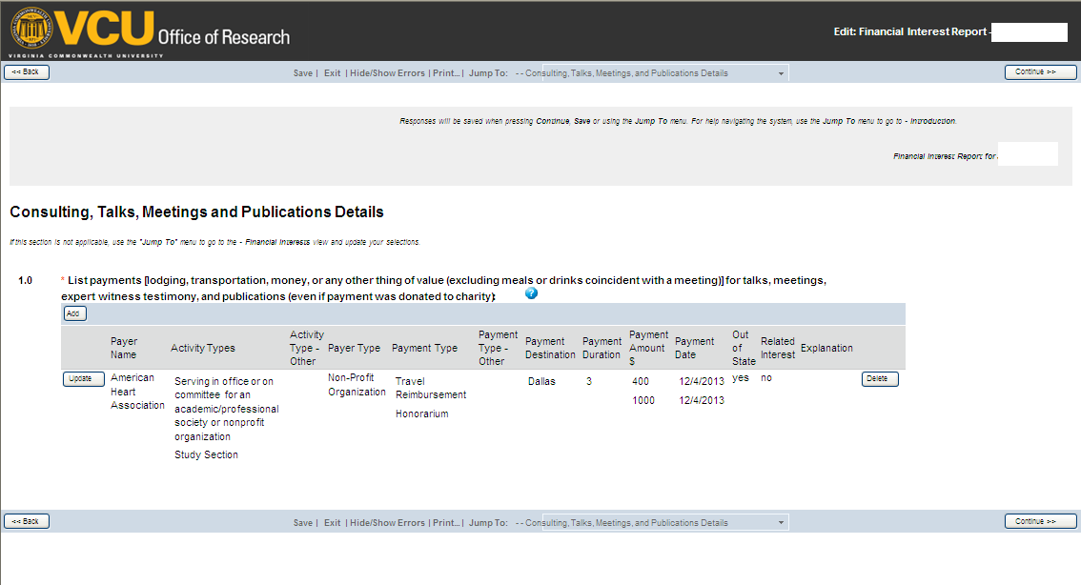
Sample Details View

Slide 17
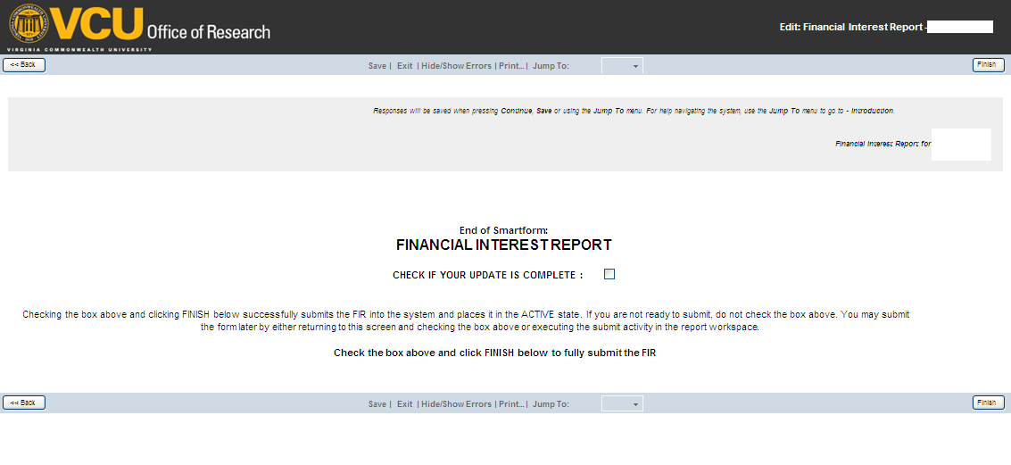
Submitting the FI smartform
Make sure to check the ‘Update is Complete’ box before clicking the ‘Finish’ button to submit a FIR

Slide 18
When is a FIR reviewed?
Upon submission of proposal to OSP or protocol to IRB/IACUC – Completion date verified – must be within the most recent update period
Prior to protocol approval and/or prior to award processing - Review request sent to COI Office for each ‘COI investigator’s’ FIR to be assessed for FCOI in the context of the research
Updated FIR (meeting trigger conditions) is reviewed by COI Office

Slide 19
How is a FCOI identified?
Financial Interests reported
FIR review requested in context of proposal or protocol
To COI Pgm for expedited review; to COIC for convened review
No FCOI
Conflict of Interests Competing Financial
Interests

Slide 20
Competing Financial Interests – VCU only
CFIs may include:
Financial interest(s) in a publicly traded entity that, individually, or in aggregate, exceeds $0 but is less than $5,000 on the date of report and during the 12 months preceding an investigator’s report (e.g. consulting, honoraria; equity or ownership interest including stock, stock options; compensated travel).
Unlicensed Intellectual Property to be used within the research
Licensed Intellectual Property for which royalty payments are distributed through the VCU Intellectual Property Foundation
Competing Financial Interests will be referred to the Conflict of Interests Committee for expedited or full Committee review and possible internal management. Competing Financial Interests are not reported to NIH or subject to other requirements of the PHS “Objectivity in Research” regulations.

Slide 21
VCU Responsibilities mandated by the PHS “Objectivity in Research” regulations
Sub-recipients: Verify with sub-recipient institutions whether this Policy in its entirety or whether the financial COI policy of the sub-recipient institution will apply to its investigators who are collaborating with VCU investigators.
Public disclosure via response within 5 days to a written request meeting required criteria
Enhanced reporting of managed COI to PHS or Final Rule-adherent sponsor

Slide 22
VCU Responsibilities mandated by the PHS “Objectivity in Research” regulations
Retrospective review for bias and mitigation report for noncompliance: Upon a determination of non-compliance with this policy, complete a retrospective review of the PHS-funded research project as well as the Investigator’s activities within 120 days to determine if there was bias in the design, conduct, or reporting of the research. A COI mitigation report must be sent to the PHS agency if bias is found. The PHS agency may determine that further corrective action is needed.

Slide 23
Questions?
For more information:
VCU COI website – Policy, guidance, etc.: http://www.research.vcu.edu/coi/index.htm
See VCUeRA for AIRS resources – videos and guidance:
https://www.vcu.edu/vcuera/airs.htm
eRAHELP@vcu.edu – for system questions
AIRS@vcu.edu – for content questions
AIRS access: http://airs.research.vcu.edu/

