Slide 1
Instructions for VCU’s Internal Approval Form
Form is required to obtain Authorized Official’s signature on proposals and awards
OSP – 8/2006

Slide 2
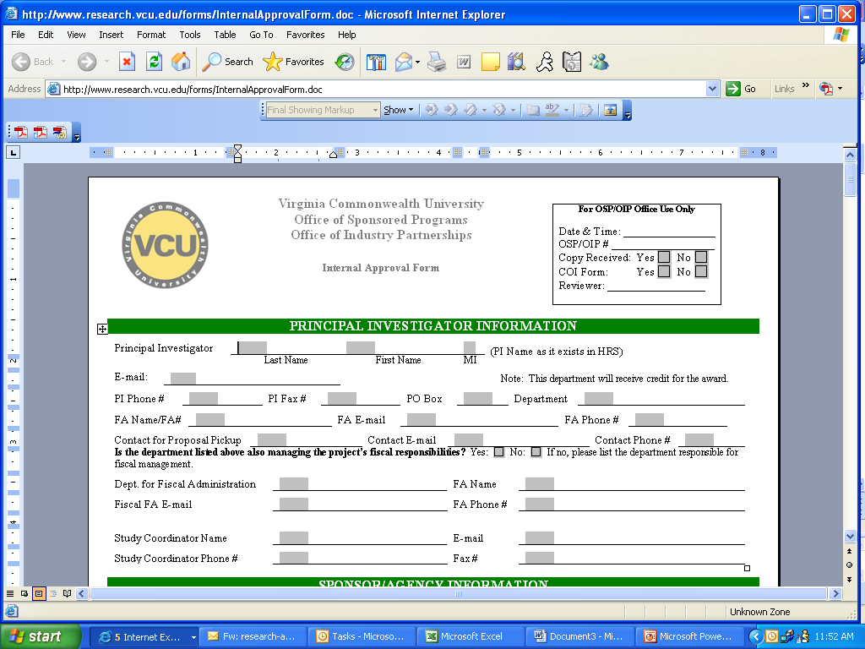
Complete all sections as applicable. Especially important is the section requesting information on fiscal management. This has an impact on how any resultant award is distributed.
Note: The FA listed will be the individual that receives copies of all documentation related to the proposal and/or award.

Slide 3
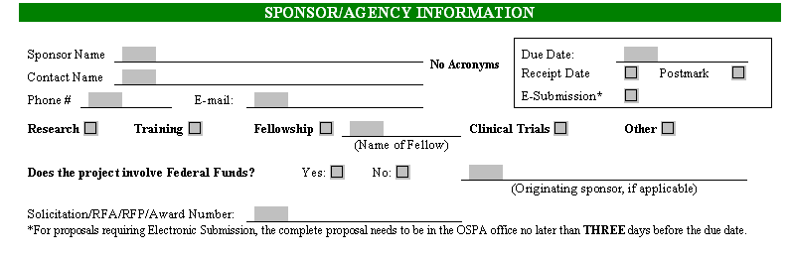
Sponsor Name without Acronyms, e.g. National Institutes of Health
Date Due to Sponsor
Type of Date
Type of Project Proposed
Assists in determining appropriate F&A rate
Federal fund involvement – Helps OSP and G&CA determine how the project will be coded for audit (CFDA Number or DPAS Number)
Copy of Solicitation/RFA/RFP should always be submitted to OSP, preferably as soon as you are aware that a proposal is being submitted. Often, solicitations and RFPs contain terms and conditions or sample contracts that must be addressed at the time of proposal. Limits negotiation opportunities after award.

Slide 4
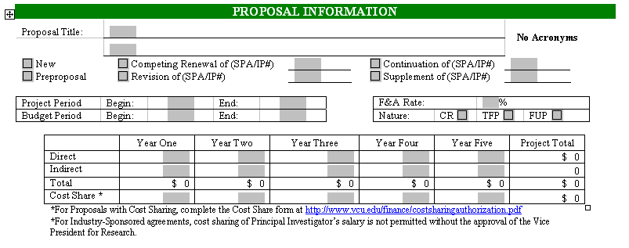
Status of proposal – allows OSP to match files appropriately
F&A rate utilized in proposal budget and anticipated type of award, if funded
Complete title of proposal
Project Period – Full proposed project period dates, e.g. three-years, five years
Budget Period – Dates of anticipated first budget period, e.g. first year
Budget Information for Entire Project Period, broken down by period, usually years. Direct, Indirect, Total and Cost Share for each period and then Project Totals

Slide 5
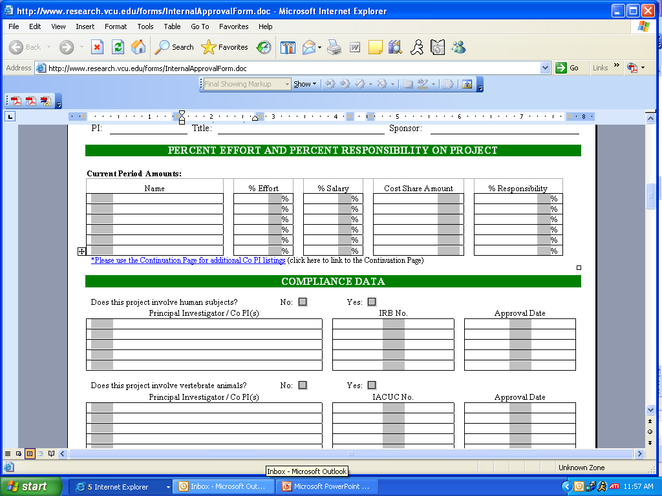
All information for this section should be completed for the FIRST budget period indicated on page 1
Further explanation for these columns is also available on the next page
Amount of Cost-Share for each Individual – Cost Share forms should be submitted for each
Percentage of Responsibility for each for each Individual
List PI and Co-PIs for first budget period
Percentage of Effort on project for each individual
Percentage of Salary requested in project budget for each individual

Slide 6
EXPLANATION OF PERCENT EFFORT AND PERCENT RESPONSIBILITY FOR PROJECT PARTICIPANTS
This section must be completed for every proposal submitted. The “% Effort” column will be the institutional record of committed effort; therefore, the total percentage of effort for the project should be entered for each individual.
The “% Salary” column should reflect the percentage of salary requested from the Sponsor. Should the “% Salary” column be less than the “% Effort” column, the cost share amount must be entered and a cost-share authorization form submitted with the proposal.
The objective of collecting the “% Responsibility” is to accurately reflect each individual’s responsibility for the project. A separate reporting process is being developed that will calculate sponsored project activities based on individual and reported by individual, department, and school.
The percentages assigned to the “% Responsibility” column should reflect “credit” for intellectual and technical responsibility for the project. They need not represent salary or effort distributions for all project participants. These percentages will be applied to the amount received from the sponsor and that amount will be credited to the named individual.
Please use whole percentages only. The total of the % Responsibility column must total 100%. A sample is presented below for information purposes.
Name % Effort % Salary Cost Share Amount % Responsibility
PI 25 25 0 75
Co PI 25 20 4000 25
Technician 50 50 0 0
Postdoc 100 100 0 0

Slide 7
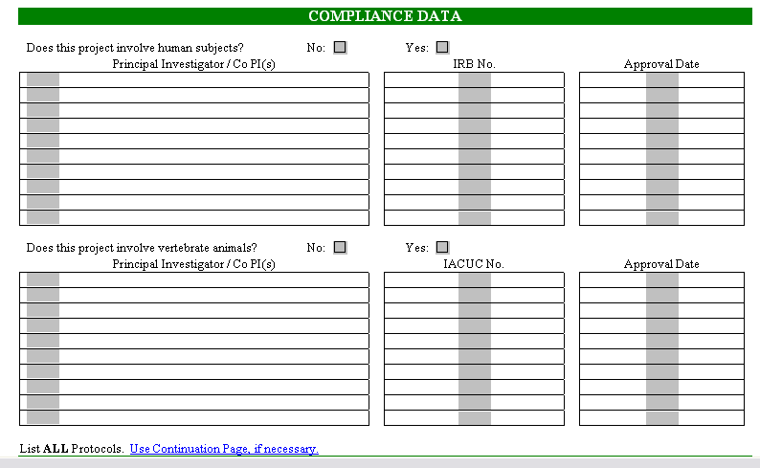
Protocol PI or Co PI – can be different than proposal PI
Human Subject and/or Vertebrate Animal Involvement – Protocols submitted must reflect the same work as included in proposal
ORSP Assigned IRB No.
Protocol Approval Date or “Pending” if not yet approved
ORSP Assigned IACUC No.

Slide 8
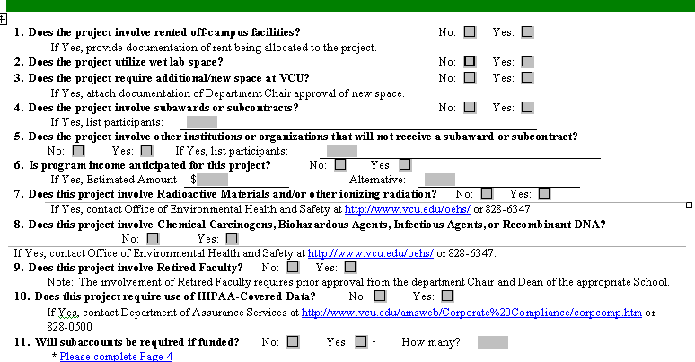
New Questions – Space must be provided by the Department/School. Office of Research does not have space to allocate. Please designated if wet lab space is required.
Off-campus rented facilities – Use off-campus F&A rate
Biohazards and Recombinant DNA – OEHS requirements
Program Income – Often requires separate account establishment
Use of HIPAA-Covered Data – Special requirements for record keeping and reporting
Subaccounts – Number – Will assist G&CA in account setup. Detailed information on page 4.
Subawards – Full documentation from subawardee is required.
Cooperative agreements – Institutional participation in agreement but not necessarily paid as subawardee – often cost-sharing in project
Radioactive materials – Must have contact with OEHS and comply with requirements – Reminder for PI and FA
Retired Faculty Involvement – Follow VCU Guidance – Must have HR approval

Slide 9
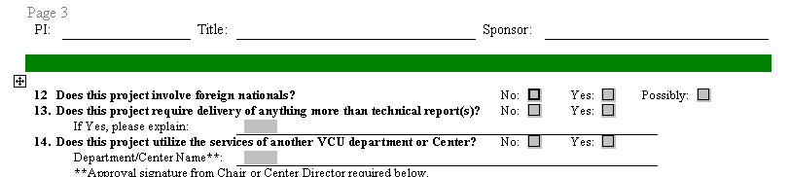
Questions 12 and 13 relate to needed information for export control review as required by U.S. law.
Usage of services of other VCU departments/centers. For example:
Radiation Oncology Laboratory General Clinical Research Center Survey & Evaluation Research Lab

Slide 10
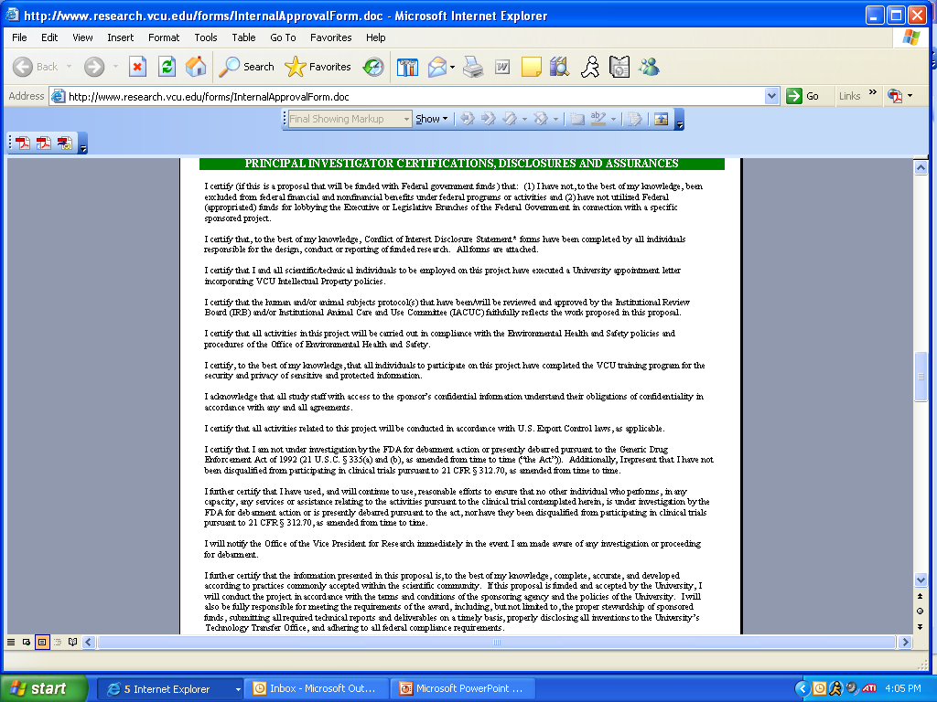
Required Certifications, Disclosures and Assurances for all proposal submissions. Covers Federal and University regulations.
VCU Intellectual Property Policies
Conflict of Interest forms. Also assuring that all those required to complete the forms have done so.
Debarment certification
OEHS requirements
HIPAA Training requirements
Export Control law compliance
Confidentiality requirements
IRB & IACUC protocol congruence
Clinical Trial Certifications
Debarment initiation notification

Slide 11
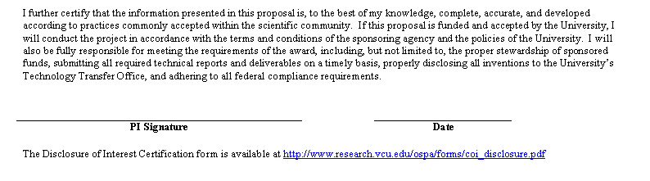
Final Certification – Compliance with Sponsor and University requirements. Responsible for all required reporting and deliverables on a timely basis. Will disclose all intellectual property developed.
Must be PI’s signature. Proxies not accepted.

Slide 12
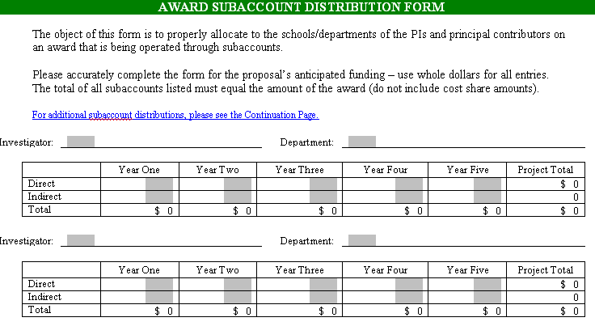
Subaccounts must be created if other departments/schools are to receive credit for their portion of the award.
Investigator to be credited with the subaccount amount
Investigator Department
Amount of subaccount for Year One
Subaccount Totals

Slide 13
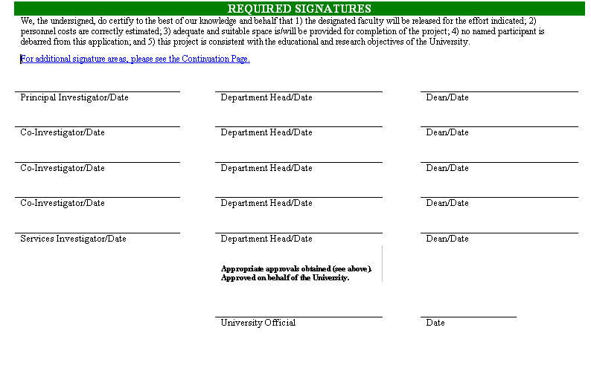
Department Chair certifies release time, salary verification, and space allocations
Dean certifies same
Approval of Radiation Oncology Lab, GCRC, SERL
University signature indicates receipt of all required approvals and compliance with Sponsor and University guidelines regarding proposal submission. Relies on PI assurances and Chair and Dean approvals to make this decision.

