Slide 1
HIPAA and RESEARCH
5th Thursday
May 31, 2007

Slide 2
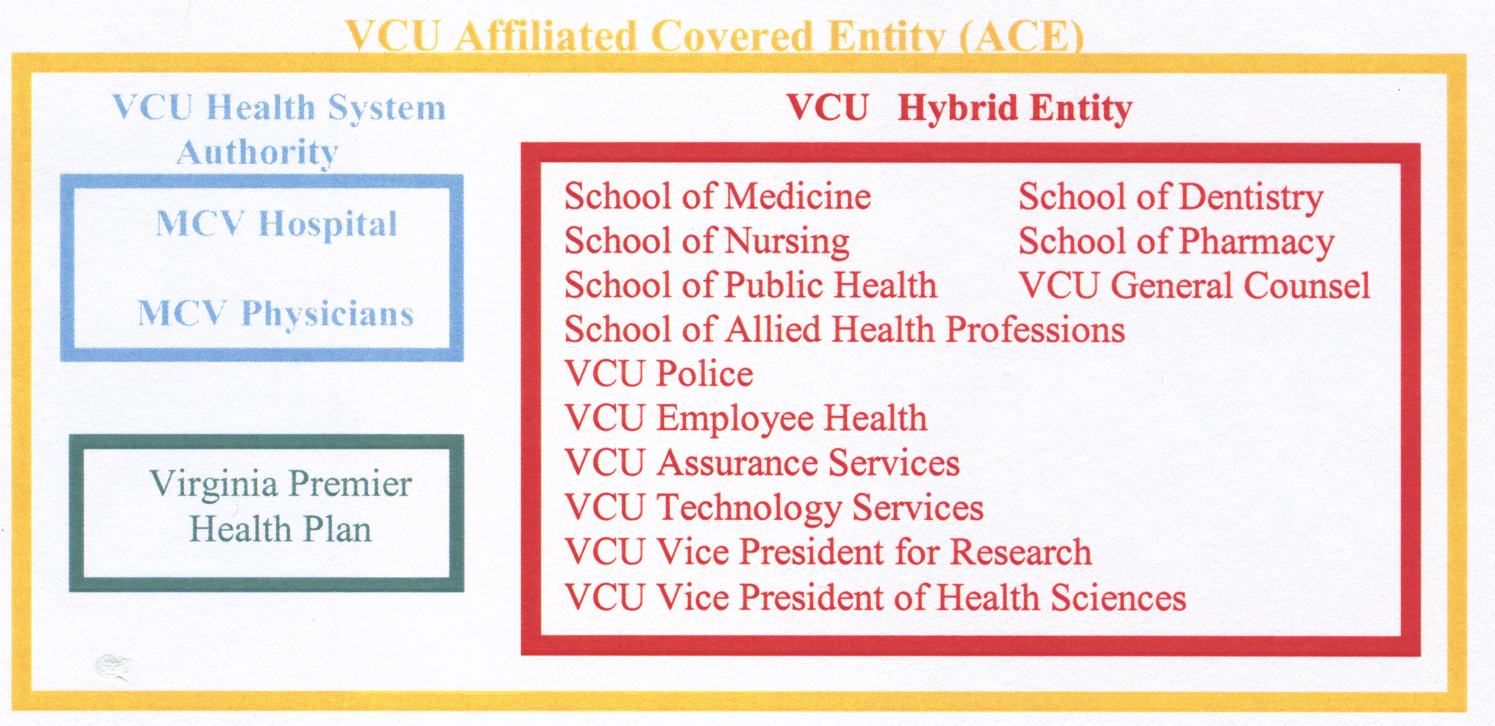

Slide 3
HIPAA Privacy Regulation Concepts
HIPAA does not regulate research
HIPAA applies to the healthcare industry through the operations of covered entities such as the VCU ACE
HIPAA does not override or replace regulations for human subject research such as 46 CFR 46 (OHRP) and 21 CFR 50 and 56 (FDA)
HIPAA impacts research by regulating how covered entities may permit access to data that is “Protected Health Information” in their custody.

Slide 4
Concepts Con’t
HIPAA requires covered entities to obtain certain documents from researchers before allowing research access to or use of PHI. These may include:
  Waiver of Authorization
  Approval for access to PHI in preparation for research
  Limited Data Set agreement

Slide 5
Concepts Con’t
Researchers who are also healthcare providers must provide the same HIPAA documents to use their patient’s PHI in research as researchers who are not healthcare providers.
In other words, a physician’s right to access a patient’s PHI for healthcare purposes does not entitle that physician to access that same information for research purposes.

Slide 6
What HIPAA Documentation is Required?
The Requirements Are Based On the Identifiers In The Data :
PHI that includes identifiers (beyond a limited data set)
PHI Limited Data Set
Decedents’ Data
Reviews in Preparation for Research
De-identified Data Set

Slide 7
HIPAA De-identification
Once data is de-identified it is no longer subject to HIPAA regulations.
The HIPAA regulation does allow for using special codes for re-identification of such data, the VCU Health System requires specific approval by the Privacy Officer if codes for re-identification are to be used.

Slide 8
The following identifiers for the patient and family
Must be removed to create a de-identified data set:
1. Names 2. Telephone Numbers
3. FAX numbers 4. Email Addresses
5. All Dates 6. Medical Records #
7. Account # 8. Social Security #
9. Health Plan # 10. Vehicle #
11. Device/Serial # 12. Certificate/License Web # 13. Identity (URL) 14. IP Address
15. Biometric Identifiers 16. Photos
17. Geographic Identifiers Smaller Than State
18. Any Other Identifying Number, Characteristic or Code

Slide 9
PHI In Preparation For Research
A review preparatory to research allows a researcher to examine PHI to determine the feasibility of performing a research protocol. During this period the researcher may not remove or record and remove any PHI from the the VCU Health System.
HIPAA allows the researcher, if they are part of the VCU ACE to contact potential subjects. Such a practice should be approached with great caution unless the researcher is known to the patient.

Slide 10
Decedent Data In Research
A VCU Health System researcher may use decedent data by sending a signed statement to the Compliance Services Department that:
  The information will be used solely for research
  All PHI obtained is of decedent(s)
  This regulation is specific to research and for non-research, decedent PHI is protected the same as PHI for living individuals.

Slide 11
LIMITED DATA SET
A Limited Data Set includes PHI that is largely de-identified but may include certain identifiers
The use of a Limited Data Set REQUIRES
a signed “Data Use Agreement”

Slide 12
Limited Data Set (con’t)
A Limited Data Set as defined by HIPAA may contain no “identifiers”from the list of identifiers previously shown except it may contain:
  Elements of dates including birth date, admission date, dates of procedures, date of death, etc.
  Geographic information such as state, city, town, census tract, precinct, and ZIP code. May not include street name, address or post office box number.

Slide 13
Limited Data Set (con’t)
Data Use Agreement

Slide 14
Research Data Includes Identifiers Beyond A Limited Data Set
Required HIPAA documentation:
  Authorization signed by the subject (or legally authorized representative); or
  Waiver of Authorization

Slide 15
Research Authorization
Subject’s signed permission to disclose or use PHI for research. This is not a blanket permission and must be specific:
  What PHI? What purpose? By whom? How long? And other requirements as shown.
  A research authorization is in addition to the IRB Informed Consent and usually signed at the same time as the IC.
  The Research Authorization does not require a specific expiration date.

Slide 16
Waiver of Authorization
No more than minimum risk
Adequate plan to protect identifiers
Destruction of identifiers as soon as possible
Assurance the PHI will not be disclosed for purposes other than approved
Research could not practicably be carried out w/o the waiver
Waiver will not adversely affect the subject’s welfare or rights
Subjects, if appropriate will be provided information at a later date

Slide 17
Subject Rights Under HIPAA
Access to research PHI (NOTE: Access to PHI can be temporarily suspended in order to legitimize the research – This must be explained in the Authorization
Request an amendment to the PHI
Get an accounting of the disclosures (any disclosure not in the authorization)
Request restrictions on uses and disclosures
Withdraw the authorization (NOTE: If a subject withdraws authorization the researcher may use the information gathered

Slide 18
Subject Rights (con’t)
A researcher can disqualify the potential subject from the protocol upon refusal to sign the authorization.

Slide 19
HIPAA LINK
www.vcu.edu/hipaa

Slide 20

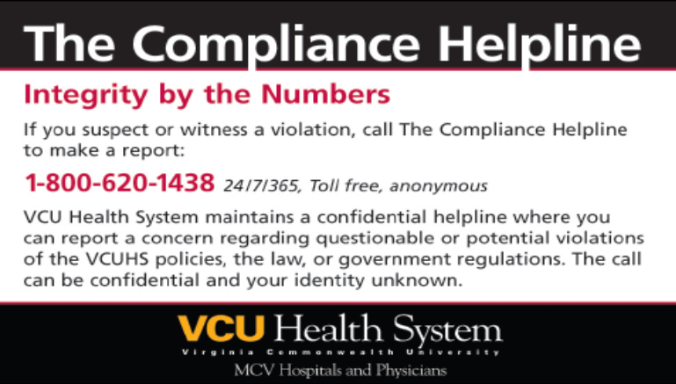
COMPLIANCE HELPLINE
Confidential reporting
Operated by Global Compliance
Available 24 hours a day, 7 days a week
Helpline web-based reporting: https://www.compliancehelpline.com/welcomePageVCUHS.jsp
Helpline web-based reporting: https://www.compliancehelpline.com/welcomePageVCUHS.jsp

