Slide 1
Understanding Data Registry Setup and Maintenance Policies
Nichole Haywood
IRB Protocol Analyst
Phone: (804) 827-2272
Fax: (804) 827-1448
nsrichar@vcu.edu
Enid Virago, PhD CIP, CCRP
Research Liaison Specialist for Human Research Protections
Phone: (804) 828-7712
Fax: (804) 827-1448
viragoea@vcu.edu

Slide 2
Resources used to Create this Presentation
Gliklich RE, Dreyer NA, eds. Registries for Evaluating Patient Outcomes: A User’s Guide. 2nd ed.(Prepared by Outcome DEcIDE Center [Outcome Sciences, Inc. d/b/a Outcome] under Contract No. HHSA29020050035I TO3.) AHRQ Publication No.10-EHC049. Rockville, MD: Agency for Healthcare Research and Quality. September 2010.
http://www.outcome.com/ahrq-registries-evaluating-patient-outcome.htm
Developing the Registry of Patient Registries Dan Levy
http://www.ahrq.gov/news/events/conference/2011/levy/index.html
Most recent HHS update on data security
http://www.hhs.gov/ohrp/sachrp/20110124attachmentatosecletter.html
VCU IRB WPP Section XVII:4 Special Requirements and Guidance for Investigators. Research Involving Data Registries/Specimen Banks
www.research.vcu.edu/irb/wpp/flash/XVII-4.htm
VCU IRB WPP Section XVII:5 Special Requirements and Guidance for Investigators. Genetics Research
http://www.research.vcu.edu/irb/wpp/flash/XVII-5.htm

Slide 3
Goal of Presentation
Give an overview of the research field of data registries
Some information on repositories
Review current VCU IRB policy & procedure
Review current state of registries (HHS) guidance
Upcoming changes in registry policy/guidance

Slide 4
Registry Definition
A registry is an organized system that uses observational study methods to collect uniform data (clinical and other) to evaluate specified outcomes for a population defined by a particular disease, condition, or exposure, and that serves one or more predetermined scientific, clinical, or policy purposes.
The registry database describes a file (or files) derived from the registry.

Slide 5
Registry vs. Repository
Registry-A registry is used for the collection & maintenance of information on individuals who have a similar condition and who will consent to being contacted for future studies or who agreed to allow their data to be used for future studies in a specific area of research.
Repository-A repository is used for the collection and storage of identifiable specimens. By participating in the repository , the subjects consent to be contacted for possible participation in future studies or who agreed (in advance) to allow their data to be used for future studies in a specific area of research.

Slide 6
Purpose of Registry
To describe the natural history of a condition or disease
To determine effectiveness or cost effectiveness of treatments/services and/or health care products
To measure or monitor safety and harm
To measure quality of care

Slide 7
Do You Need a Registry/Repository?
Do the data already exist?
If so, is the quality of the data sufficient to answer the related research questions?
Can you afford to maintain a registry/ repository?

Slide 8
VCU IRB Policy for Creating a Registry/Repository
You need IRB review and approval if you are establishing, or accessing, a human subject research registry.
The PI's plan for establishing or contributing to the human subject research registry may be:
1) fully described as part of a new protocol submission to the IRB; (2) fully described as an amendment to an existing research protocol; or (3) a separate, free-standing protocol*.
If you are going to establish a registry at VCU, your SOPs need to answer these questions in detail
Who has responsibility for the integrity of the registry and who can have access to the registry for research purposes and how is access granted?
What is the process for informed consent related to the registry/specimen bank?
Research is more difficult if the PI Includes language that states that the PI will recontact the subject if a registry/repository requests data, etc., related to the subject. It’s best to include the probability in the original consent
How is system privacy and confidentiality ensured?
Must meet VCU standards (noted later)

Slide 9
For IRB Approval
Provide IRB number of related study if there is one
Describe the purpose of the registry
Attest to having Standard Operating Procedures (SOPs) written and in place for operation
Who is responsible for management of the registry/repository?
Describe how specimens/data is obtained
Describe how long data/specimens will be stored and how they will be stored
Describe conditions under which data/specimens will be released
Qualifications of team deciding whether requesting study fits ICF criteria
Describe (in detail) staff training
Specify information in Informed Consent document (ICF)
Parameters for data/sample use agreed to by subject
How this information will be tracked and confirmed
Describe the IT mechanism
Clear information regarding subject’s option to decline contributing to a registry/repository and still participate in study (if possible)
Describe process to be used by subject to access their data/specimens, withdraw data and/or destroy specimen.
List Identifiers (including linkable codes) that will accompany data/samples to
Registry/repository
To PIs requesting to use the data

Slide 10
Creating a Registry – SOPs
Components in Standard Operating Procedure Manual
Set specific goals:
Data quality
Study enrollment
specific measures that the registry is intended to describe
Identify Key Stakeholders
Assess Feasibility – Funding
Build a registry team
Establish a governance and oversight Plan
Consider the scope and Rigor needed
Define the core dataset, patient outcomes and target population
Develop a study plan or protocol
Develop a project plan
Determine what will happen when the registry ends.

Slide 11
VCU IRB Policy for Accessing or Contributing to an Existing Registry
General guidelines you will use for developing a usage protocol/amendment.
You will need a data usage or sharing agreement
What is the process for informed consent related to the registry/specimen bank?
Submit the ICF from your study and detailed description of existing registry’s documentation (purpose, process, agreements, etc.)
How is system privacy and confidentiality ensured?

Slide 12
Contributing to a Registry
General Guidelines
* Very important documents
Data Sharing Agreement (School of Medicine)
http://www.medschool.vcu.edu/technology/security/documents/VCUSOM_DataSharingAgreement.doc
Data Use Agreement (Sue Robb negotiates)
http://www.research.vcu.edu/forms/Data+Use+Agreement+for+Use+of+Limited+Data+Set.docx (HIPAA)
Research Data Ownership, Retention, and Access Policy
http://www.assurance.vcu.edu/Policy%20Library/Research%20Data%20Ownership,%20Retention%20&%20Access.pdf
Ownership of Research Data and University Disposition
Consistent with federal policy and prevailing higher education practice, Research Data belong to the University.
Intellectual Property Policy http://www.assurance.vcu.edu/Policy%20Library/Intellectual%20Property%20Policy.pdf

Slide 13
Following the Informed Consent Document
The registry you are contributing to must abide by parameters of Informed Consent Document (ICF).
Registry focus matches ICF focus
Registry data security matches ICF constraints & VCU Security policy & data classification policy.
http://ts.vcu.edu/askit/mc-docs/VCUSecurityStandardforResearchData.pdf
http://ts.vcu.edu/askit/mc-docs/VCUDataClassificationGuidelines.pdf
Notes:
.

Slide 14
3 Consent Options
1. I give permission for my data/tissue samples to be stored and used for research related to [insert topic]
YES ____________________ NO ____________________
2. I give permission for my data/tissue samples to be stored and used for future research about other health problems.
YES ____________________ NO ____________________
3. I give permission for my data/tissue samples to be stored; however, I want to be contacted prior to any future use of my data/tissue samples for research.
YES ____________________ NO ____________________

Slide 15
GWAS/dbGap
The proposed National Institutes of Health (NIH) GWAS Policy calls for investigators funded by the NIH for GWAS:
to submit de-identified genetic (genotypic and
phenotypic) data to a centralized NIH repository;
and,
to submit documentation that describes how the
investigators will protect privacy and
confidentiality of research participants.

Slide 16
Informed Consent Comments
Points for IRBs to Consider
– Description of GWAS activities
–Appropriate research use
– Data distribution
– Risks: to individuals, families, groups and
populations
• Privacy and use of genetic information
Follow up such as return of results, participant
withdrawal, possible commercial use

Slide 17
Certificate of Confidentiality http://www.research.vcu.edu/irb/wpp/flash/XII-2.htm http://www.research.vcu.edu/irb/wpp/flash/XVII-5.htm
Biggest risk for many studies is the potential for a breach of confidentiality.
COC = refuse to disclose identifying information in any civil, criminal, administrative, legislative, or other proceeding, whether at the federal, state, or local level.
Identifying information is broadly defined as any item or combination of items in the research data that could lead directly or indirectly to the identification of a research subject.
Certificates of Confidentiality help achieve the research objectives and promote participation in studies by assuring privacy to subjects.
Certificates can be used for biomedical, behavioral, clinical or other types of research that is sensitive. Sensitive means that disclosure of identifying information could have adverse consequences for subjects or damage their financial standing, employability, insurability, or reputation.
Examples of sensitive research activities include but are not limited to the following:
Collecting genetic information;
Collecting information on psychological well-being of subjects;
Collecting information on subjects' sexual attitudes, preferences or practices;
Collecting data on substance abuse or other illegal risk behaviors;
Studies where subjects may be involved in litigation related to exposures under study (e.g., breast implants, environmental or occupational exposures).
Classify risk and describe how you will minimize it.

Slide 18
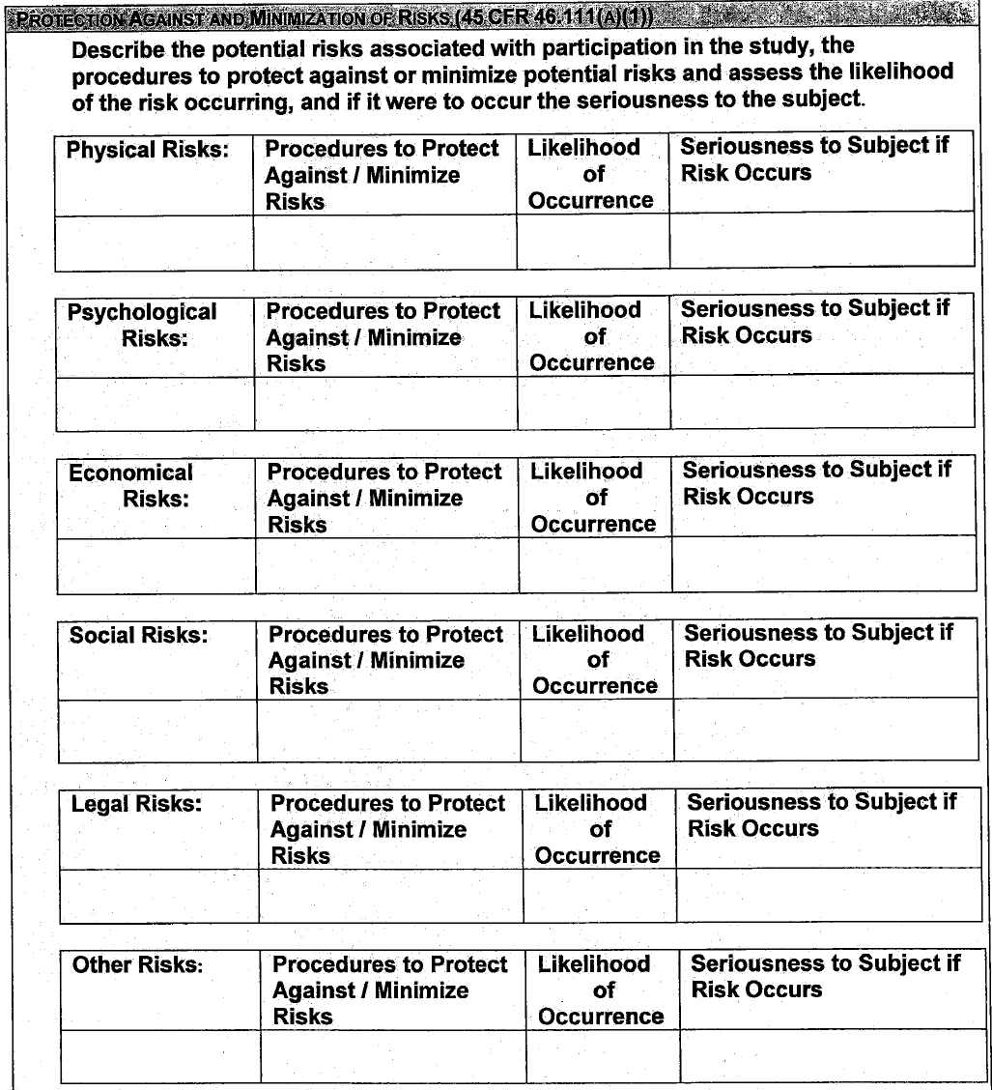
Risk Reduction Table

Slide 19
If you are accessing a registry
If your study meets definitions of Human Subjects and Research, you will need IRB approval.
Human subject: a living individual about whom an investigator conducting research obtains: data through intervention interaction with the individual or identifiable private information.
Research: a systematic investigation, including research development, testing, and evaluation, designed to develop or contribute to generalizable knowledge. Activities that meet this definition constitute research even if they are a component of a larger non-research activity (e.g., instruction, demonstration) [regulations at 45 CFR 46 as enforced by the Office for Human Research Protections].

Slide 20
Registries/Repositories In the Future
What is in the works?
Do you want to plan ahead?

Slide 21
Registries & Repositories
The field is changing quickly – plan for the future as best you can
You can post your registry at http://www.outcome.com/ropr.htm
ClinicalTrials.gov may have registry posting in the future
Assess your potential for a Breach and have a written plan
Genetic samples (Risks to third parties, insurance, employment, etc.)
How to handle “incidental findings”
Etc….

Slide 22
Confidentiality Breach Policies
VCU Information Security Standard (2009), pg. 34
http://www.assurance.vcu.edu/Policy%20Library/VCU%20Information%20Security%20Standard.pdf
More than 1000 people, notify Office of Attorney General (VA). Section E. of Code of Virginia, §18.2-186.6
HHS Office of Civil rights. Final Rule (HIPAA) HITECH (Health Information Technology for Economic and Clinical Health Act)
http://www.gpo.gov/fdsys/pkg/FR-2013-01-25/pdf/2013-01073.pdf

Slide 23
Registry of Patient Registries This system contains registry specific information intended to promote collaboration, reduce redundancy, and improve transparency among registry holders. The RoPR data entry system allows for registry owners to provide information about the following:
Classification and Purpose - the type of registry and its purpose
Contact and Conditions of Access - circumstances under which the registry can be contacted, and contact information for those interested in collaboration, participation and/or data access
Progress Reports - includes information about the growth of the registry and any relevant references to available progress reports
Common Data Elements - Descriptions of registry-specific standards, scales, instruments, and measures
The Agency for Healthcare Research and Quality (AHRQ) has designed and deployed the RoPR system to complement ClinicalTrials.gov by providing additional registry-specific data elements.

Slide 24
Voluntary uploading of registry information is available.
The following screen shot slides are from…
Developing the Registry of Patient Registries. Slide Presentation from the AHRQ 2011 Annual Conference (Text Version). December 2011. Agency for Healthcare Research and Quality, Rockville, MD. http://www.ahrq.gov/about/annualconf11/berliner_gliklich_hyatt_levy/levy.htm

Slide 25
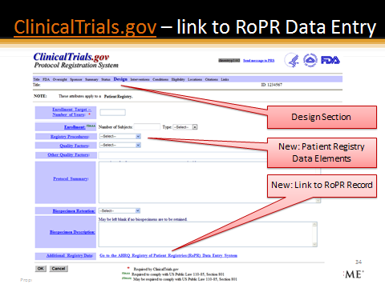

Slide 26
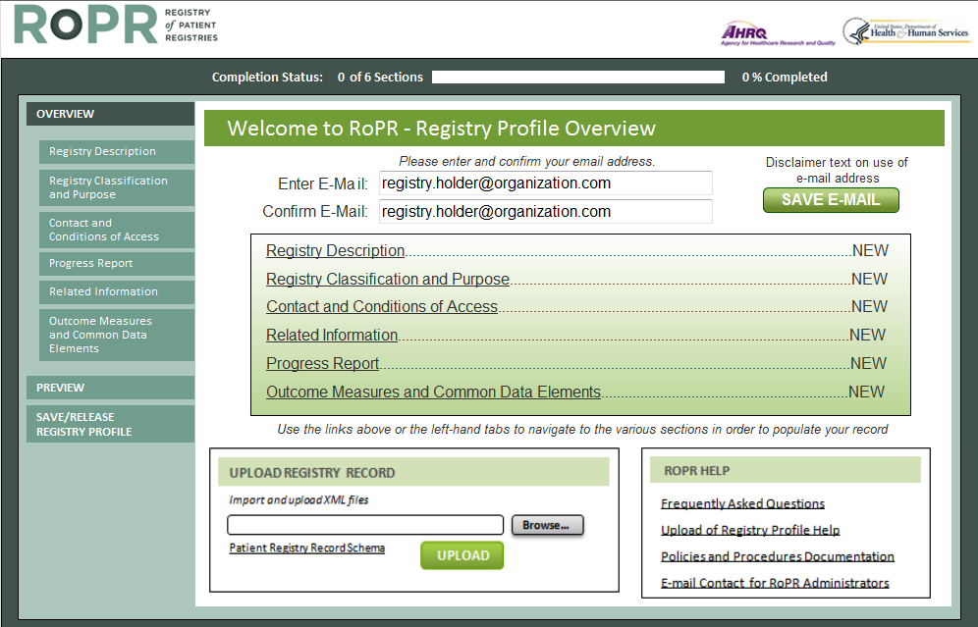
RoPR Data Entry

Slide 27
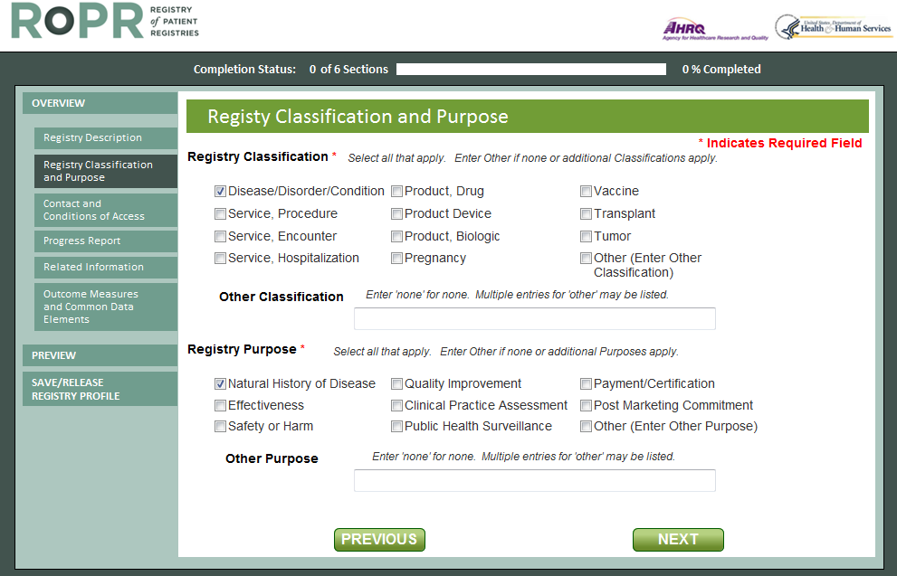
RoPR – Registry Classification and Purpose
Multi-Select
Other

Slide 28
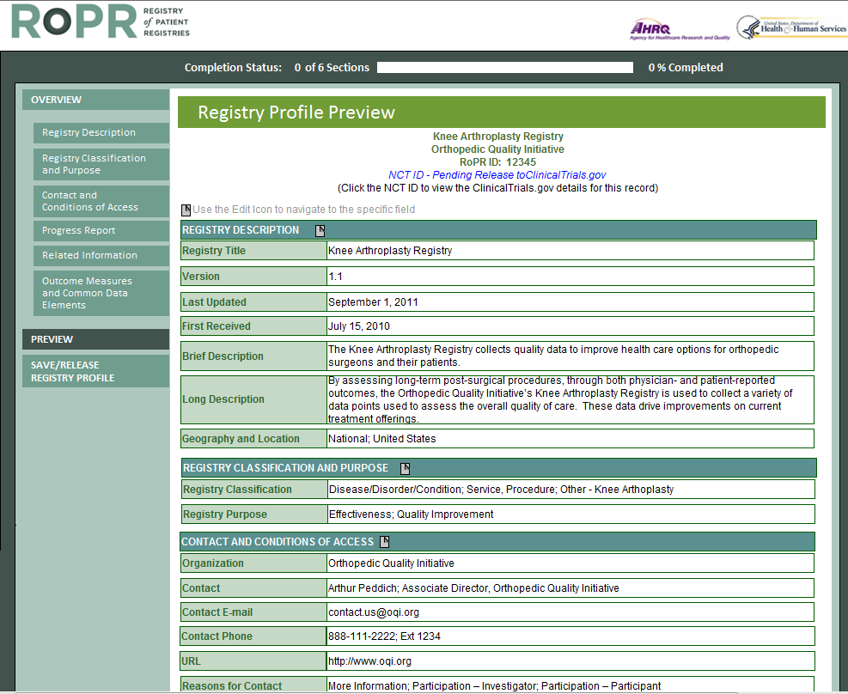
RoPR – Preview Registry Profile

Slide 29
The Buzz on Incidental Findings
2 year NIH Study Findings:
When reidentification of individual contributors is possible and when findings that are analytically valid, reveal an established and substantial risk of a serious health condition, and are clinically actionable should generally be offered to consenting contributors…
Article suggests the biobank should work to enable the biobank research system to discharge four core responsibilities:
(1) clarify the criteria for evaluating findings and the roster of returnable findings,
(2) analyze a particular finding in relation to this,
(3) reidentify the individual contributor, and
(4) recontact the contributor to offer the finding.
Wolf SM, et al. Managing incidental findings and research results in genomic research involving biobanks and archived data sets. Genet Med. 2012 Apr;14(4):361-84. doi: 10.1038/gim.2012.23.

Slide 30
Planned Additions for Third Edition of the “Registries for Evaluating Patient Outcomes: A User’s Guide
Patient identity management
Protection of data from litigation
Data protection concerns
Public-private partnerships
Statistical techniques for analyzing combined data
Pregnancy registries
Registry transitions

Slide 31
Questions
Thank you

Slide 32
Resources (1)
AHRQ Agency for healthcare Research And Quality
Power point on developing the Registry of Patient Registries (integrating with Clinicaltrials.org)
http://www.ahrq.gov/legacy/about/annualconf11/berliner_gliklich_hyatt_levy/levy.htm
Registries
Web stream of presentation from AHRQ Conference
http://effectivehealthcare.ahrq.gov/index.cfm/registry-webcast/
AHRQ Registry User Guide
http://effectivehealthcare.ahrq.gov/ehc/products/74/531/Registries%202nd%20ed%20final%20to%20Eisenberg%209-15-10.pdf
Research Report - Final – May 31, 2012
Registry of Patient Registries (RoPR): Project Overview
http://effectivehealthcare.ahrq.gov/ehc/products/311/1114/DEcIDE40_Registry-of-patient-registries_FinalReport_20120531.pdf
Registry of Patient Registries (RoPR) Policies and Procedures
http://effectivehealthcare.ahrq.gov/search-for-guides-reviews-and-reports/?pageaction=displayproduct&productID=1114
Options for Developing a Repository of Expired Patient Registries
http://effectivehealthcare.ahrq.gov/ehc/products/311/1306/DEcIDE42_ExpiredRegistries_FinalReport_20121031.pdf

Slide 33
Resources (2)
Data Confidentiality and Security
Most recent update on data security
http://www.hhs.gov/ohrp/sachrp/20110124attachmentatosecletter.html
OHRP’S OCTOBER 16, 2008 “GUIDANCE ON ENGAGEMENT OF INSTITUTIONS IN HUMAN SUBJECTS RESEARCH.”
http://www.hhs.gov/ohrp/policy/cdebiol.pdf
Dana-Farber/Harvard Cancer Center Clinical Research Support
Office for Human Research Studies (OHRS)
Resources for Biospecimen and Biobanking Research
http://www.dfhcc.harvard.edu/clinical-research-support/office-for-human-research-studies-ohrs/resources-for-biospecimen-and-biobanking-research/

Slide 34
Resources (3)
From SOCRA
http://www.socra.org/html/faq.htm#FDAGuidanceInvestigator
What is HIPAA?
How does AAHRPP’s Standard I.7.A. pertain to IRB approval of protocols for Phase 1 trials?
How Do You Register Clinical Trials with The FDA?
Clinical Trial Terminology - Glossary and Acronyms
How can I get into clinical research?
Are there any clinical research courses?
Is there any development in new Regulatory Science Courses? New!
Are there any schools with specifically designed curriculums in clinical research offered by institutions of higher learning?
What salary might I expect in clinical research?
GCP Fact or Fiction Review Document (PDF)
GCP Questions for The FDA
New FDA Guidance on Investigator Responsibilities
Information Sheet Guidance for Sponsors, Clinical Investigators, and IRBs Frequently Asked Questions - Statement of Investigator (Form FDA 1572)
How do I get answers to questions I have concerning the FDA regulations?
Are there any books on clinical research and/or clinical trials?

Slide 35
Resources (4)
How do I know if my product is regulated by FDA?
http://www.fda.gov/ForIndustry/FDABasicsforIndustry/ucm237623.htm
New FDA Guidance on Investigator Responsibilities
http://www.fda.gov/downloads/Drugs/GuidanceComplianceRegulatoryInformation/Guidances/UCM187772.pdf
FDA Inspections, Compliance, Enforcement, and Criminal Investigations
http://www.fda.gov/ICECI/EnforcementActions/BioresearchMonitoring/default.htm

Slide 36
Resources (5)
Bioresearch Monitoring
FDA/ORA Bioresearch Monitoring Information Page
Background
Application Integrity Policy:
Compliance Lists: FDA Debarment List - Firms or persons convicted of a felony under Federal law for conduct relating to the development or approval, including the process for development or approval, of any new or abbreviated drug application. Clinical Investigators - Disqualification Proceedings Nonclinical Laboratories Inspected under GLP Regulations since FY 1990 Public Health Service Administrative Actions Listing (Link to external document, not maintained by FDA/ORA)

Slide 37
Resources (6)
FDA Clinical Trials guidance documents
http://www.fda.gov/RegulatoryInformation/Guidances/ucm122046.htm
FDA Educational Resources
http://www.fda.gov/ForIndustry/FDABasicsforIndustry/ucm235225.htm
Information about FDA Compliance and Enforcement Actions
http://www.fda.gov/AboutFDA/Transparency/TransparencyInitiative/ucm254426.htm

