Slide 1
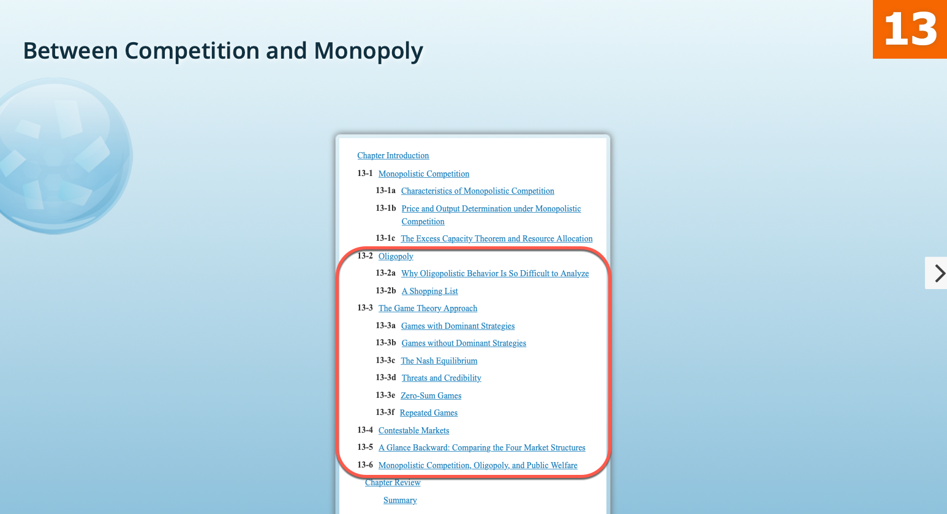

Slide 2
“People of the same trade seldom meet together for merriment and diversion, but the conversation ends in a conspiracy against the public, or on some contrivance to raise prices”
Adam Smith, An Inquiry into the Nature and Causes of the Wealth of Nations (1776)

Slide 3

Oligopoly
A market dominated by a few sellers
How many is “a few”?
10? 50? 1,000?
The number of firms has to be small enough to allow firms to:
Coordinate (collude) if they are so inclined
Watch closely actions taken by their competitors in order to take defensive reaction
Few Firms
Implies that
There are significant barriers to entry

Slide 4
Oligopoly: Competition has a face and a name
A market dominated by a few firms
These firms:
May compete (non-cooperative oligopoly) or may cooperate (cooperative oligopoly)
May sell identical or differentiated products
Are interdependent: when making decisions, must take into account the expected reaction of their competitors
Are price setters, but their control over the price depends on the level of coordination among the firms in the oligopoly

Slide 5
Examples of Oligopolies
Music Industry
Film and Television
The music industry is dominated by three major recording labels: Sony, Universal, and Warner
Wireless Carriers
The combined market share of the four major wireless carrier companies in the U.S.—Sprint-Nextel, T-Mobile, Verizon, and AT&T—is over 98%.
Film and television production in the U.S. is dominated by five media conglomerates: The Walt Disney Company, WarnerMedia, NBCUniversal, Sony, and Viacom.
Domestic Airlines
Baby Formula
With four major domestic airlines- American Airlines, Delta Air Lines, Southwest Airlines, and United Airlines - flying about 80% of all domestic passengers in 2017
Three companies—Abbott, Mead, and Nestle—account for the vast majority of formula sold in the U.S.
Abbott alone has more than 40% of the market
98% of the formula sold in the U.S. is made in the U.S. there is no foreign competition because the U.S. has a tariff and regulatory system effectively designed to keep foreign production out of the U.S market.
U.S. Car Manufacture
With three leading auto manufacturers in the United States: Ford, GM, and Stellantis (the new iteration of Chrysler through mergers).
Aircraft Manufacture
Global Car Manufacture
Twelve key manufacturers: Toyota, Honda, Volkswagen, Renault-Nissan-Mitsubishi, Daimler, Ford, GM, Stellantis, BMW, SAIC, Hyundai
Ten key manufacturers: Lockheed Martin, Airbus, Boeing, Raytheon Technologies, Northrop Grumman, General Electric, Safran, Leonardo, Bombardier, and United Aircraft Corporation. Boeing and Airbus are the two biggest airplane manufacturers in the world. Together, they own nearly 90% of the market.

Slide 6

Models of Oligopoly Behavior
No single general model of oligopoly behavior exists. These are models of oligopoly behavior:
Collusion:
The Cartel model: Firms agree to act as one
Price Leadership model: One firm in the group (often the largest) makes pricing decisions and the rest “tacitly” follow.
The Kinked Demand Model (for the special oligopoly case of Duopoly) Explains “price stickiness”: the fact that oligopoly prices change less frequently than in perfectly competitive markets
The contestable market model:The group behaves as PC market.
Strategic Interaction: Game Theory

Slide 7
The Cartel (Collusion) Model
A cartel is a combination of firms which “Collude” (agree to act as a single firm).
The oligopoly sets price and quantity as if they were a single firm (a monopoly): all firms must charge the same price and each firm must produce only a portion (quota) of the total amount produced.
Collusion is ilegal in the U.S. (Antitrust laws prohibit price fixing)
If the cartel can limit the entry of other firms, they can increase their profits.
Examples of Cartels: OPEC, drug cartels

Slide 8
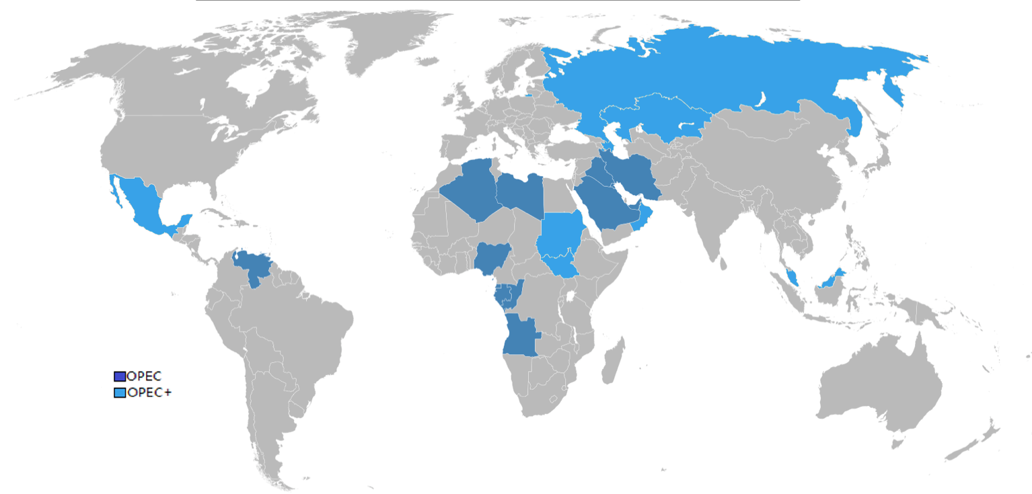
Organization of Petroleum Exporting Countries
O
P
E
C
Non-OPEC member countries (Azerbaijan, Bahrain, Brunei Darussalam, Kazakhstan, Malaysia, Mexico, Oman, Philippines, Russia, Sudan and South Sudan ) also participate in voluntary supply cuts to bind policy objectives between OPEC and non-OPEC members. The group including these countries is known as OPEC+
The Most Famous Oligopoly
Founded in Baghdad, Iraq, on September 1960 by the first five members Iran, Iraq, Kuwait, Saudi Arabia and Venezuela.
Qatar (1961), Indonesia (1962), Libya (1962), the United Arab Emirates (1967), Algeria (1969), Nigeria (1971), Ecuador (1973), Gabon (1975), Angola (2007), Gabon (2016), Equatorial Guinea (2017), Republic of the Congo (2018),
Notes:
The Organization of the Petroleum Exporting Countries (OPEC) was founded in Baghdad, Iraq, with the signing of an agreement in September 1960 by five countries namely Islamic Republic of Iran, Iraq, Kuwait, Saudi Arabia and Venezuela. They were to become the Founder Members of the Organization.
These countries were later joined by Qatar (1961), Indonesia (1962), Libya (1962), the United Arab Emirates (1967), Algeria (1969), Nigeria (1971), Ecuador (1973), Gabon (1975) and Angola (2007).

Slide 9
Price and Output Determination for the a Cartel
OPEC does not have an effective enforcement mechanism except for occasional price wars…
MC
,P
,MR
If the quantity that reaches the market is Q₀, each member gets this price per unit sold: P₀
MC
If any member produces more than its allotted quota, the quantity reaching the market would be higher than Q₀
…and the price for ALL members will be lower than P₀
P₀
Drug Cartels use violence as a very effective enforcement mechanism
P₁
MC = MR
D
Q₀
Q₁
Q
Each member must produce only a portion of this total
To Maximize Profit, the Cartel must produce Q₀
MR

Slide 10
Price and Output Determination in Price Leadership
An effective enforcement mechanism would be the threat of a price war which smaller firms can not survive
To sell Q₀units, the firm sets the industry price equal to P₀
MC
,P
,MR
MC
All other firms must charge this same price
P₀
MC = MR
D
Q₀
Q
The Dominant Firm choose its output Q₀ to maximize its own profits
MR

Slide 11
The Kinked Demand Model
Prices of commodities traded in near competitive markets (corn, soybeans, pork bellies, and silver) change little second by second but prices of products supplied by oligopolists (baby formula, cars, televisions, refrigerators) change every few months or more and usually by a large amount
This model explains this “price stickiness” in oligopoly

Slide 12
The Kinked Demand Model of Oligopoly
Assume that each firm in the Oligopoly uses the following reasoning about its competition:
My competitors will not increase their price and I will lose a lot of sales
If I increase my price
Above the current price, demand is more elastic
P₁
I increase price by 10%
D₀
The result is a Demand line with a “kink” at the current price
P₀
D₀
P₁
Quantity demanded drops by 20%
Quantity demanded drops by 20%
I increase price by 10%
Below the current price, demand is less elastic
P₀
I decrease price by 10%
Q₁
Q₀
P₂
Quantity demanded increase by 5%
D₁
Q₁
Q₀
Q₁
I decrease price by 10%
P₀
My competitors will also decrease their price and I will gain very little in extra sales
P₂
If I decrease my price
D₁
Quantity demanded increase by 5%
Q₀
Q₁

Slide 13
Price and Output Determination in the Kinked Demand Model of Oligopoly
But this demand only applies to prices below the current price
Oligopolists like all other produces choose output to maximize profit where MR = MC
For the oligopolist to increase the price
MC₂
The Oligopolist price is still P₀
Costs must increase above the gap
Even if costs increase
A Demand line with a “kink” at the current price
Below the current price, demand is less elastic
The Oligopolist price is P₀
Above the current price, demand is more elastic
MC₁
MC₀
P₂
D₀
But this demand only applies to prices above the current price
P₀
MC = MR
MR₀
D₀
MC = MR
Results in a “gap” in the Marginal Revenue
MC = MR
Which explains why prices of products supplied by oligopolists change less often and by a large amount
D
D₁
MR₀
Q₀
Q₂
MR₁
MR

Slide 14
Types of Costs
Recoverable Costs
Expenses a firm has make to enter an industry which can be recovered because the commodity can be resold or the service can be refunded if the firm exits the industry
Examples:
Purchase of capital goods such as airplanes, trucks, buildings, etc which can be used by other businesses. These capital goods can be sold if the firm decides to exit the industry
Rent of a building if the building can be sublet for the remaining portion of the contract after the firm exits the industry
Non- Recoverable Costs
Expenses a firm has make to enter an industry which can not be recovered because the commodity can not be resold or the service can not be refunded if the firm exits the industry.
Examples:
Specialized equipment that can not be used in other businesses: A nuclear power plant can only be used in the nuclear power industry.
The money the Telecoms had to spend to win mobile phone licenses at auction in 2000.
Money spent on research and development of a new drug

Slide 15
Free Entry and Free Exit
The type of costs a firm incurs when entering an industry may also add to the list of barriers to entry/exit
If to enter an industry a firm only incurs recoverable costs, these costs do not represent a barrier to enter and will not represent a barrier to exit either
Entry and Exit are free
If to enter an industry a firm must incur non-recoverable costs, these costs will represent a barrier to enter and will also represent a barrier to exit
Entry and Exit are not free
Notes:
Sunk costs are investment costs incurred before a certain activity takes place which cannot be recovered by the possible sale of the asset they produced.
Highly specific investment (e.g. R&D) are usually sunk costs.
Sunk costs represent barriers to exit. A firm which has incurred in high sunk costs will have difficulties in deciding to exit the market even if it sees good opportunities outside.
Conversely, a firm that is deciding whether to enter into a certain business will have to consider with a particular attention the sunk costs and the risk that during the operations period they might not be recovered. Sunk costs, in this perspective, represent barriers to entry.
In the case of an exporter, an example of sunk costs could be the costs of analysing the market and of exploring opportunities and seeking commercial partners.
"The more the setting up of an activity is innovative, the more is it likely to involve long periods of gestation, and thus higher sunk costs" states Prof. Sergio Bruno in "The economics of ex-ante coordination".
High sunk costs makes an investment irreversible, what, couple with uncertainty about the future, impacts the level of investment by industry, as this empirical analysis points out.

Slide 16
The Contestable Market Model
A contestable market is defined as one in which there are no barriers to entry or exit
To enter this market a firm only incurs recoverable costs, these costs do not represent a barrier to enter and will not represent a barrier to exit either
Entry is free and Exit is costless
To be able to make a profit, firms in this type of market must prevent other firms from entering
Just as in Perfect Competition!
Since entry is free and exit is costless, the only way to prevent entry into a Contestable market is to make zero (only normal) profit to eliminate the incentive for new firms to enter.
Firms in the industry must charge Price = ATC for zero profit
Even if the market has only one firm, the threat of entry will force that firm to sell at zero profit, just as in a perfectly competitive market!

Slide 17
In a Contestable Market, firms in the industry must charge Price = ATC to prevent entry
Monopolies exist because entry into the industry is restricted
P, MC, ATC, MR
Supernormal profit in a Non-Contestable Monopoly
MC
The monopolist charge P₀
In a Contestable monopoly the threat of entry keeps the price close to P₁ and profits close to zero
ATC
P₀
Profit
The monopolist charge P₁= ATC
ATC
P₁= ATC
D
q
Q₀
Q₁
the Monopolist produce Q₁
To Maximize Profit, the Monopolist produce Q₀
MR

Slide 18
Comparing the Contestable Market and Cartel Models
The stronger the ability of oligopolists to collude and prevent entry, the closer the oligopoly price would be to the monopoly price
The weaker the ability to collude and to prevent entry, the closer the oligopoly price would be to perfectly competitive pricing
Most oligopoly markets lie between these two extremes.

Slide 19
Prisoner’s Dilemma
You and your partner are arrested. The police have insufficient evidence for a conviction, so they put you in separate rooms to prevent you from talking to each other.
You are offered the following deal:
Time spent in jail
If s/he does not confess
If s/he confesses
If you confess and your partner does not, you go free and s/he receives a 10-year sentence
s/he gets:
10 years
s/he gets:
5 years
If you confess
You get:
zero years
You get:
5 years
If your partner confess and you don’t, s/he goes free and you receive a 10-year sentence
s/he gets:
6 months
s/he gets:
zero years
If you don’t confess
You get:
6 months
You get:
10 years
If neither confess, both get six months in jail for a minor charge
If both confess, each receives a 5-year sentence
Should you confess or not?

Slide 20
First, assume that your partner does NOT confess
We then ignore this side of the matrix
We then ignore his/her result
Second, assume that you only care what happens to you
If s/he does not confess
If s/he confesses
s/he gets:
10 years
s/he gets:
5 years
Your best decision if s/he does not confess is to confess
Best
If you confess
You get:
zero years
You get:
5 years
s/he gets:
6 months
s/he gets:
zero years
If you don’t confess
Your best decision is clear:
If you confess, you get zero
You get:
6 months
You get:
10 years
If you don’t confess you get 6 months in jail

Slide 21
Now, assume that your partner does confess
We then ignore this side of the matrix
We then ignore his/her result
Also, assume that you only care what happens to you
If s/he does not confess
If s/he confesses
s/he gets:
10 years
s/he gets:
5 years
Your best decision if s/he does confess is to confess
Best
If you confess
You get:
zero years
You get:
5 years
s/he gets:
6 months
s/he gets:
zero years
If you don’t confess
Your best decision is clear:
If you confess, you get 5 years in jail
You get:
6 months
You get:
10 years
If you don’t confess you get 10 years in jail

Slide 22
A Dominant Strategy is one that gives the best result regardless of what the other party chooses to do
Time spent in jail
A Dominant Strategy
If s/he does not confess
If s/he confesses
s/he gets:
10 years
s/he gets:
5 years
Your best decision whether s/he does confess or not is to confess
If you confess
To confess
You get:
zero years
You get:
5 years
s/he gets:
6 months
s/he gets:
zero years
If you don’t confess
You get:
6 months
You get:
10 years

Slide 23
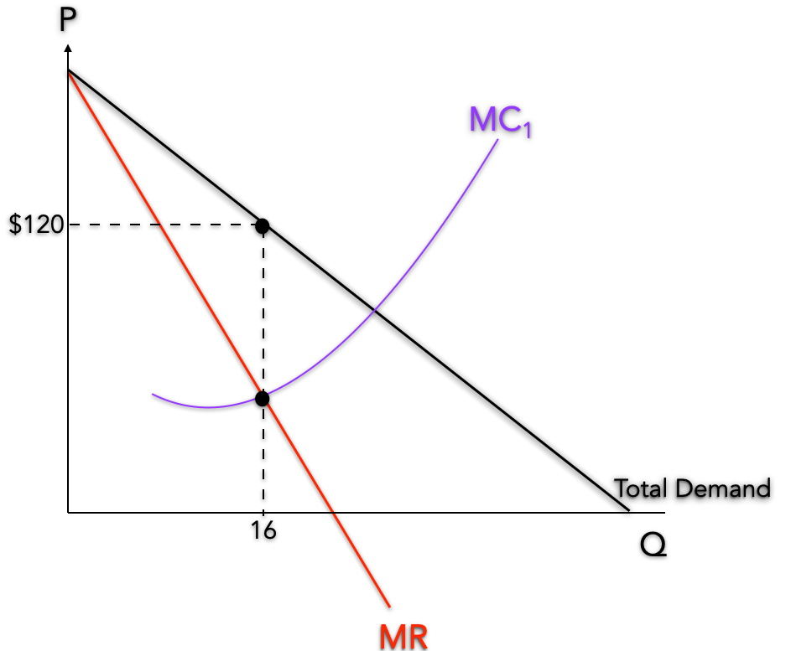
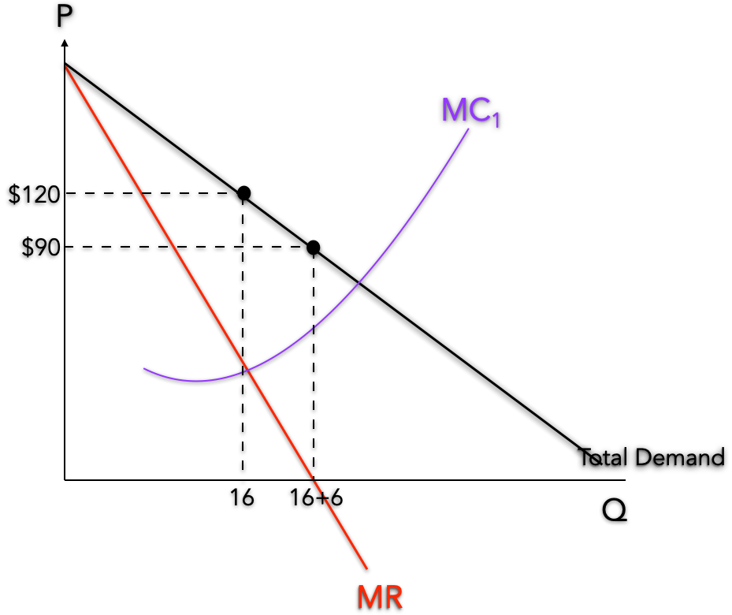
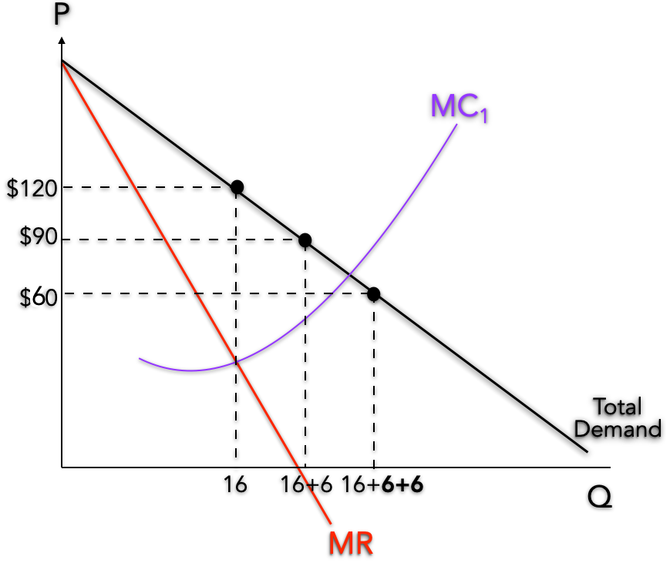
To cooperate or not to cooperate?
Two countries (country A and country B) produce oil. They agree to cooperate to set price and quantity as one:
If one of them cheats and produces 6m barrels more than the 8m agreed, the price falls:
Total Revenue = 120x16 =$1,920
Each country produce half (8million barrels)
One country produce 8m as agreed, the other country produces 6m barrels more
Each country gets half: $960
Revenue for 8 million barrels = 90 x 8 =$720
Revenue for 14 million barrels = 90 x 14 =$1,260
Revenues
If country B cooperates
If country B cheats
If both countries cheat and produce 14m barrels each the price falls even more:
If country B cooperates
If country B cheats
If country A cooperates
B gets:
$960
B gets:
$1,260
If country A cooperates
Both countries cheat: each produce 6m barrels more
A gets:
$960
A gets:
$720
Revenue for 28 million barrels = 60 x 28 =$1,680
B gets:
$720
B gets:
$840
If country A cheats
Each country gets half: $840
If country A cheats
A gets:
$1,260
A gets:
$840

Slide 24
Let’s find the best strategy for Country A
What should country A do if B cooperates?
We then ignore country B’s revenues
We then ignore this side of the matrix
Country A only cares for its own revenue
If country B cooperates
If country B cheats
If country B cooperates
If country B cheats
If country A cooperates
B gets:
$960
B gets:
$1,260
Country A’s best strategy if B cooperates is to cheat
If country A cooperates
A gets:
$960
A gets:
$720
B gets:
$720
B gets:
$840
If country A cheats
If country A cheats
Best: cheat
A gets:
$1,260
A gets:
$840
If A cooperates, it gets $960 in revenue
If A cheats, it gets $1,260 in revenue

Slide 25
Let’s find the best strategy for Country A
What should country A do if B cheats?
We then ignore this side of the matrix
We then ignore Country B’s revenues
Country A only cares for its own revenue
If country B cooperates
If country B cheats
If country B cooperates
If country B cheats
Country A’s best strategy regardless of what country B does is to cheat!
B gets:
$960
B gets:
$1,260
If country A cooperates
Country A’s best strategy if B cheats is to cheat
If country A cooperates
A gets:
$960
A gets:
$720
B gets:
$720
B gets:
$840
Dominant Strategy: cheat!
If country A cheats
If country A cheats
Best: cheat
A gets:
$1,260
A gets:
$840
If A cooperates, it gets $720 in revenue
If A cheats, it gets $840 in revenue

Slide 26
Let’s find the best strategy for Country B
What should country B do if A cooperates?
We then ignore country A’s revenues
Country B only cares for its own revenue
If country B cooperates
If country B cheats
If country B cooperates
If country B cheats
Best: cheat
If country A cooperates
B gets:
$960
B gets:
$1,260
Country B’s best strategy if A cooperates is to cheat
If country A cooperates
A gets:
$960
A gets:
$720
B gets:
$720
B gets:
$840
If country A cheats
If country A cheats
A gets:
$1,260
A gets:
$840
If B cooperates, it gets $960 in revenue
If B cheats, it gets $1,260 in revenue
We then ignore this side of the matrix

Slide 27
Let’s find the best strategy for Country B
What should country B do if A cheats?
We then ignore country A’s revenues
Country B only cares for its own revenue
Dominant Strategy: cheat!
If country B cooperates
If country B cheats
If country B cooperates
If country B cheats
We then ignore this side of the matrix
Country B’s best strategy regardless of what country A does is to cheat!
If country A cooperates
B gets:
$960
B gets:
$1,260
Country B’s best strategy if A cheats is to cheat
If country A cooperates
A gets:
$960
A gets:
$720
B gets:
$720
B gets:
$840
If country A cheats
If country A cheats
A gets:
$1,260
A gets:
$840
Best: cheat
If B cooperates, it gets $720 in revenue
If B cheats, it gets $840 in revenue

Slide 28
If both countries cooperate and abide by their agreement:
Revenues
If country B cooperates
If country B cheats
If country B cooperates
If country B cheats
If country A cooperates
B gets:
$960
B gets:
$1,260
If country A cooperates
A gets:
$960
A gets:
$720
B gets:
$720
B gets:
$840
If country A cheats
If country A cheats
A gets:
$1,260
A gets:
$840
They will each make $960 in revenue

Slide 29
If both countries follow their own self interest
Consumers are better off when companies do not or not allowed to collude
Dominant Strategy for B: cheat!
Less than what they would have made cooperating!
Revenues
If country B cooperates
If country B cheats
If country B cooperates
If country B cheats
Both countries cooperate: produce 16m barrels; price $120
If country A cooperates
B gets:
$960
B gets:
$1,260
If country A cooperates
A gets:
$960
A gets:
$720
Dominant Strategy for A: cheat!
B gets:
$720
B gets:
$840
Both countries cheat: produce 28m barrels; price $60
If country A cheats
If country A cheats
A gets:
$1,260
A gets:
$840
Both countries will cheat the agreement
Both countries will be worse off: they will each make $840 in revenue

Slide 30
Games Without a Dominant Strategy
Let’s find the best strategy for Country B
We ignore A’s revenues
Best: cheat
What should country B do if A cooperates?
Country B only cares for its own revenue
If country B cooperates
If country B cheats
If country B cooperates
If country B cheats
If country A cooperates
B gets:
$960
B gets:
$1,260
Country B’s best strategy if A cooperates is to cheat
If country A cooperates
A gets:
$960
A gets:
$720
B gets:
$720
B gets:
$840
If country A cheats
If country A cheats
A gets:
$1,260
A gets:
$840
If B cooperates, it gets $960 in revenue
If B cheats, it gets $1,260 in revenue
We ignore this side of the matrix

Slide 31
What is the best strategy for Country B if A cheats?
We ignore country A’s revenues
Country B only cares for its own revenue
Best: cheat
Country B’s best strategy if A cooperates was to cheat
If country B cooperates
If country B cheats
If country B cooperates
If country B cheats
NO Dominant Strategy
If country A cooperates
B gets:
$960
B gets:
$1,260
We ignore this side of the matrix
If country A cooperates
Country B’s best strategy if A cheats is to cooperate
A gets:
$960
A gets:
$720
B gets:
$720
B gets:
$700
If country A cheats
If country A cheats
Best: cooperate
A gets:
$1,260
A gets:
$700
If B cooperates, it gets $720 in revenue
If B cheats, it gets $700 in revenue
What to do when there is no Dominant Strategy?

Slide 32
If there is no Dominant Strategy, choose the least worse…
The Maximin Criteria
We ignore A’s revenues
Worst outcome: Cooperate
Let’s find the “worst outcome” for Country B
If country B cooperates
If country B cheats
What is the worst outcome for country B if A cooperates?
If country B cooperates
If country B cheats
If country A cooperates
B gets:
$960
B gets:
$1,260
If country A cooperates
Country B only cares for its own revenue
A gets:
$720
A gets:
$960
B gets:
$720
B gets:
$840
Country B’s worst outcome occurs if it cooperates
If country A cheats
If country A cheats
A gets:
$1,260
A gets:
$840
If B cooperates, it gets $960 in revenue
We ignore this side of the matrix
If B cheats, it gets $1,260 in revenue

Slide 33
The Maximin Criteria: Choose the Strategy whith the maximum of the worst outcomes
Country B’s worst outcome if it cooperates: 720
If country B cooperates
If country B cheats
If country B cooperates
If country B cheats
If country A cooperates
B gets:
$960
B gets:
$1,260
If country A cooperates
Country B’s worst outcome if it cheats: 700
A gets:
$960
A gets:
$720
B gets:
$720
B gets:
$700
If country A cheats
If country A cheats
Maximum of these: 720 (Cooperate)
A gets:
$1,260
A gets:
$700
Maximin strategy for B: Cooperate

Slide 34
Be a pessimist: Assume the worst will happen and choose the strategy that gives you the highest of the worst outcomes
The Maximin Criteria
Maximin strategy for A: Cooperate
Revenues
If country B cooperates
If country B cheats
If country A cooperates
B gets:
$960
B gets:
$1,260
The maximum of these two “worst” outcomes is $720 when country A cooperates
A gets:
$960
A gets:
$720
B gets:
$720
B gets:
$700
If country A cheats
A gets:
$1,260
A gets:
$700

Slide 35
Nash Equilibrium
To find a Nash equilibrium:
Find the best payoff for each alternative move of the other player
Revenues
If country B cooperates
If country B cheats
If country A cooperates
B gets:
$960
B gets:
$1,260
If B cheats, the best payoff for A (the highest between $720 and $700) is $720
A gets:
$960
A gets:
$720
B gets:
$720
B gets:
$700
If B cooperates, the best payoff for A (the highest between $960 and $1,260) is $1,260
If country A cheats
A gets:
$1,260
A gets:
$700
If A cheats, the best payoff for B (the highest between $720 and $700) is $720
If A cooperates, the best payoff for B (the highest between $960 and $1,260) is $1,260

Slide 36
Nash Equilibrium
Revenues
Consider this situation when A cooperates and B cheats:This is also a Nash equilibrium, because neither player has an incentive to do otherwise:
If country B cooperates
If country B cheats
If country A cooperates
B gets:
$960
B gets:
$1,260
A gets:
$960
A gets:
$720
A can not increase his payoff by switching to cheat
B gets:
$720
B gets:
$700
B can not increase his payoff by switching to cooperate
If country A cheats
A gets:
$1,260
A gets:
$700
Consider this situation when A cheats and B cooperates:This is a Nash equilibrium, because neither player has an incentive to do otherwise:
A can not increase his payoff by switching to cooperate
B can not increase his payoff by switching to cheat

Slide 37
Player 2 strategies
The first value in each cell is the payoff for player 1
A
B
C
The second value in each cell is the payoff for player 2
A
0,0
50,80
10,20
Player 1 strategies
In this example, there are three Nash equilibria
Max
Max
B
80,50
0,0
10,30
Max
Max
C
20,10
30,10
20,20
To find the Nash equilibria:
Max
Max
Find the maximum for each column: maximum payoff for player 1 (first value in each cell)
Find the maximum for each row: maximum payoff for player 2 (second value in each cell)
If the both members of a pair are the maximum for the respective row/column, the cell represents a Nash equilibrium.
An N×N matrix may have between 0 and N×N Nash equilibria.

Slide 38
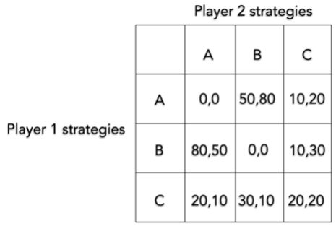
Min
Min
Min
Min
The Maximin for player 2: The maximum of these minimum payoffs is 10: using either strategy A or strategy B

Slide 39
Determining Industry Structure
Economists use one of two methods to measure industry structure:
The Concentration Ratio
The Herfindahl–Hirschman Index
The value of sales by the top n firms of an industry as a percentage of total industry sales.
The most commonly used concentration ratio is the four-firm concentration ratio.
The higher the ratio, the closer to an oligopolistic or monopolistic type of market structure
A ratio of 40% or more means that an oligopoly exists because power is concentrated in a few firms in the industry
Is calculated by adding the squared value of the individual market shares of all firms in the industry
The Herfindahl index gives higher weights (than those given by the concentration ratio) to the largest firms in the industry because it squares market shares.
Used by the Department of Justice to determine whether a merger is allowed to take place: Less than. 1,000 is considered competitive and the merger is allowed

Slide 40
Firm
Share of the market
4 Firm Concentration Ratio
The Herfindahl–Hirschman Index
A
50%
B
25%
50²+25²+4²+4²+4²+4²+4²+4²+1² =
50+25+4+4 = 83%
C
4%
2,500+625+16+16+16+16+16+16+1 = 3,222
D
4%
E
4%
F
4%
G
4%
H
4%
I
1%

Slide 41
The four firm concentration ratio gives the same value for a Duopoly and a Monopoly
The four firm concentration ratio gives a higher value for a Duopoly than a Monopoly
Number of Firms
Share of the market
4 Firm Concentration Ratio
The Herfindahl–Hirschman Index HHI
Monopoly
1
100%
100+0+0+0 = 100%
100²= 10,000
Duopoly
2
50%
50+50+0+0 = 100%
50²+50²= 2 x (50²) = 5,000
Perfect Competition
10,000
100/10,000 =0.01%
0.01+0.01+0.01+0.01 = 0.04%
10,000 x (0.01²) = 1
The Herfindahl–Hirschman Index HHI is a more accurate measure of concentration

Slide 42
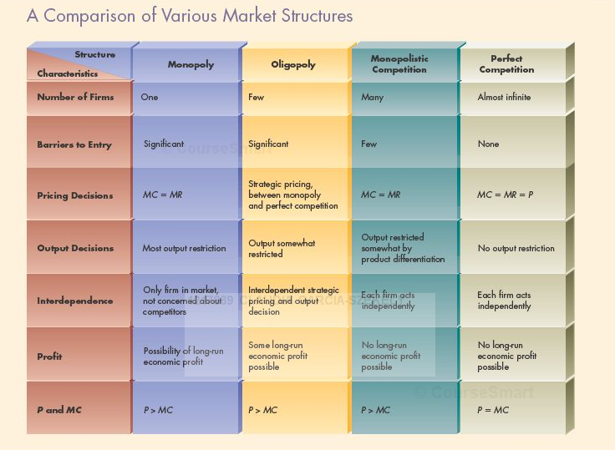
© 2000 Claudia Garcia - Szekely

Slide 43
