Slide 1

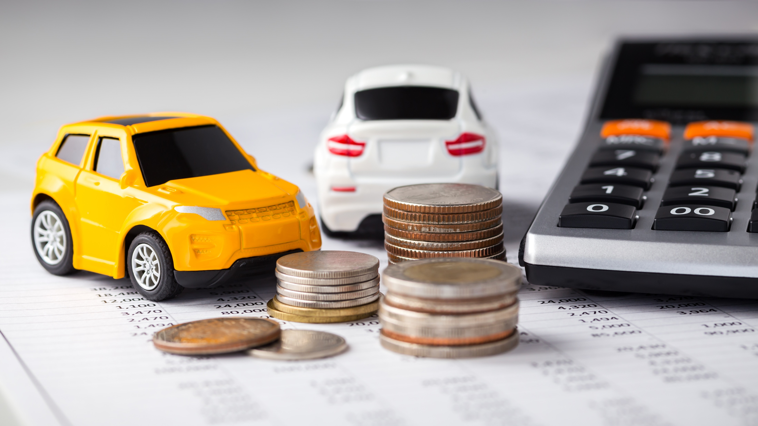
Predicting Cross-sell Opportunities for Car Insurance
Power of
Machine Learning:
Sarahais Zerpa Felipe Starling Keiyau Sin
November 2020

Slide 2

Our Client
Insurance company
Market leader in health insurance
Strategic goal: Increase revenue from car insurance
This Photo by Unknown Author is licensed under CC BY-NC-ND

Slide 3

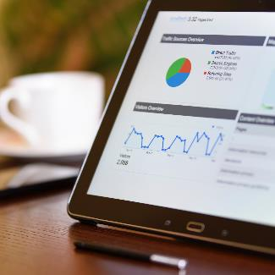

The Problem
Massive Database
Scarce Analytics
Limited Marketing Resources
Over 380,000 existing health insurance customers (Data source: Kaggle)
No analytics on which customers might be interested in car insurance
Not time- & resource-efficient to target each of the 380,000 customers

Slide 4




Solution
Build
Validate
Create
K-nearest Neighbor Algorithm
Results
Web app for customer service team
Use machine learning to predict cross-sell opportunities

Slide 5
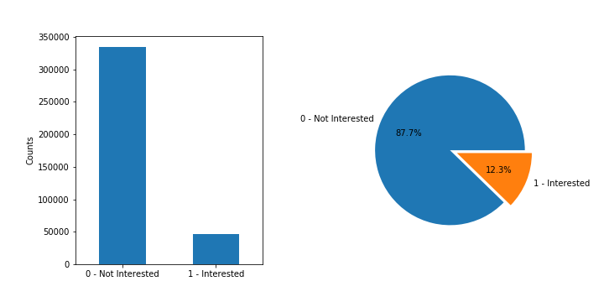
Explore the Data
Data contains 11 customer attributes: Gender, age, vehicle age, previous vehicle damage, vintage with company, interest in car insurance etc.
Large dataset (>380,000 records), but only 12% is interested in car insurance

Slide 6
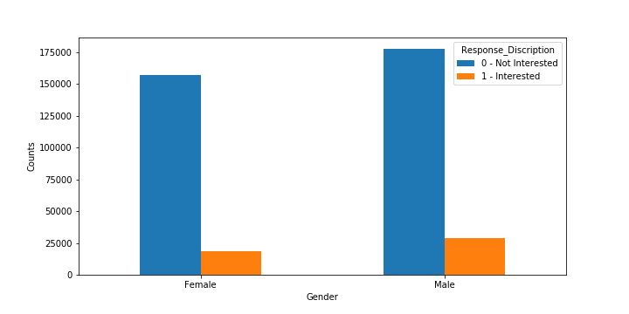
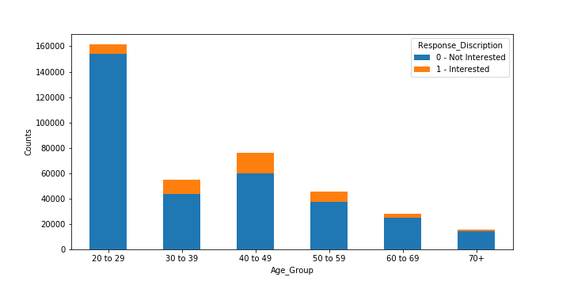
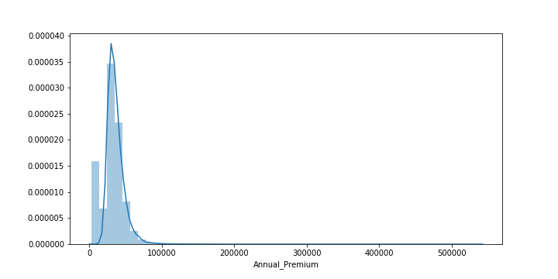
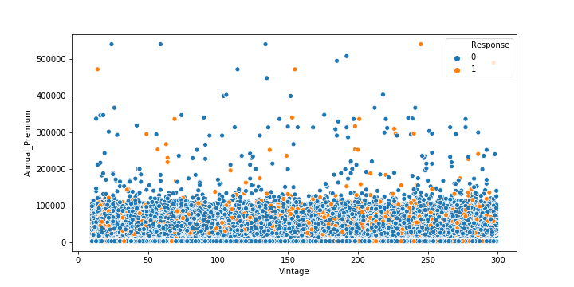
Explore the Data
Number of customer interested in car insurance by gender

Slide 7
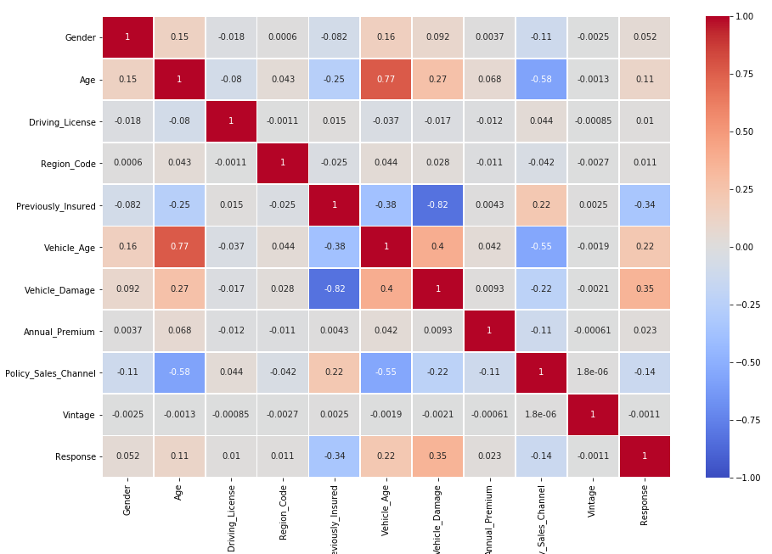
Explore the Data
Correlation analysis between different attributes
Vehicle Age has the most relation to “Response”
Strongest positive correlation is between age and car age
Strongest negative relation is between car damage and previously insured

Slide 8
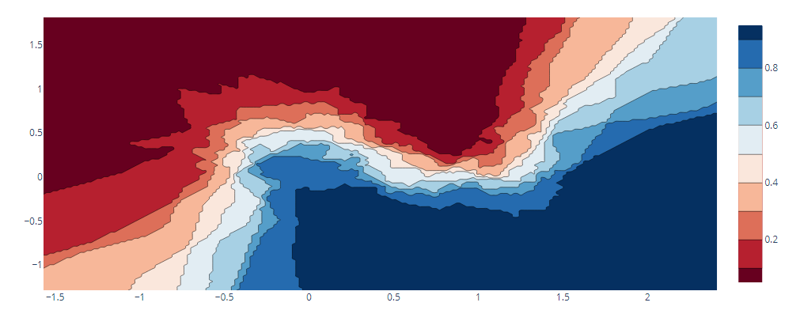

Why KNN Algorithm?
Classification problem: What attributes do potential customers have? How can we identify likely car insurance buyers?
Classify data points based on their proximity and association to other available data
Good fit for recommendation engines
Source: https://www.ibm.com/cloud/learn/supervised-learning

Slide 9
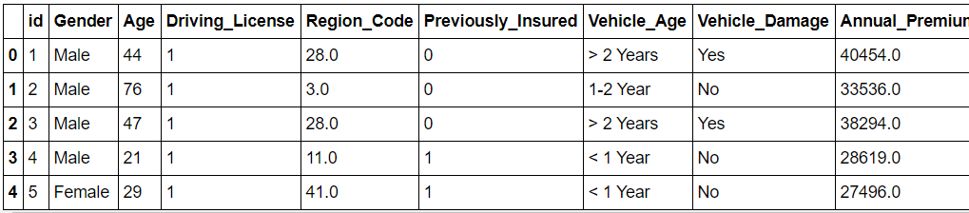

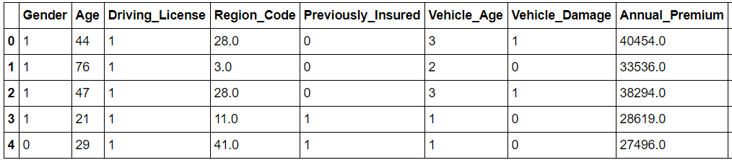

KNN in Action
1. Pre-process data
Convert categorical data to numeric values
2. Test Train Split

Slide 10
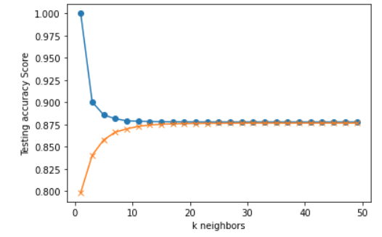

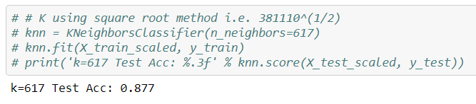
KNN in Action
3. Determine K-factor
Number of K neighbors start to converge at around 17, with accuracy level at ~0.876
Similar level of accuracy using the square root method
K=17 was selected, to run algorithm more efficiently, while maintaining an acceptable level of accuracy

Slide 11
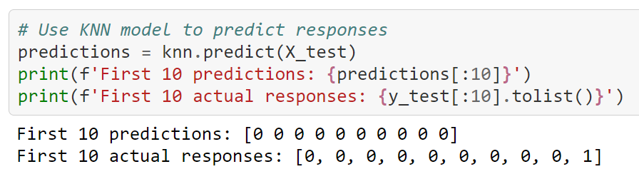

KNN in Action
4. Predict & Validate Results
X_test data: 95278 records
Number of correct predictions: 83425
Accuracy level: 0.876
Number of correct positive responses: 28

Slide 12
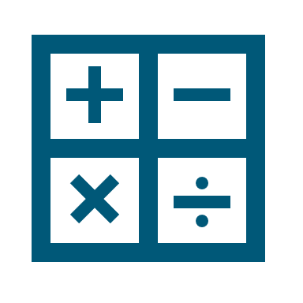




The Infrastructure
KNN Algorithm (pickle)
6. Get predictions
5. Request model to predict response on customer data
7. Send predictions to the web app
Flask (on Heroku)
1. User sending query of customer ID
Web App
2. Send query to Flask
3. Send API calls to SQLite
4. Get data of queried customer ID
SQLite

Slide 13
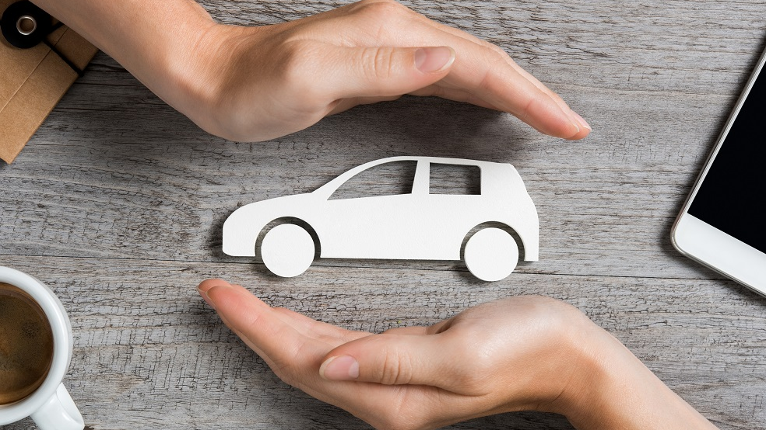
Web App

Slide 14

Reflections & Next Steps
Apply oversampling onto the dataset to increase the number of interested customers in order to address the issue of few positive responses in original dataset.
Experiment with model results to achieve a 90-95% accuracy level.
Experiment with using less customer attributes to identify interested and non-interested customers.
Apply a different method to load large datasets into web apps.
Automate the selection of customer ID when customer dials in
Make available a form entry method for users to select and submit different attributes to predict cross sale potential.
This Photo by Unknown Author is licensed under CC BY-NC-ND

Slide 15
Q&A

Slide 16


Thank You
https://cross-sale-predictions.herokuapp.com/

