Slide 1
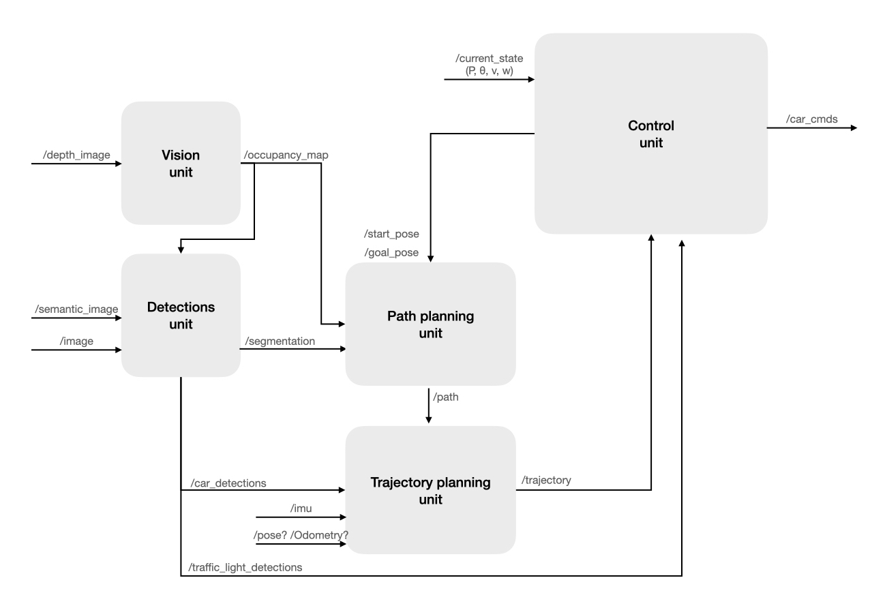
Control
Traffic light info
Vision
“/map” Nav_mgs/GetMap
“move_base_simple/goal”
geometry_msg/PoseStamped
Detection
Move_base
2D cost map
Car detection
Global planer
Odometry
Trajectory Local planer

