Slide 1
Programming 4
Lecture 02: Pointers
Semester 1, 2020
Kaiako: Grayson Orr
Te Kura Matatiniki Otago, O ̄tepoti, Aotearoa
Friday, 21 February

Slide 2
Last class
C++ history
C++ CLI general features
Operators
Conditionals
Loops

Slide 3
Pointers
Pointers are used rarely in C# and not used
at all in Java
Pointers are used a lot in C++
All user-defined and system objects are handled
via pointers
Complex data structures (e.g. linked lists) rely
heavily on pointers

Slide 4
Pointers
When you declare a variable (e.g. int num), it
is assigned a memory location where its value
will be stored
Memory Addresses
Memory
115
116
num will be stored here
117
118
119
Notes:
The memory addresses aren’t really small numbers like 115, 116, 117, etc
They are big gigabyte like numbers but the logic is the same

Slide 5
Pointers
Pointers are special variables that hold memory addresses where values live
You can think of num as the variable whose value
is stored at memory address 117
You can use the pointer to observe and change the value of num (e.g. the value stored at memory
address 117)
Notes:
Pointer variables can only ever hold a memory address. The same way ints can only hold whole numbers, or a bool can only hold true or false.
With C++ is that some kinds of data can be dealt with only via pointers

Slide 6
Pointers
To declare a pointer in C++, use the * operator.
int *numPtr;
Currently, numPtr points to an integer
numPtr value will be a memory address
That memory address must contain an integer
Notes:
The compiler doesn’t get confused between * as “this is a pointer” and * as “multiply”

Slide 7
Initialising pointers
You can’t assign a memory address directly to
a pointer
You can’t say numPtr = memory address 117
You can initialise a pointer by:
Setting it to point to an existing variable
Creating a new variable for it to point to
Setting it equal to an already initialised pointer

Slide 8
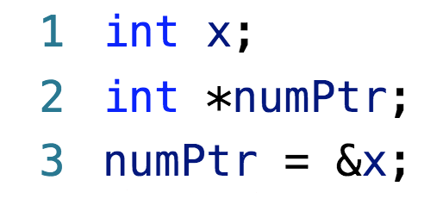
Initialising pointers – method 1
Setting it to point to an existing variable:
& is ”the address of”
numPtr contains the address of x
numPtr “points to” x

Slide 9
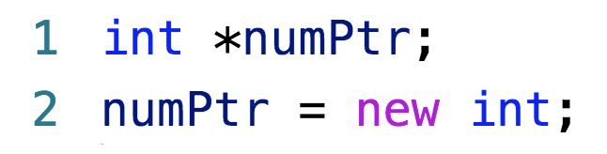
Initialising pointers – method 2
Creating a new variable for it to point to:
“new int” allocates sufficient memory to hold an int
Returns the memory address of the allocated space
numPtr points to that memory address
Notes:
numPtr is assigned the address returned by the new, so it “points to” that address
It may seem silly to go through all this trouble when we could just create an int. And in fact, when working with simple primitive types like int, we don’t usually bother with pointers
We must remember that user-defined classes and complex system classes like buttons *must* be managed via pointers – C++ requires this
When we first meet pointers, it is easier to understand them when using something simple like an int

Slide 10
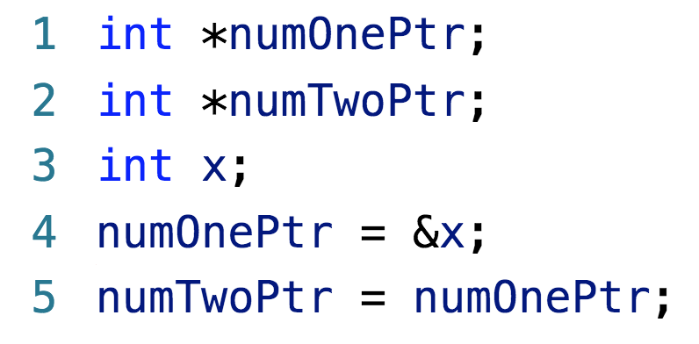
Initialising pointers – method 3
Setting it equal to an already initialised pointer:

Slide 11
Dereferencing pointers
Dereferencing – finding the value stored at the
memory address a pointer is pointing to (e.g. holds
the value of)
The dereferencing operator is also *
* means “the value stored at”
Or colloquially “the value of the guy the pointer is pointing to”
*numPtr means “the value stored at the memory address held by numPtr”
Or “the value of the variable numPtr is pointing to”

Slide 12
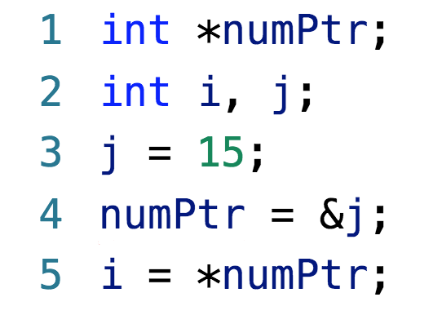
Example
Notes:
i = 15

Slide 13
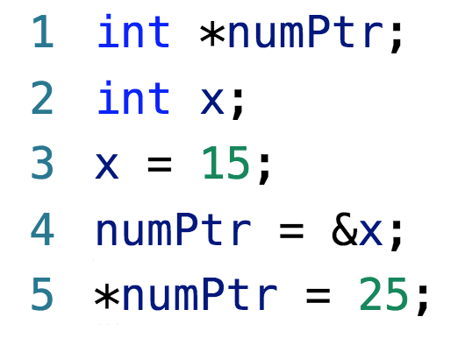
Example
Notes:
When assigning to *numPtr, we are assigning to “the variable numPtr is pointing to”
numPtr is pointing to (i.e. is holding the address of) x. So x now holds 25

Slide 14
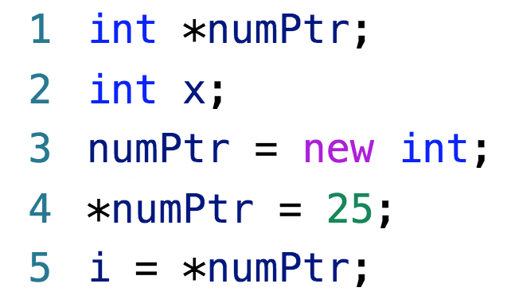
Example

Slide 15
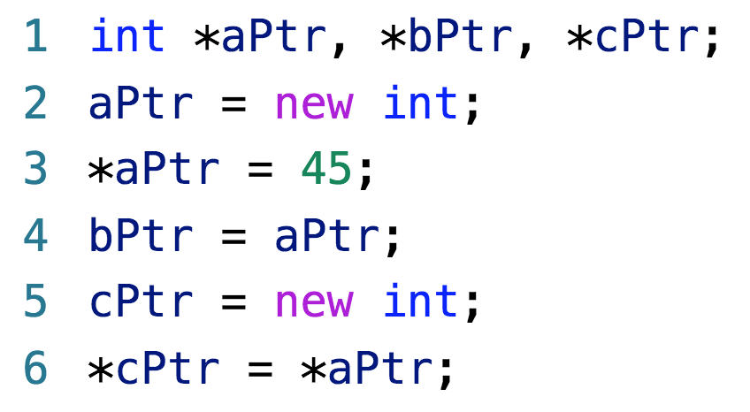
Example
What are the values of aPtr, bPtr and cPtr?
What are the values of *aPtr, *bPtr and *cPtr?
Notes:
Pointer problems can get quite complicated, but the logic is always the same, just work through it carefully
What are the values of aPtr, bPtr and cPtr? => Don’t know, they’re memory addresses
What are the values of *aPtr, *bPtr and *cPtr? => All 45
We’ll see lots more about pointers as we go. Don’t fret about all the operators – in practice, we don’t use them all that much in Visual C++
What is critical is that you understand that pointers don’t hold the data themselves, they hold the address of the data
Keep clear the difference between the value of a pointer (the address it holds) and the value of the data it points to (what you get when you dereference)

Slide 16
How are pointers really used?
Refer and share large data structure without
making a copy of the structures
Used to specify relationships among data – linked
lists, trees, graphs, etc

Slide 17
Unmanaged vs. Managed
.NET supports two different kinds of
pointer-based data:
Unmanaged (Native C++)
Managed (C++ CLI)
Managed objects can be moved in memory by the system while the program is running
Unmanaged objects can not be moved
If you create managed objects, you get automatic garbage collection

Slide 18
Unmanaged vs. Managed
Unmanaged
myClass* unmanagedPtr;
unmanagedPtr = new myClass(…);
Managed
myClass^ unmanagedPtr;
unmanagedPtr = gcnew myClass(…);
Notes:
unmanagedPtr is a pointer to an instance of myClass
The object unmanagedPtr points to will not move, and we must free its memory ourselves
managedPtr is a handle to an instance of myClass
The object managedPtr points to may move, and the system will free its memory when nobody is pointing to it

Slide 19
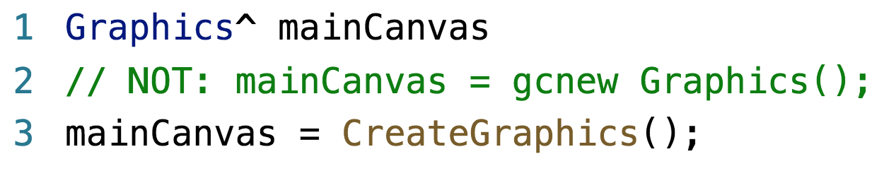
Graphics
In .NET, forms don’t automatically come with
a drawing surface (canvas)
You must create one
Create an instance of the class Graphics
Using namespace System::Drawing

Slide 20
Global variables
There are technically no global variables
We add data properties to the Form class

Slide 21
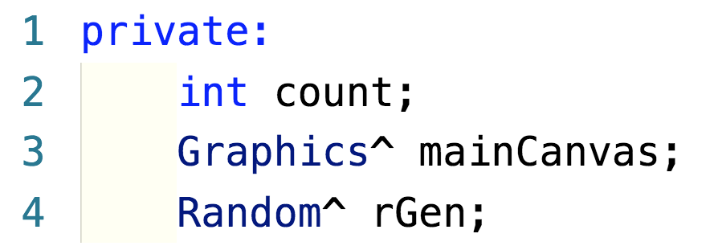
Declaring form data properties

Slide 22
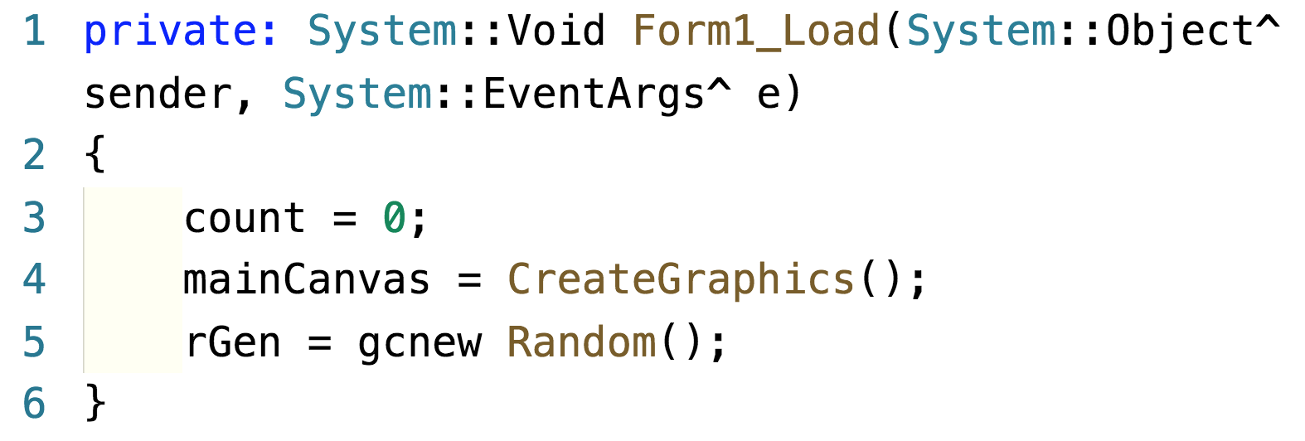
Instantiating form data properties

Slide 23
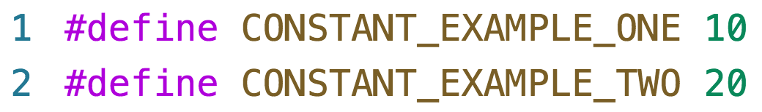
Constants

