Slide 1
Programming 4
Lecture 03: File Structure
Semester 1, 2020
Kaiako: Grayson Orr
Te Kura Matatiniki Otago, O ̄tepoti, Aotearoa
Wednesday, 26 February

Slide 2
.h and .cpp
In C++, we need to separate the definition
of our classes from the implementation of
our classes.
Definitions go in .h
Implementations go in .cpp
For each class, we have a .h and .cpp file
Notes:
Today, we introduce the .h and .cpp file structure
You have not seen this in C# or Java
Class names and public entities start with uppercase and private entities start with lowercase

Slide 3
C++ class definition syntax
Variables are declared but not initialised
Function prototypes are declared but no
implementation code
Visual C++ classes either have ref or value
A value class is one with no methods
There are three scoping options – private,
protected and public
Code implementation is done in the .cpp
Notes:
In the .h we declare, but do not initialise data members
In the .h we give function prototypes, but do not implement code
Classes in Visual C++ are either ref or value. The default is ref.
A value class is one with no methods – record/structures
We ignore this and just make ref classes
There are three scoping options:
Private - accessible only by class members
Protected – accessible by class members and descendants of the class
Public – accessible by everyone
We you declare new function prototypes in the .h file, you can use the wizard to generate the methods in the .cpp. This is much like C# in Programming 2
It is possible to add existing classes and we will be doing this quite often this semester. Take care with wiring everything up, you can get lost really quick

Slide 4
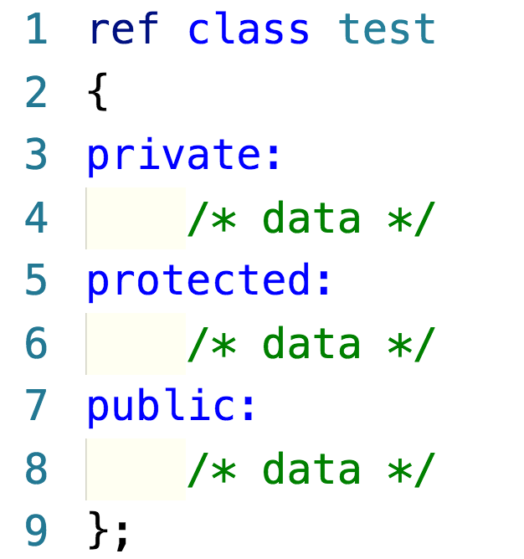
Example
Notes:
Form classes are an exception to the no code implementation rule

Slide 5
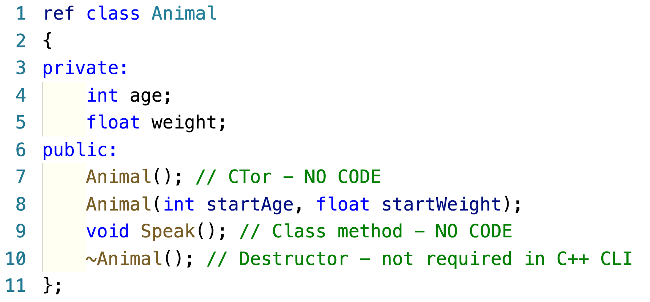
Example – Animal.h
Notes:
Variables are not initialised at declaration
Function prototypes are not implemented at declaration
Constructors – no return type and have the same name as the class
We have two overloaded constructors – a class with more than one constructor with different arguments
The convention is C++ is to name the input arguments something different from the variable. In Programming 2 and 3, you used the “this” keyword to differentiate in the code
Destructors are methods that are executed when the memory for an object instance is released. In managed languages with automatic garbage collection, we generally don’t have to write destructors. There are some advanced situations where you do – where you want to perform particular clean-up tasks when a object is deleted from memory. This can be closing files or database connections, or manually deleting dynamically generated properties of the class

Slide 6
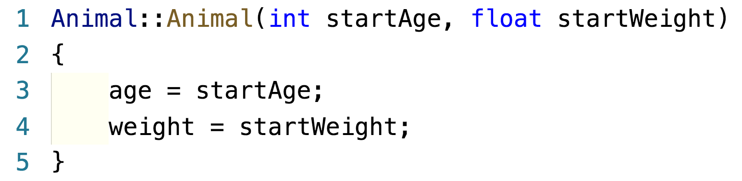
Example – Animal.cpp
Notes:
In .cpp, you provide code for every method declared in the .h
Recall that we have two constructors and a method called Speak() – we will write code for all three
Class name::constructor name(optional arguments) { initialise values }
You prefix the function with the class name and scoping operator ::
This is how the compiler matches up the code in the .cpp with the declaration in .h file
This is how it knows when class Animal calls its method, which code should be executed
If you omit the class identifier, the code will not compile because it won’t be able to match up the .h and .cpp methods

Slide 7
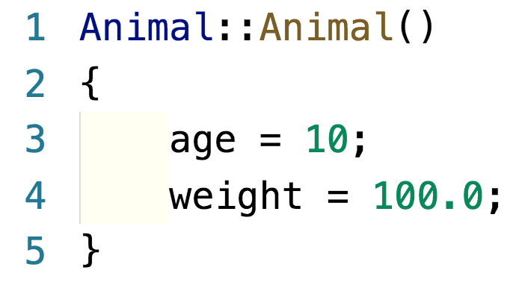
Example – Animal.cpp
Notes:
When no data values are passed in, we have to come up with default values

Slide 8
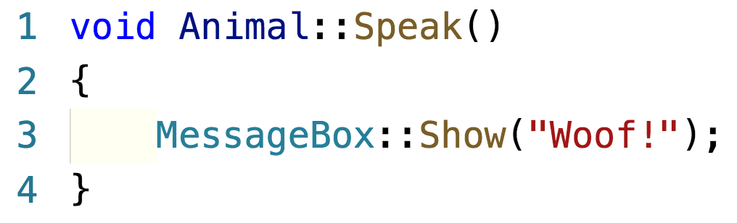
Example – Animal.cpp
Notes:
You must mark the method in the .cpp with the class name and scoping operator ::
One comment about this code – if you try and run it, it will fail. The compiler won’t be able to recognise MessageBox. Form components have their own system namespace
If you want to do this, put your system namespaces in the .h file

Slide 9
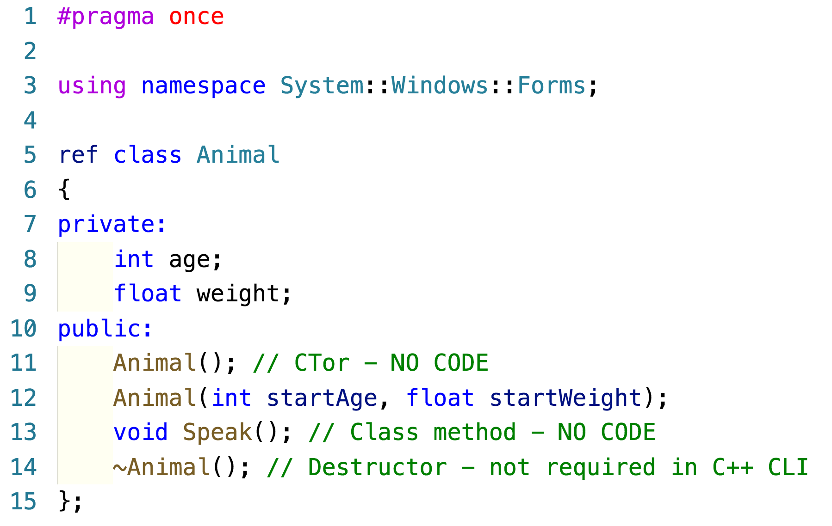
Example – Animal.h
Notes:
Complete Animal.h
#pragma once is automatically supplied by the system. That’s the first line of every .h file you get. It tells the compiler to only add this class once to the build
Add a using statement for any namespace you need. One easy way is to just copy the ones from MyForm.h and paste them in
This semi-colon is part of the code supplied by the system when you create a class. It follows the closing curly bracket of the class definition code block, which starts with ref class Animal. BE CAREFUL WITH IT. NEVER DELETE IT

Slide 10
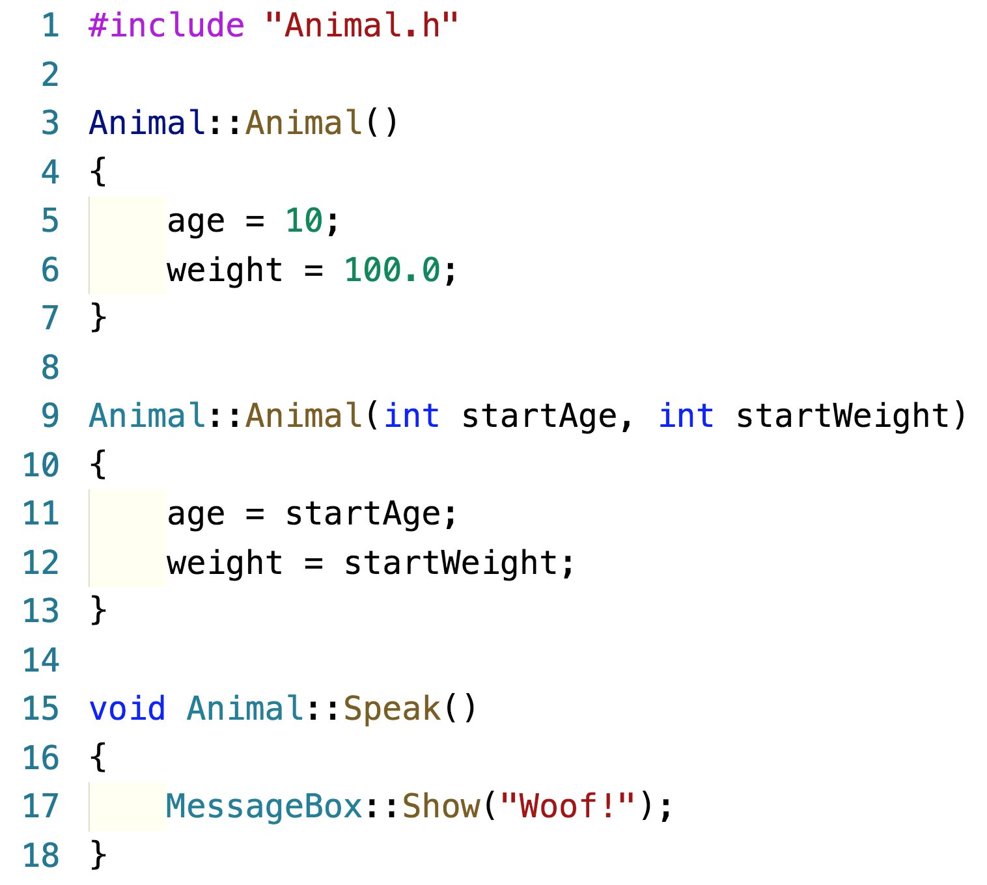
Example – Animal.cpp
Notes:
Complete Animal.cpp
All # statements are compiler directives
#include says go get this file and paste it in here before you compile me
The .h and .cpp structure is a direct map to the OO distinction between the interface and implementation
You may have heard of information hiding. The .h tells you everything you need to know to use the class; implementation details are hidden in the .cpp
This is one of the reasons C++ is a more pure OO language than C#

Slide 11
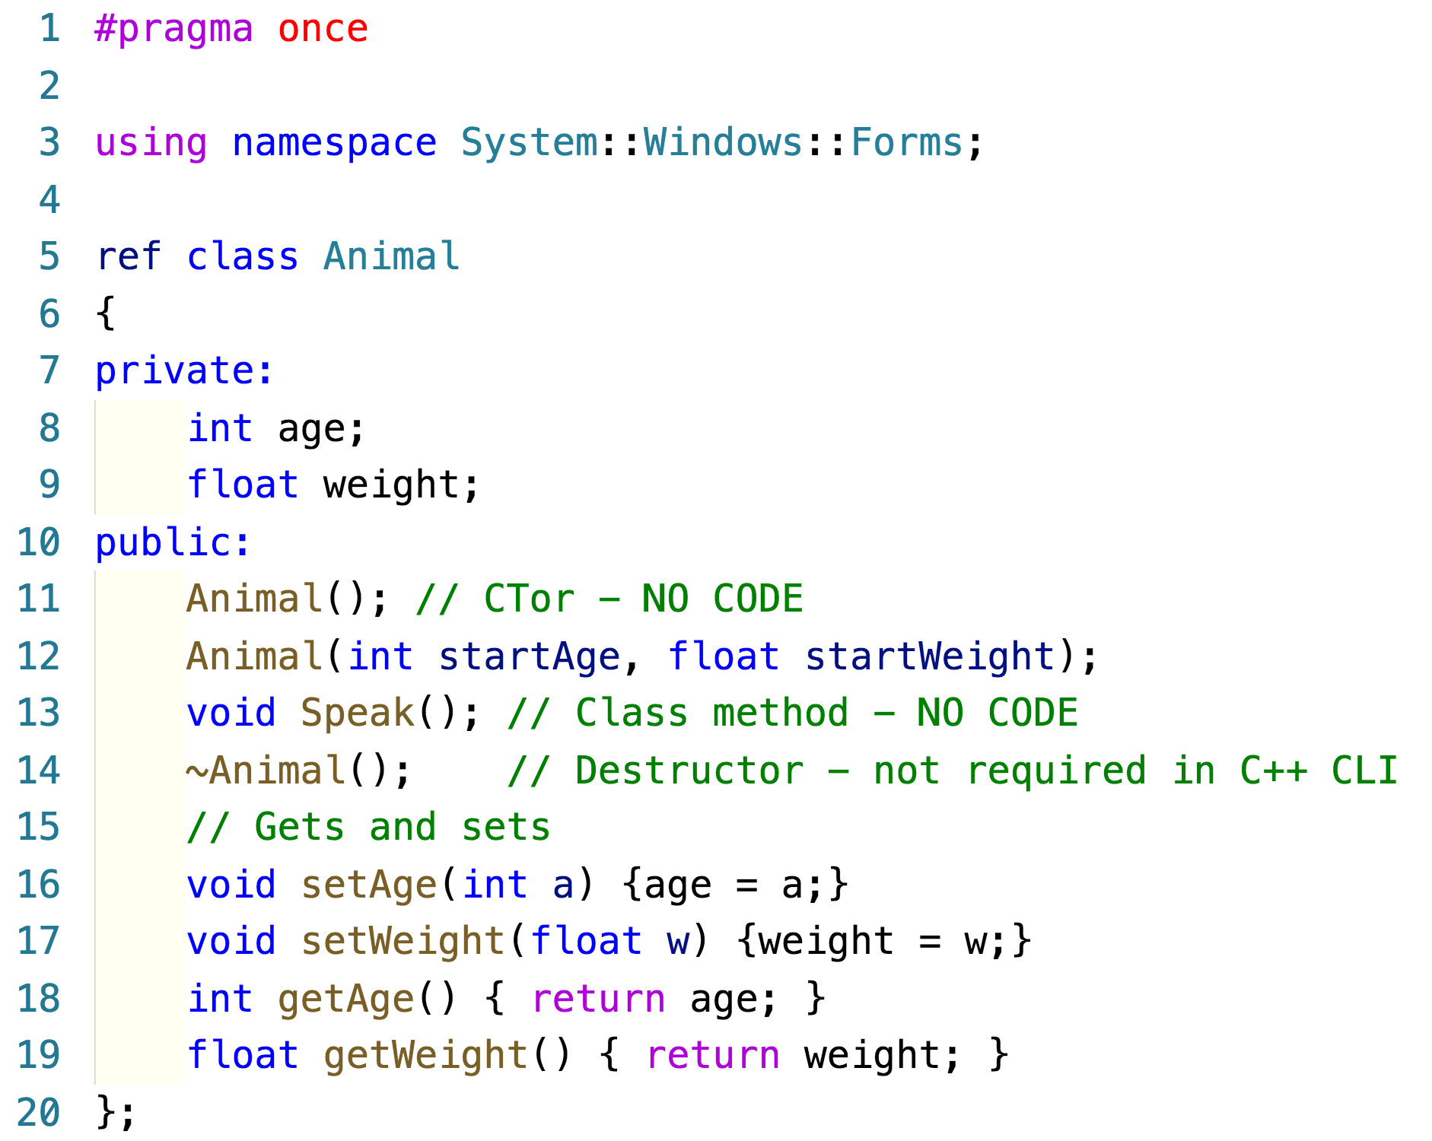
Implementing one line methods
Notes:
An exception to the “no code” rule is made when the method contains exactly one line of code

Slide 12
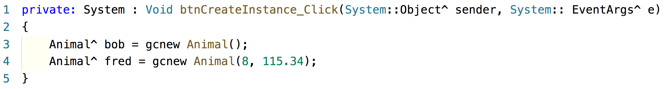
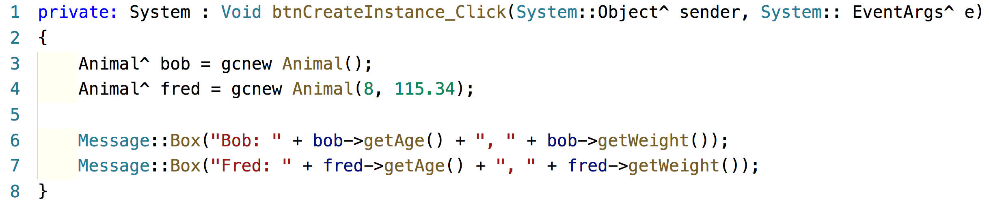
Create class instances
Notes:
This is how we create a class instance

Slide 13
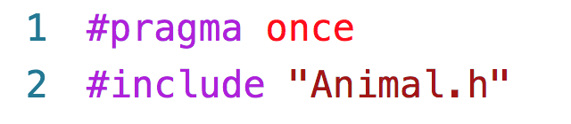
Remember #include

Slide 14
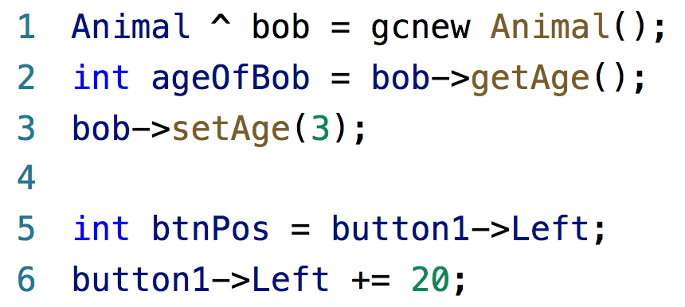
A .NET alternative to sets and gets
If class data members are private, and you
write set and get methods

Slide 15
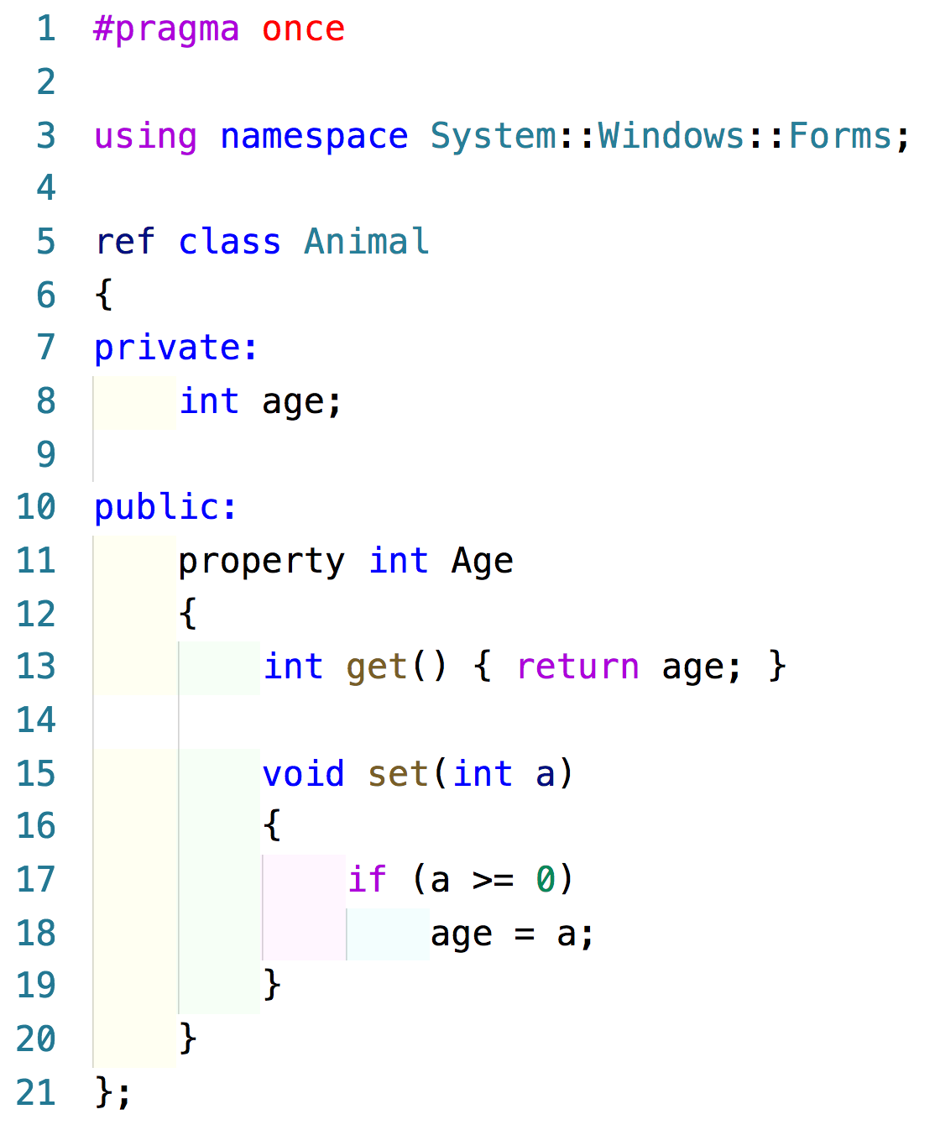
.NET property
Notes:
Many system object data members are done this way, and you can use this approach in your own classes as well
Private member, with lowercase first letter
Public member, with uppercase first letter

Slide 16
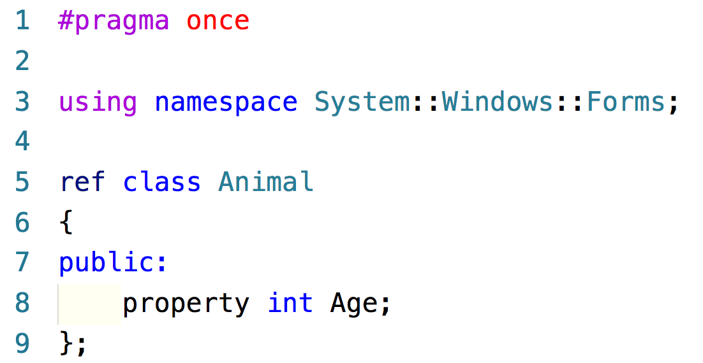
.NET property – less typing

Slide 17
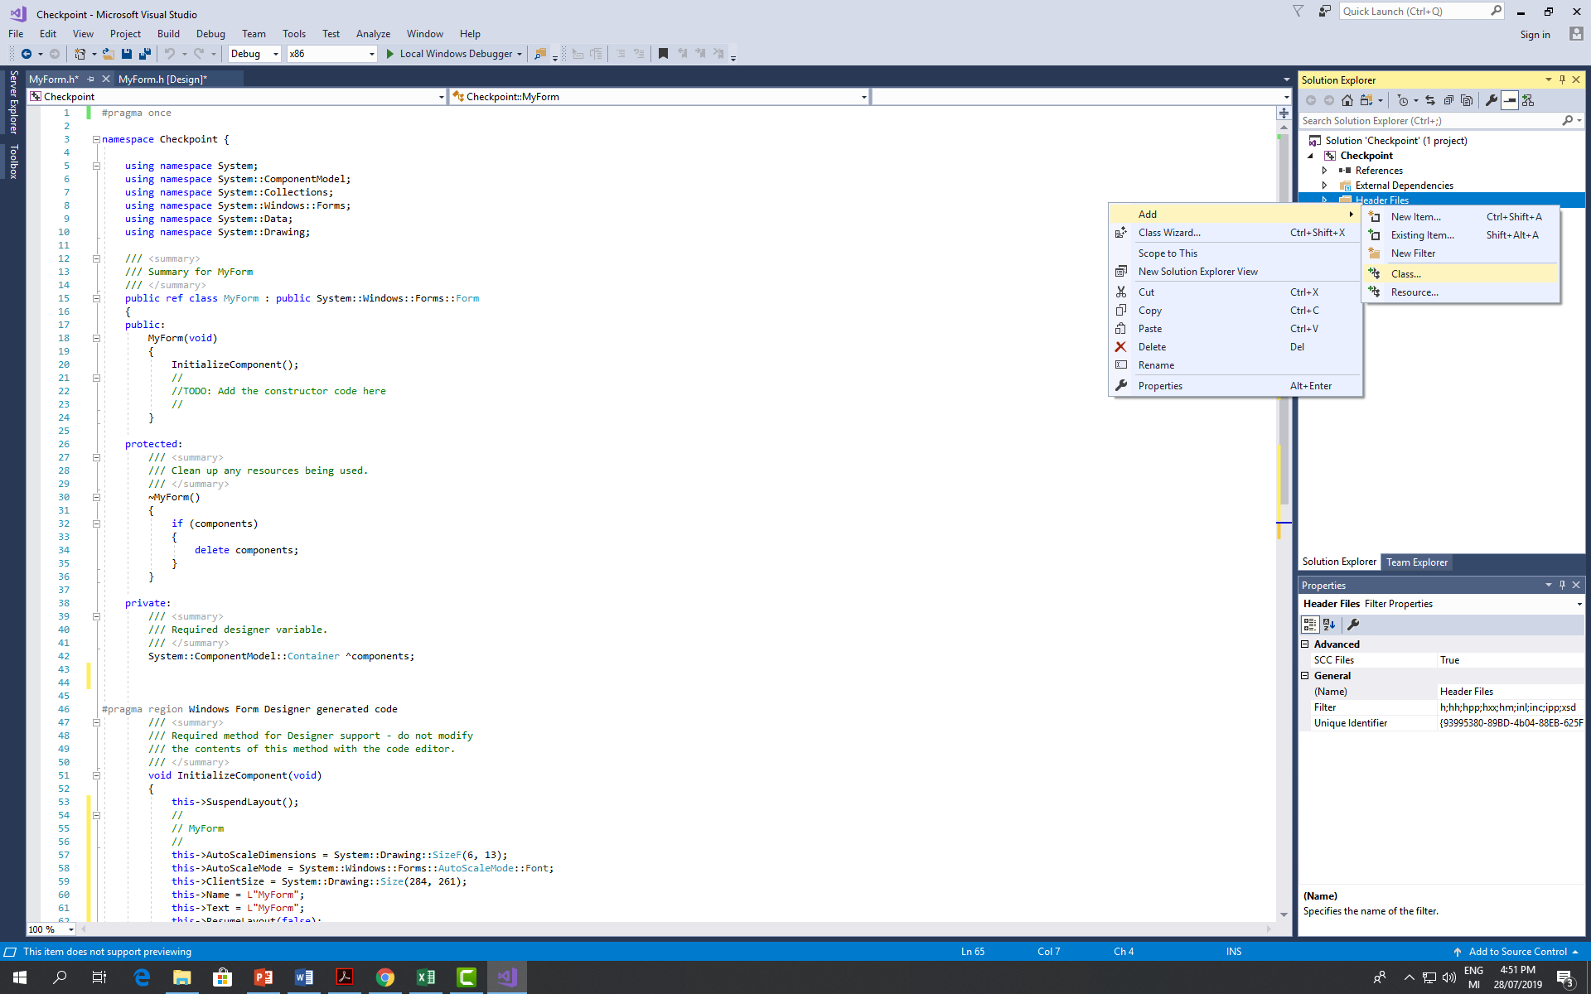
Creating a new class

Slide 18
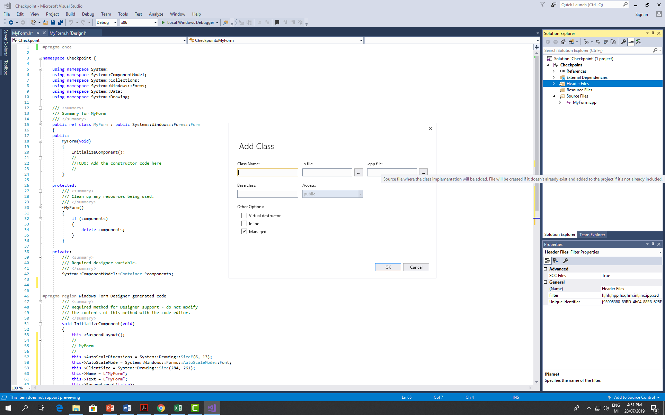
Creating a new class

Slide 19

Creating a new class

Slide 20
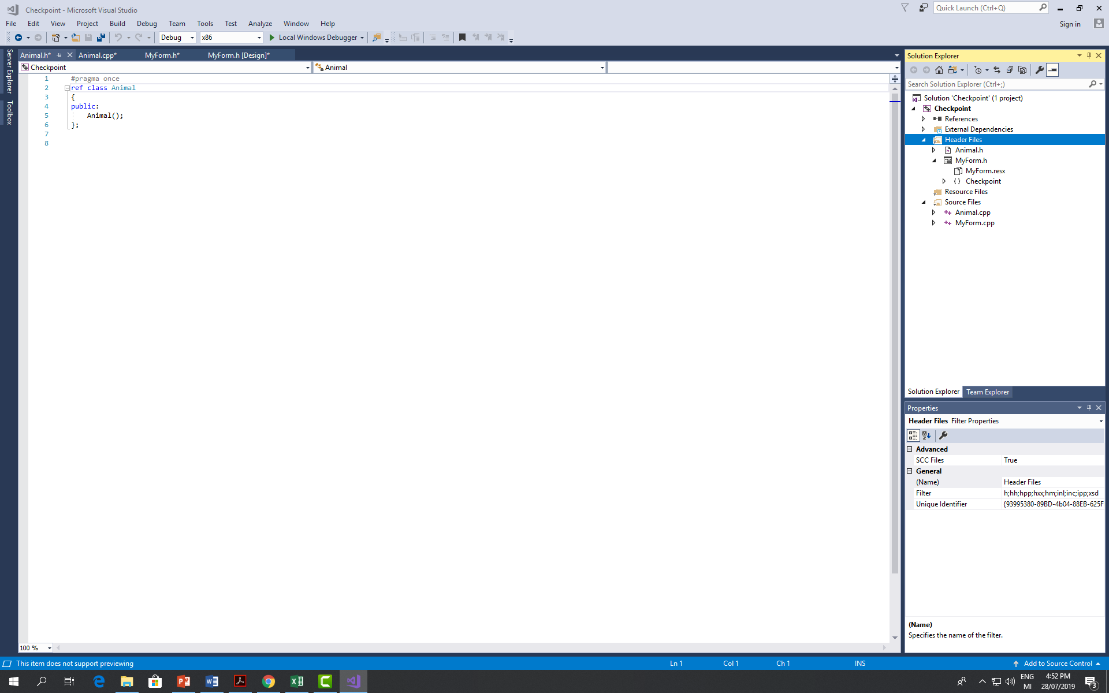
Creating a new class

