Slide 1
Programming 4
Lecture 04: Event Loop
Semester 1, 2020
Kaiako: Grayson Orr
Te Kura Matatiniki Otago, O ̄tepoti, Aotearoa
Friday, 28 February

Slide 2
The game cycle
Initialise system
While the game isn’t over
Begin
Check for input
Update game state
Display game state
End
Close
Notes:
Most games have the same underlying structure
Wait for input, update state and display state
Input is generally done by the user, although the game state may also change due to game events or triggers – example in Sim City residents abandon a building if the crime rate is too high – this happens when a user doesn’t do anything
In games, this often called the event loop or game cycle

Slide 3
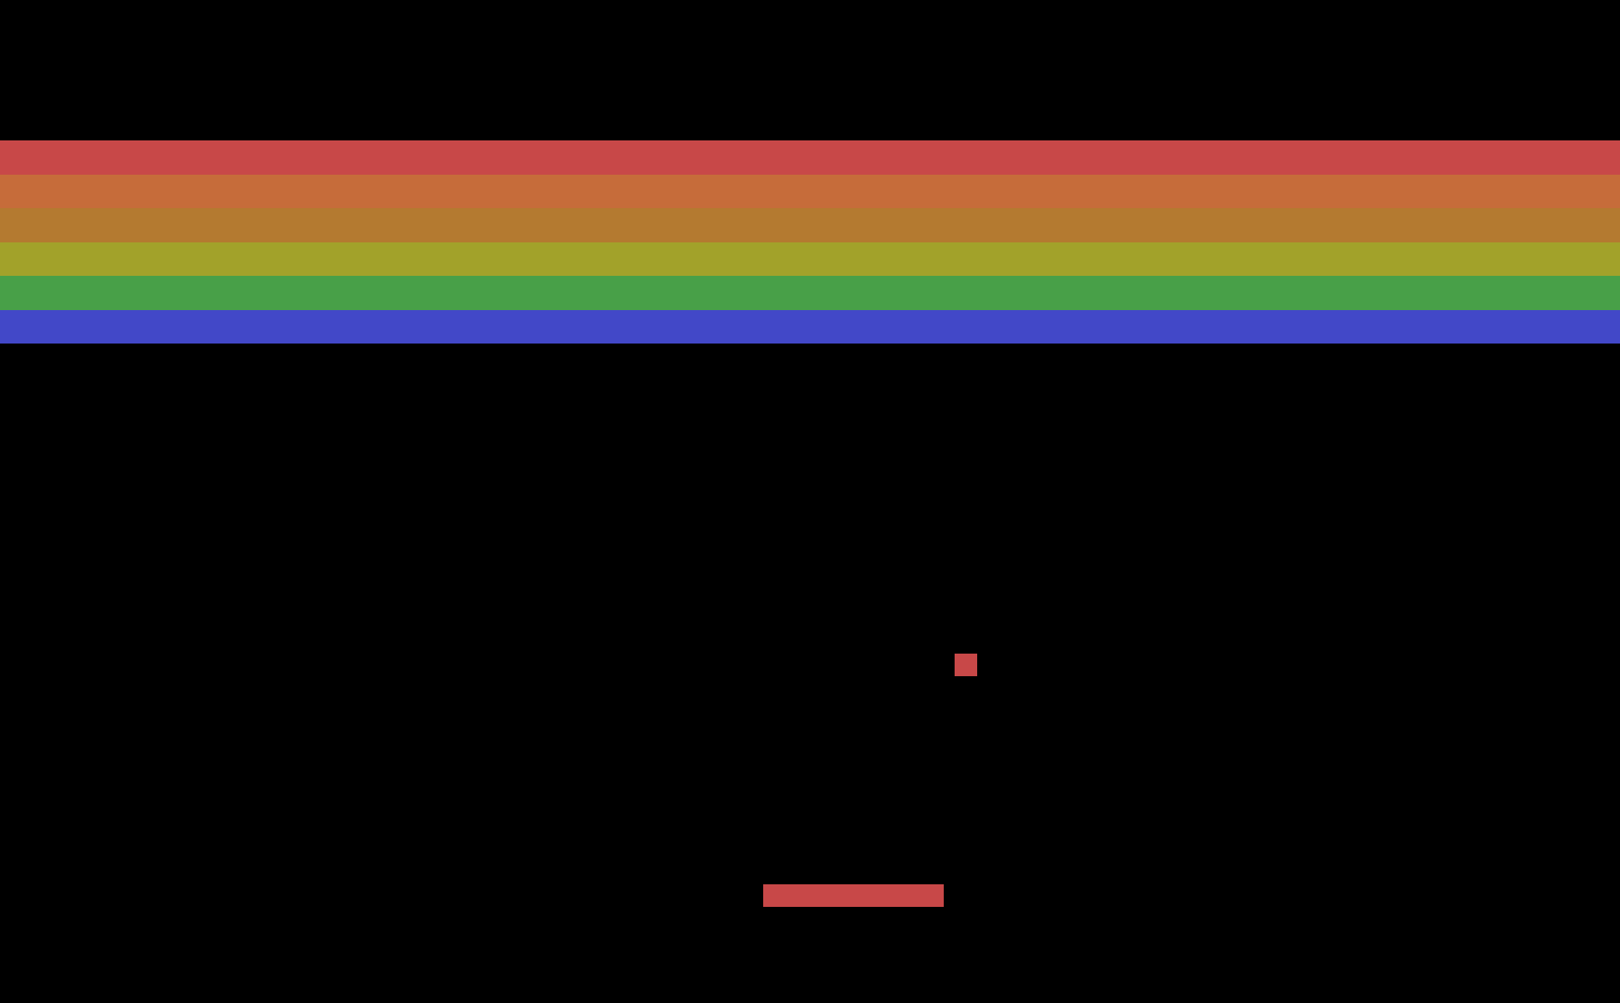
Example: Breakout
Notes:
Image source: https://bit.ly/2LUc0Du
In Breakout, the ball moves constantly
The player uses the arrow or aswd keys to move the paddle along the bottom of the screen
If the ball hits the paddle it bounces off
If the balls hits a brick at the top of the screen, the brick is destroyed and the ball bounces off

Slide 4
Game cycle for Breakout
Check for user input
Update position of the paddle – user input
Update position of the ball – continuous motion
Check collision between paddle and ball
Update state as appropriate
Check collision between ball and brick
Update state as appropriate
Redraw screen
Notes:
To update the state of the ball when it hits the paddle – reverse the direction of the ball
To update the state of the ball when it hits a brick – remove brick and redraw undestroyed bricks

Slide 5
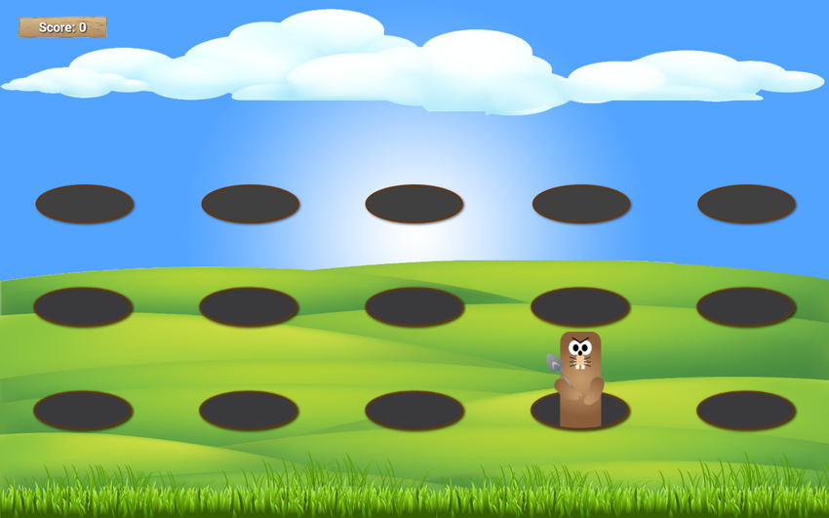
Example: Whack-a-mole
Notes:
Image source: https://bit.ly/2SSL0oO

Slide 6
Game cycle for Whack-a-mole
Check for user input
Check collision between the mouse and mole
Update mole hit count
Select new random mole and modify its visibility
Update screen
Notes:
For simplicity, assume that all the moles are there all the time, we toggle their visibility

Slide 7
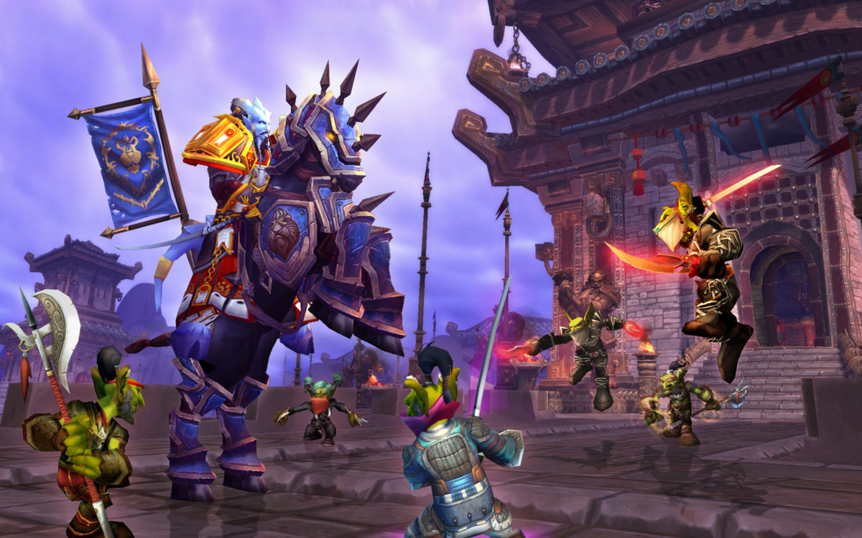
Example: World of Warcraft
Notes:
Even complex games like WOW and RuneScape follow the general game cycle

Slide 8
Game cycle for World of Warcraft
Check for all user inputs
Trigger all events
Update entity states
Update all entity locations
Update 3D geometry
Render display
Notes:
We will look at states later in the course

Slide 9
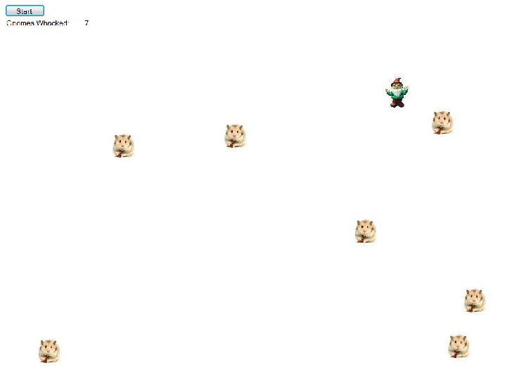
Today’s practical – Whack-a-gnome

Slide 10
Whack-a-gnome
Gnomes appear randomly on the screen
One gnome at a time
Gnomes remain briefly on the screen, then disappear
If the user clicks on the gnome, it turns into a hamster
Hamster remain on the screen
The count of whacked gnomes is maintained
Game ends when all gnomes have been squashed

Slide 11
Architecture
Classes:
Something to represent an individual gnome
Something to manage a collection of gnomes
What about handling display and user input?
What about running the game cycle?
Notes:
The first step in any OO task is to think about what classes do I need
For this practical, we will use Gnome and GnomeFamily
Display, user input and game cycle are handled by the Form class

Slide 12
Gnome class
A Gnome needs to know/have:
A canvas to draw itself
What image to draw
Its X and Y location
Whether it is a hamster
A Gnome needs to be able to:
Be created
Draw itself
Erase itself
Change its image
Determine if the mouse pointer is within its bounds

Slide 13
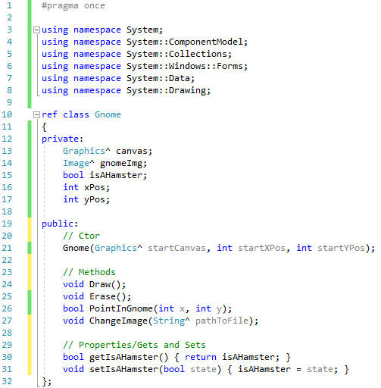
Gnome.h
Notes:
Why do we need to pass in the canvas? Not all objects can create a drawable surface, i.e. a Graphics class instance
What will we do with the image object? Draw each gnome onto the canvas by calling its DrawImage method
Why do Draw and Erase not having arguments? We will draw and erase each gnome at its own X and Y position
How will we write the PointInGnome method? A simple rectangular collision detection computation

Slide 14
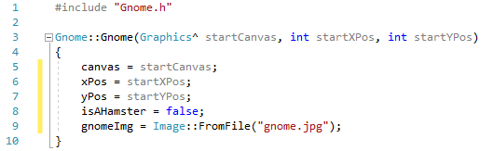
Gnome constructor
Notes:
Where does the images go? If you don’t want to give an absolute path, you must know what the system uses for its default path. This is different C# and C++. In Visual C++, the relative path during compilation is where the .h and .cpp file are, not where the executable file is generated

Slide 15
GnomeFamily
A GnomeFamily needs to know/have:
How many Gnomes it holds
A data structure to hold its collection of Gnomes
A random number generator
A canvas to give its Gnomes at creation
A GnomeFamily needs to be able to:
Be created
Create its Gnomes
Draw and erase it Gnomes
Check if a Gnomes has been clicked on
Change its Gnomes image
Change its Gnomes hamster states
Notes:
What should we use to hold that collection?
You will see that the GnomeFamily methods are really just methods being called in the elements of the collection
For example, to draw all gnomes, you loop through the collection telling each Gnome to draw itself. To draw a single gnome, you index into the collection and tell that gnome to draw itself
This is a very common architecture: A fairly complex class, and a manager class that holds a collection of the first class and exercises its methods
Note these patterns. Much of OO programming is knowing the right pattern to use

Slide 16
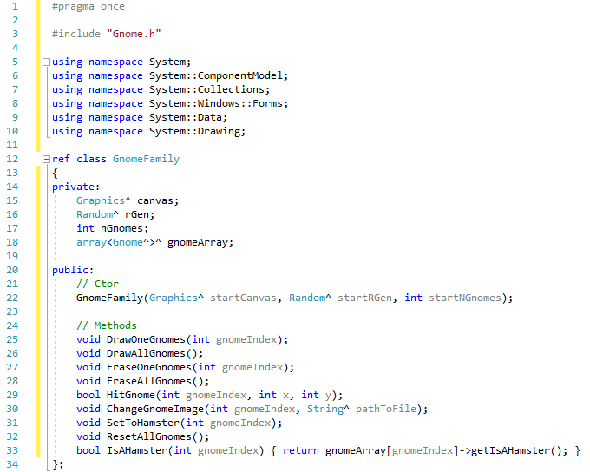
GnomeFamily
Notes:
Note the #include underneath #pragma once

Slide 17
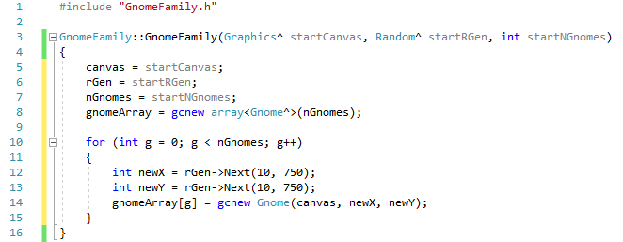
GnomeFamily constructor
Notes:
Make sure you use constant – my example is bad

Slide 18
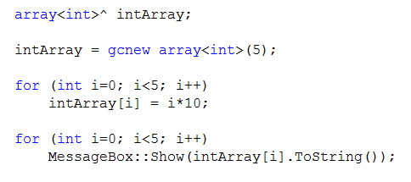
Managed arrays
Managed arrays are class instances
You can create a pointer/handler to an array
You allocate space for the array elements
Notes:
This is the Visual C++ way of creating arrays
This syntax is odd but you will get use to it
After you have created this, intArray is used like a regular array
“intArray is a pointer to an array of integers”
Allocate enough space for an array of 5 integers, and pointing intArray at it
Set intArray’s value to start of that memory

Slide 19
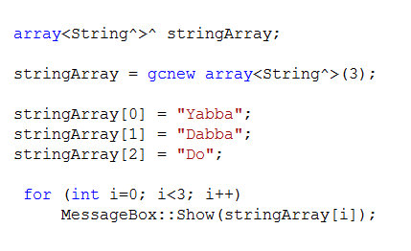
Managed arrays
What if you want an array of complex objects?
Complex objects are worked
You need an array of pointers

Slide 20
Form data members
Graphics^ mainCanvas;
Random^ rGen;
GnomeFamily^ gnomeFamily;
int gnomeIndex;
int hamsterCount;

Slide 21
Form methods
Form load event
Position the form on the screen
Initialise hamsterCount and gnomeIndex
Create mainCanvas, rGen and gnomeFamily
Button click event
Reset all Gnomes
Set the counter back to zero
Turn on the timer
Notes:
Note we must create gnomeFamily after the other two. Do you know why?

Slide 22
Form methods
Mouse down event
Ask the gnomeFamily if the mouse position is contained
within the current gnome
If true:
Tell the gnomeFamily to change the current gnomes
image to a hamster
Tell the gnomeFamily to change the current gnomes
hamster state
Increment the hamster count
Notes:
Mouse location has an X and Y property
Do you remember how to get the MouseDown event handler? See the lightning bolt in the properties window

Slide 23
Form methods
Timer event
Erase the current gnome
Display all squashed gnomes
Select a new gnome and display
If all the gnomes have been squashed:
Turn off the timer
Show a message
Notes:
Timer event is the game cycle – we check and update state, then redraw

Slide 24
Today’s practical
Use the information provided in this PowerPoint
to create Whack-a-gnome
Images are provided or you can use your own
Remember:
Use GitHub for development
Commit and push often

