Slide 1
Programming 4
Lecture 05: Linked List
Semester 1, 2020
Kaiako: Grayson Orr
Te Kura Matatiniki Otago, O ̄tepoti, Aotearoa
Wednesday, 4 February

Slide 2
Data storage for games
How can we store all the data needed?
How can we represent objects in our game?
Notes:
Objects – enemies, treasure, power ups

Slide 3
Static storage
Arrays
Advantages:
Easy to create and initialise
Easy to index into
Built into most development environments
Disadvantages:
Inflexible size - fixed
Awkward for deletion
Notes:
int arr[] = { 1, 2, 3 }; - static
int* arr = new int[3]; - dynamic
The size of the array has to be declared in advanced
Causes problems such as the array is too small and can’t hold enough items
Or the array is too large and is wasteful

Slide 4
Dynamic storage
Linked lists
Slightly more complex than arrays
Sequence of elements where each item
links to the next item
monster
monster
monster
monster
Notes:
You can add and remove items from your list as required – this happens during the lifetime of the program
An item contains a link to another item of the same type
Strings, characters, numbers, items can be sorted, unsorted, duplicate or unique
You can build a chain of items
All data operations (add, delete, search, etc.) are possible on linked lists

Slide 5
Dynamic storage
We need to know where their first and last
nodes are
Head and tail pointer
head
tail
monster
monster
monster
Notes:
To operate on lined lists, we need to know where their first and last nodes are. Thus, maintain special pointers to the head and tail
In fact, as we shall see, the only thing a lined list needs to store is its head and tail pointers. It doesn’t store the nodes at all
Given the head and tail, and on the assumption that all the nodes in the list are correctly hooked together, the list can be traversed, giving access to all the nodes, without explicitly store their locations
Draw example on the board [1][2][3][4]
Insertion – O(n) linear and slow
Draw example on the board (1 head, *)---(2, *)---(3, *)---(4 tail, *)---null
Time complexity for arrays, in terms of insertion and deletion at the start and end is unknown
Advantages:
If last element is known O(1) and if last element is not known O(n):
Insertions/pre appending O(1) constant and fast
Deletion O(1) constant and fast
Disadvantages:
Stored in arbitrary memory so we don’t know where - random
Get nth element O(n) linear and slow
Appending O(n) linear and slow

Slide 6
Structure – Node object
Mandatory
Node
Node^ Next;
Notes:
Any class can be a linked list node
Nodes are simple objects
Here is their generic structure…
Note the Next pointer is a pointer to another item of the same type – the next node in the linked list
Note that Next is capitalized for a reason

Slide 7
Structure – Linked list
Linked list
Node^ head;
Node^ tail; - optional
Notes:
The linked list object doesn’t own any nodes directly
It just keeps track of the head and tail nodes
This is all it needs to insert, delete, traverse – i.e. perform all required list operations

Slide 8
Linked list operations
To create a linked list
Create a head node pointer
Create a tail node pointer
Set the both head and tail to null pointer
Notes:
Lists are empty when they start
Be careful not to let pointers contain garbage – by garbage I mean memory addresses
Always set “empty” pointers to the null value for the language and environment you are working in
Note that way you express null is different language to language. In C#, it is null, but in Visual C++, it is nullptr
You are going to be able to tell when linked lists are empty
You have gotten to the end of the linked list by looking for these null pointers
If you don’t initalise correctly to nullptr, the standard algorithm for linked list operations will not work

Slide 9
Linked list operations
To count the number of items in a linked list:
Start at the node pointed to by head
Node count equals zero
Loop through all nodes – head not equal to null pointer
Increment node count
Go to the next node in the linked list
Return the number of items
Notes:
Pseudocode for counting the number of items in a linked list

Slide 10
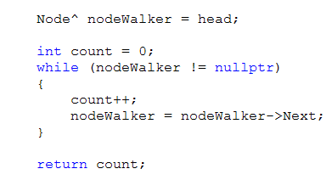
Linked list operations – code example
Notes:
Actual code – so use this in your practical today
Note how critical it is that Next always be initalised to nullptr in the constructor
If you don’t do this, the while is infinite or until in breaks the computer
What type is it returning?

Slide 11
nodeWalker = nodeWalker->Next
nodeWalker is a Node pointer
It is not a Node
It has no Next property
So how can we talk about its Next?
When working with pointers, ptr->Next does not
mean “your Next property”
It means “the Next property of the object you are pointing at”
Notes:
nodeWalker is a pointer
It is 32 or 64 bits of memory that can hold a memory address, which should be the memory address of a Node
It is not a Node
It doesn’t have any of the properties of a Node, so what does it mean to say nodeWalker->Next?

Slide 12
nodeWalker = nodeWalker->Next
So nodeWalker = nodeWalker->Next
Means:
Find the guy nodeWalker is pointing at
Take that’s guy’s Next value
Assign that value to nodeWalker
Notes:
When we assign that value to nodeWalker, where is he now pointing? To the guy his guy was pointing to. That is, he has taken one step down the chain

Slide 13
nodeWalker = nodeWalker->Next
nodeWalker
node1
node2
Notes:
nodeWalker is pointing to node1
The Next of node1 is the address of node2

Slide 14
nodeWalker = nodeWalker->Next
nodeWalker
node1
node2
Notes:
nodeWalker = nodeWalker->Next points nodeWalker at node2
What if we called nodeWalker->Next again?
Node2, being at the end of the list, his Next = nullptr
So if you say nodeWalker = nodeWalker->Next again, nodeWalker is nullptr
That’s how you drop/break out of the loop

Slide 15

Linked list operations
To add a new node to an unordered linked list
Add it to the end
Process:
Set the Next pointer of the current last node to the new node
Set tail to the new node
Notes:
How can we talk to the current last node? Tail is pointing to him
Remember, tail->Next means the Next of the guy tail is pointing to
What if there aren’t any nodes in the list?
What is the value of tail? Nullptr
What will happen when you say tail->Next? Boom!!!
What can you do? Recognise that this is a special case. This is very common. We have the ordinary thing we do most of the time and we have the boundary cases

Slide 16
Adding to a linked list
If the list isn’t empty (i.e. tail isn’t nullptr), add the new node to the end
If tail is nullptr?
Make both head and tail point to the new node
Notes:
What flow of control structure will we nee? If else statement

Slide 17
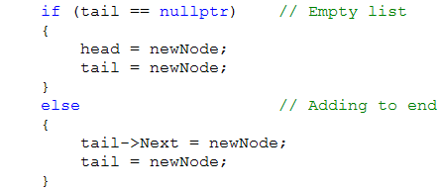
Adding to a linked list
Notes:
Actual code – use this in your practical today
What flow of control structure will we need? If else statement
newNode is the Pellet being passed in

Slide 18
Linked list operations
To delete a node
head
tail
monster1
monster2
monster3
Notes:
To delete monster2

Slide 19
Linked list operations
To delete a node
head
tail
monster1
monster2
monster3
Notes:
To delete monster2

Slide 20
Linked list operations
monster1->Next = monster2->Next
head
tail
monster1
monster2
monster3
Notes:
To delete monster2…simply set

Slide 21
Linked list operations
monster2’s memory will be garbage collected
head
tail
monster1
monster3
Notes:
We can delete it now if we want or we can just let it be garbage collected
The system will see that nobody points to it anymore, and will free it from the heap

Slide 22
Deleting
But how would we find monster1 (i.e. the node before the one we want to delete)?
Algorithm:
Start at the beginning
For each node ask “is the node after this one
(i.e. its Next) the one who is to be deleted?”
If so, it is the previous node
Set the Next of the previous node to the Next
of the node to be deleted
Doubly linked list
Anyone know a real-world example
You do this on a daily basis
Notes:
Imagine the node you want to delete is somewhere in the middle of the list
Remember these nodes are really scattered all over in memory
You only know the address of the node you want to delete
You can get the address of the node after him by looking at his Next, but how can you get the address of the node before him?
Someone may suggest doubly-linked list here. A good example of the right data structure for the right job. But assume you don’t want to hassle with the overhead of a DL List
What is a real world example of a doubly linked list?
Draw example of a doubly linked list - null---(1 head, *)---(2, *)---(3, *)---(4 tail, *)---null

Slide 23
Deleting continued
Deleting monster3
head
tail
monster1
monster2
monster3
monster4
nodeToDelete
Notes:
The algorithm in action

Slide 24
Deleting continued
Deleting monster3
head
nodeWalker
tail
monster1
monster2
monster3
monster4
nodeToDelete
Notes:
Start at the beginning
NodeWalker = head

Slide 25
Deleting continued
nodeWalker = nodeWalker->Next
head
nodeWalker
tail
monster1
monster2
monster3
monster4
nodeToDelete
Notes:
Move along

Slide 26
Deleting continued
nodeWalker = nodeWalker->Next
head
nodeWalker
tail
monster1
monster2
monster3
monster4
nodeToDelete

Slide 27
Deleting continued
nodeWalker->Next now equals nodeToDelete
head
nodeWalker
tail
monster1
monster2
monster3
monster4
nodeToDelete

Slide 28
Deleting continued
nodeWalker->Next = nodeToDelete->Next
head
nodeWalker
tail
monster1
monster2
monster3
monster4

Slide 29
Deleting continued
monster3 will be garbage collected
head
nodeWalker
tail
monster1
monster2
monster4

Slide 30
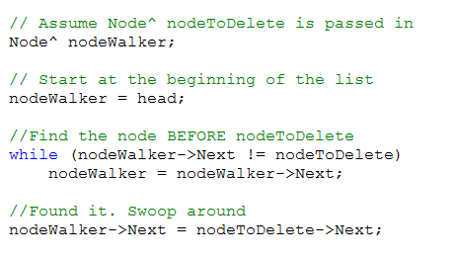
Deleting continued
Assume Node^ nodeToDelete is passed in
Start at the beginning of the list
Find the node before nodeToDelete
Found it. Swoop around
Notes:
Note that there’s actually more than we have here
We need to deal with the case where we are asked to delete a node that isn’t actually in the list, and there are boundary cases, for example, when you are deleting the first node, or deleting from a list that only has one node in it. Then there is no node before
When we build our own linked list, we will look at these, and there is a detailed handout to help you
For now, just make sure you understand the logic of this basic case of deleting a node from the middle of the list
Use a similar approach for adding a node to an ordered list

Slide 31
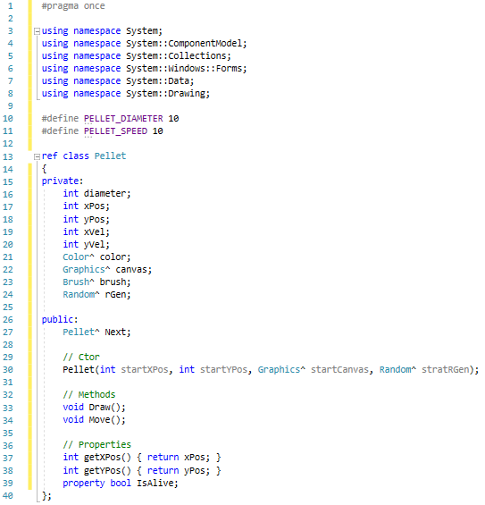
Pellet.h
This will give you an error when you give it a default value in .cpp. You should be able to figure out why…
Notes:
We are going to build a little pellet (coloured circle) class so we can start firing projectiles
We will need a Pellet class that can serve as a node – what will need??? Data fields and a Next pointer
We will need a linked list class for Pellets – we need a head and tail

Slide 32
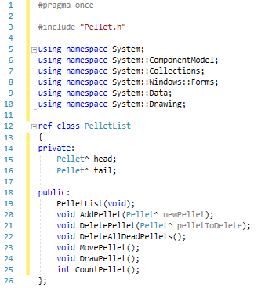
PelletList.h

Slide 33
KeyDown event handler
if (e->KeyData == Keys::Left)
Move chicken 10 pixels to the left
if (e->KeyData == Keys::Right)
Move chicken 10 pixels to the right
If (e->KeyData == Keys::Space)
Create new instance of Pellet
Add pellet to the linked list

Slide 34
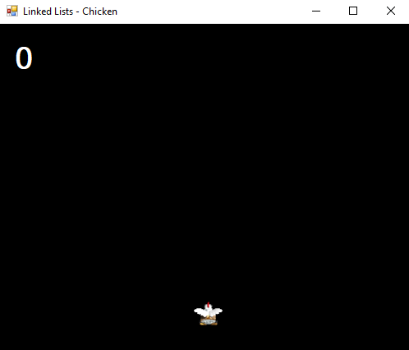
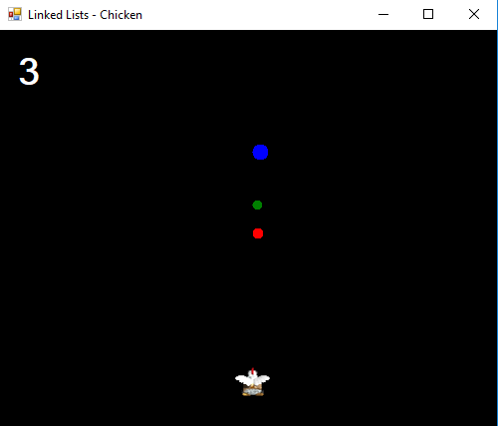
Practical – spitting chicken

