Slide 1
Programming 4
Lecture 06: 2D Animation
Algorithms & Double Buffering
Semester 1, 2020
Kaiako: Grayson Orr
Te Kura Matatiniki Otago, O ̄tepoti, Aotearoa
Friday, 13 March

Slide 2
Directional movement

Slide 3




Multiple sprite sheets
We will being multiple sprite sheets for our
practical
Notes:
www.reinerstilesets.de/2d-grafiken/

Slide 4
Multiple sprite sheets
Think of this as an array of four bitmaps
Each with a direction of either 0, 1, 2, 3
What changes do we need to make to the
Sprite class?
Notes:
Let’s assume that you have figured out which of these spriteSheets to use
The UpdateFarme() is identical
Move() and Draw() need to change. He needs the correct bitmap/sprite sheet for Draw() and needs the correct values to modify xPos and yPos for Move() so that he moves in the correct compass direction
Draw()
Drawing to the canvas is identical – using a Rectangle(currentFrame * frameWidth, 0, frameWidth, frameHeight) and DrawImage(), etc
But, instead of having a single sprite sheet variable that you always pass to canvas->DrawImage(), you have an array of sprite sheets, and at each draw, you select the correct one to pass to canvas->DrawImage()
You can use your new class property to index into the Bitmap array and select the correct Bitmap to give to canvas->DrawImage()
Something like Bitmap^ currentBitmap = spriteSheet[spriteDirections]
If you’ve put your bitmaps in the array as shown above, if he’s moving east, you want 0; if he’s moving south you want 1, etc
So you will somewhere (think about where….) need to put those numbers into your spriteDirections state variable
You could imagine code like “spriteDirections = 2”, but that’s confusing because, what is 2? It’s better to use sensible string values, but we still need an int to index into the array. There are two acceptable ways to do this in C++/CLI

Slide 5

Direction constants
Two ways you can create a sprite direction:
#define EAST 0
#define SOUTH 1
#define WEST 2
#define NORTH 3
Notes:
#defines – easy and bulletproof, but somewhat limited. You will see them a lot, especially in older C++ code
Put these statements in Sprite.h, up at the top, before the class definition (not inside it).
Sprite will understand them, and so will any class that includes Sprite, like, for example, the Form (still thinking about where we set spriteDirections?)
Remember that #define is a text-replace, not an expression that gets evaluated
If this order isn’t the one that makes sense to you, use any order you want. Just match the location of each spriteSheet to its defined directional value
Enum – more flexible, but there are scoping and access issues

Slide 6
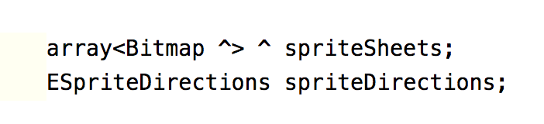
Modify Sprite.h
Modify your Sprite class (in the .h)
Notes:
Change the current single Bitmap^ to an array of Bitmap^
Add the spriteDirections. Use an int if you are using constants
Either add a get/set method for the spriteDirections, or make it a property
When we change sprite sheets there will be some work to do, so we will write a set method for that
Assume for now you have the same number of frames for each direction
How will you set frameWidth? We were using (int)spriteSheet->Width / nFrames. Now we have multiple sprite sheets, so must use (int)spriteSheet[i]->Width / nFrames with I starting off at 0

Slide 7
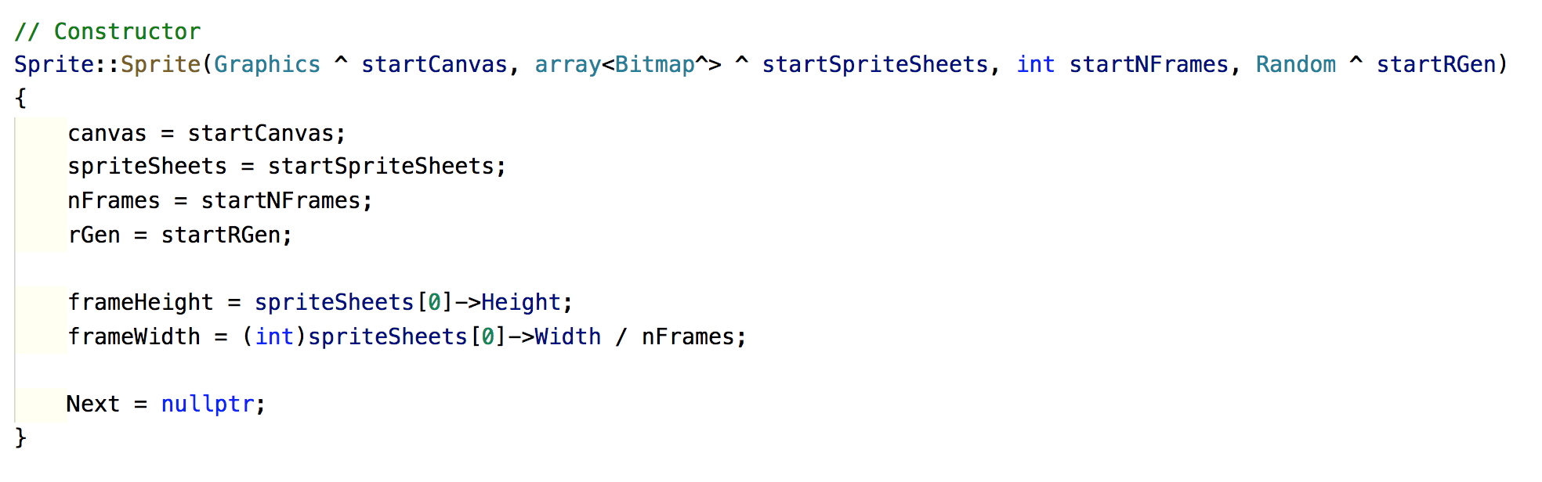
Modify Sprite.cpp
Modify your Sprite constructor
Notes:
There is two possible approaches:
Pass in an array of bitmaps
Pass in an array of file name and let the sprite create his bitmaps
Here is the pass the bitmaps way
A pointer is sent into a preloaded array, and you just grab the address it holds

Slide 8
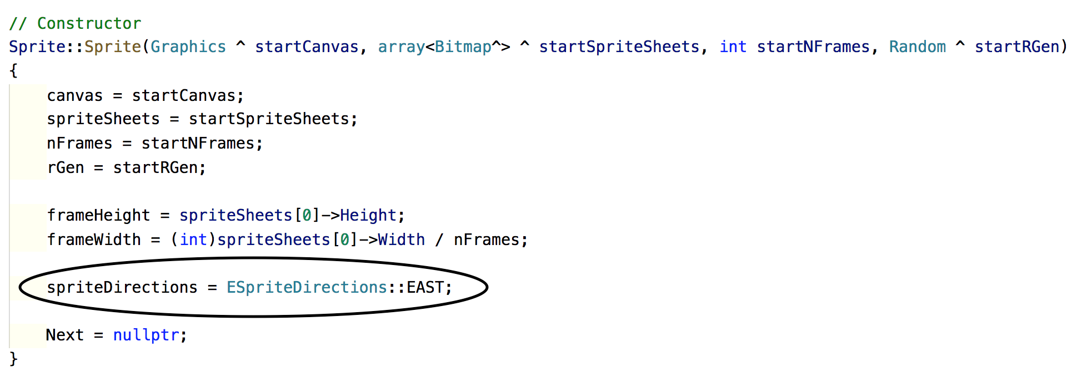
Modify Sprite.cpp
Give the sprite’s direction a default value
Notes:
You will need to give your spriteDirections class data member a default value
Here I am giving spriteDirections the default value of 0 or EAST

Slide 9
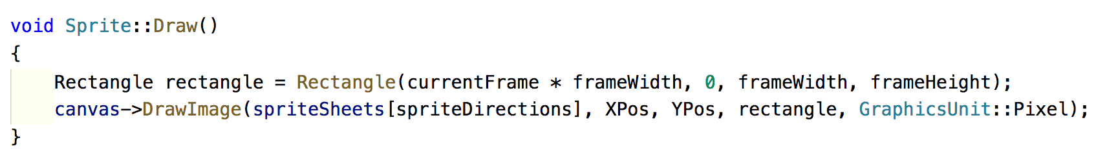
Drawing sprite
We should think about writing maintainable code
Make use of intermediate variables
Note my X and Y position are properties
Notes:
It is much the same as before, except we pass the array of bitmaps into canvas->DrawImage() instead of a single bitmap
We will set spriteDirections to EAST, SOUTH, etc in the key down event handler
If we place our sprite sheets in the array correctly, we can use this to select the correct bitmap
Assuming EAST 0 and around clockwise, how do we then do this? Put the east facing sheet into position 0, the south-facing sheet in position 1, etc

Slide 10
Moving sprite
Velocities need to be separated into a magnitude
and a direction
Let xVel and yVel now represent the magnitude of
a single step
Add direction properties to control the x and y
direction of movement
Direction values = {-1, 0, 1}
One direction value for x/horizontal movement
and one for y/vertical movement
To control the axis (direction) of movement, multiply
the velocities by their direction values
Add the results to xPos and yPos
Notes:
This is the tricky one. We need to move the sprite (i.e. change its xPos and yPos) in the correct direction
We want to continue with xPos += xVel and yPos += yVel, we now need to have the correct values to add to xPos and yPos in our Move()
Let’s start first thinking only about East/West movement (so yVel= 0 and doesn’t matter). You will easily be able to expand the logic to include North/South
So far, since our move was xPos += xVel, if we wanted to move East we made xVel positive, say 5. If we wanted to move West, we multiplied xVel by -1, changing it to -5. That way, we could use the same code in the Move (better than trying to sometimes add and sometimes subtract)
If you try to do directional movement by changing xVel, you will spend a lot of time toggling and your code will get messy
A more elegant solution can be achieved by recognising that there are really two components to the Sprite’s velocity: the size (magnitude) of the step, and the positive or negative direction of the step
In our above example, the size was always 5, the direction for East was positive and the direction for West was negative
The total movement is achieved by taking magnitude times direction and incrementing xVel by that amount. (5 * -1) or (5 * +1)
You can extend this logic to yVel by assuming that you can have a direction of 0. This simplifies your move equation (as we will see in a minute)
Starting now, we are going to break up our velocities into these two components. We will see the implementation advantage of this as we proceed
Magnitude is how much the sprite moves at each timer tick (i.e. how fast he is going)
Direction is positive/negative on the x-axis and positive/negative on the y-axis
xVel and yVel represent the magnitude of a single “step” when the sprite moves
So you must adjust their sign (positive or negative) to produce movement in the correct direction along the x and y axes

Slide 11
Moving sprite
Example:
Assume xVel = 5 and yVel = 5
What are the xDirection and yDirection values
to move:
East?
South?
West?
North?
In each case we would compute:
xPos += (xVel * xDirection)
yPos += (yVel * yDirection)
Notes:
You can easily do NE, SE, SW ad NW
You will need to come up with an elegant way of handling user input
When we perform the computation, the sprite moves in the desired direction
If his image shows him facing that way, we have convincing directional movement

Slide 12
Moving sprite
If direction is | Multiply xVel by | Multiply yVel by
EAST | 1 | 0
SOUTH | 0 | 1
WEST | -1 | 0
NORTH | 0 | -1
Notes:
You could organise your intuitions there into this little table
How then do you store and use these values? Do you need 8 new data properties for your Sprite: xDirEast, yDirEast, xDirSouth, yDirSouth, etc.? No
See this nice table? Whenever you find yourself expressing logic by putting things into a table, you should consider whether an array would help
We don’t want to have to store 8 individual direction variables. In addition to being simply cumbersome, it would be very awkward to switch between them when we changed directions. It would require some large switch statement or if-else
If instead we store the direction variables in a nice array, we can use spriteDirections to index into it exactly as we use spriteDirections to index into the bitmap array. Just put the directions for EAST in location 0, for SOUTH in location 1, etc.

Slide 13

Moving sprite
Assume an array<Point>^ velocityDirections represents this table:
If direction is | Multiply xVel by | Multiply yVel by
EAST | 1 | 0
SOUTH | 0 | 1
WEST | -1 | 0
NORTH | 0 | -1
Notes:
This code will go in your Move()

Slide 14
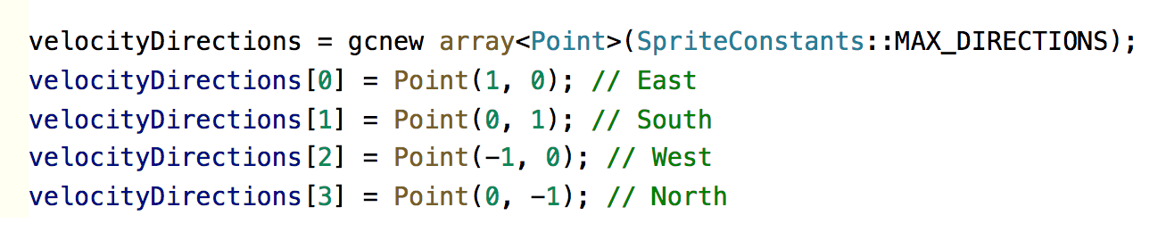
Velocity directions
Declare velocityDirections in Sprite.h
Instantiate velocityDirections in Sprite.cpp
Notes:
Instantiate in the Sprite constructors
MAX_DIRECTIONS = 4

Slide 15
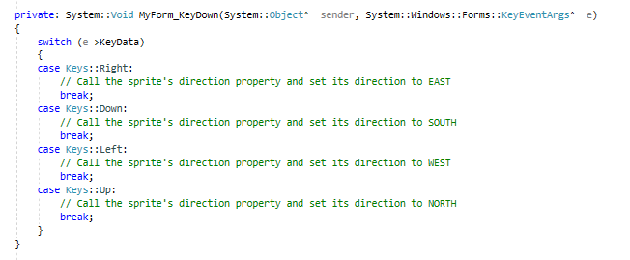
Controlling sprite
Key down event in MyForm.h

Slide 16
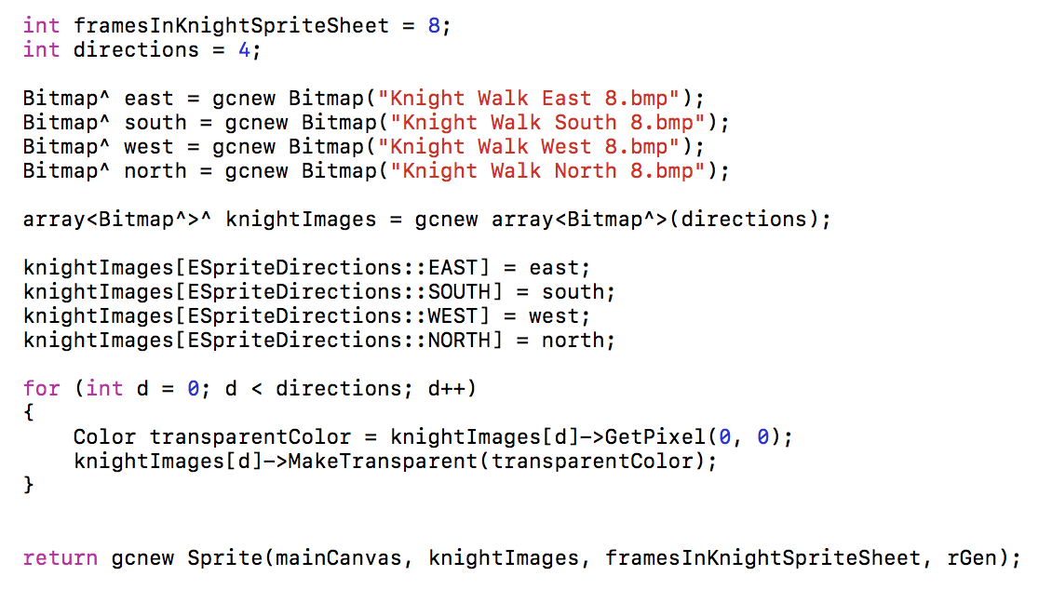
Creating sprite
Create a method called generateKnightSprite()

Slide 17
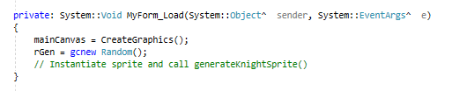
Initialisation

Slide 18
God object
Anti-pattern
Single “all-knowing” object
Object that knows too much or does too much
Create user-defined objects in MyForm.h

