Slide 1
Programming 4
Lecture 10: Manual Scrolling Tile Map
Semester 1, 2020
Kaiako: Grayson Orr
Te Kura Matatiniki Otago, O ̄tepoti, Aotearoa
Wednesday, 25 March

Slide 2
Scrolling
The world can be much larger than what is shown on our screens
In a scrolling game, the tile mapping technique is the same
Except the map is bigger than the screen
Notes:
In most modern 2D games, the game world is larger than can be displayed in a single screen
The screen displays just a portion of the world, and during game play, in response to movement of a player character (in, e.g. RPGs) or in response to manual navigation by the player (in e.g. city builders), that portion changes
This movement is called scrolling
In a scrolling game, the Tile Mapping technique is the same, except the map is bigger than the screen
We think of the area that shows on the screen as being seen through a viewport, that slides around
When there is a player character, the viewport is usually positioned so that the player is in the centre as it moves (i.e. it follows the player character around)
Implementing scrolling is complicated. It requires management of even more coordinate spaces, and there is some maths. Therefore, we approach it in a couple of stages
We will first talk about the core mechanics and computation of scrolling
Then we will look at manual scrolling
Then we will look at how to scroll around a moving player character
Finally, we will add sprites to the map – they must appear only when their portion of the world is visible

Slide 3
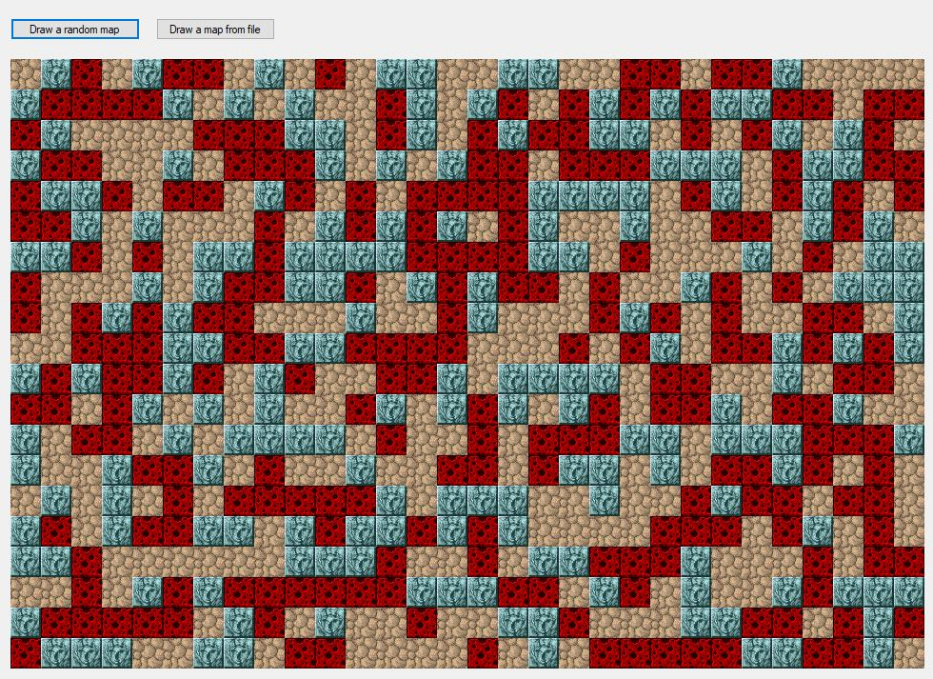
Scrolling

Slide 4
Example world
Super Mario Bros (NES)
SMB uses 16x16 pixel tiles
SMB uses a world that is very wide, but only one
screen high (211 tiles wide and 14 tiles high)
Notes:
Using Super Mario Bros (Original NES version) as an example
SMB uses 16x16 pixel tiles, but everything here applies to any tile size
SMB uses a world that is very wide, but only one screen high. Again, everything here applies to games with large worlds in both dimensions. You just need to extend to the y-axis
This image shows the whole world for one level. It is 211 tiles wide

Slide 5
Example viewport
Viewport is 18 tiles wide and 14 tiles high
Notes:
The player only sees a screen at a time, 18 tiles wide (of the total 211) by 14 tiles high
This is the “viewport”
As the player character is moved, the tiles drawn to the screen change to show what part of the world the player character is standing in
We can think about this is achieved: In our simple tile map, we translated the integer values in the 2D map array into pixels on the screen
In a scrolling map, we do exactly the same thing, except that, at each animation cycle, we are displaying only a portion of that integer array
All we have to do is figure out which portion we need to display
That job will be taken care of by a new class for our engine – the Viewport

Slide 6
Coordinate systems
(0,0) in Viewport coordinates
(screen coordinates)
(100, 100) in World
coordinates
(0, 0) in
World
coordinates
Notes:
We have to think of the game as having three separate coordinate systems
First we separate into:
The world coordinates = where things are in the big world map
The viewport coordinates = where things are in the viewport (the part of the world map being shown) and therefore on the screen/canvas. (Note that you can use a panel to make a canvas != actual application window, but we will tend to refer to the visible playing area as “the screen” informally.)
Previously, the world and the visible area were always the same size, so we didn’t have to treat these separately – now we do.
To figure out what should appear in the Viewport area (i.e. What to draw to the screen) you must know where the upper left corner of the Viewport is in World coordinates.
You store this position in pixels, then translate that into map tiles for drawing.
As the Viewport moves, you need to re compute which part of the map should be visible....

Slide 7
Coordinate systems
(0,0) in Viewport coordinates
(screen coordinates)
(300, 200) in World
coordinates
(100, 100) in World
coordinates
(0, 0) in
World
coordinates
(200, 100) in Viewport
coordinates
Notes:
Then we need to think about the 3rd coordinate system – the canvas
The tile in the upper left corner of the viewport must be drawn to the upper left corner of the screen
So the Viewport and Screen coordinate spaces overlap
But we still have to work out the exact pixel location of each tile on the screen (we’ve done this – row and column * tileside)
Extend for all tiles by iterating over the Viewport
Therefore, to make a scrolling tilemap, we have to figure out:
What tiles should be drawn
Where they should be drawn
As the Viewport moves, you need to re compute which part of the map should be visible

Slide 8
Coordinate systems
(262, 0) in World
(0, 0) in Viewport
(0, 0) in World
World continues…
(300, 200) in World
(38, 200) in Viewport
Notes:
Another example of adding sprites
You should see there is an equation here…
We’ll look in more detail at the maths in practical

Slide 9
Creating a world
Your world needs to be big
Extend your TileMap to be much larger than
your screen dimensions
Viewport
World TileMap
Notes:
We need to change the code from last week…
You need to change the map rows and columns so that the map is much bigger than the Form
Make them 10 times larger than the viewable area, just so we can really test moving around
So if you are currently using a map that is 20 rows by 30 columns (like the demo file from last week), leave the Form the same size, but make the map 200 rows by 300 columns

Slide 10
Viewport class
Your Viewport class needs to know:
It’s location in the World
It’s row and column dimensions
The world TileMap to work from
The Graphics canvas to draw to
Notes:
You need to create a Viewport class
It will be responsible for the viewable area
In our first practical, we will brute force move the Viewport around with the arrow keys
(But, in a roguelike, the Viewport is centred around the player character, so you place its upper left by shifting it over and up from the upper left of the player character. We do this in the next practical.)

Slide 11
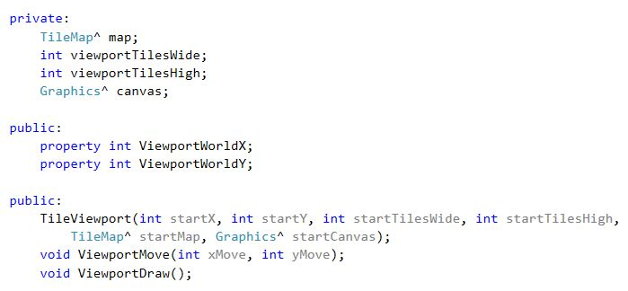
Viewport class
Notes:
We will need more methods as we go. These are to get started with manual movement
Here we pass the distance to move into the move method as arguments
You could also give the Viewport x and y velocities

Slide 12
How the Viewport draws itself
Draw all the world tiles that are in the Viewport’s area
We must be able to:
Start at the upper left location of the Viewport (in the world)
Double for loop over all rows and columns of the Viewport
Get each TileBitmap
Figure out where to draw it on the canvas

Slide 13
1. Iterate over the Viewport
Pseudocode:
For all rows r of the Viewport (in the world)
For all the columns c of the Viewport (in the world)
Get the bitmap for the tile at (r, c) in the world TileMap
Figure out where it goes on the screen
Draw it there
Notes:
In a more code-like format
So there are three things we must do:
Figure out where in the world tile map to start
Get each corresponding tile bitmap
Figure out where to draw it with DrawImage
We will talk generally about the logic of each step in turn – there is more detail in the handout

Slide 14
2. What Tile to start on?
The world has two units of measurement for location:
Pixel locations – e.g. Sprite and Viewport upper left corner positions
Row, column locations – tiles in the tile map background
The Viewport stores the pixel location of its upper
left corner
We need the tile location of the Viewport’s upper
left corner
We must translate from pixel (x, y) location to tile
map (row, column) location
Notes:
The Viewport stores its pixel location, not its tile location. This allows us to take steps smaller than one tile in size, which is necessary for smooth scrolling
Imagine what it would look like if the game had to move 32 or 64 pixels at a time – very jumpy
This requires maths

Slide 15
2. What Tile to start on?
If an object is at pixel location pixelX, pixelY, what
is its row, column location?
viewportTileX = ViewportWorldX / tileSide;
viewportTileY = ViewportWorldY / tileSide;

Slide 16
3. Getting a TileBitmap => data chain
Given a row, column location in the world
TileMap, how does the Viewport know what
Bitmap^ to draw?
Passes world row and column
Passes int from map array...
Indexes into Tile^ array...
Viewport
TileMap
TileSet
Tile
Bitmap^
Bitmap^
Bitmap^

Slide 17
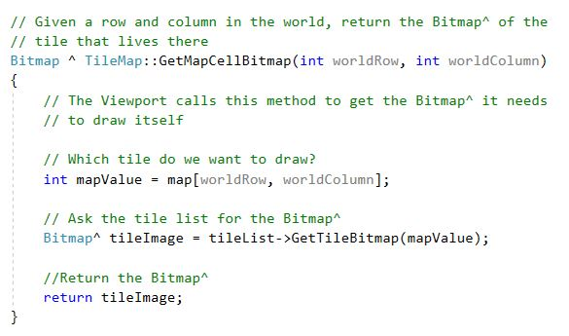
New TileMap method needed

Slide 18
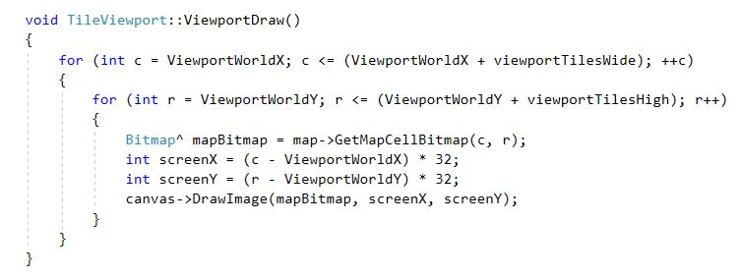
The double for loop
Note this is not the final code…

Slide 19
Where to draw on the screen
Place the upper left tile at 0,0 on the canvas
and iterate as normal using the loop driver variables
What if your Viewport edge is not on a tile boundary?
You need to start drawing in the middle of a tile
Two steps:
Figure out how many pixels you are from the tile boundary
Shift your drawing location that many pixels to the left
viewportOffsetX = ViewportWorldX % tileSide;
viewportOffsetY = ViewportWorldY % tileSide;
DrawImage happy to take a negative pixel position
Notes:
As discussed on the preceding slide...
See any problem here? What if you’re not on a tile boundary? (Attempt to draw...)
For example, your tiles might be 32 pixels, but your player character has a velocity of 5
So you will need to be able to draw partial tiles
How many pixels are you from the edge? Location % tileside
Shift to the left. You will start in the middle of a tile on the left hand edge of the screen, then draw a viewport’s worth of pixels.
If the viewport needs to move 1 more pixel to the right, everything just shifts one pixel over
Give your original DrawImage that negative pixel position. It’s quite happy to start drawing off the screen
The visible pixels will start to appear at exactly the Viewport’s location in the world
And what about that “viewport’s worth of pixels”? If your Viewport is 100 pixels wide, your screen is 100 pixels wide. If you start at -10 and draw 100 pixels, you will only file 90 pixels of the screen
What to do? => Go back and look at the double for. It runs one extra column and row
See handout for more discussion of the Viewport draw logic

Slide 20
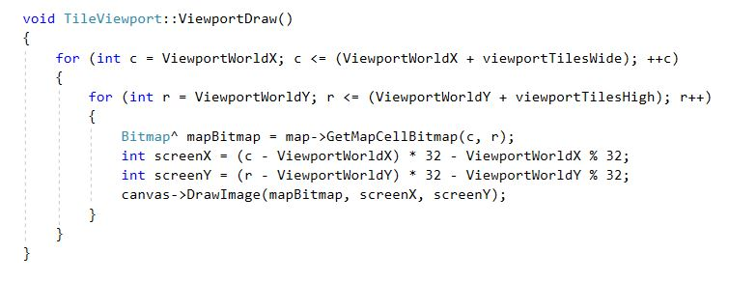
Where to draw on the screen

Slide 21
Moving the Viewport
Adjust ViewportWorldX and ViewportWorldY
Add bounds checking

