Slide 1
Programming 4
Lecture 13: Finite State Machine
& Inheritance
Semester 1, 2020
Kaiako: Grayson Orr
Te Kura Matatiniki Otago, O ̄tepoti, Aotearoa
Wednesday, 8 April

Slide 2
FSM: state, actions and events
States and events
Sleeping
Neighbour cat in yard
Becomes
hungry
Neighbour
Cat gone
Full
Eating
Chasing neighbour cat
Notes:
The next technique up. We will build one of these systems next week
This approach requires describing the behaviour of an entity in terms of states, actions and events.
NB: The diagram shows only the states and events. The Actions are included in an additional table that has a column for State and a column for Action. Seen next slide
If the behaviour can be captured this way, there is a good structured technique for coding it up
Example: This is a diagram describing the behaviour of my cat Eddie
Usually, my cat is in the sleeping state. His actions there are sleeping, drooling and occasionally rolling over
If a neighbour cat enters the yard, my cat will sense it. This is an event and causes him to change state
He changes to the Chasing Neighbour Cat state. His actions in this state are targeting the neighbour cat (like the Approachers did with Blobbo), and hissing
When the neighbour cat is gone, he returns to the sleep state
In the sleep state, he can become hungry. This event might occur every 15 minutes of being in the sleep state. This event would move him into the Eating state
And so on
This type of diagram is an example of a construct used in many areas of computer science and mathematics. It is called a Finite State Machine
Note that the details of the actions associated with a state are not included in the diagram, but are inferred
FSMs can be used to describe fairly complex behaviour, and they are easy to code. Think about how you would code my cat…

Slide 3
FSM: state, actions and events
Actions
When in state... | Action...
Sleeping | Lie down with eyes closed Drool Roll over with ROLL_PROB Update Hunger
Chasing | OrientTo(NeighbourCat) Move Hiss
Eating | Gobble food Update Fullness
Notes:
NB. Note that here there is nothing about changing state
This is just what you do while in a particular state

Slide 4
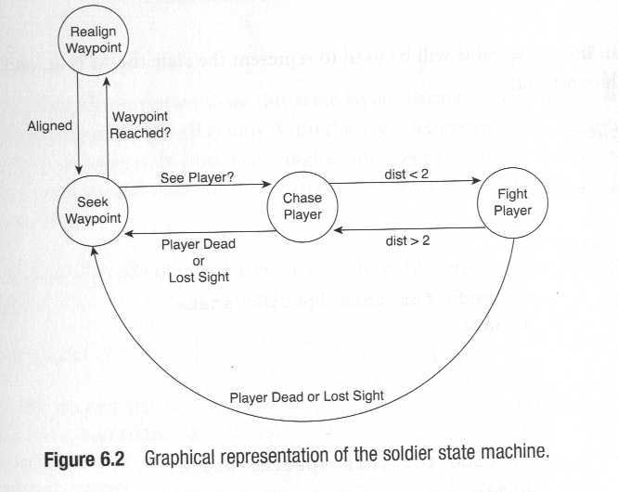
FSM in games
Notes:
The FSM is very common in games programming, because many of the required behaviours can easily be captured using the states-events-actions approach
Here is an FSM for a patrolling guard AI
From Dalmau, Core Techniques and Algorithms in Game Programming
The enemy has a predefined set of waypoints that he patrols in a cyclical way
The enemy detects the player when it is inside his “viewing cone” (field of vision)
If enemy sees player, it chases
If enemy gets close enough to player, he stops chasing and starts hitting
Most of the time in Seek Waypoint, walking toward waypoint
When waypoint reached, turns toward next waypoint
When realigned, returns to Seek state
If while Seeking, see player, moves to Chase state
And so on.

Slide 5
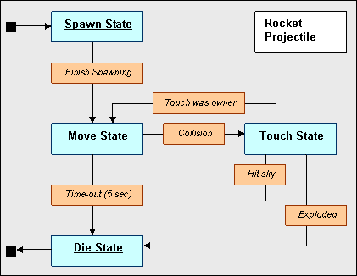
FSM in games
Notes:
Real FSM From Quake
Quake is pretty much all FSM

Slide 6
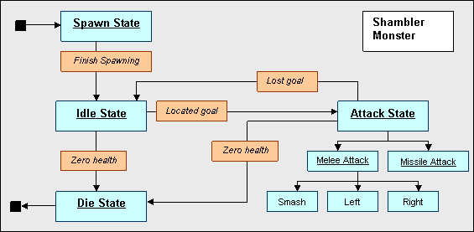
FSM in games
Notes:
From Quake again

Slide 7
FSM in games
Quake II NPCs have nine states:
Standing
Walking
Running
Dodging
Attacking
Melee
Seeing the enemy
Idle
Searching

Slide 8
Coding an FSM
To code an FSM, you need two primary methods:
Update state
Perform actions
Notes:
The update state method says: Given the state I am currently in, check for each of the events that cause me to change state. If one has occurred, change
The perform actions method says: Given the state I am currently in, do whatever actions are associated with being in that state
At each game cycle, all AIs do their update state. Then all AIs do their perform actions
In practice, a managing class like a sprite list, or something that holds an array of entities, iterates over its collection and calls the methods on each one. All update, then all action

Slide 9
Coding an FSM
Update state
switch (catState)
case Sleeping:
if (cat in yard)
CatState = Chasing;
else if (has not eaten for 15 minutes)
CatState = Eating;
Break;
case Chasing:
if (neighbour cat gone)
CatState = Sleeping;
break;
…..
Notes:
Both of these methods are built on one big switch statement
NB: In this method, we only make sure we are in the correct state. We don’t do anything
In pseudocode, it looks like this (for my cat)
Then the bulk of the coding is to be able to keep track of things like how long since you have eaten (use counter variables) and whether there is another cat in the yard (write methods that accept a collection of neighbour cats and check their locations)

Slide 10
Coding an FSM
Perform actions
switch (catState)
case Sleeping:
Drool();
if (rGen->Next(100) > ROLLPROB) Rollover();
Haven’tEatenCount++
break;
case Chasing:
TargetAction(NeighbourCat);
Hiss();
break;
…..
Notes:
Here are all the things one does in each state
It is important when coding an FSM to keep quite clear what is an event that changes state and what is an action while in a state. Don’t mix them up. Don’t, for example, put actions in the UpdateState method. That will make your code much harder to maintain than if you keep the two types of code clearly separated
And so on. You need to figure out how to implement all the behaviours, but the scheduling code is quite straightforward

Slide 11
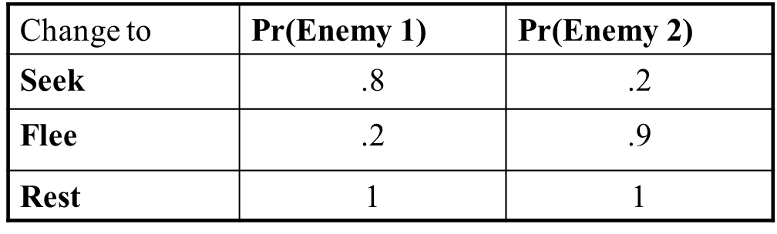
Probabilistic FSM
Seek
Flee
Rest
Notes:
We can extend the FSM to make the behaviours more interesting, and more useful for game play, by adding some stochasticity
In our discussion so far, a given event always triggered a particular state change. More realistic behaviours can be achieved by adding a stochastic component
That is, event E will cause change to state S with probability P (in our previous examples, P was always 1)
By adjusting the probability distributions, you can get different behaviours from the same FSM
Enemy 1 would be very aggressive, and enemy 2 would be very passive

Slide 12
Inheritance in OO - review
A group of classes are related in that they have a common core of shared functionality and/or data
Child classes extend parent (base classes) by descent
Child classes contain all public or protected data and methods of their ancestors
Inheritance promotes code reuse and reduces code duplication
Child classes contain additional data, additional functionality or polymorphic implementations
The parent-child relationship must be an “is-a” relationship, not a “has-a” relationship
Notes:
You already know this so we’ll whip through it quickly
We’ll look at the difference between “additional” and “polymorphic in a moment
We’ll talk about is-a and has-a as well

Slide 13
Inheritance in OO - review
Inheritance for extension
Base Class: Common Core
Child Class: + Specialised
Notes:
One time we inherit
The base class is something useful
But then there is a version of it that adds something specialised
So our sprite class is an animated character. But our player character has, for example, an inventory and inventory management methods, that no other animated character needs
We might descend “PlayerSprite”, or if we are really planning ahead, “InventorySprite”

Slide 14
Inheritance in OO - review
Inheritance for polymorphism
Base Class – Common Core
Including ImportantJob()
Child Class1
Implements ImportantJob() with algorithm 1
Child Class2
Implements ImportantJob() with algorithm 2
Notes:
One time we inherit.
The base class is something useful
All elements of this class must do important job
But there are multiple logically distinct ways to do this important job
So you descend multiple children. Each exposes the identical function prototype, but the code bodies are different
At runtime, you create an instance of the child class. When ImportantJob is called, the system executes the corresponding code version
So we started our sprite class with simple vectorised movement. Then we saw that some sprites need directional movement (players, NPCS) and other sprites need trajectory-based movement (projectiles). So we might choose to descend two classes from sprite. Directional and Trajectory
Then PlayerSprite/InventorySprite would descend from Directional. Or you might go Sprite->Inventory->Player
At this point you can see one of the risks associated with inheritance – cumbersome heirarchies
Can you think of a way to implement this directional/trajectory distinction without inheritance?
State variables and a switch in the move method
This would allow you to have a player character who could also jump
Some might mention interfaces. Also a possibility

Slide 15
Dangers of inheritance
Cumbersome hierarchies – confusing to use
Single hierarchical structure not a good match for information architecture.
Hidden functionality in ancestors
Notes:
You can very quickly find yourself needing 100s of classes to make all the feature sets you need. Dependency injection (strategy pattern) is a better solution here (cf. OOSD)
Especially in the absence of multiple inheritance it can get awkward
E.G. We really want our player character to descend from DirectionalSprite and InventorySprite to combine the features of the two
For linguistic reasons (specifically, potential ambiguity) most modern languages don’t allow this
Interfaces are your friend here (cf. OOSD)
Hidden functionality is the worst one. You can’t see what the child can do just by looking at its .h file. The deeper your hierarchy, the worse it gets

Slide 16
Don’t use inheritance
...when it isn’t a true “is-a” relationship
Notes:
Aggregation/Composition is the preferred technique here
Using composition and interfaces to achieve code reuse and polymorphism

Slide 17
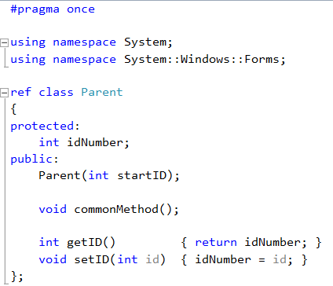
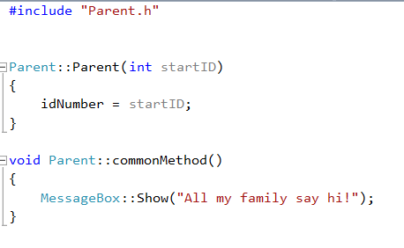
Inheritance syntax in C++
Notes:
Assume this class, with .h on the left and .cpp on the right
We are going to descend from it
What will the children have?
An int idNumber with set and get methods
A method commonMethod as shown

Slide 18

Inheritance syntax in C++
In Child1.h
Notes:
The first inheritance use case – a child needs additional functionality
Descend with :public and the name of the base class
This is equivalent to the extends keyword in Java
There is private inheritance as well, but it is out of scope for us
Make sure to include the parent’s .h file to put the parent type in scope
If you fill in the base class box in the class creation wizard, it does this bit for you

Slide 19
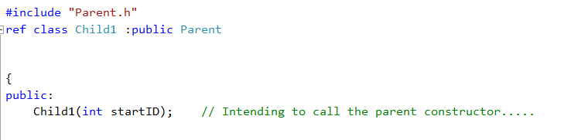
Inheritance syntax in C++
In Child1.h
If you want to call the parent constructor, make sure the child constructor contains at least all
the input arguments that the parent constructor contains
Notes:
In the parent constructor, we initialise the common data values and perform other common initialisation
You only want to write this code once, so you put it in the parent class and let the child call the parent constructor
This is just a normal function call, so you must pass the required arguments to that call

Slide 20
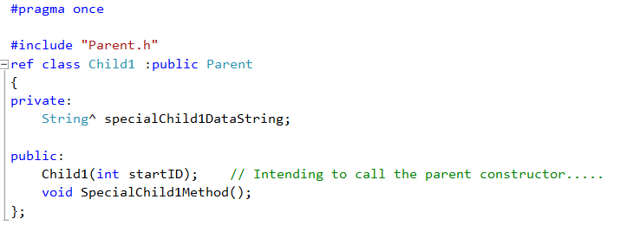
Inheritance syntax in C++
In Child1.h
Notes:
Then child1 can have whatever additional data and methods it needs
In the .cpp these work exactly as they do for any non-child class
Only the constructor is different....

Slide 21
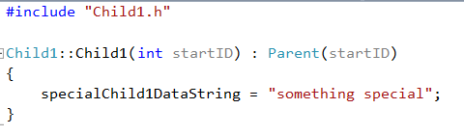
Inheritance syntax in C++
In Child1.cpp
Notes:
Note the syntax for the call to the parent
: after the child arg list
Give the parent class’s name. Some languages just say “base”. This is not one of them
This is a function call. It needs arguments. In this case, just pass the input arg to the child along. NO DATA TYPE
Don’t become confused. Even though this call is in the prototype line, it is not a prototype or part of the prototype. IT IS A FUNCTION CALL.
In the code body, do whatever you want.
What is the state of the instance after this constructor? => both specialCihldDataString and idNumber are initialised.

Slide 22
Inheritance syntax in C++
Overriding
virtual
The parent provides a default code body (may be empty)
Children have the option of overriding with their own code, or using the parent’s default version
abstract
The parent provides no code body
All children must provide their own code
Instances of the parent class cannot be instantiated
Notes:
The second inheritance use case – polymorphism
The parent provides a method (with or without default code body) and children can (or must) override the method, providing their own code
Abstract is safer (each class guaranteed to have the right logic), virtual is more convenient (you can provide a default method)
If there is any sensible default, one tends to go virtual, especially because there is an alternative to abstract classes (interfaces; cf. OOSD)

Slide 23
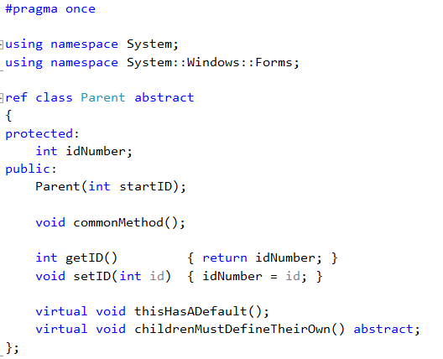
Inheritance syntax in C++
Notes:
The syntax is a little odd. Just go with it

Slide 24
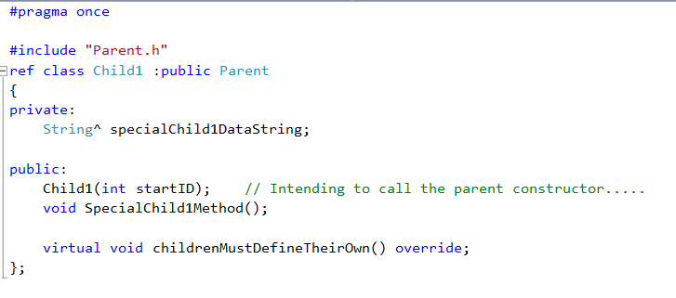
Inheritance syntax in C++
In Child1.h
Notes:
When the child overrides, they mark it in the .h. This just tells the compiler you really mean it

Slide 25
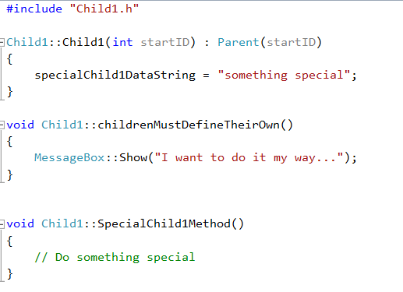
Inheritance syntax in C++
In Child1.cpp
Notes:
In the .cpp, it just looks normal. No virtual or override keywords
Other languages have different rules for how virtual, abstract and override are marked. You really have to look it up every time you switch languages. But the logic is always the same

Slide 26
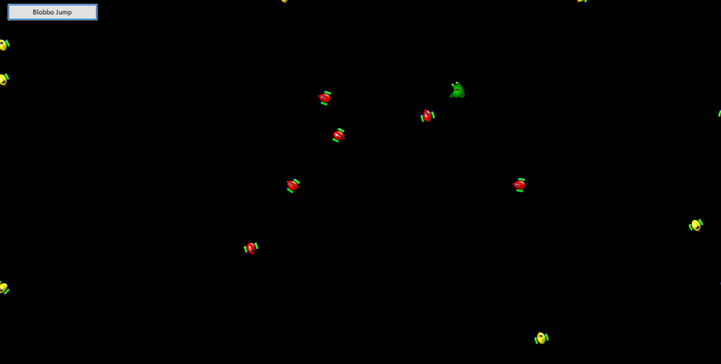
Practical
Approach-avoid

Slide 27
Practical
Use Inheritance InheritanceApproachAvoid Skeleton
Carefully study the existing classes, SimpleSprite, SpriteList and Form1. Read the comments in Form1.h
Add two new classes Approacher and Avoider, both descended from SimpleSprite, so that your
application runs as in the demo
Before creating your new child classes, decide:
What data members and methods do they inherit from their parent?
What additional data members (if any) do they each need?
What additional methods (if any) do they each need?
What inherited methods (if any) do they each need to override?
If you are going to add methods or override inherited methods, what is the logic for each one?

Slide 28
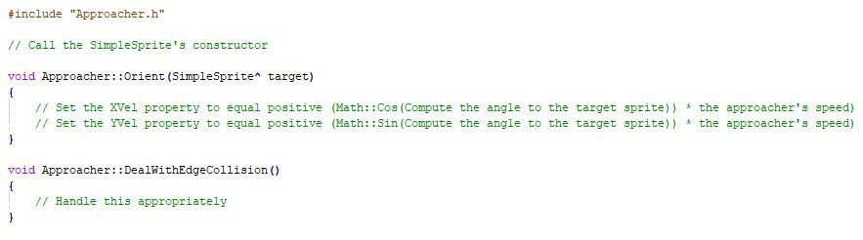
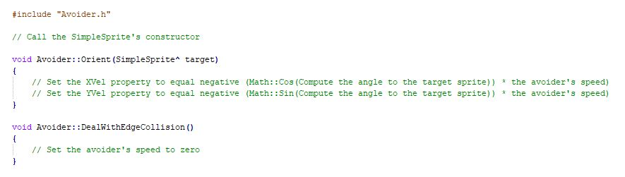
Practical – code examples

