Slide 1
Automatic Piano Reduction (Backend II): Algorithms
CSCI4999 KY1802 (2018-19 Second Term)
Szeto Ethan (1155079061)
Yik Wai Pan (1155079854)
Supervisor: Prof. Kevin Yip Yuk Lap
Co-supervisor: Dr. Lucas Wong

Slide 2
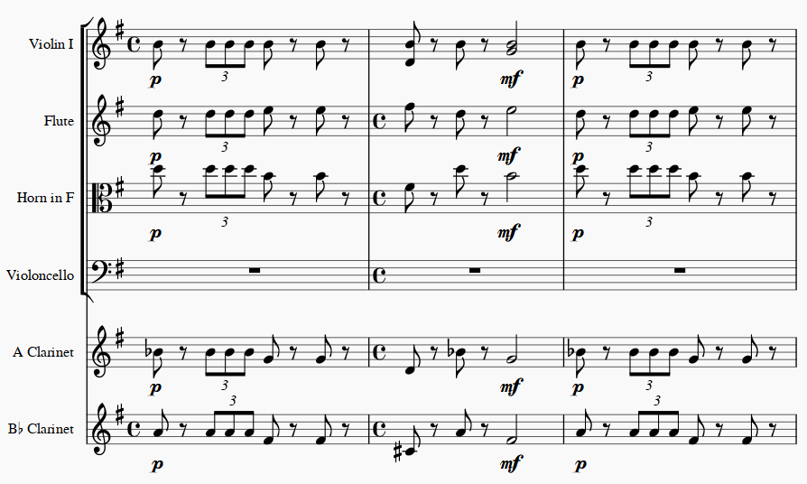
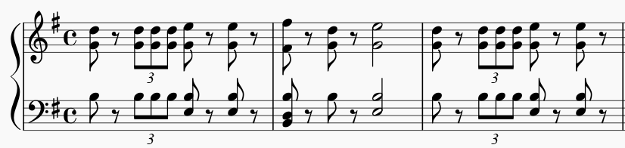
Piano Reduction
Multi-Staff Score
Two-Staff Score
Resemble the original score
Playable by two hands

Slide 3
For ease of discussion…
Original Score is the score before performing piano reduction
Consist of multiple instruments
Answer Score is the score after piano reduction performed by human
Downloaded from Musescore.com, or
Obtained from previous groups
Reduced Score is the score computed by our machine learning component
Processed Score is the score generated by the post-processor after the score is reduced by the machine learning component

Slide 4
Overview of Previous Work

Slide 5
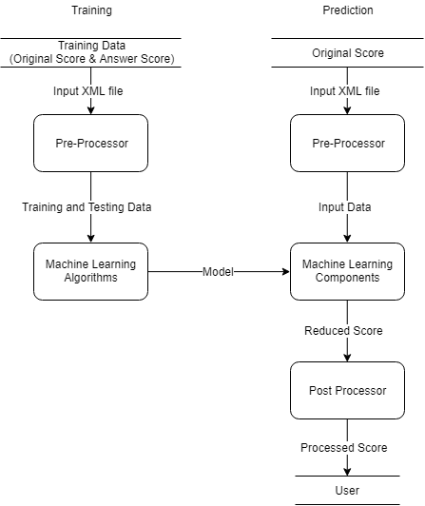
Architecture Overview
Transform the file to data for further processing
Reduce the score based on a given style
Adjust the score to make it playable

Slide 6
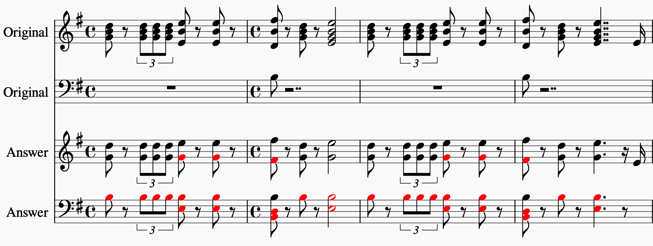
Change of Notes Representation
Piano reduction involves removing and replacing notes depending on the reduction style
Models from previous teams only determined which notes should be kept
New notes could not be added after the reduction
High accuracy of piano reduction could not be achieved

Slide 7
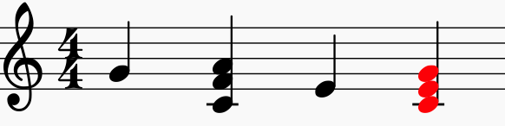
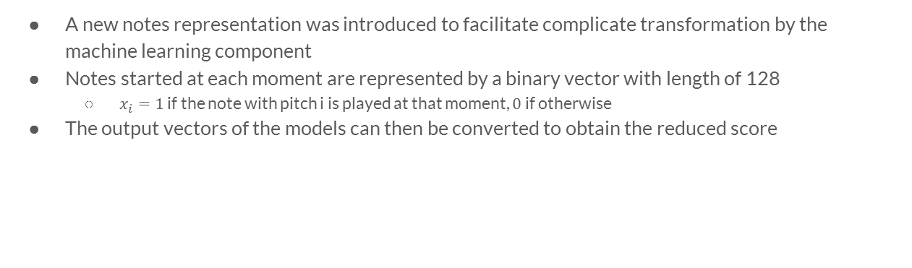

Change of Notes Representation
A new notes representation was introduced to facilitate complicate transformation by the machine learning component
Notes started at each moment are represented by a binary vector with length of 128
$x_{i}=1$ if the note with pitch i is played at that moment, $0$ if otherwise
The output vectors of the models can then be converted to obtain the reduced score
$$\left[\begin{matrix} ⋮ \\ 0 \\ 0 \\ 0 \\ 0 \\ 0 \\ 0 \\ 0 \\ 1 \\ 0 \\ 0 \\ ⋮\end{matrix}\begin{matrix} ⋮ \\ 1 \\ 0 \\ 0 \\ 0 \\ 0 \\ 1 \\ 0 \\ 0 \\ 0 \\ 1 \\ ⋮\end{matrix}\begin{matrix} ⋮ \\ 0 \\ 0 \\ 0 \\ 0 \\ 1 \\ 0 \\ 0 \\ 0 \\ 0 \\ 0 \\ ⋮\end{matrix}\begin{matrix} ⋮ \\ 1 \\ 0 \\ 0 \\ 0 \\ 1 \\ 0 \\ 0 \\ 1 \\ 0 \\ 0 \\ ⋮\end{matrix}\right]$$
C4
C#4
D4
D#4
E4
F4
F#4
G4
G#4
A5

Slide 8
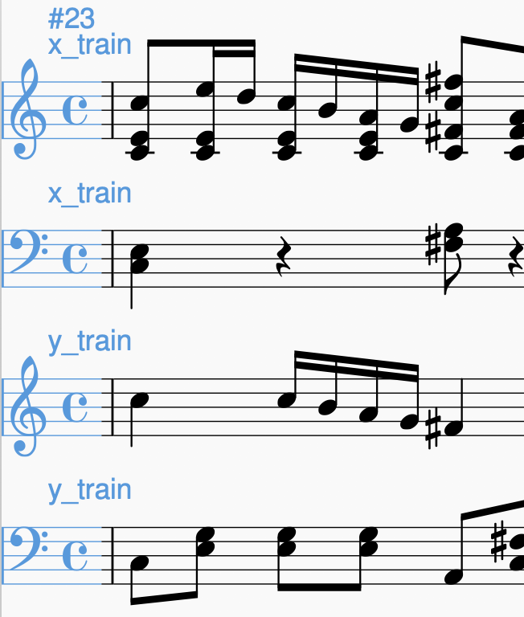
Using Musical Features and Previous Moments
Musical features for each note constructed by previous groups were used
Whether the note belongs to the active rhythm part
Whether the note is with the lowest pitch of the offset
…
Notes of previous moments were also used to provide more information for the models
Notes used as Input
Expected Output

Slide 9
Use of Recurrent Neural Network
Gated Recurrent Unit (GRU) and Long Short-Term Memory (LSTM) models were experimented
GRU models performed slightly better due to the smaller number of parameters
Model Used | AUC ROC Score of Cross Validation with models trained using one score | AUC ROC Score when model trained using multiple scores applied on a left-out score
Feedforward Neural Network | 0.944682 | 0.951143
Feedforward Neural Network with features | 0.941098 | 0.965061
LSTM | 0.955347 | 0.972017
LSTM with features | 0.950584 | 0.985114
GRU | 0.958431 | 0.973463
GRU with features | 0.951305 | 0.986343

Slide 10
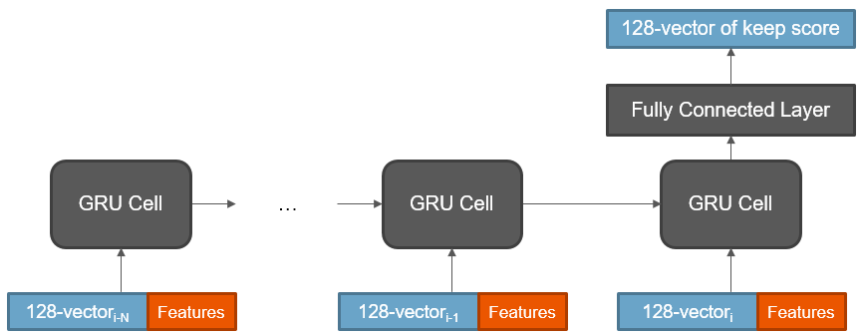
Model Overview

Slide 11
Machine Learning Component

Slide 12
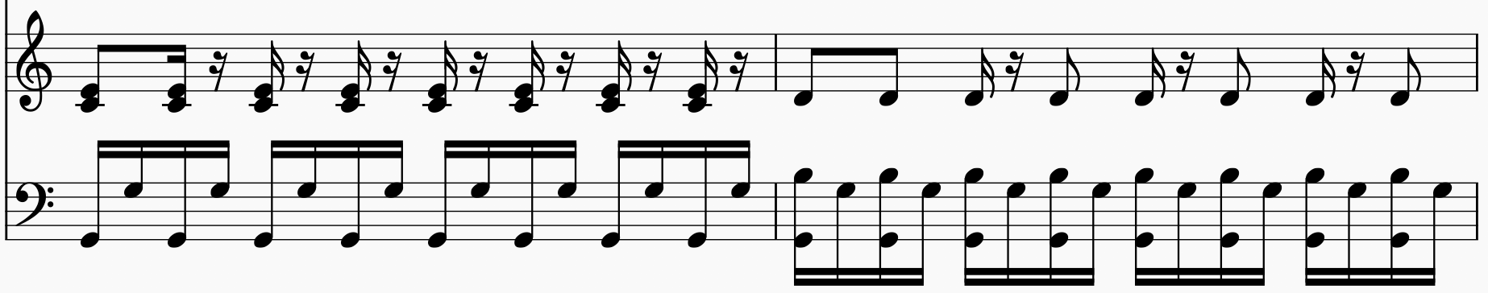
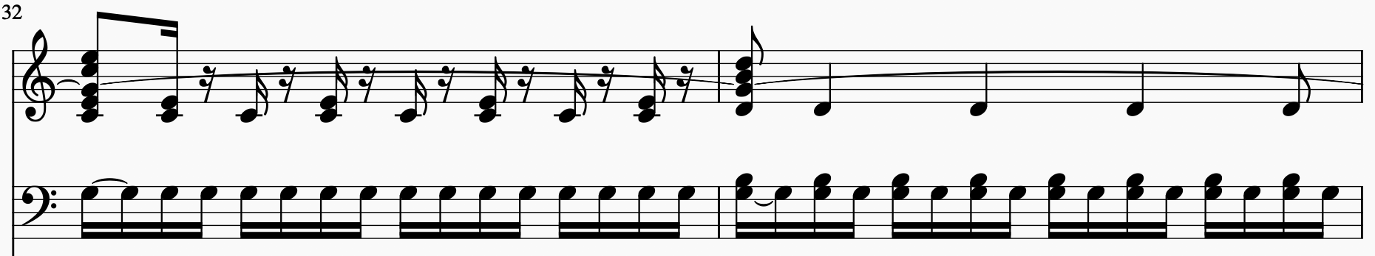
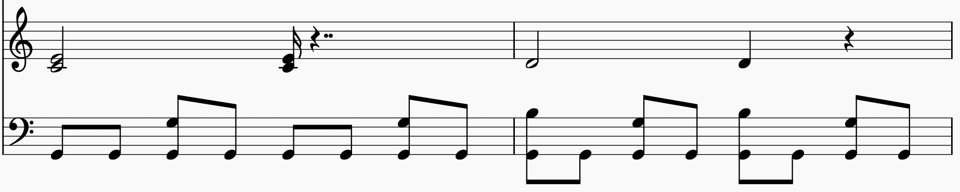
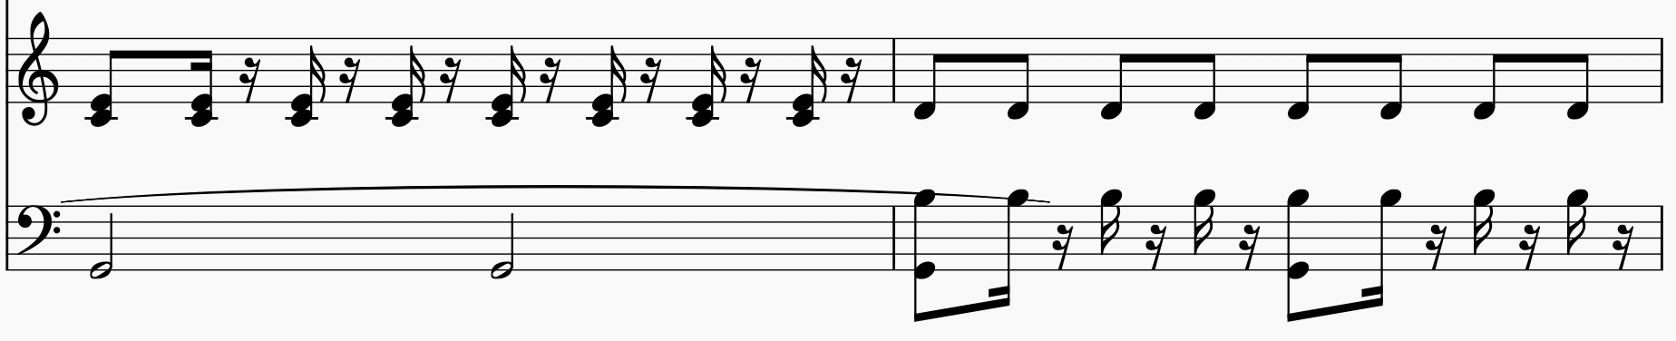
Objective
A musical score can be reduced in different ways based on different styles
Aim to generate models that effectively learn a particular reduction style

Slide 13
Training Data
Different reductions of Mozart's Cosi fan tutte are obtained from previous groups and can be used as training data
A machine learning model can be generated using each reduction score
Simply using the original data may not be sufficient
Some notes may not appear in the data
Chords in different keys cannot be learnt as well

Slide 14
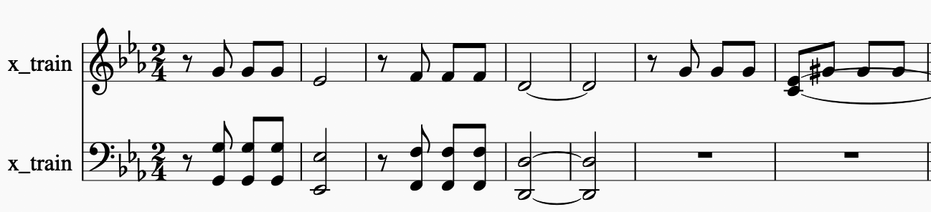
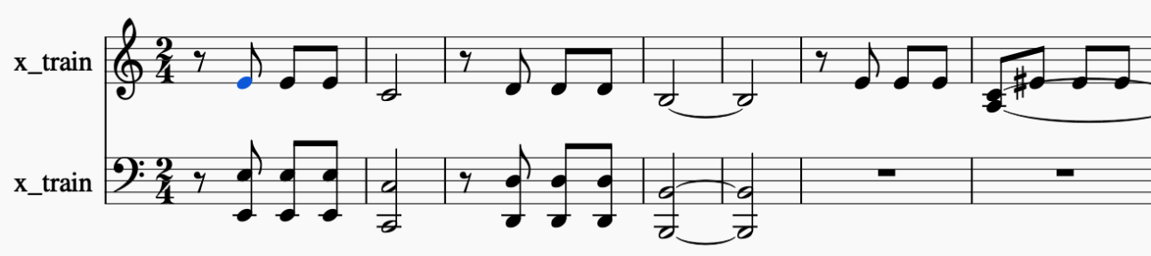
Approach 1 - Key Standardization
Perform key transposition before the score is input into the model
The whole musical piece is transposed to C Major or A Minor, which has no flats and no sharps
After the model generates the reduction, the reduction is transposed back to the original key reversely
In practice, music modulation often occurs in the scores
Standardization becomes ineffective and the model fails to reduce the modulated parts

Slide 15
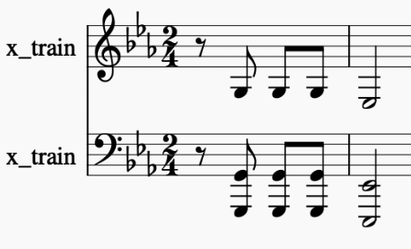
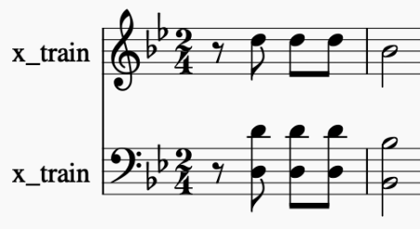
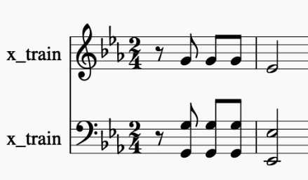
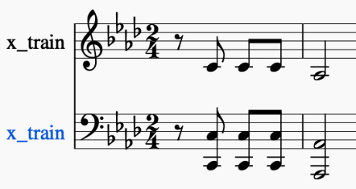
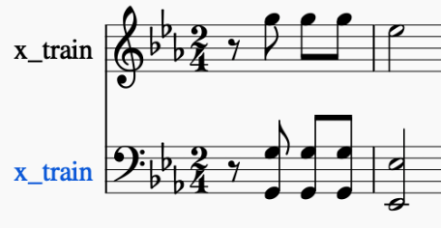
Approach 2 - Key Transpositions of Training Data
Increase the variety of training data by generating multiple versions of it
25 copies of the original and answer scores, with notes in each score shifted by -12 to +12 pitch classes respectively, are generated and used as training data
This approach is used as it alleviates the modulation problem
…

Slide 16
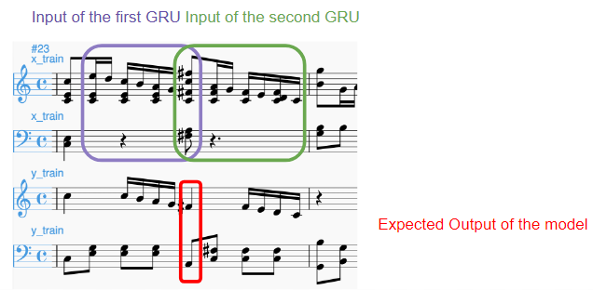
Use of Subsequent Moments
Similar to the previous moments, subsequent moments can be used as input as well
Might provide information like consecutive patterns and repeating notes
A model that takes notes of both previous and subsequent moments as input is introduced
Two Gated Recurrent Unit cells are used, one for previous moments and one for subsequent moments
The output of two cells are concatenated to generate the reduction

Slide 17
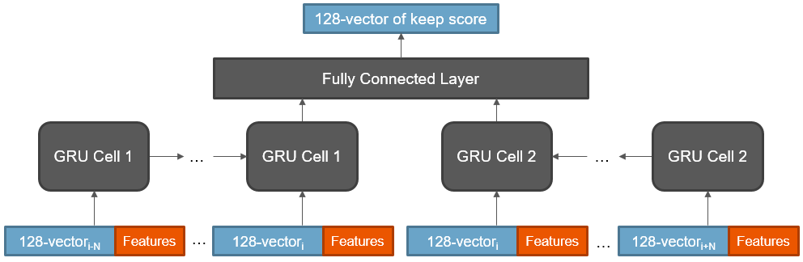
Model Overview

Slide 18
Post-Processor

Slide 19
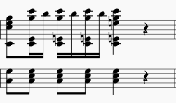
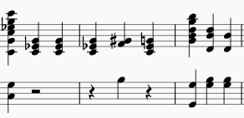
Motivation
Reduced score generated by machine learning model might not be playable all the time
Examples:
Increase the playability of the reduced score, which benefit the pianist
Notes:
The machine learning component does not consider the playability problem, otherwise the model will be very complicated

Slide 20
Idea
Evaluate the playability of the piano score
However, every pianist has their style to play the notes
We can only estimate how the pianist will play the notes
Generate a score which is the most playable
Notes:
It would be better if we have the information of how the pianist will play the score, which is the finger arrangements

Slide 21
Playability Calculation Model
After assigning notes to fingers, we can calculate the “cost” of the arrangement
The piano score is more playable if total “cost” of the arrangements of the whole score is lower
Modify as few notes as possible if the notes can possibly be played already
Notes:
We have designed the playability calculation model to calculate the playability of the score, evaluated moment by moment

Slide 22
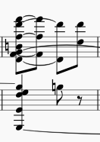
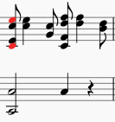
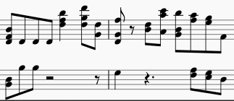
Penalties
Finger Busyness Penalty
More than 10 notes to be played at one moment
Range Penalty
Distance between the first note and last note of one hand exceeds the hand size
Hand Movement Penalty
Given to moments that one hand travels from one position to a position far away
Number of Changes Penalty
Excess changes are penalized

Slide 23


Optimization Algorithm – Hill Climbing
Try to reduce the moments in the score that have high penalties by changing notes by octaves
Modify as few notes as possible

Slide 24
Algorithm
Repeat until no possible further changes:
Randomly modify the notes and recalculate the new penalty
If the new penalty is lower than the original one then commit the change
Otherwise, revert the change

Slide 25
Advantages
Users can select the extent of score simplification based on their piano skill level
By changing the input parameters of the model
Prevents over-simplification problem
Notes:
There are other advantages of the post-processor

Slide 26
Model Evaluation

Slide 27
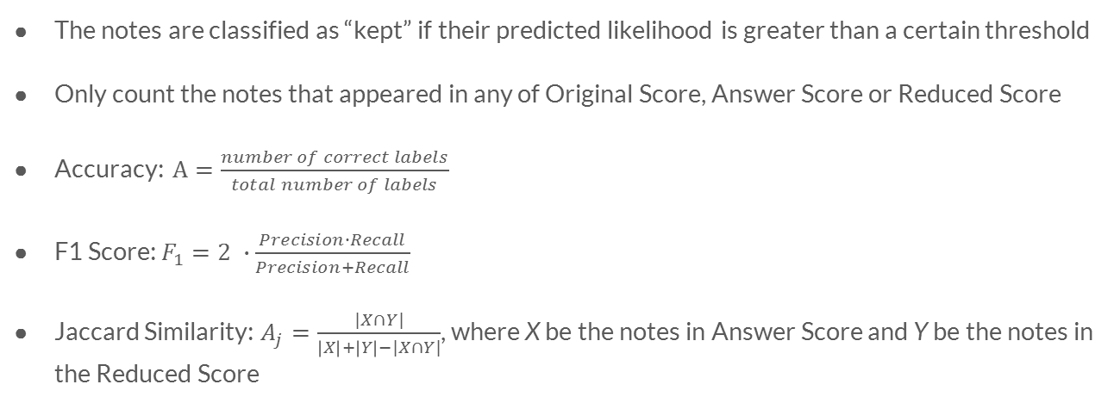
Evaluation Metrics
The notes are classified as “kept” if their predicted likelihood is greater than a certain threshold
Only count the notes that appeared in any of Original Score, Answer Score or Reduced Score
Accuracy: $A=\frac{number of correct labels}{total number of labels}$
F1 Score: $F_{1}=2 ∙\frac{Precision∙Recall}{Precision+Recall}$
Jaccard Similarity: $A_{j}=\frac{|X∩Y|}{\left|X\right|+\left|Y\right|−|X∩Y|}$, where X be the notes in Answer Score and Y be the notes in the Reduced Score

Slide 28
Effectiveness of Learning the Reduction Style
Three answer scores of Mozart's Cosi fan tutte were used to evaluate the models
Two of the reductions (Cosi 2 and Cosi 7) have a large number of notes
The other one (Cosi 9), reduced by Dr. Lucas Wong, has less notes and is more playable
The same 90% of the three Answer Scores are used to train their own models respectively
The remaining 10% of the three scores are input into the models to evaluate the performance
It can be expected that if the training data of the model is the same reduction with the testing data, the model should achieve higher scores than the others

Slide 29
Testing Data: Cosi 2
Model |  | Training Data | F1 Score | Accuracy | Jaccard Similarity
Semester 1 | GRU with features considering previous moments only | Cosi 2 | 0.80076628 | 0.75644028 | 0.66773163
 |  | Cosi 7 | 0.7609075 | 0.67915691 | 0.61408451
 |  | Cosi 9 | 0.69201521 | 0.6206089 | 0.52906977
Semester 2 | GRU with features considering both previous and subsequent moments | Cosi 2 | 0.85992218 | 0.83138173 | 0.75426621
 |  | Cosi 7 | 0.77205882 | 0.70960187 | 0.62874252
 |  | Cosi 9 | 0.73387097 | 0.69086651 | 0.57961783
Baseline Models | Logistic Regression | Cosi 2 | 0.71428571 | 0.65339579 | 0.55555556
 |  | Cosi 7 | 0.74545455 | 0.67213115 | 0.5942029
 |  | Cosi 9 | 0.54590571 | 0.57142857 | 0.37542662
 | Naive Bayes | Cosi 2 | 0.56763926 | 0.61826698 | 0.3962963
 |  | Cosi 7 | 0.5655527 | 0.60421546 | 0.39426523
 |  | Cosi 9 | 0.54068242 | 0.59016393 | 0.3705036
 | Keep All | / | 0.76071429 | 0.68618267 | 0.61383285

Slide 30
Testing Data: Cosi 7
Model |  | Training Data | F1 Score | Accuracy | Jaccard Similarity
Semester 1 | GRU with features considering previous moments only | Cosi 2 | 0.73743017 | 0.66978923 | 0.5840708
 |  | Cosi 7 | 0.82312925 | 0.75644028 | 0.69942197
 |  | Cosi 9 | 0.74676525 | 0.67915691 | 0.59587021
Semester 2 | GRU with features considering both previous and subsequent moments | Cosi 2 | 0.78638941 | 0.735363 | 0.64797508
 |  | Cosi 7 | 0.86940966 | 0.82903981 | 0.76898734
 |  | Cosi 9 | 0.75146771 | 0.70257611 | 0.60188088
Baseline Models | Logistic Regression | Cosi 2 | 0.72795497 | 0.66042155 | 0.57227139
 |  | Cosi 7 | 0.75752212 | 0.67915691 | 0.60968661
 |  | Cosi 9 | 0.57416268 | 0.58313817 | 0.40268456
 | Naive Bayes | Cosi 2 | 0.52040816 | 0.55971897 | 0.35172414
 |  | Cosi 7 | 0.51980198 | 0.54566745 | 0.35117057
 |  | Cosi 9 | 0.47474748 | 0.51288056 | 0.31125828
 | Keep All | / | 0.77217391 | 0.69320843 | 0.62889518

Slide 31
Testing Data: Cosi 9
Model |  | Training Data | F1 Score | Accuracy | Jaccard Similarity
Semester 1 | GRU with features considering previous moments only | Cosi 2 | 0.68852459 | 0.64402810 | 0.52500000
 |  | Cosi 7 | 0.72727273 | 0.65573771 | 0.57142857
 |  | Cosi 9 | 0.75609756 | 0.71896956 | 0.60784314
Semester 2 | GRU with features considering both previous and subsequent moments | Cosi 2 | 0.75416667 | 0.72365340 | 0.60535117
 |  | Cosi 7 | 0.74901961 | 0.70023419 | 0.59874608
 |  | Cosi 9 | 0.80952381 | 0.79391101 | 0.68000000
Baseline Models | Logistic Regression | Cosi 2 | 0.66942149 | 0.62529274 | 0.50310559
 |  | Cosi 7 | 0.67054264 | 0.60187354 | 0.50437318
 |  | Cosi 9 | 0.56910569 | 0.62763466 | 0.39772727
 | Naive Bayes | Cosi 2 | 0.54810496 | 0.63700234 | 0.37751004
 |  | Cosi 7 | 0.54084507 | 0.61826698 | 0.37065637
 |  | Cosi 9 | 0.51296830 | 0.60421546 | 0.34496124
 | Keep All | / | 0.68821293 | 0.61592506 | 0.52463768

Slide 32
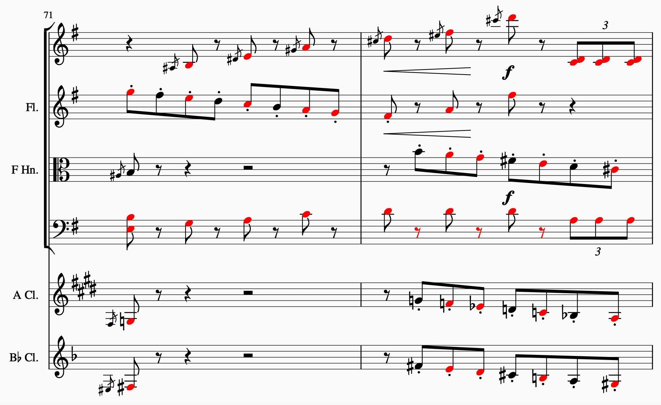
Using Chord as Feature
The importance of chords for piano reduction could not be known in previous years
Chord identification can be done beforehand to enhance the models if chords are useful
Mozart’s Cosi fan tutte and Tchaikovsky's Nutcracker March are used
The chords given by Dr. Lucas Wong are manually input into the Original Score
Notes belong to the chord are marked and become a binary feature for the notes
New models are trained to compare the results with the ones which do not use the chord as feature

Slide 33
Using Chord as Feature
5-fold cross validation is done to evaluate the average scores of the models with and without the chord feature
The score is split into 5 parts evenly
In the i^{th}-fold run, the i^{th} part of the score is selected as the validation data and the models use the rest of the parts as the training data
The averaged results of the 5 runs are taken as the overall performance of the models

Slide 34
Using Chord as Feature
Testing Data: Mozart's Cosi fan tutte
Model | Using Chord as Feature? | F1 Score | Accuracy | Jaccard Similarity
GRU considering previous moments only | Yes | 0.640748714 | 0.560737148 | 0.478001895
 | No | 0.641015116 | 0.557500050 | 0.478107646
GRU considering both previous and subsequent moments | Yes | 0.648954164 | 0.576282305 | 0.487183272
 | No | 0.655681072 | 0.571184689 | 0.497043710

Slide 35
Using Chord as Feature
Testing Data: Tchaikovsky's Nutcracker March
Model | Using Chord as Feature? | F1 Score | Accuracy | Jaccard Similarity
GRU considering previous moments only | Yes | 0.829648254 | 0.748093610 | 0.722803364
 | No | 0.833857150 | 0.756957531 | 0.731328508
GRU considering both previous and subsequent moments | Yes | 0.839500875 | 0.763506127 | 0.738497945
 | No | 0.846575515 | 0.779274425 | 0.755235207

Slide 36
Using Chord as Feature
Results suggest that the chord feature cannot improve the machine learning component
Metrics drop when the feature is added
Using the chords as binary feature might be insufficient
The inversion of chords might need to be considered as well
The GRU model might already be capable of learning the chord relations between the notes

Slide 37
Using Different Input Lengths of Models
The models can input any number of previous and subsequent moments
The choice of input length of the Gated Recurrent Unit model may affect the reduction performance
Another 5-fold cross validation is performed

Slide 38
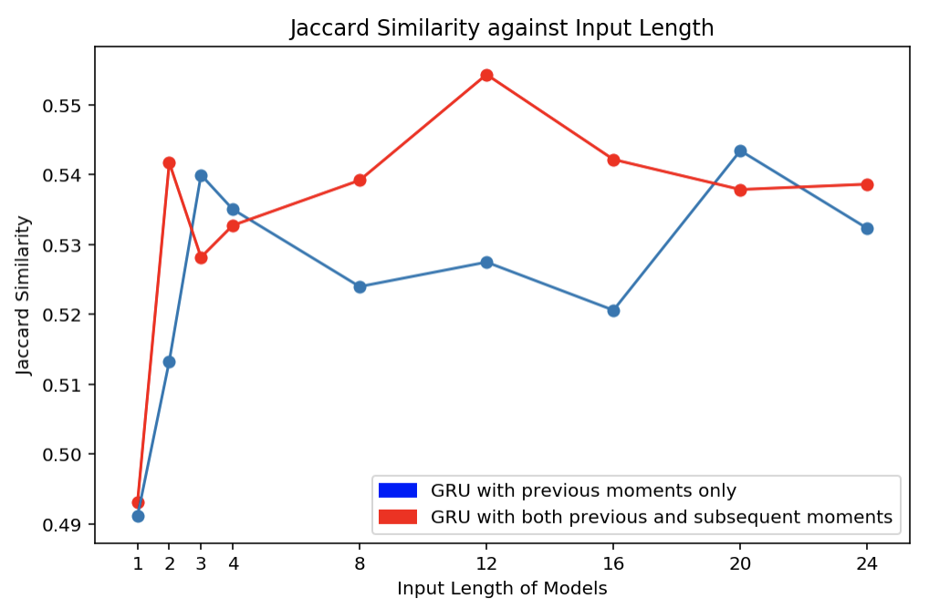
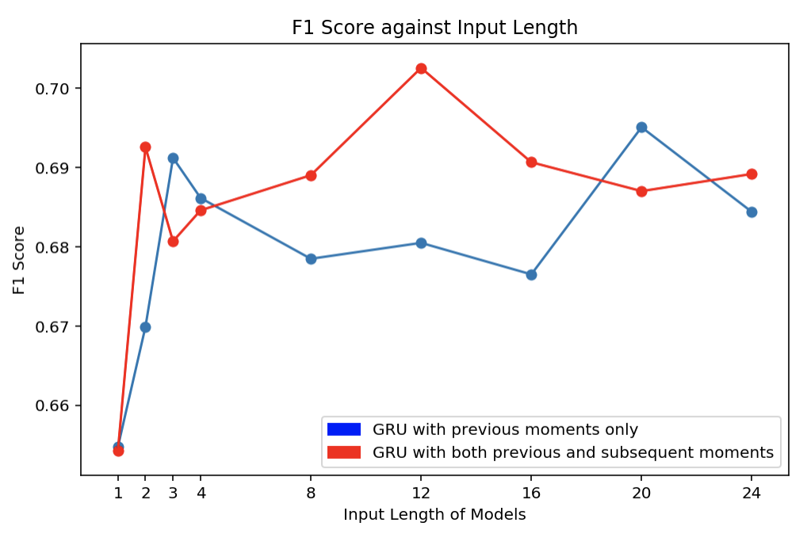
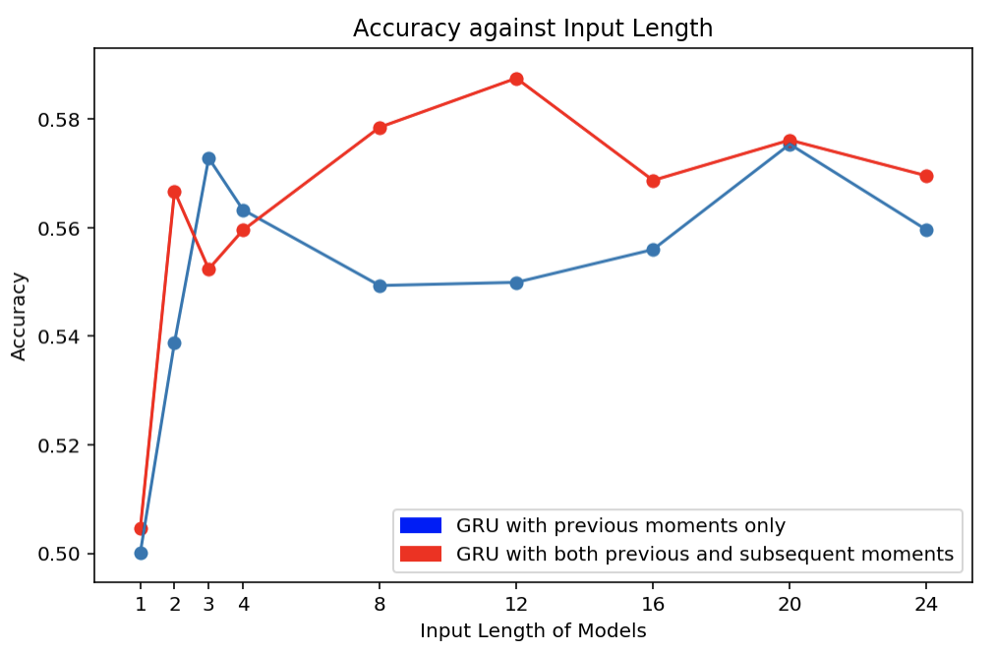
Evaluation Results
Another reduction of Mozart's Cosi fan tutte is used as training data and testing data

Slide 39
Using Different Input Lengths of Models
Input lengths might have insignificant influence on the performance of the models
Both results fluctuate when the input length of the model increases
Metrics drop drastically when the input length become 1, showing that the adjacent moments give useful information to the model

Slide 40
Examples of Results

Slide 41
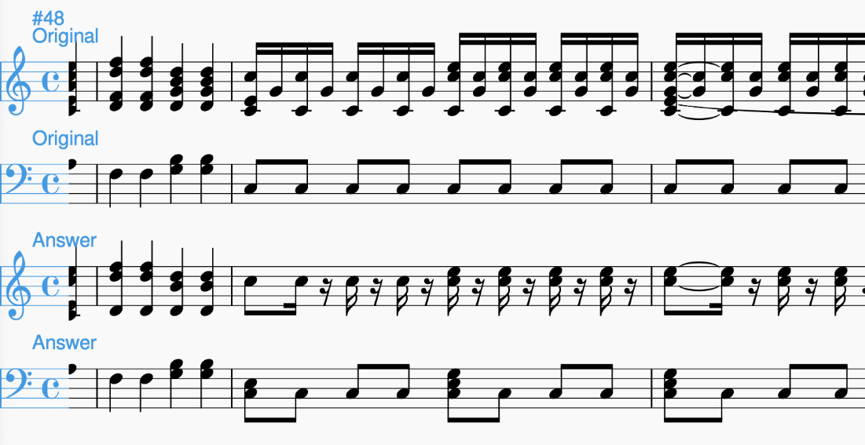
Reduction Model Used
A Gated Recurrent Unit model is trained using 90% of the Answer Score of Cosi fan tutte, which is reduced by Dr. Lucas Wong:
Notes:
The following examples are generated by a gated recurrent unit model, considering both previous and subsequent moments
The model is trained using 90% of the answer score of Cosi, which is reduced by Dr. Lucas Wong

Slide 42
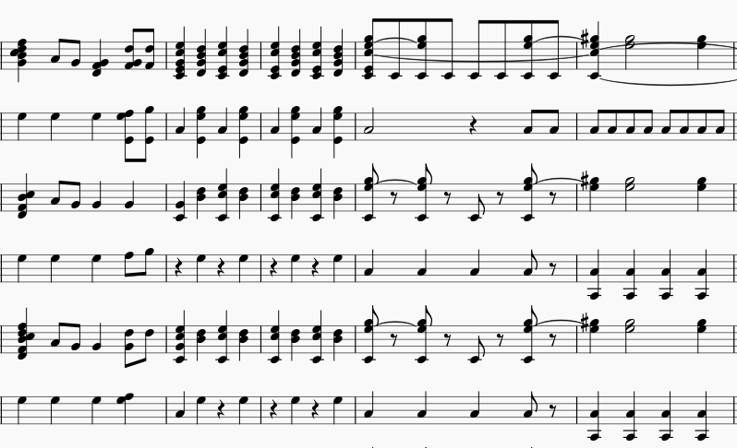
Reduction of Cosi fan tutte - Reduction Style
Original Score
Answer Score
Reduced Score
Notes:
The model is able to learn the reduction style
From this example, the model successfully learns to reduce the quavers into crotchets in the left hand part of the last measure
in second and third measures of the example, the models can learn to reduce the crotchets into rest notes, except for the first beat of the second measures
As we can see, the model can greatly learn the reduction style from the training example.

Slide 43
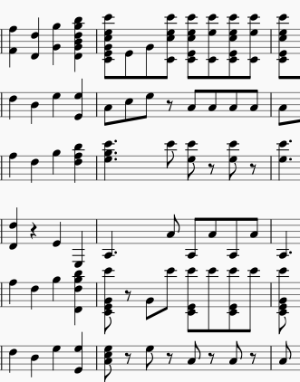
Reduction of Cosi fan tutte – Harmony Preservation
Original Score
Answer Score
Reduced Score
Notes:
While the model is able to learn the reduction style, the harmony of the piece can also be preserved.
Although some of the predictions are incorrect, it can be seen that those incorrect moments had their number of the notes reduced.
More importantly, the incorrect predictions, whether there are newly added notes or not, can still match with the chord that the original notes belong to.
It indicates that the Gated Recurrent Unit model can learn from the combination of notes from the training data and maintain the harmony of the reduction.
in the first beat of the last measure, a new note G-4 is generated by the model. Even though the generated note is incorrect, it is still within the chord that the others notes of that onset belong to.
As a result, the generated notes and the incorrect predicted note did not destroy the harmony.

Slide 44
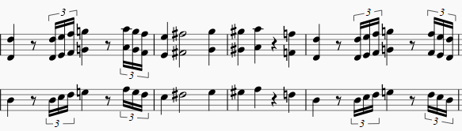
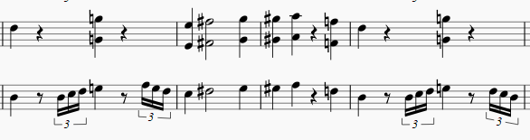
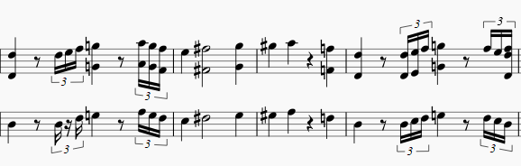
Reduction of Cosi fan tutte – Tempo Overlooking
Original Score
Answer Score
Reduced Score
Notes:
There are still rooms of improvement for the machine learning model
Since the notes are separated according to the moment they belong to only, the tempo of each notes cannot be learnt by the model well.
No matter how long the moments last for, they are all treated as the same and each occupies one unit in the sequence
As a result, the model is not able to distinguish between a fast melody and a slow melody well, resulting in reducing both melodies in a similar way.
the model mishandles the triplets in the first measure and treats it as normal notes
And applies the "reduction style" of keeping and discarding notes alternatively to the triplets, causing a break in the three triplets

Slide 45
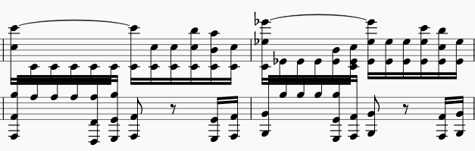
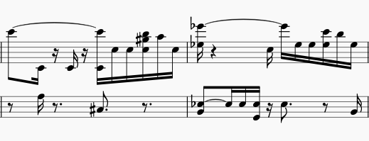
Reduction of Beethoven's Symphony No.7 Movement 1 – Reduced Notes
Original Score
Reduced Score
Notes:
The same model is used to apply the same reduction on another musical pieces, Beethoven’s Symphony No.7, obtained from musescore.com
the model is capable of reduce the score with the given style
The original score contains a large number of notes on most moments, and the model successfully reduce the number of notes
in the treble clef, the repeating notes (C4 in measure 1 and E4 in measure 2) are greatly reduced
In the bass clef, multiple notes are reduced as well, following the simple style of the training data
the harmony is not destroyed.
It is shown that the reduction style can be applied on this musical piece.

Slide 46
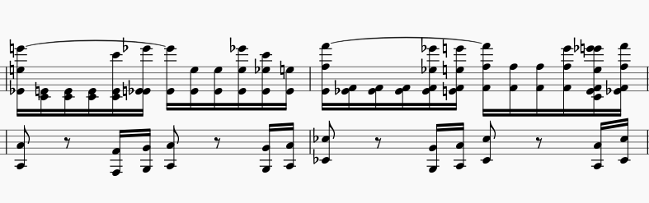
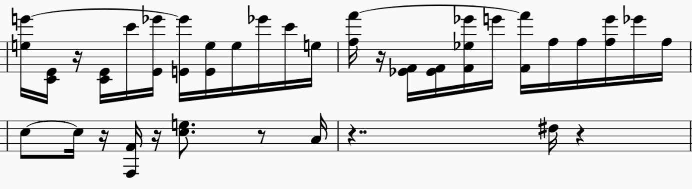
Reduction of Beethoven's Symphony No.7 Movement 1 – Inconsistency
Original Score
Reduced Score
Notes:
Sometimes, inconsistency occurs in the reduced score
a few of them may not be reduced while the rest of them are discarded, failing to apply the same reduction consistently
Possible reasons:
different combinations of the set of notes in each moment
the previous moment and the subsequent moment of the notes of the input are different so the notes are treated differently

Slide 47
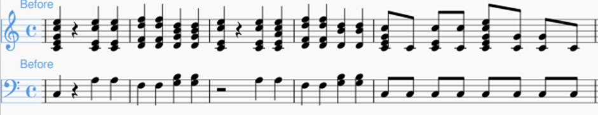
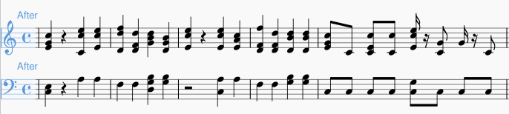
Post-Processor - Mozart's Cosi fan tutte Example
The number of the notes at the same onset is reduced
Playability is increased
The melody can still be kept when some notes are removed
Before Post-processor
After Post-processor

Slide 48
Conclusion

Slide 49
In this semester…
An improved machine learning model for piano reduction is proposed
The learning of reduction style is evaluated
A post-processor is designed and implemented
All components are integrated as a package
Notes:
We proposed an improved machine learning model for piano reduction
We also evaluate the ability of learning the reduction style of the model
Moreover, we designed and implemented a post-processor which can increase the playability of the reduced score
After all, we integrate all components as a package

Slide 50
Future Work
Produce more training samples with musicians
Achieve a better understanding about the reduction styles
Further Investigations on Chord Feature
E.g. inversions, bass note, root note
Model Ensembling
Improve the accuracy of the original machine learning models
Notes:
it is encouraged for us to invite musicians to produce more training samples
we can understand the rules that the musicians used to perform the reduction and better evaluations and analysis can be performed
Due to the limited amount of time, we cannot further investigate the usefulness of the chord feature
we should adopt alternative methods such as considering the inversions of the chord, or giving different values for bass note/ root note etc.
In order to improve the accuracy of the machine learning models, we would apply model ensembling techniques
different models trained by different parts of training data can be combined to form a larger model

Slide 51
Reference
[1] C. Olah, “Understanding LSTM Networks,” 27 8 2015. [Online]. Available: http://colah.github.io/posts/2015-08-Understanding-LSTMs/. [Accessed 27 11 2018].
[2] R. Gandhi, “Introduction to Sequence Models — RNN, Bidirectional RNN, LSTM, GRU,” 27 6 2018. [Online]. Available: https://towardsdatascience.com/introduction-to-sequence-models-rnn-bidirectional-rnn-lstm-gru-73927ec9df15. [Accessed 27 11 2018].

Slide 52
Demo

