Slide 1
BACKGROUND & METHODOLOGY
Adaptive Geodesic Conformal Prediction for
Spherical Harmonic Climate Reconstruction
Uncertainty: Reconstruct Temperature From Scattered Observations to Trustworthy Climate Maps
Why the problem matters, then explain methodology -> contribution -> result
Sze Ying Choong · MSc Data Science
Notes:
Good morning. My name is Sze Ying Choong, and today I'll be presenting my MSc dissertation, titled Adaptive Geodesic Conformal Prediction for Spherical Harmonic Climate Reconstruction. The main focus of this dissertation is uncertainty: when we reconstruct temperature from scattered observations, how can we tell how much we should trust the prediction at each location? I'll first briefly introduce the problem and why it matters, then explain my methodology and contribution, before moving on to the main results.

Slide 2
THE PROBLEM
Reconstructing continuous temperature field from scattered dots
Many things we care about — temperature, pressure, magnetic fields — vary smoothly across the whole surface of the Earth.
But we only observe them at a limited number of locations: weather stations, cities, sensors.
The task is to fill in the gaps: reconstruct a continuous field over the entire sphere from these sparse, unevenly distributed observations.
Coverage is not uniform — dense in places like Europe, very sparse over oceans, mountains, and remote regions.
The challenge is to understand where those predictions are reliable.
?
?
Blue dots = observation cities · gaps = unobserved regions
Adaptive Geodesic Conformal Prediction — Background & Methodology
2
Notes:
The problem I'm studying is reconstructing a continuous temperature field from scattered observations. We only observe temperature at a limited number of locations, and these observations are unevenly distributed. Some regions have dense coverage, while others, such as remote and mountainous areas, have very little. So the challenge is not only to reconstruct the field, but also to understand where those predictions are reliable.

Slide 3
WHY THIS MATTERS
A Prediction Without Trust Isn't Enough
1
2
3
Decision Making in applications
Accuracy isn't uniform
RMSE hides this variation
Reconstructed fields feed into agriculture, environmental monitoring, and other downstream models — decisions are only as good as the map they're based on.
The model can be excellent where data is in densely observed regions , and far less reliable where it is sparse — e.g. oceans, deserts, high mountains.
Being told the model is ‘90% accurate on average’ doesn’t tell you whether to trust the prediction at any one specific location.
This dissertation focuses on giving every prediction a local, spatially-aware measure of how much to trust it — not just an overall average.
That's the gap I address with spatially adaptive uncertainty quantification.
Adaptive Geodesic Conformal Prediction — Background & Methodology
3
Notes:
Why does this matter?
These reconstructed fields can be used for decision-making in applications such as agriculture and environmental monitoring, so knowing where predictions are reliable is important. More importantly, prediction accuracy is not uniform. A model can perform well in densely observed regions and poorly in sparse ones. A single global metric such as RMSE hides this variation. It tells us how well the model performs on average, but not whether we should trust a prediction at a particular location. That's the gap I address with spatially adaptive uncertainty quantification.

Slide 4
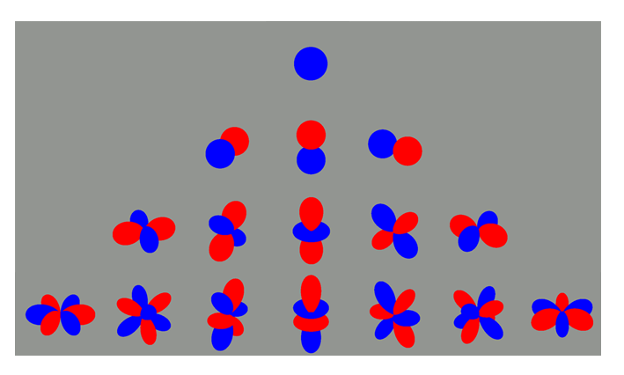
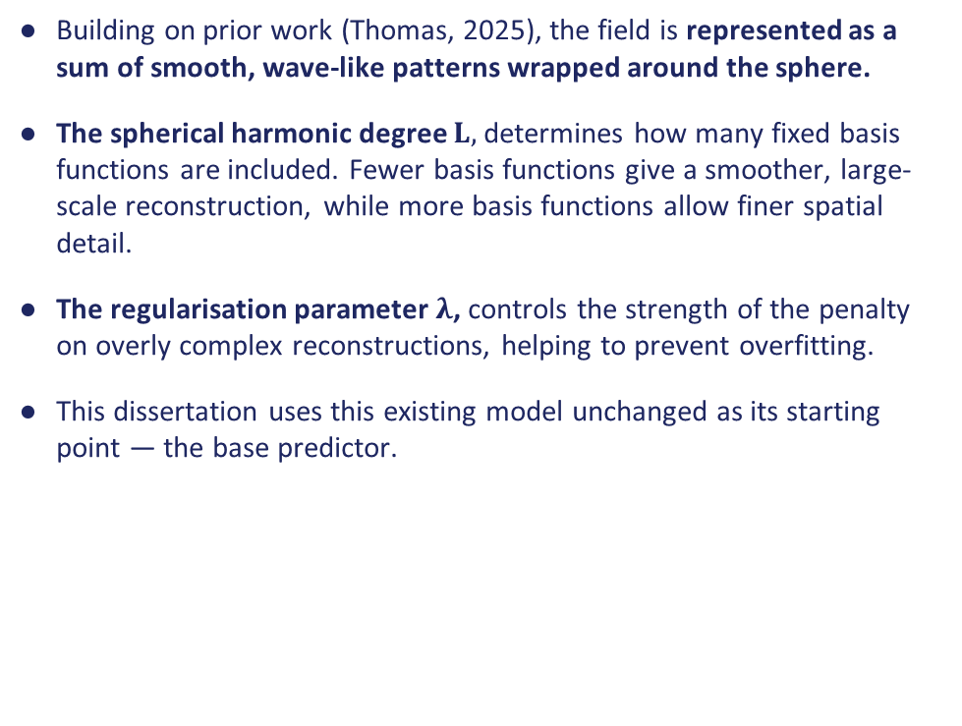
METHODOLOGY · STEP 1
Spherical Harmonics — Reconstructing the Field
Building on prior work (Thomas, 2025), the field is represented as a sum of smooth, wave-like patterns wrapped around the sphere.
The spherical harmonic degree $L,$ determines how many fixed basis functions are included. Fewer basis functions give a smoother, large-scale reconstruction, while more basis functions allow finer spatial detail.
The regularisation parameter $λ$, controls the strength of the penalty on overly complex reconstructions, helping to prevent overfitting.
This dissertation uses this existing model unchanged as its starting point — the base predictor.
increasing degree, L — model complexity
Example figure from (Thomas, 2025) Figure 2: Spherical harmonics for degrees 0 to 3.
These are examples of the fixed basis functions used to represent the temperature field.
Adaptive Geodesic Conformal Prediction — Background & Methodology
4
Notes:
The methodology has two main parts.
First, I use the existing spherical harmonic model to reconstruct the temperature field. It represents the field using smooth, wave-like patterns on the sphere. These are fixed spherical harmonic basis functions. For a chosen maximum degree L, we include all the basis functions up to that degree. We then use a regularised least-squares problem to estimate the coefficient of each basis function, and the reconstructed temperature is obtained as a linear combination of these fixed basis functions using the estimated coefficients.
So, L controls the number of basis functions included, and therefore the level of spatial detail in the reconstruction, while the regularisation parameter lambda, helps prevent overfitting. I use this existing model as the base predictor; my contribution comes in the uncertainty layer.

Slide 5
METHODOLOGY · STEP 2
Conformal Prediction — Knowing How Much to Trust Each Point
Conformal prediction wraps around any existing predictor and adds a calibrated interval around each prediction.
It comes with a guaranteed coverage rate (e.g. 90% of the time the true value falls inside the interval) — without needing to know how the underlying model works internally.
Unlike Gaussian Processes, it makes no assumption about the shape of the model's errors — it only needs a held-out calibration set.
This dissertation's key idea: let the interval widen or narrow depending on how difficult each location is — instead of one fixed size everywhere.
Easy location
narrow interval
Hard location
wide interval
Same predictor, same target coverage — interval width adapts to local difficulty.
Adaptive Geodesic Conformal Prediction — Background & Methodology
5
Notes:
Second, I use conformal prediction to quantify uncertainty around those predictions. Standard conformal prediction gives a calibrated interval with a target coverage, such as 90%. But standard conformal uses the same interval width everywhere. My idea is to make that width depend on local prediction difficulty: narrower where the model is reliable, and wider where it is less reliable.
----------------------------------------------------------------------------------------
Okay, but how exactly did i make the interval adaptive?
“To do this, I first use five-fold cross-validation on the training data to obtain out-of-sample residuals. These residuals tell me how difficult the model finds different locations to predict. I then use geodesic K-nearest neighbours to estimate a local difficulty, which I denote by sigma-hat of x. In other words, for a new location, I look at nearby observations on the sphere and use their cross-validation residuals to estimate how difficult that region is. Finally, I use this estimated difficulty to normalise the calibration residuals. This gives me an adaptive conformal threshold, which is then scaled according to the difficulty at each prediction location.“ So the overall idea is simple: estimate where the model is difficult to predict, and use that information to make the uncertainty interval wider or narrower accordingly.

Slide 6
OUR CONTRIBUTION
Adapting Geodesic Conformal Prediction to Scalar Fields
Prior work
This dissertation
Amiri Shahbazi & Baheri (2026)
Scalar climate reconstruction
Designed for manifold-valued responses — e.g. a direction on a sphere. Geometry is used to measure error on the OUTPUT.
The response (temperature) is scalar, not manifold-valued. Geometry is instead used on the INPUT side — to define which locations are ‘nearby’ when estimating local difficulty.
In short, this dissertation contributes:
A methodological adaptation, new local difficulty estimator σ̂(x), empirical validation, robustness checks across model complexity, and a geographic interpretation of where uncertainty concentrates.
Used geographical distance on the sphere to identify nearby locations and estimate local prediction difficulty, sigma-hat(x).
Used this difficulty estimate to adapt the conformal interval at each location.
adapt conformal prediction to spherical temperature reconstruction by using geodesic neighbourhoods to estimate local prediction difficulty
Adaptive Geodesic Conformal Prediction — Background & Methodology
6
Notes:
This is where my contribution comes in. The method I adapted was originally designed for manifold-valued responses, where geometry is used to measure error in the output. Here, temperature is scalar, so I can't apply it directly. Instead, I move the geometry to the input side. I use geographical distance on the sphere to identify nearby locations and estimate local prediction difficulty, sigma-hat(x). I then use this difficulty estimate to adapt the conformal interval at each location. So, in one sentence: My contribution is to adapt conformal prediction to the spherical temperature reconstruction setting by using geodesic neighbourhoods to estimate local prediction difficulty, so that uncertainty intervals vary spatially while retaining conformal coverage.

Slide 7
RESULTS
Does this adaptive approach actually improve uncertainty estimates?
Results · Sze Ying Choong · MSc Data Science
Notes:
So the key question is whether this adaptive approach actually improves uncertainty estimates in practice. Let's look at the results.

Slide 8
BASELINE COMPARISON
Marginal Coverage — Looks Similar…
Method | Marginal Coverage | Mean Interval Width
Standard (non-adaptive) | 90.9% | 4.65 °C
Adaptive geodesic (proposed) | 93.7% | 4.59 °C
Both methods land close to the 90% nominal target — and interval widths are nearly identical
So marginal coverage alone makes the two methods look basically equivalent…
…that's exactly the problem. It hides what's actually happening underneath.
Adaptive Geodesic Conformal Prediction — Results Walkthrough
8
Notes:
First, looking at marginal coverage, both methods perform well. Standard conformal gives 90.9% coverage with a mean interval width of 4.65°C, while the adaptive method gives 93.7% coverage with a slightly smaller width of 4.59°C. So, based on marginal coverage alone, the two methods look very similar. But this is exactly where marginal coverage can be misleading, because it averages across all locations. The more important question is what happens in easy versus difficult regions.

Slide 9
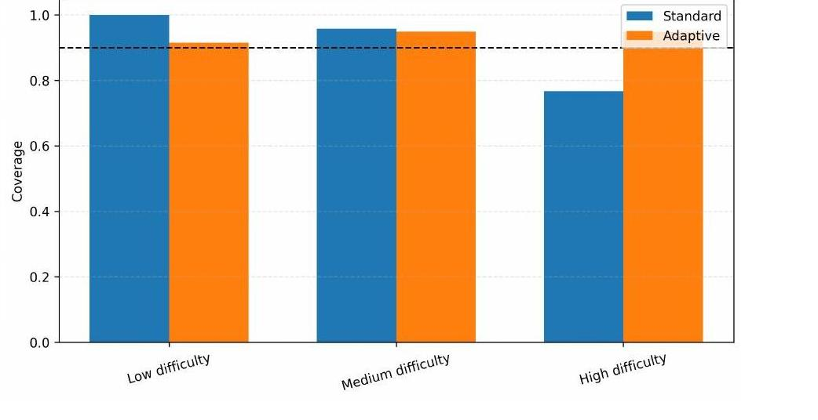
MAIN RESULT
Coverage by Difficulty Tertile
Tertile | Standard | Adaptive | Adapt. Width
Low difficulty | 100.0% | 91.5% | 1.48 °C
Medium difficulty | 95.7% | 94.9% | 3.89 °C
High difficulty | 76.7% | 94.8% | 8.46 °C
Standard over-covers the easy tertile (100%) and badly fails the hard tertile — 76.7%, a 13-point miss below target
Adaptive stays within 91–95% across all three — right where reliability matters most
Not from inflating width overall — it's reallocated: 1.48°C on easy locations, 8.46°C on hard ones
Coverage by difficulty group vs 90% target (dashed line)
Adaptive Geodesic Conformal Prediction — Results Walkthrough
9
Notes:
This is the main result. I divided the test locations into three groups according to estimated difficulty: low, medium, and high. For standard conformal, coverage is 100% in the easy group, 95.7% in the middle, but only 76.7% in the hardest group. So the overall 90% coverage hides a clear problem: the method over-covers easy locations but under-covers the difficult ones. The adaptive method changes this substantially. Coverage is 91.5%, 94.9%, and 94.8% across the three groups.
So coverage is much more balanced and stays close to the 90% target. And importantly, this isn't achieved by simply making every interval wider. The adaptive widths increase from 1.48°C in easy locations to 8.46°C in difficult ones. So the key idea is reallocation, not inflation: smaller intervals where prediction is easy, and larger intervals where prediction is difficult. That's the main improvement I'm trying to achieve.

Slide 10
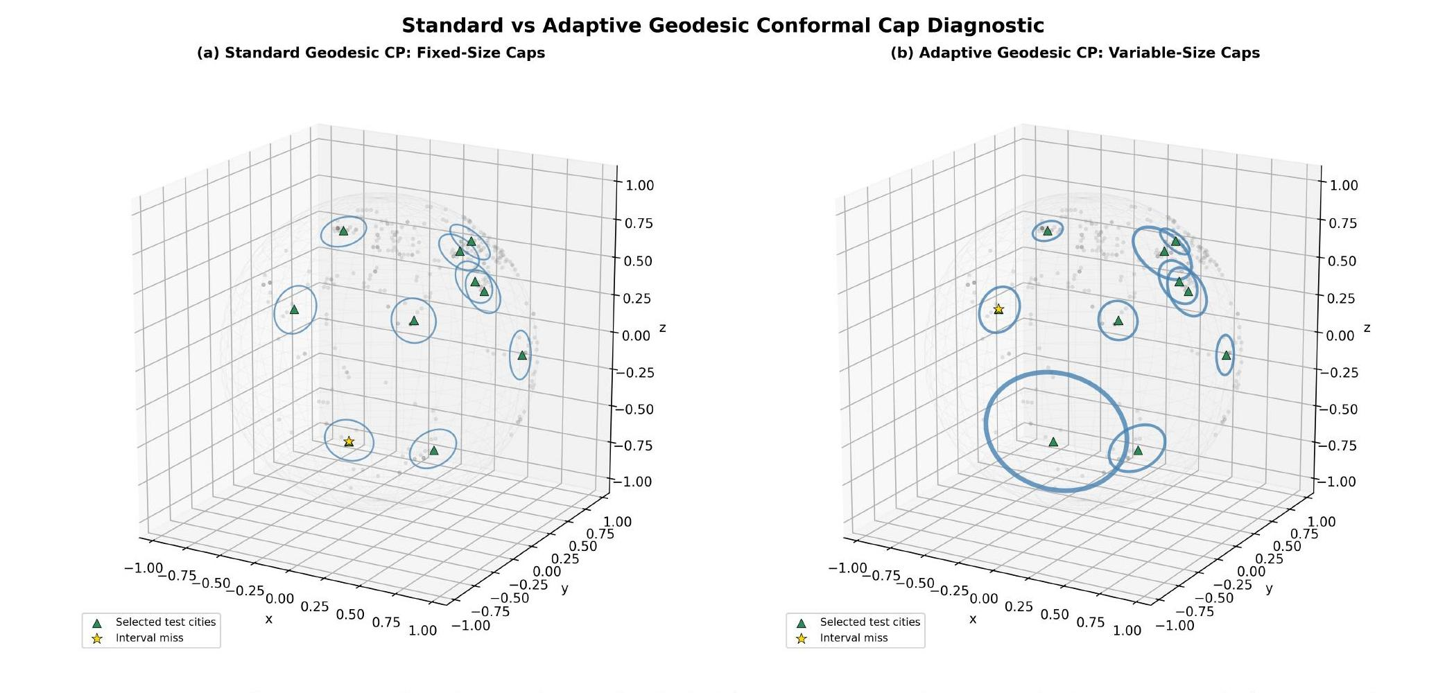
GEOMETRIC INTUITION
Same Result, Seen on the Sphere
Left: standard method — every cap the same fixed size
Right: adaptive method — caps grow in high-difficulty areas, shrink in easy ones
Gold stars = coverage misses — adaptive doesn't eliminate misses, it reallocates where the risk sits
Adaptive Geodesic Conformal Prediction — Results Walkthrough
10
Notes:
This is the same result shown geometrically. Standard conformal uses a fixed-size cap everywhere, whereas the adaptive method changes the cap size according to local difficulty. The green triangles show the selected test cities, and the stars show coverage misses. For example, on the right, the standard cap misses the true value, while the larger adaptive cap covers it. The important point is that the adaptive method doesn't eliminate misses; it reallocates uncertainty to better match local difficulty.

Slide 11
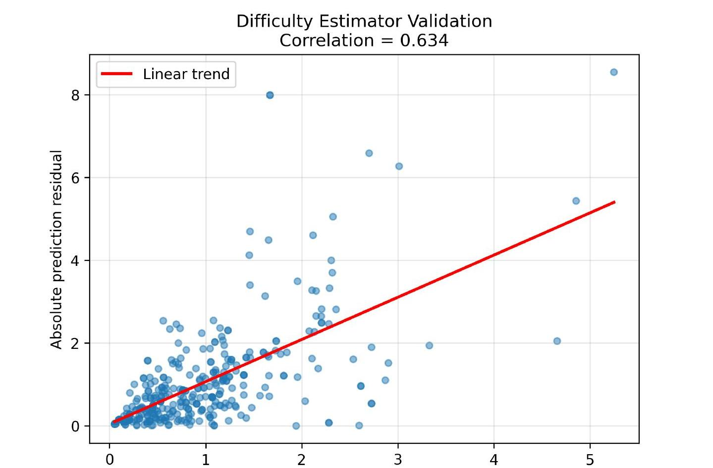
VALIDATION
Is σ̂(x) Actually Meaningful?
Pearson correlation between σ̂(x) and true absolute residual:
r = 0.634
Higher than the source paper's real-world case study (r = 0.516)
Two plausible explanations — not mutually exclusive:
Easier setting: exact coordinates, scalar response
Temperature is more spatially autocorrelated than geomagnetic anomalies
Can't fully separate these two with the current data — flagged directly in the Discussion
Adaptive Geodesic Conformal Prediction — Results Walkthrough
11
Notes:
This raises an important question: is sigma-hat(x) actually informative? I compared the estimated difficulty with the true absolute prediction error. The Pearson correlation is r=0.634. This is higher than the r=0.516 reported in the source paper's geomagnetic case study. There are a couple of possible explanations, including the simpler scalar setting or stronger spatial autocorrelation in temperature. I can't separate these explanations with the current data, so I treat them as possible explanations rather than conclusions.

Slide 12
STRESS TEST
Six Difficulty Bins Instead of Three on Adaptive Method
Bin | n | Mean σ̂ | Coverage
1 (easiest) | 59 | 0.185 | 94.9%
2 | 59 | 0.435 | 88.1%
3 | 59 | 0.663 | 89.8%
4 | 58 | 0.969 | 100.0%
5 | 57 | 1.256 | 96.5%
6 (hardest) | 59 | 2.267 | 93.2%
Coverage ranges from 88.1% to 100% across six bins
Worst bin: 88.1% (only 1.9% points below the 90% target)
Compare to the standard method's worst tertile: 76.7%
Pattern holds at finer resolution — not an artefact of picking three groups
σ̂ = estimated local difficulty (defined earlier) — higher means the model expects a harder prediction
Adaptive Geodesic Conformal Prediction — Results Walkthrough
12
Notes:
I also repeated the analysis using six difficulty bins instead of three on adaptive method. Coverage ranges from 88.1% to 100%, with the worst bin only 1.9 percentage points below the target. That's a big contrast with the standard method, whose worst group dropped all the way to 76.7%. So the same pattern holds at finer resolution, not just an artefact of the grouping

Slide 13
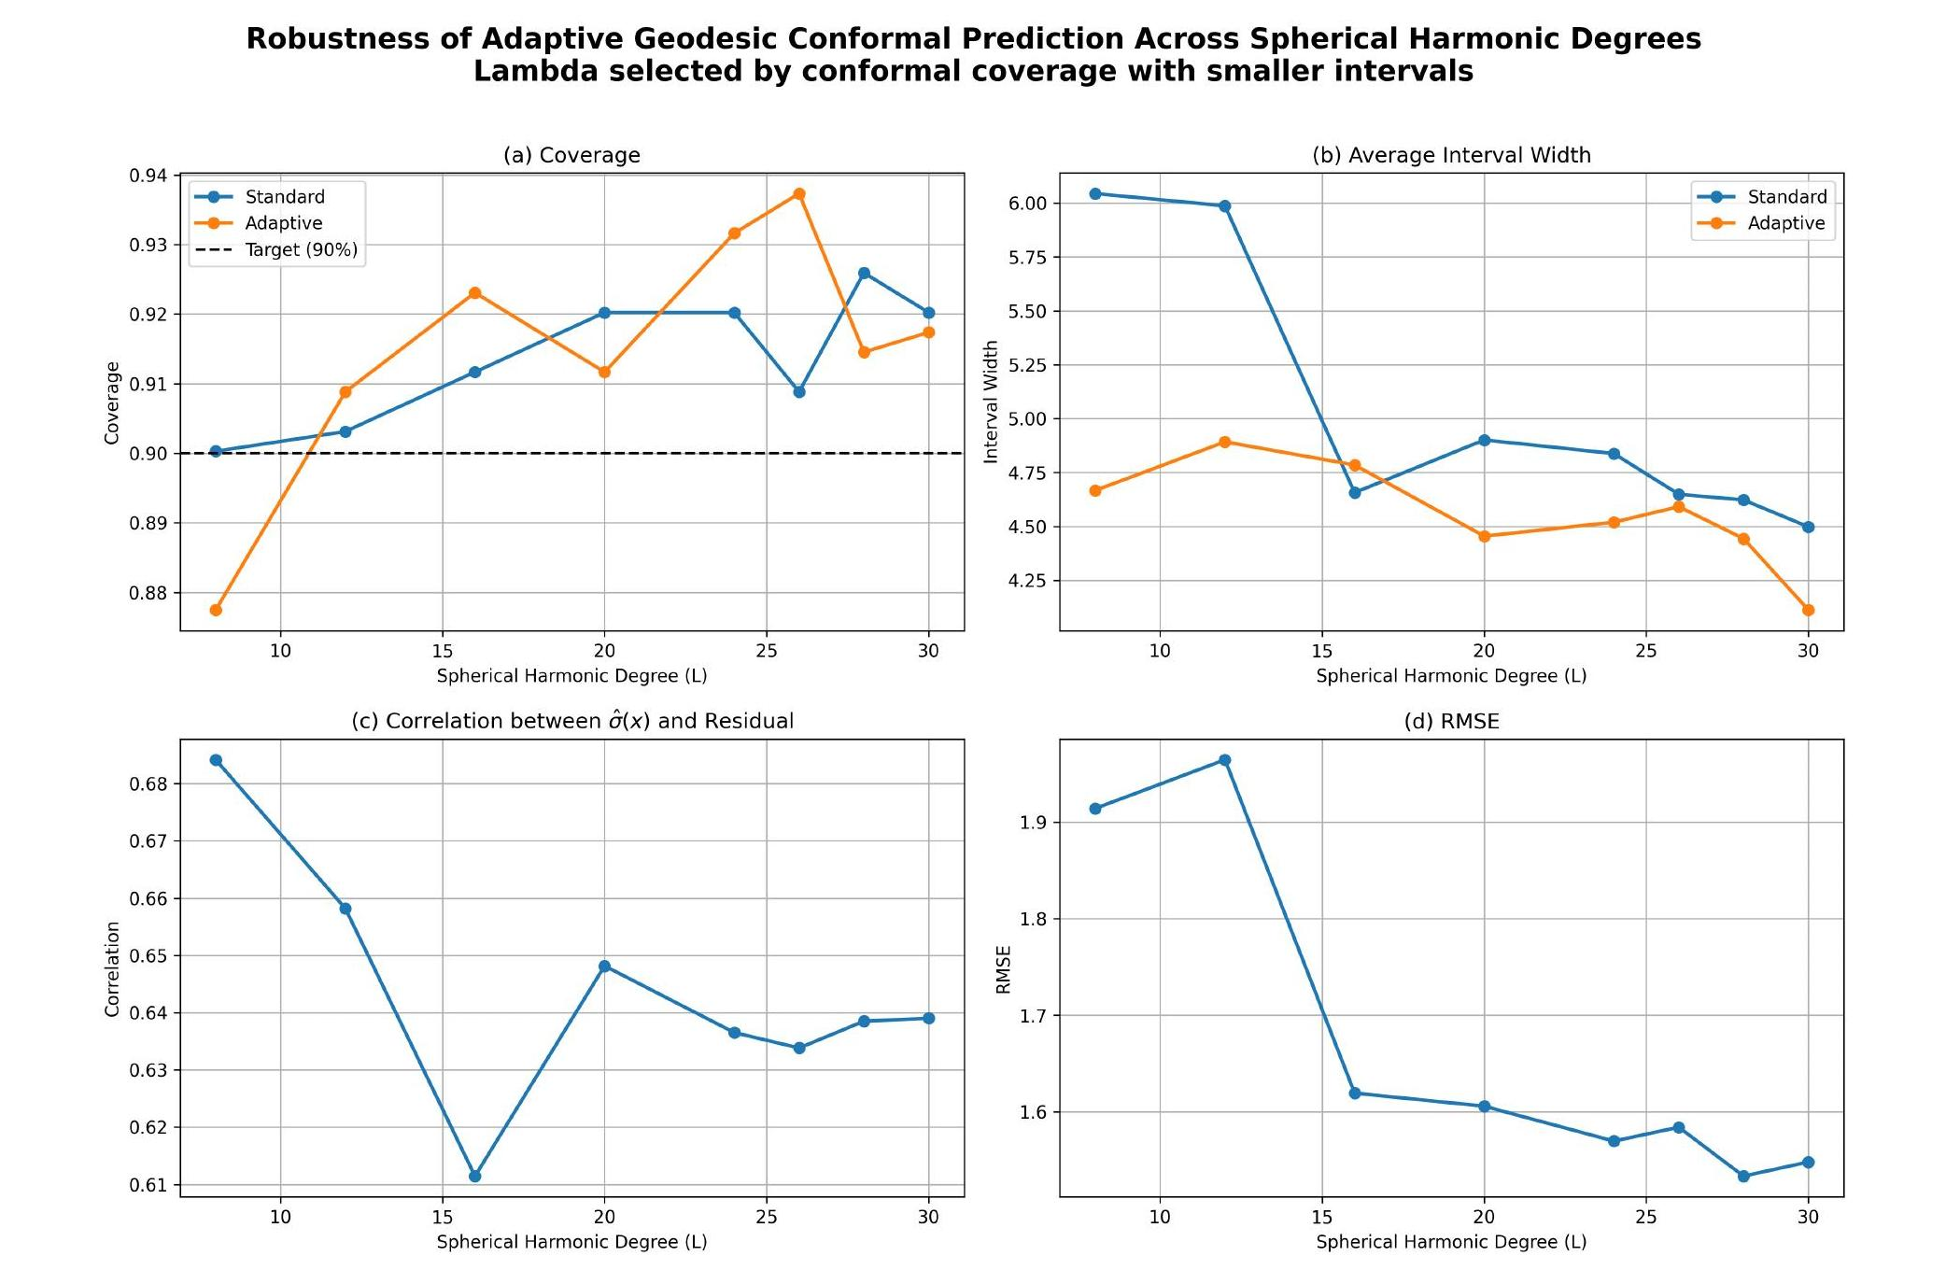
ROBUSTNESS CHECK
Does This Hold Across Model Complexity?
Repeated the full pipeline at L = 8 through L = 30
Adaptive coverage stays close to 90% across all degrees
Correlation r stays in a tight band — 0.61 to 0.68
Two different λ-selection criteria give consistent results
Not a fluke of choosing L=26 specifically
Adaptive Geodesic Conformal Prediction — Results Walkthrough
13
Notes:
I then checked whether the result depends on the chosen model complexity. I repeated the pipeline from L=8 to L=30. Adaptive coverage remains close to 90%, and the correlation between estimated difficulty and actual error stays between about 0.61 and 0.68. So the main finding is not specific to L=26; it persists across a broad range of model complexity.

Slide 14
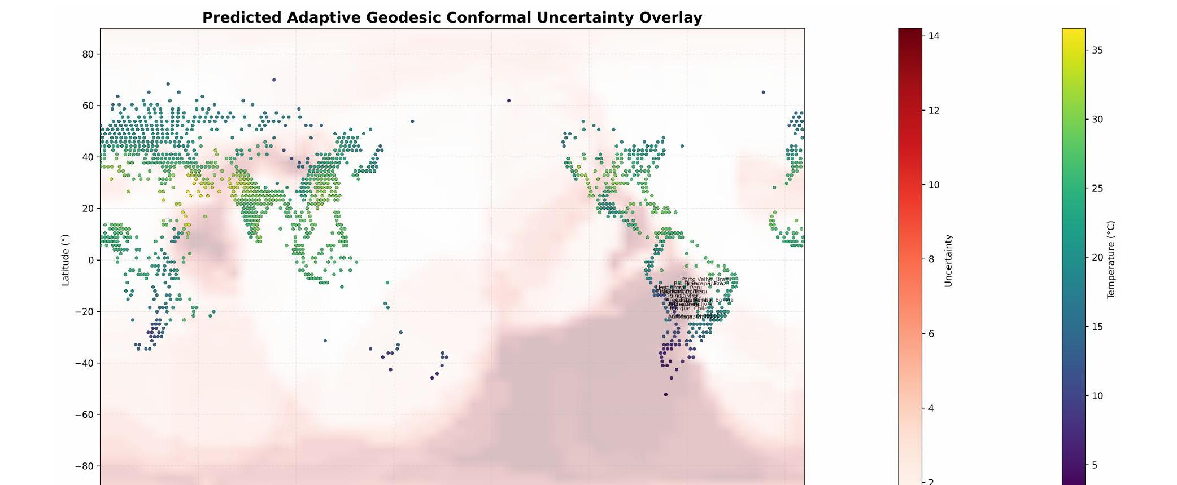
GEOGRAPHIC INTERPRETATION
Where Is Uncertainty Concentrated?
17 of the 20 highest-uncertainty cities are in the high-altitude Andes (Bolivia, Peru, N. Chile)
These cities typically have only 2–5 neighbours within 250 km — much sparser than Europe or E. China
Plausible story: sparse observations + high-elevation climate variability the model struggles to capture — but correlation, not proven causation
Adaptive Geodesic Conformal Prediction — Results Walkthrough
14
Notes:
Finally, I looked at where the highest estimated uncertainty occurs geographically. 17 of the 20 highest-uncertainty cities are in the high-altitude Andes, mainly Bolivia, Peru, and northern Chile. These locations typically have only two to five neighbours within 250 kilometres, much sparser than regions such as Europe and eastern China. So sparse observations and the difficulty of modelling high-altitude temperature provide a plausible explanation for the pattern. But this is an association, not proof of causation.

Slide 15
WHAT THIS MEANS
Three takeaways
1
2
3
Standard conformal fails where it matters
σ̂(x) is informative
The result remains robust
Badly under-covers hard regions (76.7%). Adaptive fixes this by reallocating width, not inflating it.
r = 0.634, and the pattern is geographically interpretable — concentrated in the high Andes.
Holds across spherical harmonic degrees L = 8 to L = 30, with two different selection criteria.
a spatially adaptive uncertainty layer that gives more balanced uncertainty estimates across the temperature field.
Notes:
So, to conclude, there are three main points. First, standard conformal achieves good marginal coverage, but hides substantial under-coverage in difficult regions. The adaptive method improves this by reallocating interval width according to local difficulty, without increasing the overall average width. Second, the difficulty estimate is informative, and Third, the result remains robust across different model complexities. So the main contribution is a spatially adaptive uncertainty layer that gives more balanced uncertainty estimates across the temperature field.
Thank you.

Slide 16
Thank You !
THE END……
Move on to Q & A session……
Sze Ying Choong · MSc Data Science
Notes:
That is the end of my presentation, Thankyou!

Slide 17
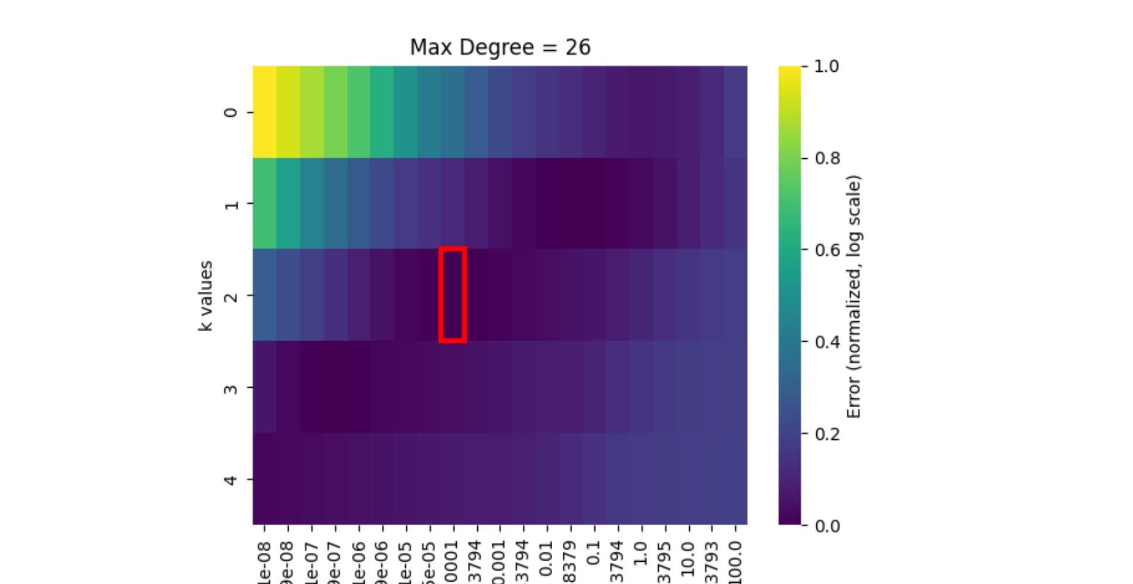
SETUP
Hyperparameter Selection
5-fold cross-validated grid search over λ and Sobolev order k, at fixed degree L = 26
Minimum error at λ = 10⁻⁴, k = 2
Low-error region is broad and shallow — not a fragile choice
This configuration is used throughout every result that follows
Adaptive Geodesic Conformal Prediction — Results Walkthrough
Notes:
[Backup slide — only bring this up if asked what model or parameters were used.]
Model parameters were selected using a 5-fold cross-validated grid search over the regularisation parameter, lambda, and the Sobolev order, k, with the spherical harmonic degree fixed at 26. The best-performing configuration was lambda equal to 10 power of -4 , and k equals 2, so this is the configuration used throughout. One useful point here is that the low-error region is fairly broad, rather than a very sharp minimum, so the result doesn't depend critically on this one particular choice.

Slide 18
PIPELINE OVERVIEW
BACKUP — ONLY IF ASKED
From Raw Observations to Adaptive Intervals
Berkeley Earth Temperature Data
3,510 cities, July 2003
Standard CP | Adaptive CP
One global threshold, q̂ | Local difficulty, σ̂(x)
Same interval width everywhere | Variable interval width
No spatial adaptation | Geodesic spatial adaptation
Preprocessing & Data Splitting
Train / Validation / Calibration / Test
Spherical Harmonic Regression
Reconstruct the temperature field
5-Fold Cross-Validation
Generate out-of-fold residuals
Geodesic k-NN Difficulty Estimation
σ̂(x), k = 20
Adaptive Conformal Calibration
Normalise calibration residuals by σ̂(x)
Adaptive Prediction Intervals
Wider where difficulty is high, narrower where low
Adaptive Geodesic Conformal Prediction — Results Walkthrough
Notes:
[Backup slide — only walk through this if asked how the method works end-to-end, or to explain the full pipeline step by step.]
So, how does the proposed method actually work?
I start with the Berkeley Earth temperature observations, which are preprocessed and divided into training, validation, calibration and test sets. I first fit a spherical harmonic regression model to reconstruct the temperature field. The key difference comes next. To estimate how difficult different locations are to predict, I perform five-fold cross-validation on the training data and obtain out-of-fold residuals. I then use these residuals with a geodesic K-nearest-neighbour estimator. Using the 20 nearest neighbours on the sphere, I estimate a local difficulty value, $\hat{σ}\left(x\right)$, for each location. This difficulty estimate is then incorporated into the conformal calibration. Instead of treating all calibration residuals equally, I normalise them according to the estimated local difficulty. Finally, the resulting conformal threshold is multiplied by the local difficulty estimate to produce the prediction interval. So the key idea is that the interval width is no longer fixed across the globe. Difficult regions receive wider intervals, while easier regions receive narrower intervals. For comparison, standard conformal prediction uses a single global calibration threshold, so it produces intervals with essentially the same width everywhere.

Slide 19
DISCUSSION
BACKUP — ONLY IF ASKED
What the Results Mean — and What They Don't
Standard conformal's failure isn't just a number — it maps onto a real spatial pattern, concentrated in sparse, high-difficulty regions like the Andes.
The adaptive method's advantage doesn't come from wider intervals overall — it specifically reallocates width to where it's needed, which is why the average width barely changes.
Conformal prediction was chosen over a Gaussian Process because it needs no covariance/kernel assumption — the coverage guarantee holds even if the base spherical harmonic model isn't perfectly specified.
Uncertainty maps only reflect the observed data regime — calibration doesn't extend to genuinely unobserved regions, like the open ocean, where there's no nearby data to calibrate against.
Adaptive Geodesic Conformal Prediction — Results Walkthrough
Notes:
[Backup slide — only cover this if asked to discuss what the results mean more broadly.]
A few points from the discussion chapter.
Standard conformal's failure isn't just a number — it maps onto a real spatial pattern, concentrated in sparse, high-difficulty regions like the Andes.
The adaptive method's advantage isn't from making every interval wider — it's specifically reallocating width to where it's needed, which is why the average width stays about the same.
I chose conformal prediction over a Gaussian Process because it doesn't require specifying a covariance kernel — the coverage guarantee holds even if the base spherical harmonic model isn't perfectly specified.
And it's worth being clear that these uncertainty maps only reflect the observed data regime — calibration doesn't extend to genuinely unobserved regions, like the open ocean, where there's no nearby data to calibrate against.

Slide 20
LIMITATIONS
BACKUP — ONLY IF ASKED
Where This Analysis Has Known Gaps
The underlying Berkeley Earth data is a processed, spatially-interpolated estimate, not a raw station measurement — residuals reflect fit to that processed field, not to physical truth.
σ̂(x) is estimated from only 2,106 training points using ordinary random 5-fold CV, not spatially-blocked folds — some risk of optimistic bias from spatial autocorrelation between train and validation points.
The neighbourhood size, k = 20, was inherited directly from the source paper rather than independently tuned on this dataset.
The coverage guarantee follows standard Euclidean split-conformal theory — this is a structural adaptation of the geometric idea, not a re-proof of the original manifold-response guarantee.
All results come from a single fixed calibration/test split (n = 351) — no repeated-trial variance estimates, so numbers carry unquantified sampling uncertainty.
Adaptive Geodesic Conformal Prediction — Results Walkthrough
Notes:
[Backup slide — only cover this if asked about limitations.]
A few limitations worth naming directly.
The underlying Berkeley Earth data is a processed, spatially-interpolated estimate, not a raw station measurement, so residuals reflect fit to that processed field, not to physical truth.
σ̂(x) is estimated from only 2,106 training points using ordinary random 5-fold cross-validation, not spatially-blocked folds, so there's some risk of optimistic bias from spatial autocorrelation between train and validation points.
The neighbourhood size, k=20, was inherited directly from the source paper rather than independently tuned on this dataset.
The coverage guarantee here follows standard Euclidean split-conformal theory — this is a structural adaptation of the geometric idea, not a re-proof of the original manifold-response guarantee.
And all these results come from a single fixed calibration and test split (n = 351) , so I don't have repeated-trial variance estimates — the numbers should be read with that sampling uncertainty in mind.

