Slide 1
Bellabeat Marketing Analysis Case Study
Using Smart Device Data to Drive Strategic Insights
Presented by: Shelby Zhang
Last Updated: November 04, 2024

Slide 2
Table of Contents
Bellabeat Marketing Analysis Case Studu
Business Task
Process
Insights
Conclusions
Recommendations

Slide 3
Business Task
To analyze data from non-Bellabeat smart devices, uncovering usage patterns and providing actionable insights to enhance Bellabeat’s marketing strategy.

Slide 4
Process
1
Ask
2
Prepare
3
Process
4
Analyze
5
Share
6
Act

Slide 5
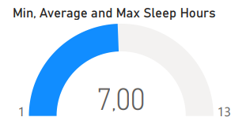
Insights - Sleep
Average Sleep Duration: 7 hours (Recommended: 7–9 hours).
Correlations:
Positive: Total minutes asleep ↔ Total time in bed.
Negative: Sedentary time ↔ Sleep duration.

Slide 6
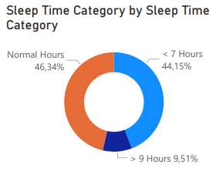
Insights - Sleep
Sleep Patterns:
44% of users sleep less than recommended.

Slide 7
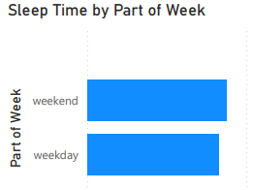
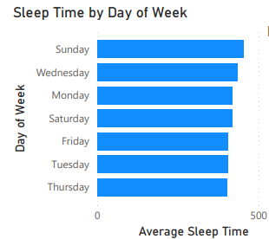
Insights - Sleep
Sleep Patterns:
Users sleep more on weekends (highest on Sunday, Wednesday, and Monday).

Slide 8
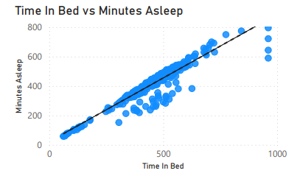
Insights - Sleep
Correlations:
Positive: Total minutes asleep ↔ Total time in bed.
Negative: Sedentary time ↔ Sleep duration.

Slide 9
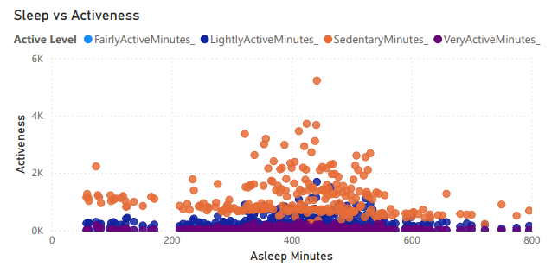
Insights - Sleep
Correlations:
Negative: Sedentary time ↔ Sleep duration.

Slide 10
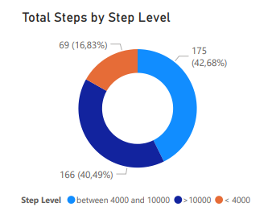
Insights - Daily Activity
Step Counts:
16.83% of users take fewer than 4,000 steps daily.
40.49% meet the recommended 10,000+ steps.

Slide 11
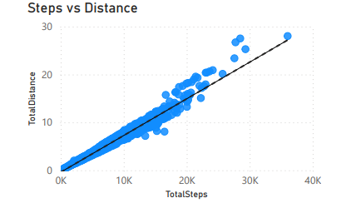
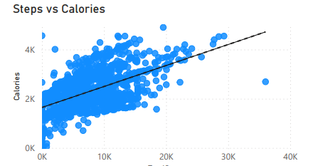
Insights - Daily Activity
Correlations:
Steps ↔ Calories Burned.
Steps ↔ Distance.

Slide 12
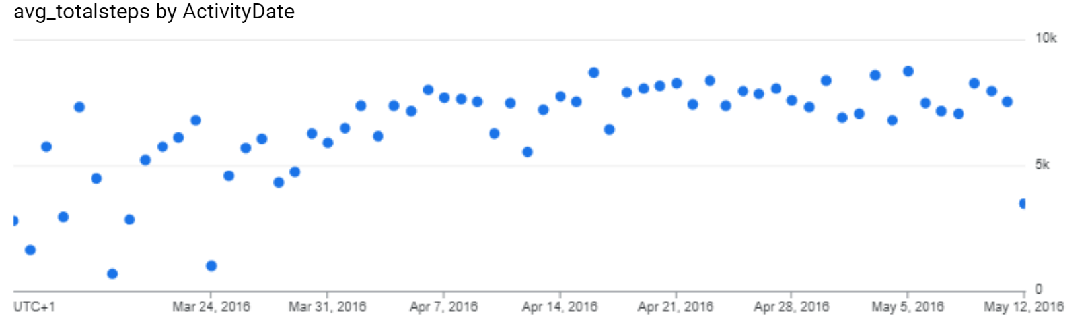
Insights - Daily Activity
Trends:
Activity increases mid- and end-month but drops on weekends.
The overall steps increase from March to May.

Slide 13
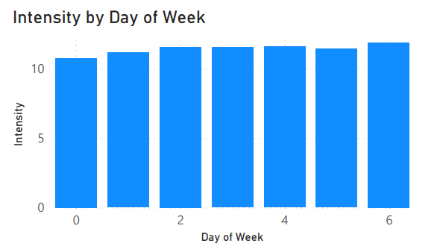
Insights - Daily Activity
Activity Patterns:
Most active on Saturdays; least on Sundays.

Slide 14
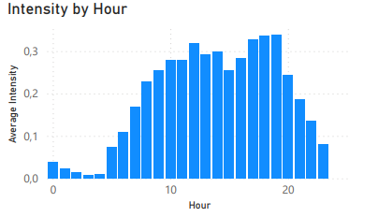
Insights - Daily Activity
Activity Patterns:
Peak activity hours: 12–2 PM and 5–7 PM.

Slide 15
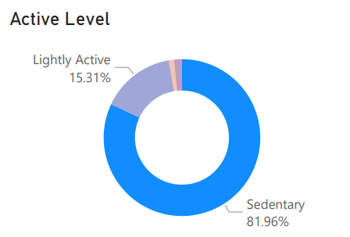
Insights - Daily Activity
Activity Patterns:
81.96% of time spent sedentary; 1.63% in very active movement.

Slide 16
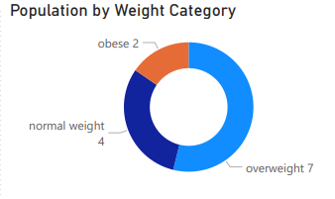
Insights - Weight
Weight Distribution:
2 users obese; 7 overweight.
69% have weight concerns.

Slide 17
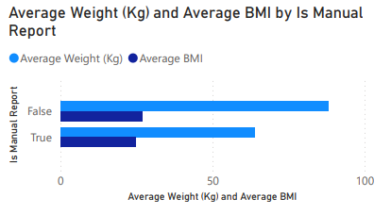
Insights - Weight
Segment Differences:
Manually reported weight: Avg. 64 kg (BMI: 24.56).
Automatically recorded weight: Avg. 88 kg (BMI: 26.79).

Slide 18
Conclusions
Sleep duration and quality are suboptimal for 44% of users.
Sedentary lifestyle prevalent, with limited active time.
Step count correlates strongly with calorie burn and distance.
Weight concerns are significant, requiring tailored approaches.

Slide 19
Recommendations
Personalized Sleep Coaching:
Use app notifications to suggest healthier bedtime routines.
Activity Challenges:
Launch monthly challenges, e.g., “March into Motion.”
Gamify step tracking with rewards for consistency.
Weight Management Support:
Promote automated tracking for convenience.
Encourage manual data entry for personalized insights.
Peak Active Hours Campaigns:
Push activity reminders during 12–2 PM and 5–7 PM.

Slide 20
Thank you!
Any questions?

