Slide 2

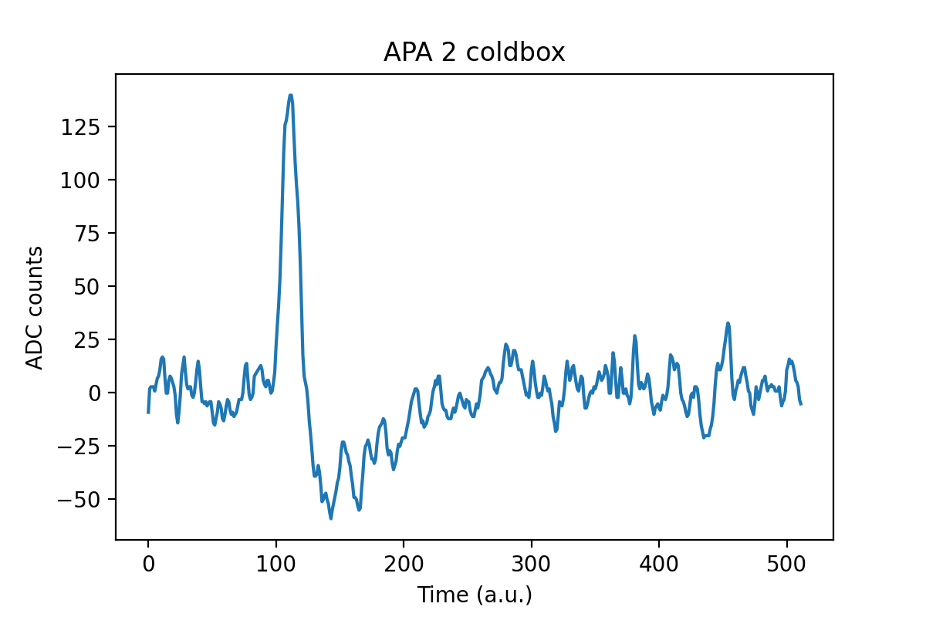
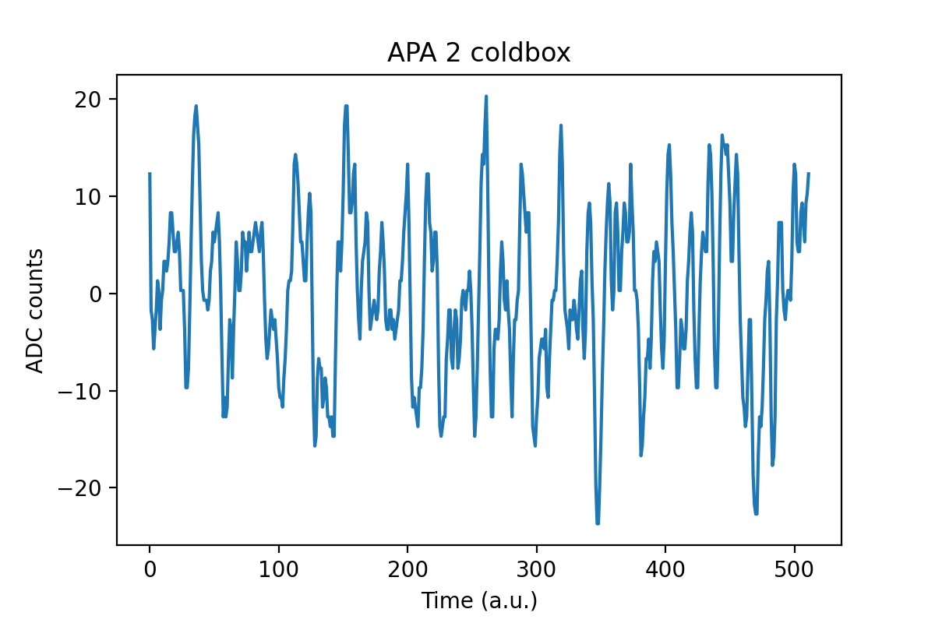
APA Coldbox test PDS data analysis
~5000 waveforms recorded with the PD modules of APA in coldbox
Charge inside each waveform is estimated for SNR calculation
signal
noise

Slide 3
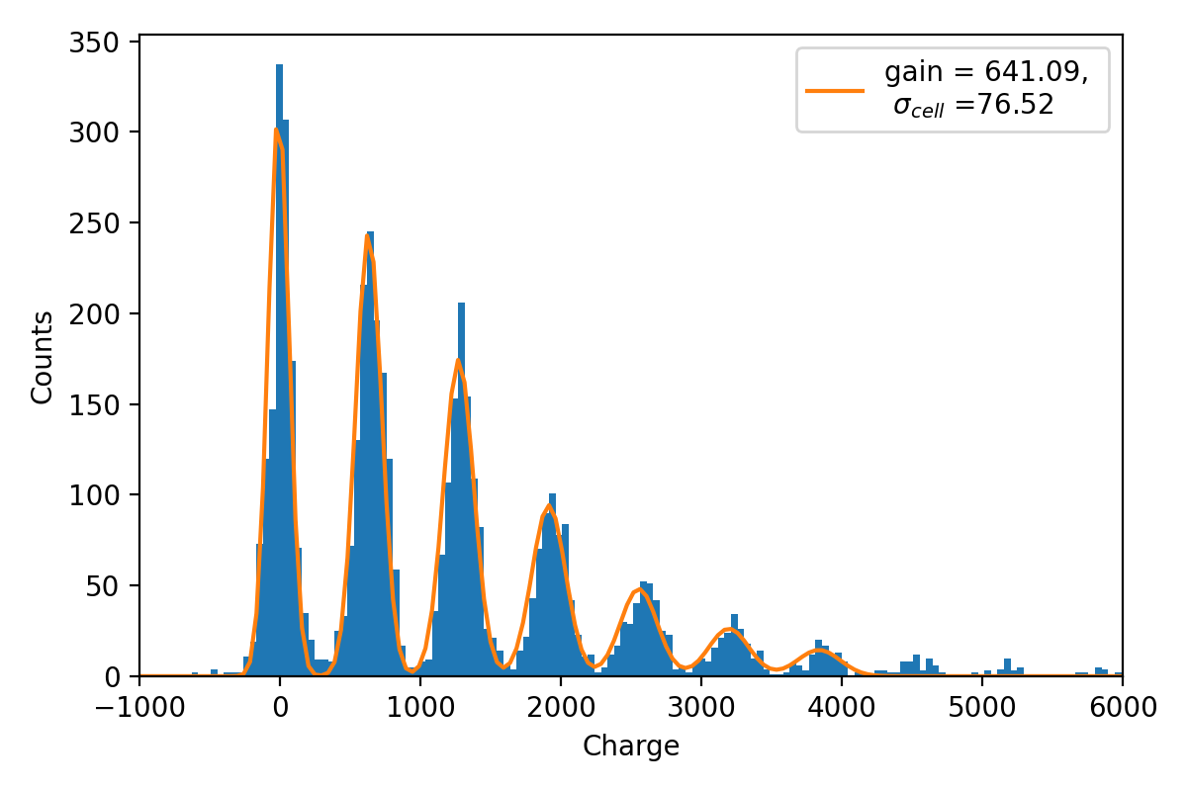
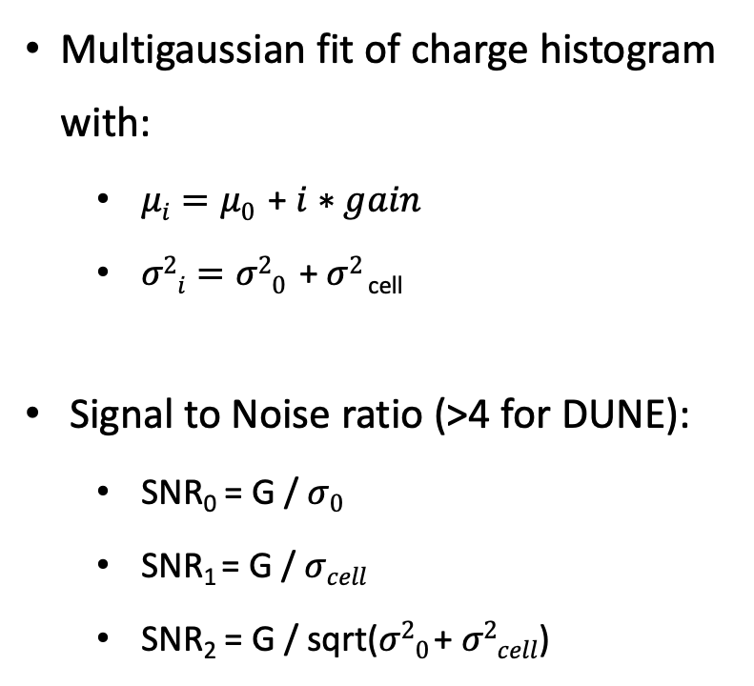
APA Coldbox test PDS data analysis
Multigaussian fit of charge histogram with:
$μi=μ0$ + $i∗gain$
$σ2i=σ20$ + $σ2$_{cell}
Signal to Noise ratio (>4 for DUNE):
SNR₀ = G / $σ0$
SNR₁ = G / $σcell$
SNR₂ = G / sqrt($σ20 \text{+} σ2cell$)

