Slide 1
How to Use FindMe! on IE8
Shaopeng Zhang

Slide 2
Press F12
With IE 8 started, press F12 on keyboard.
Follow the following instructions.

Slide 3
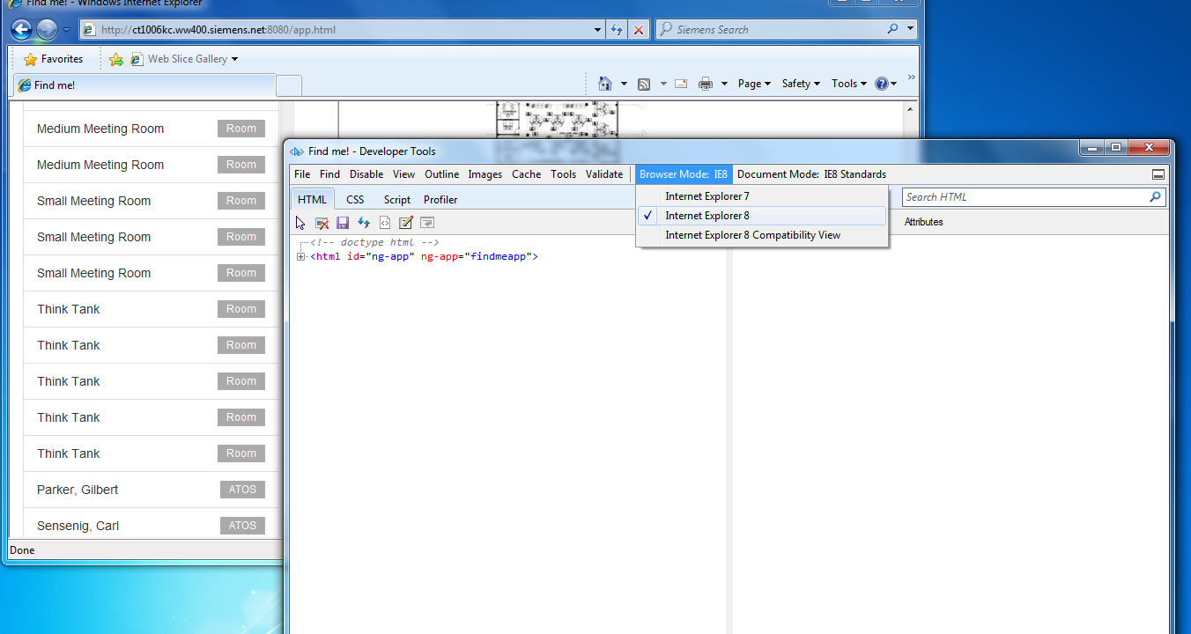
Make sure Browser Mode is set to “Internet Explorer 8”

Slide 4
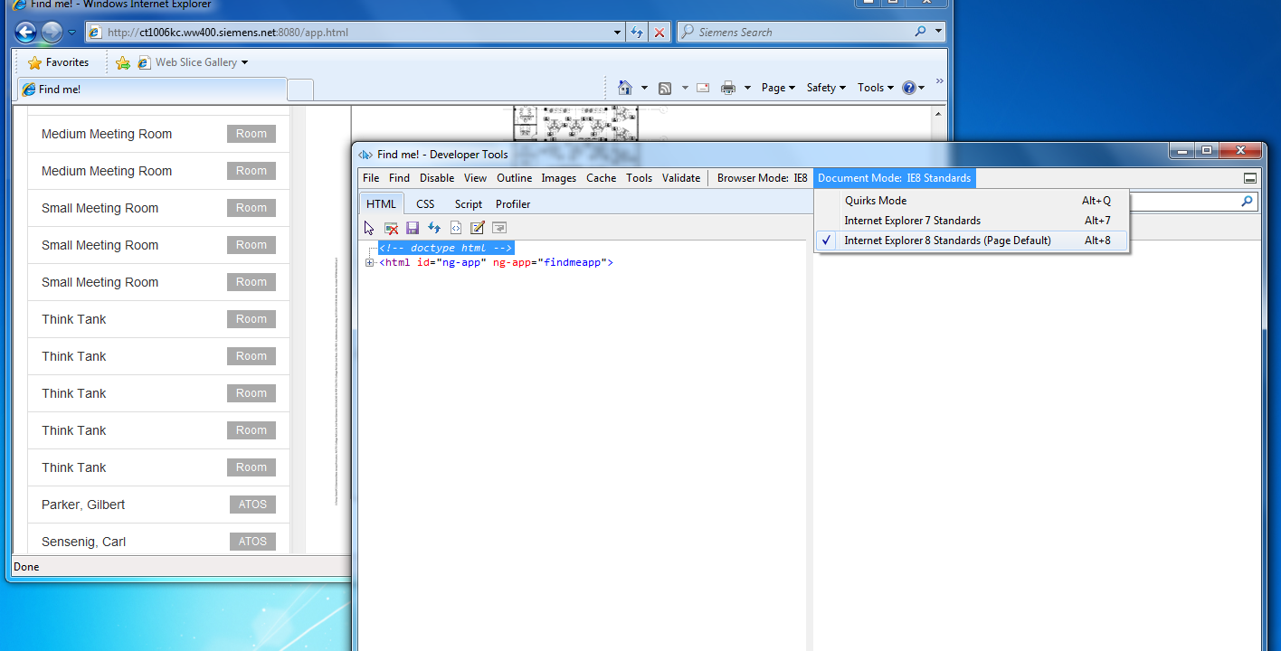
Make sure Document Mode is set to “Internet Explorer 8 Standards”

