Slide 1

Tap
Social Web Final Project
Shaopeng Zhang

Slide 2
Problem
Multiple information system
Low user engagement
Little interaction

Slide 3
Solution
Multiple information system
Use homogeneous information systems
Large user base
Easy to access/post
Easy to extract information to portal

Slide 4
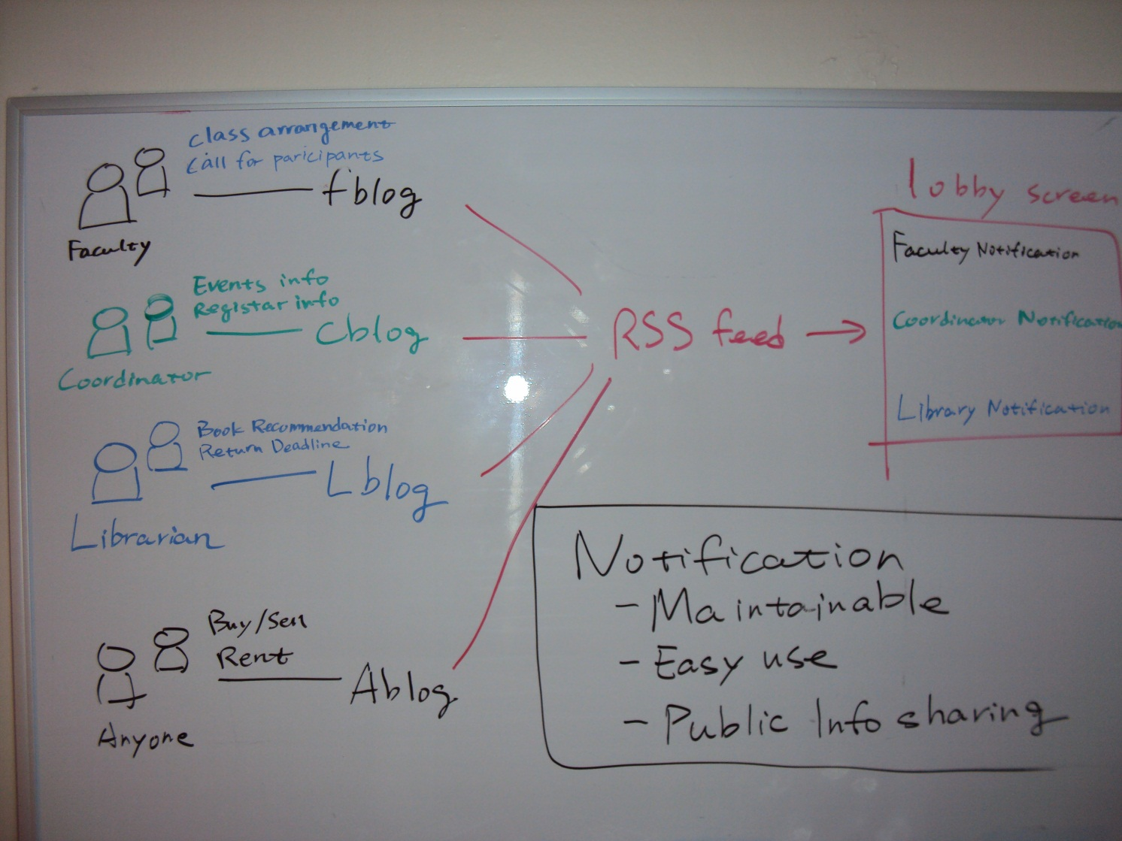
Use blogs for information posting

Slide 5
Solution
Low user engagement
Rich information source
Effectively delivered to user

Slide 6
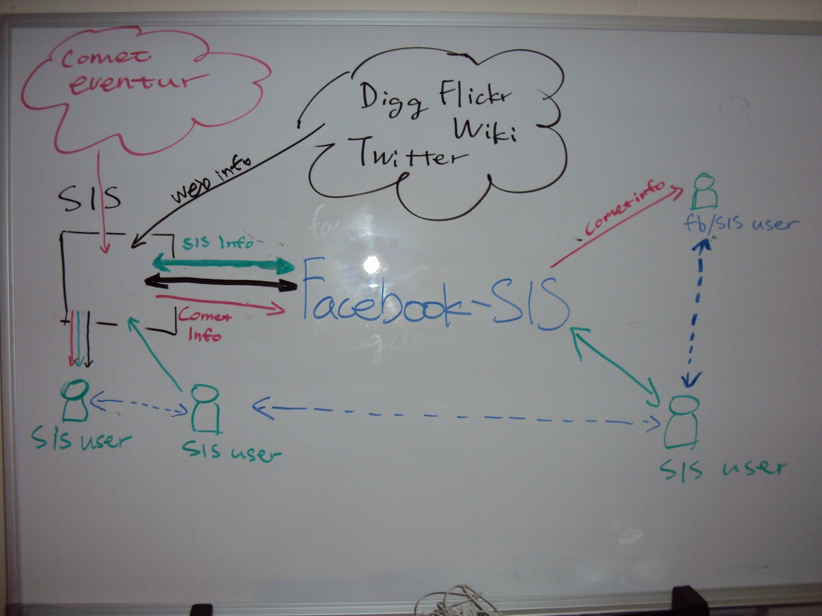
Integrating social media

Slide 7
Solution
Little interaction
Use prevalent social network tools
Large user base
Real-time interaction
Effectively solves problem

Slide 8
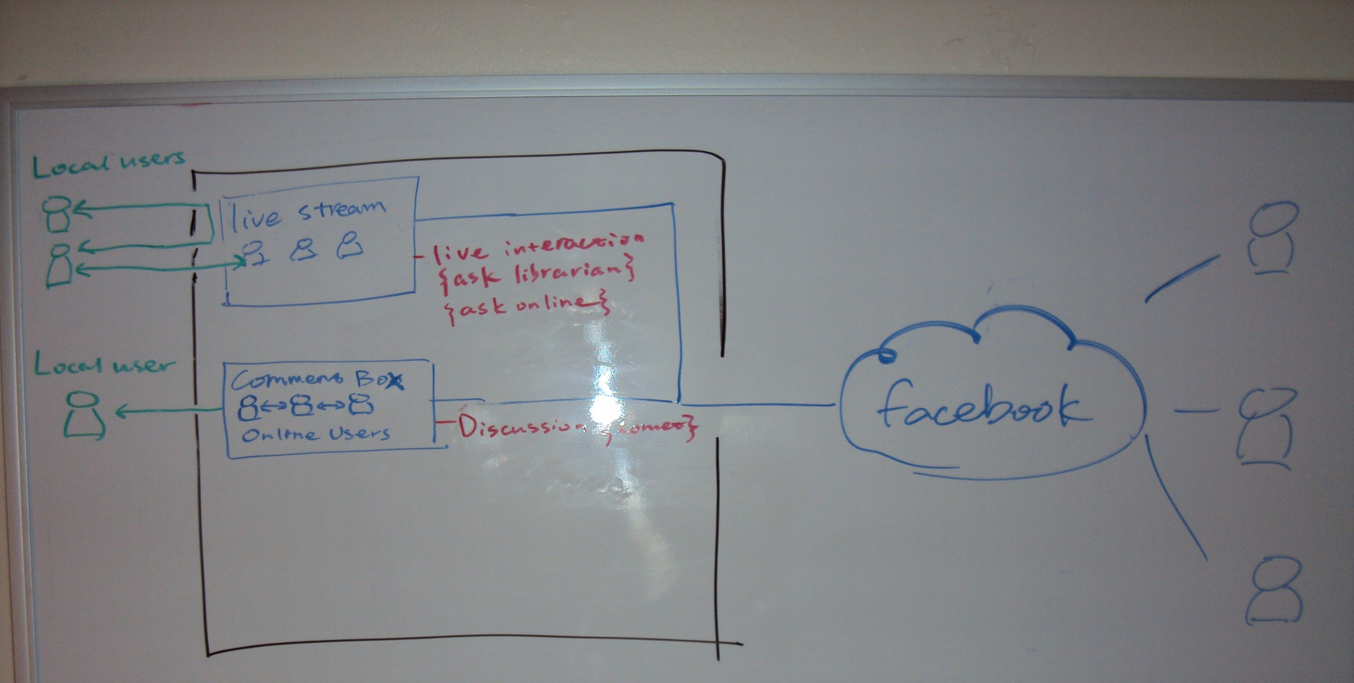
Use Facebook live stream box

Slide 9




Senario:
Talking about a research talk
Asking questions
Hey guys, is there anyone going to Tufte’s talk tomorrow?
Hey anyone at the library?
Sí
Hi this is John.
I don’t know…What does he do?
Hi John, I used E-Z borrow and got a book. Can I renew it?
He’s a famous researcher on data presentation, and also an sculptor.
Yes you can renew it for another month.
Interesting…I’ll see if I can make it.
Great. Thanks.

Slide 10
Overview
An online system supporting local community
Integrating useful information
Promote interaction among faculty, students and staffs
Support real-time communication

Slide 11
Features
Light-weight
Highly Maintainable
Ajaxified
Optimized for touchscreen

Slide 12
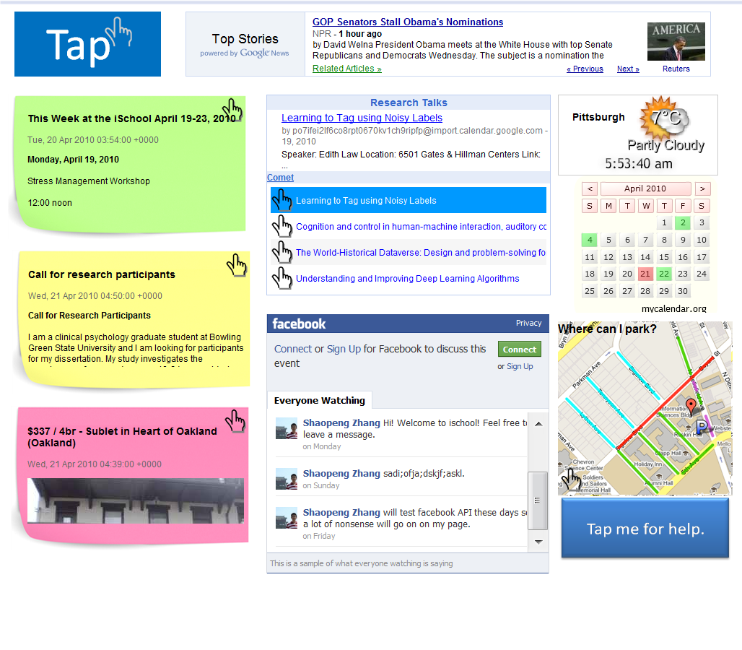
Components
Tap
Bolgs
Office posts
Faculty posts
Students posts
Research talks – Comet
Facebook Live Stream Box
Daily news – time, weather, map
Help

Slide 13
Current issues
Little input available at touch screen
User’s need considered
Constrained by touchscreen device
Less than enough functionality of facebook tools

Slide 14
Future works
Take full advantage of facebook
Enable richer interaction on touchscreen
More effectively integrate and display information

