Slide 1
PopTen
--a new resolution to your everyday meal
Shuyu (Joshua) Zhou
Andrew Deng
Ke Duan

Slide 2
Project Goals
Implement a website that returns a top ten list of restaurants
Have this list reflect the input choices of the user
Have the location of the user reflected in the output

Slide 3
Adapting to Changes
Instagram -> Closed API, questionable legality of scraping = poor choice to base a project around
Twitter, Open API
Yelp, Open Dataset
Ease of access = less worries during coding

Slide 4
Why use the Yelp Dataset?
A major question at the start, “How to determine what posts are about restaurants?”
Our solution, find a list of restaurants to use as the basis
Bonus Factor: Yelp indexes restaurants by category, which we used to determine the cuisine of each restaurant

Slide 5
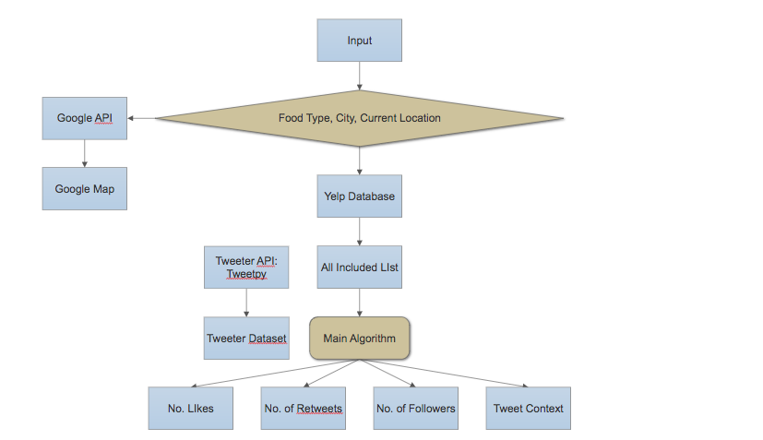
Implementation Flowchart

Slide 6
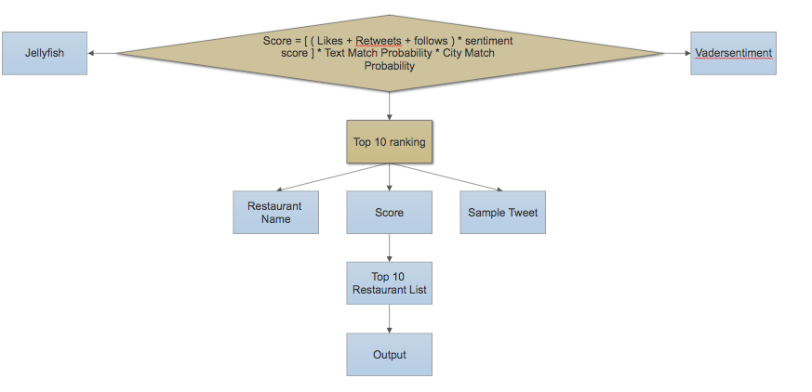
Implementation Flowchart Continued

Slide 7
A Demo

Slide 8
Encoding Challenges
Text derived from social media often uses unicode to display things like emojis
If your reader and writer use different encoding, you can receive errors that are hard to decode
Most file reading and writing commands will accept an encoding = encoding_type input
Example: pd.read_json(a_file, encoding = “uft-8”)

