Slide 1
Project Presentation
Shuyu (Joshua) Zhou, Andrew Deng, Ke Duan

Slide 2
What is our project?
Our goal of the project is to collect data from the social media (Instagram) to predict the trending restaurants within a specific location. We provide users a search engine that allows users to find what restaurants have been popular among people in order to help users make a better decision.

Slide 3
Why having this idea?
Advantages of using data from Instagram
Very large dataset
All about people’s daily life
Network effect

Slide 4
How to realize it?
Instagram
Google Map
Our project

Slide 5
Features to Cover
Instagram
Hashtags
Words & Emojis
Location tags
# of followers
Likes
Comments

Slide 6
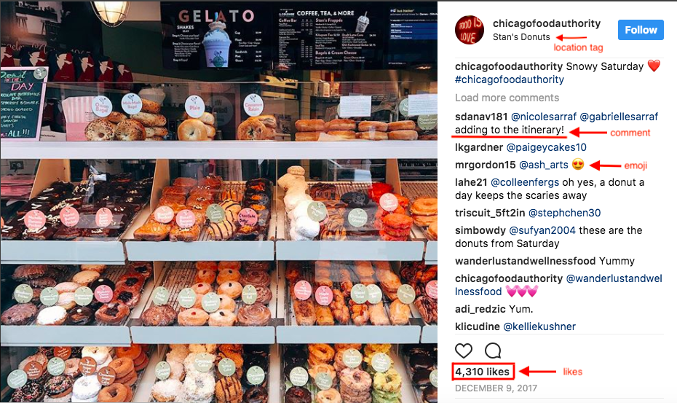
Example

Slide 7
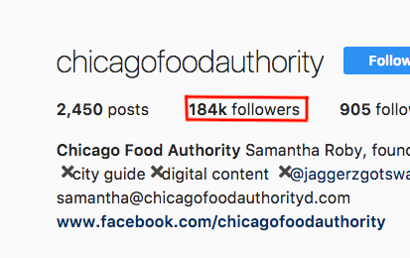
Example

Slide 8
Weighting & Ranking
We come up with a formula that calculates how influential each post is likely to be by giving each a weight.
We rank restaurants by summing up weights.

