Slide 1
PopTen
--a new resolution to your everyday meal
Shuyu (Joshua) Zhou
Andrew Deng
Ke Duan

Slide 2
Project Goals
Implement a website that returns a top ten list of restaurants
Have this list reflect the input choices of the user
Have the location of the user reflected in the output
Use social media information to derive our result

Slide 3
Adapting to Changes
Instagram -> Closed API, questionable legality of scraping = poor choice to base a project around
Twitter, Open API
Yelp, Open Dataset
Ease of access = less worries during coding
Google Maps API

Slide 4
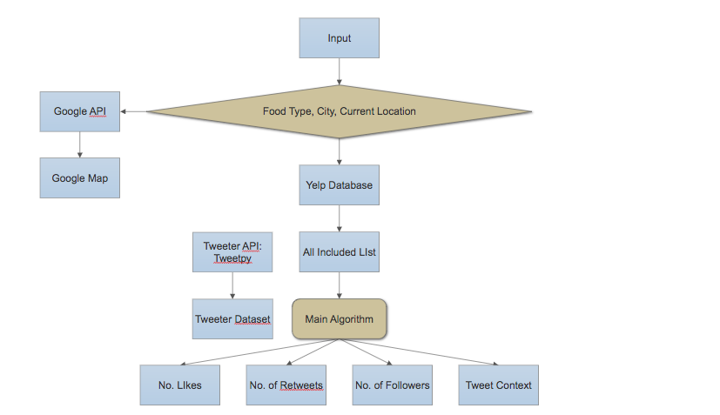
Implementation Flowchart
Notes:
This is the 1st part of diagram

Slide 5
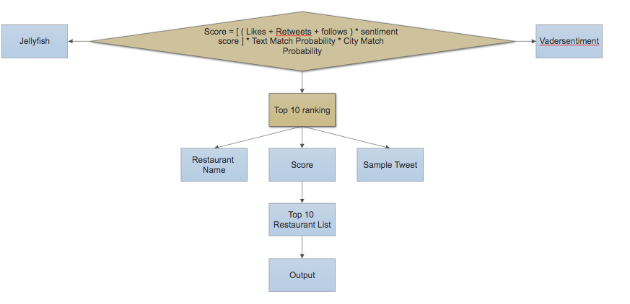
Implementation Flowchart Continued
Notes:
This is the 2nd part of diagram

Slide 6
A Demo

Slide 7
Why use the Yelp Dataset?
A major question at the start, “How to determine what posts are about restaurants?”
Our solution, find a list of restaurants to use as the basis
Bonus Factor: Yelp indexes restaurants by category, which we used to determine the cuisine of each restaurant
Constraint: Yelp dataset has limited restaurants. e.g. we don’t have information about restaurants in NYC, LA and Chicago. This limits our searching capability.

Slide 8
Encoding Challenges
Text derived from social media often uses unicode to display things like emojis
If your reader and writer use different encoding, you can receive errors that are hard to decode
Most file reading and writing commands will accept an encoding = encoding_type input
Example: pd.read_json(a_file, encoding = “uft-8”)

Slide 9
Challenges in algorithm
1. [Randomness of tweets]: twitter data is completely random. It’s not organized for the purpose of data analysis.
[Solns]:
1. Add more keywords when scraping and filtering twitter to have a filtered twitter dataset that’s more correlated with Yelp dataset.
i.e. add categorical attributes that happen 300 times or more in Yelp into keywords collection. This should be valid because there are about 55k restaurants in Yelp, then there is at least 1% chance that we expected to see a restaurant name associated with this particular attribute in a single tweet.

Slide 10
Cont. on Soln of Challenge 1
Also select relevant words such as ‘food’, ‘yummy’ into the collection.
2. Specify words as many as possible. Then use jaro-winkler to calculate the worth of a single tweet. (discussed in Step 4.3)

Slide 11
Cont.
2. [Randomness of restaurant names]: A restaurant’s name can be misleading or hidden. E.g. Woodlawn Tap is the formal name shown in Yelp, but people who often go there call it Jimmy’s.
[One Soln]:
Get as many forms of a name as possible. E.g. #name, @name. Give up those tweets that may have nicknames we have no information about.

Slide 12
Cont.
3. The shorter the name is or more common its word is used in daily life, the less accurate the result can be. E.g. ‘The Social’
[One Soln]:
give up those tweets that don’t have categorical attributes shown in Yelp or more general words like ‘food’, ‘restaurant’.

Slide 13
Cont.
4. (Related to 3) in order to have less bias, one method is to have a larger sample by increasing the twitter dataset. But the cost is it makes the searching process less efficient.
[One Soln]:
Write more efficient code. Decrease the use of ‘for’ loops as many as possible.

Slide 14
Interesting Aspects
Analyzing social media can be really time consuming
Data can have large variance
Humans tend not to write in a consistent, predictable manner
For accurate results, must think of a broad range of scenarios
Account for corner cases and niche scenarios

Slide 15
Main Algorithm
Step 1: input Yelp data that specify restaurants with a given food type. Input city name specified by the user.
Step 1.1: Further process Yelp data to keep only restaurants that are in the given city.
Step 2: Get possible forms of names for restaurant names and city name. (e.g. #Chicago).
Step 3: filter twitter data to obtain tweets that have a restaurant name, its associated categories in Yelp and possibly a city name. Differentiate tweet and retweet.
Check 3 things: restaurant name, associated categories in Yelp, the city name (if possible)

Slide 16
Cont.
Step 4: when filtering through each piece of tweet, we calculate a score for a feasible tweet.
Step 4.1: get information about # of likes, # of retweets, and # of followers.
Step 4.2: conduct sentimental analysis on tweet content. 0 if neutral; (0,1] if positive; [-1, 0) if negative.

Slide 17
Cont.
Step 4.3: Use jaro-winkler method to calculate the probability of each tweet that describes the level of match between the actual restaurant name in Yelp and the possible restaurant name found in tweet. The reason of doing this is that given a restaurant name form (#PINO), it could be the case that a tweet wrote as #PINOisadog. Average the probabilities of all possible forms.

Slide 18
Cont.
Step 4.4: repeat step 4.3 if a city name is spotted. Apply jaro-winkler to the possible city name. Otherwise, set its probability as 0.5. The reason of giving 0.5 is that we’ve already known the restaurant name is in there but we’re not sure from twitter that if it is in the given city since the writer didn’t specify the location. But we still account for it in the sense of treating it as a food chain. So we consider 50% chance the restaurant is in the given city.

Slide 19
Cont.
Step 4.5: Calculate the total score for each tweet. Sum up by each restaurant.
Step 5: Get top 10 restaurants according to scores.
Step 6: Obtain top 10’s addresses and put them on the map. Use Google Maps API to calculate directions from the user’s location to all those restaurants. We provide users with 4 commuting modes: driving, walking, biking and public transit.

