Slide 1
Data Management and Analysis with Python
CEU, January 2020

Slide 2
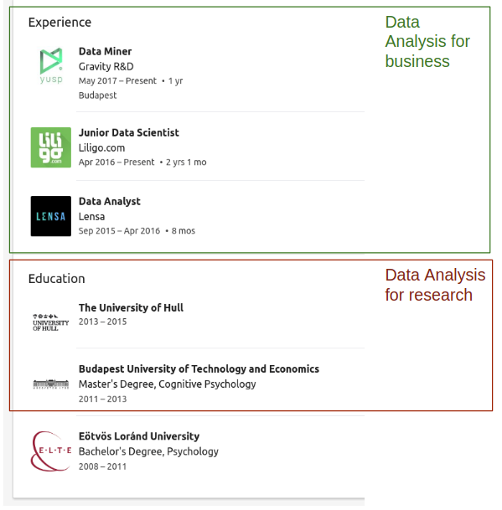
About Eszter
About Eszter

Slide 3
Goals of the class
Ability to conduct a data analysis workflow in python from the beginning to the end:
Reading, storing tabular data
Collecting data from the internet (API, scraping)
Transforming, filtering and aggregating data
Joining data tables
Basic analysis
Visualization
We’ll conduct an analysis during the class and the homework will be to conduct a similar one on a different dataset selected by you.
This is a python ‘as a second language’ course, so there won’t be a comprehensive introduction to basic programming concepts. Only the steps required to the analysis will be covered in order to give you as many practical skills as possible.

Slide 4
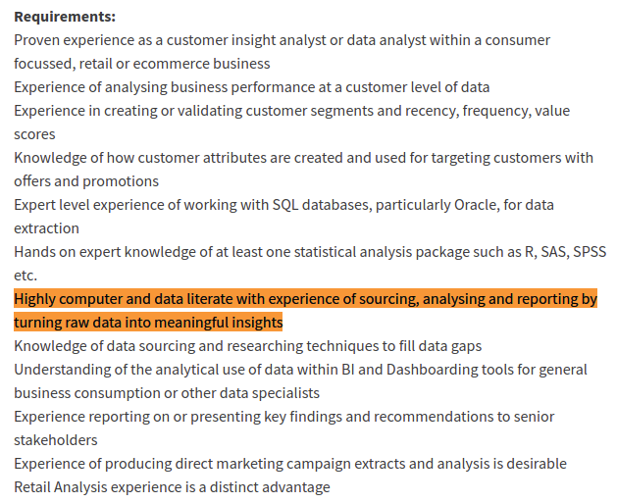
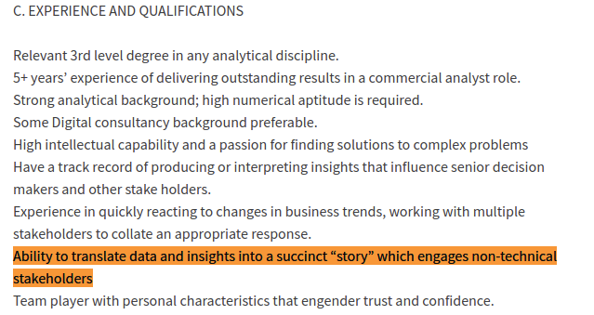
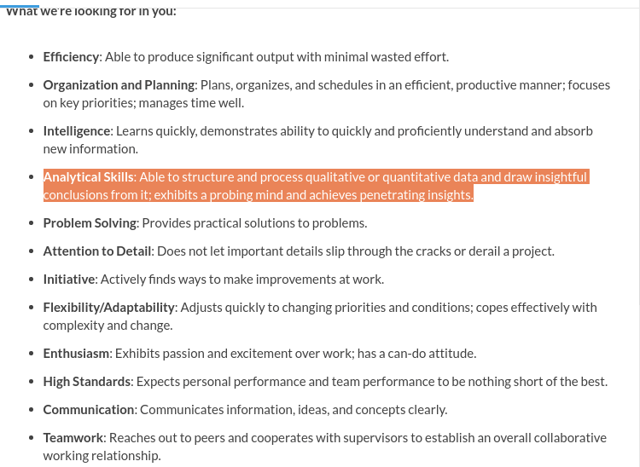
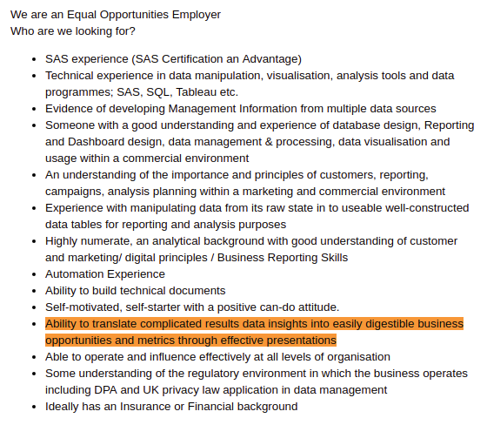
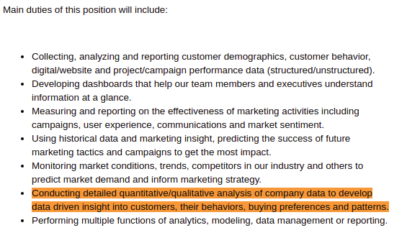
Goals of the class

Slide 5
Administrative information
You can miss 3 classes without failing. (Please don't be late)
Before each class download the data and the exercise notebook from the google drive shared
Grading
After some sessions a step of the analysis will be given as homework. The deadline is always 8AM on the next Tuesday. Plus the full analysis needs to be ready by 8AM, 7th April.
Each homework will count 10% towards the final grade + the full analysis will count 50%
There is a google drive folder shared with you with separate folders for weeks. When submitting the homework:
Create a folder inside the current week’s folder with your name
Upload the data + one notebook that is called YourNameWeekX.ipynb
Please don't use my ceu email, you can reach me at somoseszter@gmail.com

Slide 6
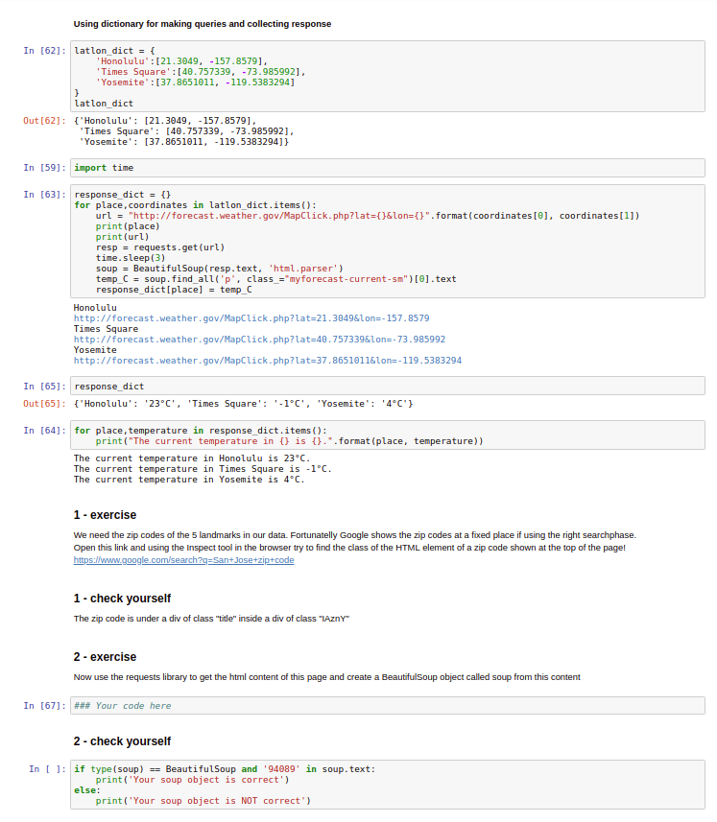
Class structure
Your computer stay closed, pay attention!
Talk about what will be covered
Showing examples in notebook
You solve the exercises
in pairs
start next exercise only if you answer for the current one is correct
don't be afraid of ask me
Home work
will be discussed at the end of every session

Slide 7
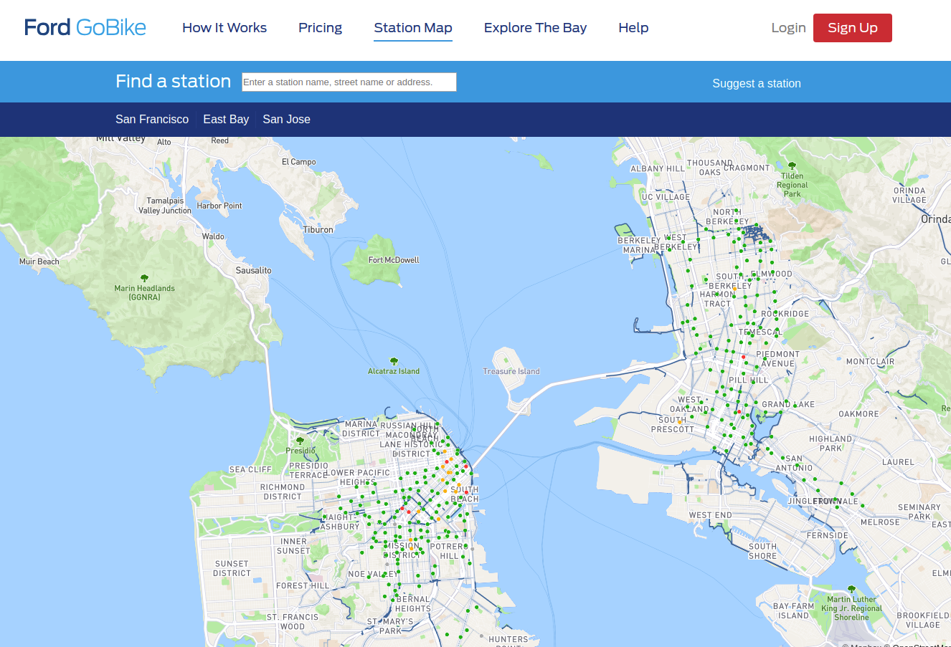
Dataset: Bay Area Bike Sharing

Slide 8
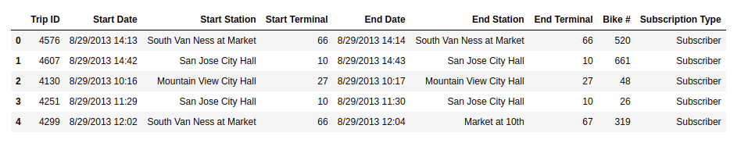
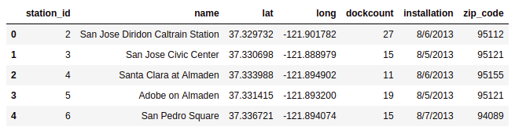
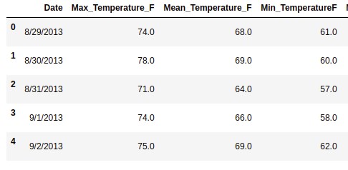
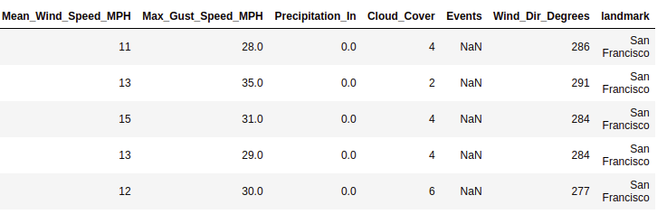
Dataset: Bay Area Bike Sharing
...

Slide 9
Questions and analysis steps
Q1: Is there a difference between Subscriber/Customer in daily/weekly routine?
Reading csv data into pandas dataframes and saving dataframes as csv
Using the os modul to interact with the operating system
Using lists to read several csv files and then concatenate them into one dataframe
Deal with duplicates and missing values
Descriptives
Dealing with date format data
Filtering the dataframe
Grouping and pivoting data
Bar charts
Q2: Is there difference in Subscriber/Customer behavior between days with different weather conditions?
Boxplot
Using dictionary objects to collect data using API service
Using dictionary objects to collect data from web scraping
Joining dataframes
Define custom functions to transform columns
Scatter plots with regression line
Q3: Are there stations more similar to each other? Which stations are those? In what features are they similar?
Applying custom functions for data transformation
Cluster analysis

Slide 10
How to choose dataset for your project
Minimum 1000 rows, maximum 1 million rows (you can work with only part of the data if you find a big one)
Minimum 1 nominal and 1 numeric column
Be able to ask a not complicated question that you’ll answer by analyzing the data
You’ll have to collect additional data by scraping or using API. Choose a dataset that you’ll be able to find connected data to.
The data can consist of multiple tables (even better if it does)
Where to find datasets
https://www.kaggle.com/datasets
https://github.com/fivethirtyeight/data
https://www.dataquest.io/blog/free-datasets-for-projects/
Home work for 14th January 8AM
Find a dataset and ask a question about it! Create a folder under Week1 on Google Drive and upload the data + a google document with your question. You can change your question later based on my feedback or if you find a better one.

Slide 11
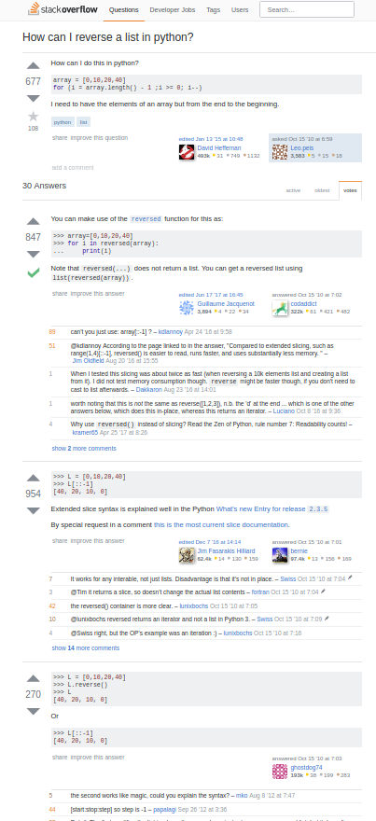
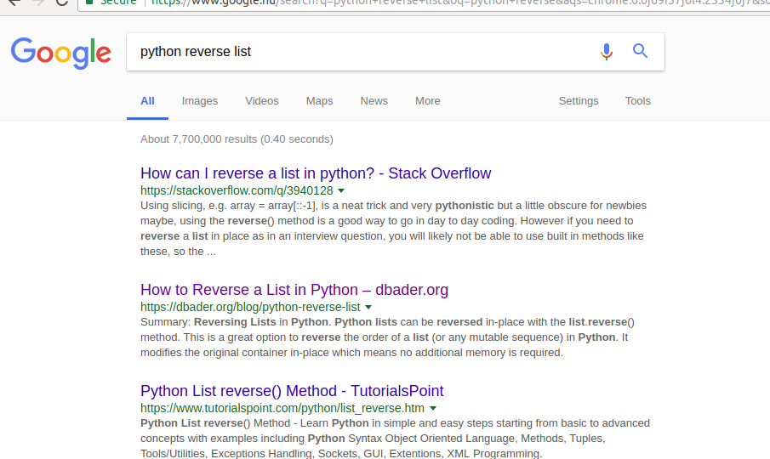
Effective usage of google
Stackoverflow is very useful
the problem
solution codes
discussion
define the language (python)
phrase the general problem you have, not the specific case
wrong: put fifth element to second place
good: change order of elements in list

Slide 12
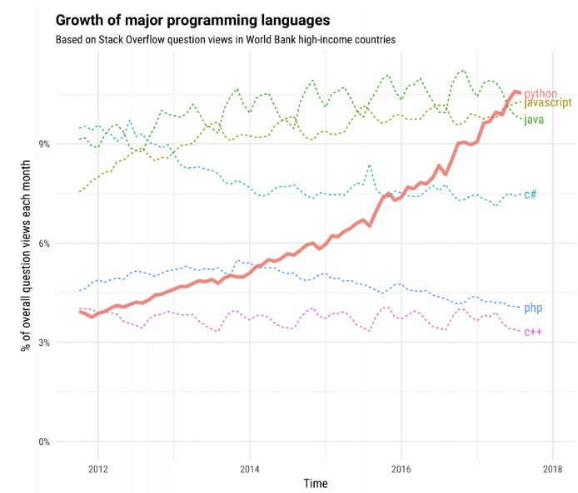
Why Python Python?
https://stackoverﬂow.blog/2017/09/06/incredible-growth-python/

Slide 13
Why Python?
Advantages
clean and simple language: Easy-to-read and intuitive code, easy-to-learn minimalistic syntax, maintainability scales well with size of projects.
expressive language: Fewer lines of code, fewer bugs, easier to maintain.
The main advantage is ease of programming, minimizing the time required to develop, debug and maintain the code.
A large standard library, and a large collection of add-on packages
Free :)
Very helpful online community
Don't be scared if not everything is in the slides or explained in the notebooks. Learning how to google effectively is part of the class. A very good resource is Stackoverflow.

Slide 14
Why Python?
Disadvantages
the execution of python code can be slow compared to other programming languages, this means it might not be ideal for huge data sets or building large systems.
Since anyone can contribute code, it is somewhat decentralized, packages and documentation are spread out at diﬀerent places

Slide 15


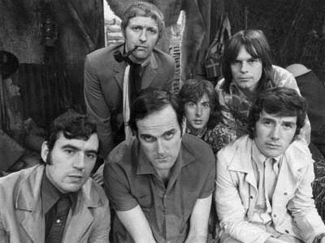

Why Python?
X

Slide 16

How to get Python
We work with a distribution called Anaconda, which includes already a lot of packages and utilities that we will need. It’s free and available for Mac, Windows, Unix

Slide 17

We will use Python through a tool called Jupyter notebook
(also called IPython notebook)

Slide 18


Open a Jupyter notebook
Click on the Anaconda symbol

Slide 19
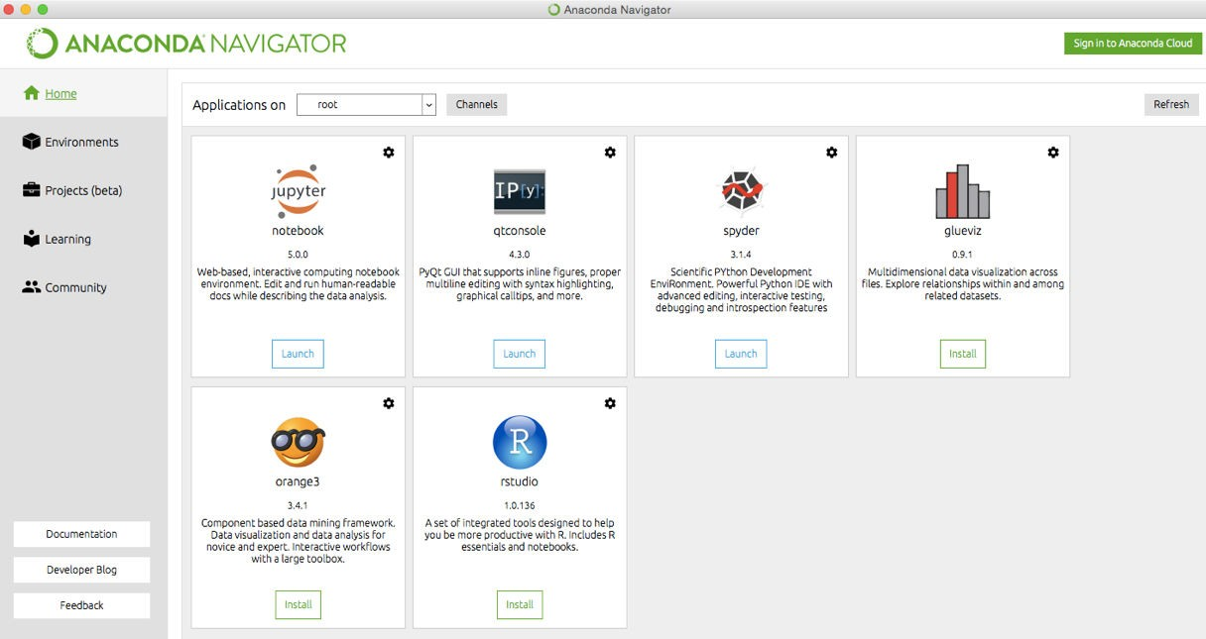
You’ll see a window similar to this. Click on ‘Launch’ Jupyter notebook
Open a Jupyter notebook

