Slide 1
Data Management and Analysis with Python
CEU, January 2020

Slide 2
Questions and analysis steps
Q1: Is there a difference between Subscriber/Customer in daily/weekly routine?
Reading csv data into pandas dataframes and saving dataframes as csv
Using the os modul to interact with the operating system
Using lists to read several csv files and then concatenate them into one dataframe
Deal with duplicates and missing values
Descriptives
Dealing with date format data
Filtering the dataframe
Grouping and pivoting data
Bar charts
Q2: Is there difference in Subscriber/Customer behavior between days with different weather conditions?
Boxplot
Using dictionary objects to collect data using API service
Using dictionary objects to collect data from web scraping
Joining dataframes
Define custom functions to transform columns
Scatter plots with regression line
Q3: Are there stations more similar to each other? Which stations are those? In what features are they similar?
Applying custom functions for data transformation
Cluster analysis

Slide 3
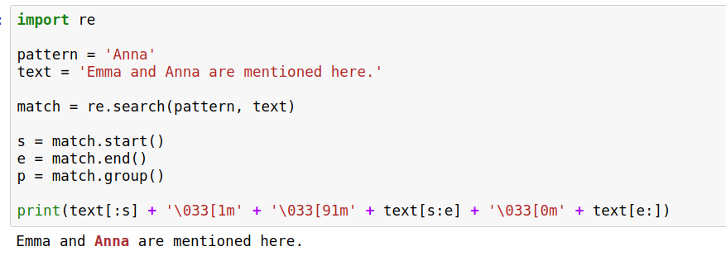
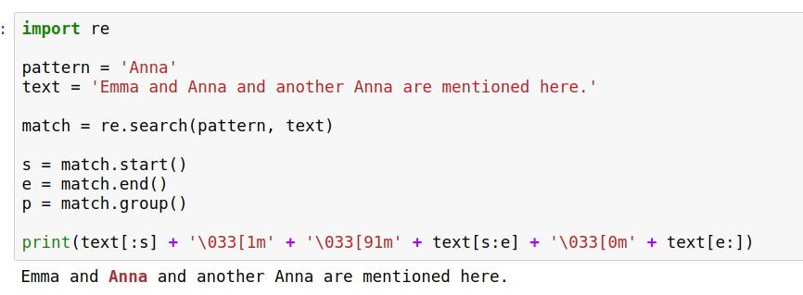
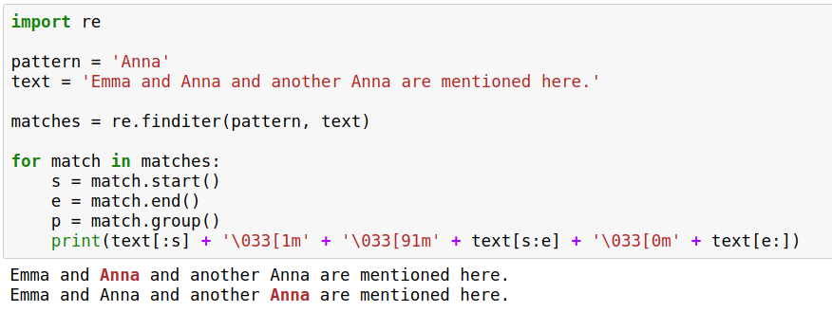
String manipulation advanced: re module
Searching
a text

Slide 4
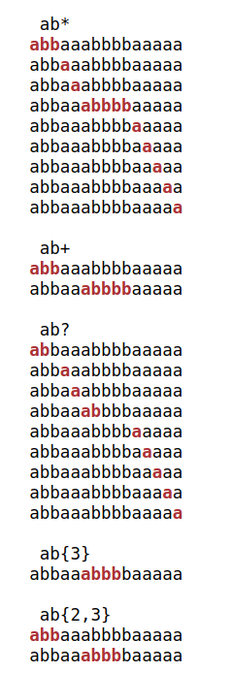
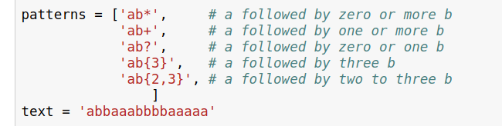
Repetitions

Slide 5
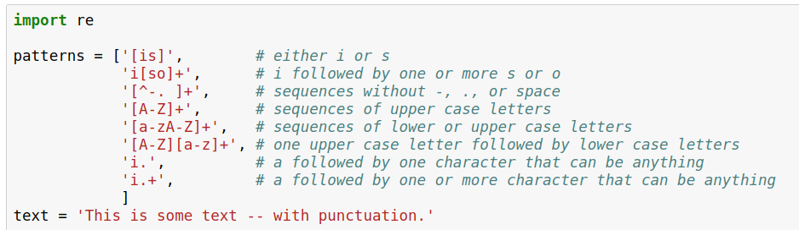
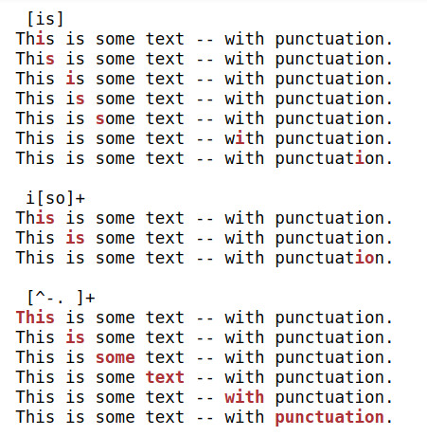
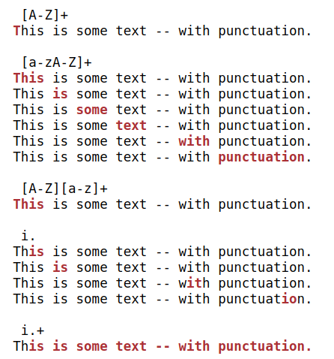
Character sets

Slide 6
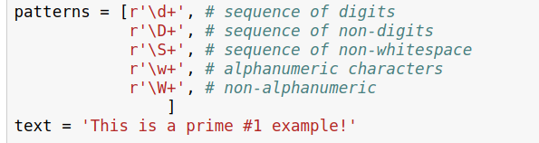
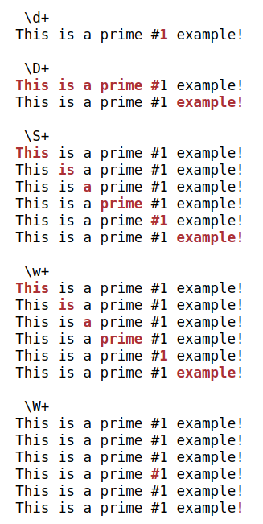
And see many more examples and more complex usages here:
https://pymotw.com/2/re/

Slide 7
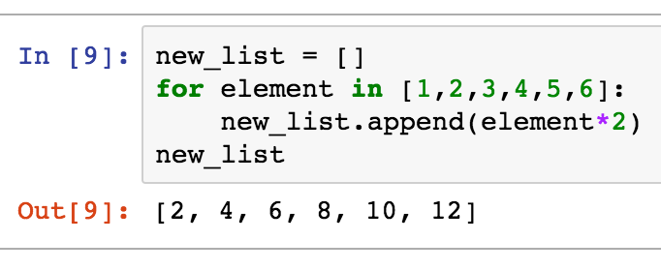
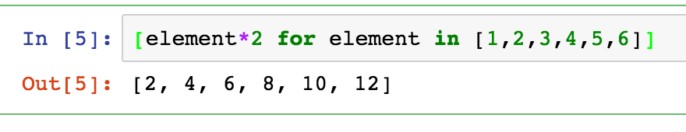
A very pythonic process:
list comprehension
With list comprehension
Changing each element of a list
nicer and cleaner way to do the same

Slide 8




List comprehension
[i*i for i in range(5) if i % 2 == 0]
newlist
transformation
ﬁlter
iteration
brackets, to signal python this is a list

