Slide 1
Music Genre Classification
Péter Czumbel, Szilárd Horváth

Slide 2
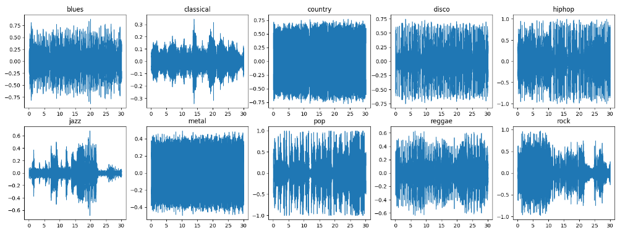
Audio data for different genres

Slide 3
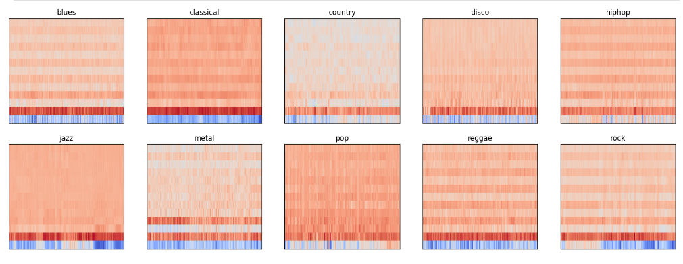
Mel Spectogram for different genres

Slide 4
MFCC and Mel spectrograms
Music is created by humans and for humans, so what really matters is what humans hear from the audio
MFCC is an audio transformation technique that extracts a number of features from the data, which can represent better what a human would hear listening to the given audio
Mel spectrograms are a visual representation of the MFCC features

Slide 5
CNN
For the CNN model we used the Mel spectograms of the audio
We used different kind of layers to reduce the chance of overfitting and to improve the accuracy: Batchnormalization, AveragePooling, Dropout
It performed the best between our 3 models.

Slide 6
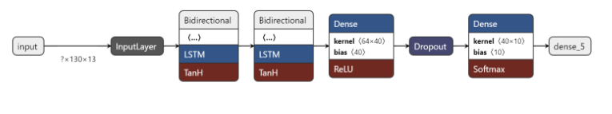
LSTM
For the LSTM model we used the MFCCs extracted from the audio data
Dropoutlayers didn’t work well between the LSTMs so we only put them between the dense layers
The accuracy wasn’t as high as the CNN model’s

Slide 7
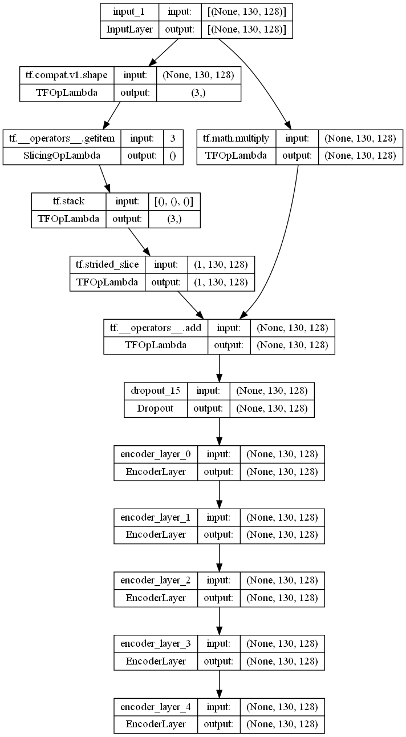
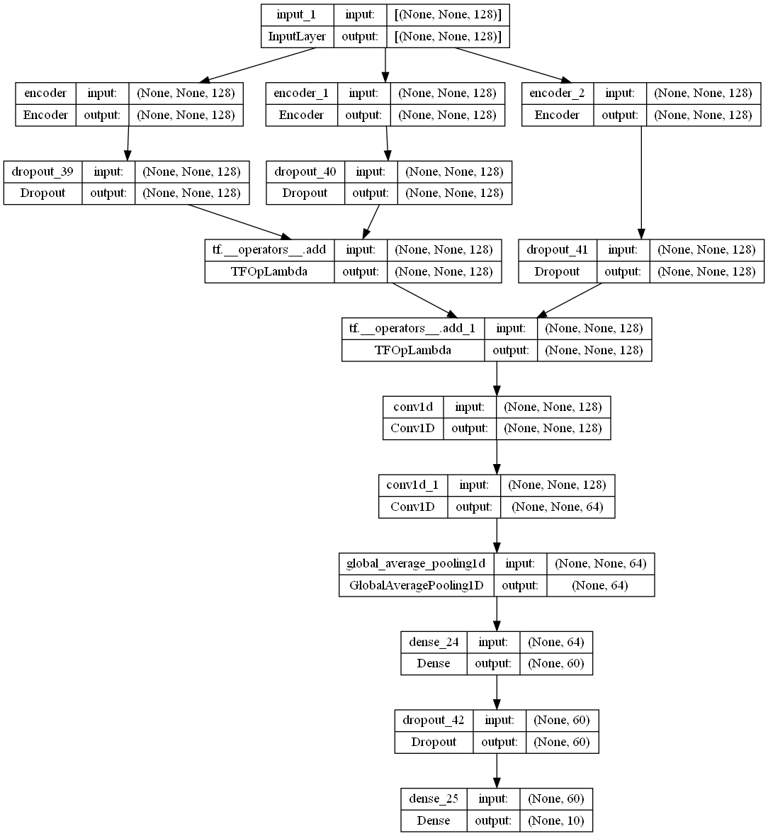
Transformer

Slide 8
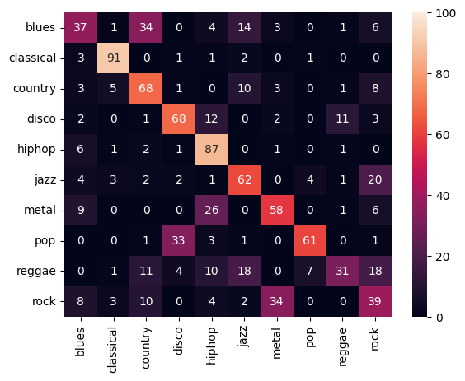
Evaluation
CNN: 66%
LSTM: 44%
Transformer: 61%

Slide 9
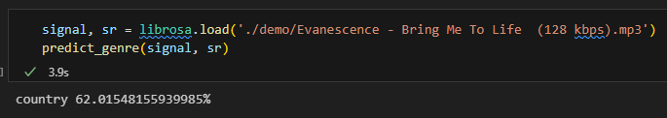
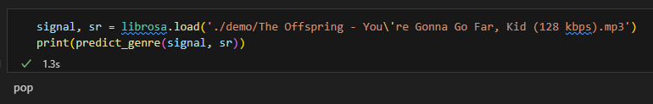
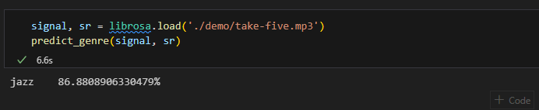
Demo

