Slide 1
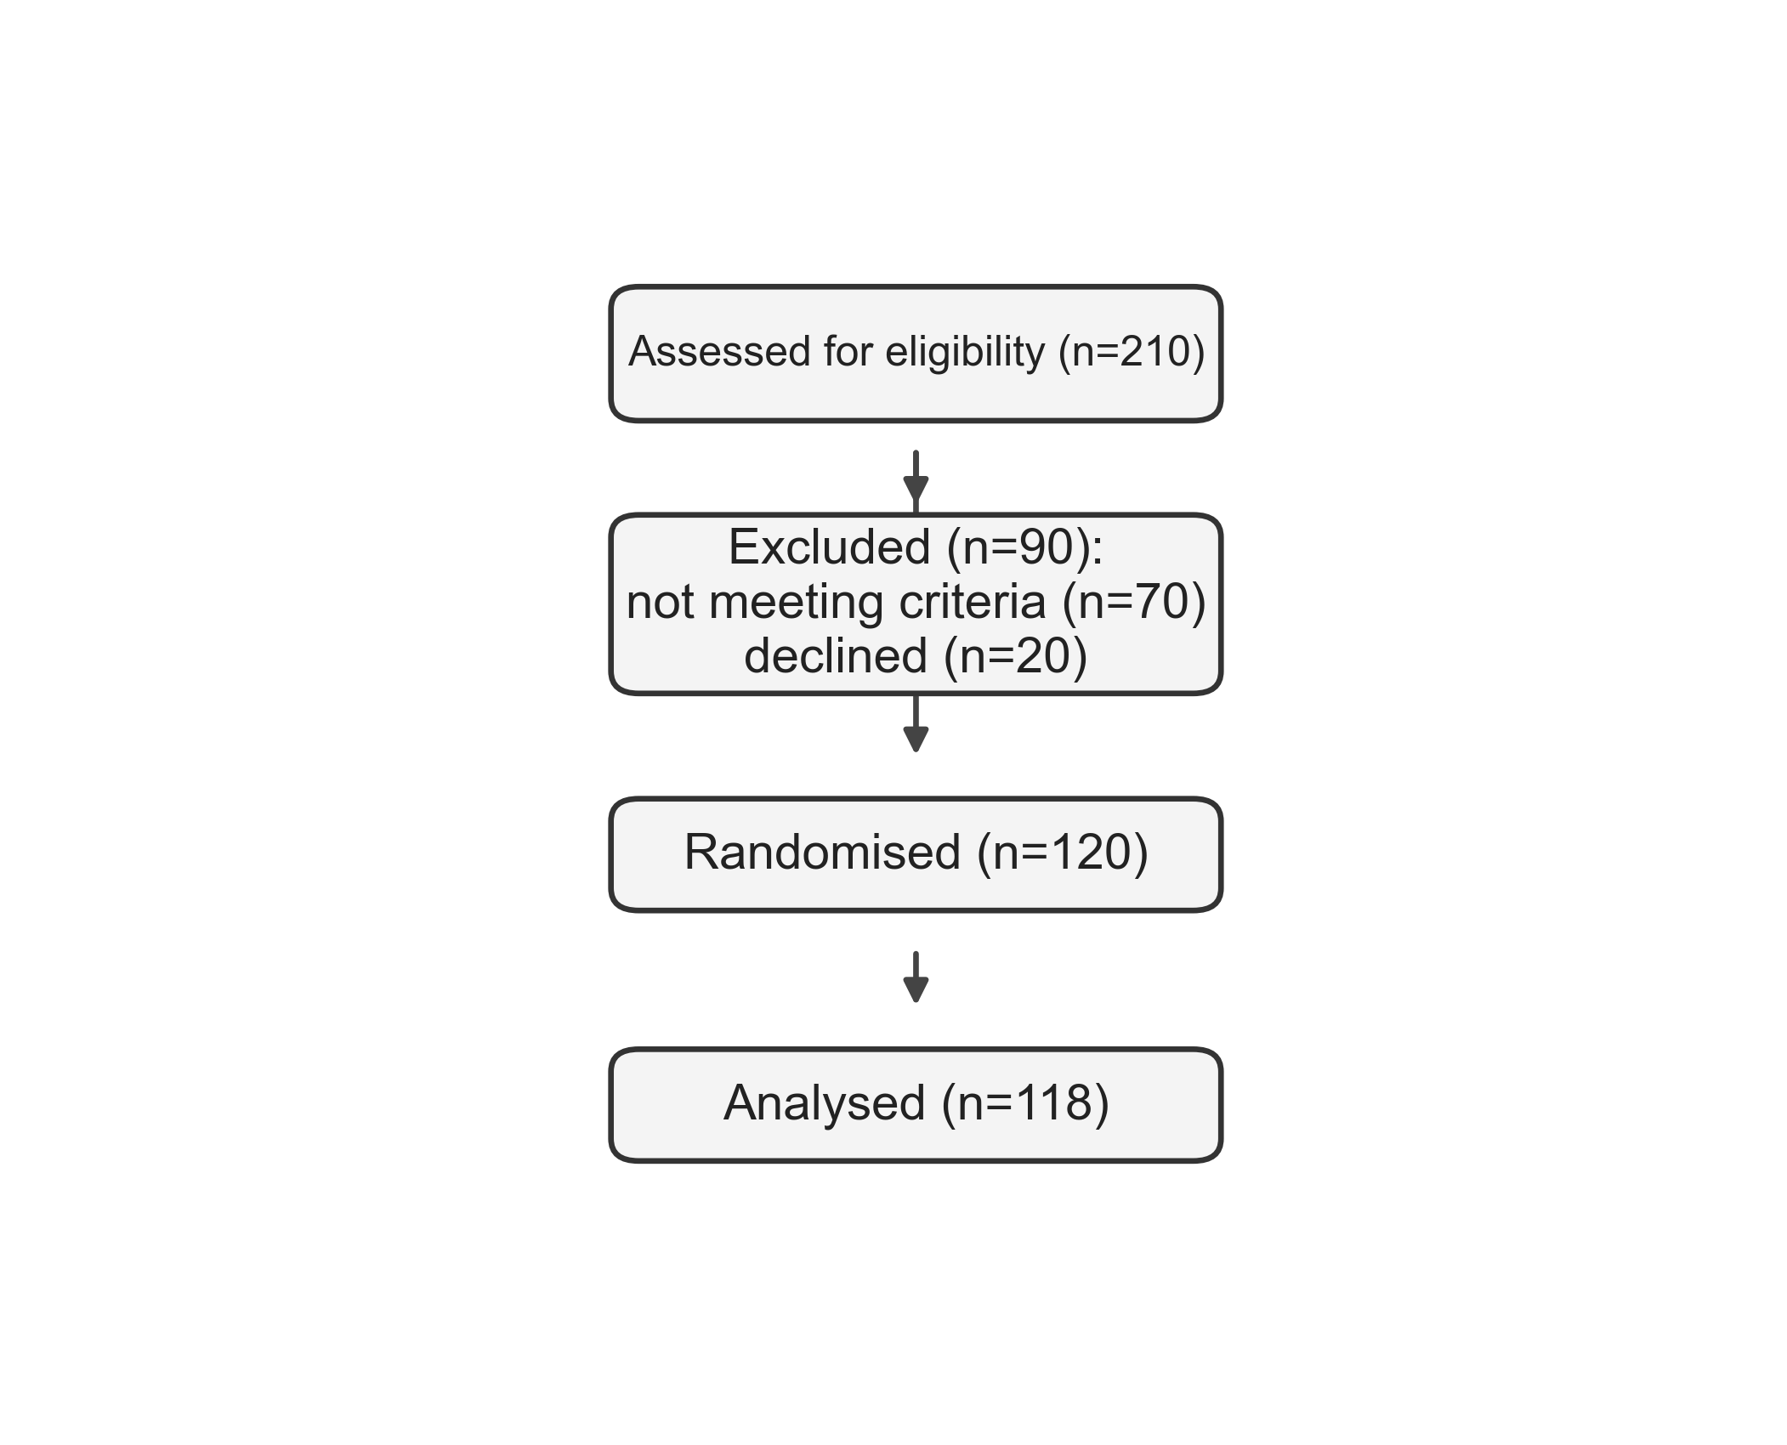
Assessed for eligibility (n=210)
Excluded (n=90): not meeting criteria (n=70) declined (n=20)
Randomised (n=120)
Analysed (n=118)

