Slide 1
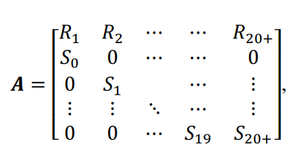
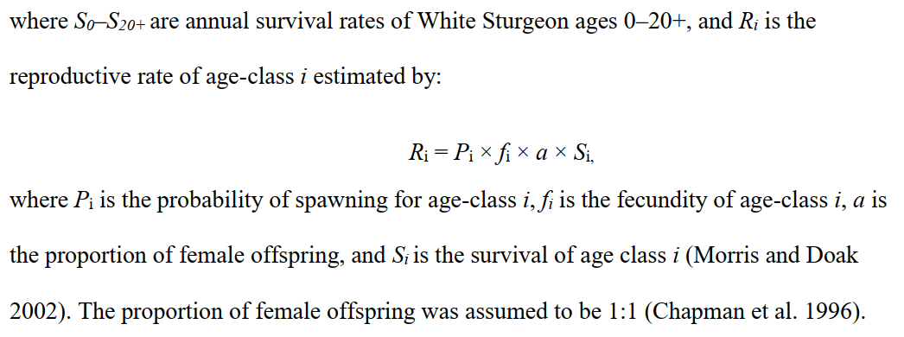
Starting Data: catch data where for each fish a length has been recorded. A portion of this catch has been aged from which we can age the un-aged fraction.
Using gear selectivity modeling methods developed by R. Millar, we can adjust our catch accordingly. https://www.stat.auckland.ac.nz/~millar/selectware/code.html
The crux of this model is a female-based Leslie matrix. As such, we need age-based frequency, fecundity (as spawning probability), survival probability, and egg count. (Below from Blackburn thesis.)

Slide 2
Age Distribution
catch data (lengths)
adjusted _{gear selectivity}
age-frequency (as fraction at each age)
x pop est.
divided by fraction females
age-distribution
age-distribution_{F}
not adjusted
Spawning Probability
Chapman (1989)
age-specific spawning probability
GLM
Egg Count
Devore (1995)
LIN REG
age-specific egg count
Survival Probability
For each level of µ
Assumes constant S
S-F for fish subject to harvest
age-specific survival probability

Slide 3
Make post-breeding Leslie matrices meaning WST caught right AFTER (post) their "birthday" can contribute newborn (age 0) animals to next year's census by surviving to their next birthday, then reproducing ON that birthday. Ex: fecundity of 9-year-olds (10th fecundity row element in matrix) is: survival from 9-10 (S9, 10th survival element), times fecundity on 10th bday (f10, 11th repro element)
http://vlab.amrita.edu/?sub=3&brch=65&sim=183&cnt=1
http://www.afrc.uamont.edu/whited/Age%20Structured%20Matrix%20Population%20Modeling.pdf
https://github.com/jasondubois/spopmodel

