Slide 1
Eclipse 4.5 Mars and the best plugins
Excellence in
Software Engineering
by Paul Verest

Slide 2
About presenter
Paul Verest
Working at intersection of software and economics
Joined EPAM Hybris team in May 2015 as SDE
See myself as Developer, coding Architect
Java, Spring, Android
I am from Ukraine. Speaking Russian, English, German, Chinese (started in 2006). Moved to China, Beijing in 2010 with my future wife.
Now we have 2 years-old son Michael.
Organizing
Shenzhen JUG http://szjug.github.io/
Eclipse-China http://www.eclipsechina.org/
Tools project Nodeclipse http://www.nodeclipse.org/
Confidential

Slide 3
Contents
Contents
Foundation
Projects
IDE
What’s new in 4.5 Mars
How to find best plugins

Slide 4

Eclipse Foundation
1. Foundation
https://www.eclipse.org/org/
Eclipse is a community for individuals and organizations who wish to collaborate on commercially-friendly open source software.
The Eclipse Project was originally created by IBM in November 2001 and supported by a consortium of software vendors. The Eclipse Foundation was created in January 2004 as an independent not-for-profit corporation to act as the steward of the Eclipse community.

Slide 5
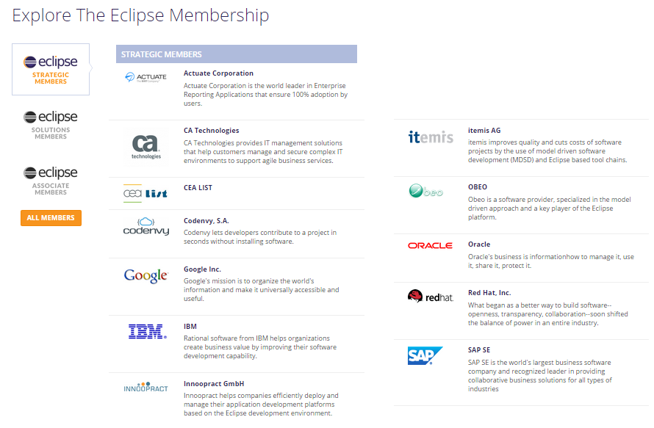
Members
https://www.eclipse.org/membership/exploreMembership.php
As well as: Airbus, Atos, BMW, Sisco, Daimler, Dell, Eriscson, GitHub, Gradle, HP, Huawei, Intel, Nokia, Pivotal, Sonatype, Talend, Tata, ..
ARM, Siemens, Tsinghua University, Xilinx, ..
Totally more than 190

Slide 6

Projects
https://projects.eclipse.org/list-of-projects
220+ projects
Most known are:
Cloud Dev
Eclipse platform
IDE
Hudson
IoT
Jetty
Vert.x

Slide 7
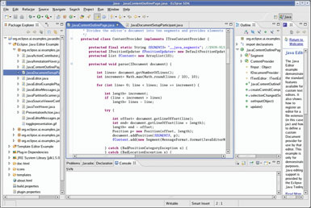


Eclipse IDE
https://www.eclipse.org/ide/
For most developers
Eclipse = Eclipse (desktop) IDE,
But there is also cloud IDE under way.
There are many Eclipse-based IDEs:
Spring Tools Suite (STS),
Red Hat JBoss Developer Studio,
IBM Rational products, Nodeclipse Enide
https://en.wikipedia.org/wiki/List_of_Eclipse-based_software

Slide 8
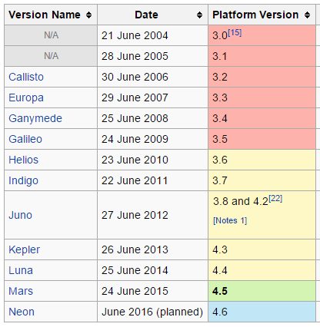
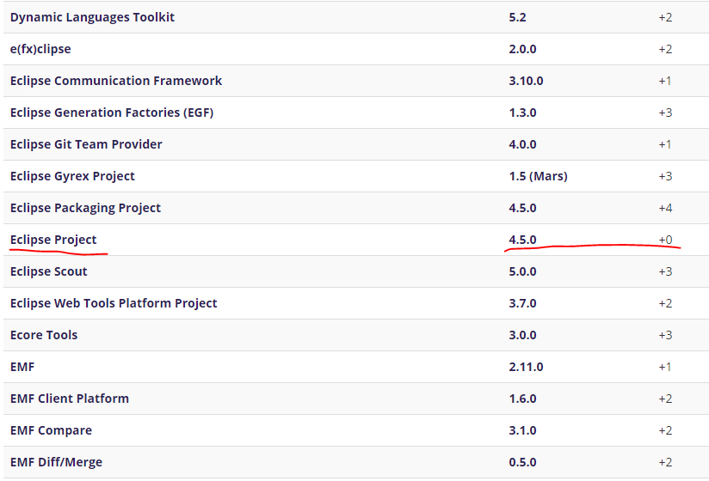
Eclipse simultaneous release / release train
https://en.wikipedia.org/wiki/Eclipse_(software)
https://projects.eclipse.org/releases/mars

Slide 9
What is new in Mars
https://www.eclipse.org/mars/
Of course Java and Maven new features
Docker tools;
Gradle tools;
What is new in Mars Eclipse IDE 4.5
Workbench
Default heap 1024MB
Improved Open With.. Dialog
Close Tabs to the Right
Hierarchical Project Presentation
Improved Dark theme
Java Development
Convert method reference to lambda and back
And more improvements for Java8, debugging, JUnits

Slide 10
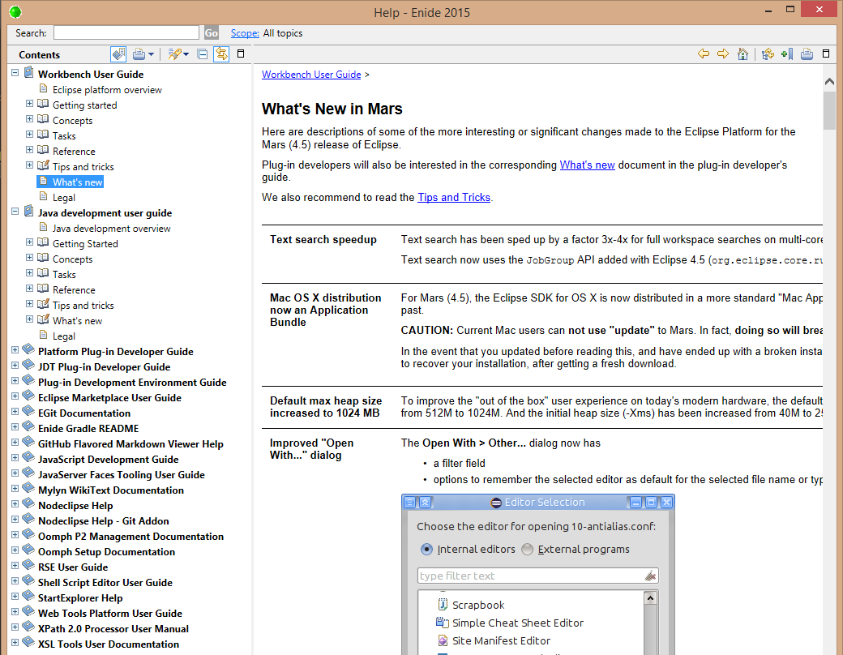
Help -> Help Contents

Slide 11
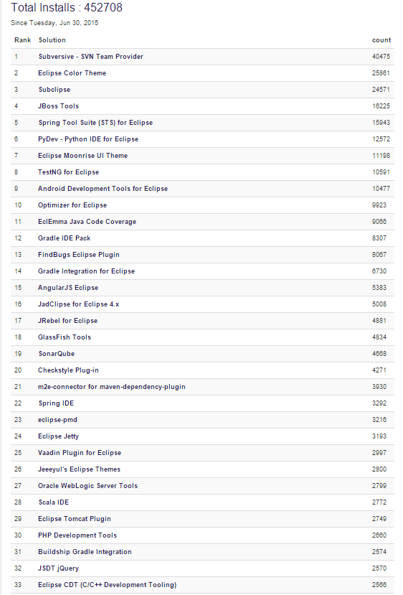
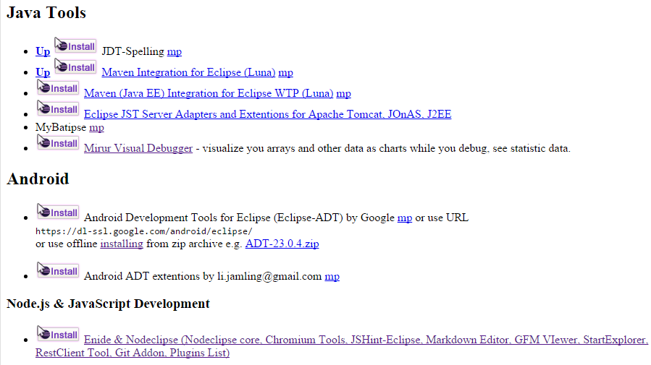
Recommended plugins
To discover
1. Eclipse Marketplace stats
2. Nodeclipse Plugins List
3. search
http://marketplace.eclipse.org/metrics/successful_installs/last30days
http://www.nodeclipse.org/updates/list

Slide 12
List inside Enide 2015 feature
<!-- for use with http://www.nodeclipse.org/updates/enide-2015/ -->
<!-- Nodeclipse-1 repo -->
<!-- Nodeclipse -->
<import feature="org.nodeclipse.enide.nodejs.feature"/>
<import feature="org.nodeclipse.pluginslist.feature"/>
<import feature="org.nodeclipse.phantomjs.feature"/>
<import feature="com.eclipsesource.jshint.feature"/>
<!-- Minimalist -->
<import feature="org.nodeclipse.enide.editors.gradle.feature"/>
<import feature="org.nodeclipse.enide.gradle.feature"/>
<import feature="org.dadacoalition.yedit"/>
<import feature="gitaddon.feature"/>
<!-- Enide Tools Collection -->
<import feature="markdown.editor.feature"/>
<import feature="code.satyagraha.gfm.viewer.feature"/>
<import feature="de.bastiankrol.startexplorer.feature"/>
<import feature="code.google.restclient.tool.feature"/>
<import feature="org.eclipse_icons.editor.feature"/>
<import feature="net.jeeeyul.pdetools.feature"/>
<import feature="net.sourceforge.shelled"/>
<!--
<import feature="org.sweetlemonade.eclipse.json.feature"/>
use jsonedit-feature
-->
<import feature="net.mihai-nita.ansicon"/>
<import feature="pm.eclipse.editbox.feature"/>
<import feature="zipeditor"/>
<!-- JavaTools -->
<import feature="jdt.spelling.feature"/>
<!-- General -->
<import feature="com.github.eclipsecolortheme.feature"/>
<!-- Other -->
<import feature="jsonedit-feature"/>

Slide 13
Some favorites
Eclipse ColorTheme
EditBox
JDT Spelling
StartExplorer
Eclipse Terminal
Zip Editor

Slide 14
Thank You for your Time!
Q&A http://szjug.github.io/
Excellence in
Software Engineering

