Slide 1

Java 8, Java 9
Excellence in Software Engineering
by Paul Verest 伟保罗
深圳JUG Oct15

Slide 2
About presenter
Paul Verest
Working at intersection of software and economics (having diplomas for both)
Joined EPAM Hybris team in May 2015
See myself as Developer with Business insight
Java, Spring, Android
I am from Ukraine. Speaking Russian, English, German, Chinese (started in 2006). Moved to China, Beijing in 2010 with my future wife.
Now we have 2 years-old son Michael.
Organizing
Shenzhen JUG http://szjug.github.io/
Eclipse-China http://www.eclipsechina.org/
Nodeclipse tools http://www.nodeclipse.org/

Slide 3

About EPAM – best company in 2015 by Forbes
http://www.forbes.com/sites/louiscolumbus/2015/06/15/the-best-software-companies-to-work-for-in-2015/

Slide 4
Contents
Contents
Intro
Java 8
Java 9

Slide 5


Java is …
1. Intro
Java is a general-purpose computer programming language that isconcurrent, class-based, object-oriented,^{[12]} and specifically
designed to have as few implementation dependencies as possible. It is intended to let application developers "write once, run anywhere" (WORA),^{[13]} meaning that compiled Java code can run on all platforms that support Java without the need for recompilation.^{[14]} Java applications are typically compiled to bytecode that can run on anyJava virtual machine (JVM) regardless of computer architecture. As of 2015, Java is one of the most popular programming languages in use,^{[15][16][17][18]} particularly for client-server web applications, with a reported 9 million developers.^{[citation needed]} Java was originally developed by James Gosling at Sun Microsystems (which has since been acquired by Oracle Corporation) and released in 1995 as a core component of Sun Microsystems' Java platform. The language derives much of its syntax from C and C++, but it has fewer low-level facilities
than either of them.
https://en.wikipedia.org/wiki/Java_(programming_language)

Slide 6
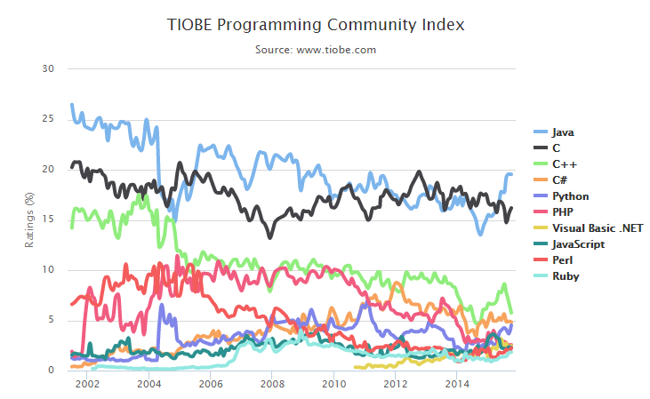
Java is still within TOP programming languages
1. Intro
http://www.tiobe.com/index.php/content/paperinfo/tpci/index.html

Slide 7
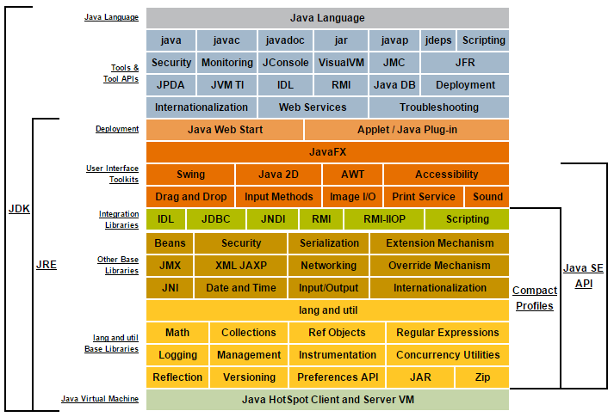
Java Conceptual Diagram
https://docs.oracle.com/javase/8/docs/

Slide 8

Schedule
1. Intro
Java 8
2013/06/13 M7 Feature Complete
...
2014/03/18 GA General Availability
Java 9
2015/12/10 Feature Complete
...
2016/09/22 General Availability

Slide 9
Java 8
1. Lambda Expressions & Method References
2. Streams & Parallel operations
3. Java + JavaScript
4. New date / time APIs
5. Annotation
http://www.infoq.com/interviews/naftalin-lambda-streams

Slide 10
Lambda expressions
Enhancements in Java SE 8
https://docs.oracle.com/javase/8/docs/technotes/guides/language/enhancements.html#javase8
1.1 Lambda expressions
http://docs.oracle.com/javase/tutorial/java/javaOO/lambdaexpressions.html
btn.setOnAction(new EventHandler<ActionEvent>() {
@Override
public void handle(ActionEvent event) {
System.out.println("Hello World!");
}
});
->
btn.setOnAction(
event -> System.out.println("Hello World!")
);

Slide 11
Method reference
1.2 Method reference
http://docs.oracle.com/javase/tutorial/java/javaOO/methodreferences.html
class PersonAgeComparator implements Comparator<Person> {
public int compare(Person a, Person b) {
return a.getBirthday().compareTo(b.getBirthday());
}
}
Arrays.sort(rosterAsArray, new PersonAgeComparator());
The method signature of this invocation of sort is the following:
static <T> void sort(T[] a, Comparator<? super T> c)
Notice that the interface Comparator is a functional interface. Therefore, you could use a lambda expression instead of defining and then creating a new instance of a class that implements Comparator:
Arrays.sort(rosterAsArray,
(Person a, Person b) -> {
return a.getBirthday().compareTo(b.getBirthday());
}
);
However, this method to compare the birth dates of two Person instances already exists as Person.compareByAge. You can invoke this method instead in the body of the lambda expression:
Arrays.sort(rosterAsArray,
(a, b) -> Person.compareByAge(a, b)
);
Because this lambda expression invokes an existing method, you can use a method reference instead of a lambda expression:
Arrays.sort(rosterAsArray, Person::compareByAge);

Slide 12
Method reference (simpler example)
Consumer<String> printlnLambda = s -> System.out.println(s);
printlnLambda.accept("Hi");
Consumer<String> printlnRef = System.out::println;
printlnRef.accept("and");
Consumer<String> printlnTwice = printlnLambda.andThen(printlnRef);
printlnTwice.accept("Bye");

Slide 13
Streams & Parallel operations
Integer[] intArray = {1, 2, 3, 4, 5, 6, 7, 8 };
List<Integer> listOfIntegers =
new ArrayList<>(Arrays.asList(intArray));
System.out.println("Sum of integers: " + listOfIntegers.stream().reduce(Integer::sum).get());
Stream<String> currencies =
Stream.of("GBP", "EUR", "USD", "CAD", "AUD", "JPY", "HKD" );
currencies.forEach( ccy -> System.out.println( ccy ) );
currencies.forEach( System.out::println );

Slide 14
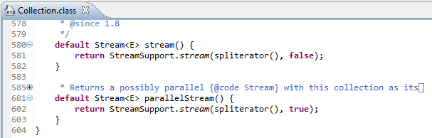

Streams & Parallel operations
To go parallel just replace stream() with parallelStream()

Slide 15

java.util.function & java.util.stream
java.util: An existing package which, in addition to the java.lang.invoke package,
integrates the Java Collections Framework with streams and provides general utility functionality used by streams.
java.util.function: A new package that contains general purpose functional interfaces
that provide target types for lambda expressions and method references.
java.util.stream: A new package that contains the majority of interfaces and classes
that provide functionality to streams and aggregate operations
https://docs.oracle.com/javase/8/docs/technotes/guides/language/lambda_api_jdk8.html

Slide 16
5. Nashorn – The Node.js on JVM (Avatar.js)
This is the javascript engine that enables us to run javascript to run on a jvm. It is similar to the V8 engine provided by chrome over which Node.js runs. It is compatible with Node.js applications while also allowing actual Java libraries to be called by the javascript code running on server. This is exciting to say at the least as it marries scalability and asynchronous nature of Node.js with safe and widespread server side Java middleware directly.
6. Date/Time changes (java.time)
http://download.java.net/jdk8/docs/api/java/time/package-summary.html
The Date/Time API is moved to java.time package and Joda time format is followed. Another goodie is that most classes are Threadsafe and immutable.

Slide 17
New Annotations
@NotNull @ReadOnly @Regex
https://blogs.oracle.com/java-platform-group/entry/java_8_s_new_type
@NonNull List<@NonNull String>
@Regex String validation = "(Java|JDK) [7,8]"

Slide 18

Cautious Note
New technology is risk factor for your project
and will make team pace slower.
When you start using Java 8:
- make sure JRE 8 is installed in all environments (DEV, SIT, UAT, PROD)
- all team has to get to the same level
and agree on what to use
plan to review/change all older code
Learn on other's errors
https://lab.getbase.com/java-8-speeds-slows/

Slide 19
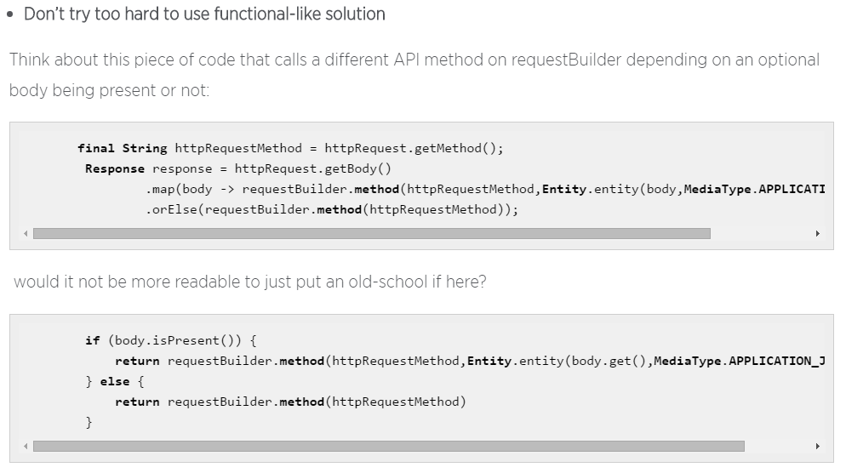
Don’t try to hard

Slide 20

Java 9
#java 9 will be complete this year and released in #septemer #2016 http://openjdk.java.net/projects/jdk9/
There will be less new language features, compared to Java 8 (mainly new HTTP APIs to support HTTP 2.0), but much more inner changes like modularity, no more /jre folder in JDK, #jshell, Multi-Release JAR Files (all-in-one jar for many Java versions), Compact Strings (likely using UTF-8 internally)

Slide 21
61 JEPs (Java Enhancement Proposals)
230: Microbenchmark Suite 231: Remove Launch-Time JRE Version Selection 232: Improve Secure Application Performance 233: Generate Run-Time Compiler Tests Automatically 235: Test Class-File Attributes Generated by javac 236: Parser API for Nashorn 237: Linux/AArch64 Port 238: Multi-Release JAR Files 240: Remove the JVM TI hprof Agent 241: Remove the jhat Tool 243: Java-Level JVM Compiler Interface 244: TLS Application-Layer Protocol Negotiation Extension 245: Validate JVM Command-Line Flag Arguments 246: Leverage CPU Instructions for GHASH and RSA 247: Compile for Older Platform Versions 248: Make G1 the Default Garbage Collector 249: OCSP Stapling for TLS 250: Store Interned Strings in CDS Archives 251: Multi-Resolution Images 252: Use CLDR Locale Data by Default 253: Prepare JavaFX UI Controls & CSS APIs for Modularization 254: Compact Strings 255: Merge Selected Xerces 2.11.0 Updates into JAXP 256: BeanInfo Annotations 257: Update JavaFX/Media to Newer Version of GStreamer 258: HarfBuzz Font-Layout Engine
262: TIFF Image I/O 263: HiDPI Graphics on Windows and Linux 265: Marlin Graphics Renderer 266: More Concurrency Updates 267: Unicode 8.0 268: XML Catalogs 270: Reserved Stack Areas for Critical Sections 274: Enhanced Method Handles
102: Process API Updates 110: HTTP 2 Client 143: Improve Contended Locking 158: Unified JVM Logging 165: Compiler Control 193: Variable Handles 197: Segmented Code Cache 199: Smart Java Compilation, Phase Two 201: Modular Source Code 211: Elide Deprecation Warnings on Import Statements 212: Resolve Lint and Doclint Warnings 213: Milling Project Coin 214: Remove GC Combinations Deprecated in JDK 8 215: Tiered Attribution for javac 216: Process Import Statements Correctly 217: Annotations Pipeline 2.0 219: Datagram Transport Layer Security (DTLS) 220: Modular Run-Time Images 221: Simplified Doclet API 222: jshell: The Java Shell (Read-Eval-Print Loop) 223: New Version-String Scheme 224: HTML5 Javadoc 225: Javadoc Search 226: UTF-8 Property Files 227: Unicode 7.0 228: Add More Diagnostic Commands 229: Create PKCS12 Keystores by Default

Slide 22
Java 9 main features
1. modularity
2. HTTP2 support and new HTTP API
3. jshell
Process API
Logging
http://www.infoq.com/articles/Java9-New-HTTP-2-and-REPL

Slide 23
New HTTP API, Process API
HttpResponse response = HttpRequest.create(
new URI("http://www.infoq.com")).body(noBody()) .GET().send();
int responseCode = response.responseCode();
String responseBody = response.body(asString());
System.out.println("Your pid is " + Process.getCurrentPid());

Slide 24
238: Multi-Release JAR Files, 254: Compact Strings
238: Multi-Release JAR Files
jar root
- A.class
- B.class
- META-INF
- versions
- 8
- A.class
- B.class
- 9
- A.class
254: Compact Strings
http://www.infoq.com/articles/Java9-New-HTTP-2-and-REPL
http://blog.takipi.com/5-features-in-java-9-that-will-change-how-you-develop-software-and-2-that-wont/

Slide 25
Ultimate truth
http://openjdk.java.net/projects/jdk9/

Slide 26
Links
http://openjdk.java.net/projects/jdk8/
http://www.oracle.com/technetwork/java/javase/8-whats-new-2157071.html
https://leanpub.com/whatsnewinjava8/read
http://www.javacodegeeks.com/2014/03/8-new-features-for-java-8.html
http://openjdk.java.net/projects/jdk9/
http://www.infoq.com/articles/Java9-New-HTTP-2-and-REPL

Slide 27
Thank You for your Time! Q&A http://szjug.github.io/
Excellence in Software Engineering

