Slide 1
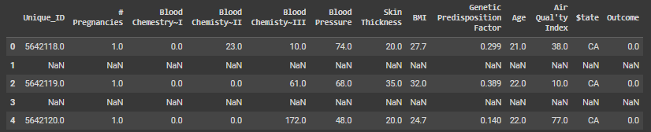
The dataset
The dataset contains 7679 records and 13 columns which are:
Unique_ID - Unique identifier for each record,
# Pregnancies - Number of pregnancies,
Blood Chemestry~I, Blood Chemisty~II, Blood Chemisty~III - Different blood chemistry measurements,
Blood Pressure - Blood pressure level,
Skin Thickness - Probably defining the skin thickness,
BMI - Body Mass Index,
Genetic Predisposition Factor - Factor indicating genetic risk,
Age - Age of the patient,
Air Qual'ty Index - Air quality index in the patient’s environment,
$tate - The state where the patient resides,
Outcome - The binary target variable, indicating whether the disease is present (0 = no disease, 1 = disease)
Medical Report
Initially, the dataset was not clean so a few steps had to be taken before any work was conducted. The cleanup steps included:
Removing half of the rows as each record was followed by a row full of empty values,
Cleaning column names,
Removing any potential duplicate records,
Deleting entries with state code equal to „KU” as there is no such state in the USA

Slide 2
The dataset
The dataset contains 7679 records and 13 columns which are:
Unique_ID - Unique identifier for each record,
# Pregnancies - Number of pregnancies,
Blood Chemestry~I, Blood Chemisty~II, Blood Chemisty~III - Different blood chemistry measurements,
Blood Pressure - Blood pressure level,
Skin Thickness - Probably defining the skin thickness,
BMI - Body Mass Index,
Genetic Predisposition Factor - Factor indicating genetic risk,
Age - Age of the patient,
Air Qual'ty Index - Air quality index in the patient’s environment,
$tate - The state where the patient resides,
Outcome - The binary target variable, indicating whether the disease is present (0 = no disease, 1 = disease)
Medical Report
Initially, the dataset was not clean so a few steps had to be taken before any work was conducted. The cleanup steps included:
Removing half of the rows as each record was followed by a row full of empty values,
Cleaning column names,
Removing any potential duplicate records,
Deleting entries with state code equal to „KU” as there is no such state in the USA

Slide 3
The dataset
The dataset contains 7679 records and 13 columns which are:
Unique_ID - Unique identifier for each record,
# Pregnancies - Number of pregnancies,
Blood Chemestry~I, Blood Chemisty~II, Blood Chemisty~III - Different blood chemistry measurements,
Blood Pressure - Blood pressure level,
Skin Thickness - Probably defining the skin thickness,
BMI - Body Mass Index,
Genetic Predisposition Factor - Factor indicating genetic risk,
Age - Age of the patient,
Air Qual'ty Index - Air quality index in the patient’s environment,
$tate - The state where the patient resides,
Outcome - The binary target variable, indicating whether the disease is present (0 = no disease, 1 = disease)
Initially, the dataset was not clean so a few steps had to be taken before any work was conducted. The cleanup steps included:
Removing half of the rows as each record was followed by a row full of empty values,
Cleaning column names,
Removing any potential duplicate records,
Deleting entries with state code equal to „KU” as there is no such state in the USA
Medical Report

Slide 4
The dataset
The dataset contains 7679 records and 13 columns which are:
Unique_ID - Unique identifier for each record,
# Pregnancies - Number of pregnancies,
Blood Chemestry~I, Blood Chemisty~II, Blood Chemisty~III - Different blood chemistry measurements,
Blood Pressure - Blood pressure level,
Skin Thickness - Probably defining the skin thickness,
BMI - Body Mass Index,
Genetic Predisposition Factor - Factor indicating genetic risk,
Age - Age of the patient,
Air Qual'ty Index - Air quality index in the patient’s environment,
$tate - The state where the patient resides,
Outcome - The binary target variable, indicating whether the disease is present (0 = no disease, 1 = disease)
Medical Report
Initially, the dataset was not clean so a few steps had to be taken before any work was conducted. The cleanup steps included:
Removing half of the rows as each record was followed by a row full of empty values,
Cleaning column names,
Removing any potential duplicate records,
Deleting entries with state code equal to „KU” as there is no such state in the USA

Slide 5
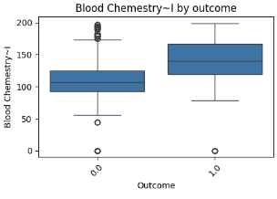
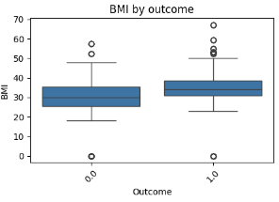
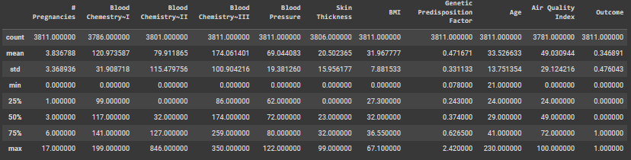
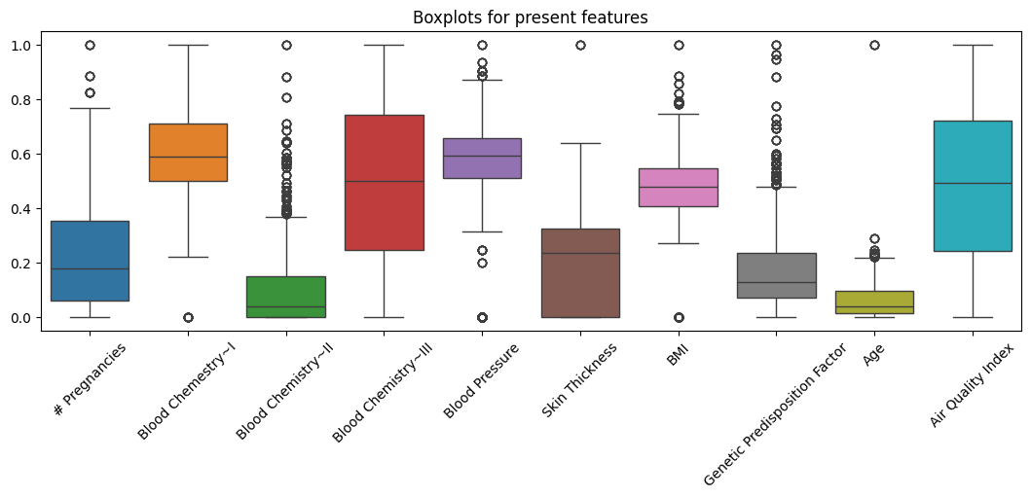
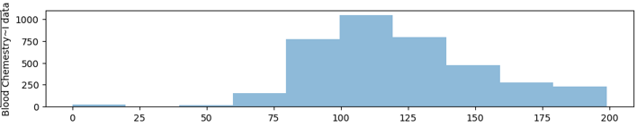
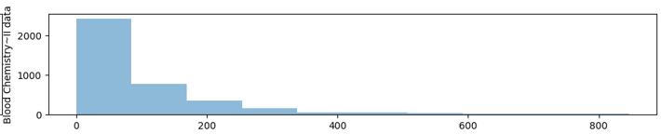
Outliers – Atypical values
Examining the distribution helped point out that some extreme values may have an impact on the outcome. Finally, the decision was made to remove outliers from columns # Pregnancies and Skin Thickness but for other features a logical boundries were set. The data was filtered by:
Age has to be between values 0 and 120
BMI has to be between values 10 and 70
Blood pressure has to be between values 50 and 200
After investigating the data further there was a possibility of detecting some abnormal values (outliers) that may cause the data to be inconsistent. For instance, there is a low probability that a few examined people had 17 pregnancies or a skin thickness level equal to 99 when the average is 20.
Empty values – null values
Data distribution by features
A few records contained empty values in columns Air Quality Index, Blood Chemestry~I and Blood Chemestry~II. The decision on how to handle them was correlated with their data distribution.
Air Quality Index – empty values were filled with the average Air Quality Index of the state of each record
Blood Chemestry~I – empty values were filled with the average Blood Chemestry~I by outcome
Blood Chemestry~II – empty values were filled with the mode of Blood Chemestry~II by outcome

Slide 6
Outliers – Atypical values
After investigating the data further there was a possibility of detecting some abnormal values (outliers) that may cause the data to be inconsistent. For instance, there is a low probability that a few examined people had 17 pregnancies or a skin thickness level equal to 99 when the average is 20.
Data distribution by features

Slide 7
Outliers – Atypical values
After investigating the data further there was a possibility of detecting some abnormal values (outliers) that may cause the data to be inconsistent. For instance, there is a low probability that a few examined people had 17 pregnancies or a skin thickness level equal to 99 when the average is 20.
Examining the distribution helped point out that some extreme values may have an impact on the outcome. Finally, the decision was made to remove outliers from columns # Pregnancies and Skin Thickness but for other features logical boundries were set. The data was filtered by:
Age has to be between values 0 and 120
BMI has to be between values 10 and 70
Blood pressure has to be between values 50 and 200
Data distribution by features
Empty values – null values
A few records contained empty values in columns Air Quality Index, Blood Chemestry~I and Blood Chemestry~II. The decision on how to handle them was correlated with their data distribution.
Air Quality Index – empty values were filled with the average Air Quality Index of the state of each record
Blood Chemestry~I – empty values were filled with the average Blood Chemestry~I by outcome
Blood Chemestry~II – empty values were filled with the mode of Blood Chemestry~II by outcome

Slide 8
Outliers – Atypical values
Examining the distribution helped point out that some extreme values may have an impact on the outcome. Finally, the decision was made to remove outliers from columns # Pregnancies and Skin Thickness but for other features logical boundries were set. The data was filtered by:
Age has to be between values 0 and 120
BMI has to be between values 10 and 70
Blood pressure has to be between values 50 and 200
After investigating the data further there was a possibility of detecting some abnormal values (outliers) that may cause the data to be inconsistent. For instance, there is a low probability that a few examined people had 17 pregnancies or a skin thickness level equal to 99 when the average is 20.
Empty values – null values
Data distribution by features
A few records contained empty values in columns Air Quality Index, Blood Chemestry~I and Blood Chemestry~II. The decision on how to handle them was correlated with their data distribution.
Air Quality Index – empty values were filled with the average Air Quality Index of the state of each record
Blood Chemestry~I – empty values were filled with the average Blood Chemestry~I by outcome
Blood Chemestry~II – empty values were filled with the mode of Blood Chemestry~II by outcome

Slide 9
Outliers – Atypical values
After investigating the data further there was a possibility of detecting some abnormal values (outliers) that may cause the data to be inconsistent. For instance, there is a low probability that a few examined people had 17 pregnancies or a skin thickness level equal to 99 when the average is 20.
Examining the distribution helped point out that some extreme values may have an impact on the outcome. Finally, the decision was made to remove outliers from columns # Pregnancies and Skin Thickness but for other features logical boundries were set. The data was filtered by:
Age has to be between values 0 and 120
BMI has to be between values 10 and 70
Blood pressure has to be between values 50 and 200
Data distribution by features
Empty values – null values
A few records contained empty values in columns Air Quality Index, Blood Chemestry~I and Blood Chemestry~II. The decision on how to handle them was correlated with their data distribution.
Air Quality Index – empty values were filled with the average Air Quality Index of the state of each record
Blood Chemestry~I – empty values were filled with the average Blood Chemestry~I by outcome
Blood Chemestry~II – empty values were filled with the mode of Blood Chemestry~II by outcome

Slide 10
Examining the distribution helped point out that some extreme values may have an impact on the outcome. Finally, the decision was made to remove outliers from columns # Pregnancies and Skin Thickness but for other features logical boundries were set. The data was filtered by:
Age has to be between values 0 and 120
BMI has to be between values 10 and 70
Blood pressure has to be between values 50 and 200
Outliers – Atypical values
Empty values – null values
After investigating the data further there was a possibility of detecting some abnormal values (outliers) that may cause the data to be inconsistent. For instance, there is a low probability that a few examined people had 17 pregnancies or a skin thickness level equal to 99 when the average is 20.
A few records contained empty values in columns Air Quality Index, Blood Chemestry~I and Blood Chemestry~II. The decision on how to handle them was correlated with their data distribution.
Air Quality Index – empty values were filled with the average Air Quality Index of the state of each record
Blood Chemestry~I – empty values were filled with the average Blood Chemestry~I by outcome
Blood Chemestry~II – empty values were filled with the mode of Blood Chemestry~II by outcome
Data distribution by features

Slide 11
Outliers – Atypical values
Examining the distribution helped point out that some extreme values may have an impact on the outcome. Finally, the decision was made to remove outliers from columns # Pregnancies and Skin Thickness but for other features logical boundries were set. The data was filtered by:
Age has to be between values 0 and 120
BMI has to be between values 10 and 70
Blood pressure has to be between values 50 and 200
After investigating the data further there was a possibility of detecting some abnormal values (outliers) that may cause the data to be inconsistent. For instance, there is a low probability that a few examined people had 17 pregnancies or a skin thickness level equal to 99 when the average is 20.
Empty values – null values
Data distribution by features
A few records contained empty values in columns Air Quality Index, Blood Chemestry~I and Blood Chemestry~II. The decision on how to handle them was correlated with their data distribution.
Air Quality Index – empty values were filled with the average Air Quality Index of the state of each record
Blood Chemestry~I – empty values were filled with the average Blood Chemestry~I by outcome
Blood Chemestry~II – empty values were filled with the mode of Blood Chemestry~II by outcome

Slide 12
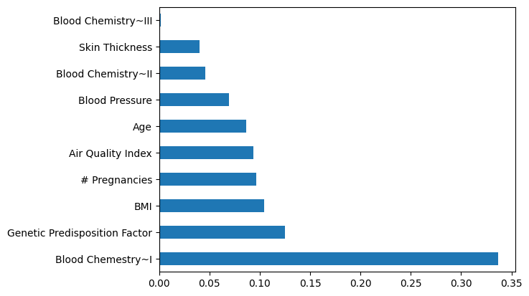
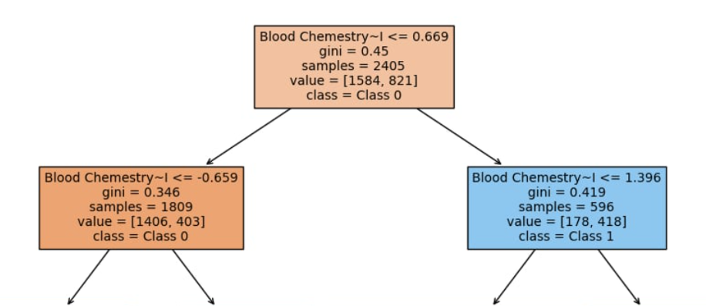
Exploratory Data Analysis
Feature Importance
A further analysis helped discover some key insights.
The target variable (Outcome) indicates that around 35% of the patients in this dataset were labeled as having an illness,
Outcome is correlated the most with Blood Chemistry~I, BMI and Number of Pregnancies suggesting these may be important predictors of the disease,
Number of Pregnancies is strongly correlated with age,
People having an illness tend to have higher Blood Chemestry~I (average 105 vs 71 for healthy people) and Genetic Predisposition Factor (average 0.55 vs 0.42)
Recommendations
Model
Based on the analysis, here are some key recommendations for the doctor to help discover patients at a higher risk for the disease:
Focus on Blood Chemestry~I and Genetic Predisposition Factor as higher values may indicate higher risk for the disease,
Biological factors primarily have a greater impact on the likelihood of illness, but environmental factors, such as air quality, can also play a significant role. Higher air quality index levels are associated with an increased likelihood of diagnosing the illness,
Additional bilogical and environmental factors would be beneficial, so further examination is advised.
The model chosen for this task was Decission tree classifier due to its low complexity and high interpretability. The model enables the doctor to trace the decision-making process that leads to classifying a patient as ill.
Kamil Szkoła

Slide 13
Feature Importance
Exploratory Data Analysis
A further analysis helped discover some key insights.
The target variable (Outcome) indicates that around 35% of the patients in this dataset were labeled as having an illness,
Outcome is correlated the most with Blood Chemistry~I, BMI and Number of Pregnancies suggesting these may be important predictors of the disease,
Number of Pregnancies is strongly correlated with age,
People having an illness tend to have higher Blood Chemestry~I (average 105 vs 71 for healthy people) and Genetic Predisposition Factor (average 0.55 vs 0.42)
Recommendations
Based on the analysis, here are some key recommendations for the doctor to help discover patients at a higher risk for the disease:
Focus on Blood Chemestry~I and Genetic Predisposition Factor as higher values may indicate higher risk for the disease,
Biological factors primarily have a greater impact on the likelihood of illness, but environmental factors, such as air quality, can also play a significant role. Higher air quality index levels are associated with an increased likelihood of diagnosing the illness,
Additional bilogical and environmental factors would be beneficial, so further examination is advised.
Kamil Szkoła
Model
The model chosen for this task was Decission tree classifier due to its low complexity and high interpretability. The model enables the doctor to trace the decision-making process that leads to classifying a patient as ill.

Slide 14
Exploratory Data Analysis
A further analysis helped discover some key insights.
The target variable (Outcome) indicates that around 35% of the patients in this dataset were labeled as having an illness,
Outcome is correlated the most with Blood Chemistry~I, BMI and Number of Pregnancies suggesting these may be important predictors of the disease,
Number of Pregnancies is strongly correlated with age,
People having an illness tend to have higher Blood Chemestry~I (average 105 vs 71 for healthy people) and Genetic Predisposition Factor (average 0.55 vs 0.42)
Feature Importance
Model
The model chosen for this task was Decission tree classifier due to its low complexity and high interpretability. The model enables the doctor to trace the decision-making process that leads to classifying a patient as ill.
Recommendations
Based on the analysis, here are some key recommendations for the doctor to help discover patients at a higher risk for the disease:
Focus on Blood Chemestry~I and Genetic Predisposition Factor as higher values may indicate higher risk for the disease,
Biological factors primarily have a greater impact on the likelihood of illness, but environmental factors, such as air quality, can also play a significant role. Higher air quality index levels are associated with an increased likelihood of diagnosing the illness,
Additional bilogical and environmental factors would be beneficial, so further examination is advised.
Kamil Szkoła

Slide 15
Exploratory Data Analysis
Feature Importance
A further analysis helped discover some key insights.
The target variable (Outcome) indicates that around 35% of the patients in this dataset were labeled as having an illness,
Outcome is correlated the most with Blood Chemistry~I, BMI and Number of Pregnancies suggesting these may be important predictors of the disease,
Number of Pregnancies is strongly correlated with age,
People having an illness tend to have higher Blood Chemestry~I (average 105 vs 71 for healthy people) and Genetic Predisposition Factor (average 0.55 vs 0.42)
Recommendations
Model
Based on the analysis, here are some key recommendations for the doctor to help discover patients at a higher risk for the disease:
Focus on Blood Chemestry~I and Genetic Predisposition Factor as higher values may indicate higher risk for the disease,
Biological factors primarily have a greater impact on the likelihood of illness, but environmental factors, such as air quality, can also play a significant role. Higher air quality index levels are associated with an increased likelihood of diagnosing the illness,
Additional bilogical and environmental factors would be beneficial, so further examination is advised.
The model chosen for this task was Decission tree classifier due to its low complexity and high interpretability. The model enables the doctor to trace the decision-making process that leads to classifying a patient as ill.
Kamil Szkoła

Slide 16
Exploratory Data Analysis
Feature Importance
A further analysis helped discover some key insights.
The target variable (Outcome) indicates that around 35% of the patients in this dataset were labeled as having an illness,
Outcome is correlated the most with Blood Chemistry~I, BMI and Number of Pregnancies suggesting these may be important predictors of the disease,
Number of Pregnancies is strongly correlated with age,
People having an illness tend to have higher Blood Chemestry~I (average 105 vs 71 for healthy people) and Genetic Predisposition Factor (average 0.55 vs 0.42)
Model
The model chosen for this task was Decission tree classifier due to its low complexity and high interpretability. The model enables the doctor to trace the decision-making process that leads to classifying a patient as ill.
Recommendations
Based on the analysis, here are some key recommendations for the doctor to help discover patients at a higher risk for the disease:
Focus on Blood Chemestry~I and Genetic Predisposition Factor as higher values may indicate higher risk for the disease,
Biological factors primarily have a greater impact on the likelihood of illness, but environmental factors, such as air quality, can also play a significant role. Higher air quality index levels are associated with an increased likelihood of diagnosing the illness,
Additional bilogical and environmental factors would be beneficial, so further examination is advised.
Kamil Szkoła

Slide 17
Feature Importance
Recommendations
Based on the analysis, here are some key recommendations for the doctor to help discover patients at a higher risk for the disease:
Focus on Blood Chemestry~I and Genetic Predisposition Factor as higher values may indicate higher risk for the disease,
Biological factors primarily have a greater impact on the likelihood of illness, but environmental factors, such as air quality, can also play a significant role. Higher air quality index levels are associated with an increased likelihood of diagnosing the illness,
Additional bilogical and environmental factors would be beneficial, so further examination is advised.
Kamil Szkoła

