Slide 1
FANUC CRT to LCD Upgrade
Professional Technical Sharing and Case Analysis
Kongto Technology | cncdisplay.com | 2026
Notes:
大家好，今天我将为大家分享一个关于FANUC老旧CNC系统CRT显示器升级为LCD的专业技术案例。这个案例不仅解决了客户的实际痛点，也展示了如何通过技术升级为老旧设备注入新的活力。希望通过这次分享，能为大家在设备改造和维护方面提供一些有价值的参考。

Slide 2
目录CONTENTS
01
02
03
04
05
Project Background & Challenges
Solutions
Installation Details
Upgrade Effects & Value Analysis
Summary & Outlook
"Visual Bottleneck" of Old CNC Systems
Industrial TFT-LCD Replacement Kit
5-Step Upgrade & Transformation
Visual Effects & ROI
Value of Equipment Modernization
Notes:
本次分享将分为五个部分。首先，我们会探讨项目的背景和客户面临的挑战。接着，详细介绍我们提供的工业级LCD替换解决方案。然后，我们会一步步拆解安装实施过程。之后，分析升级带来的实际效果和投资回报。最后，对整个项目进行总结并展望未来。

Slide 3


01
Equipment Aging Dilemma
Production Efficiency Constraints
Project Background & Challenges
Over 10-year-old CNC equipment with severely aged CRT/LCD displays: blurry visuals, distorted colors, limited viewing angles, and poor user experience.
Delayed display response and non-intuitive data presentation lead to significantly reduced debugging/processing efficiency, restricting production capacity.
Visual Bottleneck of Aging CNC Systems
Notes:
First, let's move to Part 1: Project Background and the severe challenges our client faces. In today's smart manufacturing landscape, the display systems of aging equipment have become a major bottleneck restricting productivity.
Please look to the right side. The client's key challenges can be summarized in two points:
1. Visual Dilemma from Equipment Aging: Many CNC machines are over 10 years old, with factory-original CRT or early LCD screens severely aged. They are blurry, have narrow viewing angles, and in the complex lighting of the workshop, workers can barely read the screen, greatly impairing the operating experience.
2. Direct Constraint on Production Efficiency: Aging display systems are not only slow to respond but also have poor interface design with scattered critical data. This lengthens debugging time and increases the risk of errors due to unreadable data. These "visual bottlenecks" have seriously dragged down the entire production line's capacity.
This is the fundamental reason for launching this upgrade project: to break the visual bottleneck and unleash manufacturing potential.

Slide 4




Inherent Defects of CRT Technology and Industrial Application Dilemmas
Lifespan and Attenuation
Safety Hazards
Energy Consumption & Heat
Volume and Weight
The lifespan of CRT core components is about 15,000 hours. After expiration, irreversible issues like brightness drop, poor focus, and color distortion occur.
Internal high voltage (tens of thousands of volts) risks electric shock, and trace X-ray radiation threatens operator health.
Power consumption (25-30W) is much higher than modern displays, generating excessive heat and increasing cooling burdens.
Large volume and heavy weight hinder equipment miniaturization and complicate on-site installation and maintenance.
Notes:
CRT technology has many inherent defects. First, the lifespan is short, and irreversible attenuation occurs after more than 15,000 hours. Second, it has safety hazards of high voltage and radiation. In addition, it has high energy consumption, large heat generation, and is bulky, all of which bring great troubles to industrial applications.

Slide 5
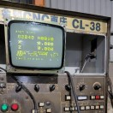


Core Pain Points Faced by Customers
1. Sharp Decline in Display Quality
Insufficient screen brightness, blurry characters, almost unrecognizable in strong light, increasing the risk of visual fatigue and misoperation.
2. High & Unsustainable Maintenance Costs
Original CRTs discontinued; second-hand parts are low-quality, short-lived, and expensive to repair with extremely low ROI.
3. Impact on Production Efficiency & Safety
Blurred display prolongs programming/tool setting; misread parameters may cause scrap or machine collisions.
Notes:
These technical flaws translate directly into three core pain points for customers. First, display quality has seriously degraded, requiring operators to lean close to the screen to see clearly, greatly increasing the risk of misoperation. Second, maintenance costs are high and unsustainable; original parts have long been discontinued, leaving only unreliable second-hand alternatives. Finally, these issues directly impact production efficiency and safety, leading to downtime and increased scrap rates.

Slide 6

02
Solution
Plug-and-Play · Seamless Upgrade
Upgrades CRT to industrial-grade LCD Full compatibility, plug-and-play Industrial-grade reliability & long lifespan
Kongto Industrial TFT-LCD Replacement Kit
Notes:
面对这些挑战，我们提出了一套成熟的解决方案：采用工业级TFT-LCD替换套件，实现“即插即用”的无缝升级，从根本上解决CRT带来的所有问题。

Slide 7
Core Technical Specification Comparison
Feature Comparison
Original CRT (A61L-0001-0093)
Industrial LCD Upgrade
Advantage Interpretation
Display Technology
Cathode Ray Tube (CRT)
Industrial TFT-LCD
Tech generation gap, solving CRT's inherent defects.
Resolution
640×400
800×600
Resolution increased >50%, picture clearer.
Brightness
Approx. 200 cd/m²
350-450 cd/m²
Brightness doubled, adapts to industrial lighting.
Service Life
15,000 hours
50,000+ hours
Lifespan ×3+, stable for over 10 years.
Power Consumption
25-30W
8-12W
Energy saving ~70%, eco-friendly.
Operating Temp
0-40°C
-10~+60°C
Wider range for harsh industrial env.
Radiation/Safety
High voltage/X-ray
Radiation-free
Eliminate hazards, protect health.
Notes:
This is a comparison of core technical specifications between old and new solutions. It can be seen that the LCD solution has achieved comprehensive超越 in all key indicators such as resolution, brightness, lifespan, power consumption, operating temperature and safety. Especially, the lifespan is extended by more than three times and the energy consumption is reduced by 70%, which are tangible advantages.

Slide 8




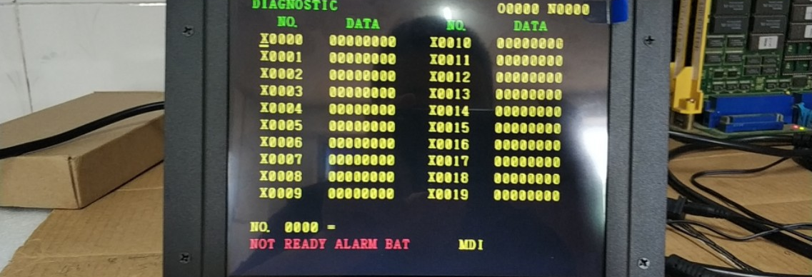
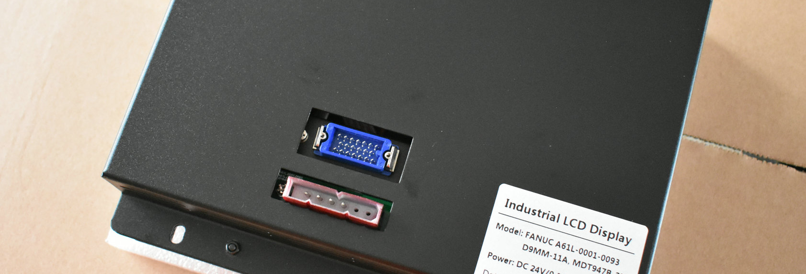
Plug-and-Play Design Concept
Fully Compatible Interface
The signal input interface is completely consistent with the original CRT, directly connected, no need to change the circuit.
Built-in Signal Conversion
The module integrates a dedicated signal conversion board to perfectly convert the FANUC system signal.
Integrated Power Supply
Built-in wide voltage adaptive power supply, directly using the original power supply of the machine tool.
OSD Menu Control
Support calling up the menu through physical buttons to easily adjust brightness, contrast and other parameters.
Notes:
The core advantage of our solution lies in the "plug-and-play" design. It has a fully compatible interface, built-in signal conversion and power modules, and supports OSD menus for parameter adjustment. This means the installation process is very simple and can be completed by ordinary electricians. As you can see, this is our LCD replacement kit, with clear front display and compact back structure.

Slide 9





03
STEP 01
STEP 02
STEP 03
STEP 04
STEP 05
Scheme Confirmation
Power-off Operation
Equipment Installation
Power-on Debugging
Normal Operation
Installation Implementation Details
Confirm the model and installation plan, prepare tools and materials.
Turn off the main power supply of the machine tool and wait for the capacitor to discharge completely.
Remove the old CRT and install the new LCD kit.
Restore the power supply, test the display effect, and fine-tune the parameters.
Confirm that everything is normal and hand over to the customer for use.
Five Steps to Complete the Upgrade · 30 Minutes Quick Fix
Notes:
Next, we will introduce the installation and implementation process in detail. The entire process is very simple, and we have summarized it into five steps. An ordinary electrician can complete it within 30 minutes following the guidelines.
Step 1: Scheme Confirmation. Our solution consultants will visit the site in advance, and based on your on-site circuit environment and renovation requirements, issue a detailed renovation plan and a list of required accessories to ensure everything is foolproof.
Step 2: Power-off Operation. For safety reasons, you must first cut off the main power supply of the corresponding circuit, and use a test pen to confirm the absence of voltage again before starting the subsequent wiring operations.
Step 3: Equipment Installation. Our smart module is compact and can be directly fixed in the original switch back box. During installation, you only need to connect the live wire and load wire according to the clear markings on the module, without requiring complex professional knowledge.
Step 4: Power-on Debugging. After wiring is completed, restore the main power supply, check the indicator light status of the device, confirm that the basic on/off function of the switch is normal, and ensure the physical renovation is completed.
Step 5: Normal Operation. Take out your phone and scan the QR code on the device to add it to our management platform, then configure scene linkage according to personal habits, and all smart functions will be activated.
Through this standardized five-step process, even inexperienced users can easily complete the smart upgrade and renovation of the entire house.

Slide 10

Installation Steps (1-3)
⚠️ Preparation: Safety First
1. Prepare tools (Phillips screwdriver, anti-static wristband) to prevent electrostatic damage. 2. Turn off the main power and wait 10+ minutes for full discharge.
01
Remove CRT Display
• Remove the plastic housing of the panel. • Unscrew the four CRT fixing screws. • Disconnect the signal/power cables.
02
Install LCD Kit
• Place the LCD kit into position. • Align and tighten the screws. • Ensure no screen obstruction.
03
Connect Cables
• Connect signal cable to LCD. • Connect power cable properly. • Check all connections are secure.
Notes:
Before installation, prepare tools and ensure power is off for safety. Step 1: Remove the old CRT display carefully, especially disconnecting the high-voltage cable. Step 2: Place the new LCD kit in the original position and secure it. Step 3: Connect the signal and power cables (interfaces are fool-proof designed).

Slide 11
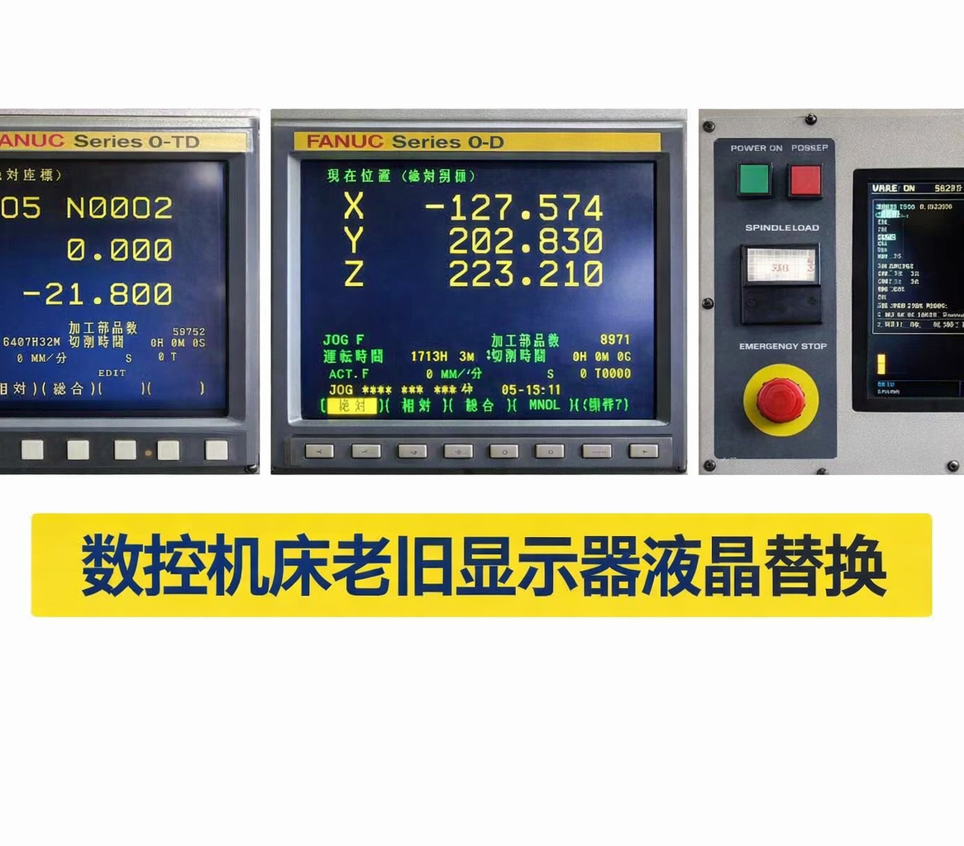
Installation Steps & Effect Demonstration
04
Power-on Test & Debugging
• Restore main power and test all functions. • Adjust brightness/contrast via OSD for optimal display.
05
Completion & Acceptance
• Ensure all parameters display clearly. • Clean up site and complete handover.
Front View After Upgrade:
New LCD screen with high color accuracy and clear picture, improving visibility.
Notes:
Step 4 is power-on test: adjust via OSD after startup. Step 5 is acceptance: confirm normal display. The picture on the right shows the clear and bright effect after installation.

Slide 12

04
Performance & Value Analysis
PERFORMANCE & ROI ANALYSIS
In-depth analysis of core performance metrics and long-term business value transformation
Visual Effects & ROI
Notes:
安装完成后，升级效果是立竿见影的。在第四部分，我们将分析升级带来的直观效果和长期的投资回报价值。

Slide 13
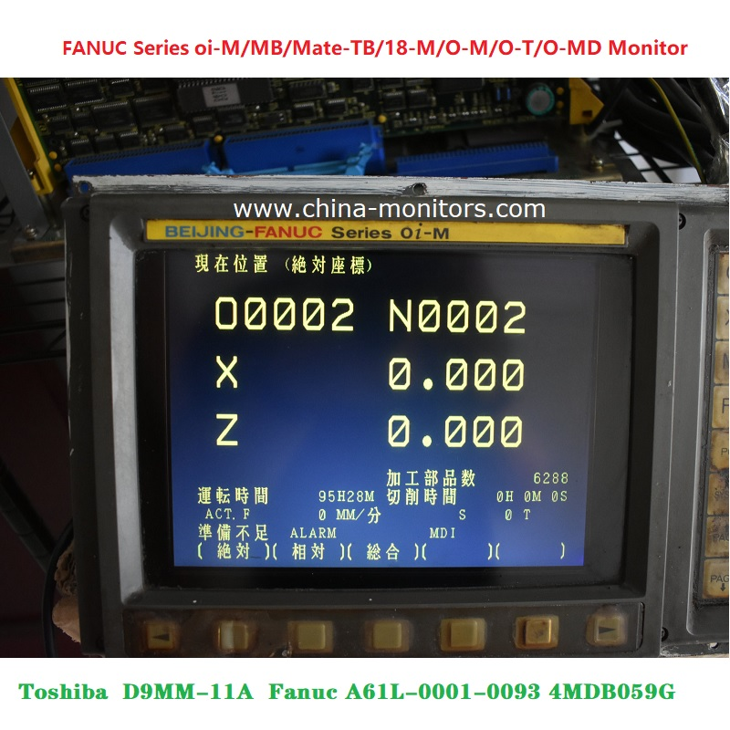




Upgrade Effects & ROI Analysis
01 / Visual Effect Comparison
Display Quality
Efficiency
Stability
Bid farewell to blur and flicker, achieving clear images and a stable, flicker-free visual experience.
Significantly optimizes operation, reducing programming time by an average of 15%.
Eliminates unexpected downtime caused by aging CRT monitor failures.
02 / ROI Analysis
Annual Maint Cost
¥2,000
Annual Loss
¥25,000
Upgrade Cost
¥1k - 3k
Payback Period
Based on cost savings & gains
≈ 1 Month
Notes:
The upgrade results are significant: display quality is greatly improved, operation efficiency is reduced by an average of 15%, and equipment stability is guaranteed. Considering maintenance savings and efficiency gains, the upgrade cost can be fully recovered in about 1 month. The LCD's lifespan of up to 50,000 hours means maintenance-free operation for over 10 years.

Slide 14
05
KONGTO
Technology
Summary and Outlook
Review the key milestones and core achievements of the project, and explore the infinite possibilities of future intelligent upgrades.
The Value of Equipment Modernization
www.cncdisplay.com
Notes:
最后，让我们对本次项目进行总结，并展望未来。

Slide 15


Summary and Outlook
Summary
Outlook
This upgrade and renovation is a typical modernization project with"Small Investment, Big Return". It not only directly resolves the pain points in operation and maintenance of the old display system, but also, by systematically improving the usability and stability of the equipment, unblocks the key links of production information flow, laying a solid and reliable hardware foundation for the enterprise's digital transformation.
Amid the wave of intelligent manufacturing, localized and key technical upgrades to existing equipment are a pragmatic and efficient path for enterprises toEnhance Core Competitiveness. By introducing mature, cost-effective alternative technologies, enterprises can significantly extend asset life and optimize operating costs without bearing the capital expenditure of large-scale new equipment, ultimately achieving the strategic goals of "cost reduction, efficiency improvement, and quality enhancement".
Notes:
In summary, this upgrade is a typical "Small Investment, Big Return" project. It not only solves immediate problems but also, more importantly, lays the foundation for the enterprise's digital transformation. Looking ahead, we believe that key technological upgrades to existing equipment will be an important means for enterprises to achieve cost reduction, efficiency improvement, and enhanced competitiveness.

Slide 16
Q & A
Thank you for watching
Kongto Technology | cncdisplay.com | Professional Industrial Display Solutions Provider
szkongto01@foxmail.com
Notes:
我的分享到此结束，感谢大家的聆听。现在是问答环节，欢迎大家提问。

