Slide 1
UESTC ID:
GUID:

Slide 2
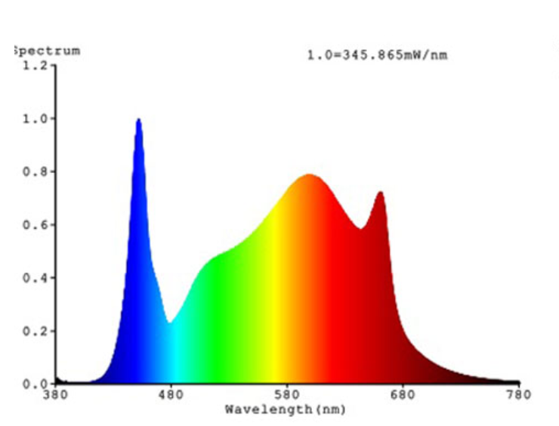
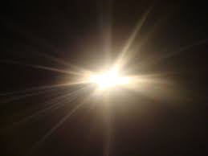
USB Spectrometer
FT

Slide 3
Structure of the spectrometer
Diffraction Grating
Source
Single Slit
USB Camera

Slide 4
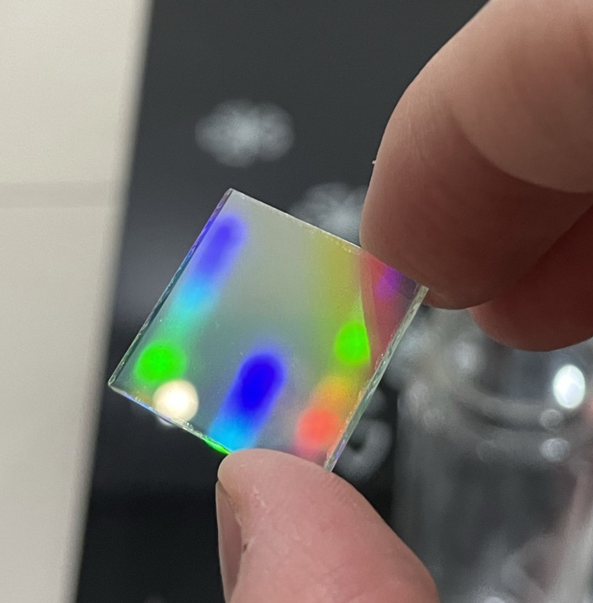
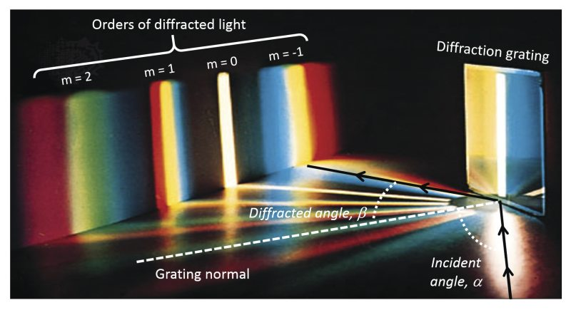
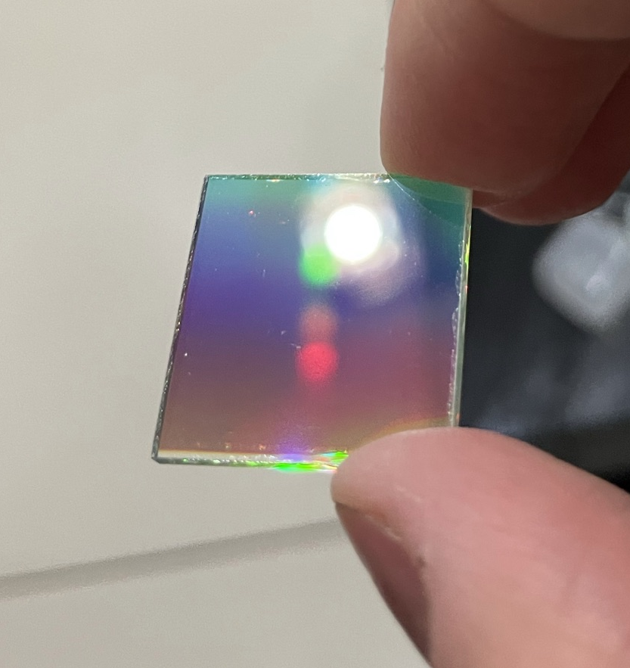
Diffraction Grating

Slide 5

Diffraction Grating
Combination of multi-split interference and single-split diffraction
$$d\left(\sin\left(θ_{i}\right)−\sin\left(θ_{m}\right)\right)=mλ$$
$$θ_{m}=arcsin\left(\sin\left(θ_{i}\right)−\frac{mλ}{d}\right)$$

Slide 6
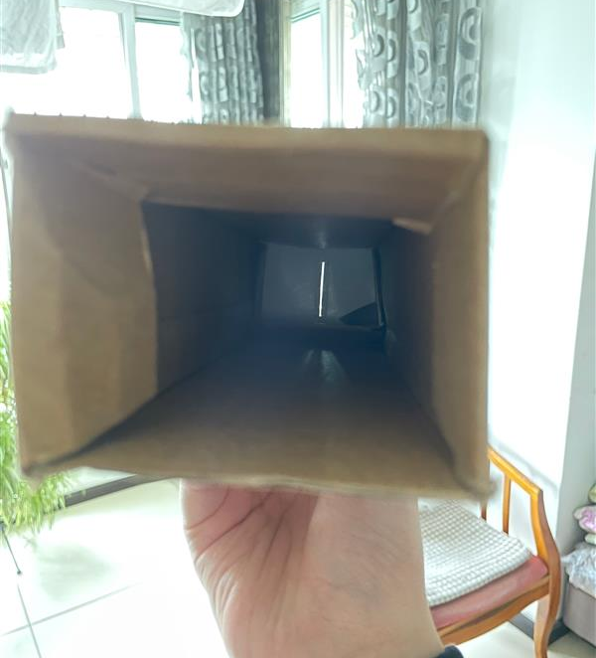
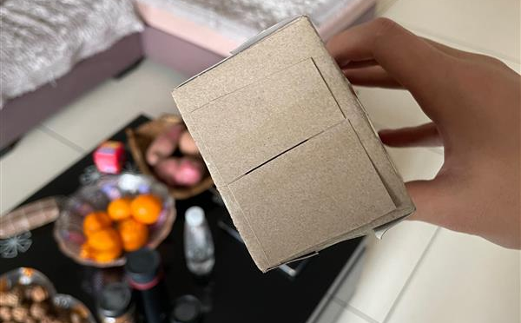
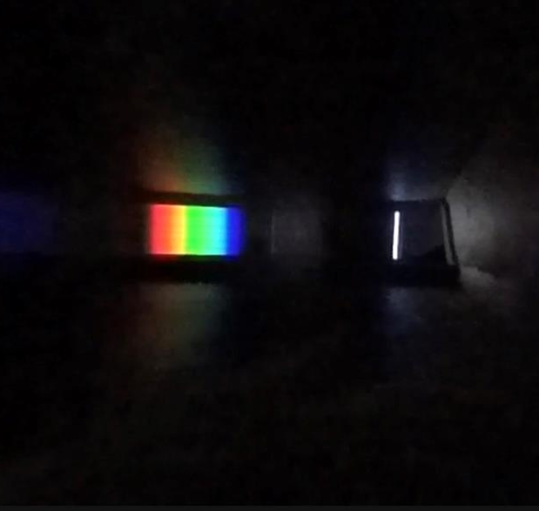
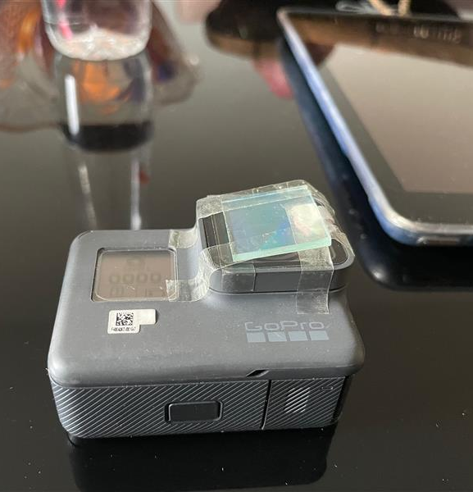
Hardware Demo

Slide 7
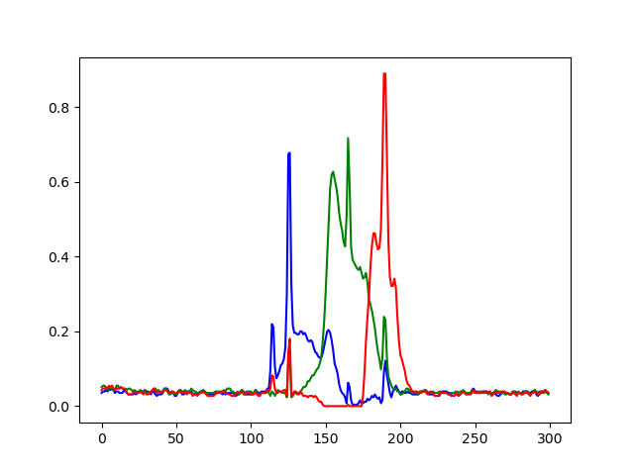
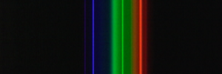




Software Demo
Using following open-source tools

Slide 8
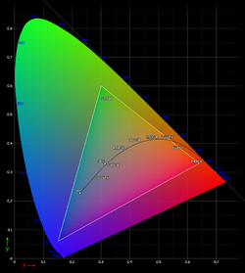
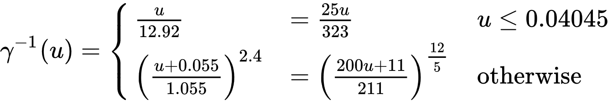
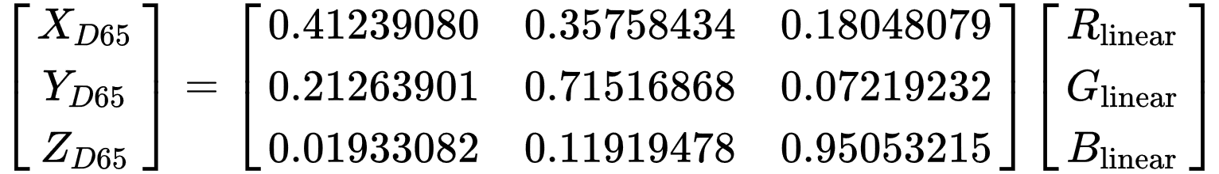
Luminance Calibration
Where u is RGB in SRGB
The Value Y is the relatively luminance

Slide 9
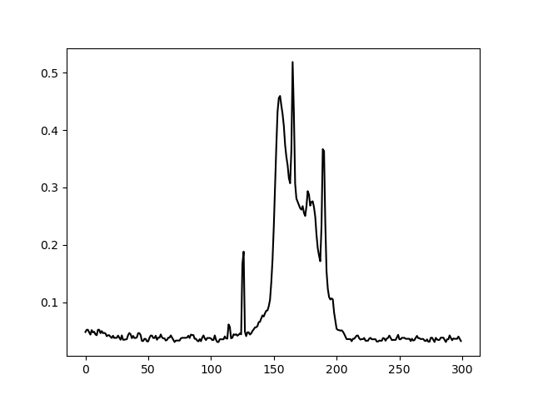
Luminance Calibration

Slide 10
Work to be done...
Mapping the X-axis to wavelength
Made an easy-to-use GUI

