Slide 1
虛擬化技術 Virtualization Technique
System Virtualization
Memory Virtualization

Slide 2
Agenda
Basic concept of memory management
Brief introduction to ARM v7 AMSA
Memory Virtualization
Shadow page table
Hardware assistance
Comparison

Slide 3
Basic concept of memory management

Slide 4
Memory Management Unit
A hardware component responsible for handling accesses to memory requested by the CPU
Address translation: virtual address to physical address (VA to PA)
Memory protection
Cache control
Bus arbitration
Page tables are maintained by operating system, and MMU only references them.
TLB updates are performed automatically by page-table walking hardware

Slide 5
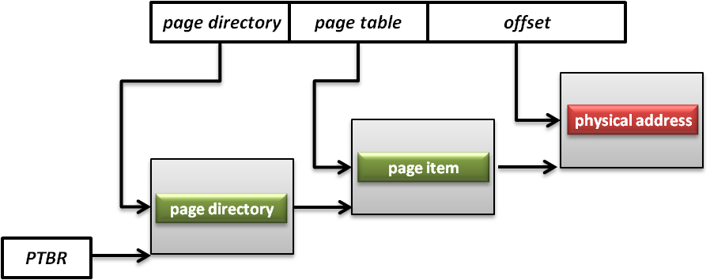
Page Tables
A page table is the data structure used by a virtual memory system to store the mapping between virtual addresses and physical addresses
Translation table base register(TTBR)
Also called page table base register
A register that stores the address of the base page table for MMU

Slide 6
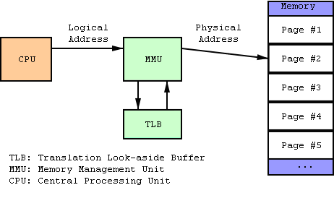
TLB
Translation look-aside buffer
A CPU cache that memory management hardware uses to improve virtual address translation speed
The TLB is typically implemented as content-addressable memory (CAM)
The CAM search key is the virtual address and the search result is a physical address

Slide 7
Brief introduction to ARMv7 VMSA

Slide 8
ARMv7 VMSA
VMSA: Virtual memory system architecture
Support four mapping types
16MB Super section
1MB Section
64KB Large page
4KB Small page
Basically a 32-bit two-layer translation table
Other features (virtualization extension and 64-bit large physical address extension) would be mentioned in the future class

Slide 9
L1 Page Table
First-level table
Translation properties for a Section and Super-section
Translation properties and pointers to a second-level table for a Large page or a Small page.
L1 descriptor[1:0]
0b00, invalid or fault entry
Translation fault
0b01, page table
Address of 2nd level translation table
0b10, section of super-section
0b11, special usage with PXN attribute

Slide 10
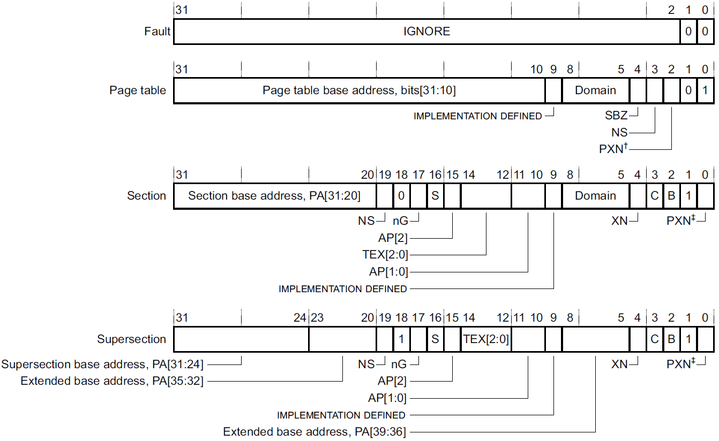
1st Page Table Descriptor

Slide 11
L2 Page Table
Second-level tables
The base address and translation properties for a Small page or a Large page.
That is, page tables
1KB
L2 descriptor[1:0]
0b00, invalid or fault entry
Translation fault
0b01, large page
0b1x, small page

Slide 12
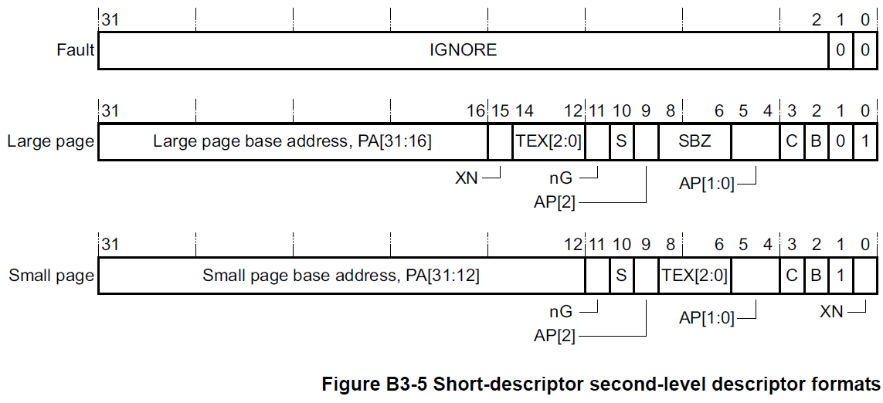
2nd Page Table Descriptor

Slide 13
Memory Virtualization
Concepts
Shadow page table
Hardware assistance
Comparison

Slide 14
Memory Management on a VM
Traditionally, OS fully controls all physical memory space and provides a continuous addressing space to each process
Guest OS is just one of user space processes of host OS
If guest OS is allowed to access the physical memory arbitrarily, then what happens?
In system virtualization, VMM should make all virtual machines share the physical memory space

Slide 15
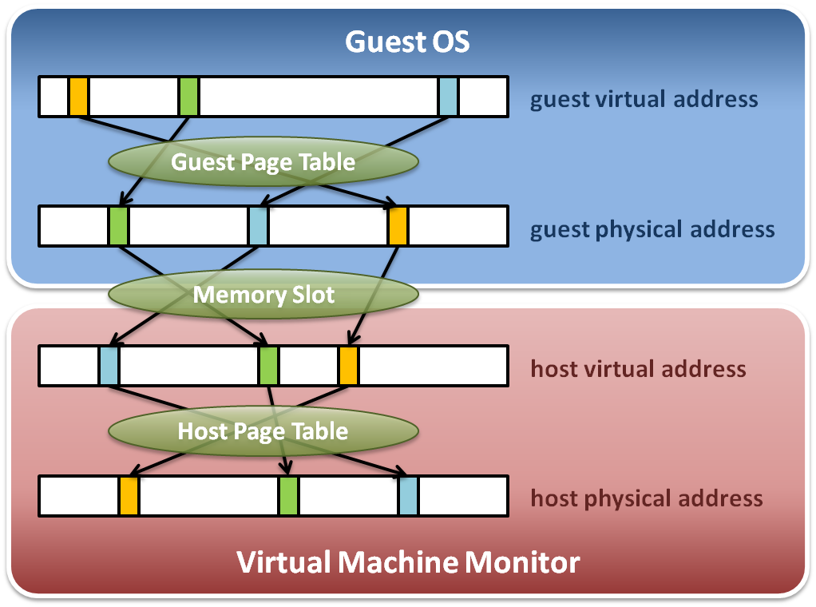
Memory Virtualization
Memory virtualization architecture

Slide 16
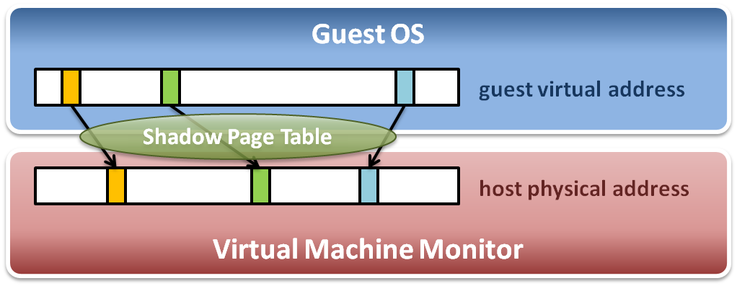
Memory Virtualization
The performance drop of memory access is usually unbearable. VMM needs further optimization.
VMM maintains shadow page tables :
Direct virtual-to-physical address mapping
Use hardware TLB for address translation

Slide 17
Goals of Memory Virtualization
Address Translation
Control table-walking hardware that accesses translation tables in main memory.
Memory Protection
Define access permission which uses the Access Control Hardware.
Access Attribute
Define attribute and type of memory region to direct how memory operation to be handled.
How to implement?
Software solution: shadow page table
Hardware solution
NPT on SVM from AMD
EPT on VMX from Intel
ARM v7 VMSA (Virtual Memory System Architecture) with virtualization extension

Slide 18
Memory Virtualization
Concepts
Shadow page table
Hardware assistance
Comparison

Slide 19
Shadow Page Table
Map guest virtual address to host physical address
Shadow page table
Guest OS will maintain its own virtual memory page table in the guest physical memory frames.
For each guest physical memory frame, VMM should map it to host physical memory frame.
Shadow page table maintains the mapping from guest virtual address to host physical address.
Page table protection
VMM will apply write protection to all the physical frames of guest page tables, which lead the guest page table write exception and trap to VMM.

Slide 20
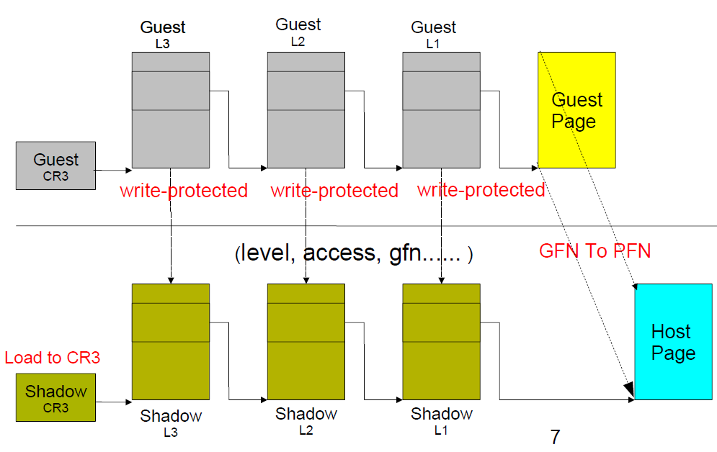
Shadow Page Table: Overview

Slide 21
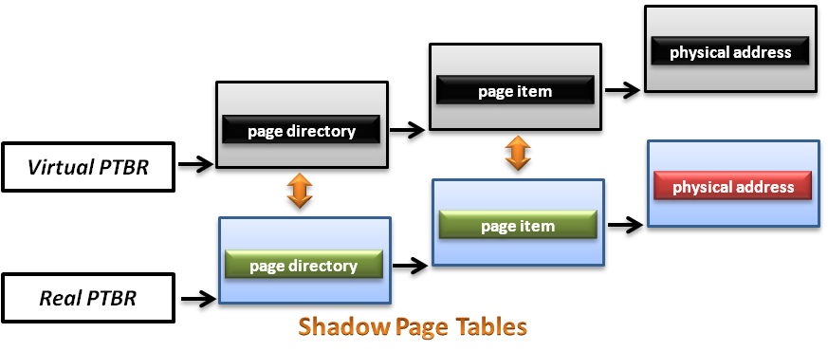
Shadow Page Table
How does this technique work ?
VMM should make MMU virtualized
VMM manages the real PTBR and a virtual PTBR for each VM
When a guest OS is activated, the real PTBR points to the corresponding shadow page table of the guest OS
When the guest OS attempts to modify the PTBR, it will be intercepted by VMM for further emulation

Slide 22
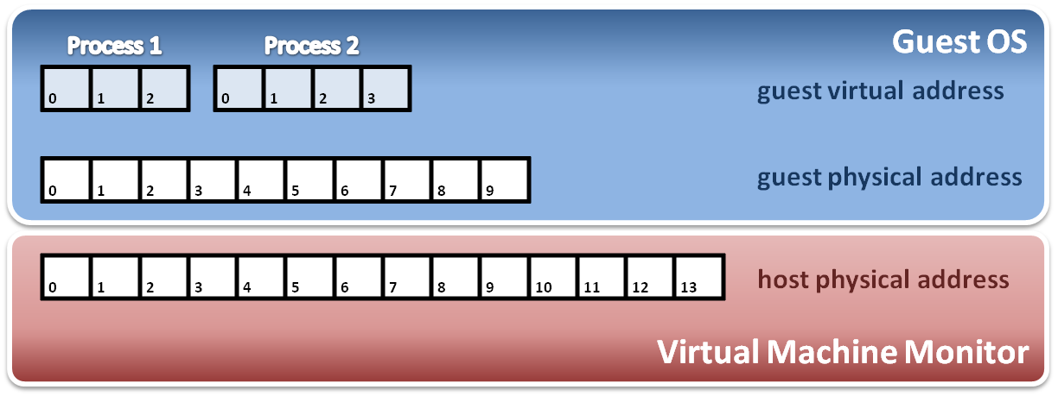
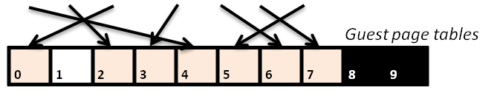
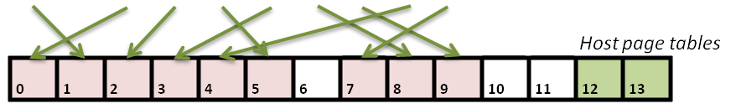
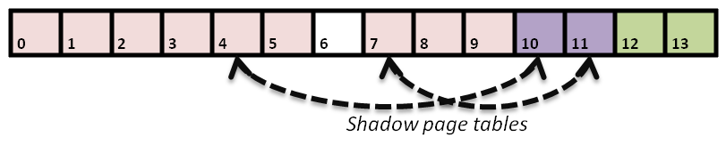
Shadow Page Table
Construct shadow page table
Guest OS will maintain its own page table for each process.
VMM maps each guest physical page to host physical page.
Create shadow page tables for each guest page table.
VMM should protect host frame which contains guest page table. (that means to write protect the guest page tables in host memory)
Write protection

Slide 23
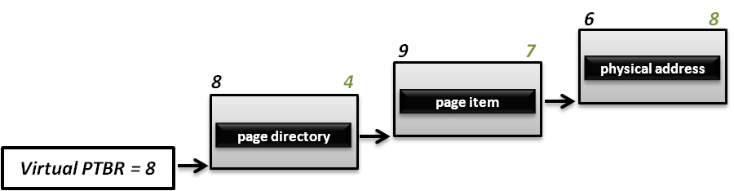
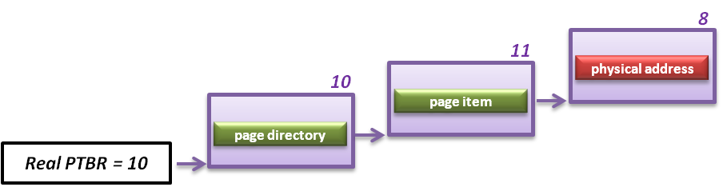
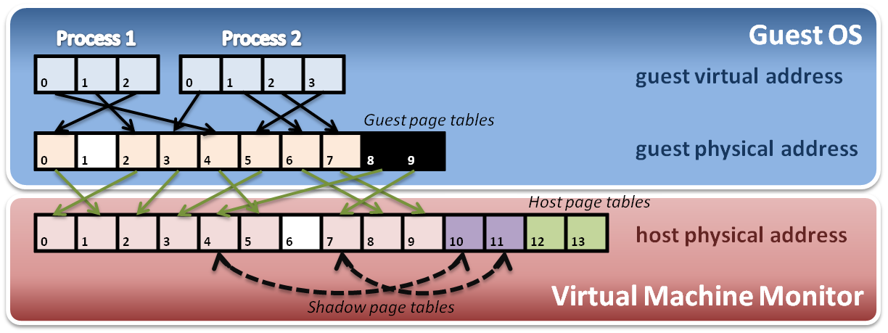
Shadow Page Table
Implement with PTBR :
For example, process 2 in guest OS wants to access its memory whose page number is 1.

Slide 24
SPT Maintenance
If guest OS modify one of its page tables, then the corresponding entry of SPT must be updated.
We call it “shadow” because SPT is just like the shadow of page tables of guest OS.
How to identify this kind of modification?
Guest OS could read/write a physical frame with the help of SPT.
Mark those physical frames used as guest page tables read-only, so that when a guest OS tries to modify its guest page table, an exception would be triggered.
Then VMM checks the modification and updates the corresponding entry on SPT

Slide 25
Shadow Page Table
Shadow page table operations :
Context switch
New process
Access
Process 1
Page Table
Process 2
Page Table
Process 3
Page Table
Virtual PTPR
Guest OS
Real PTPR
VMM
Page fault !
Shadow 1
Page Table
Shadow 1
Page Table
Shadow 3
Page Table
Load !
Corresponding mapping table
Switch the pointer to new location
Create new shadow page table mapping to new process

Slide 26
Big Overhead
A page fault caused by guest OS would launch the walking process that costs a lot of overhead.
Several steps to get a new entry on shadow page table
Walk page tables on guest OS
Check the permission on guest
Offset shift: GPA to HVA
Walk page tables on VMM
Check the permission on VMM
New entry established!
Invalidate the TLB entry
Each new process on guest OS would consume two pages. One is the page table on guest OS, and the other is the corresponding shadow page table.

Slide 27
Page Walking Process on ARM
PABT / DABT
Trap
Real MMU Behavior
Shadow Table Behavior
1
2
3
Initial
Synchronization
Guest
Page Table
Walker
Guest
Permission
Checker
MMIO
Access
Checker
Shadow Page Table
Mapping
Shadow Page Table
Update
True permission fault
Hidden translation fault
True translation fault
MMIO emulation

Slide 28
Step 1
While a page fault is occurred, Guest Page Table Walker will walk through guest page table to check if the fault is from guest
PABT / DABT
Trap
1
Guest
Page Table
Walker
Guest
Permission
Checker
MMIO
Access
Checker
Shadow Page Table
Mapping
Shadow Page Table
Update
True permission fault
Hidden translation fault
True translation fault
MMIO emulation

Slide 29
Step 2
Step 2 will check if guest access permission is not allowed
PABT / DABT
Trap
2
Guest
Page Table
Walker
Guest
Permission
Checker
MMIO
Access
Checker
Shadow Page Table
Mapping
Shadow Page Table
Update
True permission fault
Hidden translation fault
True translation fault
MMIO emulation

Slide 30
Step 3
Step 3 will check if the guest physical memory address used is located in the range of MMIO address
PABT / DABT
Trap
3
Guest
Page Table
Walker
Guest
Permission
Checker
MMIO
Access
Checker
Shadow Page Table
Mapping
Shadow Page Table
Update
True permission fault
Hidden translation fault
True translation fault
MMIO emulation

Slide 31
Steps 4 & 5
Step 4 and step 5 are used to build up shadow page tables and maintain their consistency between guest and shadow ones
PABT / DABT
Trap
4
5
Guest
Page Table
Walker
Guest
Permission
Checker
MMIO
Access
Checker
Shadow Page Table
Mapping
Shadow Page Table
Update
True permission fault
Hidden translation fault
True translation fault
MMIO emulation

Slide 32
Optimization For SPT
Para-virtualization
Reduce VM exits
Guest OS would send a hyper call to VMM when guest OS sets the page table entries.
This method will eliminate from using write-protection for synchronization
No trap for non-present PTEs
Reduce VM exits
If the page-fault is caused by PTE not present, it is not intercepted by the host
Only works on VMX

Slide 33
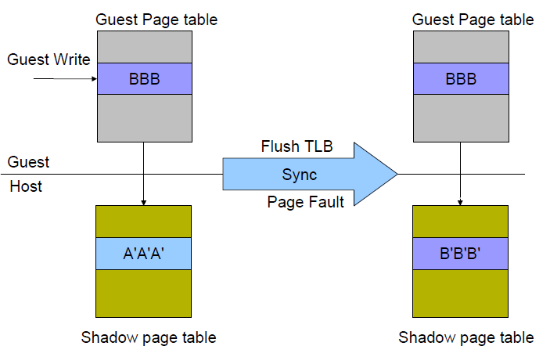
Optimization For SPT
Un-synchronize shadow page table pages
Reduce VM exits
Allow the guest page table to be writable if and only if the page is the last level page-structure (level 1)
Based on TLB rules
We need to flush TLB
to ensure the translation
use the modified page
structures, then we can
Intercept the TLB flush
operations and sync shadow
pages
Sometimes, TLB need not
be flushed, then it can be
synced through page fault

Slide 34
Optimization for SPT
KSM: kernel shared memory
Kernel space
Kernel space
User space
User space
Guest Process 1
Guest Process 2
Shadow table
Kernel space
Shadow table
The shadow tables of kernel space
are shared by all guest processes
User space
Shadow table

Slide 35
Other Issues
Page fault and page protection issue
When a physical page fault occurs, VMM needs to decide whether this exception should be injected to guest OS or not
If the page entry in a guest page table is still valid, VMM prepares for the corresponding page and does not inject any exception to guest OS.
If the page entry in a guest page table is invalid, then VMM directly injects the virtual page fault to guest OS.

Slide 36
Memory Virtualization
Concepts
Shadow page table
Hardware assistance
Comparison

Slide 37
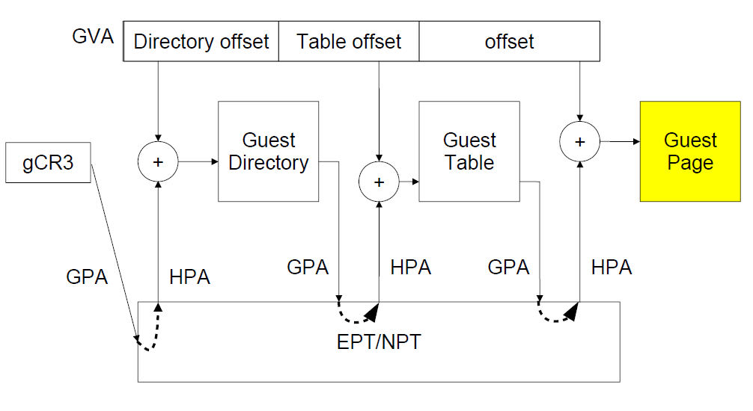
Hardware Assistance: Overview

Slide 38
Hardware Solution
Difficulties of shadow page table technique :
Shadow page table implementation is extremely complex.
Page fault mechanism and synchronization issues are critical.
Host memory space overhead is considerable.
But why we need this technique to virtualize MMU ?
MMU do not first implemented for virtualization.
MMU is knowing nothing about two level page address translation.
Now, let us consider hardware solution.

Slide 39
Extended Page Table
Concept of Extended Page Table (EPT) :
Instead of walking along with only one page table hierarchy, EPT technique implement one more page table hierarchy.
One page table is maintained by guest OS, which is used to generate guest physical address.
The other page table is maintained by VMM, which is used to map guest physical address to host physical address.
For each memory access operation, EPT MMU directly gets the guest physical address from guest page table, and then gets the host physical address by the VMM mapping table automatically.

Slide 40
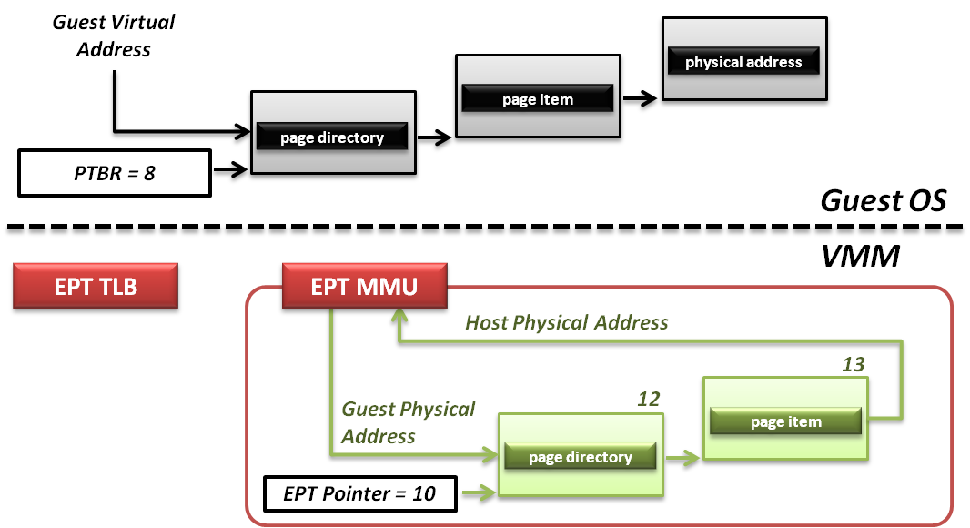
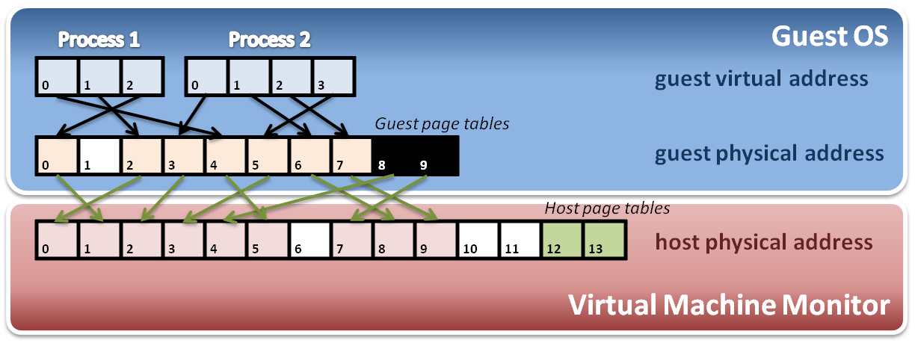
Extended Page Table
Memory operation :
6
8
9
7
8
4
Data

Slide 41
Memory Virtualization
Concepts
Shadow page table
Hardware assistance
Comparison

Slide 42
Question
Computer architecture with virtualization extension is a trend.
Hardware-assisted techniques replace many software methods of virtualization.
However, is hardware-assisted implementation a definite winner?

Slide 43
Comparisons
Hardware-assisted
Software solution
Walk any requested address
Appropriate to programs that have a large amount of page table miss when executing
Less chance to exit VM (less context switch)
Two-layer EPT
Means each access needs to walk two tables
Easier to develop
Many particular registers
Hardware helps guest OS to notify the VMM
Only walk when SPT entry miss
Appropriate to programs that would access only some addresses frequently
Every access might be intercepted by VMM (many traps)
One reference
Fast and convenient when page hit
Hard to develop
Two-layer structure
Complicated reverse map
Permission emulation

Slide 44
Combination?
Is hardware-assisted implementation a definite winner?
No
How about combining these two methods?
Selective memory virtualization
The VMM can dynamically choose the memory management mechanism depending on the executing status.
Challenge
Hard to figure out the standard that we judge a program performs too many page table misses
An accurate algorithm to sample behaviors of a program is necessary
Group from Peking University completed a selective solution on VEE 2011
Gain just a little bit performance improvement
For now, it’s not worth to do so.

Slide 45
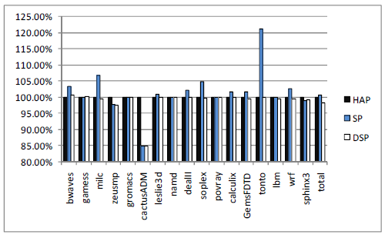
Selective Memory Virtualization
Experiment data
The bar shows the normalized execution time
The lower, the better.
HAP: hardware-assisted page table
SP: shadow page table
DSP: dynamic selective page table
Take hardware extension as 100%
We can see that…
Generally HAP is faster than SPT, but not always.
The performance of DSP is best , but only tiny disparities. (about 2%)

Slide 46
Memory Virtualization Summary
Software implementation
Memory architecture
MMU (memory management unit)
TLB (translation look-aside buffer)
Shadow page table
MMU virtualization by virtual PTBR
Shadow page table construction
Page fault and page table protection
Hardware assistance
Extended page table
Hardware walk guest and host page table simultaneously

Slide 47
Reference
Selective hardware/software memory virtualization
http://www.cs.mtu.edu/~zlwang/papers/vee11.pdf
ARM® Architecture Reference Manual: ARMv7-A and ARMv7-R edition

