Slide 1



Xen 3.0 and the Art of Virtualization
Ian Pratt
XenSource Inc. and University of Cambridge
Keir Fraser, Steve Hand, Christian Limpach and many others…
Computer Laboratory
Notes:
Gerd Knor of Suse, Rusty Russell, Jon Mason and Ryan Harper of IBM

Slide 2
Outline
Virtualization Overview
Xen Architecture
New Features in Xen 3.0
VM Relocation
Xen Roadmap
Questions

Slide 3
Virtualization Overview
Single OS image: OpenVZ, Vservers, Zones
  Group user processes into resource containers
  Hard to get strong isolation
Full virtualization: VMware, VirtualPC, QEMU
  Run multiple unmodified guest OSes
  Hard to efficiently virtualize x86
Para-virtualization: Xen
  Run multiple guest OSes ported to special arch
  Arch Xen/x86 is very close to normal x86
Notes:
POPF doesn’t trap if executed with insufficient privilege

Slide 4
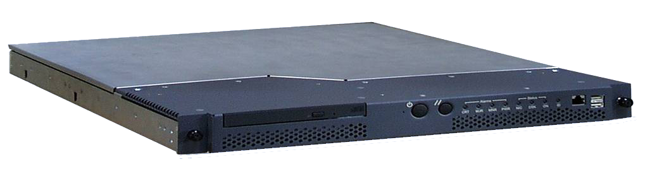




Virtualization in the Enterprise
Consolidate under-utilized servers
X
Avoid downtime with VM Relocation
Dynamically re-balance workload
to guarantee application SLAs
X
X
Enforce security policy

Slide 5
Xen 2.0 (5 Nov 2005)
Secure isolation between VMs
Resource control and QoS
Only guest kernel needs to be ported
  User-level apps and libraries run unmodified
  Linux 2.4/2.6, NetBSD, FreeBSD, Plan9, Solaris
Execution performance close to native
Broad x86 hardware support
Live Relocation of VMs between Xen nodes
Notes:
Commercial / production use
Released under the GPL; Guest OSes can be any licensce

Slide 6
Para-Virtualization in Xen
Xen extensions to x86 arch
  Like x86, but Xen invoked for privileged ops
  Avoids binary rewriting
  Minimize number of privilege transitions into Xen
  Modifications relatively simple and self-contained
Modify kernel to understand virtualised env.
  Wall-clock time vs. virtual processor time
    Desire both types of alarm timer
  Expose real resource availability
    Enables OS to optimise its own behaviour
Notes:
X86 hard to virtualize so benefits from more modifications than is necessary for IA64/PPC
popf
Avoiding fault trapping : cli/sti can be handled at guest level

Slide 7
Xen 2.0 Architecture
VM0
VM1
VM2
VM3
Device
Manager &
Control s/w
Unmodified
User
Software
Unmodified
User
Software
Unmodified
User
Software
GuestOS
(XenLinux)
GuestOS
(XenLinux)
GuestOS
(XenLinux)
GuestOS
(Solaris)
Back-Ends
Native
Device
Drivers
Front-End
Device Drivers
Front-End
Device Drivers
Front-End
Device Drivers
Control IF
Safe HW IF
Event Channel
Virtual CPU
Virtual MMU
Xen Virtual Machine Monitor
Hardware (SMP, MMU, physical memory, Ethernet, SCSI/IDE)

Slide 8
Xen 3.0 Architecture
VM0
VM1
VM2
VM3
Device
Manager &
Control s/w
Unmodified
User
Software
Unmodified
User
Software
Unmodified
User
Software
GuestOS
(XenLinux)
GuestOS
(XenLinux)
GuestOS
(XenLinux)
Unmodified
GuestOS
(WinXP))
AGP
ACPI
PCI
Back-End
SMP
Native
Device
Drivers
Front-End
Device Drivers
Front-End
Device Drivers
Front-End
Device Drivers
VT-x
x86_32
x86_64
IA64
Control IF
Safe HW IF
Event Channel
Virtual CPU
Virtual MMU
Xen Virtual Machine Monitor
Hardware (SMP, MMU, physical memory, Ethernet, SCSI/IDE)

Slide 9
I/O Architecture
Xen IO-Spaces delegate guest OSes protected access to specified h/w devices
  Virtual PCI configuration space
  Virtual interrupts
  (Need IOMMU for full DMA protection)
Devices are virtualised and exported to other VMs via Device Channels
  Safe asynchronous shared memory transport
  ‘Backend’ drivers export to ‘frontend’ drivers
  Net: use normal bridging, routing, iptables
  Block: export any blk dev e.g. sda4,loop0,vg3
(Infiniband / “Smart NICs” for direct guest IO)

Slide 10
System Performance
1.1
1.0
0.9
0.8
0.7
0.6
0.5
0.4
0.3
0.2
0.1
0.0
L
X
V
U
L
X
V
U
L
X
V
U
L
X
V
U
SPEC INT2000 (score)
Linux build time (s)
OSDB-OLTP (tup/s)
SPEC WEB99 (score)
Benchmark suite running on Linux (L), Xen (X), VMware Workstation (V), and UML (U)

Slide 11
TCP results
1.1
1.0
0.9
0.8
0.7
0.6
0.5
0.4
0.3
0.2
0.1
0.0
L
X
V
U
L
X
V
U
L
X
V
U
L
X
V
U
Tx, MTU 1500 (Mbps)
Rx, MTU 1500 (Mbps)
Tx, MTU 500 (Mbps)
Rx, MTU 500 (Mbps)
TCP bandwidth on Linux (L), Xen (X), VMWare Workstation (V), and UML (U)
Notes:
disk is easy
new IO isn’t as fast as not all ring 0 ; win big time

Slide 12
Scalability
1000
800
600
400
200
0
L
X
L
X
L
X
L
X
2
4
8
16
Simultaneous SPEC WEB99 Instances on Linux (L) and Xen(X)

Slide 13
x86_32
Xen reserves top of VA space
Segmentation protects Xen from kernel
System call speed unchanged
Xen 3 now supports PAE for >4GB mem
4GB
S
Xen
Kernel
S
3GB
ring 0
ring 1
User
ring 3
U
0GB

Slide 14
x86_64
2⁶⁴
Large VA space makes life a lot easier, but:
No segment limit support
Need to use page-level protection to protect hypervisor
Kernel
U
Xen
S
2⁶⁴-2⁴⁷
Reserved
2⁴⁷
User
U
0

Slide 15
x86_64
Run user-space and kernel in ring 3 using different pagetables
  Two PGD’s (PML4’s): one with user entries; one with user plus kernel entries
System calls require an additional syscall/ret via Xen
Per-CPU trampoline to avoid needing GS in Xen
r3
User
U
r3
Kernel
U
syscall/sysret
r0
Xen
S

Slide 16
x86 CPU virtualization
Xen runs in ring 0 (most privileged)
Ring 1/2 for guest OS, 3 for user-space
  GPF if guest attempts to use privileged instr
Xen lives in top 64MB of linear addr space
  Segmentation used to protect Xen as switching page tables too slow on standard x86
Hypercalls jump to Xen in ring 0
Guest OS may install ‘fast trap’ handler
  Direct user-space to guest OS system calls
MMU virtualisation: shadow vs. direct-mode

Slide 17
MMU Virtualization : Direct-Mode
guest reads
Virtual → Machine
guest writes
Guest OS
Xen VMM
Hardware
MMU
Notes:
RaW hazards

Slide 18
Para-Virtualizing the MMU
Guest OSes allocate and manage own PTs
  Hypercall to change PT base
Xen must validate PT updates before use
  Allows incremental updates, avoids revalidation
Validation rules applied to each PTE:
  1. Guest may only map pages it owns*
  2. Pagetable pages may only be mapped RO
Xen traps PTE updates and emulates, or ‘unhooks’ PTE page for bulk updates
Notes:
Important for fork

Slide 19
Writeable Page Tables : 1 – Write fault
guest reads
Virtual → Machine
first guest
write
Guest OS
page fault
Xen VMM
Hardware
MMU
Notes:
RaW hazards

Slide 20
Writeable Page Tables : 2 – Emulate?
guest reads
Virtual → Machine
first guest
write
Guest OS
yes
emulate?
Xen VMM
Hardware
MMU
Notes:
Use update_va_mapping in preference

Slide 21
Writeable Page Tables : 3 - Unhook
guest reads
X
Virtual → Machine
guest writes
Guest OS
Xen VMM
Hardware
MMU
Notes:
typically 2 pages writeable : one in other page table

Slide 22
Writeable Page Tables : 4 - First Use
guest reads
X
Virtual → Machine
guest writes
Guest OS
page fault
Xen VMM
Hardware
MMU
Notes:
RaW hazards

Slide 23
Writeable Page Tables : 5 – Re-hook
guest reads
Virtual → Machine
guest writes
Guest OS
validate
Xen VMM
Hardware
MMU
Notes:
RaW hazards

Slide 24
MMU Micro-Benchmarks
1.1
1.0
0.9
0.8
0.7
0.6
0.5
0.4
0.3
0.2
0.1
0.0
L
X
V
U
L
X
V
U
Page fault (µs)
Process fork (µs)
lmbench results on Linux (L), Xen (X), VMWare Workstation (V), and UML (U)
Notes:
Most benchmark results identical. In addition to these, some slight slowdown

Slide 25
SMP Guest Kernels
Xen extended to support multiple VCPUs
  Virtual IPI’s sent via Xen event channels
  Currently up to 32 VCPUs supported
Simple hotplug/unplug of VCPUs
  From within VM or via control tools
  Optimize one active VCPU case by binary patching spinlocks
NB: Many applications exhibit poor SMP scalability – often better off running multiple instances each in their own OS
Notes:
Xen has always supported SMP hosts
Important to make virtualization ubiquitous, enterprise

Slide 26
SMP Guest Kernels
Takes great care to get good SMP performance while remaining secure
  Requires extra TLB syncronization IPIs
SMP scheduling is a tricky problem
  Wish to run all VCPUs at the same time
  But, strict gang scheduling is not work conserving
  Opportunity for a hybrid approach
Paravirtualized approach enables several important benefits
  Avoids many virtual IPIs
  Allows ‘bad preemption’ avoidance
  Auto hot plug/unplug of CPUs
Notes:
Xen has always supported SMP hosts
Important to make virtualization ubiquitous, enterprise

Slide 27
Driver Domains
VM0
VM1
VM2
VM3
Device
Manager &
Control s/w
Unmodified
User
Software
Unmodified
User
Software
Driver
Domain
GuestOS
(XenLinux)
GuestOS
(XenLinux)
GuestOS
(XenLinux)
GuestOS
(XenBSD)
Back-End
Back-End
Native
Device
Driver
Native
Device
Driver
Front-End
Device Drivers
Front-End
Device Drivers
Control IF
Safe HW IF
Event Channel
Virtual CPU
Virtual MMU
Xen Virtual Machine Monitor
Hardware (SMP, MMU, physical memory, Ethernet, SCSI/IDE)

Slide 28
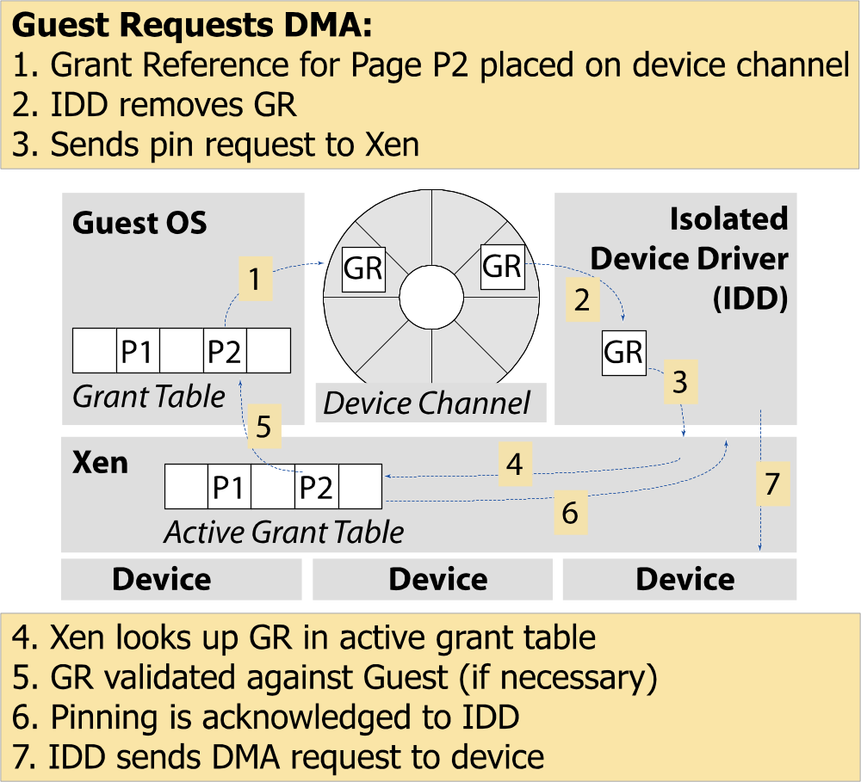
Device Channel Interface
Notes:
newring

Slide 29
Isolated Driver VMs
Run device drivers in separate domains
Detect failure e.g.
  Illegal access
  Timeout
Kill domain, restart
E.g. 275ms outage from failed Ethernet driver
350
300
250
200
150
100
50
0
0
5
10
15
20
25
30
35
40
time (s)
Notes:
Net-restart

Slide 30
VT-x / Pacifica : hvm
Enable Guest OSes to be run without modification
  E.g. legacy Linux, Windows XP/2003
CPU provides vmexits for certain privileged instrs
Shadow page tables used to virtualize MMU
Xen provides simple platform emulation
  BIOS, apic, iopaic, rtc, Net (pcnet32), IDE emulation
Install paravirtualized drivers after booting for high-performance IO
Possibility for CPU and memory paravirtualization
  Non-invasive hypervisor hints from OS
Notes:
Pacifica

Slide 31

Domain 0
Domain N
Guest VM (VMX)
(32-bit)
Guest VM (VMX)
(64-bit)
Linux xen64
3P
Control Panel (xm/xend)
Device Models
Unmodified OS
Unmodified OS
3D
Linux xen64
FE Virtual Drivers
FE Virtual Drivers
Backend
Virtual driver
Front end Virtual Drivers
Guest BIOS
Guest BIOS
Native
Device Drivers
Native Device Drivers
0D
1/3P
Virtual Platform
Virtual Platform
Callback / Hypercall
VMExit
VMExit
Event channel
0P
Control Interface
Scheduler
Event Channel
Hypercalls
Processor
Memory
I/O: PIT, APIC, PIC, IOAPIC
Xen Hypervisor

Slide 32
Guest VM (VMX)
(32-bit)
Guest VM (VMX)
(64-bit)
Domain 0
Domain N
Linux xen64
Unmodified OS
Unmodified OS
3P
Control Panel (xm/xend)
FE Virtual Drivers
FE Virtual Drivers
3D
Linux xen64
Backend
Virtual driver
Front end Virtual Drivers
Guest BIOS
Guest BIOS
Virtual Platform
Virtual Platform
Native
Device Drivers
Native Device Drivers
0D
1/3P
VMExit
VMExit
IO Emulation
IO Emulation
Callback / Hypercall
Event channel
0P
Control Interface
Scheduler
Event Channel
Hypercalls
Processor
Memory
I/O: PIT, APIC, PIC, IOAPIC
Xen Hypervisor

Slide 33
MMU Virtualizion : Shadow-Mode
guest reads
Virtual → Pseudo-physical
guest writes
Guest OS
Accessed &
Updates
dirty bits
Virtual → Machine
VMM
Hardware
MMU
Notes:
At least double the number of faults
Memory requirements
Hiding which machine pages are in use: may interfere with page colouring, large TLB entries etc.

Slide 34
Xen Tools
dom0
dom1
CIM
xm
Web svcs
xmlib
xenstore
builder
control
save/
restore
control
libxc
Priv Cmd
Back
xenbus
xenbus
Front
dom0_op
Xen

Slide 35





VM Relocation : Motivation
VM relocation enables:
  High-availability
    Machine maintenance
  Load balancing
    Statistical multiplexing gain
Xen
Xen

Slide 36
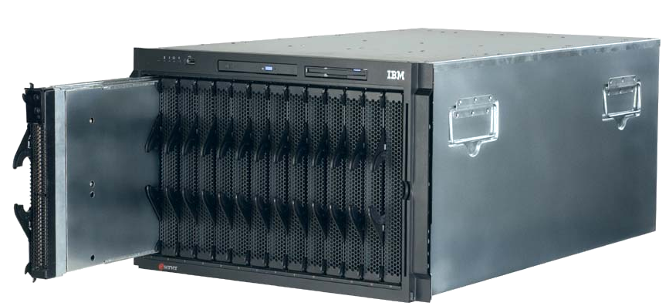
Assumptions
Networked storage
  NAS: NFS, CIFS
  SAN: Fibre Channel
  iSCSI, network block dev
  drdb network RAID
Good connectivity
  common L2 network
  L3 re-routeing
Xen
Xen
Storage

Slide 37
Challenges
VMs have lots of state in memory
Some VMs have soft real-time requirements
  E.g. web servers, databases, game servers
  May be members of a cluster quorum
  Minimize down-time
Performing relocation requires resources
  Bound and control resources used

Slide 38
Relocation Strategy
VM active on host A
Destination host selected
(Block devices mirrored)
Stage 0: pre-migration
Stage 1: reservation
Initialize container on target host
Stage 2: iterative pre-copy
Copy dirty pages in successive rounds
Stage 3: stop-and-copy
Suspend VM on host A
Redirect network traffic
Synch remaining state
Stage 4: commitment
Activate on host B
VM state on host A released

Slide 39
Pre-Copy Migration: Round 1

Slide 40
Pre-Copy Migration: Round 1

Slide 41
Pre-Copy Migration: Round 1

Slide 42
Pre-Copy Migration: Round 1

Slide 43
Pre-Copy Migration: Round 1

Slide 44
Pre-Copy Migration: Round 2

Slide 45
Pre-Copy Migration: Round 2

Slide 46
Pre-Copy Migration: Round 2

Slide 47
Pre-Copy Migration: Round 2

Slide 48
Pre-Copy Migration: Round 2

Slide 49
Pre-Copy Migration: Final

Slide 50
Writable Working Set
Pages that are dirtied must be re-sent
  Super hot pages
    e.g. process stacks; top of page free list
  Buffer cache
  Network receive / disk buffers
Dirtying rate determines VM down-time
  Shorter iterations → less dirtying → …

Slide 51
Rate Limited Relocation
Dynamically adjust resources committed to performing page transfer
  Dirty logging costs VM ~2-3%
  CPU and network usage closely linked
E.g. first copy iteration at 100Mb/s, then increase based on observed dirtying rate
  Minimize impact of relocation on server while minimizing down-time

Slide 52
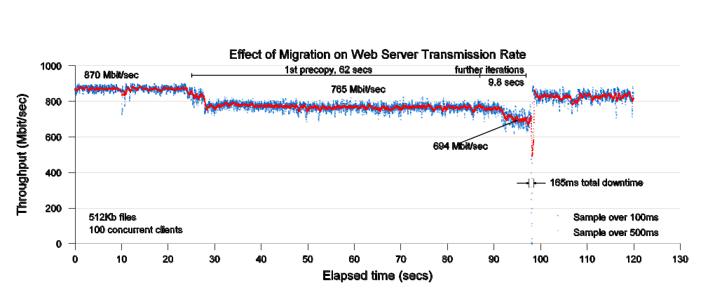
Web Server Relocation

Slide 53
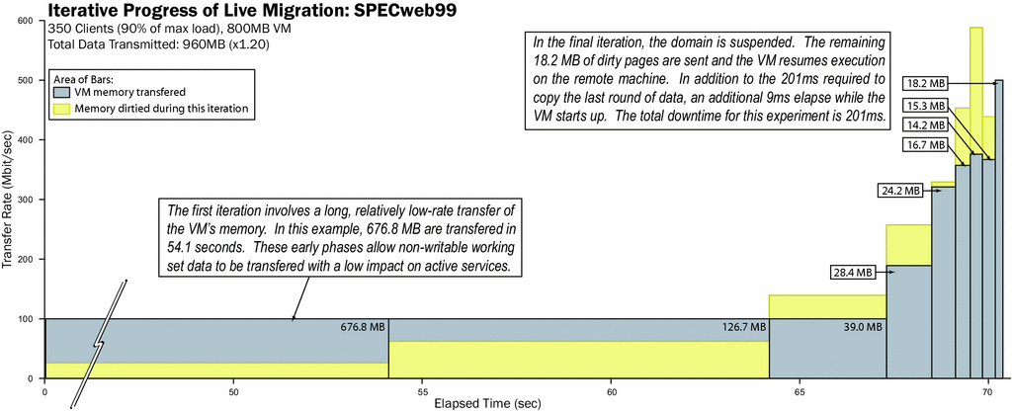
Iterative Progress: SPECWeb
52s

Slide 54
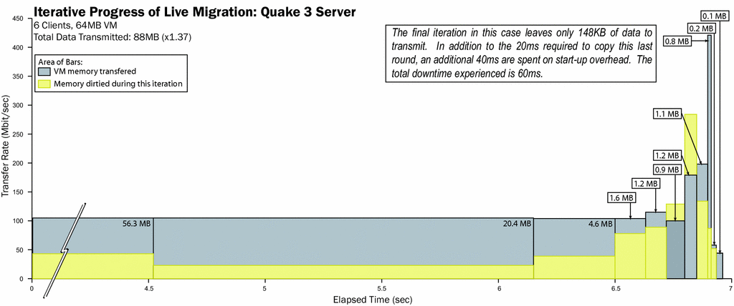
Iterative Progress: Quake3

Slide 55
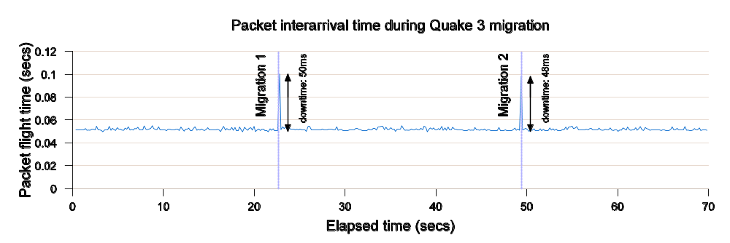
Quake 3 Server relocation

Slide 56
Xen Optimizer Functions
Cluster load balancing / optimization
  Application-level resource monitoring
  Performance prediction
  Pre-migration analysis to predict down-time
  Optimization over relatively coarse timescale
Evacuating nodes for maintenance
  Move easy to migrate VMs first
Storage-system support for VM clusters
  Decentralized, data replication, copy-on-write
Adapt to network constraints
  Configure VLANs, routeing, create tunnels etc

Slide 57
Current Status
 | x86_32 | x86_32p | x86_64 | IA64 | Power
Privileged Domains
Guest Domains
SMP Guests
Save/Restore/Migrate
>4GB memory
VT
Driver Domains

Slide 58
3.1 Roadmap
Improved full-virtualization support
  Pacifica / VT-x abstraction
  Enhanced IO emulation
Enhanced control tools
Performance tuning and optimization
  Less reliance on manual configuration
NUMA optimizations
Virtual bitmap framebuffer and OpenGL
Infiniband / “Smart NIC” support
Notes:
Framebuffer console
NUMA

Slide 59
IO Virtualization
IO virtualization in s/w incurs overhead
  Latency vs. overhead tradeoff
    More of an issue for network than storage
  Can burn 10-30% more CPU
Solution is well understood
  Direct h/w access from VMs
    Multiplexing and protection implemented in h/w
  Smart NICs / HCAs
    Infiniband, Level-5, Aaorhi etc
    Will become commodity before too long

Slide 60
Research Roadmap
Whole-system debugging
  Lightweight checkpointing and replay
  Cluster/distributed system debugging
Software implemented h/w fault tolerance
  Exploit deterministic replay
Multi-level secure systems with Xen
VM forking
  Lightweight service replication, isolation

Slide 61
Parallax
Managing storage in VM clusters.
Virtualizes storage, fast snapshots
Access optimized storage
Snapshot
L1
Root A
Root B
L2
Data
Notes:
Add more here too – Architecture diagram.

Slide 62
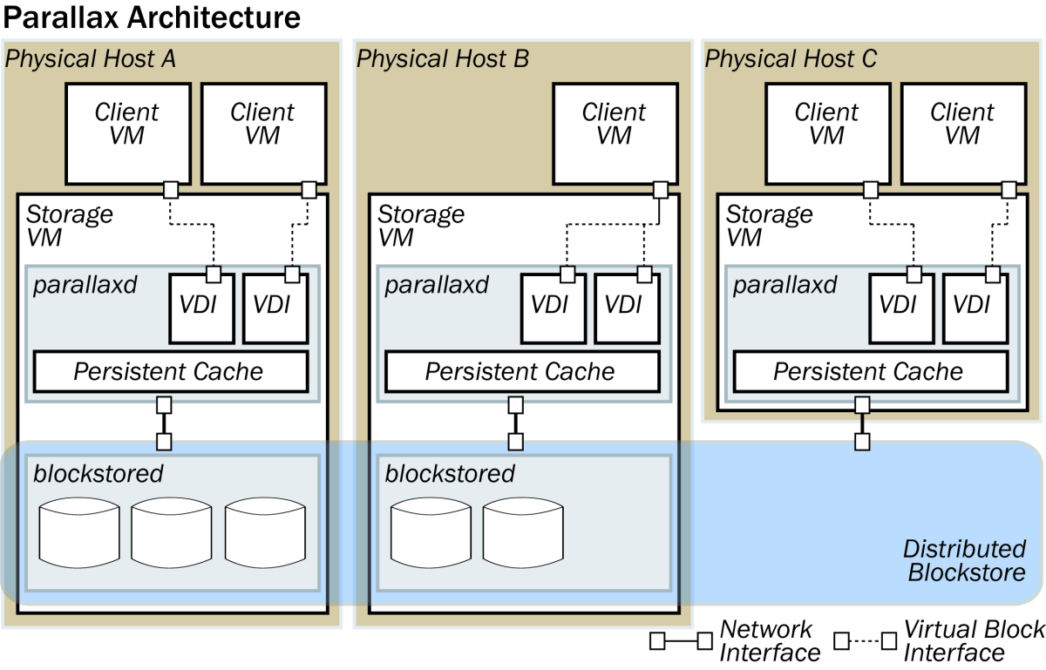

Slide 63
V2E : Taint tracking
I/O Taint
Protected VM
VN
VD
Qemu*
Control VM
Protected VM
ND
DD
VN
VD
VMM
Taint Pagemap
Net
Disk
1. Inbound pages are marked as tainted. Fine-grained taint
Details in extension, page-granularity bitmap in VMM.
2. VM traps on access to a tainted page. Tainted pages
Marked not-present. Throw VM to emulation.
3. VM runs in emulation, tracking tainted data. Qemu
microcode modified to reflect tainting across data movement.
4. Taint markings are propagated to disk. Disk extension
marks tainted data, and re-taints memory on read.

Slide 64
V2E : Taint tracking
I/O Taint
Protected VM
VN
VD
Qemu*
Control VM
Protected VM
ND
DD
VN
VD
VMM
Taint Pagemap
Net
Disk
1. Inbound pages are marked as tainted. Fine-grained taint
Details in extension, page-granularity bitmap in VMM.
2. VM traps on access to a tainted page. Tainted pages
Marked not-present. Throw VM to emulation.
3. VM runs in emulation, tracking tainted data. Qemu
microcode modified to reflect tainting across data movement.
4. Taint markings are propagated to disk. Disk extension
marks tainted data, and re-taints memory on read.

Slide 65









Xen Supporters
Operating System and Systems Management
Hardware Systems
Acquired by
Platforms & I/O
* Logos are registered trademarks of their owners

Slide 66
Conclusions
Xen is a complete and robust hypervisor
Outstanding performance and scalability
Excellent resource control and protection
Vibrant development community
Strong vendor support
Try the demo CD to find out more! (or Fedora 4/5, Suse 10.x)
http://xensource.com/community

Slide 67
Thanks!
If you’re interested in working full-time on Xen, XenSource is looking for great hackers to work in the Cambridge UK office. If you’re interested, please send me email!
ian@xensource.com

