Slide 1
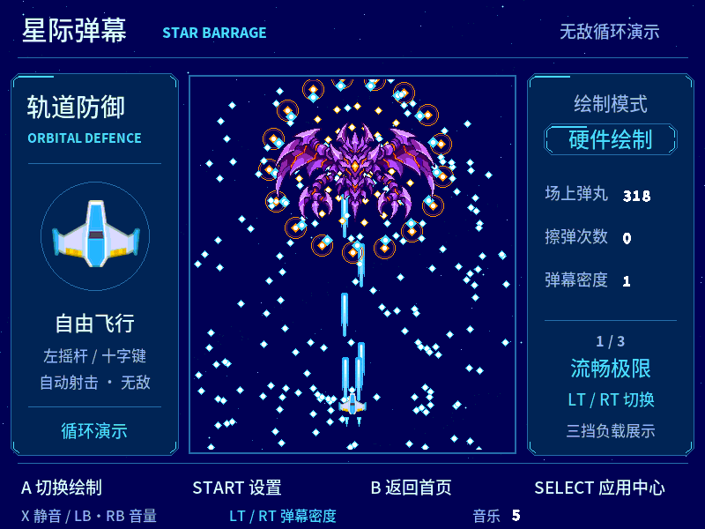

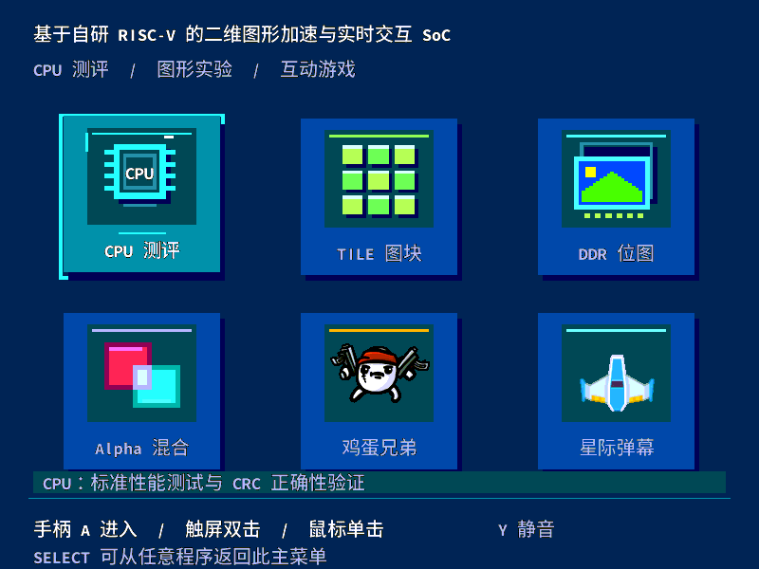
INTRODUCTION
105 MHz | RV32I + Zmmul
Custom RISC-V 2D Graphics SoC
AX7020 / XC7Z020CLG400-2
Native 800 x 600 RGB332
RISC-V C logic / PS input
Star Barrage: board capture
C applications run on a custom 105 MHz RISC-V core with hardware 2D drawing.
One 262144-byte buffer renders two bands; DDR publishes complete 800 x 600 frames.
Touch double-tap and mouse entry pass replay tests. Controller-first USB recovery is verified on the tested devices. LT/RT select three showcase tiers; ARM manages input, PCM and memory.
2D GPU: TILE / bitmap / Alpha
AX7020 / PYNQ / USB / HDMI
C
R
Egg Bros - mean FPS
800 x 300 reusable staging
R
E
60.00
E
S
41.83
HP1 to DDR / atomic frame / HDMI
A
29.75
T
U
I
L
V
T
Graphics data path
E
64
85
100
Main menu: board framebuffer capture
Multiple epochs; about 8 s each
CPU and system design
Five main pipeline stages and a restricted aligned dual-instruction path.
64 KiB read cache + 4 KiB instruction buffer.
Checksummed retirement before HOLD; keep buffers until DMA drains.
D
Measured results
CoreMark: 371.852 at 105 MHz, 4000 iterations, GCC 13.3 O3/LTO; both CRC runs pass.
TILE 512 / DDR 96 / Alpha 32 and Star density 1: strict 60 for at least 60 s.
System: 23447 LUT, 11576 FF, 126 BRAM36, 4 DSP. CPU hierarchy: 6387 LUT, 2081 FF, 4 DSP.
WNS +0.033 ns; WHS +0.057 ns.
Third-party code/media credited. Physical acceptance and photographs pending.
E
S
I
G
N
Reproduction and evidence
Eight RV32 programs rebuilt byte-for-byte.
Full source-only Vivado rebuild passed.
Reusable artifact checker and PYNQ workflow.

