Slide 1

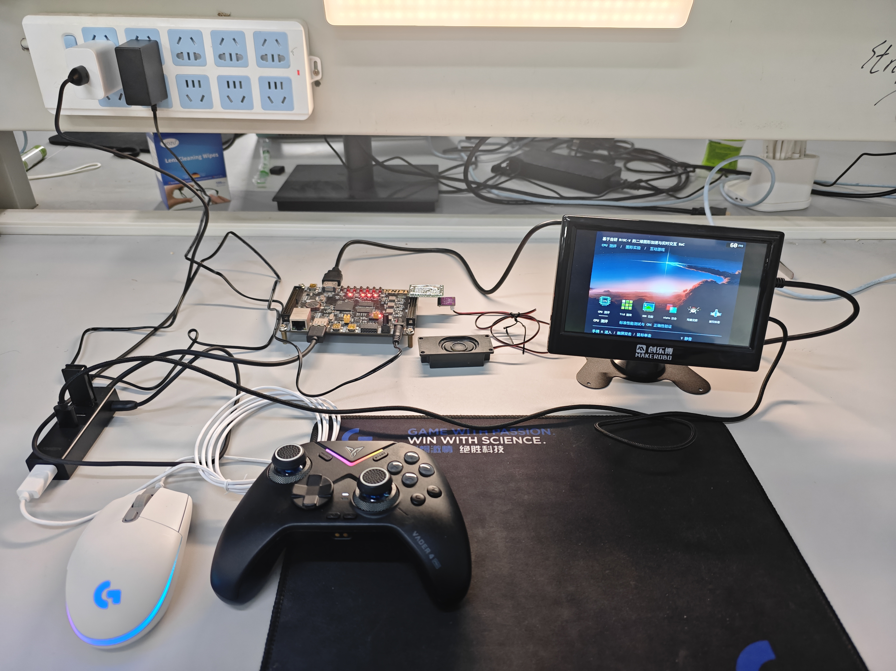

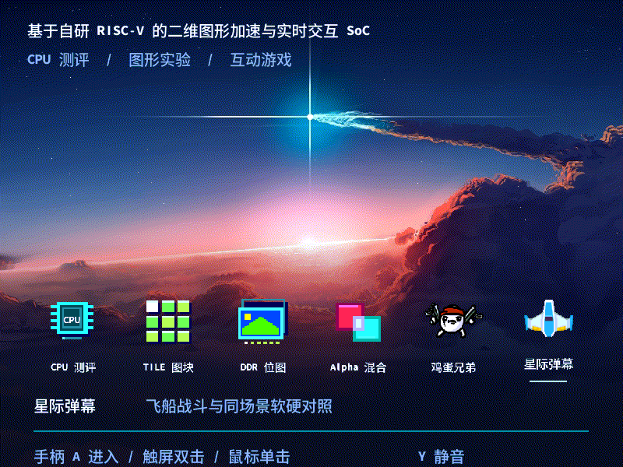
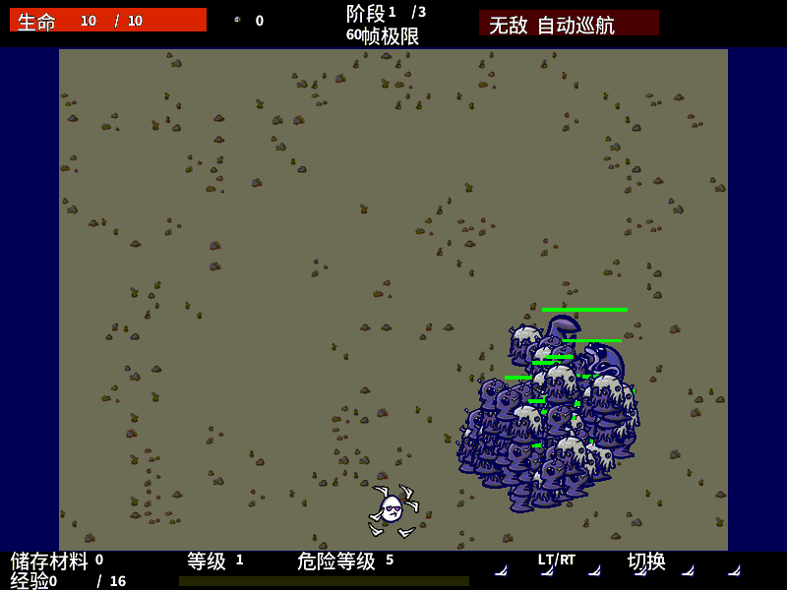
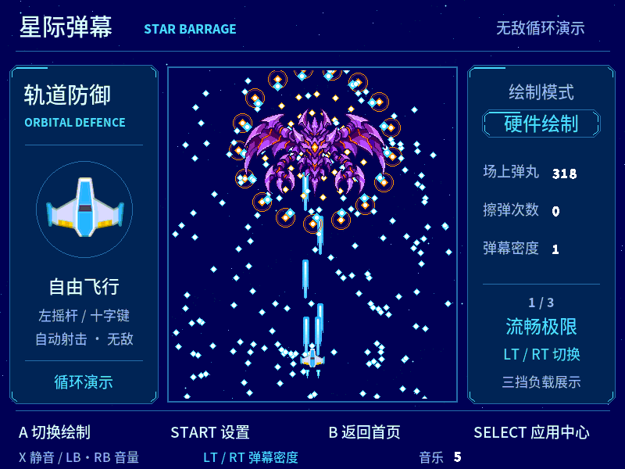
作品简介
李圣哲
自研RISC-V二维图形SoC
西安邮电大学
DDR
作品实物缩略图
手柄
触屏
鼠标
USB
程序 / 素材
显示双缓冲
实测平台：AX7020 / Zynq-7020
作品集自研 RISC-V、二维图形加速与多模态交互于一体，在单块 FPGA 上打通计算、图形、显示和音频链路。
AX7020 / Zynq-7020
USB
PS
ARM
PL
AXI
HDMI
设
计
创
新
测
试
结
果
已验证工作频率
HDMI
RISC-V 105 MHz
2D GPU
105 MHz
输入
加载
音频
64 KiB缓存
4 KiB指令
CoreMark / MHz
3.541
128 KiB工作RAM · 256 KiB两带暂存
典型应用场景
I²S
MAX98357A
CoreMark / LUT（CPU核心）
800 × 600
0.05822
系统框图
关键设计与应用价值
• 自研五级流水处理器，预测、旁路与条件双指令执行协同。
• 专用图形硬件处理图块、DDR位图和透明混合，提供同场景软硬件对照。
• 256 KiB暂存区两带复用，完成原生800×600画布与整帧提交。
• 六入口统一菜单；手柄、触屏、鼠标操作；I²S音频与自制转接板。
面向软硬件协同教学、图形验证与二维交互应用。
计算与图形协同
1. 五级流水、分支预测、结果旁路及条件双执行。
2. 64 KiB缓存、4 KiB指令缓冲和128 KiB工作RAM。
3. 专用硬件批量绘制；256 KiB暂存复用上下两带。
4. DDR双缓冲与整帧提交，实现800×600输出。
性能实测与系统资源
CoreMark 371.852；4000次；两轮CRC通过
同负载录像读数 | 软件FPS | 硬件FPS
TILE · 512 | 7.49 | 59.99
DDR · 96 | 1.88 | 60.00
Alpha · 32 | 3.33 | 60.00
系统集成与复现
统一输入、音频及应用资源交接。
独立像素参考与逐扫描计数验证。
八程序构建、RTL、仿真和实测数据随工程提供。
默认图形负载持续60 FPS，逐扫描验证≥60 s。
PL：23447 LUT / 11576 FF / 126 BRAM36 / 4 DSP
CPU核心：6387 LUT / 2081 FF / 4 DSP
WNS +0.033 ns；WHS +0.057 ns。
可加载应用与统一接口支撑教学及图形实验。

Slide 2
INTRODUCTION
Shengzhe Li
Custom RISC-V 2D Graphics SoC
Xi’an University of Posts
and Telecommunications
DDR
Working prototype
Gamepad
Touch
Mouse
USB
Code / assets
Display buffers
On board test by AMD ZYNQ7000
A custom RISC-V processor and dedicated 2D graphics hardware form an interactive FPGA SoC, integrating computation, display, input and audio.
AX7020 / Zynq-7020
USB
PS
ARM
PL
AXI
HDMI
C
Verified operating frequency
HDMI
RISC-V 105 MHz
2D GPU
R
R
105 MHz
Input
Load
Audio
E
E
64 KiB cache
4 KiB IF
S
CoreMark / MHz
A
3.541
T
U
128 KiB work RAM · 256 KiB band staging
I
L
Typical application case
I²S
MAX98357A
V
T
CoreMark / LUT (CPU core)
800 × 600
E
0.05822
System Architecture
Key design features
• Custom five-stage core with prediction, forwarding and a conditional paired-ALU path.
• TILE, DDR bitmap and Alpha hardware with matched software comparisons.
• Two-band reuse of 256 KiB staging for a native 800×600 canvas and whole-frame commit.
• Six applications, three input methods, I²S audio and a custom adapter.
Designed for hardware/software teaching and interactive 2D applications.
Compute and graphics integration
1. Five stages, prediction, forwarding and paired ALU execution.
2. 64 KiB cache, 4 KiB instruction buffer, 128 KiB work RAM.
3. Dedicated pixel pipeline and two-band staging reuse.
4. DDR double buffering and whole-frame commit.
D
Measured performance and resources
E
CoreMark 371.852; 4000 iterations; CRC passed
S
I
Same-load recording | SW FPS | HW FPS
TILE · 512 | 7.49 | 59.99
DDR · 96 | 1.88 | 60.00
Alpha · 32 | 3.33 | 60.00
G
N
System integration and reproduction
Unified input, audio and application lifecycle.
Independent pixel reference and per-scan checks.
Eight-program build, RTL, simulation and measured data are included.
Default graphics loads: 60 FPS, per-scan checks ≥60 s.
PL: 23447 LUT / 11576 FF / 126 BRAM36 / 4 DSP
CPU: 6387 LUT / 2081 FF / 4 DSP
WNS +0.033 ns; WHS +0.057 ns.
Loadable applications support teaching and graphics experiments.

