Slide 1





















Torrent vagy hasonló fájlmegosztás
Szokody Márk

Slide 2
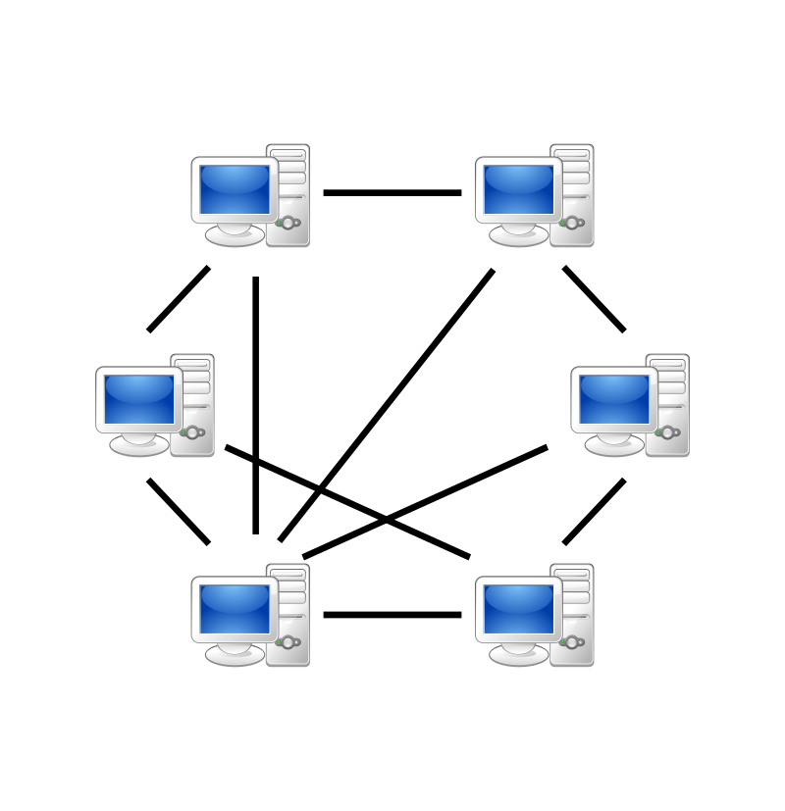
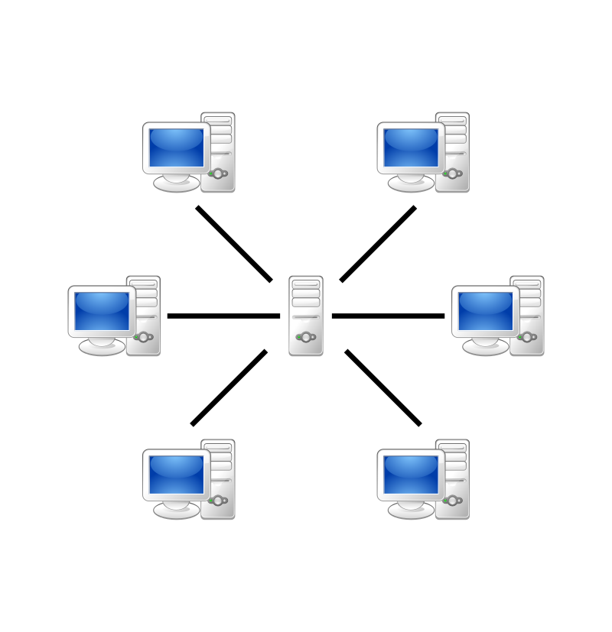
Peer to Peer
P2P
szerver-kliens

Slide 3

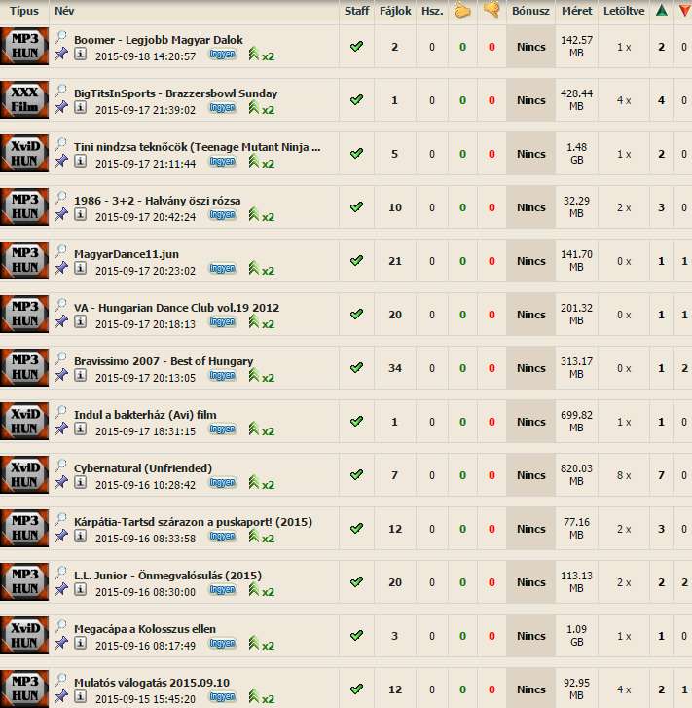
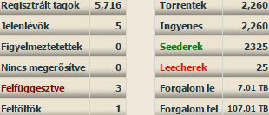
Tracker

Slide 4
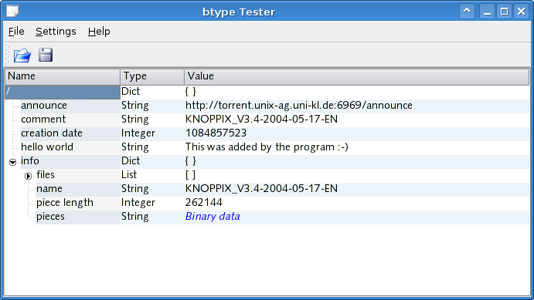
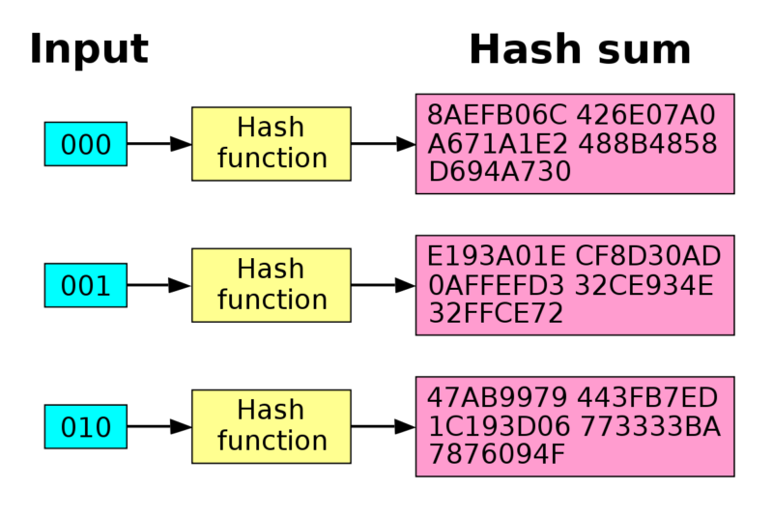
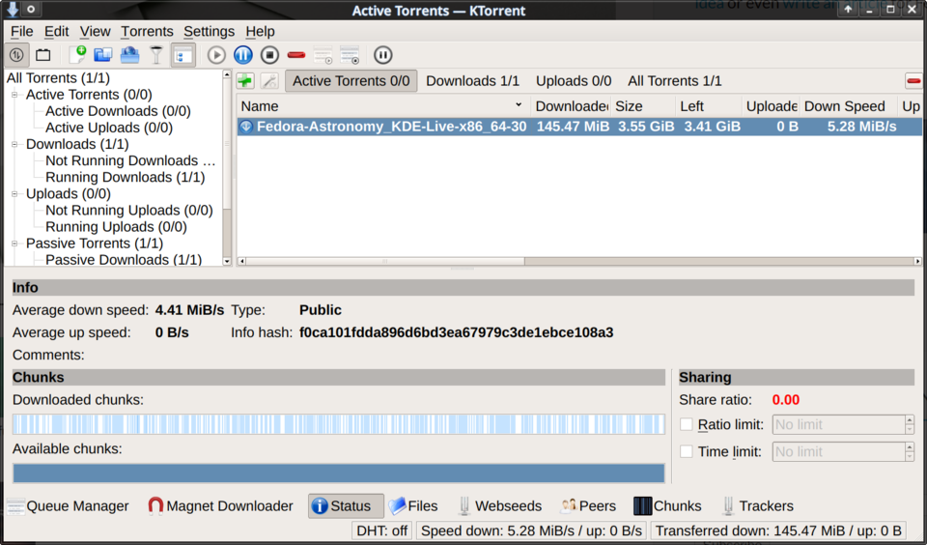
A .torrent fájl
SHA-1

Slide 5



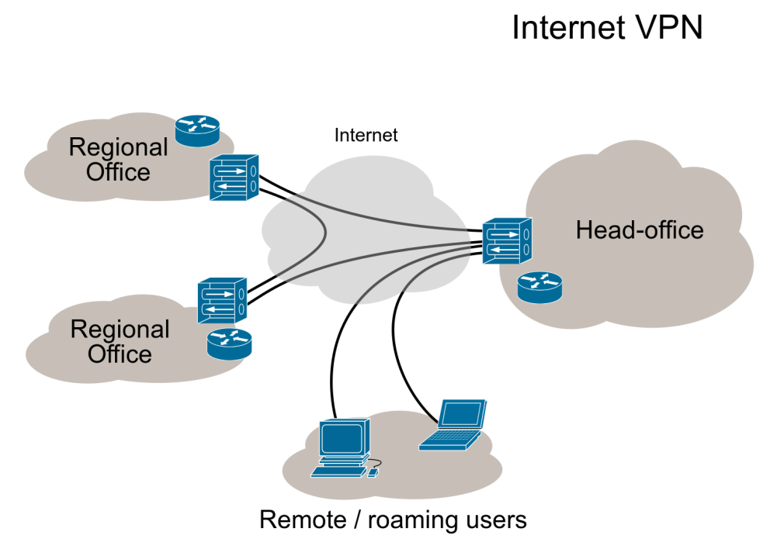
Anonimitás

Slide 6
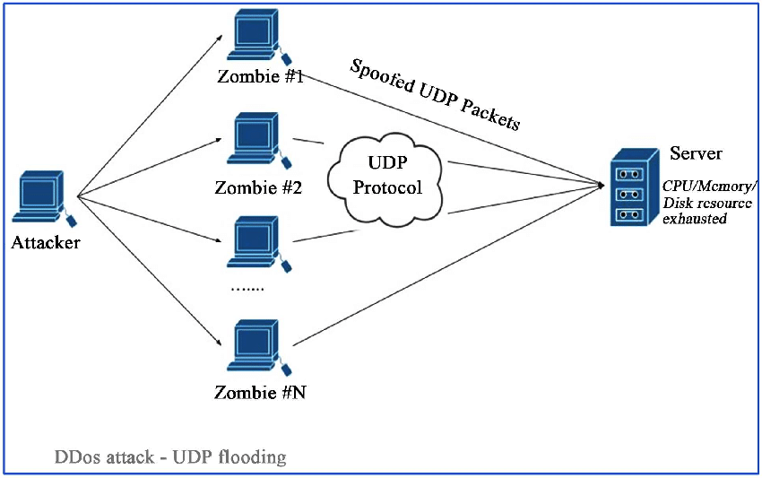

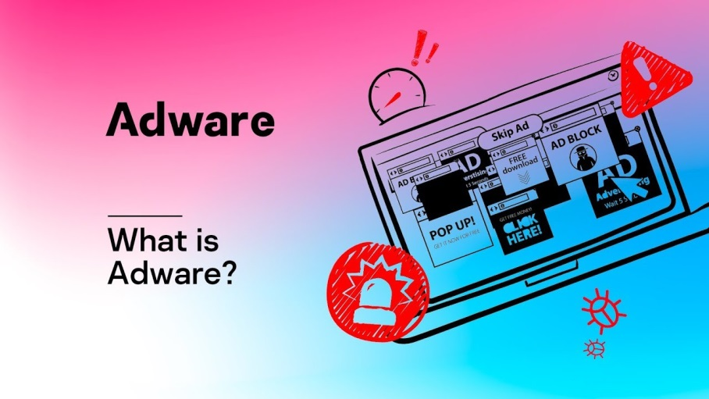
Biztonság
UDP flood
Malware-ek

Slide 7

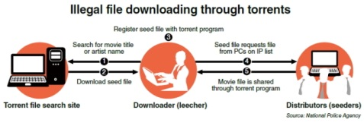

Legalitási problémák

Slide 8




Hasonló fájlmegosztási módszerek

Slide 9
Források
Információk:
https://hu.wikipedia.org/wiki/BitTorrent
https://en.wikipedia.org/wiki/Peer-to-peer
https://hvg.hu/tudomany/20080416_torrent
https://en.wikipedia.org/wiki/Metalink
https://hu.wikipedia.org/wiki/MUTE
https://en.wikipedia.org/wiki/InterPlanetary_File_System
https://en.wikipedia.org/wiki/EDonkey_network
https://en.wikipedia.org/wiki/Ed2k_URI_scheme
https://en.wikipedia.org/wiki/Magnet_URI_scheme
Képek:
0. dia:
vuze logo: https://www.vuze.com/
utorrent logo: https://en.wikipedia.org/wiki/%CE%9CTorrent
bittorrent logo: https://www.bittorrent.com/
qbittorrent logo: https://sourceforge.net/projects/qbittorrent/
bitlord logo: https://en.wikipedia.org/wiki/BitLord
bitcomet logo: https://www.bitcomet.com/en
acquisition logo: https://en.wikipedia.org/wiki/Acquisition_(software)
BlogTorrent logo: https://en.wikipedia.org/wiki/Blog_Torrent
Deluge logo: https://en.wikipedia.org/wiki/Deluge_(software)
FlashGet logo: https://en.wikipedia.org/wiki/FlashGet
FrostWire logo: https://en.wikipedia.org/wiki/FrostWire
Konqueror logo: https://en.wikipedia.org/wiki/Konqueror
ktorrent logo: https://en.wikipedia.org/wiki/KTorrent
LimeWire logo: https://en.wikipedia.org/wiki/LimeWire
Miro logo: https://en.wikipedia.org/wiki/Miro_(software)
Shareaza logo: https://en.wikipedia.org/wiki/Shareaza
Tomato Torrent logo: https://en.wikipedia.org/wiki/Tomato_Torrent
Tonido logo: https://en.wikipedia.org/wiki/Tonido
Transmission logo: https://en.wikipedia.org/wiki/Transmission_(BitTorrent_client)
Triblerlogo: https://en.wikipedia.org/wiki/Tribler
tixatia logo: https://www.softexia.com/windows/internet/file-sharing/tixati

Slide 10
1. dia:
p2p, server based: https://en.wikipedia.org/wiki/Peer-to-peer
2. dia:
strukturált, nemstrukturált: https://en.wikipedia.org/wiki/Peer-to-peer
3. dia:
Tracker: https://opentrackers.org/fusion-tracker/
4. dia :
anonimity: https://steemit.com/steemit/@calamus056/anonymity-on-the-steem-blockchain
Tor: https://hu.wikipedia.org/wiki/Tor_(szoftver)
Seedbox: https://cheapseedboxes.com/top-10-seedbox-best-providers-cheap/
SHA-1:
vpn: https://hu.wikipedia.org/wiki/Virtu%C3%A1lis_mag%C3%A1nh%C3%A1l%C3%B3zat
5. dia:
udp flood: https://www.researchgate.net/figure/UDP-Flooding-attack_fig1_327036867
malware: https://www.inc.com/joseph-steinberg/malware-101-an-overview-of-malware-types.html
adware: https://www.youtube.com/watch?v=jIyIqjOlqzY
6. dia:
copyright: https://hu.wikipedia.org/wiki/Szerz%C5%91i_jog
illegal: http://www.koreaherald.com/common_prog/newsprint.php?ud=20130530000801&dt=2
darkweb: https://vpnoverview.com/privacy/anonymous-browsing/the-dark-web/
7. dia:
magnet link: https://www.arcadepunks.com/what-is-a-magnet-link/
ipfs: https://en.wikipedia.org/wiki/InterPlanetary_File_System
metalink: https://en.wikipedia.org/wiki/InterPlanetary_File_System
eDonkey: https://www.laihuimin.com/post/edonkey-network.html
MUTE logo: https://hu.wikipedia.org/wiki/MUTE
https://arstechnica.com/information-technology/2020/01/pgp-keys-software-security-
and-much-more-threatened-by-new-sha1-exploit/

