Slide 1
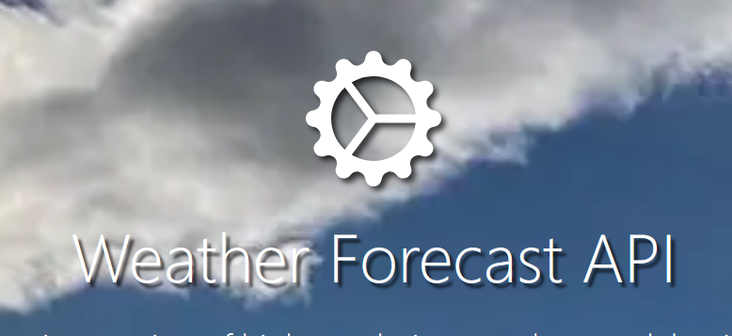
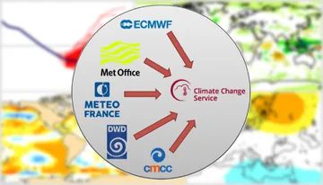
Weather data
Uncertain
Long-term means
Mean Tmin, Tmax per DOY
Long-term forecast
Daily Tmin, Tmax observation
Daily Tmin, Tmax observation
Short-term forecast
Observed
Daily Tmin, Tmax observation
Certain
“Season” for PhenoFlex
Aug
Sep
Oct
Nov
Dec
Jan
Feb
Mar
Apr
May
June
We are here

Slide 2



Weather sources
Uncertain
Long-term means
Long-term forecast
Short-term forecast
Observed
Certain
Supplied to PhenoFlex
Season
Aug
Sep
Oct
Nov
Dec
Jan
Feb
Mar
Apr
May
June
We are here

Slide 3
Weather sources
Uncertain
Long-term means
Long-term forecast
Short-term forecast
Observed
Certain
Supplied to PhenoFlex
Season
Aug
Sep
Oct
Nov
Dec
Jan
Feb
Mar
Apr
May
June
We are here

Slide 4
Weather sources
Uncertain
Long-term means
Long-term forecast
Short-term forecast
Observed
Certain
Supplied to PhenoFlex
Season
Season
Aug
Sep
Oct
Nov
Dec
Jan
Feb
Mar
Apr
May
June
We are here

Slide 6









6-month forecast
Long-term mean
Observed
Season
Jan 23
Oct 23
Nov 23
Dec 23
Jan 24
Feb 24
Mar 24
Apr 24
Dec 24
Forecast start month

