Slide 1



Towards Automated Identification of Layering Violations in Embedded Applications (WIP)
Mingjie Shen
James C. Davis
Aravind Machiry
Notes:
Hi, I am Mingjie Shen from Purdue University.
I am glad to present our work on automated identification of layering violations in embedded applications.
We thank Rolls Royce for their support.
(Click)

Slide 2
Contributions
Static analysis tool to detect a class of layering violations
Non Conventional MMIO Accesses (NCMAs)
Dataset of compilable embedded applications
Identify 369 NCMAs + developers’ rationales
Notes:
Our contributions are:
First, we Develop a static analysis tool to automatically detect a class of layering violations called Non Conventional MMIO Accesses, or NCMAs
Second, we Create the first large dataset of compilable embedded applications – containing 988 applications spanning 5 RTOSes
Third, we Identify 369 NCMAs and find reasons why developers commit layering violations (lack of concern for portability, and workarounds for undesirable behaviors of HAL APIs)
(Click)

Slide 3
Background and Motivation

Slide 4
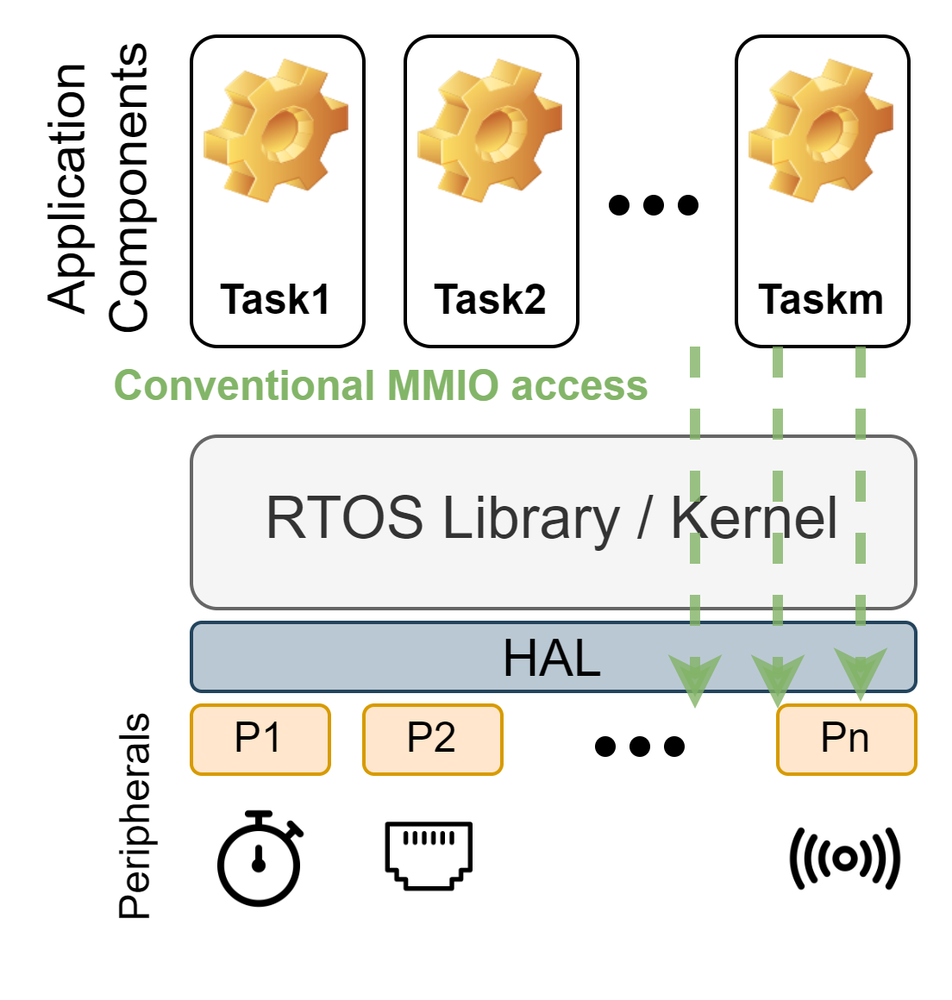
Embedded software follows a layered design
Notes:
To reduce the difficulty of porting, the embedded software application is organized into layers that communicate only with adjacent layers. If applications follow this design, it simplifies supporting a new MCU, as only one layer is impacted.

Slide 5
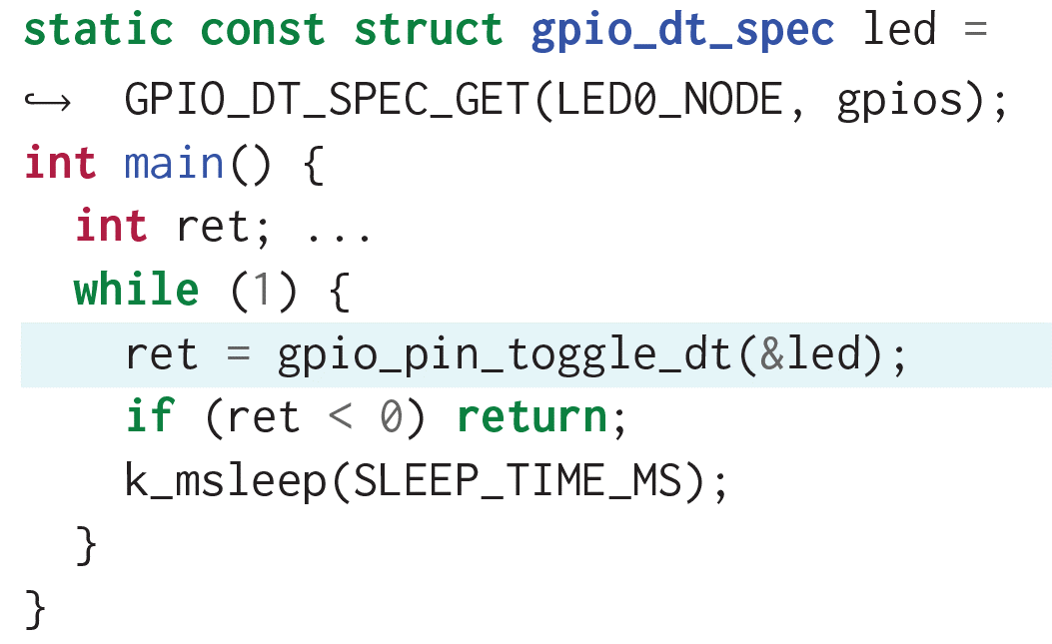
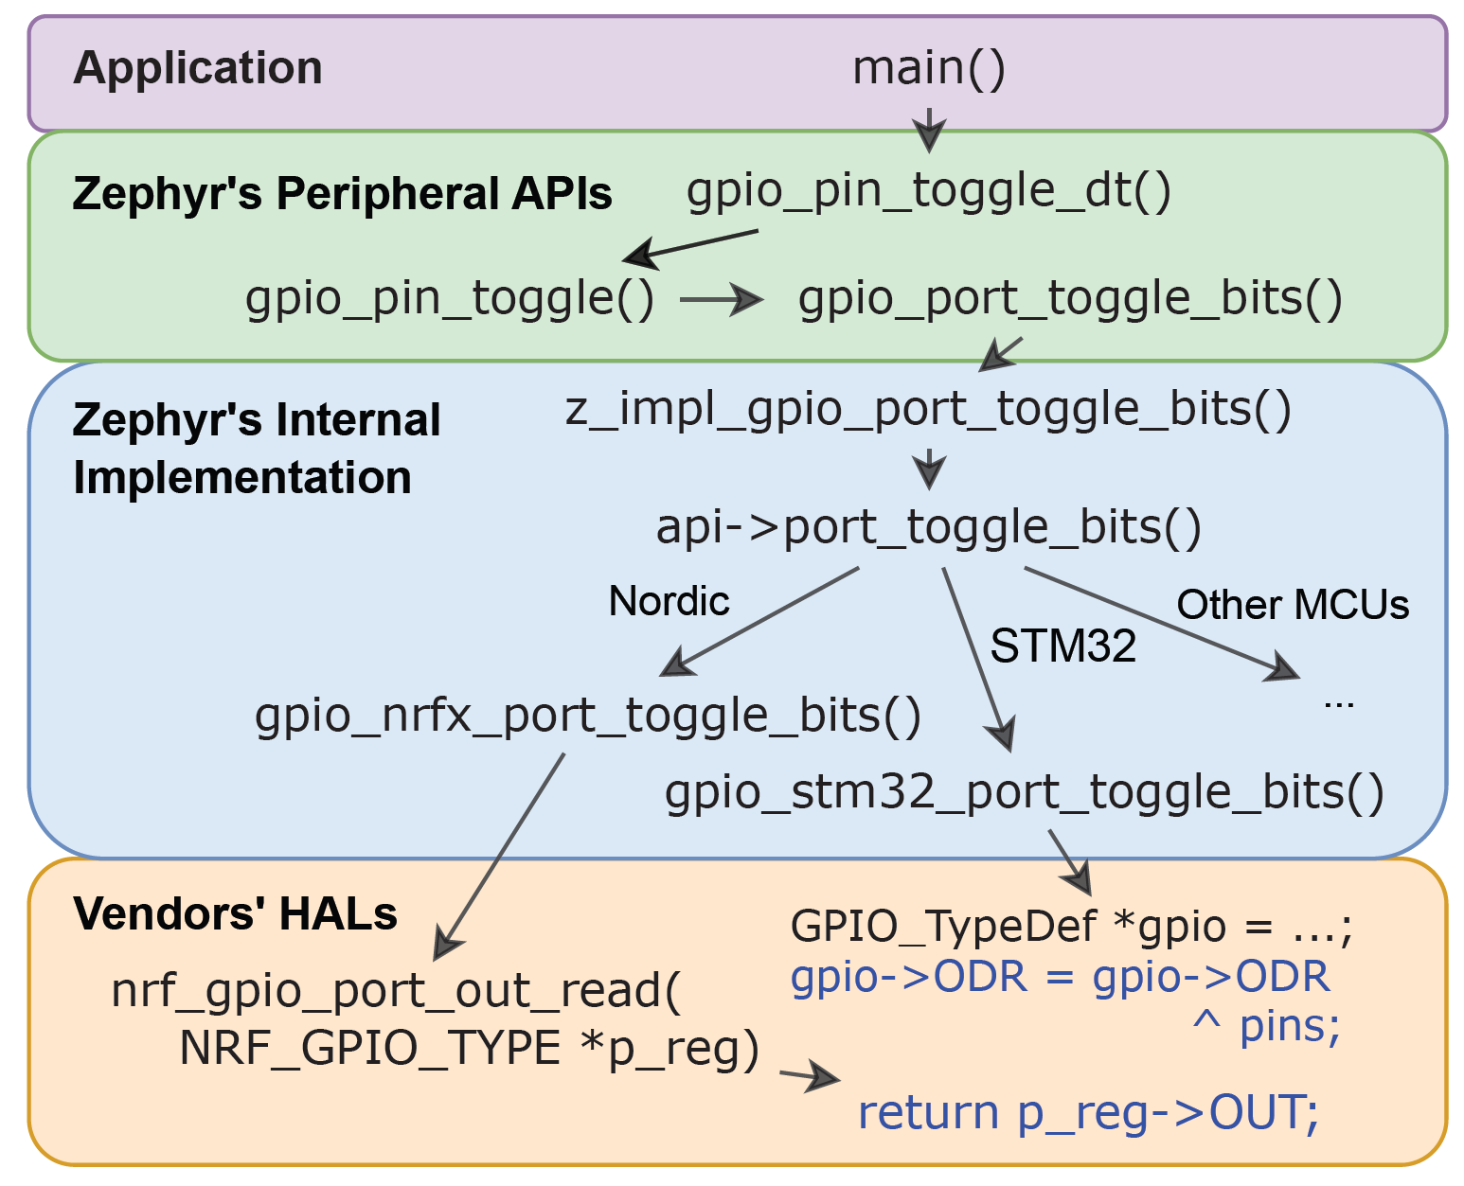
An LED blinker application of Zephyr that follows a layered design
Notes:
Let’s see an example application that follows layered design.
It interacts with only the adjacent layer through the GPIO API function (highlighted) to periodically toggle an LED pin
This application compiles and runs on all boards supported by Zephyr.
(The call graph of this application shows Zephyr’s layered design and abstractions for vendor-specific Hardware Abstraction Layers.)

Slide 6
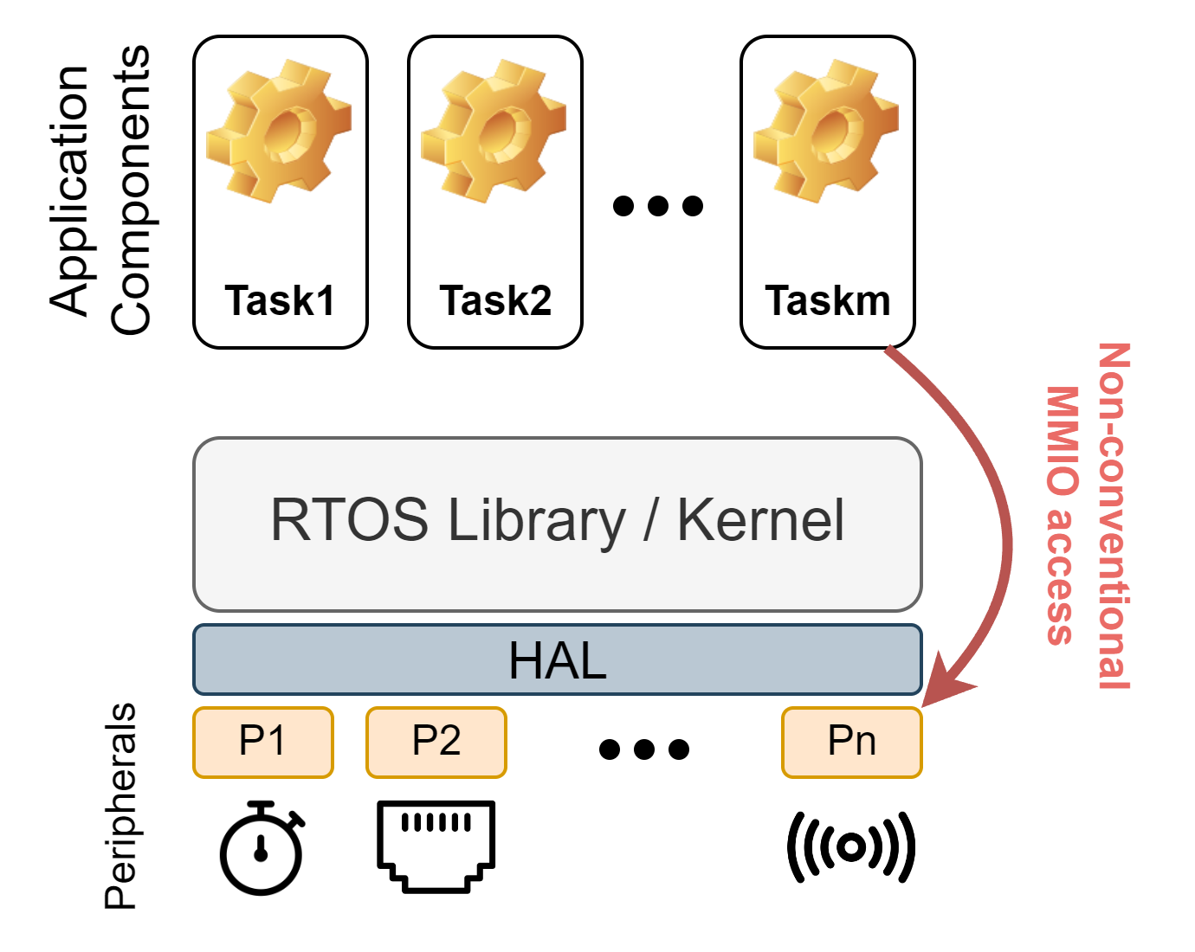
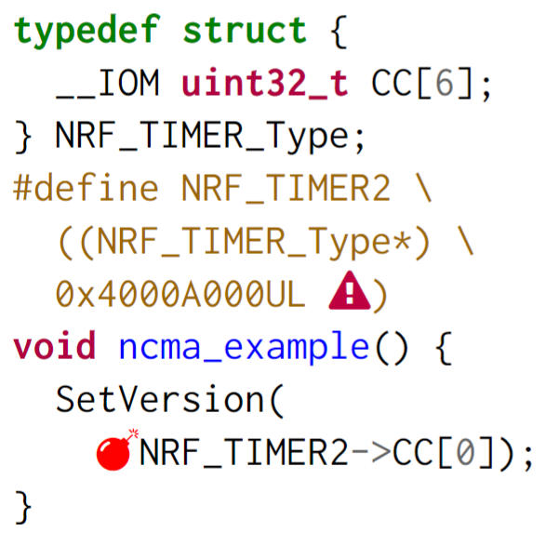
Non Conventional MMIO Access (NCMA)
Notes:
When applications commit layering violations, portability becomes worse.
Specifically, we focus on a layering violation related to hardware or peripheral access.
Most peripherals are accessed by MMIO. An application should access these memory regions through a Hardware Abstraction Layer (HAL).
When applications violate this principle by directly accessing MMIO without going through HAL, we call such access Non Conventional MMIO Access, or NCMA.
(click)
Here we show a simple example that directly accesses timer peripheral through a hardcoded MMIO address, by first casting it to a struct and accessing its member.

Slide 7
HalVD: Automated Detection of NCMAs
Notes:
Now I will present the details of HalVD, our automated technique to detect NCMAs.

Slide 8
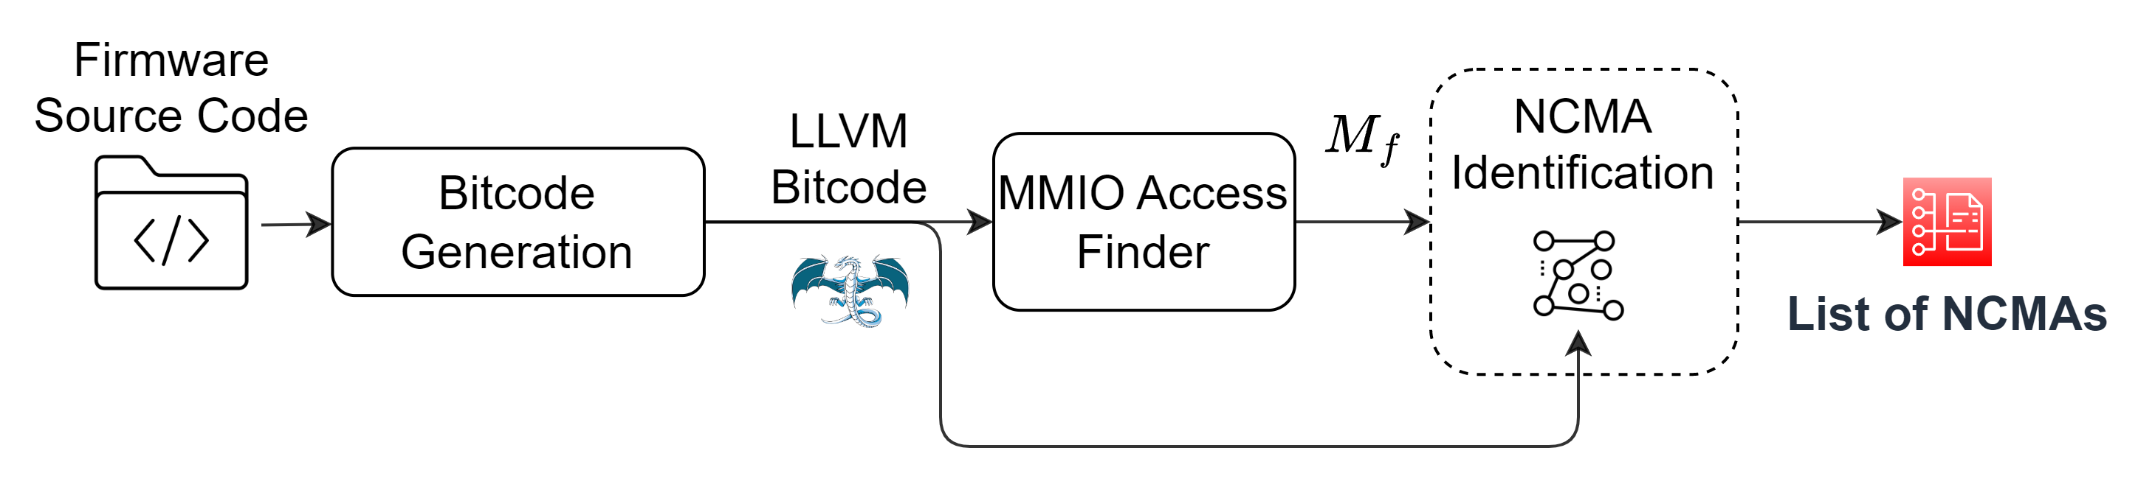
HalVD: Automated Detection of NCMAs
Goal: Report “There is an NCMA in function X at line Y in file Z.”
Custom Build Monitoring
Analysis of LLVM IR
Call Graph Heuristics
Notes:
Our goal is …
(click x 2)
Given the application’s source code, we automatically convert it to llvm bitcode using a custom build monitoring.
(click)
Next, we identify all MMIO accesses by performing a lightweight analysis of the llvm IR.
(click)
Finally, we use heuristics on the call graph to determine whether a given MMIO access is a NCMA.

Slide 9
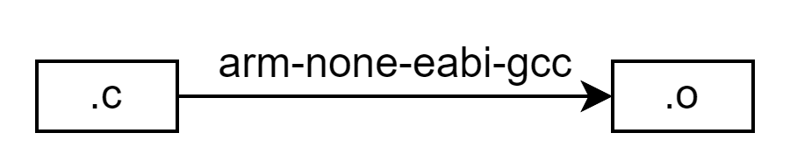
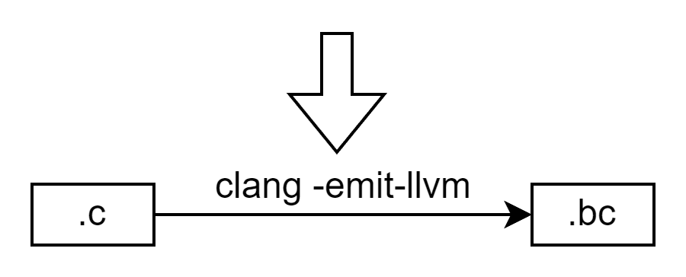
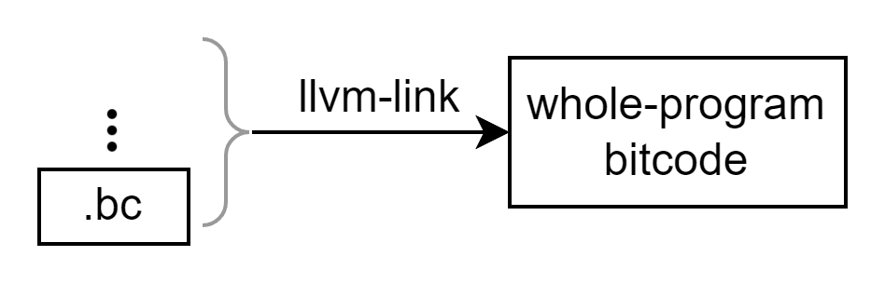
Bitcode Generation via Build Monitoring
Generating whole-program bitcode is challenging
Prior work manually modified build scripts
Our approach: runtime build monitoring
Notes:
We want to use the llvm compiler infrastructure to implement our analysis
(because, as we will explain later, it is relatively easy to detect MMIO access using llvm.)
However, it requires whole-program bitcode, i.e., one bitcode file for the entire embedded application
Generating whole-program bitcode is challenging.
Prior work manually modified build scripts (e.g. Makefile, CMakeLists.txt, etc)
We partially automate this process.
(Click)
We monitor the build process of an application to capture all invocations of the compiler
(Click)
Then, we translate each compilation command into the corresponding bitcode generation command in clang
(Click)
Finally, all the generated bitcode files are linked together into the whole program bitcode

Slide 10
Almost all embedded systems use a GCC-based toolchain…
Translation to clang involves four challenges:
Challenge | Solution
Unsupported non-standard C/C++ features | Manually comment out
Unsupported gcc-specific compile options (e.g., -mfp16-format=) | Automatically remove
Unsupported gcc-specific link options (e.g., -spec=) | Link with gcc not clang
Other toolchain-specific aspects | Pass gcc’s standard system directories of header files to clang
Notes:
Almost all embedded systems use a GCC-based toolchain. Translation to clang involves four challenges and we solved all of them.
All of our treatments are semantics-preserving.

Slide 11
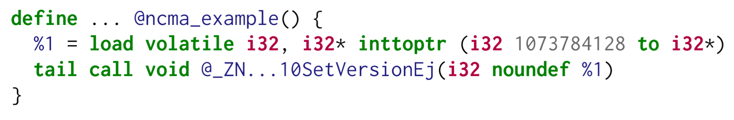
MMIO Access Finder via Constant Memory Address
Goal: Find all functions that directly access MMIO
Intuition: MMIO is usually accessed through constant (“hardcoded”) addresses
Heuristic: Identify any memory access instruction, i.e., load, store, getelementptr, whose pointer operand is a constant
Notes:
(click)
After generating LLVM IR, we want to find all MMIO access functions.
(click)
The intuition is that MMIO is usually accessed through hardcoded addresses
(click)
As is shown in this example
(click)
Thus, we Identify any memory access instruction whose pointer operand is a constant

Slide 12
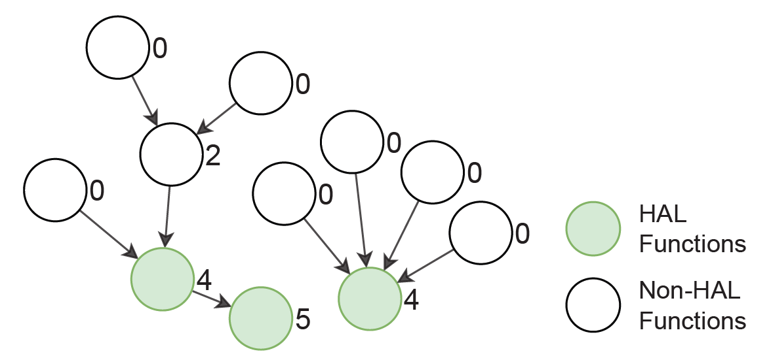
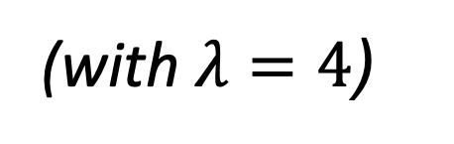

NCMA Identification via Call Graph Analysis
NCMAs occur in non-HAL functions that directly access MMIO
𝐼𝐷𝑡: transitive in-degree of nodes in the call graph
Designate nodes with $ID_{t}≥λ$ as HAL functions
(with $λ=4$)
Notes:
After finding all MMIO functions, we need to identify NCMAs among them. NCMAs occur in non-HAL functions that directly access MMIO
(click)
We Distinguish between HAL and non-HAL functions by transitive in-degree, or Idt, of nodes in the call graph
HAL functions expose necessary functionality and consequently are invoked by many functions
As a result, In the call graph, HAL functions are reachable from many functions above the HAL layer,
thus having higher transitive in-degree than non-HAL functions
Thus, we designate nodes with IDt higher than a threshold \lambda as HAL functions.

Slide 13
Evaluation

Slide 14
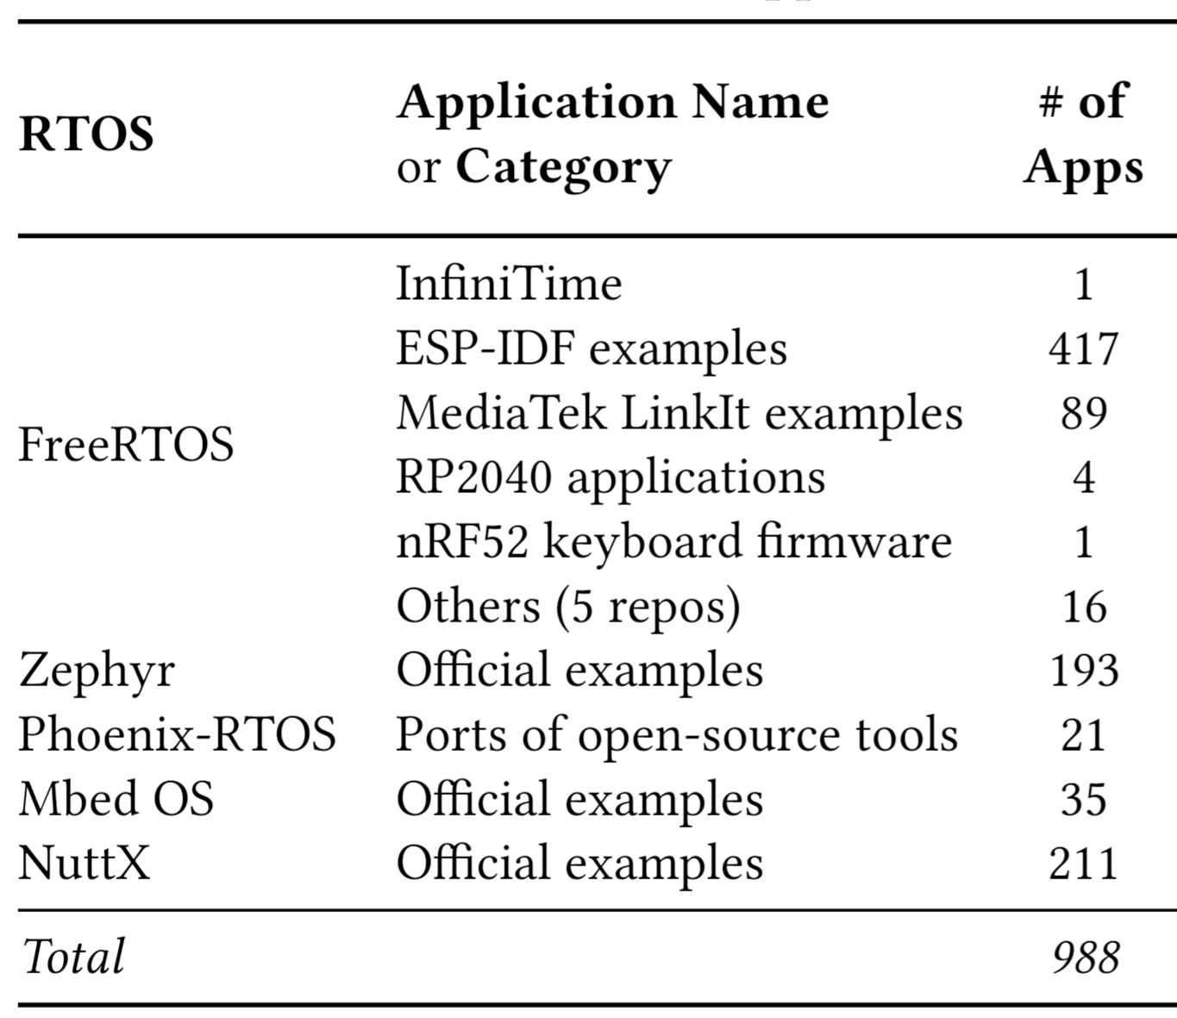





Dataset: 988 applications running on five different RTOSes
Notes:
For evaluation, we compiled 988 embedded applications and run our tool on them.
(click)
Running on five RTOSes:
FreeRTOS, Zephyr, Mbed OS, Phoenix-RTOS, and NuttX

Slide 15
Effectiveness of MMIO Access Finder via Constant Memory Address
Source of false positives
HAL functions defined as C/C++ macros
Hardcoded address may not be an MMIO address
False negatives (missing alias information)
Notes:
First, we evaluate MMIO access finder.
(click) For False positives:
(click)
Specifically in the 500+ FreeRTOS apps, FreeRTOS defines some HAL functions as C macros.
If application functions call these macros, code of direct MMIO access is expanded at the body of this app function. Thus, this func is incorrectly identified as making direct MMIO access.
(click)
We also find cases where hardcoded addresses are not MMIO addresses.
(click)
Fase Negatives are Expected because we don’t use alias information. But None of them are NCMAs. So they do No harm on our final goal.

Slide 16
Effectiveness of NCMA Identification via Call Graph Analysis
Quite a few FPs and FNs
Uncommon peripherals are not needed by many functions
Some popular app functions may be called by many other functions
Future work: Identify HAL functions based on directory structure of source tree of embedded applications
E.g. Consider all functions under directory hal/stm32/ as HAL functions
Notes:
Now we evaluate effectiveness of NCMA identification.
(click) We found quite a few FPs and FNs.
(click) Certain HAL functions expose an uncommon peripheral that may not be needed by many functions and consequently have lower 𝐼𝐷𝑡 .
(click) False negatives result from popular application functions with 𝐼𝐷𝑡 higher than 𝜆. Some application functions may be needed by many other application functions
(click) In future work, we will identify HAL functions based on directory structure of source tree.

Slide 17
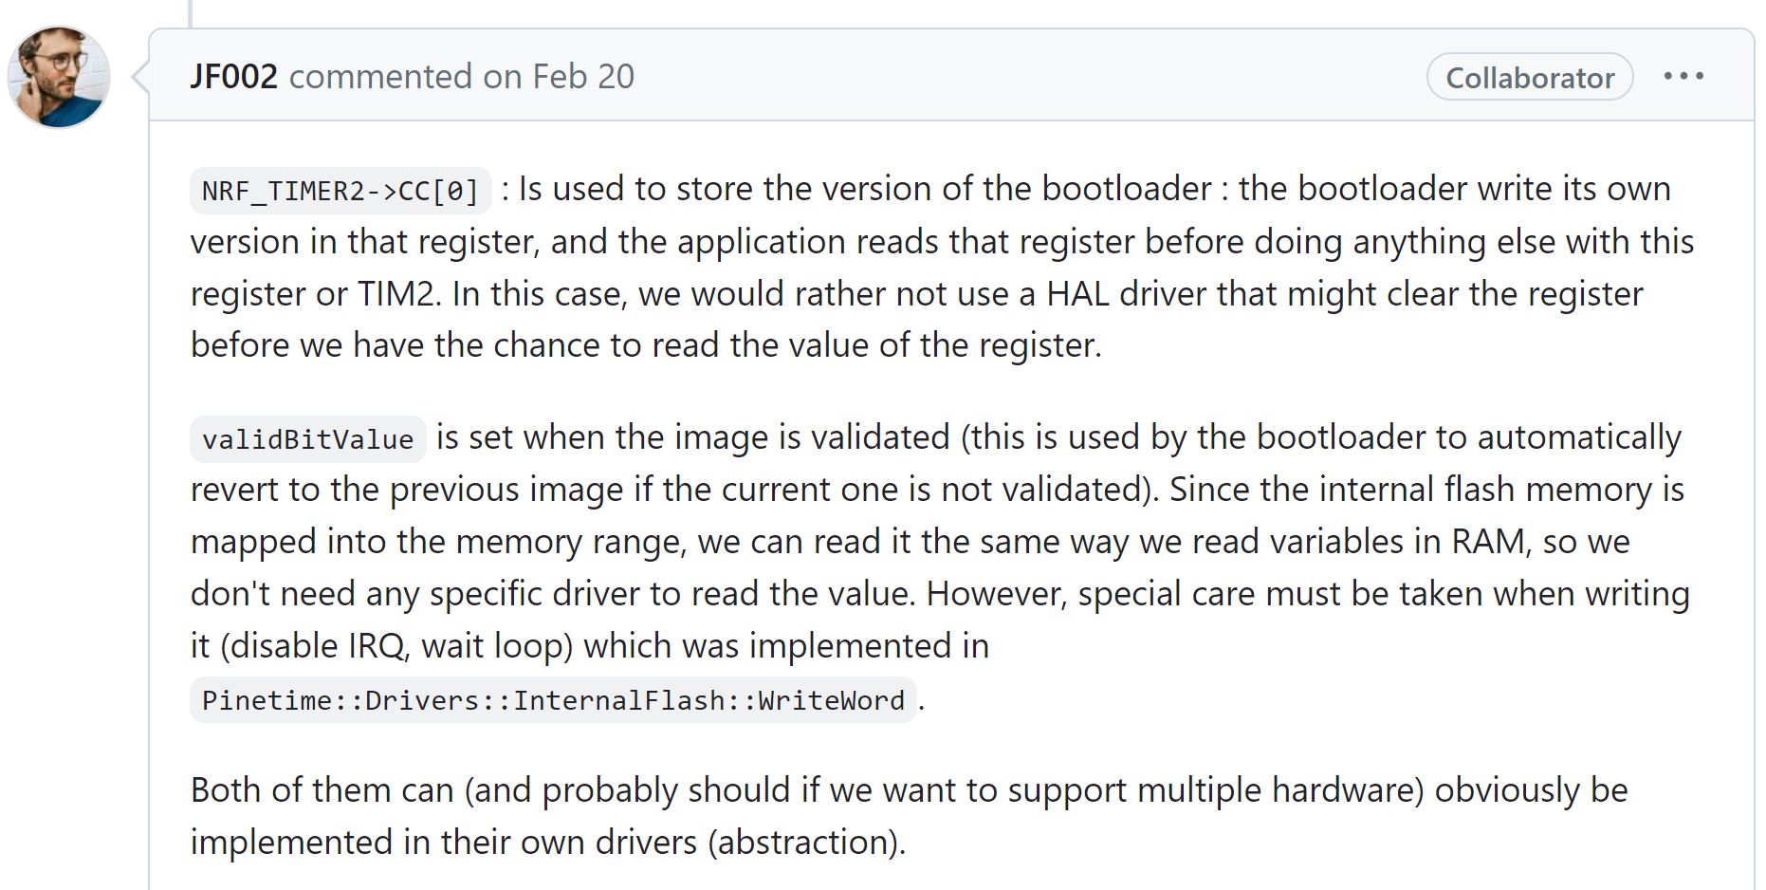
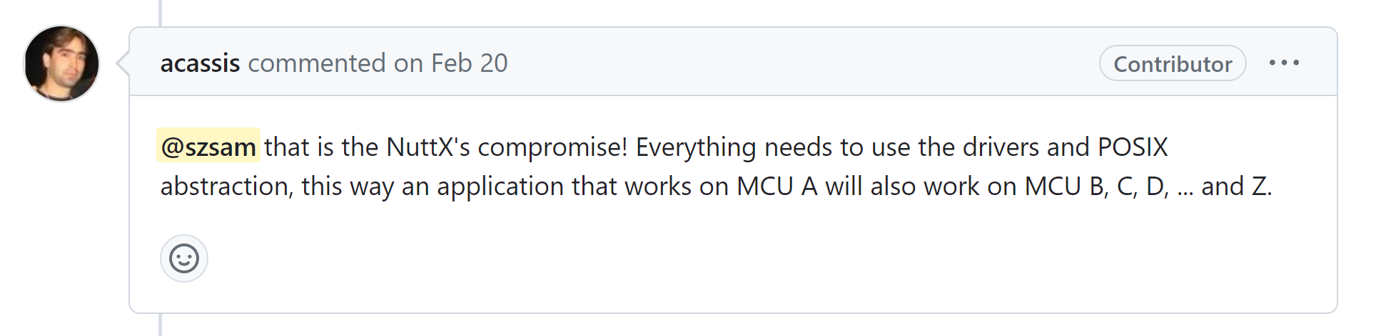
Developers Response
A few developers agreed that NCMAs needs to be fixed
Two cases where developers believe NCMAs were fine
Lack of concern for portability
Workarounds for undesirable behaviors of HAL APIs
Notes:
A few developers agreed that NCMAs needs to be fixed
(click) But there are two cases where developers believe NCMAs are fine.
First, Certain applications support only one hardware platform. Hence, non-portability is currently acceptable
Second, some HAL APIs have unexpected behavior. For example, A timer driver might clear a register before developers can read its value. HAL developers might use this information to improve their APIs
https://github.com/apache/nuttx/issues/8591
https://github.com/InfiniTimeOrg/InfiniTime/issues/1599

Slide 18



In summary…
We developed a static analysis tool to detect Non-Conventional MMIO Accesses and found 369 NCMAs in our dataset.
Contact: shen497@purdue.edu
Website: szsam.github.io
https://github.com/RTOSExploration/lctes2023-artifact
Notes:
In summary:
That's all for my talk!
We thank Rolls Royce again for their support.
Here are my contact information and our artifact. Thanks for your attention!

Slide 19
Bonus slides
19

Slide 20
