Slide 1
PDP 8 Functional Coverage Based Test Plan
Includes - Working of the Design, Block Diagrams, FSMs, Unit and Chip Level Tests
Team Members: Nitish Kumar, Shadman Samin

Slide 2
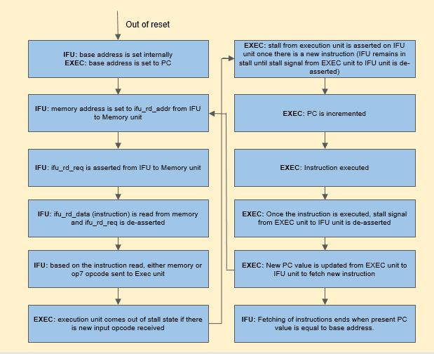
Working of the Design

Slide 3
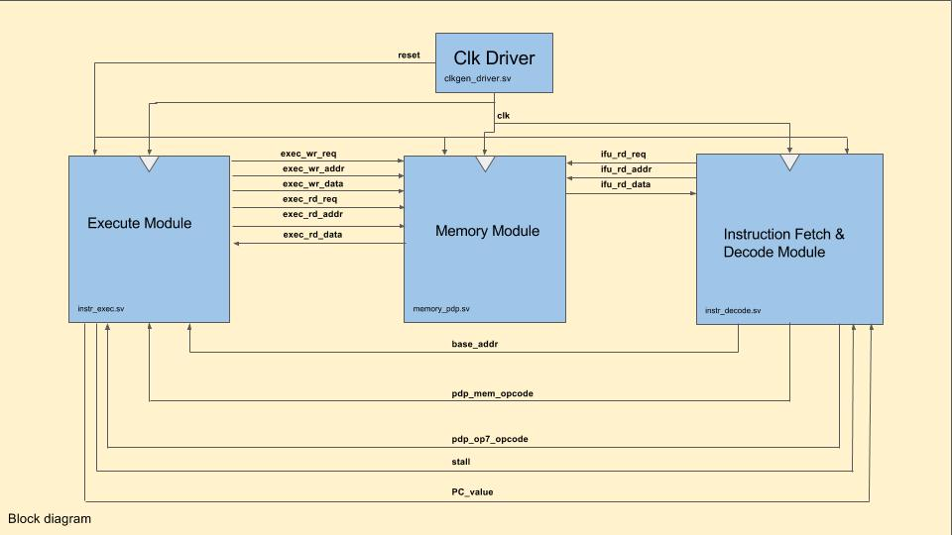
Block Diagram

Slide 4
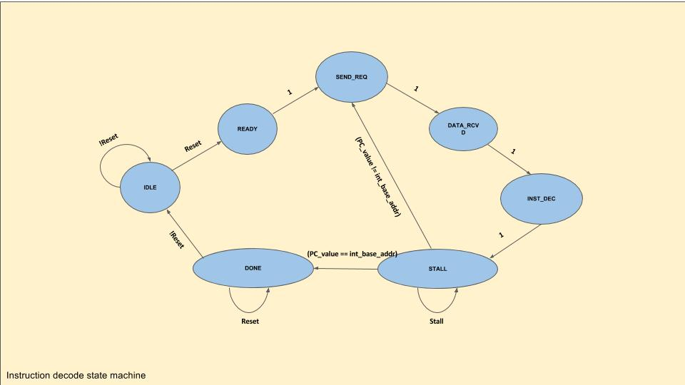
Instruction Fetch and Decode FSM

Slide 5
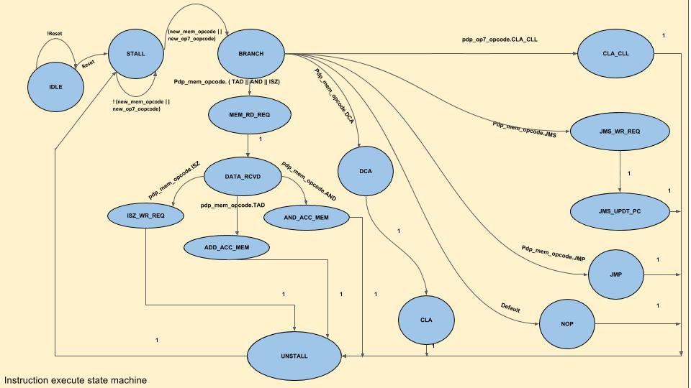
Execute FSM

Slide 6
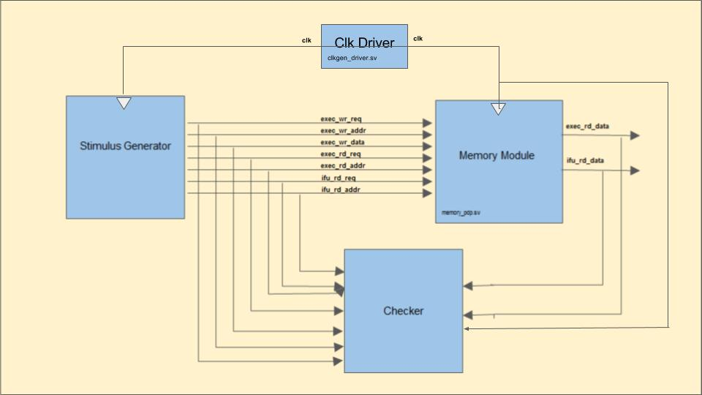
Unit level testing for Memory block

Slide 7
Unit level testing for Memory block
Functions to be verified using assertions:
Successive read after reads, write after writes, read after writes and write after reads for various locations and same location.
Valid memory addressing.
No parallel read requests from Instruction Fetch and Decode unit and Execution unit.

Slide 8
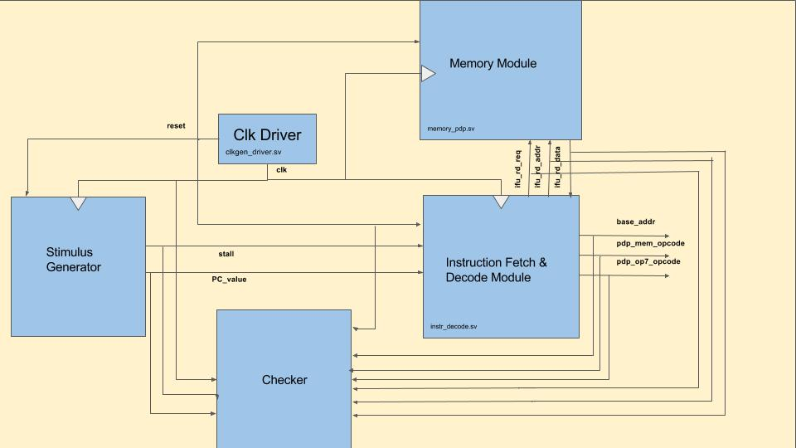
Unit level testing for Instruction Fetch and Decode block

Slide 9
Unit level testing for Instruction Fetch and Decode block
Functions to be verified using assertions:
State transitions based on the inputs to DUT.
Reset functionality.
Valid base address.
Clearing outputs pdp_mem_opcode, pdp_op7_opcode in specific states mentioned.
Assertion and de-assertion of read request in specific states mentioned.
Conversion of instructions fetched from memory to correct opcodes and memory instruction addresses.
Correct update of PC value when out of stall.
Termination of the execution when PC value equals to pre-defined base address.

Slide 10
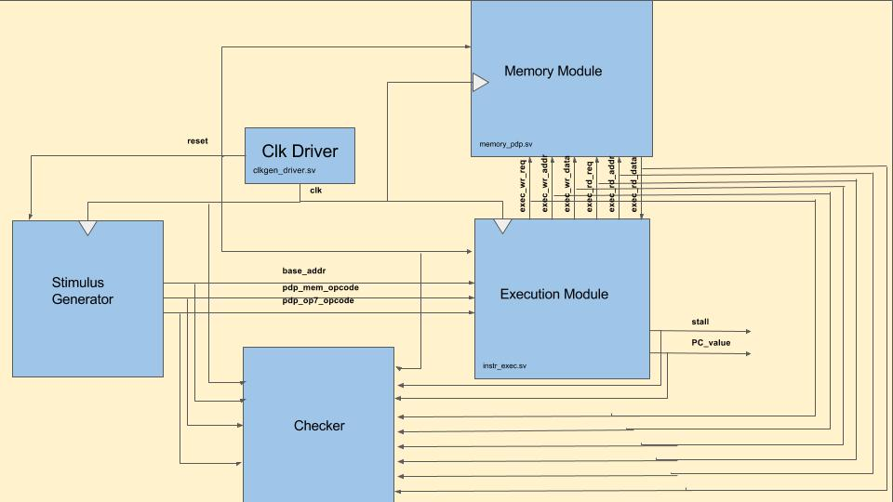
Unit level testing for Execute block

Slide 11
Unit level testing for Execute block
Functions to be verified using assertions:
State transitions based on the inputs to DUT.
Reset functionality.
Update of PC with base address when out of reset.
Assertion and de-assertion of stall signal to Instruction Fetch and Decode unit.
Incrementing and updating PC upon new opcode.
Clearing Accumulator and Link registers in specific states mentioned.
Assertion and de-assertion of read request in specific states mentioned.
Assertion and de-assertion of write request in specific states mentioned.
Correct update of Accumulator and link registers in specific states mentioned.
Correct update of memory instruction address to either read address or write address in specific states mentioned.
Correct update of write data with either (read data+1) or Accumulator register value or PC value in specific states mentioned.
Saving PC value to temporary location after issuing the new PC value to Instruction Fetch and Decode unit.

Slide 12
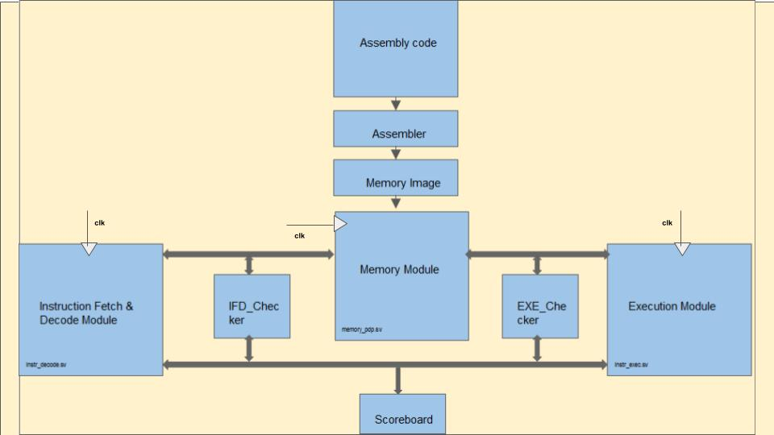
Chip level testing for the whole Design

Slide 13
Chip level testing for the whole Design
Checking strategy: Black box approach for input/output checking.
Components:
Assembly code: Assembly test for simple arithmetic tests to PDP8 processor.
Clk Driver, Instruction Fetch and Decode unit, Execution unit and Memory unit.
Checker: Checkers at unit level for Instruction Fetch and Decode unit and Execution unit are bounded at chip level testing.
Scoreboard: To keep track of the instructions being executed and states entered
Testing:
Memory image from Assembly test as inputs. (Deterministic testing)
Coverage:
Assertion based coverage for state transitions of both units.
Coverage point at the input interface i.e; between Stimulus and DUT.

Slide 14
Project Responsibilities
Duties | Nitish Kumar Marikal | Shadman Samin
Documentation – Verification Plan | ✔ | ✔
Unit Testing – Memory | ✔
Unit Testing – Instruction Fetch |  | ✔
Unit Testing – Execute | ✔
Chip Level Test – Full Design |  | ✔
Assembly – Test Stimulus Generator | ✔ | ✔

