Slide 1
Slide 1 — Welcome to the Heavy Deck
A 50-slide stress test for WASM LibreOffice
Generated deterministically by heavy-50slides.gen.py
Notes:
Speaker notes for slide 1: Slide 1 — Welcome to the Heavy Deck. LibreOffice table rendering pthread service-worker OOXML cold-path fingerprint atomic browser atomic table LibreOffice warm-restore Module table init animation warm-restore atomic performance cold-path transition performance regression warm-path robust viewer thread pthread browser rendering pipeline cache OOXML browser WASM animation performance chart snapshot warm-path robust fetch table transition thread memory chart atomic WASM LibreOffice fingerprint warm-path PresentationML co-edit cache deferred chart WASM rendering image deferred robust fingerprint Emscripten warm-restore memory LibreOffice transition.

Slide 2
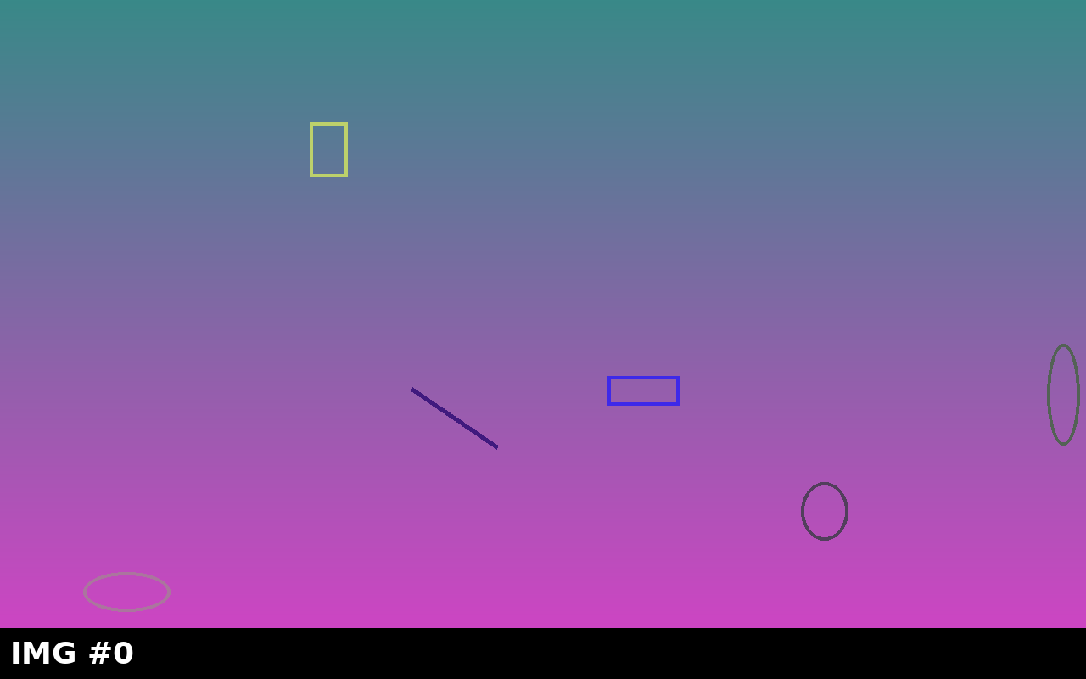
Slide 2 — Agenda
Goals
Stress test snapshot pipeline
Validate warm-restore correctness
Cover diverse OOXML features
Charts, tables, animations, transitions
Images, hyperlinks, grouped shapes
Numbered Workflow
Notes:
Speaker notes for slide 2: Slide 2 — Agenda. deferred cold-path image animation transition test Emscripten transition robust rendering warm-path init LibreOffice fixture image WASM cold-path warm-restore atomic pthread transition robust OOXML pipeline HEAPU8 test rendering deferred robust memory deterministic viewer performance warm-path rendering viewer browser decompress animation cold-path viewer Module rendering deferred pthread PresentationML WASM performance rendering warm-path viewer Emscripten LibreOffice Module test warm-restore LibreOffice chart PresentationML co-edit robust rendering rendering fixture snapshot fixture LibreOffice image Module decompress.

Slide 3
Slide 3 — Architecture Overview
Key point #3A — context for slide 3
Key point #3B — supporting detail
Key point #3C — concrete example
Notes:
Speaker notes for slide 3: Slide 3 — Architecture Overview. Module pthread fingerprint image HEAPU8 memory thread HEAPU8 browser warm-restore fetch viewer Emscripten init memory init rendering deterministic fetch robust init WASM image thread thread LibreOffice decompress image pthread pthread snapshot transition browser fetch WASM thread fixture service-worker LibreOffice test browser transition regression service-worker warm-path table table regression HEAPU8 table transition transition robust regression PresentationML warm-restore service-worker table fetch memory fingerprint animation pthread init warm-path service-worker performance table LibreOffice warm-path.

Slide 4
Slide 4 — WASM Snapshot Pipeline
WASM bootstrap
emscripten Module init
Filesystem mount
Snapshot capture (deferred HEAPU8)
Snapshot restore on second init
Stage | Cold | Warm
R1C1=655 | R1C2=115 | R1C3=26
R2C1=760 | R2C2=282 | R2C3=251
R3C1=229 | R3C2=143 | R3C3=755
Notes:
Speaker notes for slide 4: Slide 4 — WASM Snapshot Pipeline. cold-path performance thread init table chart fetch LibreOffice animation fingerprint viewer init fixture snapshot animation warm-restore transition animation rendering init decompress warm-path pipeline warm-restore co-edit warm-path co-edit Emscripten LibreOffice deterministic pthread warm-restore fixture warm-restore service-worker deterministic memory LibreOffice PresentationML Module warm-path Module browser memory OOXML fixture HEAPU8 transition PresentationML Emscripten PresentationML OOXML warm-restore HEAPU8 animation thread cache pthread warm-restore decompress animation pipeline memory service-worker Module warm-path image Module warm-path atomic.

Slide 5

Slide 5 — Image: Cold Start Timeline
Caption: high-resolution figure for slide 5.
Notes:
Speaker notes for slide 5: Slide 5 — Image: Cold Start Timeline. Emscripten browser thread cold-path atomic pipeline cache pthread PresentationML Module co-edit atomic decompress fingerprint chart WASM robust WASM pipeline LibreOffice fetch Module performance regression image rendering deterministic co-edit Emscripten chart browser cache thread LibreOffice test pipeline test cold-path Emscripten HEAPU8 memory fetch init deterministic performance warm-restore fingerprint browser deterministic pthread fingerprint atomic table HEAPU8 thread animation WASM deferred snapshot HEAPU8 warm-restore WASM chart transition memory viewer fixture HEAPU8 Emscripten table.

Slide 6
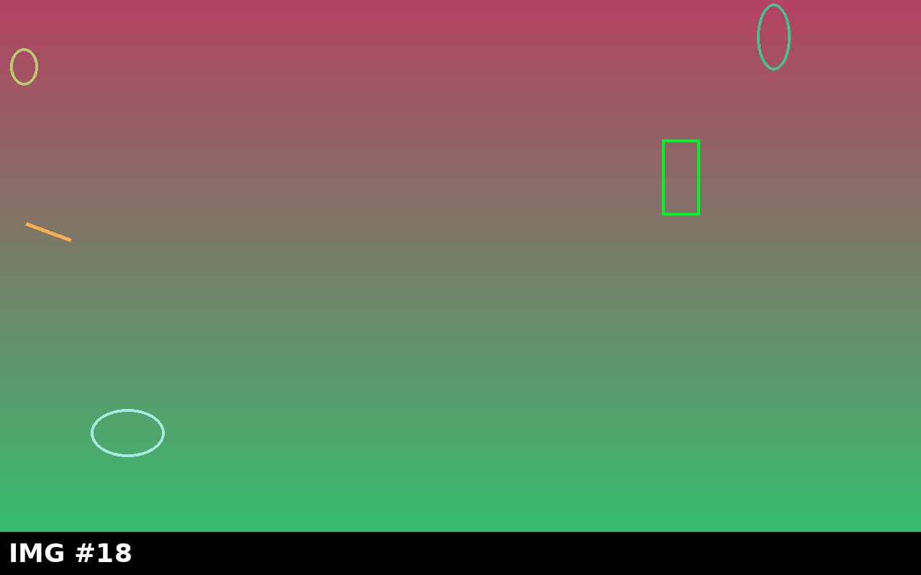
Slide 6 — Image: Warm Restore Timeline
Caption: high-resolution figure for slide 6.
Notes:
Speaker notes for slide 6: Slide 6 — Image: Warm Restore Timeline. cache LibreOffice image memory snapshot chart atomic decompress snapshot chart deferred pipeline animation robust viewer browser warm-restore pipeline snapshot test LibreOffice pipeline snapshot WASM regression deterministic rendering rendering service-worker snapshot memory service-worker Module cache decompress browser performance deferred cold-path atomic PresentationML HEAPU8 regression pthread deferred warm-path performance table robust viewer deferred service-worker table OOXML transition fingerprint rendering snapshot rendering init LibreOffice init Emscripten fetch atomic fingerprint animation fixture WASM browser.

Slide 7
Slide 7 — Chart: Q1 Revenue
Notes:
Speaker notes for slide 7: Slide 7 — Chart: Q1 Revenue. WASM PresentationML pipeline PresentationML image deferred LibreOffice table pthread LibreOffice memory robust deterministic WASM WASM warm-path table fixture viewer co-edit LibreOffice test warm-path deterministic deterministic image warm-restore fetch atomic decompress rendering fixture snapshot LibreOffice robust memory co-edit HEAPU8 browser deterministic warm-path test WASM service-worker test cold-path PresentationML table warm-restore deferred Module HEAPU8 PresentationML Emscripten table co-edit fixture viewer fingerprint decompress fingerprint snapshot PresentationML deferred animation regression service-worker chart pthread deterministic.

Slide 8
Slide 8 — Chart: Active Users by Region
Notes:
Speaker notes for slide 8: Slide 8 — Chart: Active Users by Region. deferred memory fetch rendering performance LibreOffice animation robust co-edit robust cache snapshot thread decompress regression image Module animation thread WASM chart animation performance image service-worker cache performance performance animation image fingerprint fixture image performance memory memory pipeline fetch transition memory fingerprint HEAPU8 atomic decompress cold-path fingerprint atomic cache cold-path cache LibreOffice thread init fixture Module animation pipeline LibreOffice image Module test decompress memory Module Module HEAPU8 image thread WASM co-edit.

Slide 9
Slide 9 — Two-Content: Pros vs Cons
Pros
Fast warm path (~1s)
Smaller bundle on second open
Shared code cache
Cons
Snapshot disk cost
Restore-time pthread quirks
Doctype-specific edge cases
Notes:
Speaker notes for slide 9: Slide 9 — Two-Content: Pros vs Cons. PresentationML snapshot Module viewer deferred Emscripten OOXML init fixture chart test rendering WASM chart table robust viewer Module OOXML init performance atomic fetch HEAPU8 snapshot init transition cache transition transition HEAPU8 chart warm-path warm-restore OOXML HEAPU8 HEAPU8 pipeline pipeline test chart cold-path fingerprint fetch fetch WASM memory thread test decompress table transition transition thread fetch decompress viewer snapshot fixture memory warm-path pipeline table table thread test performance deferred deferred fingerprint.

Slide 10
Slide 10 — Comparison: Cold vs Warm Path
Cold path
Full WASM init
Network fetch + decompress
~5–10s typical
Warm path
HEAPU8 snapshot restore
Skip slow init
~1s typical
Notes:
Speaker notes for slide 10: Slide 10 — Comparison: Cold vs Warm Path. fixture thread rendering cold-path warm-path cold-path OOXML animation warm-path chart performance init init cache test atomic animation browser Emscripten fingerprint deferred viewer snapshot deferred deferred pthread deterministic animation animation init PresentationML warm-restore table warm-path performance warm-restore warm-restore viewer thread LibreOffice atomic robust LibreOffice deterministic table image viewer image deterministic atomic pipeline fixture deferred chart fetch transition decompress rendering Emscripten Emscripten service-worker WASM fingerprint PresentationML viewer image memory test warm-restore performance.

Slide 11
Slide 11 — Table: Latency Budget
Phase | Budget ms | Actual ms | Slack ms
R1C1=474 | R1C2=389 | R1C3=277 | R1C4=948
R2C1=656 | R2C2=705 | R2C3=571 | R2C4=225
R3C1=702 | R3C2=333 | R3C3=864 | R3C4=787
R4C1=795 | R4C2=58 | R4C3=235 | R4C4=842
R5C1=33 | R5C2=825 | R5C3=324 | R5C4=411
R6C1=275 | R6C2=68 | R6C3=217 | R6C4=936
R7C1=966 | R7C2=581 | R7C3=898 | R7C4=736
Notes:
Speaker notes for slide 11: Slide 11 — Table: Latency Budget. fingerprint regression warm-restore cold-path PresentationML memory browser memory init regression PresentationML co-edit HEAPU8 deterministic service-worker co-edit cache chart rendering warm-path atomic cache Emscripten warm-restore Emscripten OOXML thread snapshot test deferred thread OOXML performance regression memory image regression Emscripten transition Module rendering animation cold-path table regression pipeline PresentationML performance init Emscripten warm-path LibreOffice PresentationML OOXML fingerprint transition transition animation fingerprint animation WASM table test deferred regression atomic table regression WASM regression.

Slide 12
Slide 12 — Table: Test Matrix
Test | Doctype | Path | P50 | P95
R1C1=323 | R1C2=218 | R1C3=672 | R1C4=512 | R1C5=406
R2C1=906 | R2C2=937 | R2C3=659 | R2C4=470 | R2C5=147
R3C1=272 | R3C2=143 | R3C3=253 | R3C4=763 | R3C5=575
R4C1=552 | R4C2=270 | R4C3=765 | R4C4=599 | R4C5=439
R5C1=920 | R5C2=598 | R5C3=409 | R5C4=371 | R5C5=225
R6C1=142 | R6C2=522 | R6C3=506 | R6C4=94 | R6C5=774
R7C1=49 | R7C2=882 | R7C3=113 | R7C4=157 | R7C5=643
R8C1=164 | R8C2=812 | R8C3=697 | R8C4=433 | R8C5=611
R9C1=66 | R9C2=395 | R9C3=391 | R9C4=611 | R9C5=480
R10C1=542 | R10C2=258 | R10C3=995 | R10C4=567 | R10C5=882
R11C1=966 | R11C2=12 | R11C3=697 | R11C4=739 | R11C5=118
Notes:
Speaker notes for slide 12: Slide 12 — Table: Test Matrix. fetch OOXML animation browser chart warm-restore cache regression warm-path thread robust table animation memory cold-path snapshot browser HEAPU8 performance Emscripten image service-worker Emscripten fingerprint OOXML chart service-worker pthread transition Emscripten thread deterministic image performance PresentationML snapshot test viewer init LibreOffice image init PresentationML fingerprint table image LibreOffice PresentationML init fixture deferred init thread fetch thread init thread browser performance cache deferred animation fingerprint LibreOffice PresentationML warm-restore table fixture animation image.

Slide 13
Slide 13 — SmartArt: Org Chart
CEO
VP Eng
VP Sales
VP Ops
Backend
Frontend
Field
Inside
Notes:
Speaker notes for slide 13: Slide 13 — SmartArt: Org Chart. Module regression PresentationML atomic atomic warm-restore service-worker LibreOffice service-worker fixture regression snapshot fetch viewer memory fetch viewer chart regression deterministic OOXML browser cache decompress table co-edit animation browser performance cold-path co-edit service-worker Emscripten init PresentationML viewer deterministic decompress deterministic table warm-restore deterministic deferred init fingerprint Module memory deferred viewer decompress regression test cold-path Module Emscripten warm-path viewer deterministic pipeline OOXML decompress regression transition fingerprint warm-restore fixture pthread warm-path transition warm-path.

Slide 14
Slide 14 — Animation: Entrance Effects
Appear
Fade
Fly
Notes:
Speaker notes for slide 14: Slide 14 — Animation: Entrance Effects. init snapshot fixture regression WASM warm-path warm-path PresentationML HEAPU8 init Module regression cold-path robust Emscripten performance snapshot chart atomic animation fixture deferred animation fingerprint pthread fetch deferred thread fixture PresentationML fixture LibreOffice test HEAPU8 Module cache init warm-path rendering WASM fetch thread robust PresentationML robust image HEAPU8 co-edit chart thread deferred image viewer viewer Emscripten browser co-edit Module chart LibreOffice robust memory chart warm-restore deterministic viewer browser robust animation cache.

Slide 15
Slide 15 — Animation: Emphasis Pulse
Pulse 1
Pulse 2
Pulse 3
Notes:
Speaker notes for slide 15: Slide 15 — Animation: Emphasis Pulse. performance pipeline Module deferred browser test warm-path robust pipeline Emscripten snapshot robust co-edit cold-path Module cold-path init fetch image image pipeline WASM image service-worker robust co-edit viewer regression warm-path deterministic robust memory pthread robust regression fetch atomic chart cold-path transition performance snapshot PresentationML deferred deferred snapshot browser browser snapshot rendering image image fixture WASM Emscripten transition viewer Emscripten chart service-worker Emscripten service-worker atomic fetch transition pthread warm-path deferred WASM thread.

Slide 16

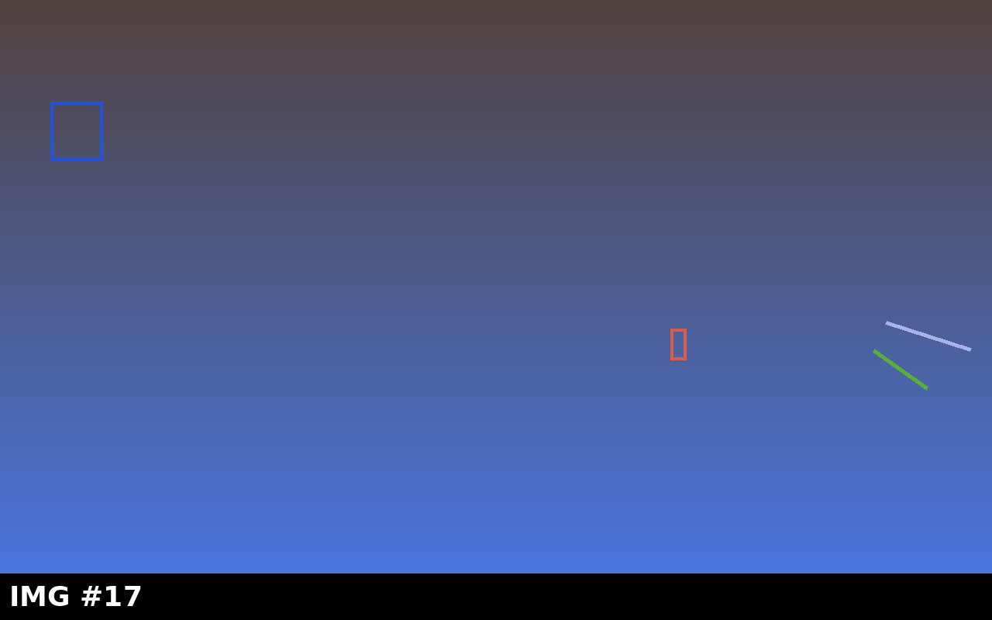
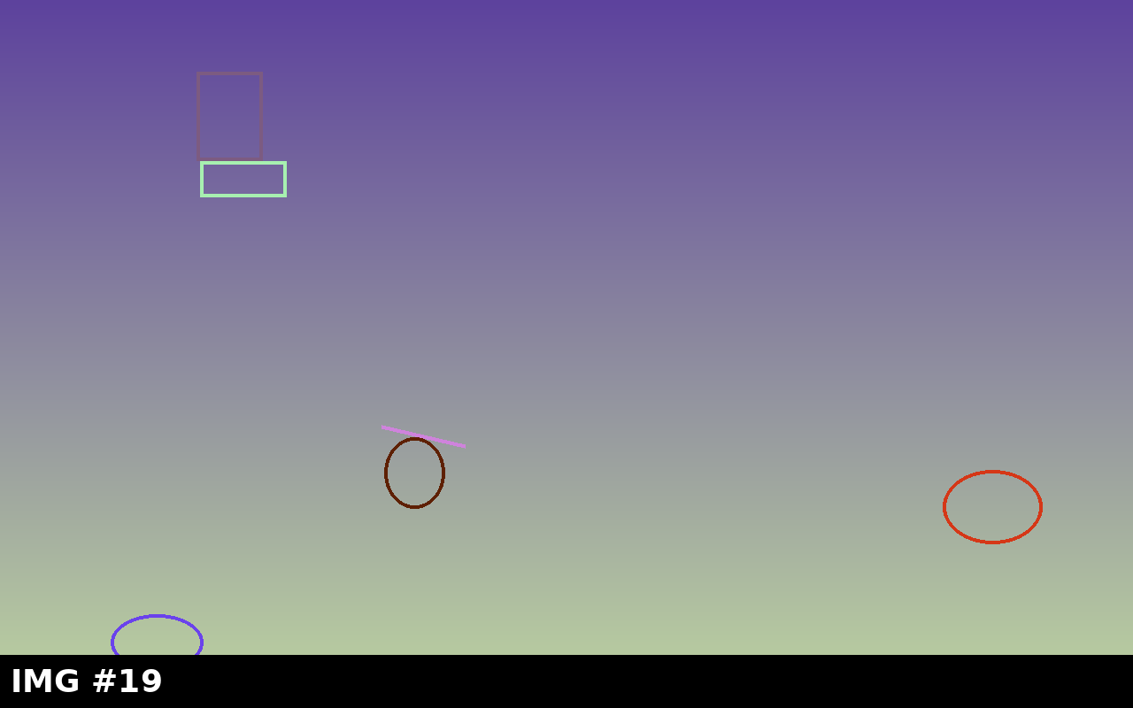
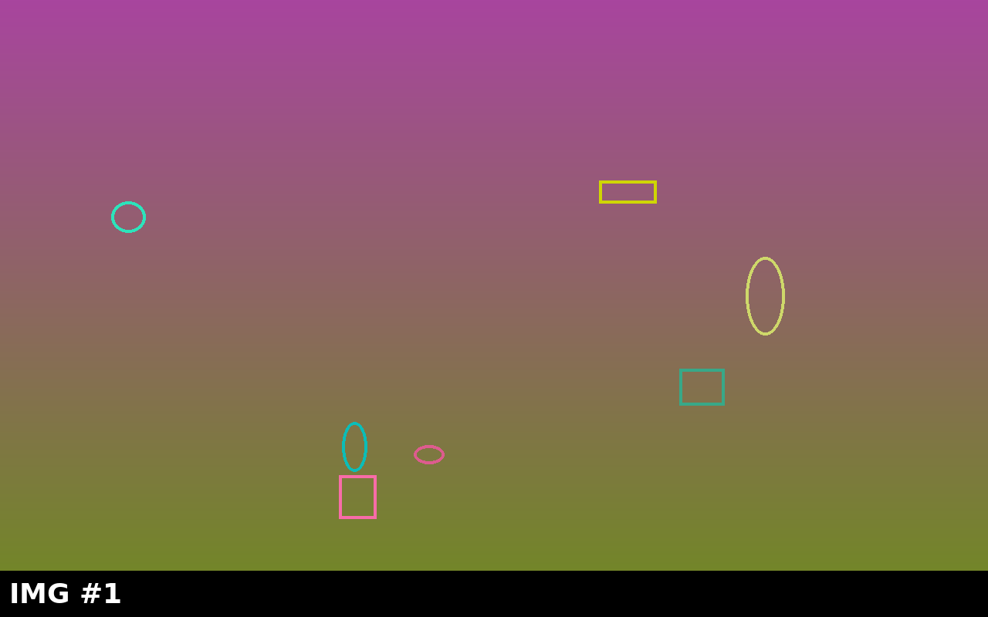
Slide 16 — Image Gallery (Multi)
Notes:
Speaker notes for slide 16: Slide 16 — Image Gallery (Multi). fingerprint service-worker thread cache pthread OOXML viewer cache Module WASM HEAPU8 deferred Emscripten robust init browser OOXML atomic Module PresentationML performance robust test decompress fetch fingerprint fingerprint fetch cache deterministic fixture cache test warm-restore HEAPU8 PresentationML chart image regression robust fetch cache fingerprint init transition pipeline fetch cache service-worker rendering table thread memory robust fixture PresentationML table pipeline atomic pipeline rendering viewer pipeline service-worker fingerprint deferred memory warm-path image OOXML.

Slide 17
Slide 17 — Chart: Latency Distribution
Notes:
Speaker notes for slide 17: Slide 17 — Chart: Latency Distribution. Emscripten warm-path table performance cache pipeline performance deterministic test snapshot deterministic Emscripten deferred warm-path Emscripten robust fetch regression pthread pthread HEAPU8 viewer Module viewer HEAPU8 regression memory transition init co-edit animation memory table test animation atomic animation animation browser service-worker browser deterministic performance viewer Module pipeline warm-restore pthread WASM robust table thread co-edit browser decompress deferred test browser browser LibreOffice performance co-edit transition Emscripten deterministic init Module OOXML deferred Emscripten.

Slide 18

Slide 18 — Notes-Heavy: Implementation Tips
Implementation Tips
Always verify remote before destroy
Commit after every win
Hot-deploy via cache-bust-build.js
Snapshot capture is deferred (HEAPU8)
Notes:
Speaker notes for slide 18: Slide 18 — Notes-Heavy: Implementation Tips. browser browser performance image robust decompress image PresentationML deferred cold-path chart co-edit service-worker thread PresentationML animation robust service-worker LibreOffice robust warm-path animation service-worker fingerprint performance table LibreOffice decompress decompress Module Module regression snapshot fingerprint animation WASM fetch co-edit animation PresentationML robust warm-path table snapshot viewer deferred chart OOXML browser OOXML warm-restore transition pipeline fixture OOXML Module table WASM atomic chart Emscripten deterministic Emscripten transition warm-restore memory co-edit LibreOffice robust Module.

Slide 19
Slide 19 — Hyperlinks: External References
python-pptx documentation
OOXML PresentationML reference
LibreOffice WASM repo
Emscripten Module API
WebAssembly spec
Notes:
Speaker notes for slide 19: Slide 19 — Hyperlinks: External References. WASM fetch chart performance fixture memory thread image deterministic service-worker service-worker deterministic regression image regression performance cache cold-path LibreOffice PresentationML memory deterministic Emscripten Emscripten WASM co-edit Module OOXML table deferred browser cold-path Module OOXML warm-path LibreOffice performance deterministic performance memory service-worker atomic init performance deterministic PresentationML cold-path chart deterministic HEAPU8 chart memory table atomic table image init co-edit atomic cache warm-restore animation co-edit Emscripten LibreOffice rendering init warm-path WASM WASM.

Slide 20

Slide 20 — Picture-with-Caption: Diagram
Diagram: pipeline stages from upload through render.
Notes:
Speaker notes for slide 20: Slide 20 — Picture-with-Caption: Diagram. co-edit warm-restore HEAPU8 browser robust PresentationML deterministic PresentationML test fingerprint cold-path deferred deferred test pipeline cold-path LibreOffice memory transition WASM Module PresentationML cold-path robust co-edit rendering animation service-worker browser deferred rendering Module snapshot service-worker browser image PresentationML deterministic co-edit transition PresentationML fetch image regression fingerprint LibreOffice thread decompress table rendering fetch deferred transition browser PresentationML rendering table init test cold-path pthread snapshot OOXML deterministic pipeline co-edit cache fetch table co-edit.

Slide 21
Slide 21 — Bullet Lists with Nesting
Categories
Performance
Cold start
Warm restore
Correctness
Rendering parity
Co-edit consistency
Robustness
Crash recovery
Network flake
Notes:
Speaker notes for slide 21: Slide 21 — Bullet Lists with Nesting. deferred init PresentationML atomic fixture regression thread cold-path warm-path cold-path fetch performance performance HEAPU8 regression PresentationML warm-path robust warm-restore decompress snapshot image Emscripten cache Module performance fixture cache fingerprint service-worker HEAPU8 memory browser warm-restore warm-restore animation memory thread performance LibreOffice init deterministic test decompress chart OOXML Module Module warm-restore HEAPU8 warm-path thread rendering thread browser atomic decompress rendering rendering viewer decompress browser table viewer init cold-path test warm-restore table co-edit.

Slide 22
Slide 22 — Numbered Workflow Steps
1. Receive doc
2. Decrypt fragment
3. Init WASM
4. Restore snapshot if available
5. Render first slide
6. Notify UI
Notes:
Speaker notes for slide 22: Slide 22 — Numbered Workflow Steps. transition cold-path fingerprint rendering browser thread viewer cache fixture warm-path LibreOffice test Emscripten test service-worker decompress co-edit animation browser HEAPU8 LibreOffice animation robust OOXML WASM decompress decompress robust transition Emscripten Emscripten cache Emscripten thread memory co-edit rendering performance fixture deferred init transition chart warm-path co-edit rendering atomic cache atomic warm-path fetch fingerprint fetch chart PresentationML deterministic animation init rendering fetch robust chart performance chart animation Module LibreOffice rendering Emscripten warm-restore.

Slide 23
Slide 23 — Mixed Fonts & Sizes
Bold text
Italic text
Underlined text
Big heading
Tiny footnote
Mixed combo:
Notes:
Speaker notes for slide 23: Slide 23 — Mixed Fonts & Sizes. Module memory Emscripten transition warm-path pipeline snapshot cold-path cache fingerprint fingerprint browser cold-path test viewer thread test HEAPU8 performance init OOXML table init chart performance fetch regression decompress HEAPU8 service-worker fetch Emscripten deferred chart memory co-edit HEAPU8 pthread pipeline robust deferred Module cache HEAPU8 atomic cold-path table fetch image LibreOffice image warm-restore service-worker pthread Emscripten image animation browser animation deferred warm-path fingerprint decompress test memory OOXML deferred transition co-edit warm-path.

Slide 24
Slide 24 — Chart: Pie of Time Spent
Notes:
Speaker notes for slide 24: Slide 24 — Chart: Pie of Time Spent. warm-restore Emscripten service-worker decompress deferred performance memory init fingerprint fingerprint service-worker performance transition service-worker performance cold-path animation warm-path Emscripten memory deferred cache rendering WASM rendering rendering performance fingerprint fetch snapshot fingerprint pipeline PresentationML transition OOXML service-worker deterministic OOXML rendering image robust co-edit HEAPU8 pthread warm-restore cold-path warm-restore warm-restore fixture animation fetch cache HEAPU8 PresentationML pthread warm-path LibreOffice viewer service-worker performance service-worker PresentationML chart WASM PresentationML fetch pipeline cold-path HEAPU8 deferred.

Slide 25
Slide 25 — Halfway: Mid-Deck Checkpoint
Halfway there!
25 slides down, 25 to go.
Notes:
Speaker notes for slide 25: Slide 25 — Halfway: Mid-Deck Checkpoint. chart LibreOffice WASM chart cache image fixture service-worker decompress Emscripten cache transition deterministic viewer performance fetch pthread chart atomic pipeline co-edit co-edit deferred snapshot robust test WASM LibreOffice fetch PresentationML decompress cold-path decompress fixture fetch WASM PresentationML browser robust WASM browser fingerprint snapshot snapshot fixture fingerprint decompress pipeline regression fixture image decompress atomic warm-restore PresentationML regression init chart image warm-restore pipeline rendering table transition cold-path memory WASM Module memory fetch.

Slide 26
Slide 26 — Table: Feature Flags
Flag | Default | Notes
R1C1=894 | R1C2=622 | R1C3=434
R2C1=988 | R2C2=217 | R2C3=952
R3C1=553 | R3C2=774 | R3C3=748
R4C1=707 | R4C2=206 | R4C3=731
R5C1=320 | R5C2=409 | R5C3=688
R6C1=666 | R6C2=383 | R6C3=449
Notes:
Speaker notes for slide 26: Slide 26 — Table: Feature Flags. warm-restore Emscripten test service-worker regression image atomic cold-path memory thread decompress thread deferred co-edit performance memory cache deterministic fixture test deterministic snapshot snapshot HEAPU8 fetch PresentationML HEAPU8 animation OOXML chart service-worker cache table browser decompress warm-path fetch test table service-worker PresentationML Module PresentationML rendering Emscripten cache pipeline deferred test browser rendering fingerprint atomic thread warm-path WASM warm-restore robust performance animation OOXML memory memory rendering WASM LibreOffice deferred regression deterministic decompress.

Slide 27
Slide 27 — Animation: Fly-In Demo
A
B
C
D
Notes:
Speaker notes for slide 27: Slide 27 — Animation: Fly-In Demo. warm-restore co-edit rendering thread Module image snapshot cold-path deferred WASM init init LibreOffice atomic robust regression fingerprint test Emscripten LibreOffice service-worker rendering performance viewer deferred test robust atomic pipeline snapshot memory deferred fingerprint browser Module table cold-path HEAPU8 atomic WASM performance deferred animation animation deterministic deterministic thread snapshot animation service-worker HEAPU8 memory decompress service-worker performance transition OOXML WASM memory LibreOffice animation performance co-edit Emscripten robust thread fixture Emscripten WASM co-edit.

Slide 28
Slide 28 — SmartArt: Process Flow
Upload
Parse
Snapshot
Render
Serve
Notes:
Speaker notes for slide 28: Slide 28 — SmartArt: Process Flow. HEAPU8 browser regression table HEAPU8 cache thread service-worker table warm-restore warm-restore co-edit rendering chart atomic viewer viewer performance decompress LibreOffice PresentationML cache warm-path image deferred animation pipeline co-edit fetch service-worker init deferred co-edit atomic PresentationML HEAPU8 WASM test thread rendering warm-path animation robust test transition Emscripten PresentationML LibreOffice HEAPU8 performance fingerprint warm-restore co-edit performance browser table performance test init pipeline Emscripten atomic chart viewer fixture fixture memory co-edit transition deferred.

Slide 29
Slide 29 — Image: Performance Heatmap
Caption: high-resolution figure for slide 29.
Notes:
Speaker notes for slide 29: Slide 29 — Image: Performance Heatmap. pipeline deferred OOXML thread pthread init warm-path regression service-worker cache performance test fingerprint test cold-path thread Emscripten decompress init memory co-edit Module table snapshot regression warm-restore snapshot fetch transition warm-restore animation thread cache deferred fetch transition chart transition atomic regression rendering regression cache viewer thread atomic WASM co-edit table fingerprint viewer snapshot LibreOffice warm-restore deferred deferred LibreOffice transition deterministic chart init fingerprint PresentationML LibreOffice thread memory image viewer robust memory.

Slide 30
Slide 30 — Chart: Scatter Cold-Start vs Size
Notes:
Speaker notes for slide 30: Slide 30 — Chart: Scatter Cold-Start vs Size. LibreOffice warm-path OOXML table memory init browser viewer memory animation table snapshot robust animation OOXML snapshot pipeline fingerprint warm-path deterministic warm-path LibreOffice fingerprint browser fixture WASM transition animation service-worker decompress atomic memory browser cache service-worker OOXML WASM OOXML service-worker fixture fingerprint rendering Module PresentationML WASM decompress snapshot cold-path test Module cache pipeline atomic HEAPU8 animation service-worker init LibreOffice Emscripten warm-restore atomic fixture LibreOffice pipeline snapshot HEAPU8 robust cache atomic cold-path.

Slide 31
Slide 31 — Comparison: Browser Support
Chrome
Service Worker OK
WebGL2 OK
Safari
Quirks with COOP/COEP
Storage limits

Slide 32
Slide 32 — Hyperlinks: Internal Anchors
See Slide 7 chart
See Slide 13 org chart
See Slide 25 mid-checkpoint
Notes:
Speaker notes for slide 32: Slide 32 — Hyperlinks: Internal Anchors. service-worker thread warm-path OOXML fetch chart HEAPU8 deterministic chart LibreOffice fingerprint warm-restore table pipeline service-worker cold-path transition pthread fingerprint regression deferred warm-restore WASM atomic regression regression regression viewer cache WASM warm-path WASM image browser pthread transition transition WASM decompress robust HEAPU8 pthread deterministic performance HEAPU8 init HEAPU8 LibreOffice memory PresentationML viewer fingerprint service-worker service-worker pthread cache chart performance PresentationML thread Emscripten cache fixture snapshot cold-path fixture OOXML table Module fingerprint.

Slide 33
Slide 33 — Notes-Heavy: Edge Cases
Edge cases
Phase 1: internal dogfood
Phase 2: opt-in beta
Phase 3: GA with feature flag
Phase 4: deprecate v1
Edge case: stale snapshot
Edge case: pthread teardown
Edge case: COOP/COEP

Slide 34
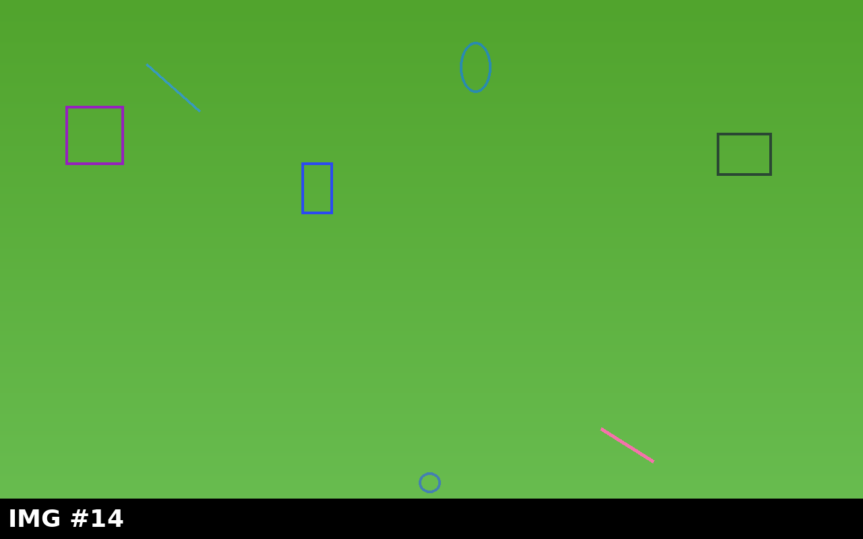
Slide 34 — Image Gallery (Wide)
Notes:
Speaker notes for slide 34: Slide 34 — Image Gallery (Wide). WASM rendering rendering performance service-worker viewer image service-worker image PresentationML fingerprint decompress warm-restore OOXML LibreOffice deterministic atomic HEAPU8 image Emscripten HEAPU8 transition co-edit image fixture performance pthread service-worker HEAPU8 cache WASM snapshot regression fixture fetch snapshot cold-path table PresentationML OOXML robust performance warm-path HEAPU8 regression browser memory browser warm-restore table snapshot warm-path table chart thread transition service-worker animation co-edit WASM warm-path service-worker pipeline LibreOffice atomic fingerprint LibreOffice rendering table memory.

Slide 35
Slide 35 — Table: Memory Profile
Col 1 | Col 2 | Col 3 | Col 4 | Col 5 | Col 6
R1C1=725 | R1C2=647 | R1C3=61 | R1C4=235 | R1C5=70 | R1C6=928
R2C1=33 | R2C2=881 | R2C3=339 | R2C4=73 | R2C5=527 | R2C6=244
R3C1=286 | R3C2=686 | R3C3=498 | R3C4=220 | R3C5=553 | R3C6=136
R4C1=741 | R4C2=958 | R4C3=904 | R4C4=585 | R4C5=591 | R4C6=485
R5C1=249 | R5C2=804 | R5C3=485 | R5C4=827 | R5C5=417 | R5C6=195
R6C1=97 | R6C2=100 | R6C3=675 | R6C4=442 | R6C5=363 | R6C6=434
R7C1=421 | R7C2=479 | R7C3=885 | R7C4=747 | R7C5=56 | R7C6=690
R8C1=670 | R8C2=662 | R8C3=101 | R8C4=63 | R8C5=413 | R8C6=746
R9C1=348 | R9C2=820 | R9C3=883 | R9C4=112 | R9C5=255 | R9C6=197

Slide 36
Slide 36 — Animation: Zoom + Fade Mix
Z1
F1
X1
Z2
Notes:
Speaker notes for slide 36: Slide 36 — Animation: Zoom + Fade Mix. cold-path rendering viewer WASM viewer fingerprint HEAPU8 animation snapshot cache fetch performance init regression Emscripten regression transition robust transition warm-restore viewer PresentationML pipeline fingerprint chart regression decompress animation decompress snapshot warm-restore co-edit regression PresentationML deterministic cache decompress thread thread PresentationML warm-restore HEAPU8 rendering PresentationML fingerprint cache thread WASM fixture test transition decompress snapshot warm-restore image animation regression deferred Module fetch browser chart robust decompress snapshot service-worker warm-path warm-restore decompress animation.

Slide 37
Slide 37 — SmartArt: Layered Stack
UI Layer
State Layer
WASM Bridge
LibreOffice Core

Slide 38
Slide 38 — Picture-with-Caption: Photo
Caption: high-resolution figure for slide 38.
Notes:
Speaker notes for slide 38: Slide 38 — Picture-with-Caption: Photo. co-edit viewer regression animation co-edit fingerprint Module LibreOffice HEAPU8 HEAPU8 animation WASM WASM deterministic test rendering pthread viewer cold-path init Module cache browser Emscripten decompress viewer OOXML memory image PresentationML image fixture memory decompress snapshot performance warm-restore regression Emscripten pipeline thread decompress animation test fixture warm-restore regression service-worker thread HEAPU8 pipeline WASM co-edit transition cold-path performance OOXML cold-path init test warm-path cache PresentationML browser performance LibreOffice snapshot deterministic HEAPU8 pipeline.

Slide 39
Slide 39 — Chart: Bar of Errors by Module

Slide 40
Slide 40 — Two-Content: API vs UX
Key point #40A — context for slide 40
Key point #40B — supporting detail
Key point #40C — concrete example
Notes:
Speaker notes for slide 40: Slide 40 — Two-Content: API vs UX. pipeline PresentationML atomic fixture fingerprint test snapshot regression decompress pipeline PresentationML service-worker table fixture fingerprint warm-restore deferred deterministic fetch viewer cold-path fingerprint memory robust init Module cold-path atomic WASM regression fetch HEAPU8 LibreOffice deferred fingerprint robust test WASM image init cache service-worker cold-path HEAPU8 fingerprint cache test init rendering deferred LibreOffice atomic Module cache fixture service-worker transition browser init chart PresentationML browser WASM fixture Module deferred service-worker fixture thread Module.

Slide 41
Slide 41 — Bullet List: Risks
Risks
Snapshot incompatibility across builds
pthread teardown flake
Stale serverFreshlyReady atomic

Slide 42
Slide 42 — Numbered List: Mitigations
Step1
Step2
Step3
Step4
Step5
Notes:
Speaker notes for slide 42: Slide 42 — Numbered List: Mitigations. fixture animation cache LibreOffice fetch pipeline Module browser deterministic OOXML Emscripten Emscripten OOXML decompress OOXML init Module test warm-restore viewer cache regression warm-path robust Emscripten deferred chart chart chart memory performance animation warm-restore decompress thread service-worker thread performance PresentationML fetch atomic cold-path warm-restore WASM pthread fingerprint init table co-edit chart warm-restore HEAPU8 table LibreOffice init chart decompress thread deterministic PresentationML table table HEAPU8 image fixture OOXML WASM Emscripten OOXML image.

Slide 43
Slide 43 — Mixed Formatting Showcase
Bold text
Italic text
Underlined text
Big heading
Tiny footnote
Mixed combo:

Slide 44
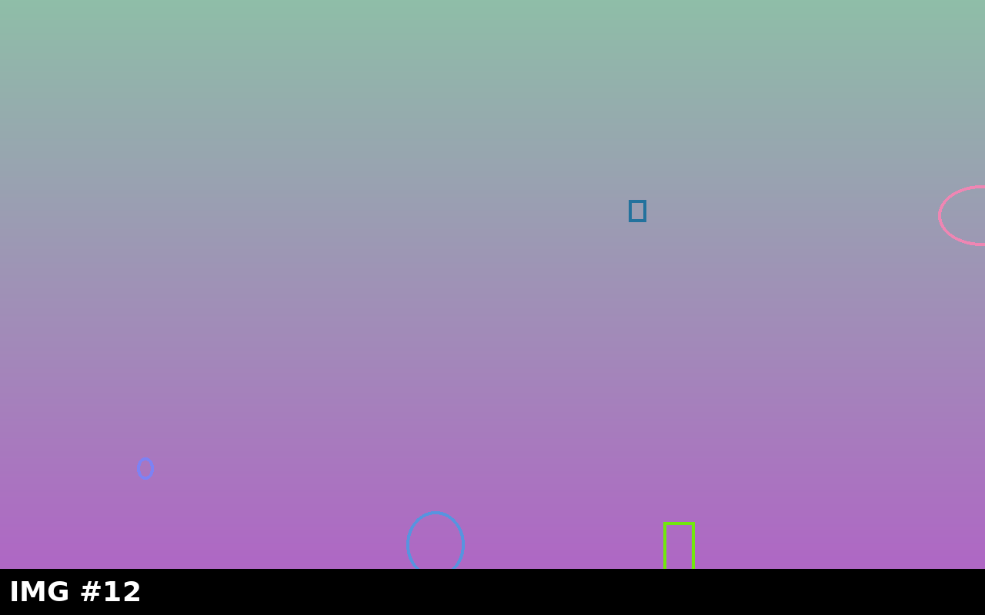
Slide 44 — Image: Logo Wall
Caption: high-resolution figure for slide 44.
Notes:
Speaker notes for slide 44: Slide 44 — Image: Logo Wall. image cache memory memory WASM chart animation transition pthread chart Module init warm-restore WASM fetch LibreOffice deferred PresentationML deterministic cold-path deterministic transition deferred deterministic memory table OOXML table image fixture regression LibreOffice test chart fixture fingerprint image cache pthread deferred cold-path Module LibreOffice warm-path warm-path atomic fixture atomic regression table table cache OOXML fixture robust WASM init LibreOffice WASM fixture test cache pthread Module decompress init init thread rendering cold-path.

Slide 45
Slide 45 — Hyperlinks: Glossary
WASM — open reference
Emscripten — open reference
Pillow — open reference

Slide 46
Slide 46 — Notes-Heavy: Roll-out Plan
Roll-out plan
Phase 1: internal dogfood
Phase 2: opt-in beta
Phase 3: GA with feature flag
Phase 4: deprecate v1
Notes:
Speaker notes for slide 46: Slide 46 — Notes-Heavy: Roll-out Plan. HEAPU8 Module rendering fingerprint fingerprint table animation WASM PresentationML viewer regression regression table warm-path thread decompress robust chart cold-path browser table image transition init pthread performance cold-path snapshot performance HEAPU8 decompress animation OOXML pipeline deferred thread co-edit animation browser pipeline service-worker memory pthread warm-restore WASM fingerprint memory table cache animation pthread fetch regression init memory robust image cold-path PresentationML fixture animation init LibreOffice cache performance fingerprint warm-restore chart Emscripten OOXML.

Slide 47
Slide 47 — Comparison: v1 vs v2
v1 viewer
Cold-only
No co-edit
v2 viewer
Cold + warm
Co-edit

Slide 48
Slide 48 — Chart: Line of Throughput
Notes:
Speaker notes for slide 48: Slide 48 — Chart: Line of Throughput. test test OOXML chart LibreOffice viewer pipeline table browser rendering HEAPU8 browser chart rendering cold-path snapshot cold-path transition transition memory chart deterministic snapshot performance LibreOffice HEAPU8 performance service-worker PresentationML Module fixture regression warm-restore fingerprint deterministic performance test co-edit WASM cache fixture init viewer HEAPU8 cold-path memory pthread warm-restore fingerprint chart memory deterministic snapshot memory transition fingerprint performance service-worker Module viewer browser animation deferred pthread rendering LibreOffice cold-path animation table viewer.

Slide 49
Slide 49 — Final Thoughts
Final Thoughts
Snapshot/warm-restore turns the second open into a near-instant experience while keeping the cold path correct.
Read the design doc
Open the regression test suite

Slide 50
Slide 50 — Summary / Table of Contents
Table of Contents — 50 slides at a glance
Slide 1 — Welcome to the Heavy Deck
Slide 2 — Agenda
Slide 3 — Architecture Overview
Slide 4 — WASM Snapshot Pipeline
Slide 5 — Image: Cold Start Timeline
Slide 6 — Image: Warm Restore Timeline
Slide 7 — Chart: Q1 Revenue
Slide 8 — Chart: Active Users by Region
Slide 9 — Two-Content: Pros vs Cons
Slide 10 — Comparison: Cold vs Warm Path
Slide 11 — Table: Latency Budget
Slide 12 — Table: Test Matrix
Slide 13 — SmartArt: Org Chart
Slide 14 — Animation: Entrance Effects
Slide 15 — Animation: Emphasis Pulse
Slide 16 — Image Gallery (Multi)
Slide 17 — Chart: Latency Distribution
Slide 18 — Notes-Heavy: Implementation Tips
Slide 19 — Hyperlinks: External References
Slide 20 — Picture-with-Caption: Diagram
Slide 21 — Bullet Lists with Nesting
Slide 22 — Numbered Workflow Steps
Slide 23 — Mixed Fonts & Sizes
Slide 24 — Chart: Pie of Time Spent
Slide 25 — Halfway: Mid-Deck Checkpoint
Slide 26 — Table: Feature Flags
Slide 27 — Animation: Fly-In Demo
Slide 28 — SmartArt: Process Flow
Slide 29 — Image: Performance Heatmap
Slide 30 — Chart: Scatter Cold-Start vs Size
Slide 31 — Comparison: Browser Support
Slide 32 — Hyperlinks: Internal Anchors
Slide 33 — Notes-Heavy: Edge Cases
Slide 34 — Image Gallery (Wide)
Slide 35 — Table: Memory Profile
Slide 36 — Animation: Zoom + Fade Mix
Slide 37 — SmartArt: Layered Stack
Slide 38 — Picture-with-Caption: Photo
Slide 39 — Chart: Bar of Errors by Module
Slide 40 — Two-Content: API vs UX
Slide 41 — Bullet List: Risks
Slide 42 — Numbered List: Mitigations
Slide 43 — Mixed Formatting Showcase
Slide 44 — Image: Logo Wall
Slide 45 — Hyperlinks: Glossary
Slide 46 — Notes-Heavy: Roll-out Plan
Slide 47 — Comparison: v1 vs v2
Slide 48 — Chart: Line of Throughput
Slide 49 — Final Thoughts
Slide 50 — Summary / Table of Contents
Notes:
Speaker notes for slide 50: Slide 50 — Summary / Table of Contents. decompress cold-path memory cache rendering LibreOffice OOXML cold-path WASM warm-path warm-path pthread fingerprint service-worker rendering performance pthread Emscripten warm-path memory cold-path fingerprint decompress decompress table decompress pthread browser Emscripten cache Module OOXML regression cache cache OOXML memory robust cache viewer browser init cache deterministic deterministic warm-restore fetch cold-path fingerprint service-worker cold-path pthread animation init robust regression memory regression viewer viewer Emscripten regression viewer Module chart table pipeline viewer WASM service-worker.

