Slide 1
KVFidelity Trace Atlas v4
Casey Reas intervention · CASK AIME24 n=30 · Qwen3-8B
A correct answer is not a score. It is a temporal event.
It emerges, persists, drifts, closes, or disappears.
CASK is the experiment. KVFidelity is the lens.
Main deck first. Defensive evidence moves to appendix.

Slide 2
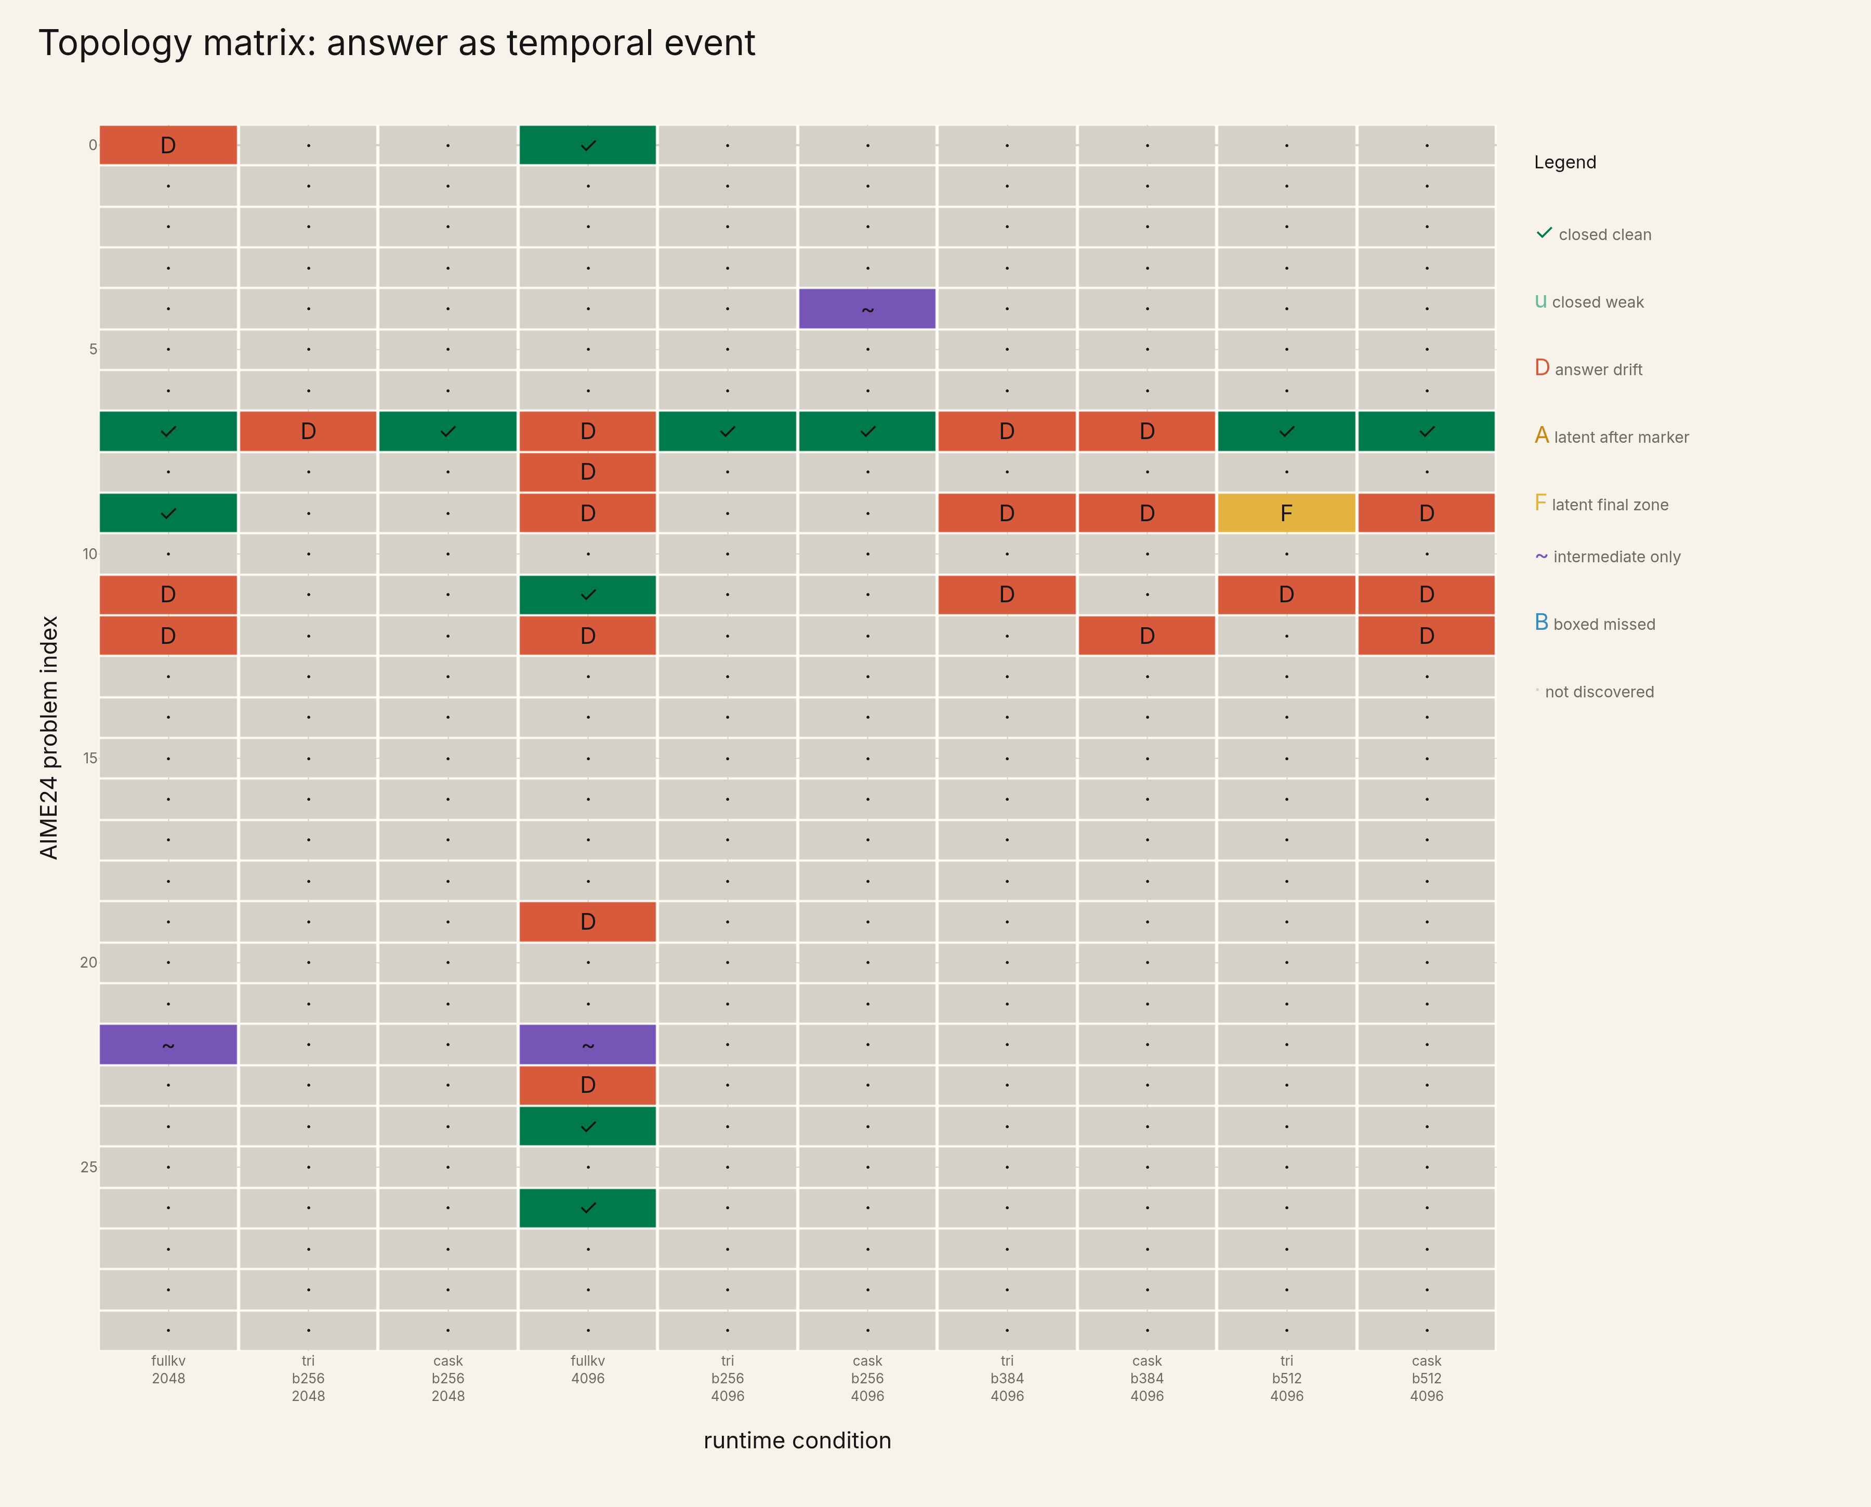
Topology matrix
The answer becomes a field: distribution, recurrence, absence, drift.

Slide 3
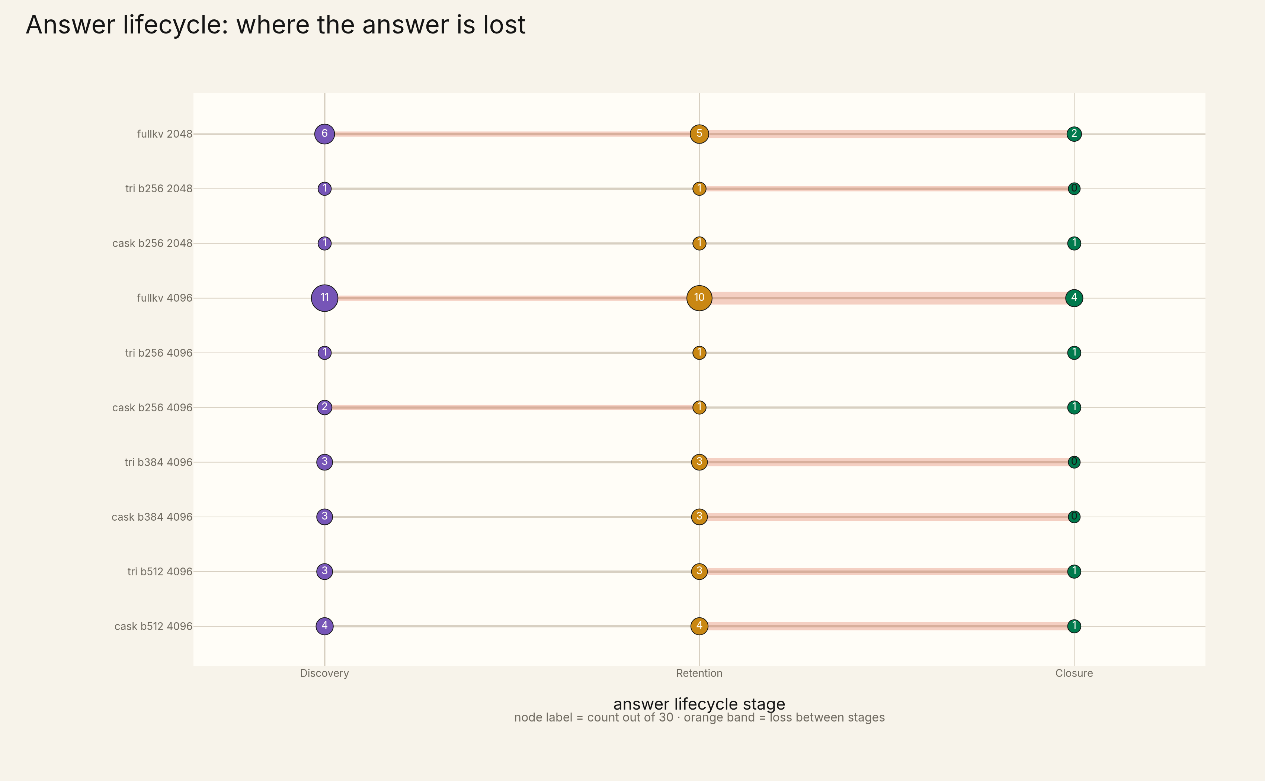
Answer lifecycle
Node labels are counts out of 30; orange bands mark loss between lifecycle stages.

Slide 4
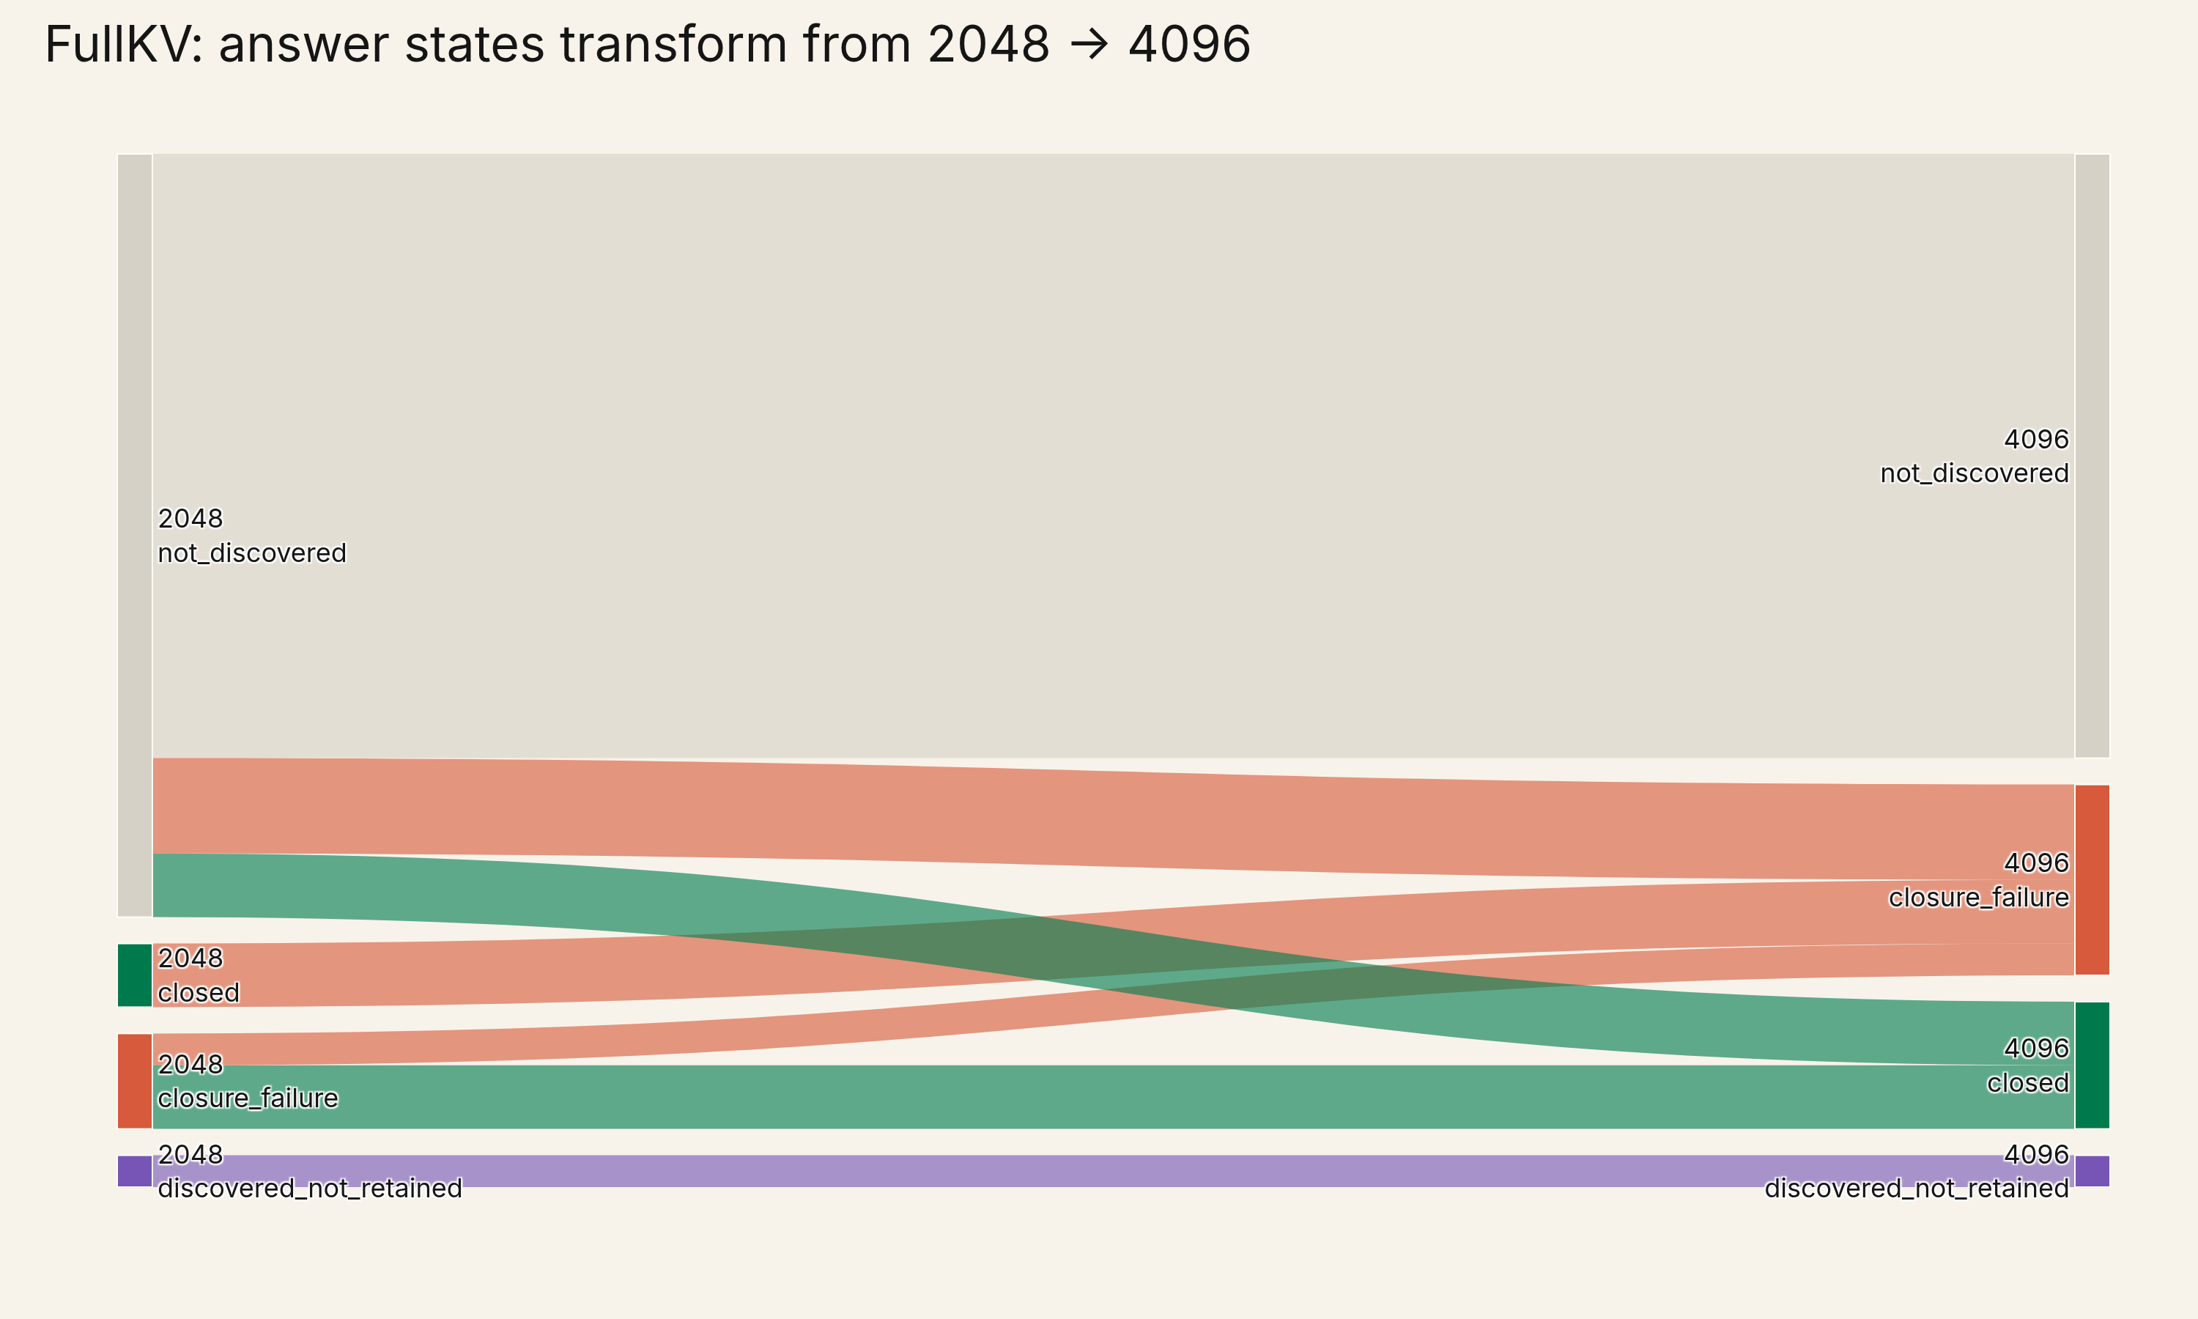
FullKV 2048 → 4096
More generation transforms states: it repairs some samples and destabilizes others.

Slide 5
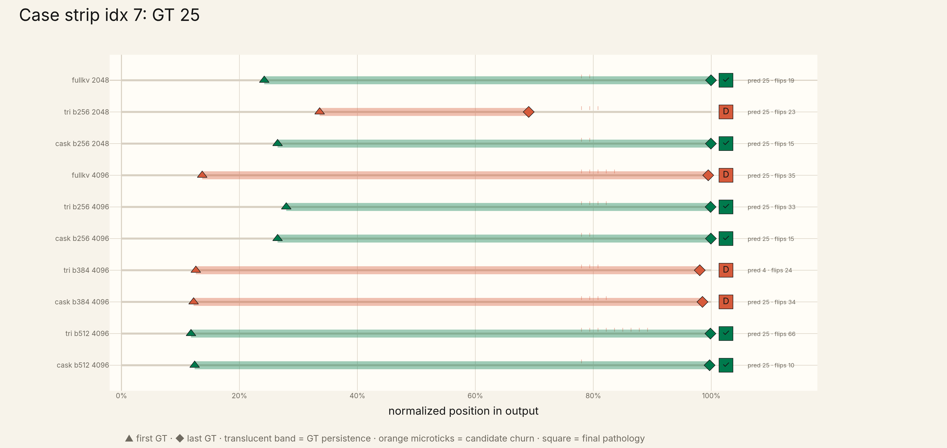
Case idx 7
Compression island: several compressed runs close cleanly while FullKV 4096 drifts.

Slide 6
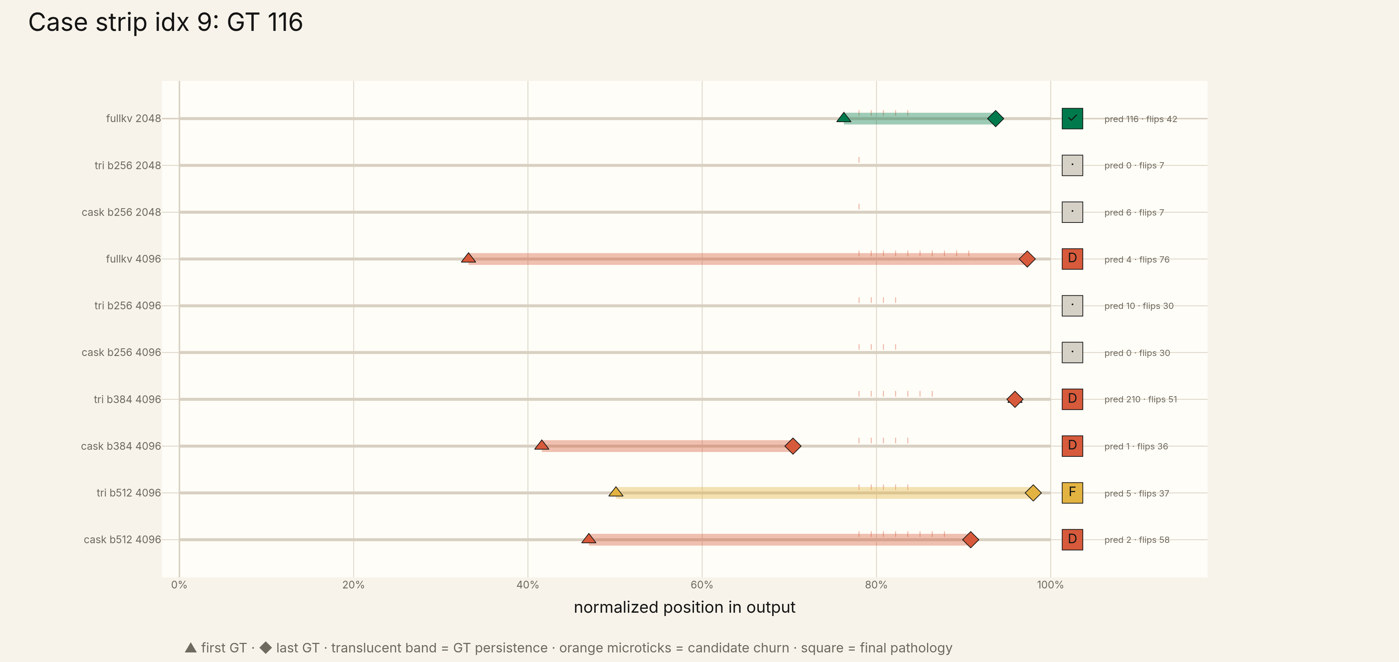
Case idx 9
The answer appears, persists, and still fails to close.

Slide 7
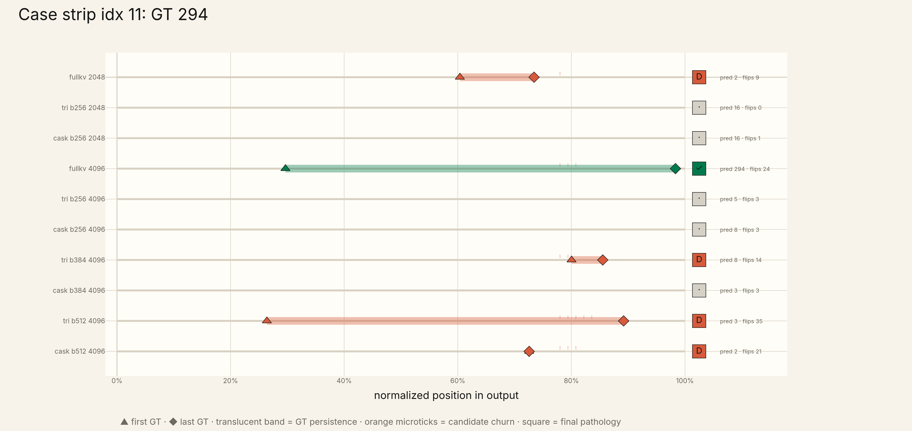
Case idx 11
More generation repairs FullKV closure; compression does not recover it here.

Slide 8
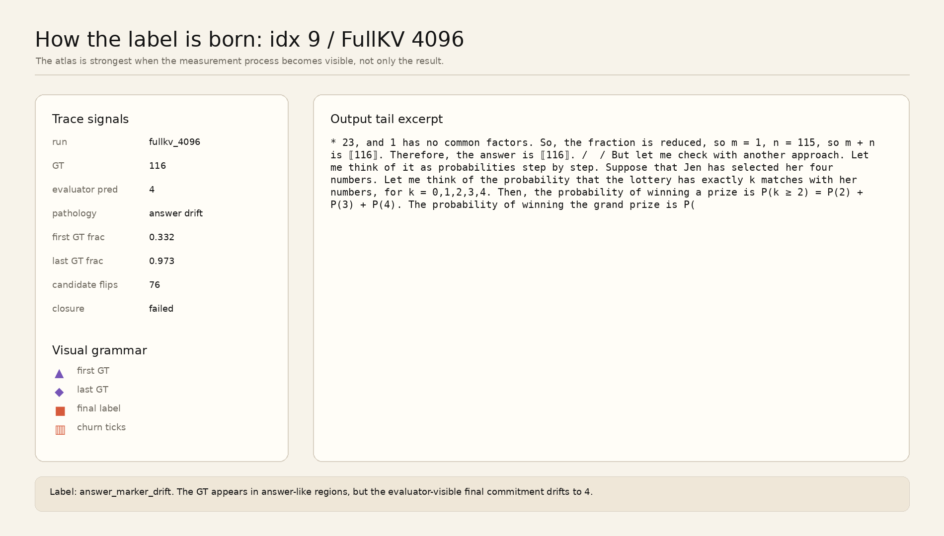
How the label is born
Make the measurement process visible: output excerpt → signals → pathology label.

Slide 9
Thesis
KVFidelity becomes strong when the correct answer stops being a score.
It becomes an event with a temporal shape.
The useful object is not a leaderboard. It is a score/partiture of answer trajectories.
Public claim remains deferred until manual label audit.

Slide 10
Appendix
Counts, caveats, alternate transitions, and full case strips.
Appendix: evidence and defensive material
The main deck shows behavior. The appendix keeps the accounting.

Slide 11
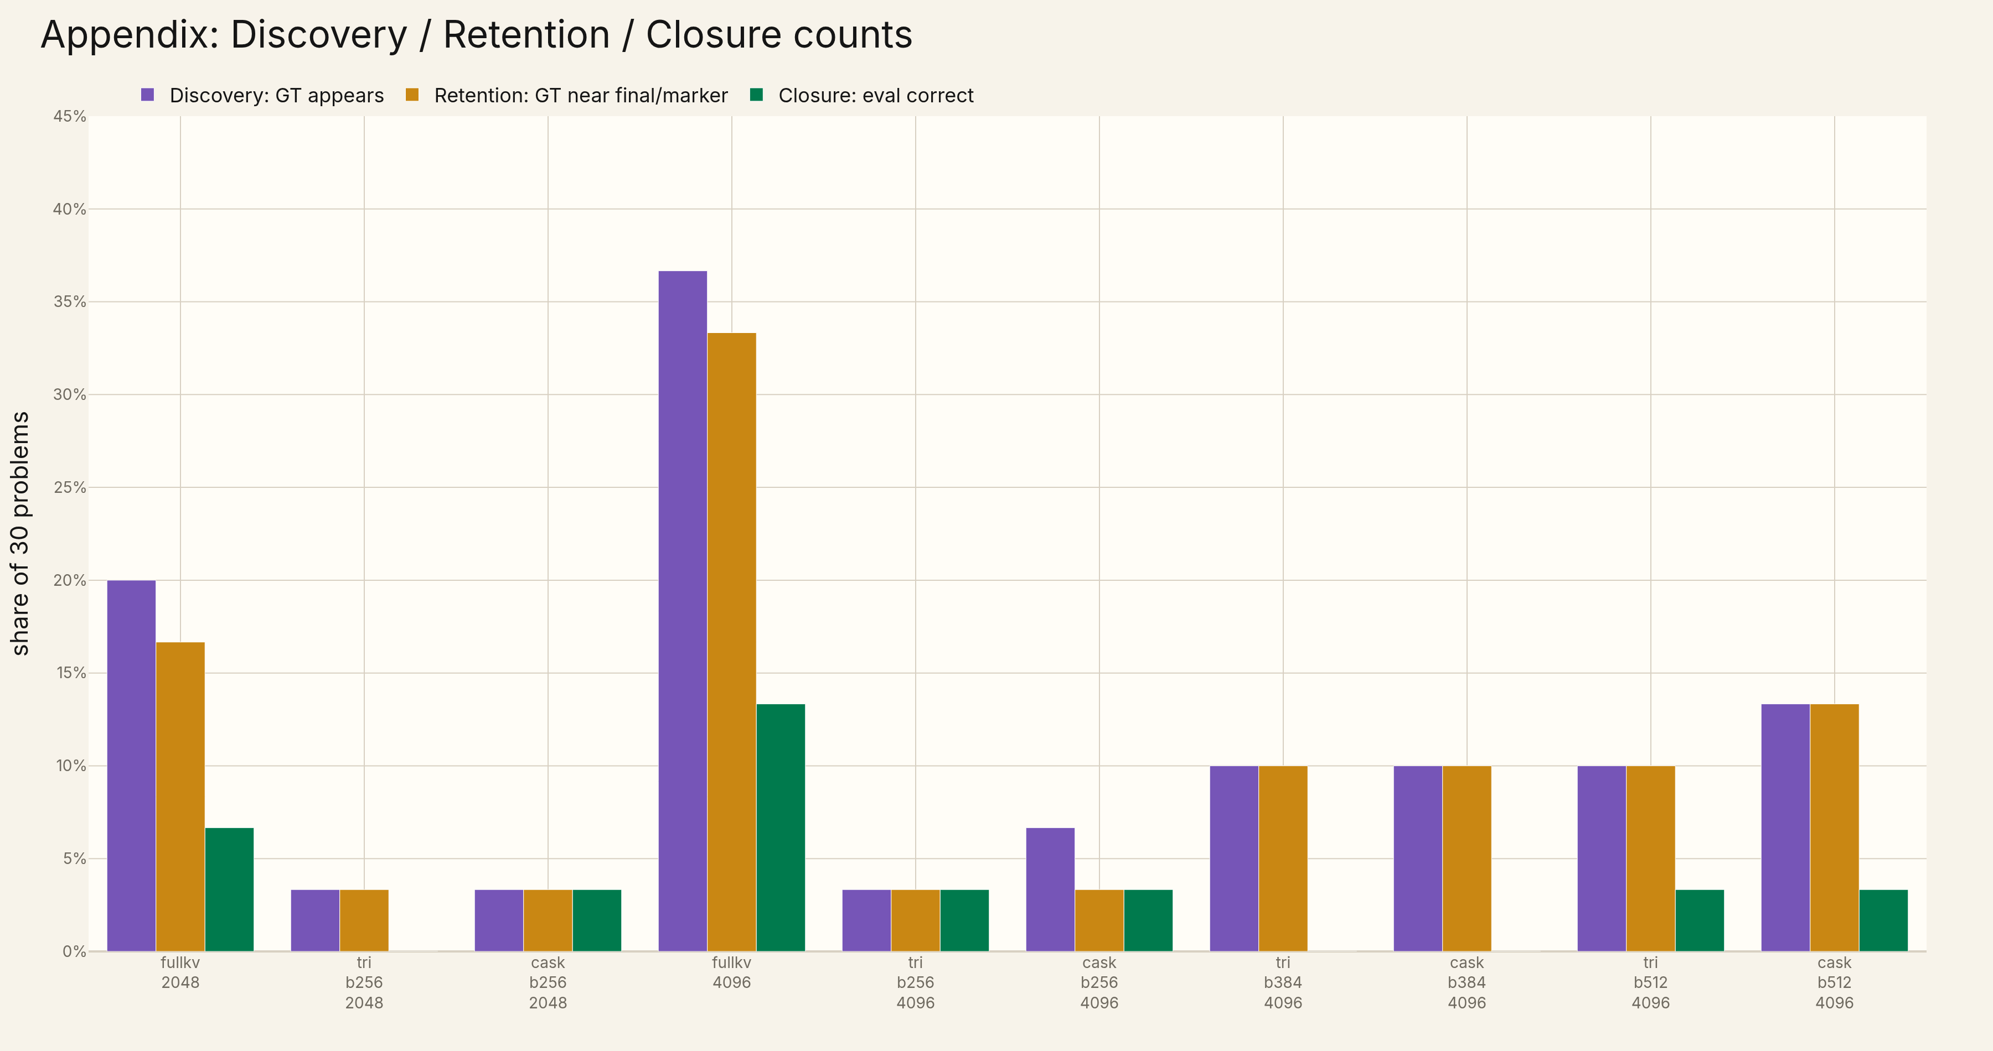
Appendix · D/R/C bars
Conventional count view retained for auditability.

Slide 12
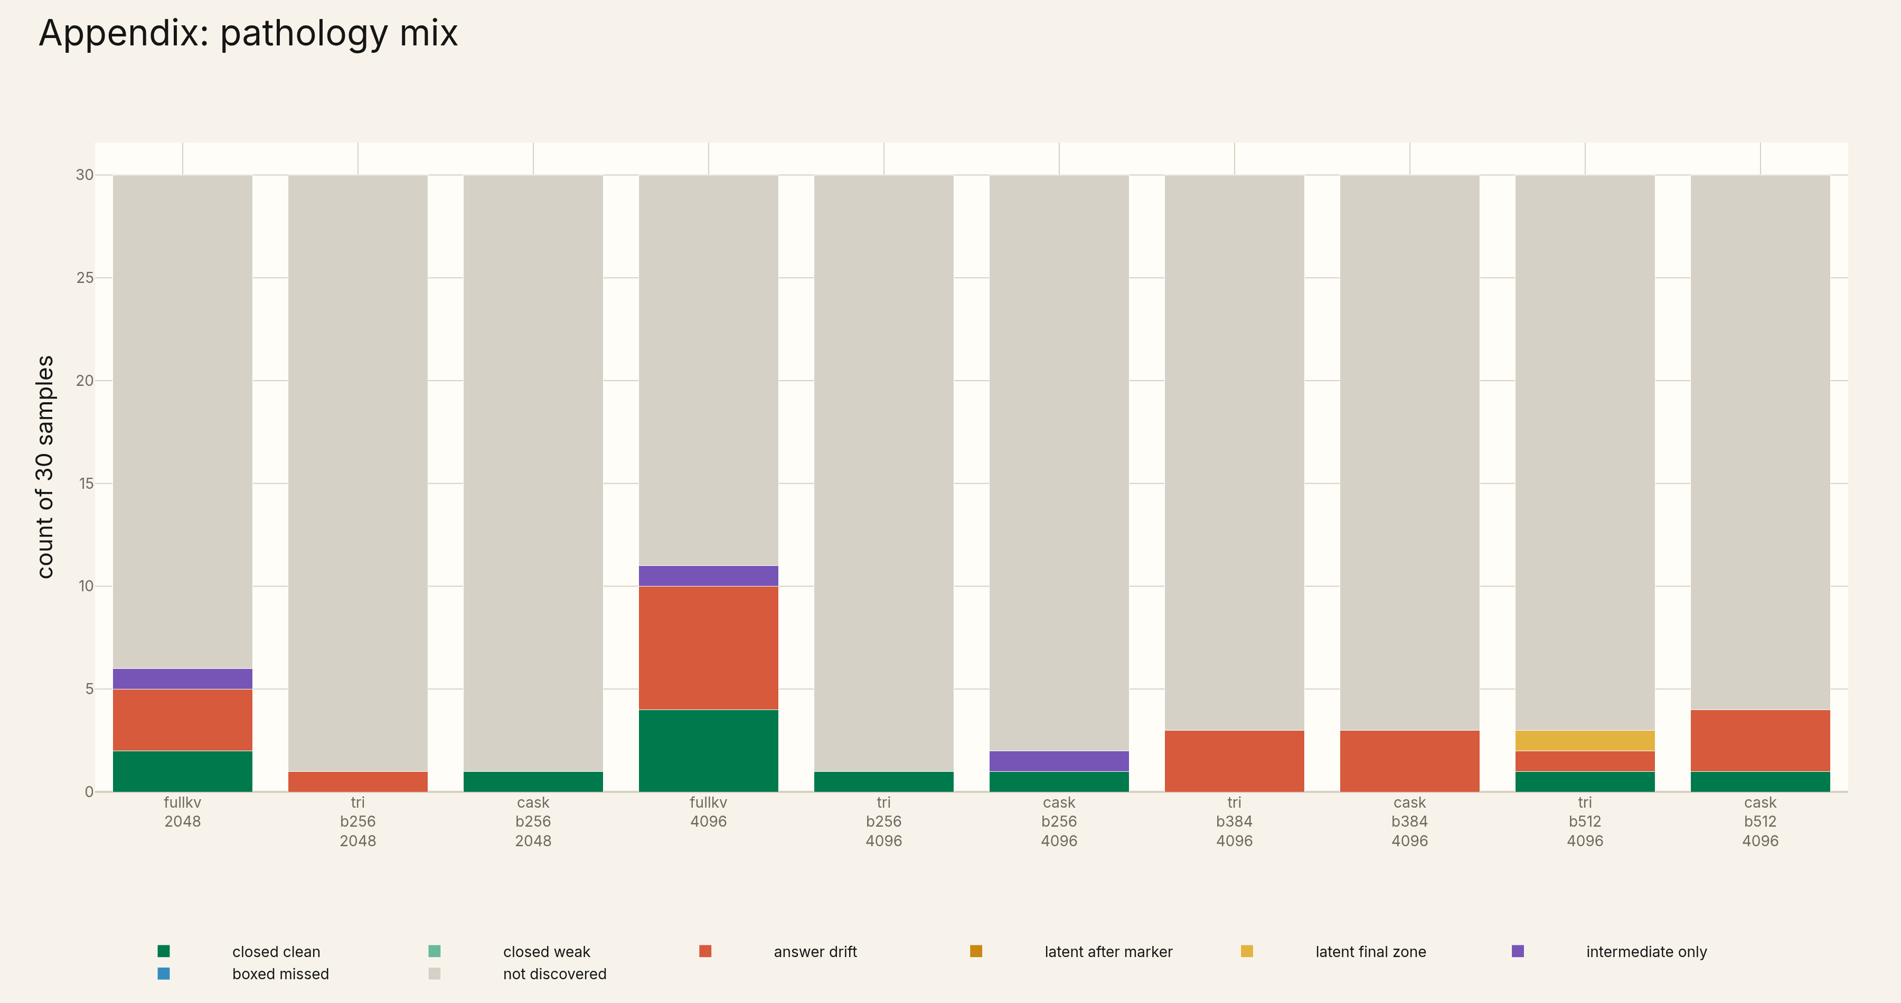
Appendix · pathology mix
Raw accuracy collapses these distinct failure modes.

Slide 13
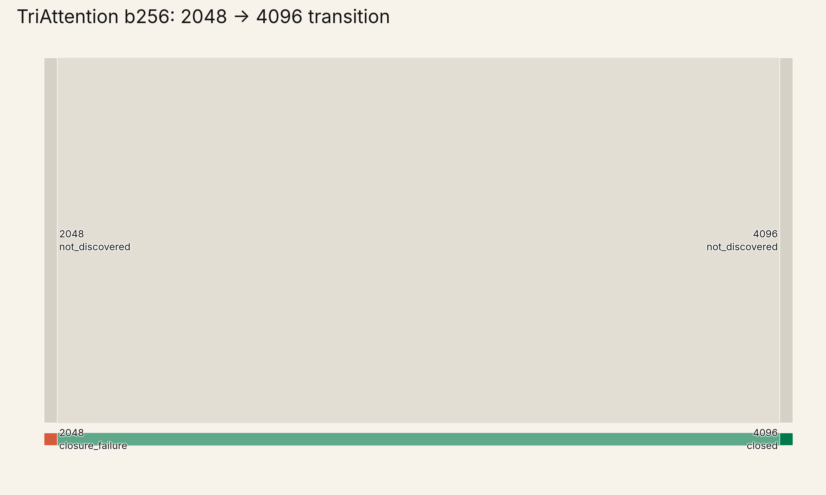
Appendix · TriAttention transition
Transition structure for the TriAttention baseline.

Slide 14
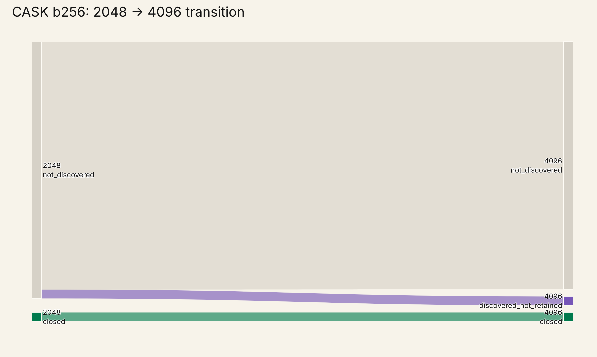
Appendix · CASK transition
CASK preserves idx 7, but does not recover FullKV gains here.

Slide 15
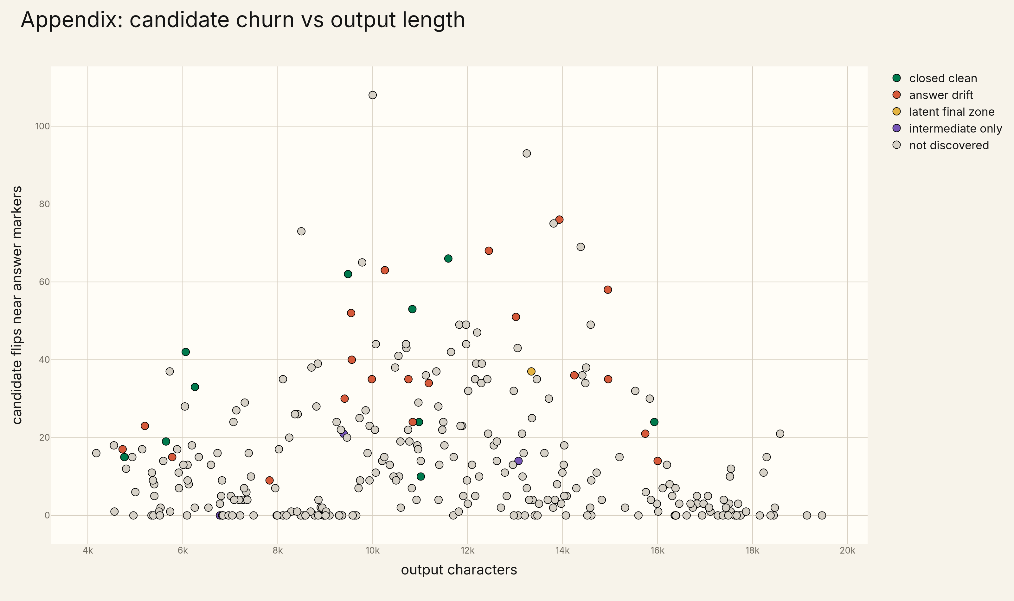
Appendix · candidate churn
Longer generation opens space for candidate drift.

Slide 16
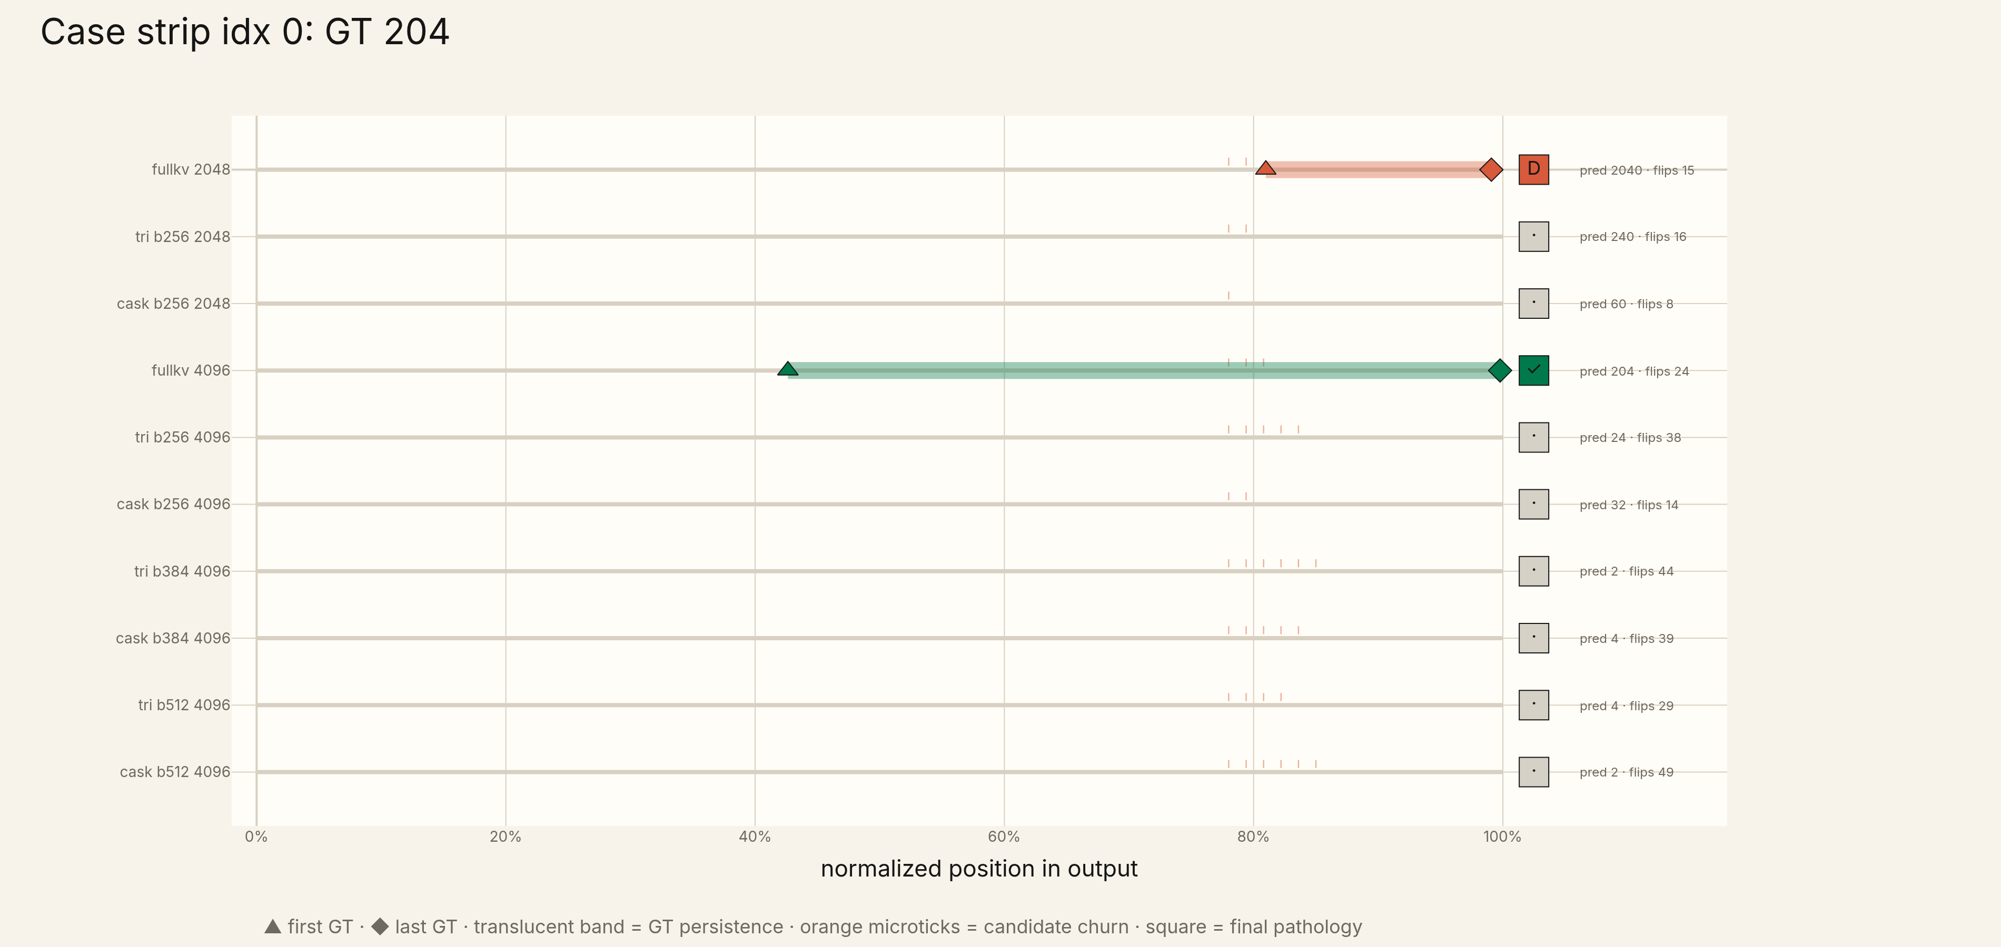
Appendix · idx 0
A FullKV 4096 gain: discovery stabilizes into closure.

Slide 17
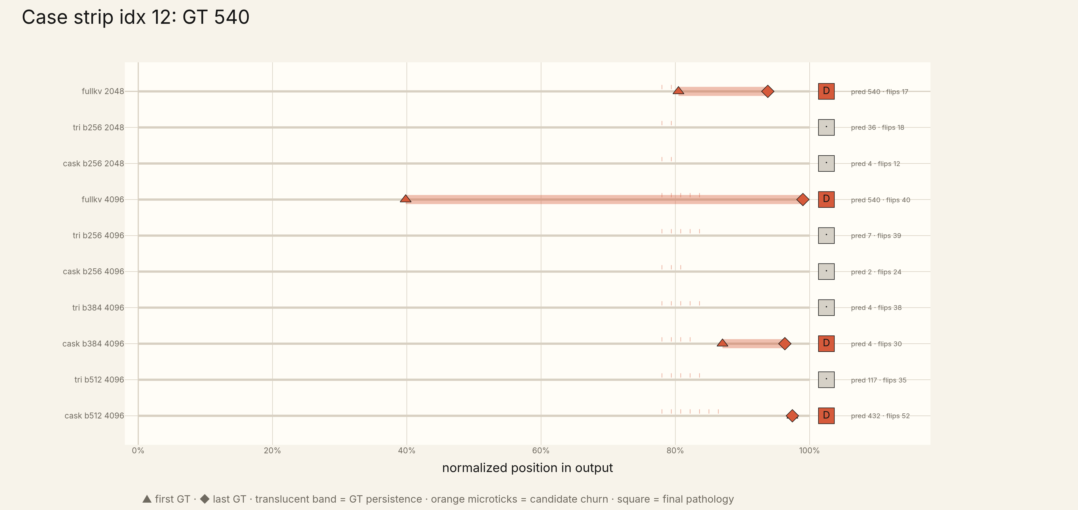
Appendix · idx 12
A drift-heavy case: churn without clean commitment.

Slide 18
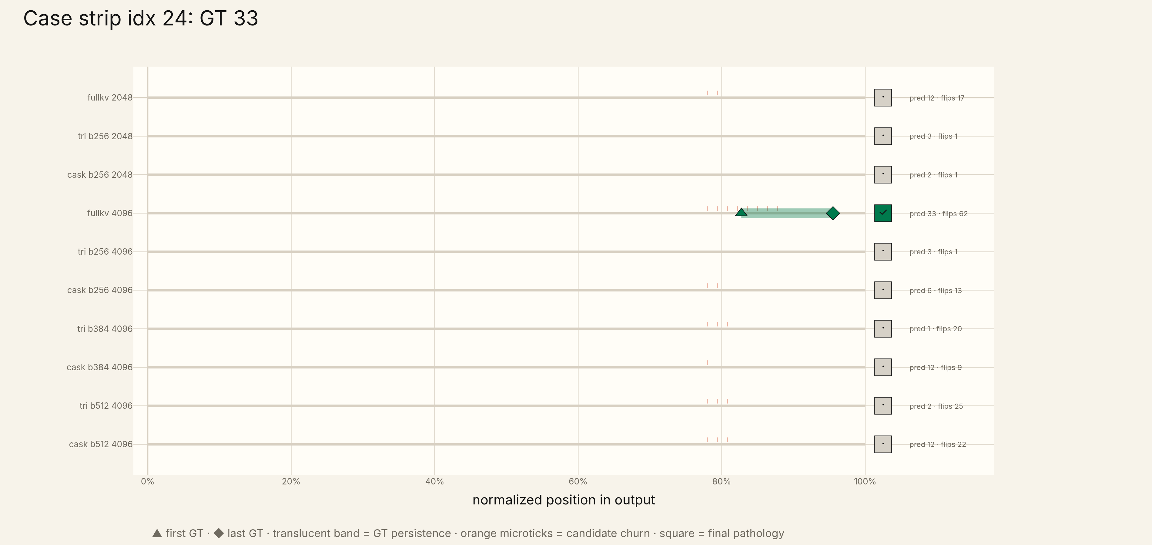
Appendix · idx 24
A FullKV 4096 closure not recovered by compression.

Slide 19
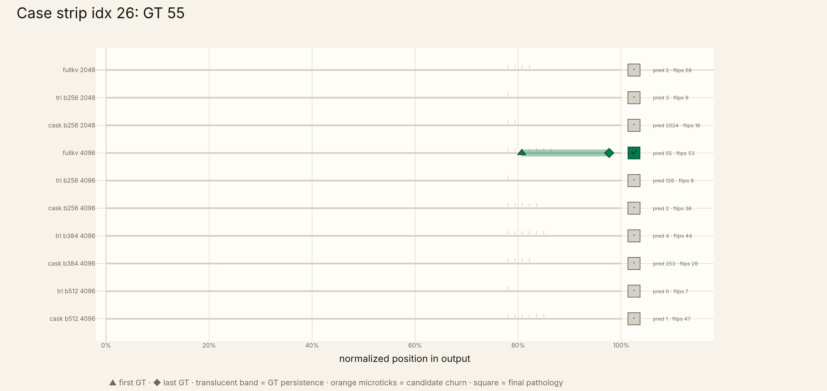
Appendix · idx 26
A FullKV 4096 closure not recovered by compression.

