Slide 2



Slide 3
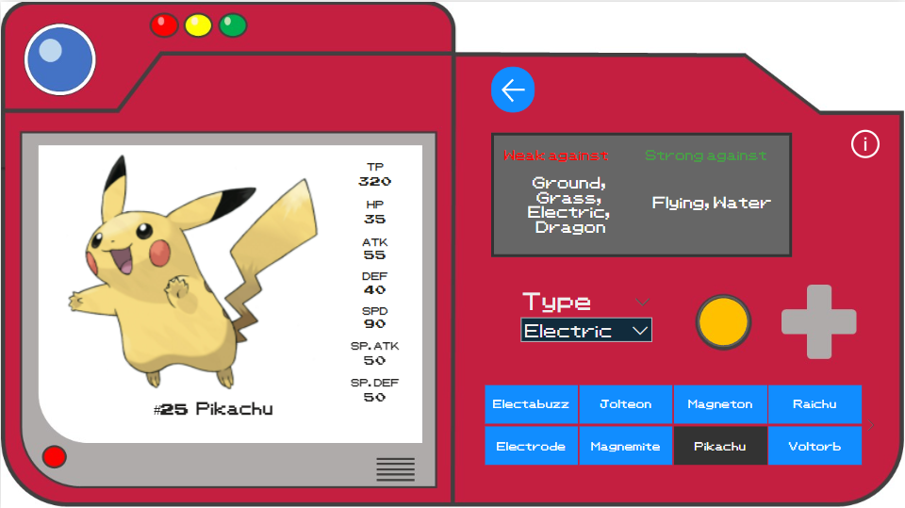
Pokemon name and National No.

Slide 4

Pokémon main stats TP – Total Power
HP – Hit Points
ATK – Attack
DEF – Defence
SPD – Speed
SP.ATK – Power of special attack
SP.DEF – Defence against special attack

Slide 5

Clear the Name filter before selecting a Pokémon type.

Slide 6

Select a Pokémon type

Slide 7
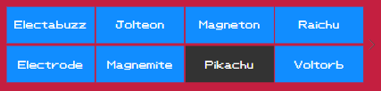
Find a Pokémon

Slide 8

Strong/weak against Pokémon type:

Slide 9

Back to Main Menu

Slide 10


You can return to this view at any time

