Slide 1
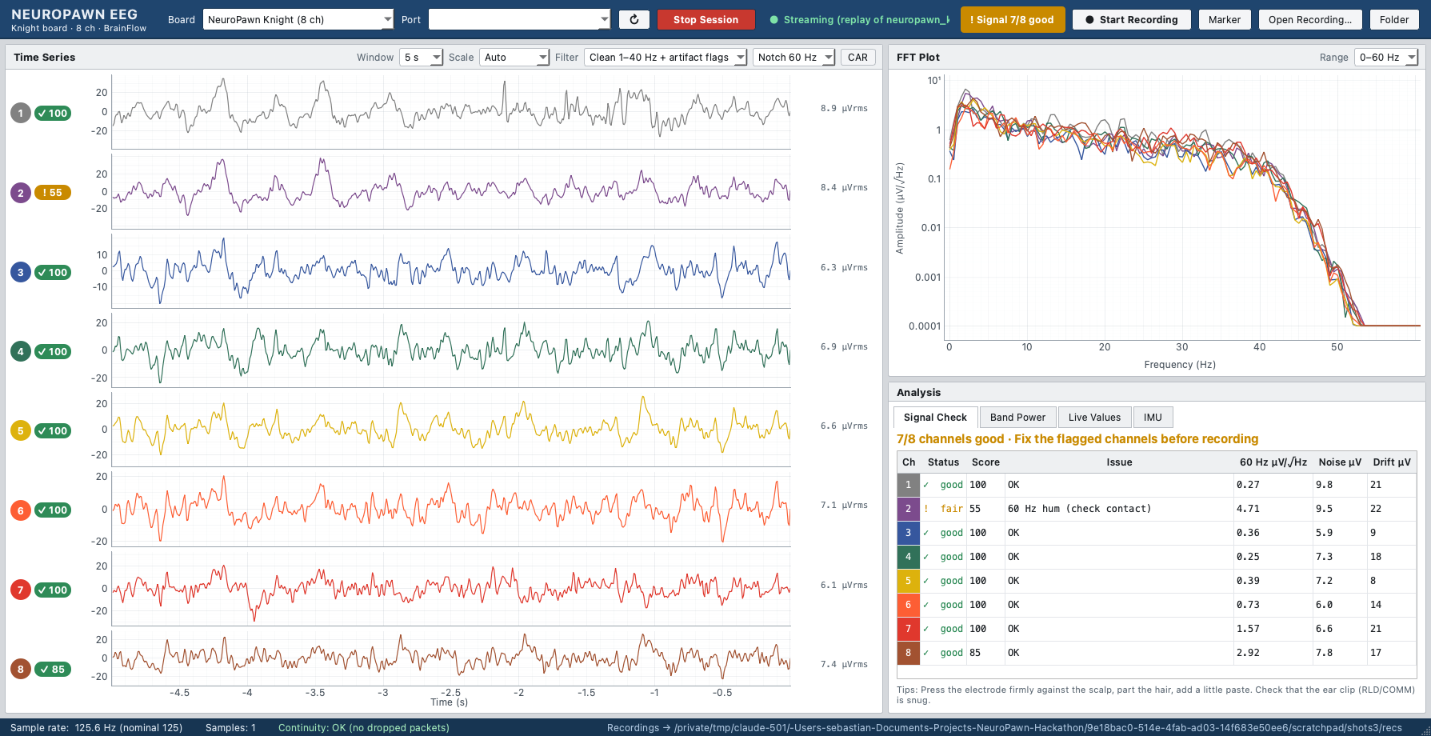
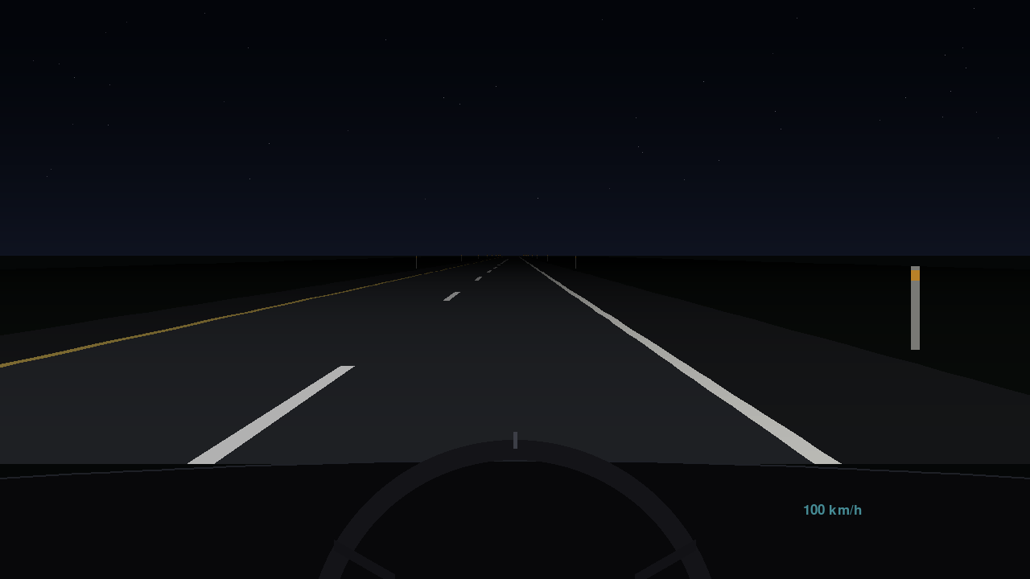
TEAM 14 · NEUROPAWN TRACK · WHAT WE BUILT IN 24 HOURS
A live EEG drowsiness detector and a drive it can interrupt
Lossless 8-channel EEG app: every sample recorded exactly, live signal-quality scores
Pre-sleep detector + Night Drive: theta must replace alpha; an alert interrupts the drive
Notes:
[~25 s]
ON SCREEN: Left is our EEG app streaming all 8 channels from the NeuroPawn Knight headset. Each colored trace is one electrode; the badge beside it is that electrode's live connection score out of 100, and the table at the bottom right says why a channel is flagged (here channel 2 has some 60 Hz mains hum). The bottom bar reads "Continuity OK": no samples dropped. Right is Night Drive, our driving game: a dark, empty highway seen from the driver's seat.
SAY: In 24 hours we built three pieces that work together. First, the acquisition app: it records every sample exactly, fixes a scale bug we found in the BrainFlow driver (it reported the Knight's signal about 80 times too large), and scores each electrode's contact live. Second, a drowsiness detector built on sleep-scoring rules: it only fires when theta waves replace alpha and rise above the person's own baseline, so blinking, opening the eyes or concentrating doesn't trigger it. Third, Night Drive, a deliberately boring drive: every 8 to 14 seconds the car drifts and the driver has to steer back, which measures reaction time, and if the detector fires, a full-screen alarm interrupts the game. Every game event is written into the EEG file on the same clock.

Slide 2
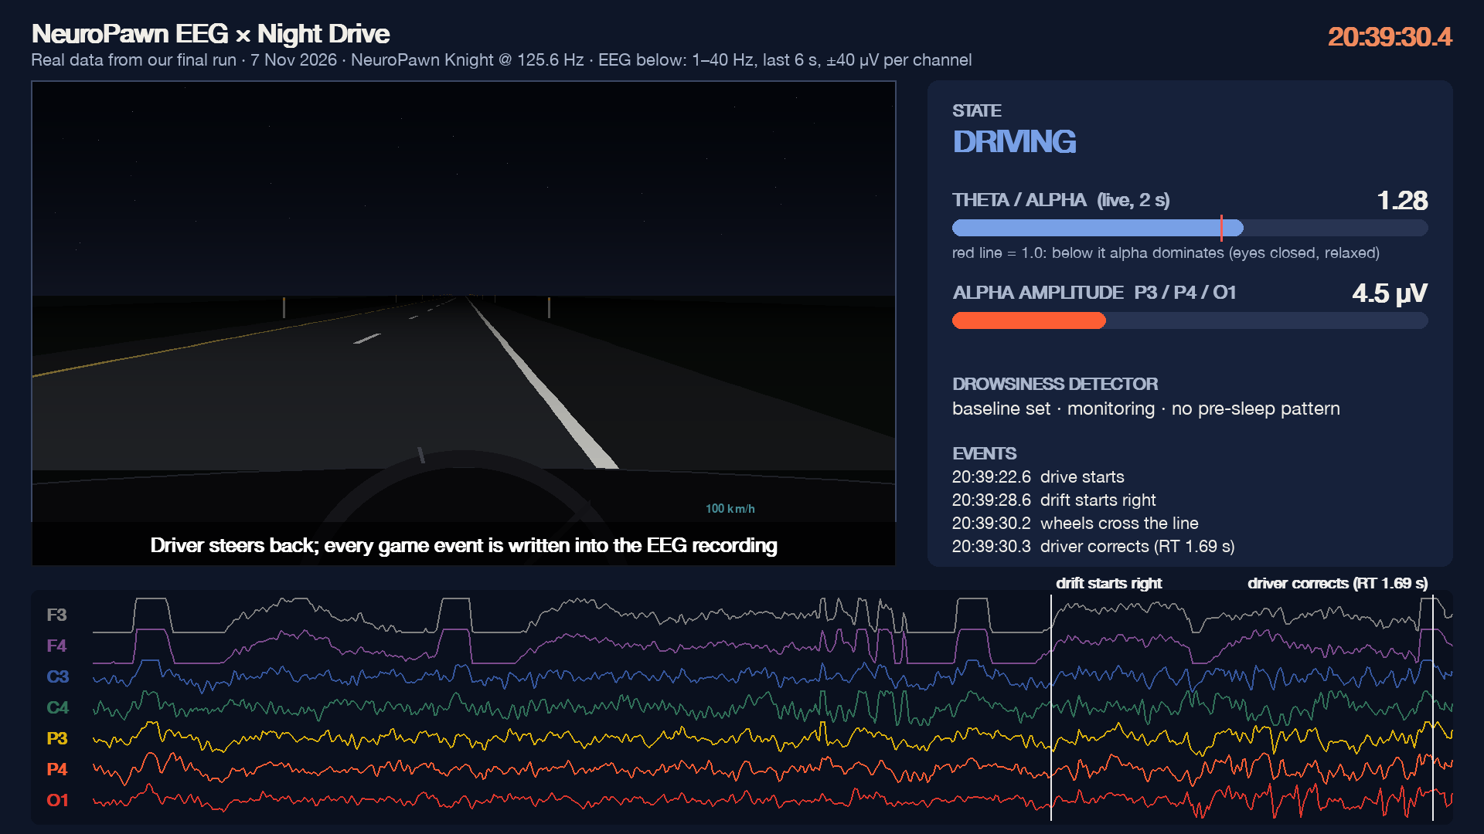
LIVE · REAL DATA FROM OUR FINAL RUN
The headset sees the brain change state, in sync with the drive
0–4 s · eyes closed
Alpha fills P3, P4 and O1; θ/α sits at 0.26
4 s · tone, eyes open
Alpha fades within seconds; θ/α climbs past 1
13–15 s · drift
Car drifts right; the driver corrects in 1.69 s. Every event is stamped into the EEG file
Notes:
[~25 s, the clip starts with the slide and loops; click it to pause]
ON SCREEN: a 15-second replay of real data from our final run. Top left: the game. Bottom: seven EEG channels scrolling, frontal at the top (F3, F4), then central (C3, C4), then the back of the head (P3, P4, O1). Right panel: the two numbers the detector watches: theta/alpha (the red tick marks 1.0) and alpha amplitude at the back of the head. Clock at top right.
WALK THROUGH: 0 to 4 s, eyes closed at the end of calibration: the bottom three traces show big, regular waves, the alpha rhythm, and theta/alpha sits around 0.26. At 4 s a tone tells the driver to open their eyes; within a couple of seconds those waves shrink and the ratio climbs past 1. That is the brain changing state, and the headset seeing it live. A countdown, then the drive starts. At 13 s the car drifts right on its own, the wheels cross the line, and the driver steers back with a 1.69-second reaction time. The white vertical lines on the EEG are those game events, stamped into the recording. The flat-topped bumps on F3/F4 are eye blinks, clipped at the display scale.
SAY (short): Here's the system on real data. Eyes closed: big alpha waves at the back of the head. Tone, eyes open: they vanish and our ratio jumps. The drive starts, the car drifts, the driver corrects in 1.7 seconds, and every one of those events lands in the EEG file.

Slide 3
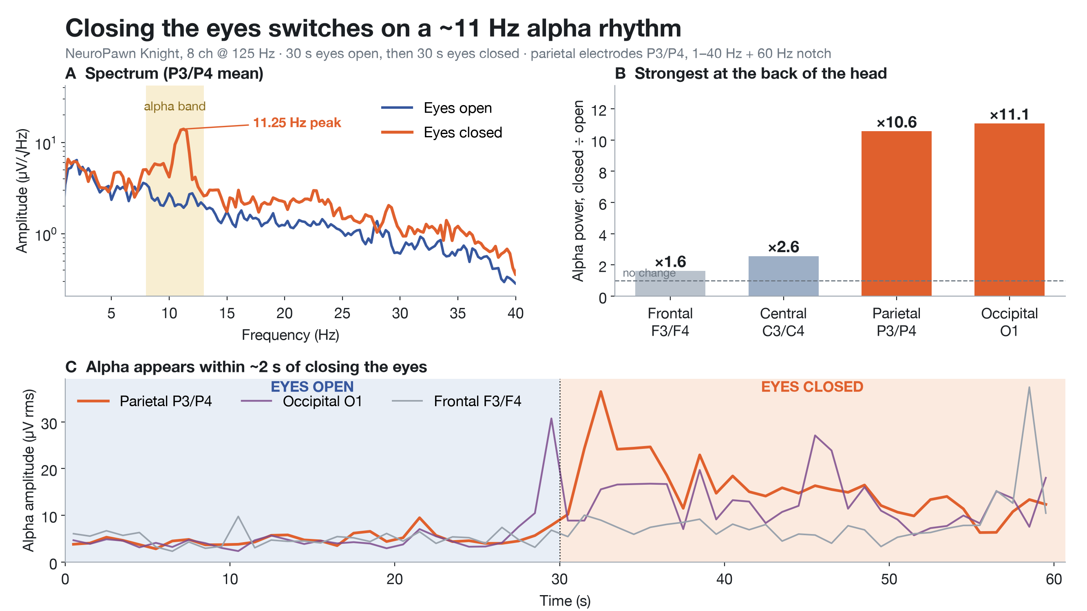
VALIDATION 1 · REAL BRAIN SIGNAL
Closing the eyes switches on alpha, and we see it
×10.6
parietal alpha with eyes closed, pilot session
×15
posterior alpha in the final run's baseline (θ/α 1.76 → 0.12)
11.25 Hz
individual alpha peak, 0.75 Hz wide: brain rhythm, not mains noise
Notes:
[~25 s]
ON SCREEN: our pilot session, 30 s eyes open then 30 s eyes closed. Panel A (top left): the frequency spectrum at the parietal electrodes. Blue is eyes open, orange is eyes closed; the yellow band is the alpha range, 8 to 13 Hz. With eyes closed a sharp peak appears at 11.25 Hz. Panel B (top right): how much alpha power grew with eyes closed in each head region; the dashed line at 1 means no change. Frontal x1.6, central x2.6, parietal x10.6, occipital x11.1: strongest at the back of the head, exactly where alpha should be. Panel C (bottom): alpha amplitude second by second; at 30 s, when the eyes close, the orange parietal line jumps within about 2 seconds. The right column repeats the headline numbers.
SAY: Before trusting a detector we had to prove the headset measures real brain rhythm. The classic test is the Berger effect: close your eyes and the back of the brain produces a strong, roughly 10 Hz alpha rhythm. We see it clearly: parietal alpha up 10.6 times, occipital 11 times, while frontal barely moves. The final run's own calibration repeated it even more strongly, about 15 times, with theta/alpha falling from 1.76 to 0.12. We also ruled out electrical noise: at our sample rate the 240 Hz mains harmonic folds to about 11.3 Hz, but that would be a razor-thin line present with eyes open too. Our peak is 0.75 Hz wide and only appears with eyes closed.

Slide 4
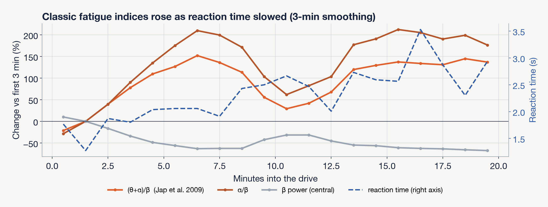
REANALYSIS · THE MOST USABLE TREND
Classic fatigue indices rose as reactions slowed
(θ+α)/β and α/β rose 100–200% (time trend ρ ≈ +0.5, p < 0.05), driven by falling beta, a known fatigue sign. They co-trend with reaction time but don't track it minute to minute (time-removed ρ ≈ 0).
Notes:
[~30 s]
ON SCREEN: the whole 20-minute drive, minute by minute, smoothed over 3 minutes. Left axis: percent change from the first 3 minutes. The two orange lines are classic EEG fatigue indices: (theta+alpha)/beta from Jap et al. 2009, and alpha/beta. The grey line is beta power over the central electrodes. The dashed blue line is the driver's reaction time, read on the right axis in seconds.
HOW TO READ IT: both orange lines climb to roughly +100 to +200% while the grey beta line falls about 60%, so the indices rise mainly because beta, the alert and engaged activity, drops. The dashed reaction time drifts up from about 1.8 s to nearly 3 s by the end.
SAY: Did the EEG change as driving got worse? Over 20 minutes the driver's reaction time slowed 59% and their lane position got more variable. Over the same period the standard fatigue indices from the driving literature rose 100 to 200%, driven by falling beta, a recognised sign of declining arousal. Both time trends are statistically significant. The honest caveat: once you remove the shared time trend, the indices don't track reaction time minute to minute, so from one run we can't fully separate fatigue from slow drifts such as electrode gel drying.

Slide 5
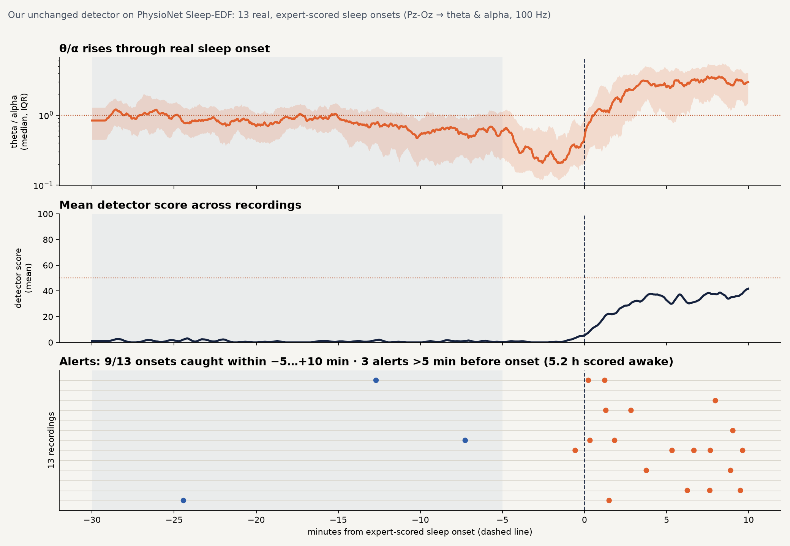
VALIDATION 2 · REAL SLEEP ONSETS, PUBLIC DATA
Tested on 13 real, expert-scored sleep onsets
9 / 13
sleep onsets caught, median 1.5 min after the expert-scored onset
3 in 5.2 h
false alarms while lying awake in bed
Not solved yet: 3 false alarms per hour in active daytime wake. PhysioNet Sleep-EDF, 2 channels; same detector code, θ and α from Pz-Oz.
Notes:
[~35 s]
ON SCREEN: our unchanged detector code run on 13 overnight recordings from PhysioNet Sleep-EDF, a public database where sleep experts scored every 30 seconds as awake or asleep. Every recording is lined up on its first sleep onset of the night, the dashed line at zero; left of it is 30 minutes of scored wakefulness in bed, right of it the first 10 minutes of sleep. Top panel: the theta/alpha ratio (median and spread across people). It dips while people lie relaxed with their eyes closed, because alpha is high, and then climbs steeply right at sleep onset as theta replaces alpha. Middle panel: the average detector score, flat at zero while awake, rising only after onset. Bottom panel: one row per person, one dot per alert. Orange dots are alerts around onset; the three blue dots are alerts while still scored awake.
SAY: Nobody on our team fell asleep at the wheel, so to test the actual sleep-onset alert we ran our exact detector on 13 real sleep onsets scored by experts. It caught 9 of the 13, typically about a minute and a half after the scored onset, the first minutes of light sleep, and gave only 3 alerts in 5 hours of people lying awake in bed. The honest caveat: in active daytime wakefulness it fired about 3 times an hour, and this 1989 dataset has only two electrodes, so we measured theta and alpha both at the back of the head. Reducing false alarms in active wake is our next problem.
IF ASKED: with theta from the forehead channel instead (our first, pre-planned mapping) it caught 6 of 13 and false-alarmed far more, because a forehead-vs-back channel ratio is about 10 in every state. Both mappings are in the repo.

Slide 6
TAKEAWAYS
×15
0
+59%
alpha when the eyes close: a low-cost headset reads real brain state
false alarms in 20 min of driving, with 98% of the EEG usable
reaction time as the EEG fatigue index rose 100–200%
Limits: one participant drove; real sleep onsets come from 13 public 2-channel recordings, and daytime false alarms (3 per hour) still need work.
Next: our own headset on sleep-restricted drivers, longer drives, and a webcam PERCLOS reference on the same clock.
Notes:
[~25 s]
ON SCREEN: three headline numbers, then one line of limits and one line of next steps.
SAY: Three takeaways. Times fifteen: a low-cost 8-channel headset with our software reads a real change in brain state; closing the eyes multiplied posterior alpha 15 times. Zero: across 20 minutes of monotonous driving, with 98% of the EEG usable, the detector raised no false alarms; normal eye-opening and concentration never triggered it. Plus 59 percent: reaction time slowed 59% while the EEG fatigue index rose 100 to 200%. Our honest limits: only one participant drove; the real sleep-onset test used 13 public two-channel recordings, where we caught 9 of 13 onsets, but false alarms during active daytime wakefulness, about 3 an hour, still need work. Next: our own headset on sleep-restricted drivers, longer drives, and a webcam eye-closure (PERCLOS) reference on the same clock. Thank you, we're happy to take questions.

