Slide 1
for Rust in Space { a_grounded: Journey; }

Slide 2
Who Am I
myrrlyn (pronounced like the wizard)
Satellite Software Engineer
Space Dynamics Laboratory
Used Rust since mid-2016
@ myrrlyn

Slide 3
What Do I Do
I build*, program, test, and operate* satellites
I have nothing to do with KubOS, but they’re cool
*I shouldn’t, but, we needed bodies and I was there
@ myrrlyn

Slide 4
What Do I Do – Spoken Details
I helped work in the laboratory in large-scale assembly of one of my projects, and I served as mission operator for four months because the orbital schedule gave us contacts in a nine-hour window on a 23-hour period.
Everyone else was married and/or didn’t want to slide their day around the clock. I was not married, and so took the role.
Explanation Slide – spoken, not shown
@ myrrlyn

Slide 5
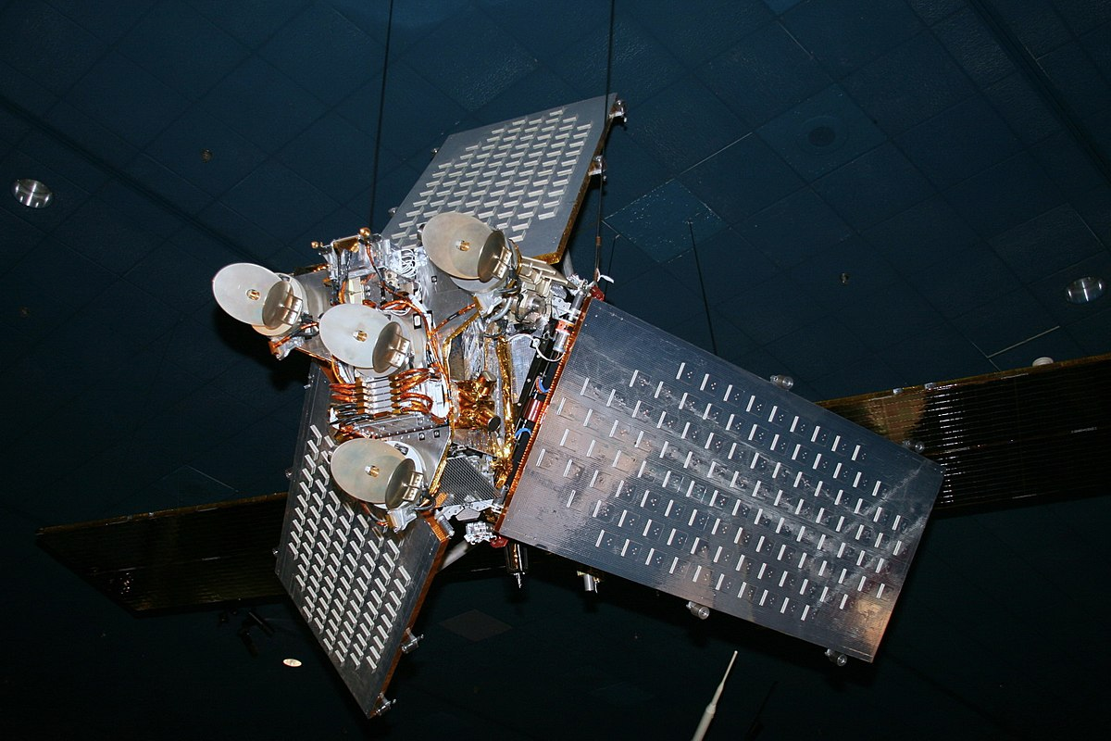
What Do I Do
You know, satellites!
@ myrrlyn

Slide 6
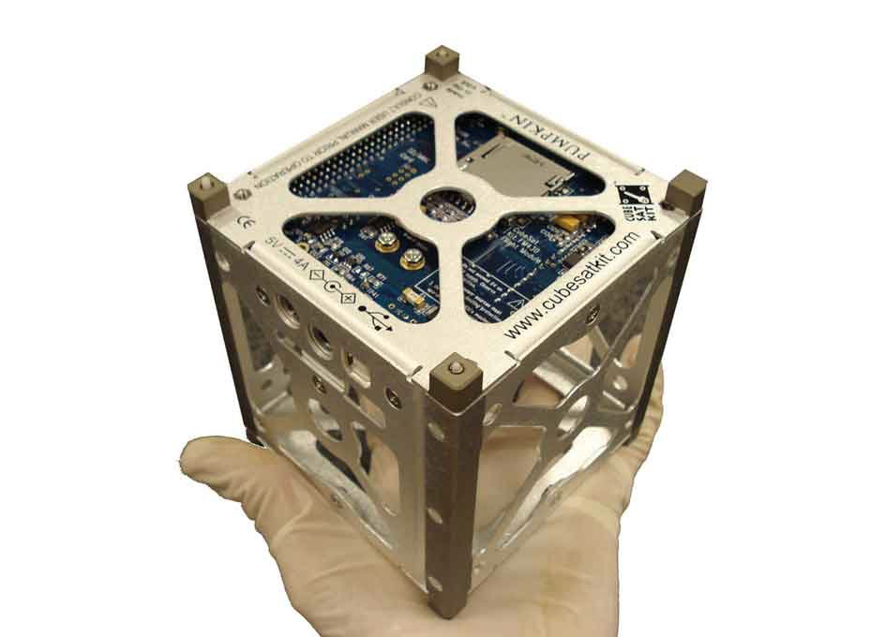
What Do I Do
Well, small satellites.
(also please don’t do this)
@ myrrlyn

Slide 7

Swift in Space
I had some memory testing to do
@ myrrlyn

Slide 8

Swift in Space
Wait, that was the wrong Swift
@ myrrlyn

Slide 9
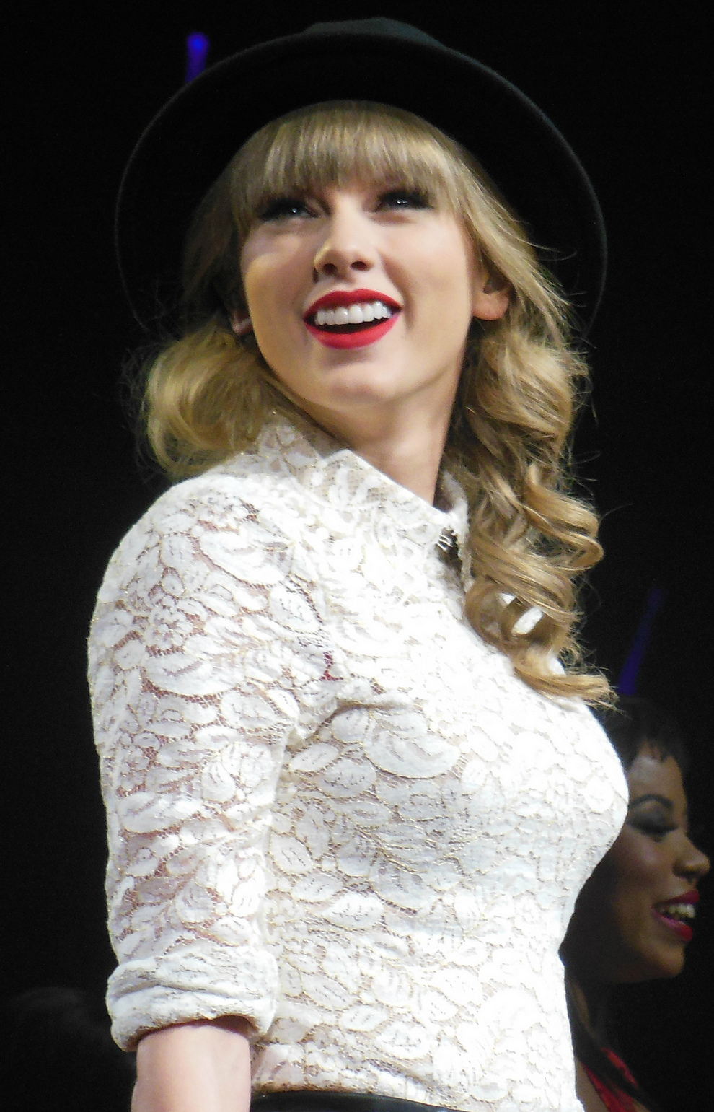
Swift in Space
There we go
@ myrrlyn

Slide 10
Swift in Space – Out-of-band Details
https://twitter.com/myrrlyn/status/922615769703227392
Follow me on Twitter; I’m the perfect mix of funny and cute.
Explanation Slide – spoken, not shown
@ myrrlyn

Slide 11
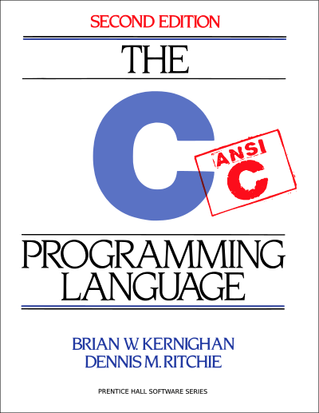
I Don’t Write Rust at Work
I write C.
@ myrrlyn

Slide 12
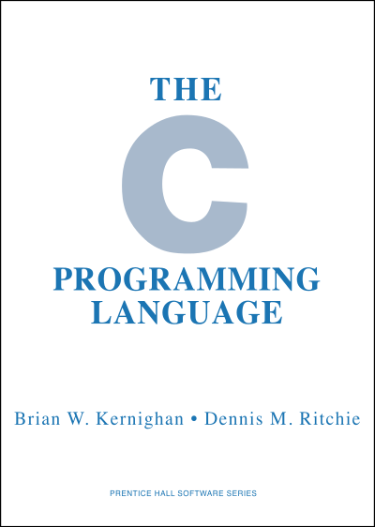
I Don’t Write Rust at Work
I write the bad C. C89, pre-ANSI
(It’s a compiler thing)
@ myrrlyn

Slide 13
I Don’t Write Rust at Work
I also write C++ 11 for on-orbit software
I write Ruby and Python for ground-station software.
Other people write C# and web applications. We use the whole stack! Lots of opportunities.
@ myrrlyn

Slide 14
I Don’t Write Rust at Work
But I want to!
@ myrrlyn

Slide 15
Rust in Supporting Space
I wrote a kernel module in C89.
I Rewrote It In Rust. I found bugs.
I re-rewrote it in C, correctly.
@ myrrlyn

Slide 16
Rust in Supporting Space
I wrote a network packet sniffer in Rust.
It took about a day.
It worked!
@ myrrlyn

Slide 17
Fun Stats
22%
@ myrrlyn

Slide 18
Fun Stats – Spoken Details
Percentage of CubeSats that are launched, and never turn on. Some are fatally damaged by the rocket. Some get jammed in the catapult. Some eject, but never activate. Some fail to deploy solar panels and run out of power.
22% fail at time zero. Another 8% fail in the first 6 months.
Space is hard, and CubeSats are small.
Explanation Slide – spoken, not shown
@ myrrlyn

Slide 19
Cosmonaut
Background project (in Rust!)
Parses XML message definitions
Generates C++ code for flight
Web app for user terminal
Manages communication up to the ground radio
@ myrrlyn

Slide 20
Cosmonaut
Barely exists
Is a learning project
Required to be open-source, but probably read-only :/
@ myrrlyn

Slide 21
Conclusion
I haven’t flown Rust (sorry!)
It’s hugely empowered the C that I have delivered
It’s made me a better programmer
Space Loves Safety!! We take that very seriously.
Rust has a place everywhere we work, and that’s SO COOL.
@ myrrlyn

