Slide 1
Eastern Bering Sea snow crab
Preliminary 2026 assessment Grant Adams Cody Szuwalski

Slide 2
Context and SSC/CPT requests

Slide 3
EBS snow crab context
Grant is the new lead and hesitant to change much his first year.
No federal OFL/ABC has ever constrained removals.
Despite conservative management relative to OFL, the stock remains at historical lows.
Commercially preferred males (>=101 mm CW) at all-time lows.
2025 survey commercially preferred male biomass: 23.28 kt (for reference, candidate Tier 3 OFLs span 36–60 kt).
Stock declared overfished in 2021; rebuilding update will be added to the September SAFE.
Currency of management
“MMB”:
OFL will not be constraining
Allows removal of all large males

Slide 4
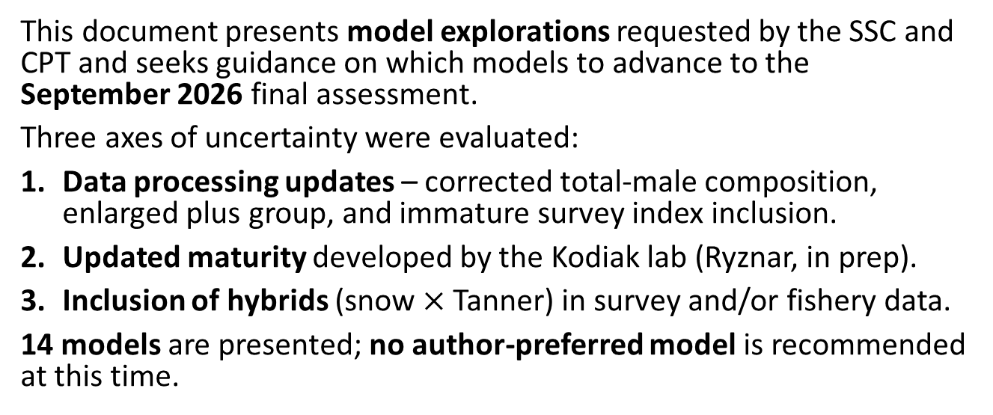
Purpose of this preliminary cycle
This document presents model explorations requested by the SSC and CPT and seeks guidance on which models to advance to the September 2026 final assessment.
Three axes of uncertainty were evaluated:
Data processing updates – corrected total-male composition, enlarged plus group, and immature survey index inclusion.
Updated maturity developed by the Kodiak lab (Ryznar, in prep).
Inclusion of hybrids (snow $×$ Tanner) in survey and/or fishery data.
14 models are presented; no author-preferred model is recommended at this time.

Slide 5
SSC comment: hybrids
2025(10) SSC. As with a similar SSC recommendation for Tanner crab, the SSC recommends consideration of different inclusions/exclusions of hybrids into the snow crab assessment (i.e., in survey and catch data) to evaluate sensitivity to these options and ensure an internally consistent approach.
Response. We evaluated inclusion of hybrids in the survey and fishery time series independently and jointly (Models 25.3a--25.3d).
Effect on management advice was modest.
Recommend excluding hybrids from further assessments because they are avoided by the directed fishery.
Retained catch already contains hybrids that cannot be separated from snow crab; recommend a smaller buffer on OFL to account for this based on amount of hybrids.
Alternative model with hybrids could inform buffer.

Slide 6
SSC comment: jittering and likelihood profiles
2025(10) SSC. The SSC recommends the use of likelihood profiles to describe uncertainty and uses jittering analyses only to ensure that the results provided come from the model with the lowest negative log likelihood.
We ran 100-jitter runs across six models across scenarios.
Likelihood profiles will be included in September 2026.
2024(10) SSC. The SSC requested investigation of the bimodality observed in the 2024 jitter analysis (two clouds of OFLs differing by ~5,000 t).
The bimodality persists in most 2026 candidates except when the immature survey index is included alongside the updated plus group (Model 25.1e, Model 25.2d). However, this leads to high estimates of mature male M (>0.6).

Slide 7
SSC comment: maturity ogive
2024(10) SSC. The SSC again requests an analysis of the probability of maturing/terminal molt which addresses the observation error in these data and the lack of a monotonically increasing curve…
Kodiak lab presented an updated workflow in January 2025; further refinements to be presented at this meeting.
The new workflow uses an sdmTMB spatiotemporal model fit to chela-based maturity classifications.
We present two maturity ogive scenarios (Models 25.2).
Observation error is not yet propagated into the assessment – this is an area of future improvement.

Slide 8
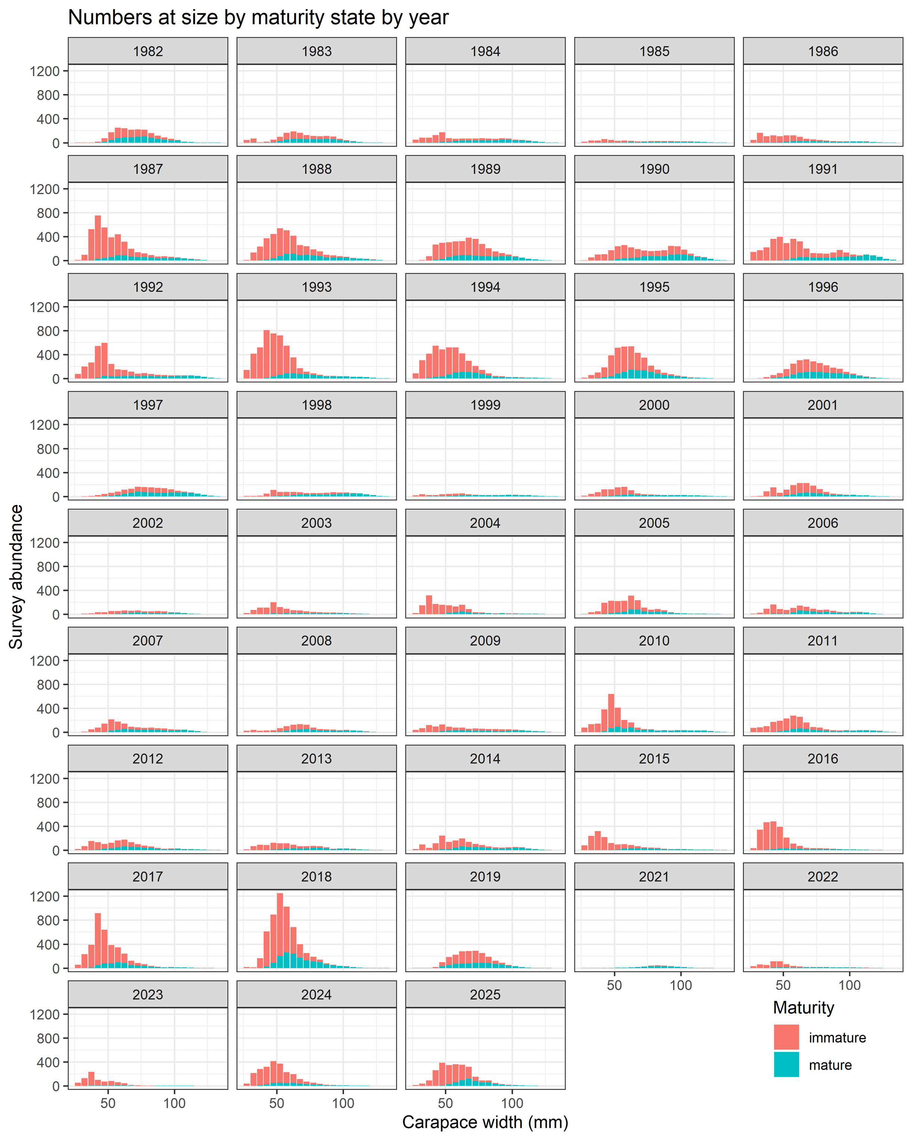
SSC comment: morphometric maturity overlay (Fig. 9)
2025(10) SSC. The SSC recommends that morphometric maturity status be overlaid on the size distribution plots to allow visual tracking of growth and the transition to maturity by cohort.
Updated figure with new survey + new maturity workflow will be in the September document.
Numbers of immature/mature crab at size from the survey, by year (legacy maturity workflow)

Slide 9
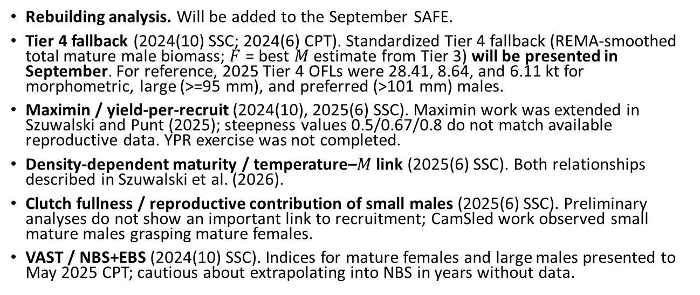
Other SSC items addressed
Rebuilding analysis. Will be added to the September SAFE.
Tier 4 fallback (2024(10) SSC; 2024(6) CPT). Standardized Tier 4 fallback (REMA-smoothed total mature male biomass; $F$ = best $M$ estimate from Tier 3) will be presented in September. For reference, 2025 Tier 4 OFLs were 28.41, 8.64, and 6.11 kt for morphometric, large (>=95 mm), and preferred (>101 mm) males.
Maximin / yield-per-recruit (2024(10), 2025(6) SSC). Maximin work was extended in Szuwalski and Punt (2025); steepness values 0.5/0.67/0.8 do not match available reproductive data. YPR exercise was not completed.
Density-dependent maturity / temperature–$M$ link (2025(6) SSC). Both relationships described in Szuwalski et al. (2026).
Clutch fullness / reproductive contribution of small males (2025(6) SSC). Preliminary analyses do not show an important link to recruitment; CamSled work observed small mature males grasping mature females.
VAST / NBS+EBS (2024(10) SSC). Indices for mature females and large males presented to May 2025 CPT; cautious about extrapolating into NBS in years without data.

Slide 10
Assessment scenarios

Slide 11
Model framework
Same structural assumptions across all scenarios – differences only in GMACS version, data processing, maturity ogive, and hybrids.
Probability of terminal molt at size input as data (varies by year and size).
Survey selectivity estimated by era (1982–88; 1989–present) and sex with priors from BSFRF.
Growth = linear function of pre-molt CW with specified variance.
Natural mortality estimated by sex/maturity with mortality events in 2018 and 2019.
All immature crab molt; mature crab undergo terminal molt.
Total and retained fishery selectivity = logistic curves.
All non-directed bycatch lumped into a single fleet.
Recruitment estimated separately for males and females; first 3 size bins.
GMACS v2.20.34 (compiled 2026-01-15) for all candidate runs except rolled forward model (Model 25).

Slide 12
Abbreviations –
Suffix | Meaning
update | Updated GMACS executable (2.20.34)
compfix | Total-male comp file corrected
plus group | Plus group widened to include all crab > 135 mm CW
imm_surv | Immature survey biomass index added
new_mat | New sdmTMB maturity workflow (Kodiak; Ryznar in prep)
hyb_fishery | Hybrid catch added to directed-fishery comp / discards
hyb_surv | Hybrid added to NMFS summer trawl survey biomass / comp
hyb_both | Hybrids added to both survey and fishery

Slide 13
Models grouped under four axes of uncertainty.

Slide 14
Axis 1 – Model & composition data updates
Model | Description
25 | September 2025 author-recommended; rolled forward (no updates)
25.1a | Model 25 fit with updated GMACS (2.20.34)
25.1b | 25.1a + correct total-male composition file
25.1c | 25.1b + plus group at >135 mm CW

Slide 15
Compfix reconciles a small file discrepancy from September 2025.
Previously removed 278/2,239 (retained), total: 422/3,151 (total), and 1/1,175 (female discard) samples
The plus-group change makes the model run substantially faster (23 min vs. 29 min) and is the structural baseline for most sensitivities.

Slide 16
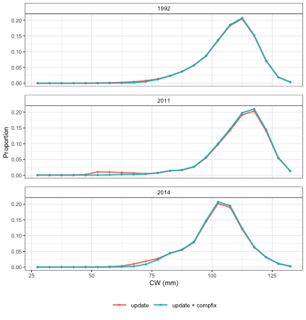
Total male composition fix
Small discrepancy between discarded and males composition used in the September 2025 assessment and the version produced by the script that translates the ADF&G files.
Re-ran the translation script and replacing the affected total-male composition entries.
Effect on management quantities is small.

Slide 17
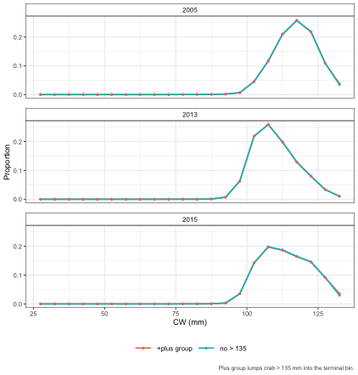
Plus group at >135 mm CW
Previous model ignored crab > 135 mm.
Updated plus group lumps all crab > 135 mm into a single bin for:
Retained males (n = 278 of 2,239 samples)
Total males (n = 422 of 3,151 samples)
Discard females (n = 1 of 1,175 samples)
Improves runtime substantially (23 min vs. 29 min for the comparable model).
Management quantities change very little.

Slide 18
Axis 2 – Immature survey biomass index
Model | Abr. | Description
25.1d | update + compfix + imm_surv | 25.1b + immature index
25.1e | update + plus group + imm_surv | 25.1c + immature index

Slide 19
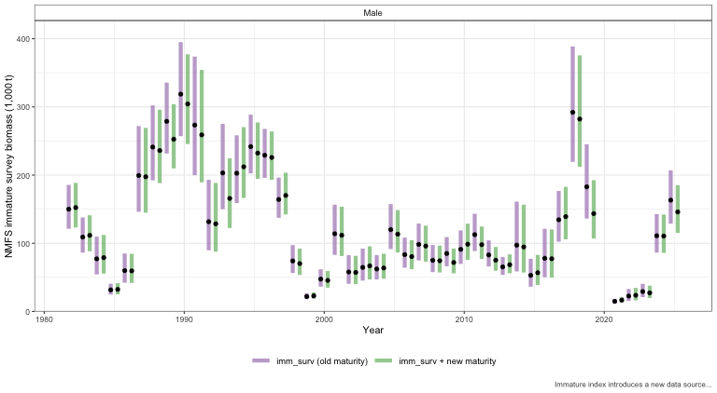

NMFS immature survey biomass index
Removes the bimodality observed in jitter analyses (see Results).
Comes with a substantially higher estimate of mature male $M$ (> 0.6) that propagates into reference points.
Combination of immature index + hybrids was not explored.

Slide 20
Axis 3 – New maturity workflow
Model | Abr. | Description
25.2a | update + new_mat | 25.1a + new ogive
25.2b | update + compfix + new_mat | 25.1b + new ogive
25.2c | update + compfix + plus_group + new_mat | 25.1c + new ogive
25.2d | update + compfix + plus_group + new_mat + imm_surv | 25.1c + new + immature survey

Slide 21
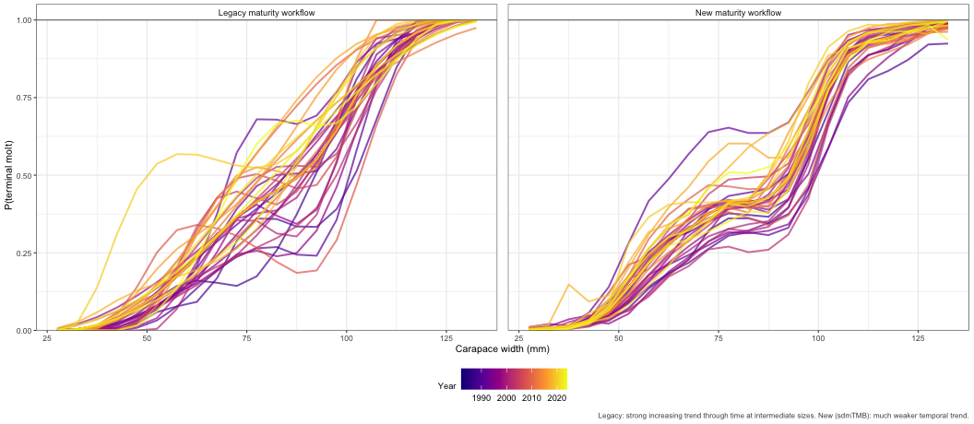
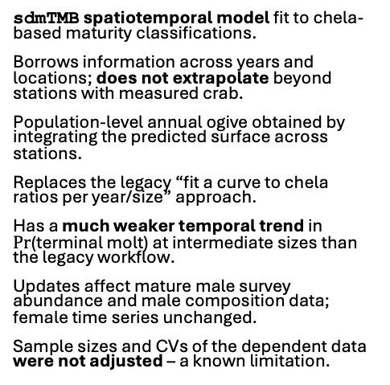
New maturity workflow (Kodiak / Ryznar, in prep)
sdmTMB spatiotemporal model fit to chela-based maturity classifications.
Borrows information across years and locations; does not extrapolate beyond stations with measured crab.
Population-level annual ogive obtained by integrating the predicted surface across stations.
Replaces the legacy “fit a curve to chela ratios per year/size” approach.
Has a much weaker temporal trend in $Pr$(terminal molt) at intermediate sizes than the legacy workflow.
Updates affect mature male survey abundance and male composition data; female time series unchanged.
Sample sizes and CVs of the dependent data were not adjusted – a known limitation.

Slide 22
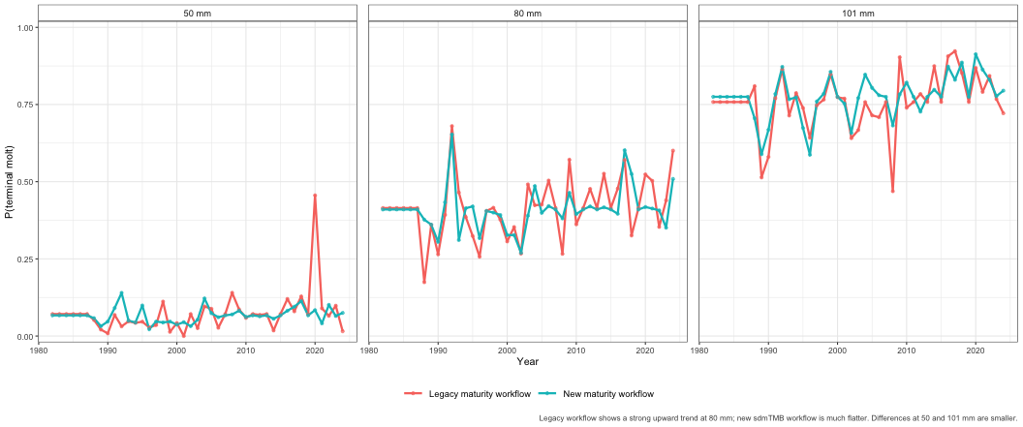

Slide 23
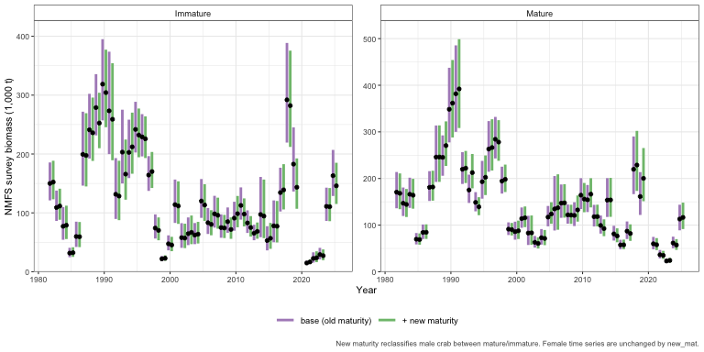
NMFS survey biomass index – mature crab (maturity effect)

Slide 24
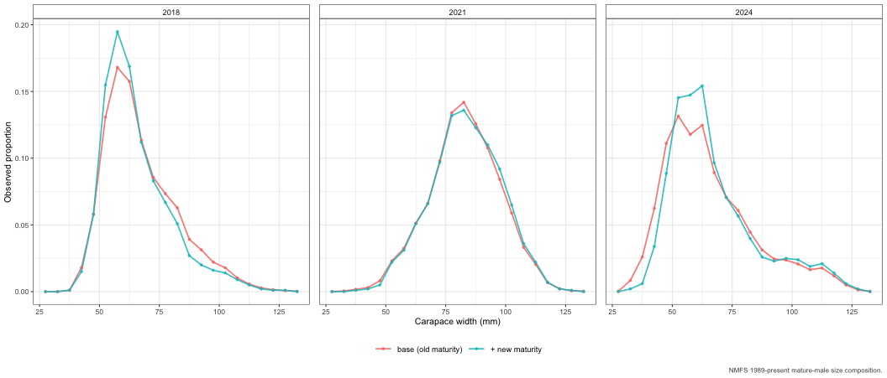

Slide 25
Axis 4 – Hybrid treatment
Model | Abr. | Description
25.3a | update + compfix + plus_group + hyb_fishery | 25.1c + hybrids in directed-fishery comp + discards
25.3b | update + compfix + plus_group + hyb_surv | 25.1c + hybrids in NMFS summer survey biomass + comp
25.3c | update + compfix + plus_group + hyb_both | 25.1c + hybrids in both survey and fishery
25.3d | update + compfix + plus_group + hyb_both + new_mat | 25.3c + new maturity workflow

Slide 26
Hybrid data: directed-fishery discards
ADF&G provided hybrid data as a separate species code (lumped opilio-, bairdi-, and unspecified-type).
Hybrid weights computed using snow crab L–W parameters (most hybrids are opilio-type).
Hybrid data are additive to existing snow-crab time series
CV on directed discards held at 0.7. Observer non-directed bycatch unchanged.
Retained hybrids cannot be separated from retained snow crab (hybrids already retained under snow IFQ; cannot be separated).

Slide 27
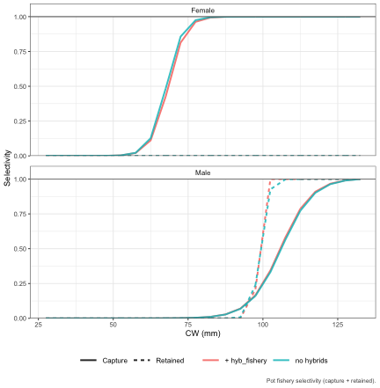
Adding hybrids to the directed pot fishery increases discards in some years – e.g. legal-male hybrid catch ~18 kt in 1997 and ~15 kt in 1998 (flagged by ADF&G as needing QC).
Models accommodate the added discards primarily through changes in estimated discard fishing mortality, not selectivity.

Slide 28
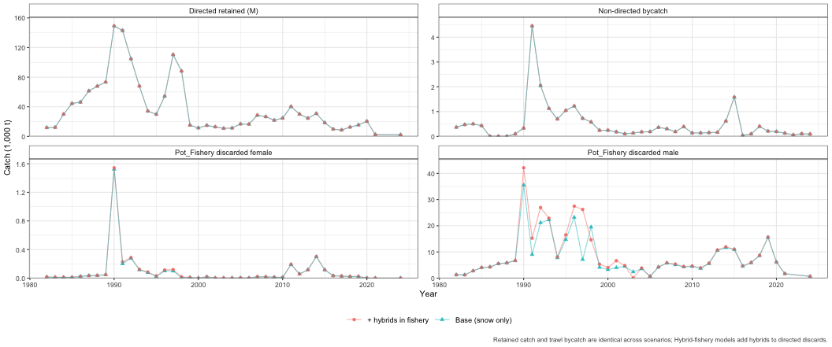
Catch data – retained, discards, bycatch

Slide 29
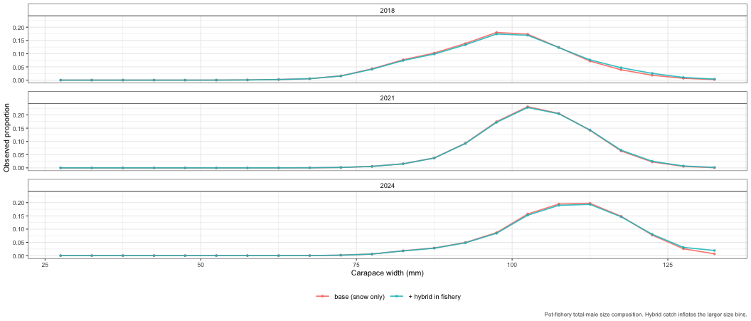
Pot fishery composition – hybrid effect

Slide 30
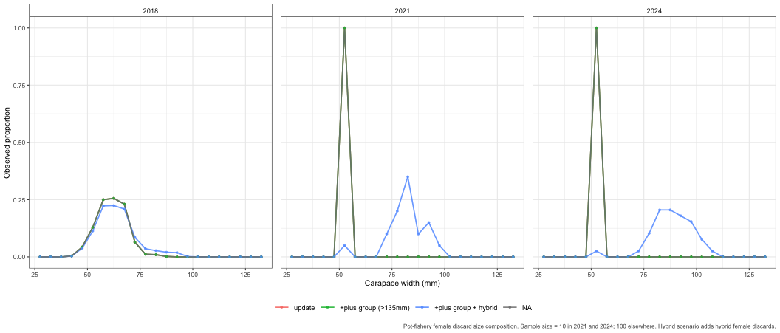
Pot fishery female discard composition

Slide 31
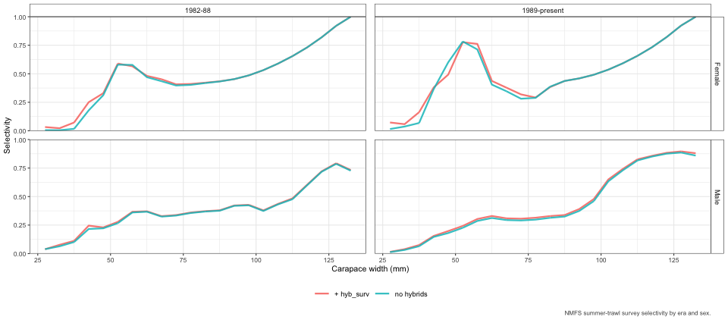
Hybrid data: NMFS summer trawl survey
Hybrid catch and composition data added to the NMFS summer trawl time-series for Models 25.3b, 25.3c, 25.3d.
Visibly higher predicted survey biomass in some years; trend through time is unchanged.
Hybrid identification quality decreases further back in the time series (consistency between ADF&G and NMFS criteria is currently an issue).

Slide 32
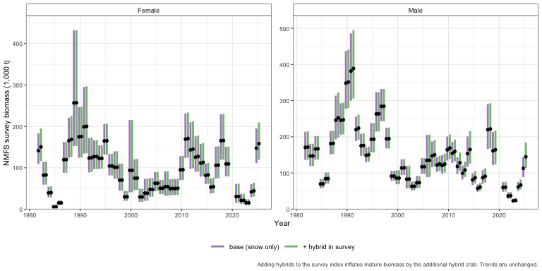
NMFS survey biomass index – mature crab (hybrid effect)

Slide 33
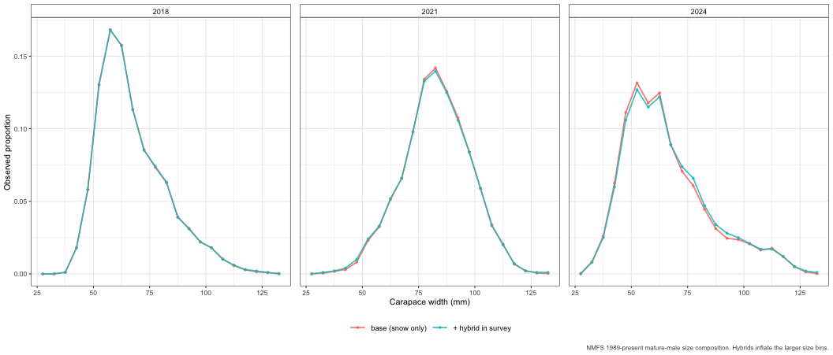
NMFS survey composition – mature males (hybrid effect)

Slide 34
Convergence and jitter analysis

Slide 35
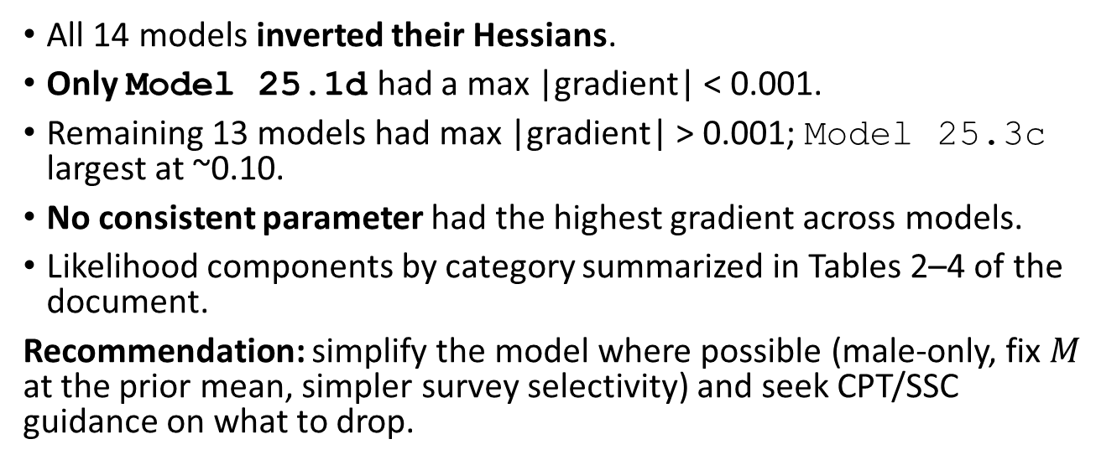
Convergence summary
All 14 models inverted their Hessians.
Only Model 25.1d had a max |gradient| < 0.001.
Remaining 13 models had max |gradient| > 0.001; Model 25.3c largest at ~0.10.
No consistent parameter had the highest gradient across models.
Likelihood components by category summarized in Tables 2–4 of the document.
Recommendation: simplify the model where possible (male-only, fix $M$ at the prior mean, simpler survey selectivity) and seek CPT/SSC guidance on what to drop.

Slide 36
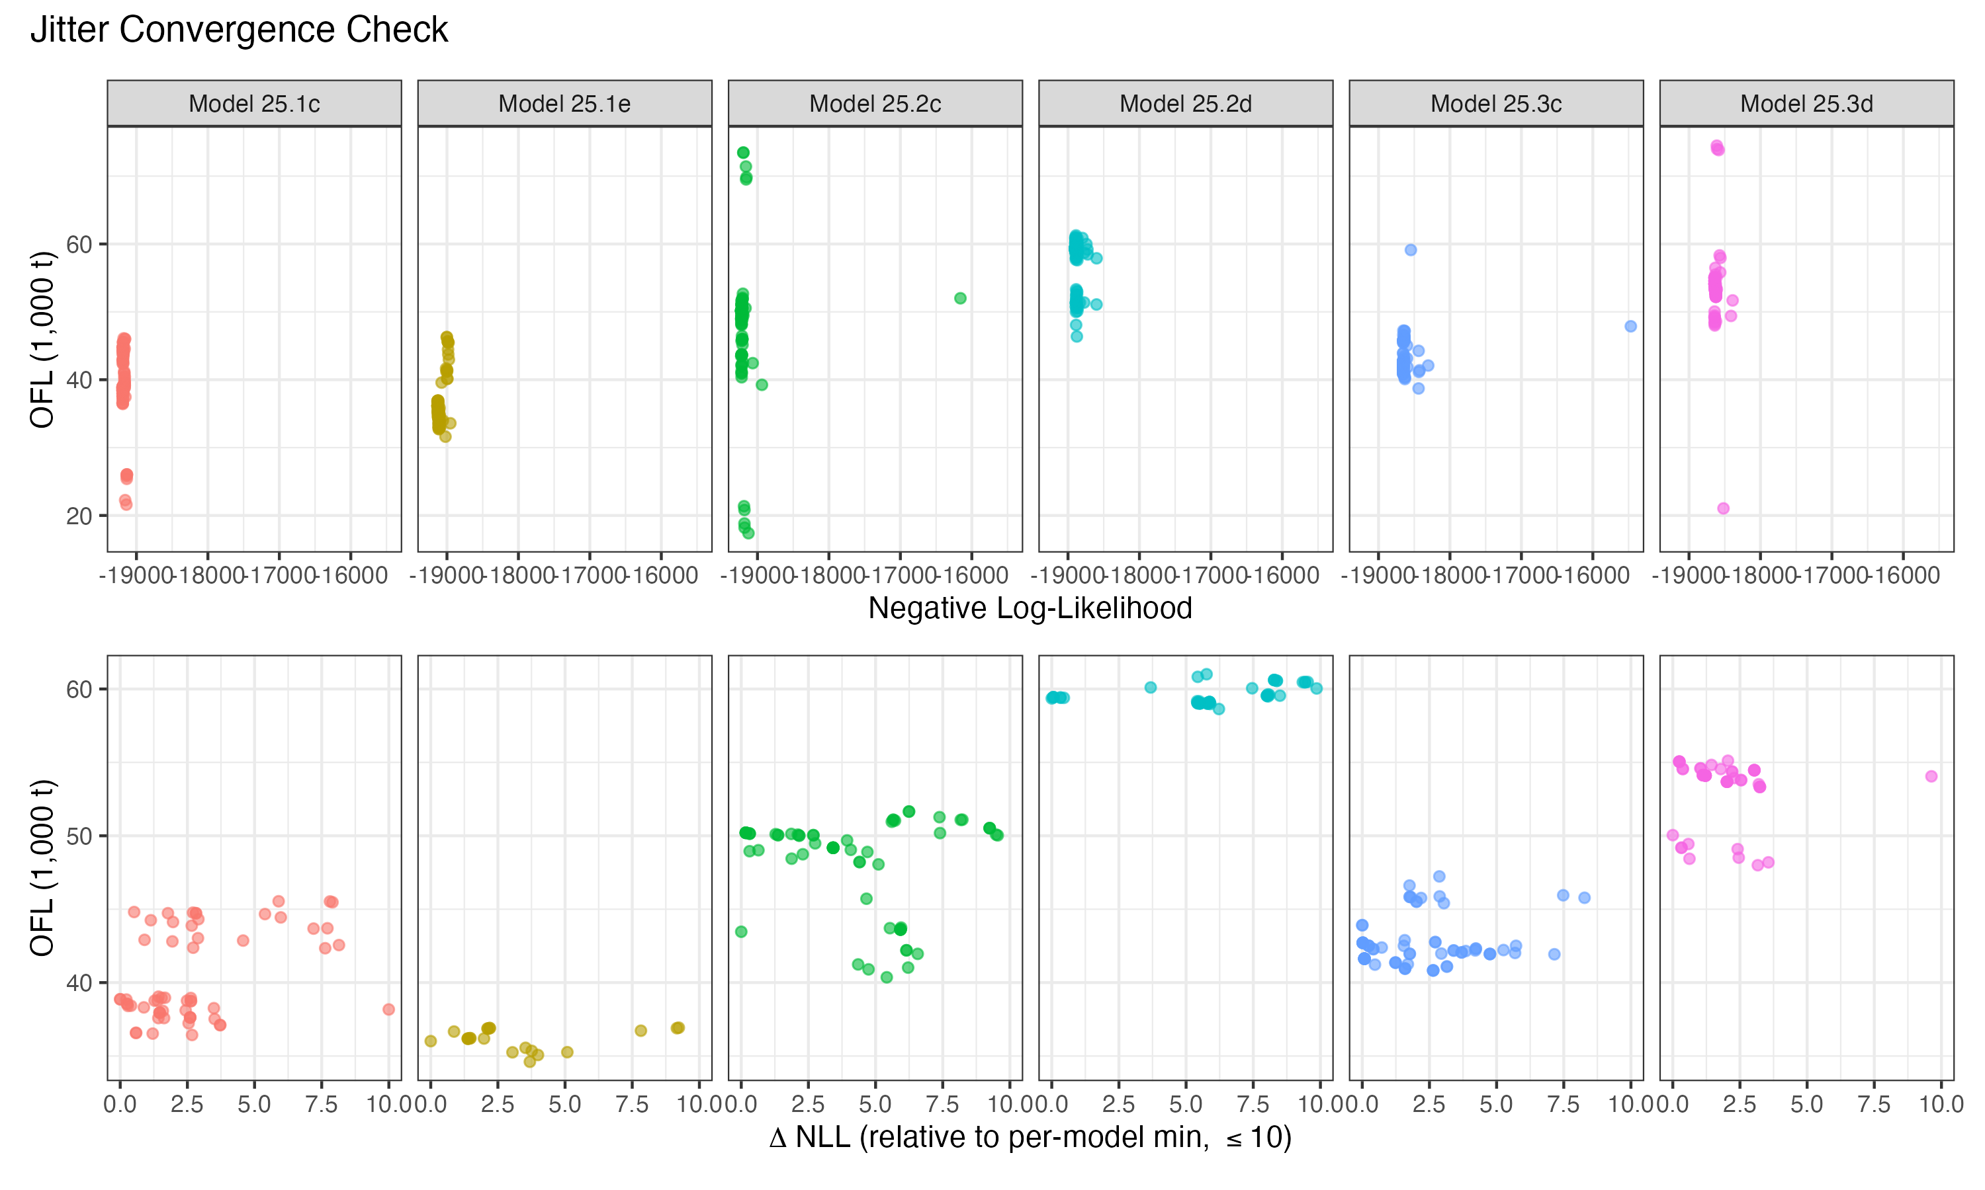
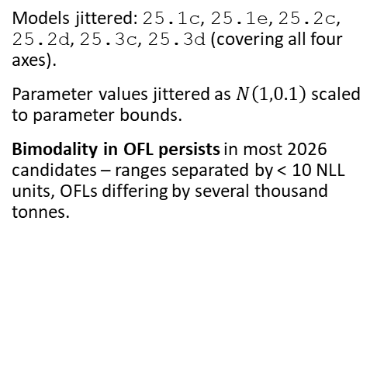
Jitter analysis – 100 starts on six models
Models jittered: 25.1c, 25.1e, 25.2c, 25.2d, 25.3c, 25.3d (covering all four axes).
Parameter values jittered as $N\left(1,0.1\right)$ scaled to parameter bounds.
Bimodality in OFL persists in most 2026 candidates – ranges separated by < 10 NLL units, OFLs differing by several thousand tonnes.

Slide 37
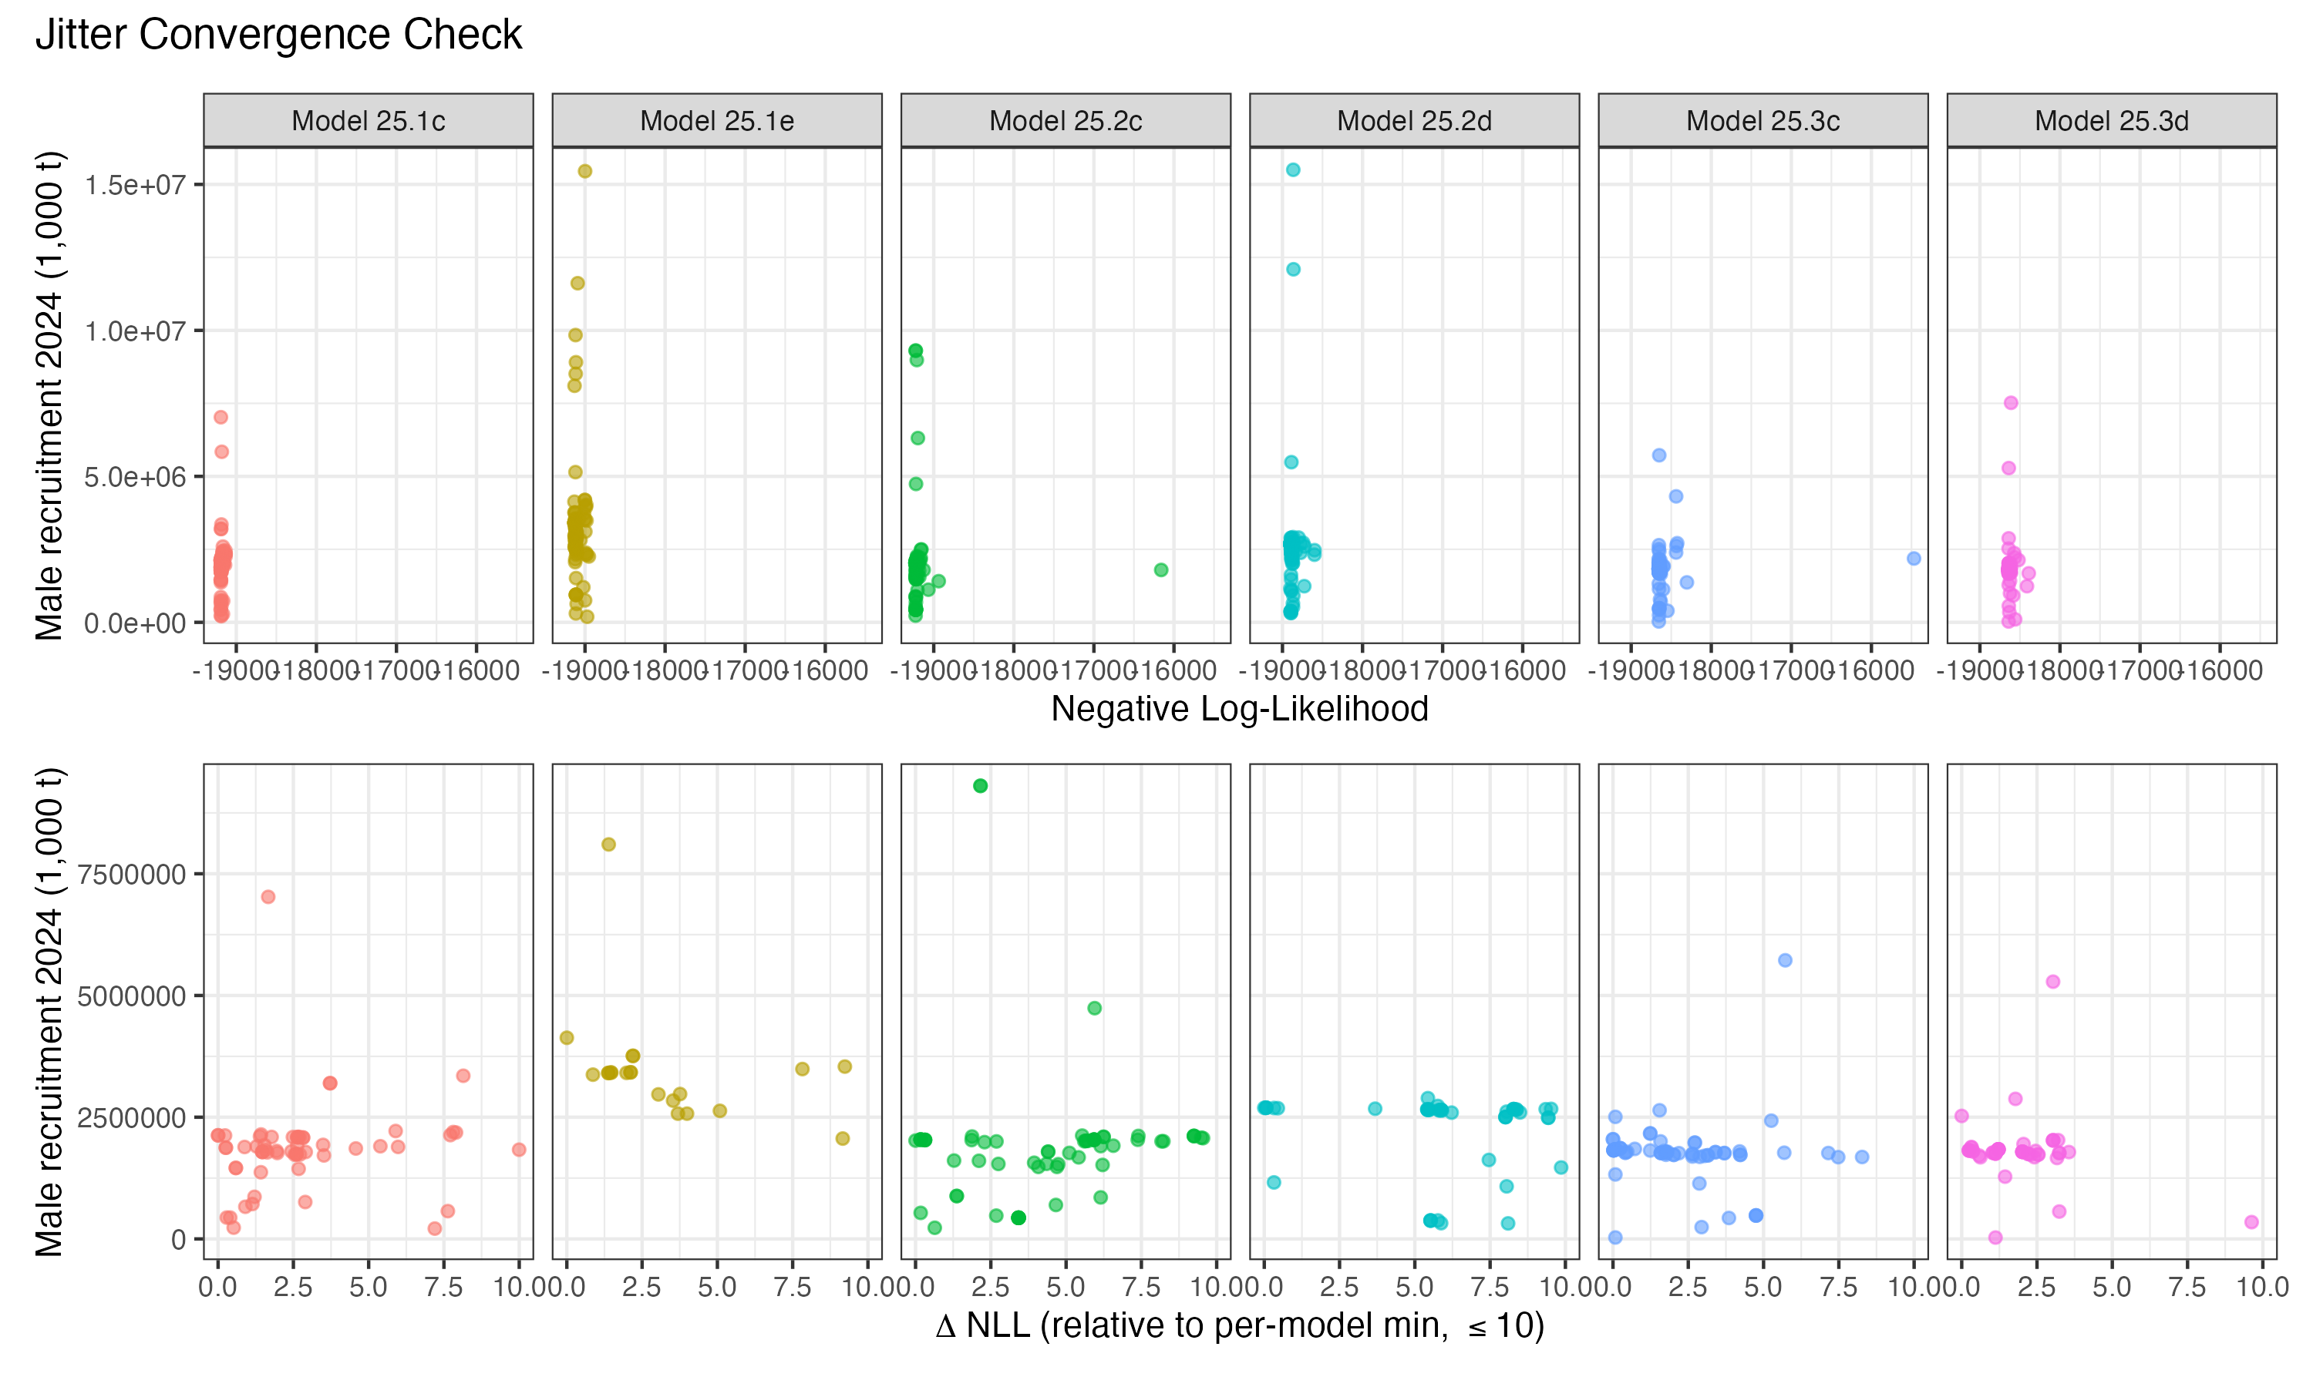
Jitter analysis – 2024 male recruitment

Slide 38
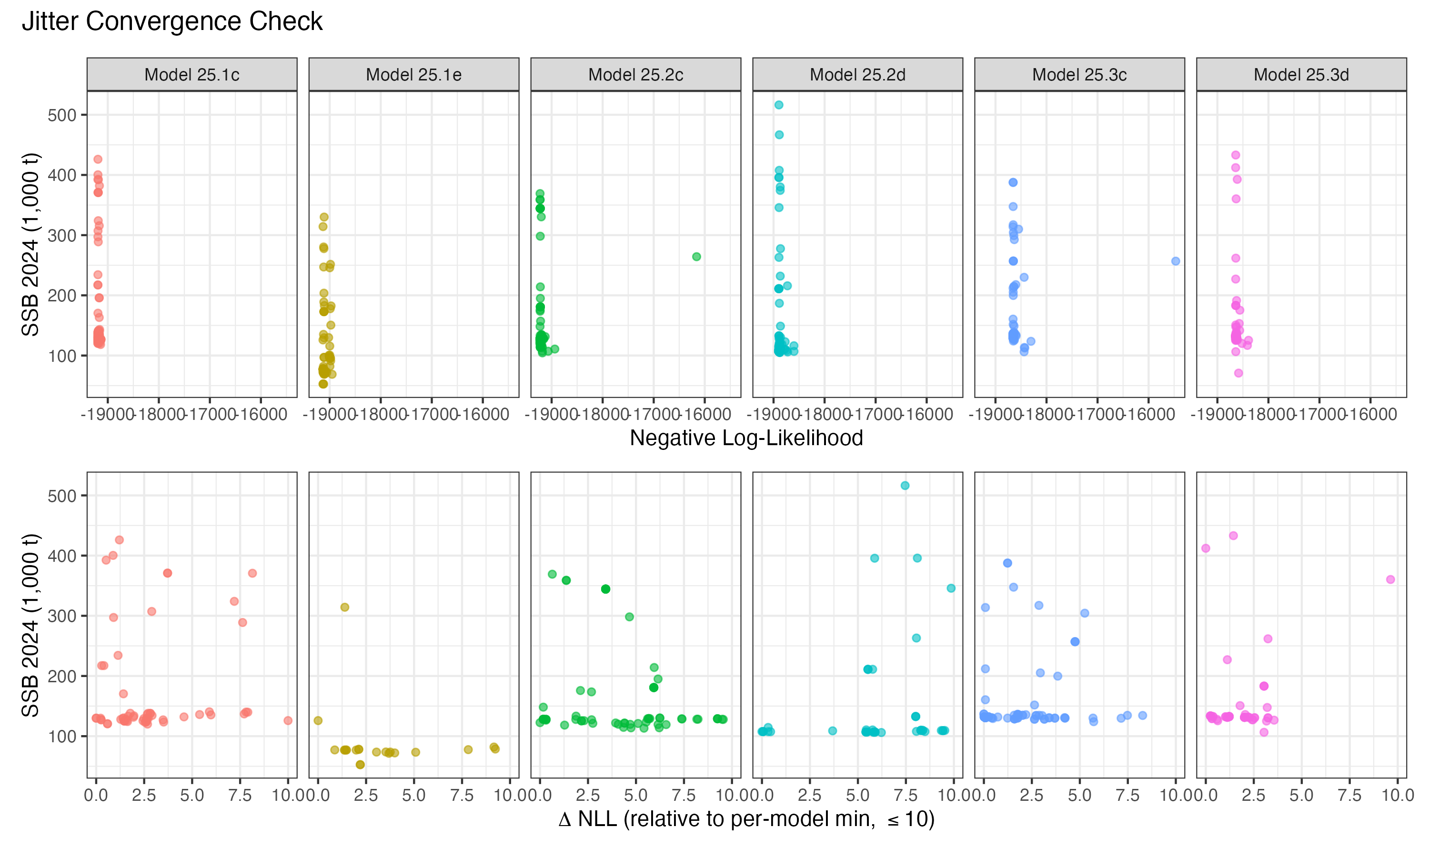
Jitter analysis – 2024 MMB

Slide 39
Interpreting the jitter results
Adding the immature index alongside the updated plus group eliminates the bimodality in OFL (Model 25.1e, Model 25.2d).
A clear spread in derived quantities still exists within 10 NLL units, so don’t read this as an unqualified improvement.
Mature male M is > 0.6 for these models
Bimodality has been a recurring issue in this assessment for several cycles.
Resolving the underlying source of multiple optima will require further investigation before September:
Which parameter combinations produce the two clouds?
Recent recruitment? Mortality events? Selectivity?
Should we include the immature index?

Slide 40
Model fits

Slide 41
Fits to mature survey biomass
Fits to mature biomass survey indices broadly similar across models.
All data-update candidates have difficulty fitting the terminal-year female biomass. New maturity workflow shifts dynamics modestly but does not resolve this.
Possible to use observed probability of terminal molt by year for females?
Models with the immature survey index fit the new immature index ok in recent years – except when paired with the new maturity ogive.

Slide 42
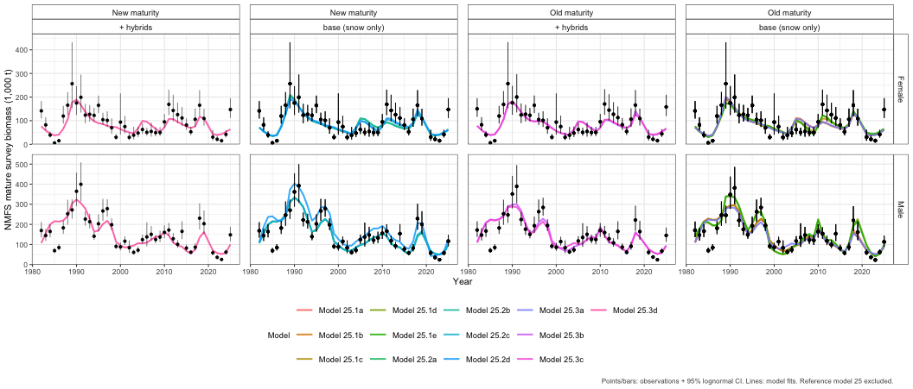
Model fits – mature biomass survey index

Slide 43
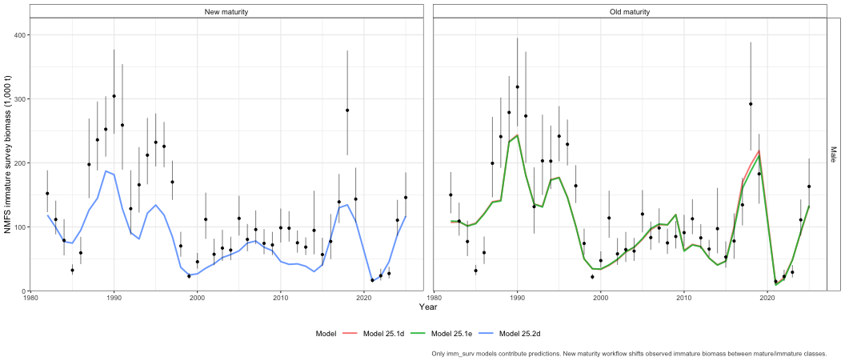
Model fits – immature biomass survey index

Slide 44
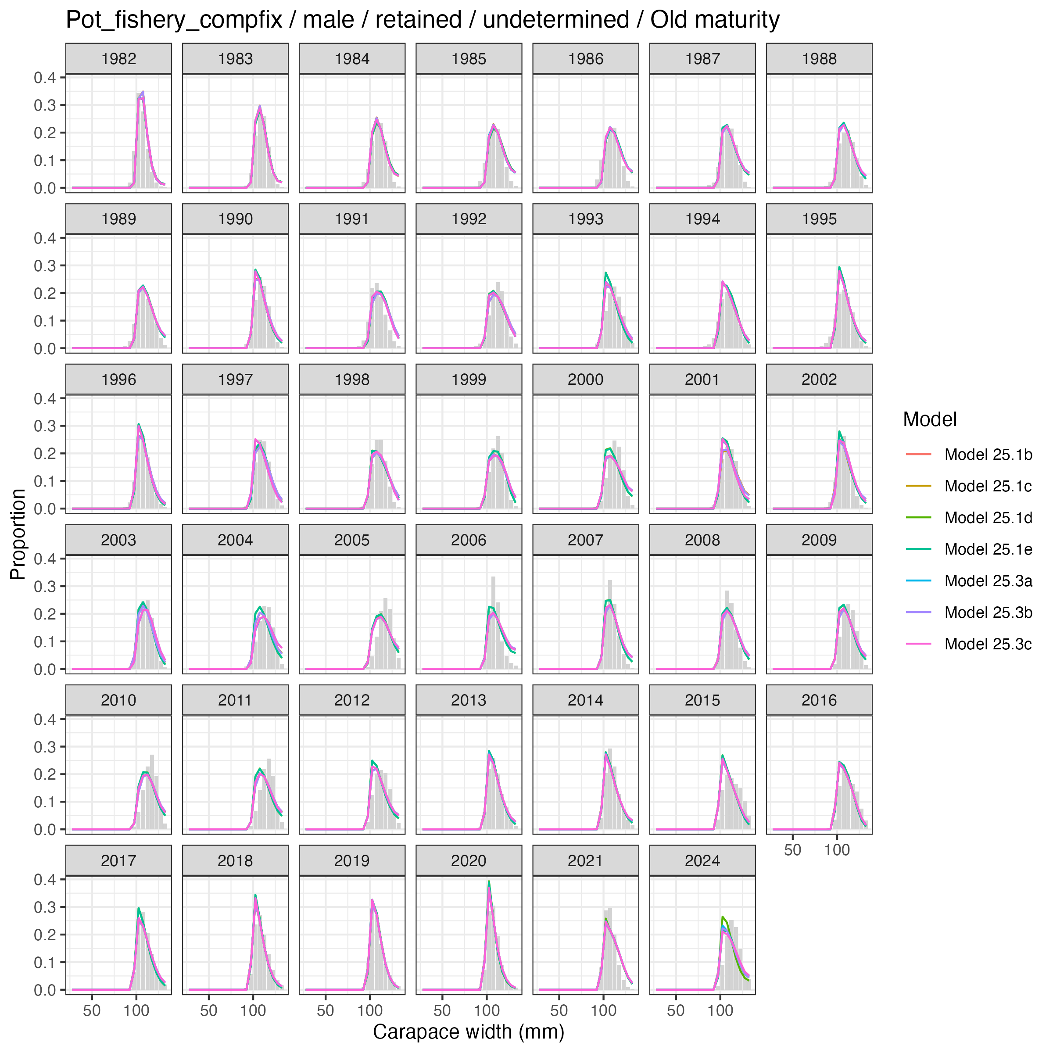
Fits to size composition data – key impressions
Retained males: small differences across models. Plus-group change makes a small visual difference at the largest sizes.
Total males: noticeable differences between standard and hybrid-fishery models, particularly in the larger size bins where hybrids are most prevalent.
Female discards (directed fishery): no visually discernible differences across models.
Non-directed fishery: some of the largest misfits (single estimated selectivity, time-varying fishery behavior). Sample sizes assumed = 100 except 2021 and 2024 (=10).
Survey size composition: broadly similar fits across models. Persistent misfits for immature females in 2009 and 2019 – could reflect unmodeled size-based mortality or time-varying probability of terminal molt.
Retained-male comp fits, across compfix models

Slide 45
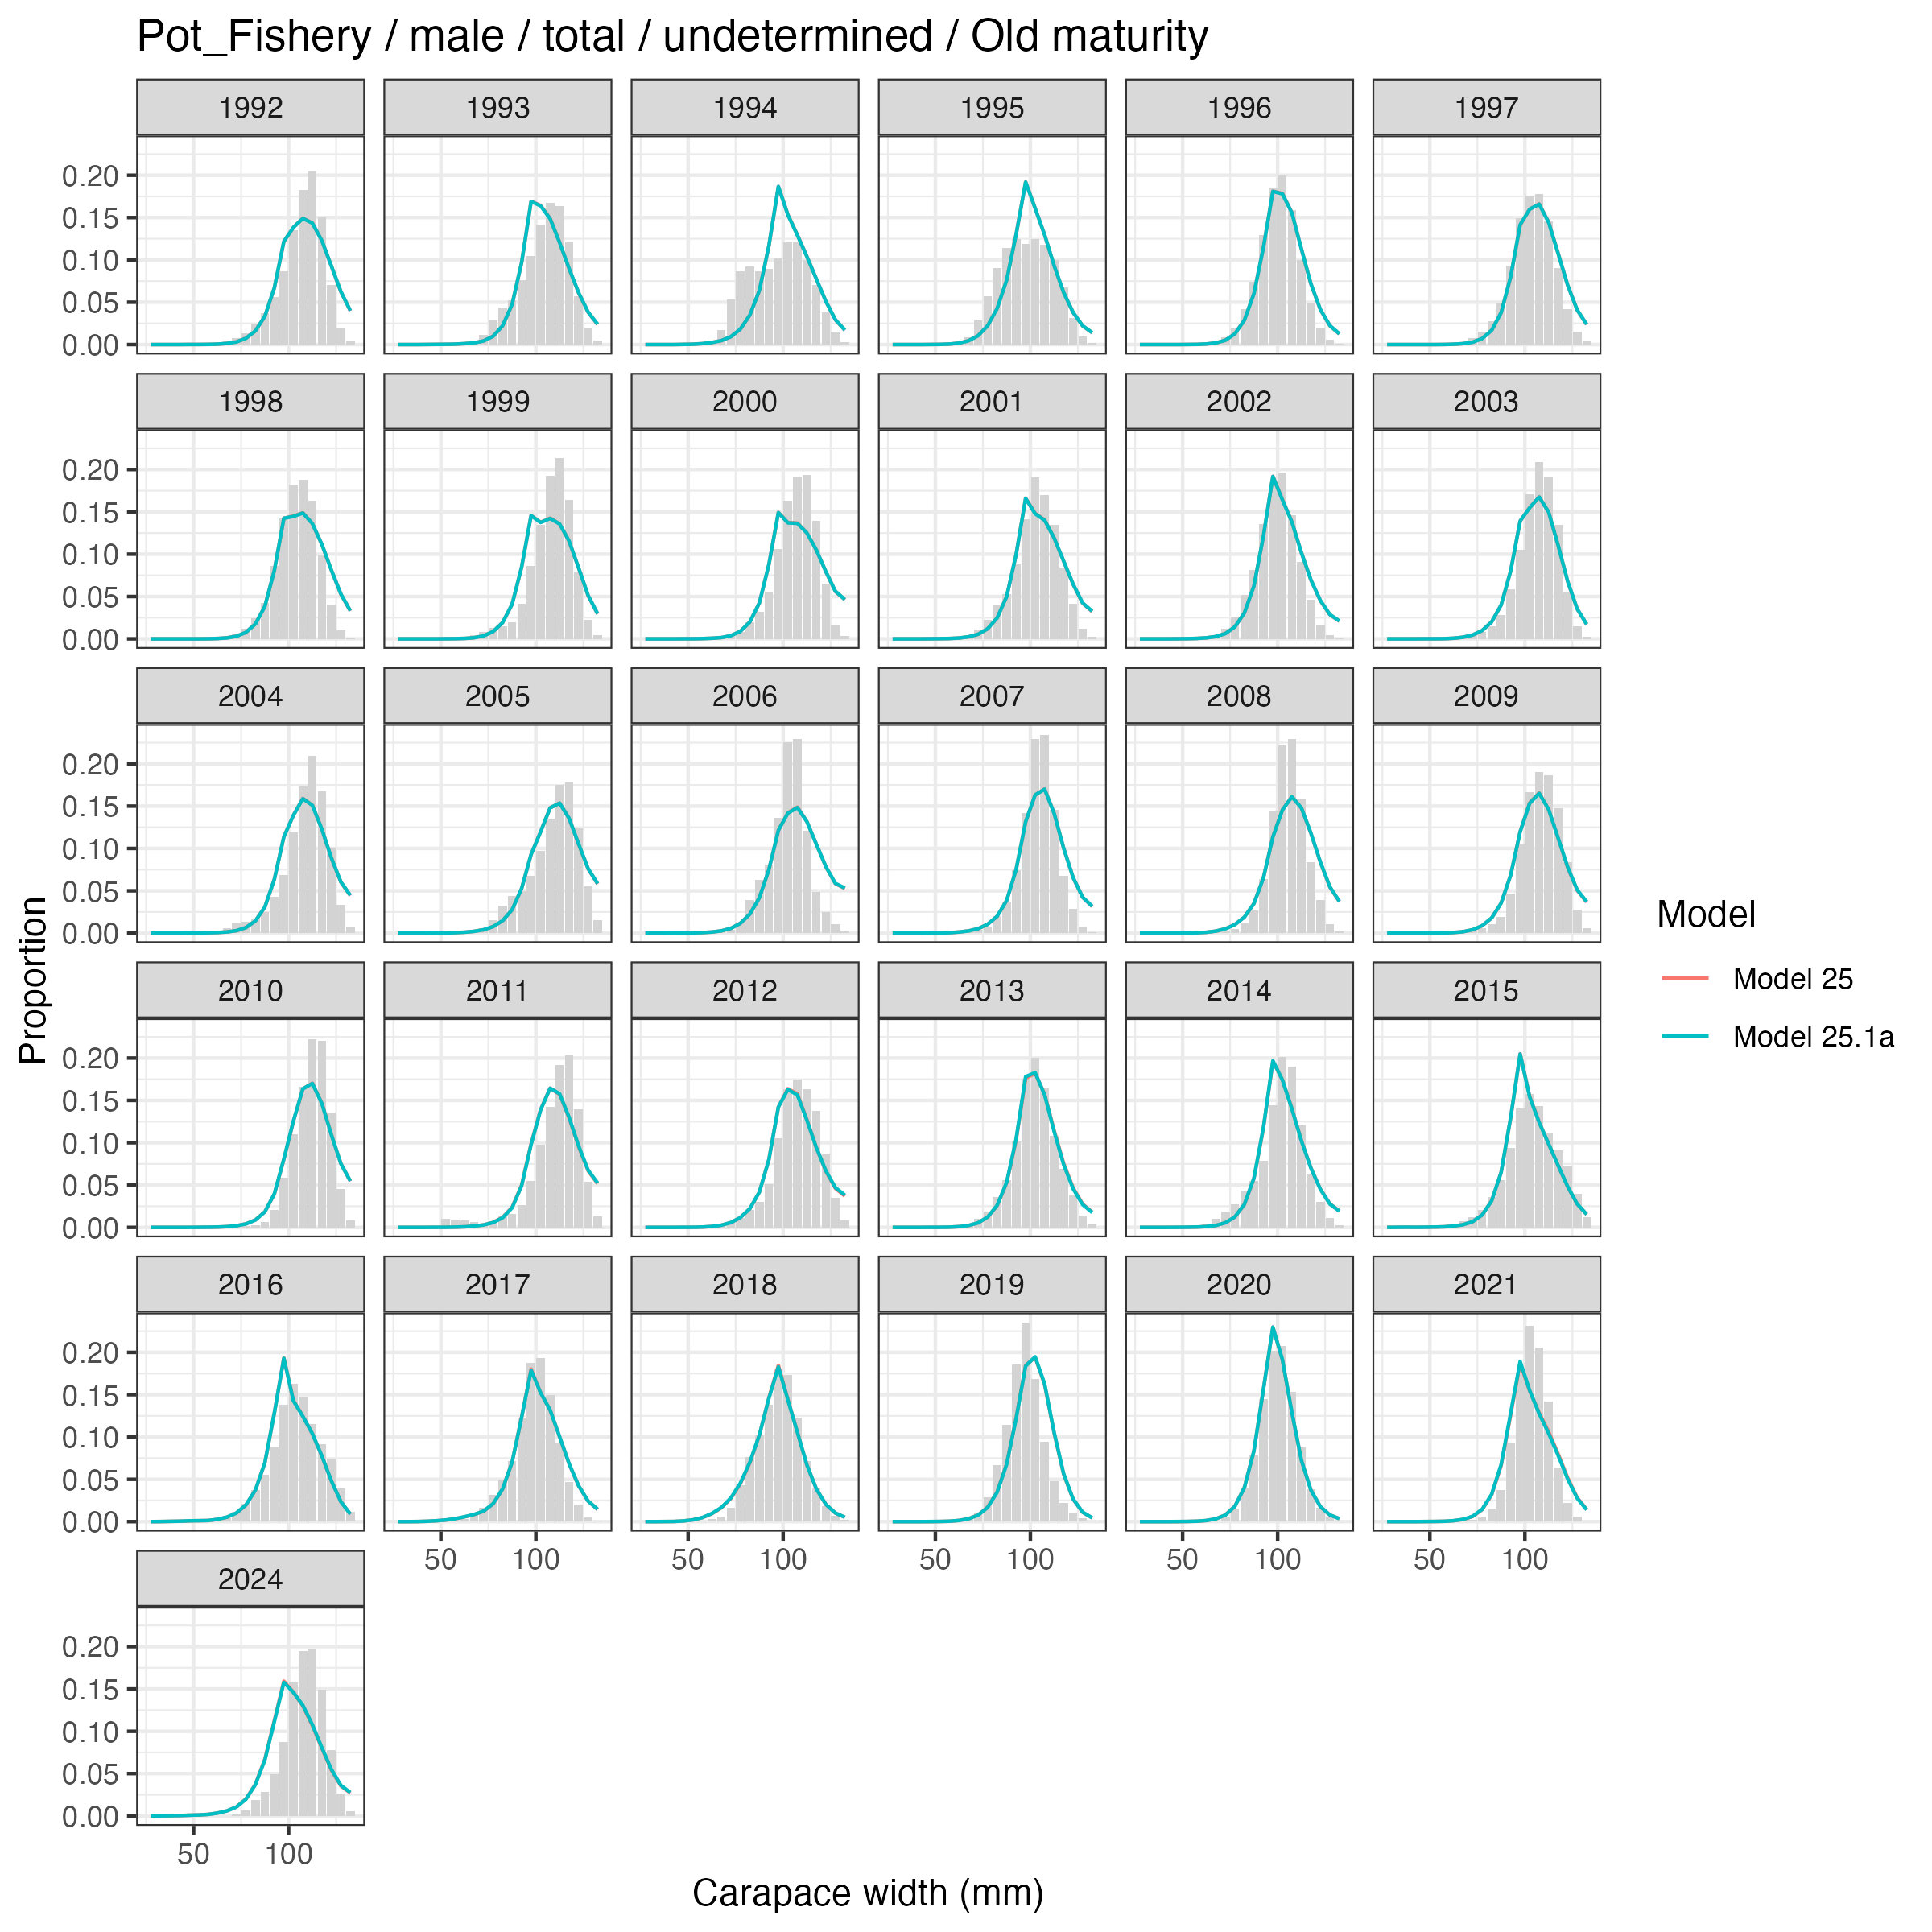
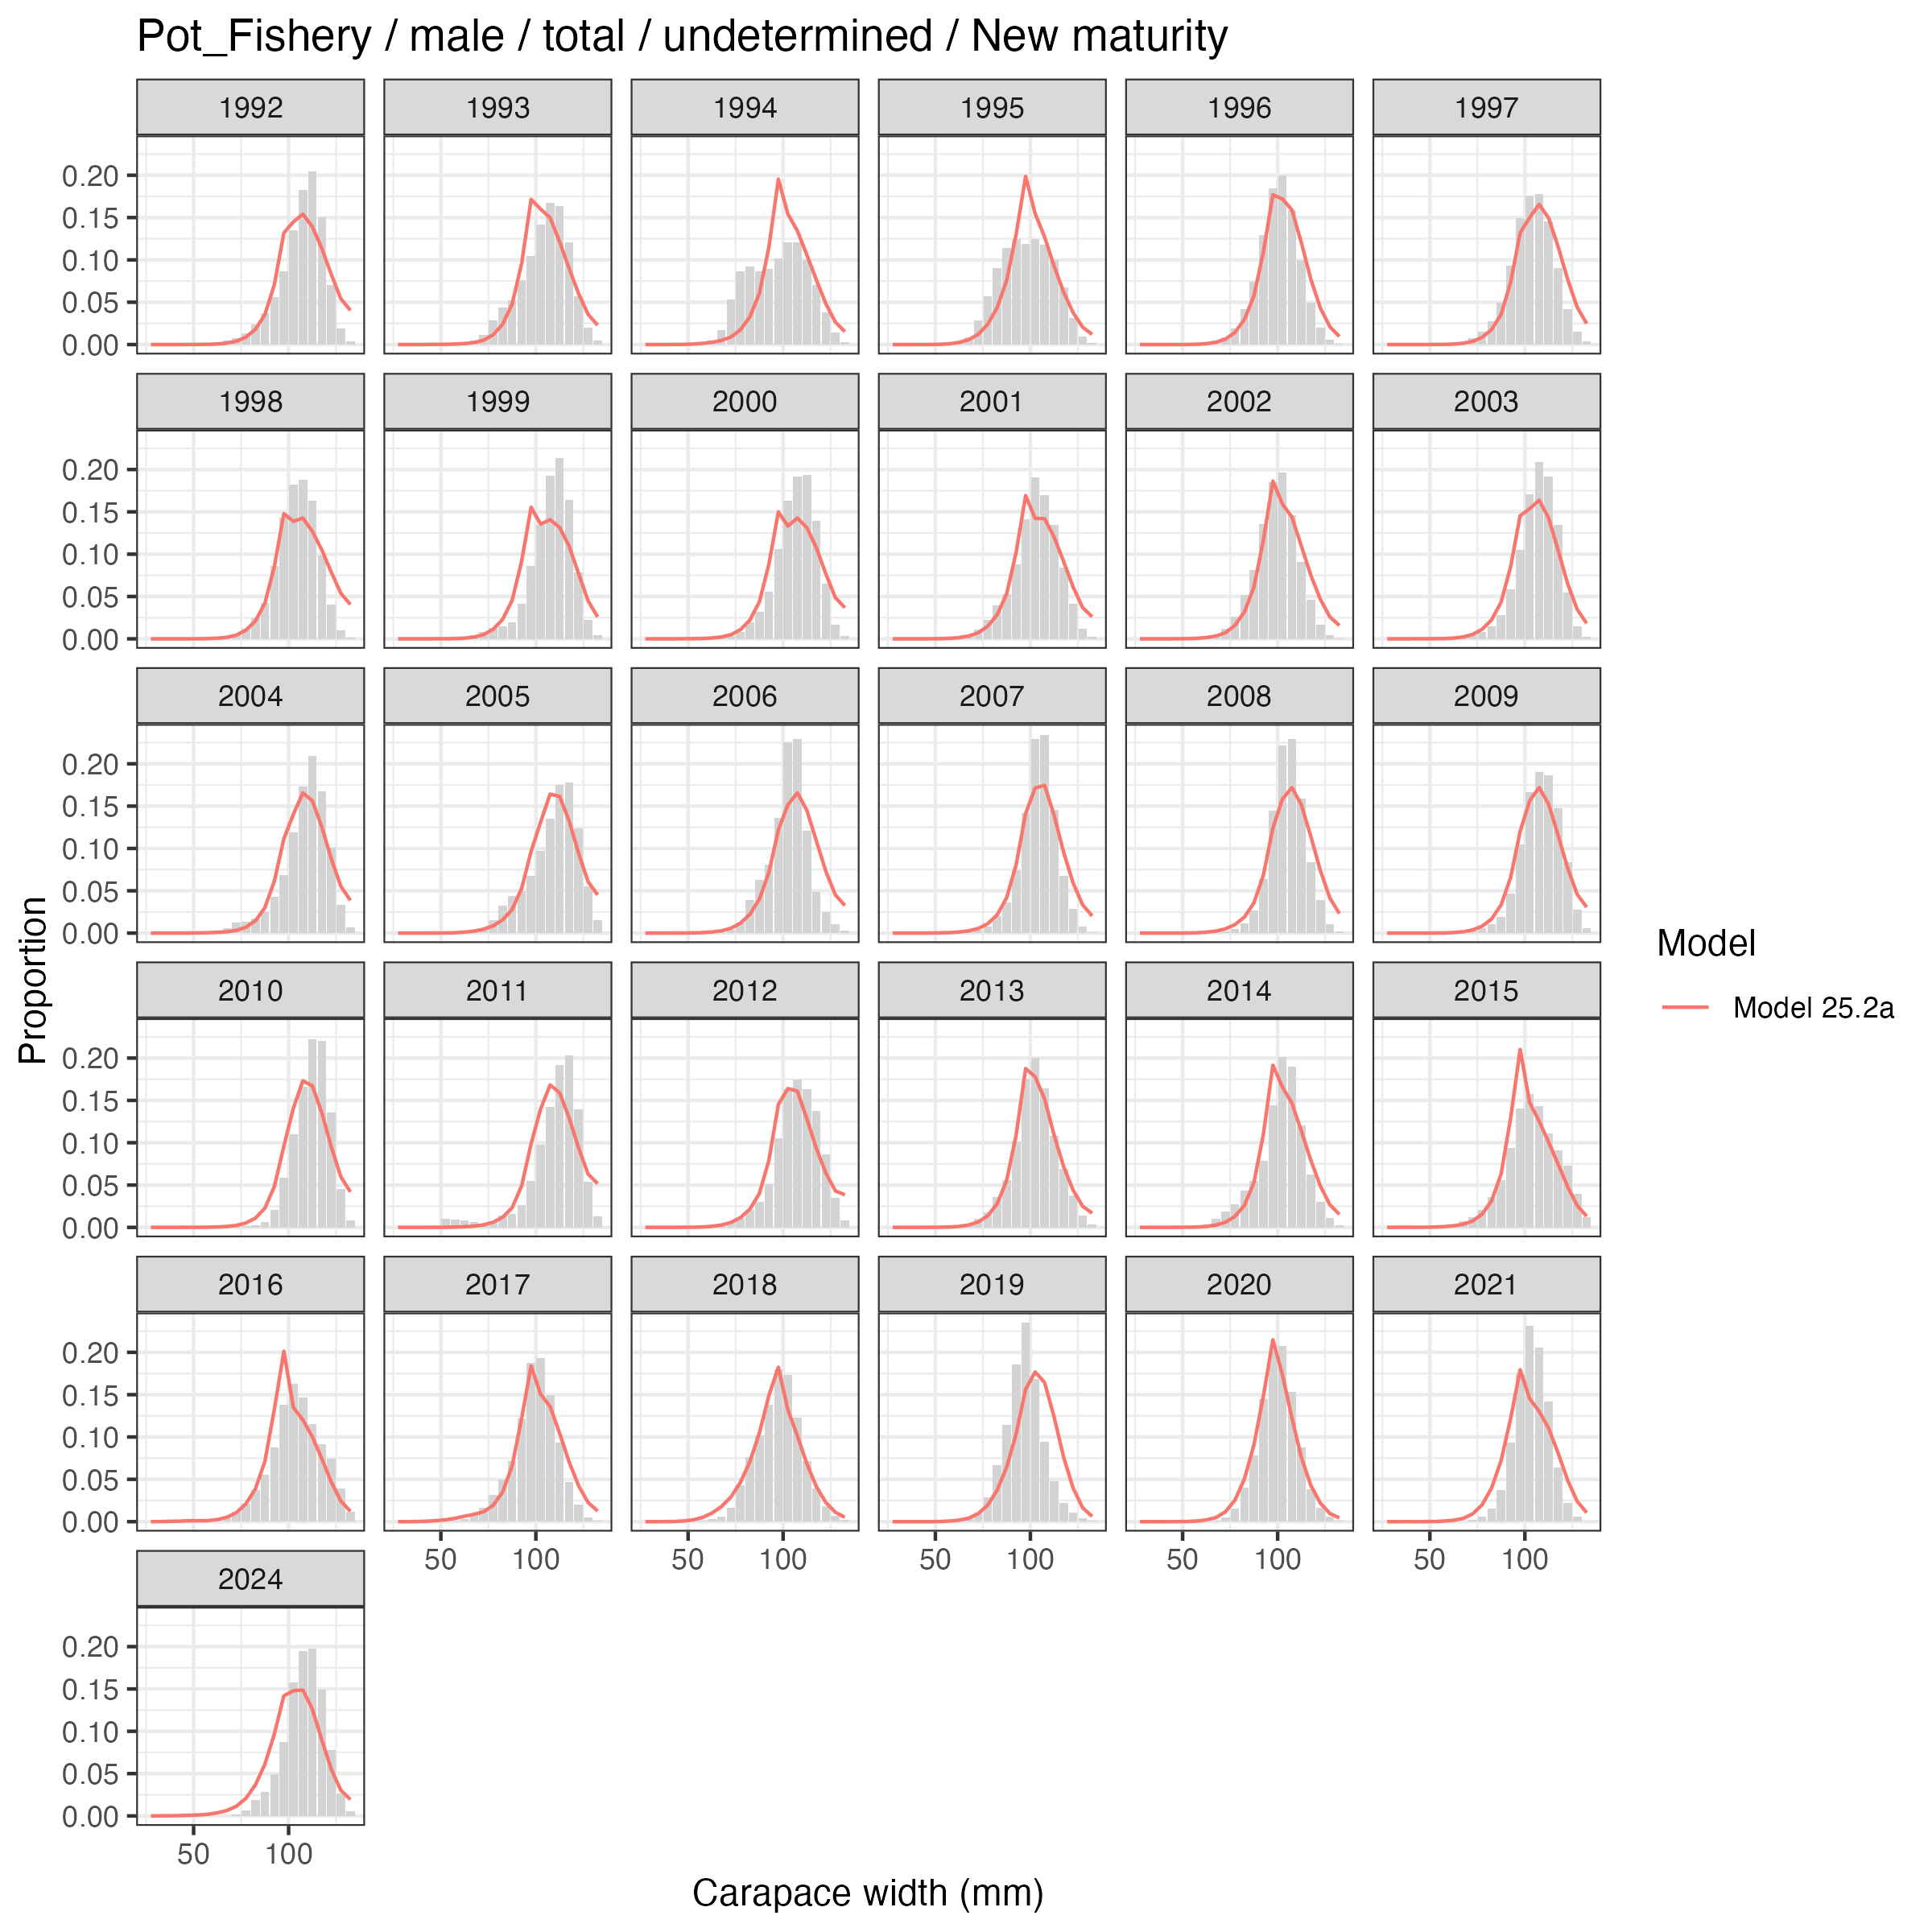
Total-male comp fits, hybrid vs. non-hybrid

Slide 46
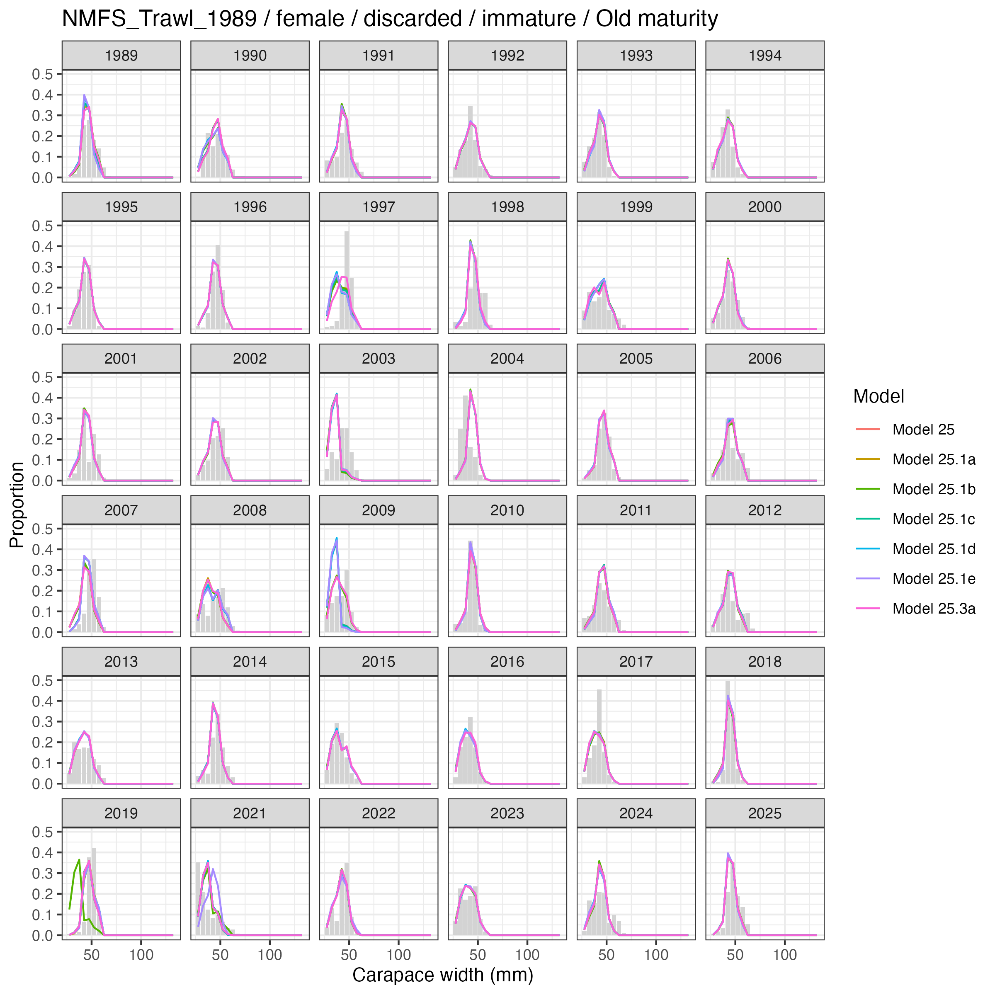
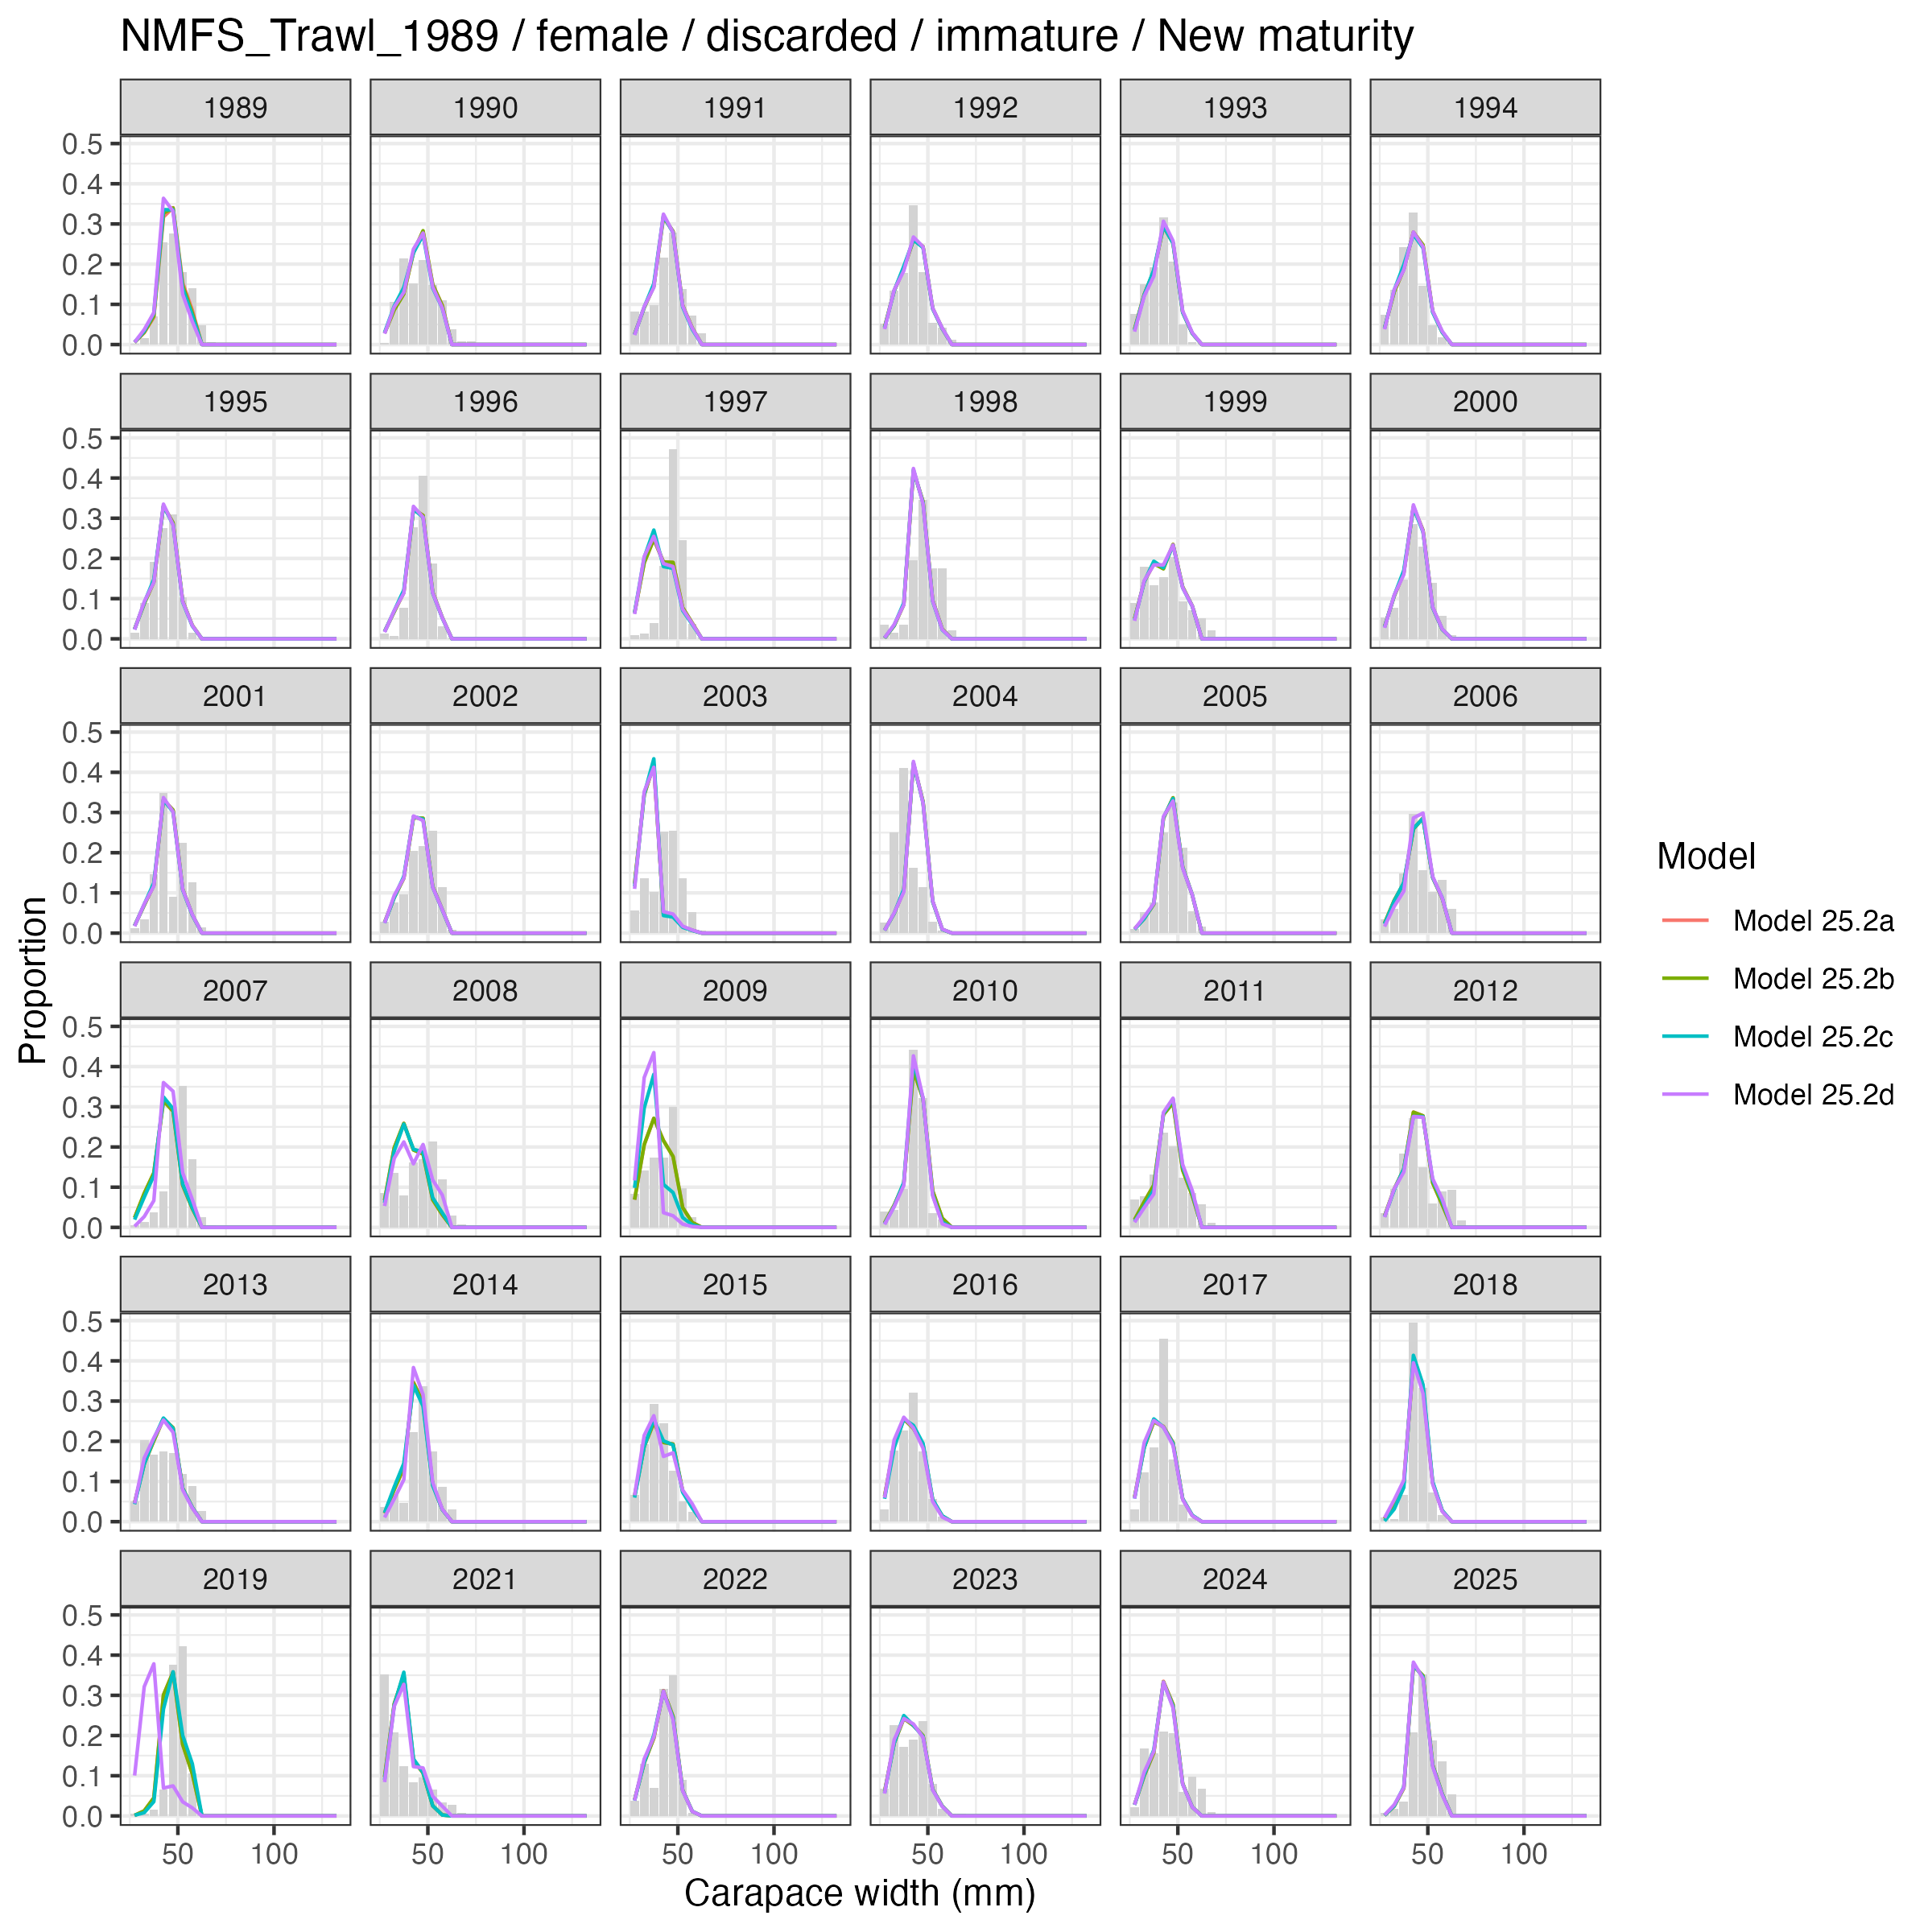
NMFS-immature female comp fits, old vs. new-maturity

Slide 47
Estimated population processes and management

Slide 48
Commercially preferred males (>=101 mm CW)
Estimated abundance of commercially preferred male crab varies among models – particularly in the early years where survey selectivity by era differs.
All models agree: abundance in recent years is at the lowest in the time series.
2025 survey biomass of preferred males = 23.28 kt.
Most recent survey selectivity estimates are similar across models for both sexes.

Slide 49
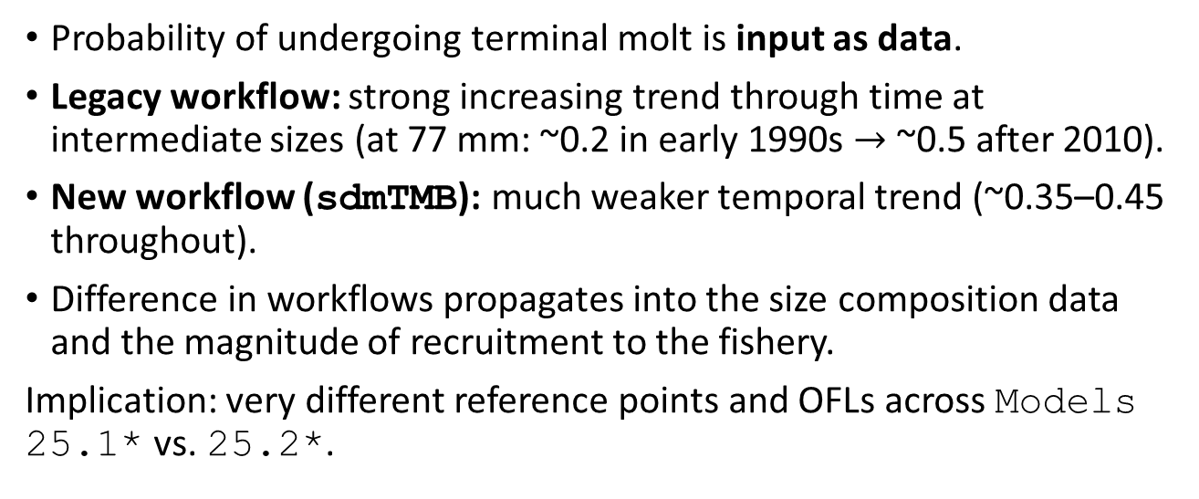
Probability of terminal molt at size
Probability of undergoing terminal molt is input as data.
Legacy workflow: strong increasing trend through time at intermediate sizes (at 77 mm: ~0.2 in early 1990s $→$ ~0.5 after 2010).
New workflow (sdmTMB): much weaker temporal trend (~0.35–0.45 throughout).
Difference in workflows propagates into the size composition data and the magnitude of recruitment to the fishery.
Implication: very different reference points and OFLs across Models 25.1* vs. 25.2*.

Slide 50
Recruitment
Recruitment trends very similar across models for the early time series, with some differences in scale and sex-specific timing.
Differences in recent-year recruitment are observed among models for males and contribute to differences in OFLs.
Sex-specific recruitment timing remains an open issue raised by the SSC – see Author Responses.

Slide 51
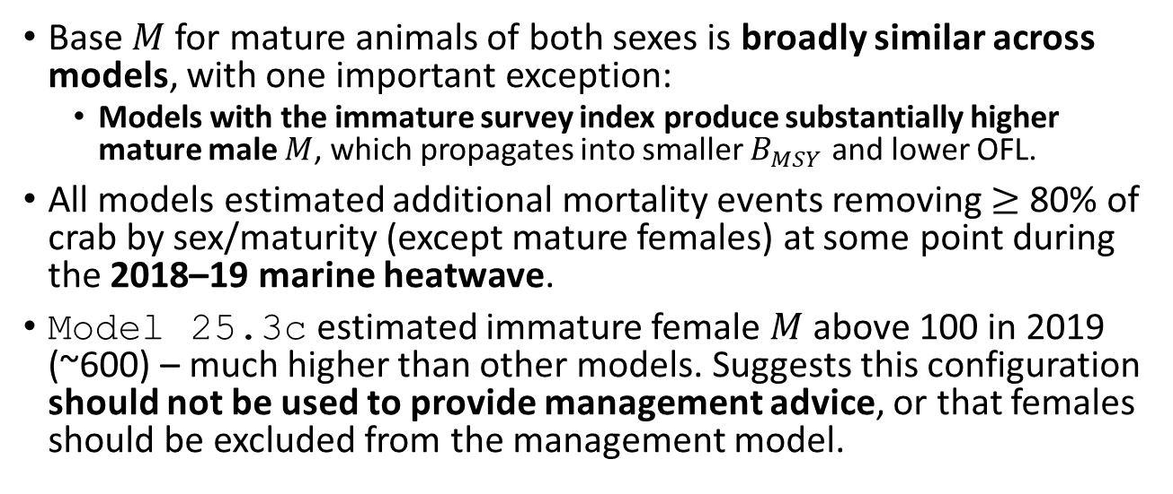
Natural mortality
Base $M$ for mature animals of both sexes is broadly similar across models, with one important exception:
Models with the immature survey index produce substantially higher mature male $M$, which propagates into smaller $B_{MSY}$ and lower OFL.
All models estimated additional mortality events removing $≥$ 80% of crab by sex/maturity (except mature females) at some point during the 2018–19 marine heatwave.
Model 25.3c estimated immature female $M$ above 100 in 2019 (~600) – much higher than other models. Suggests this configuration should not be used to provide management advice, or that females should be excluded from the management model.

Slide 52
Model | Mature M (2024) | Immature M (2024)
Model 25 | 0.285 | 0.292
Model 25.1a | 0.284 | 0.278
Model 25.1b | 0.284 | 0.300
Model 25.1c | 0.285 | 0.292
Model 25.1d | 0.662 | 0.382
Model 25.1e | 0.647 | 0.384
Model 25.2a | 0.288 | 0.283
Model 25.2b | 0.288 | 0.285
Model 25.2c | 0.288 | 0.281
Model 25.2d | 0.315 | 0.373
Model 25.3a | 0.293 | 0.277
Model 25.3b | 0.285 | 0.270
Model 25.3c | 0.293 | 0.271
Model 25.3d | 0.293 | 0.300

Slide 53
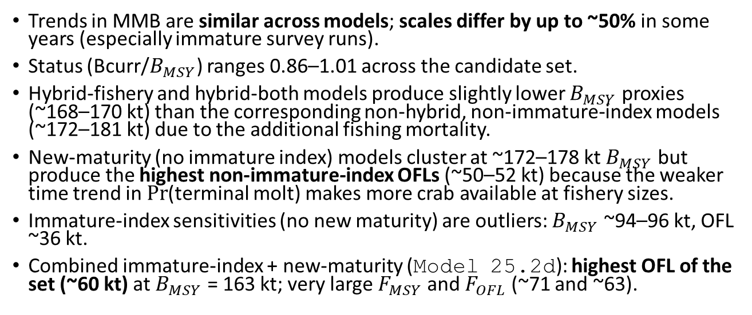
MMB time series
Trends in MMB are similar across models; scales differ by up to ~50% in some years (especially immature survey runs).
Status (Bcurr/$B_{MSY}$) ranges 0.86–1.01 across the candidate set.
Hybrid-fishery and hybrid-both models produce slightly lower $B_{MSY}$ proxies (~168–170 kt) than the corresponding non-hybrid, non-immature-index models (~172–181 kt) due to the additional fishing mortality.
New-maturity (no immature index) models cluster at ~172–178 kt $B_{MSY}$ but produce the highest non-immature-index OFLs (~50–52 kt) because the weaker time trend in $Pr$(terminal molt) makes more crab available at fishery sizes.
Immature-index sensitivities (no new maturity) are outliers: $B_{MSY}$ ~94–96 kt, OFL ~36 kt.
Combined immature-index + new-maturity (Model 25.2d): highest OFL of the set (~60 kt) at $B_{MSY}$ = 163 kt; very large $F_{MSY}$ and $F_{OFL}$ (~71 and ~63).

Slide 54
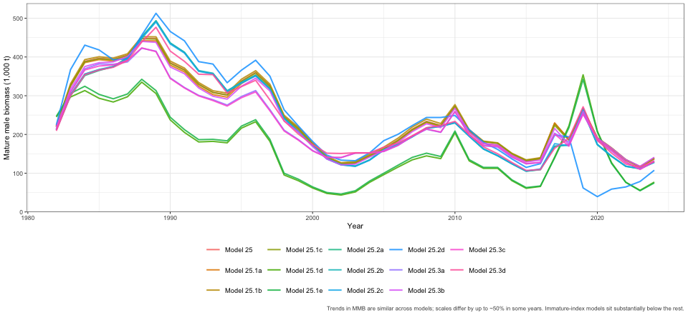
MMB time series across models

Slide 55
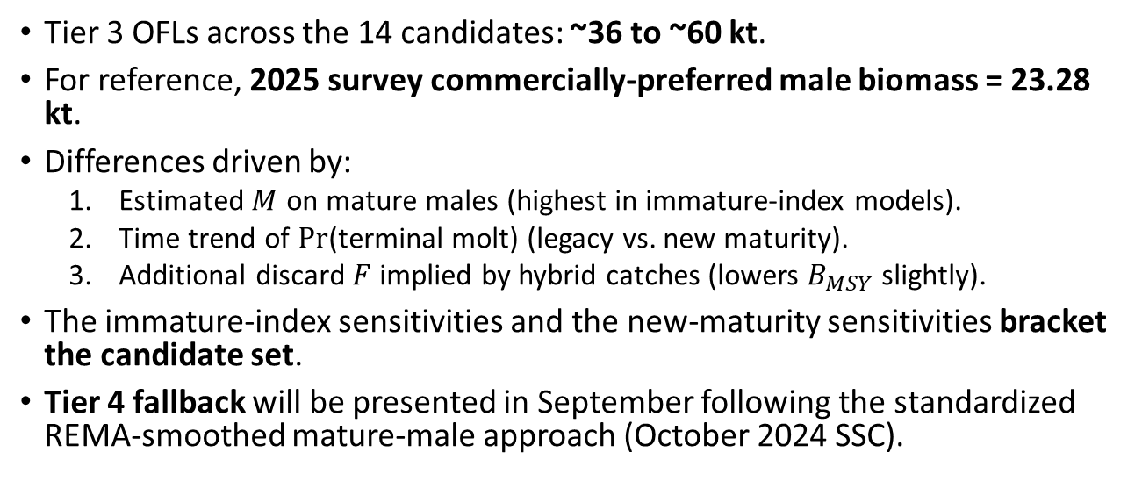
OFL summary
Tier 3 OFLs across the 14 candidates: ~36 to ~60 kt.
For reference, 2025 survey commercially-preferred male biomass = 23.28 kt.
Differences driven by:
Estimated $M$ on mature males (highest in immature-index models).
Time trend of $Pr$(terminal molt) (legacy vs. new maturity).
Additional discard $F$ implied by hybrid catches (lowers $B_{MSY}$ slightly).
The immature-index sensitivities and the new-maturity sensitivities bracket the candidate set.
Tier 4 fallback will be presented in September following the standardized REMA-smoothed mature-male approach (October 2024 SSC).

Slide 56
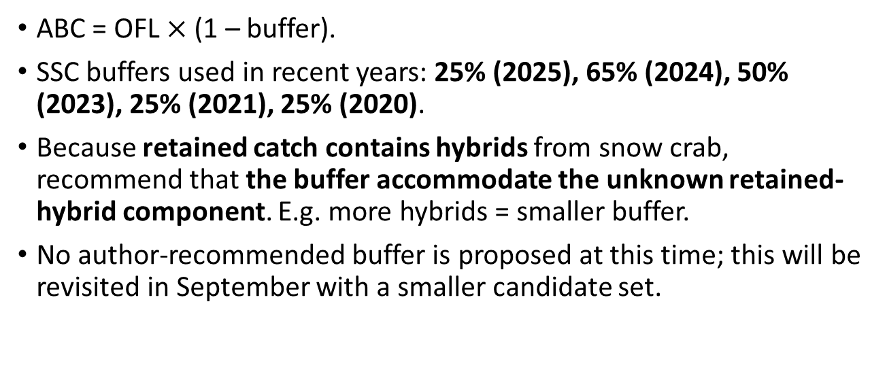
ABC buffer considerations
ABC = OFL $×$ (1 – buffer).
SSC buffers used in recent years: 25% (2025), 65% (2024), 50% (2023), 25% (2021), 25% (2020).
Because retained catch contains hybrids from snow crab, recommend that the buffer accommodate the unknown retained-hybrid component. E.g. more hybrids = smaller buffer.
No author-recommended buffer is proposed at this time; this will be revisited in September with a smaller candidate set.

Slide 57
Author requests and recommendations

Slide 58
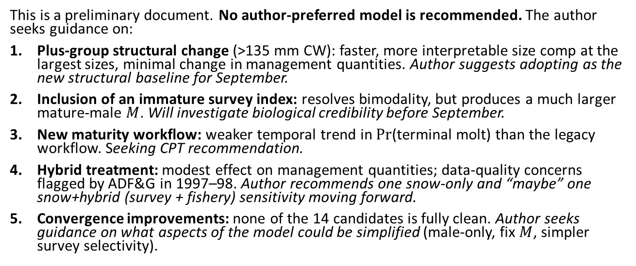
Areas where the author seeks CPT/SSC guidance
This is a preliminary document. No author-preferred model is recommended. The author seeks guidance on:
Plus-group structural change (>135 mm CW): faster, more interpretable size comp at the largest sizes, minimal change in management quantities. Author suggests adopting as the new structural baseline for September.
Inclusion of an immature survey index: resolves bimodality, but produces a much larger mature-male $M$. Will investigate biological credibility before September.
New maturity workflow: weaker temporal trend in $Pr$(terminal molt) than the legacy workflow. Seeking CPT recommendation.
Hybrid treatment: modest effect on management quantities; data-quality concerns flagged by ADF&G in 1997–98. Author recommends one snow-only and “maybe” one snow+hybrid (survey + fishery) sensitivity moving forward.
Convergence improvements: none of the 14 candidates is fully clean. Author seeks guidance on what aspects of the model could be simplified (male-only, fix $M$, simpler survey selectivity).

Slide 59
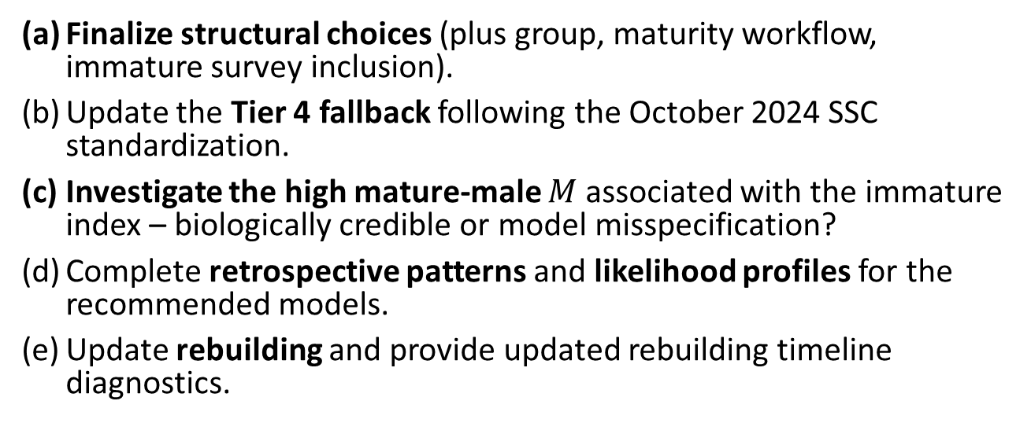
Plan for September 2026
Finalize structural choices (plus group, maturity workflow, immature survey inclusion).
Update the Tier 4 fallback following the October 2024 SSC standardization.
Investigate the high mature-male $M$ associated with the immature index – biologically credible or model misspecification?
Complete retrospective patterns and likelihood profiles for the recommended models.
Update rebuilding and provide updated rebuilding timeline diagnostics.

Slide 60
Data gaps and research priorities

Slide 61
Data gaps and research priorities
Hybrid identification consistency between ADF&G and NMFS. Different criteria for the number of secondary characteristics required for a positive hybrid identification.
Apportionment of retained catch between snow and hybrids. Currently retained catch contains both, with no method to partition.
Quality control on early hybrid catch estimates. 1997–98 catches flagged by ADF&G.
Maturity workflow comparison. Side-by-side documentation, sample-size diagnostics, and uncertainty quantification for the legacy vs. sdmTMB workflows.
Source of bimodality in the snow crab assessment. Focused investigation to identify which parameter combinations produce the two clouds.
Reproductive biology of large male snow crab. Whether small males can produce progeny that become large males and the presence of density dependent maturity remain central uncertainties for management.

Slide 62
Acknowledgments

Slide 63
Thank you
Tyler Jackson and Ben Daly (ADF&G) – hybrid catch, composition, and discard data products
Erin Ryznar and the Kodiak lab – new maturity workflow
André Punt, Buck Stockhausen, Matthieu Veron – GMACS development
CPT and SSC – comments and guidance
Questions and discussion welcome.

Slide 64
Appendix

Slide 65
Appendix: model – file mapping
Model | Folder
Model 25 | 25_gmacs/
Model 25.1a | 25_gmacs_update/
Model 25.1b | 25_gmacs_update_compfix/
Model 25.1c | 25_gmacs_update_plus_group/
Model 25.1d | 25_gmacs_update_imm_compfix/
Model 25.1e | 25_gmacs_update_imm_plus_group/
Model 25.2a | 25_gmacs_update_newmat/
Model 25.2b | 25_gmacs_update_newmat_compfix/
Model 25.2c | 25_gmacs_update_newmat_plus_group/
Model 25.2d | 25_gmacs_update_newmat_imm_plus_group/
Model 25.3a | 25_gmacs_update_hyb_fishery/
Model 25.3b | 25_gmacs_update_hyb_surv/
Model 25.3c | 25_gmacs_update_hyb_surv_and_fsh/
Model 25.3d | 25_gmacs_update_hyb_surv_and_fsh_newmat/

Slide 66
Repository: https://github.com/szuwalski/snow_crab/tree/dev-Grant
Maturity workflow: https://github.com/eryznar/Chionoecetes.maturity.workflow
GMACS: https://github.com/GMACS-project

