Slide 1

The 2026 assessment for
eastern Bering Sea snow crab
Grant Adams and Cody Szuwalski | Alaska Fisheries Science Center
Crab Plan Team | September 2026
Notes:
2-hour slot. Doc: 2026 SAFE draft. Values match the Sept 13 knit (post net-mensuration correction).

Slide 2

Tier 4 | Not overfished | No overfishing | Not Rebuilt
Model summary
Base: Tier 4 random-effects (REMA) model on morphometrically mature male biomass, ramped crab-FMP control rule, Baranov catch equation
Alternatives: 6 Tier 3 GMACS models (25.3, 26.1, 26.1a, 26.1b, 26.1c, 26.2) presented to document convergence progress; none proposed for specification
New data
Catch: 2025/26 directed fishery (4.13 kt retained) and bycatch
Survey: 2026 NMFS summer trawl survey; net-mensuration correction lowered estimates ~4% between 2024 and 2026
Notable items
Preferred males (>101 mm) 4th lowest in 44-year series; current-year population dynamics scored Level 2
Rebuilding plan (Amendment 53) in place; not overfished, no overfishing, not rebuilt
16.98 kt
13.58 kt
Recommended OFL (2026/27)
Recommended ABC (20% buffer)
0.747
109.30 kt
Stock status (B / BMSY proxy)
Mature male biomass, 2026
-16%
+13%
OFL vs 2025/26 (20.11 kt)
ABC vs 2025/26 (12.07 kt)
U.S. Department of Commerce | National Oceanic and Atmospheric Administration | National Marine Fisheries Service
EBS snow crab | September 2026 CPT | 2
Notes:
Leadership summary in the SAFE-summary-slides format. Risk scores: assessment 1, popdyn 2 (low preferred males), ecosystem 1, fishery 1. ABC rises despite lower OFL because the buffer moved 40% to 20%.

Slide 3
Outline
Management context and 2025/26 performance (10 min)
Responses to SSC and CPT comments (10 min)
Data: 2026 survey, net-mensuration correction, input corrections (15 min)
The maturity definition question (10 min)
Tier 4 assessment and 2026/27 specification (20 min)
Tier 3 models: convergence, retrospectives, male-only direction (30 min)
ABC buffer and risk table (10 min)
Rebuilding status and path to the January 2027 workshop (10 min)
U.S. Department of Commerce | National Oceanic and Atmospheric Administration | National Marine Fisheries Service
EBS snow crab | September 2026 CPT | 3
Notes:
Time allocations leave ~15 min for discussion.

Slide 4

Management context
Status, 2025/26 performance, and what changed this cycle

Slide 5
Stock status at a glance
Question | Answer | Basis
Is the stock subject to overfishing? | No | 2025/26 total catch 7.10 kt vs OFL 20.11 kt
Is the stock overfished? | No | MMB 109.30 kt above MSST 73.14 kt across the whole 95% CI
Is it approaching an overfished condition? | Unknown | No reliable projection: Tier 3 unstable, Tier 4 produces none
Rebuilt? | Not yet | Below the BMSY proxy of 146.3 kt; remains under the Amendment 53 rebuilding plan
Declared overfished October 2021; directed fishery closed 2022 and 2023
Small fishery in 2024 (2.15 kt retained), larger in 2025 (4.13 kt)
U.S. Department of Commerce | National Oceanic and Atmospheric Administration | National Marine Fisheries Service
EBS snow crab | September 2026 CPT | 5
Notes:
Overfished determination for 2024/25 was made in Oct 2025 under Tier 4.

Slide 6
Management performance, 5 most recent assessments
 | Status determination made the following October |  |  | Specification set the preceding October |  |  | Catch crab year total
Year | Tier | MSST | MMB | OFL | ABC | TAC | Retained | Total
2021/22 | 3 | 201.94 | 90.83 | 16.53 | 12.35 | 5.51 | 5.51 | 7.94
2022/23 | 3 | 171.85 | 203.71 | 22.75 | 16.98 | 0.00 | 0.00 | 0.11
2023/24 | 3 | 211.42 | 234.84 | 34.04 | 17.02 | 0.00 | 0.00 | 0.15
2024/25 | 4 | 157.41 | 132.45 | 43.21* | 15.12* | 4.63 | 4.63 | 6.19
2025/26 | 4 | 157.41 | 231.95 | 44.33 | 26.61 | 9.30 | 9.11 | 15.65
Million lb; values as used in management each year, not re-estimated by this assessment
* Specified under Tier 3 in October 2024; the Tier 4 status determination for 2024/25 came the following October
The drop in MMB at 2024/25 reflects the switch to Tier 4 estimates, not a change in the stock
Total catch was below the specified OFL in all 5 years
U.S. Department of Commerce | National Oceanic and Atmospheric Administration | National Marine Fisheries Service
EBS snow crab | September 2026 CPT | 6
Notes:
Catches are the SSC-reported values; our ADF&G data give 2.15 kt for 2024/25 vs 2.10 in the table.

Slide 7
Basis for the OFL, last 5 crab years
Crab year | Tier | M | BMSY | Basis | Proj. MMB | MMB/BMSY | FOFL | OFL
2022/23 | 3b | 0.29 | 183.10 | 1982-2021 | 55.00 | 0.300 | 0.32 | 10.32
2023/24 | 3b | 0.29 | 155.91 | 1982-2022 | 65.77 | 0.422 | 14.96 | 15.44
2024/25 | 3b | 0.28 | 191.81 | 1984-2023 | 96.77 | 0.505 | 25.07 | 19.60
2025/26 | 4b | 0.27 | 142.79 | 1982-2024 | 105.21 | 0.737 | 0.19 | 20.11
2026/27 | 4b | 0.27 | 146.29 | 1982-2026 | 109.30 | 0.747 | 0.19 | 16.98
Moved to Tier 4 for 2025/26 after the October 2025 SSC found the Tier 3 convergence problems too severe to use for advice
2026/27 row is this assessment; biomass and OFL in 1,000 t
U.S. Department of Commerce | National Oceanic and Atmospheric Administration | National Marine Fisheries Service
EBS snow crab | September 2026 CPT | 7

Slide 8
Responses to SSC and CPT comments
June 2026 and October 2025 SSC; May 2026 and September 2025 CPT, grouped by theme

Slide 9
Comment responses: model scope and convergence
Request | Response
Bring only the Tier 4 model forward in October (June 2026 SSC) | Done. OFL and ABC are calculated under Tier 4; 6 Tier 3 models shown only to document progress
Strip the model to a minimal parameter set, then add complexity back (June 2026 SSC) | Started. Model 26.2 (male-only) cuts parameters 412 to 234; staged simplification is the next step
Immature survey index is not a convergence fix by itself (June 2026 SSC + CPT) | Agreed. Not included in any model presented
Focused convergence section identifying which parameters separate minima (June 2026 SSC) | Partially addressed. Attribution ranks the parameters; selectivity leads this cycle, and the sex allocation accounts for the largest class-level movement
U.S. Department of Commerce | National Oceanic and Atmospheric Administration | National Marine Fisheries Service
EBS snow crab | September 2026 CPT | 9
Notes:
Categorized responses; full text in Section B of the document.

Slide 10
Comment responses: data and model inputs
Request | Response
Bring forward the composition correction and expanded plus group (June 2026 SSC) | Included in every model from Model 26.1 onward
Evaluate hybrid Chionoecetes data (May 2026 CPT) | Evaluated in May; excluded from all models per CPT and SSC advice; tracked in the risk table
Use likelihood profiles to describe uncertainty (Oct 2025 SSC) | Deferred until a stable, converged model exists; jitter analysis stands in
Explore male-female recruitment differences vs molt-increment fit (Oct 2025 SSC) | Not undertaken; recruitment is one total split by an estimated sex allocation, so the series are not independent
U.S. Department of Commerce | National Oceanic and Atmospheric Administration | National Marine Fisheries Service
EBS snow crab | September 2026 CPT | 10

Slide 11
Comment responses: maturity definition and Tier 4
Request | Response
Retain morphometric maturity as the basis (Oct 2025 SSC, reaffirming 2024) | Followed. Morphometric MMB is the recommended definition; >=95 mm and >101 mm reported alongside
Full Tier 4 implementation requires a harvest control rule (Oct 2025 SSC) | Done. The ramped crab-FMP rule is applied, with the Baranov catch equation; the flat rule is shown as a sensitivity
Report a stock-specific history of ABC buffers (June 2026 SSC) | Done. 5-year buffer history tabulated; mean 41%
Report uncertainty in the biomass the control rule acts on (guidelines) | Done. REMA 95% CI on terminal biomass: 81.9 to 145.9 kt (CV 14.8%)
U.S. Department of Commerce | National Oceanic and Atmospheric Administration | National Marine Fisheries Service
EBS snow crab | September 2026 CPT | 11
Notes:
The morphometric direction is the most consequential; we keep the preferred-male caution visible throughout.

Slide 12
Data
2026 survey, the net-mensuration correction, and input corrections

Slide 13
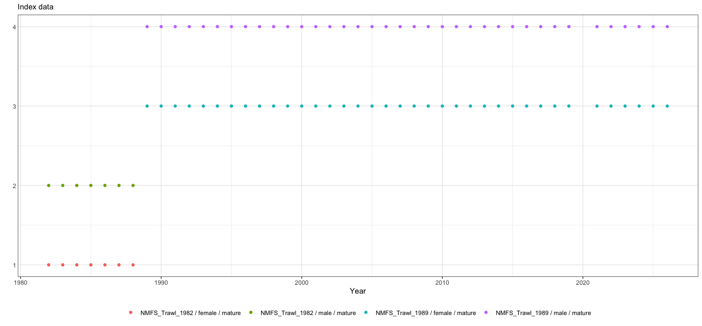
New data this cycle
2026 NMFS summer trawl survey (indices and size compositions); 2025/26 directed fishery catch and compositions (ADF&G); bycatch from NORPAC
Corrected survey specimen data came directly from the Shellfish Assessment Program; crabpack did not yet include the correction
Maturity ogives regenerated from the corrected specimen data (Kodiak workflow)
Index data used in the assessment.
U.S. Department of Commerce | National Oceanic and Atmospheric Administration | National Marine Fisheries Service
EBS snow crab | September 2026 CPT | 13

Slide 14
Net-mensuration correction (September 10)
Tanner crab CIE review found average net spread in the 2024-2025 surveys well below earlier years
Cause: the 2013 correction factor reconciling analog Marport to legacy Netmind sensors is inappropriate for the next-generation Marport sensors used since early 2024
Fix: correction factor removed; net spread recalculated for all hauls, 2024 to 2026 EBS surveys and 2025 NBS survey
Effect: spread values ~4% higher, so biomass and abundance ~4% lower in those years; earlier years unchanged
Which models include it:
  Corrected: Tier 4 model, Model 26.1b, Model 26.2, Appendix B experiments
  As used in May (uncorrected): Model 25.3, Model 26.1, Model 26.1a, whose data end in 2024
  The 26.1a to 26.1b step includes the correction
U.S. Department of Commerce | National Oceanic and Atmospheric Administration | National Marine Fisheries Service
EBS snow crab | September 2026 CPT | 14
Notes:
Data arrived Sep 11-12; full model set, jitters and retrospectives rerun on the corrected series.

Slide 15
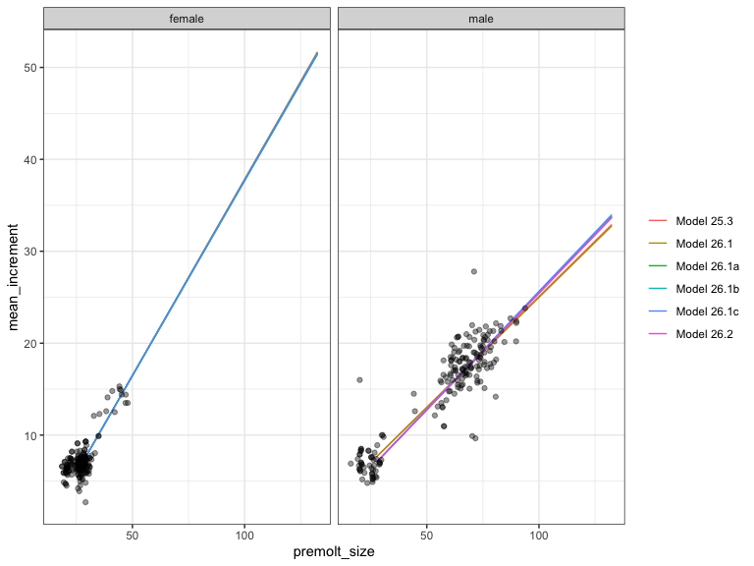
Author corrections to input data (4)
Total-male size composition corrected: resolves a discrepancy between the September 2025 file and the ADF&G processing script
Plus group expanded to include all crab >135 mm carapace width, previously excluded
Size-composition bin convention: crab exactly on a 5 mm cutoff now assigned to the upper bin
Growth transcription error corrected: a 26.3 mm crab's molt increment recorded as 73 mm instead of 7.3 mm
Also evaluated and excluded: hybrid catch and survey data; immature survey index
Fits to growth data; red dots are new 2025 observations.
U.S. Department of Commerce | National Oceanic and Atmospheric Administration | National Marine Fisheries Service
EBS snow crab | September 2026 CPT | 15

Slide 16
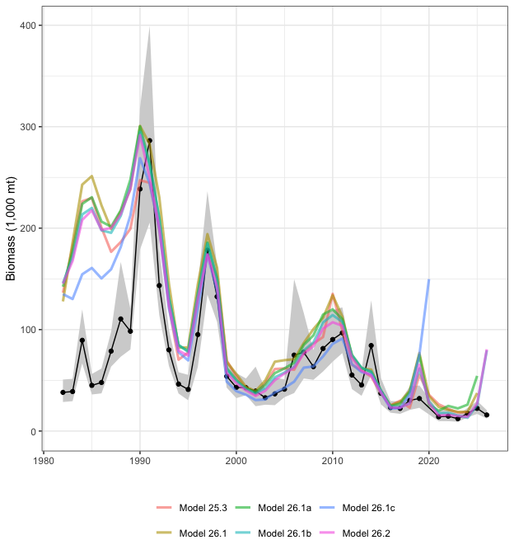
Survey trends by maturity definition
Maturity definition | 2025 | 2026 | Change (%)
Morphometrically mature males | 113.04 | 109.91 | -2.8
Large males (>= 95 mm) | 31.85 | 23.00 | -27.8
Preferred males (> 101 mm) | 22.36 | 15.88 | -29.0
Observed survey biomass (1,000 t); not model output
Preferred males: 15.88 kt, 4th lowest in the 44-year series; 28.33 million crab (CV 13%)
Morphometric biomass nearly unchanged: the choice of definition, not the survey, decides whether the stock looks stable or declining
Preferred-male (>101 mm) survey biomass (black, with 95% CI); colored lines are model estimates.
U.S. Department of Commerce | National Oceanic and Atmospheric Administration | National Marine Fisheries Service
EBS snow crab | September 2026 CPT | 16
Notes:
This asymmetry is the heart of the buffer and risk-table discussion later.

Slide 17
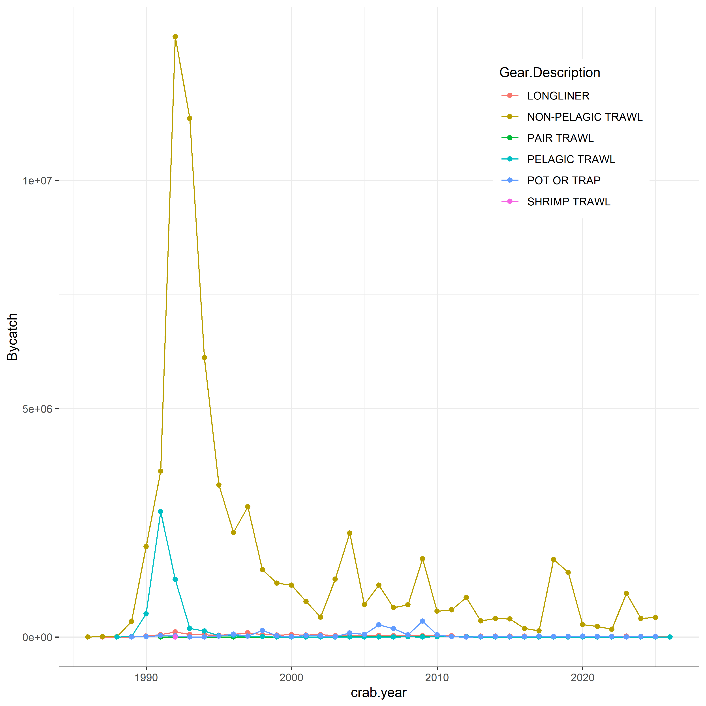
Bycatch and other removals
Total non-directed bycatch remains very small: 0.09 kt in 2024; 0.42 kt in 2025 (0.04 kt groundfish trawl, 0.38 kt other crab fisheries)
Discard mortality 30% in the directed pot fishery; trawl bycatch enters the models at 100%
Female discards very low; not a significant mortality source
Non-directed bycatch by gear, numbers of crab.
U.S. Department of Commerce | National Oceanic and Atmospheric Administration | National Marine Fisheries Service
EBS snow crab | September 2026 CPT | 17

Slide 18
The maturity definition question
Morphometric maturity vs large-male definitions

Slide 19
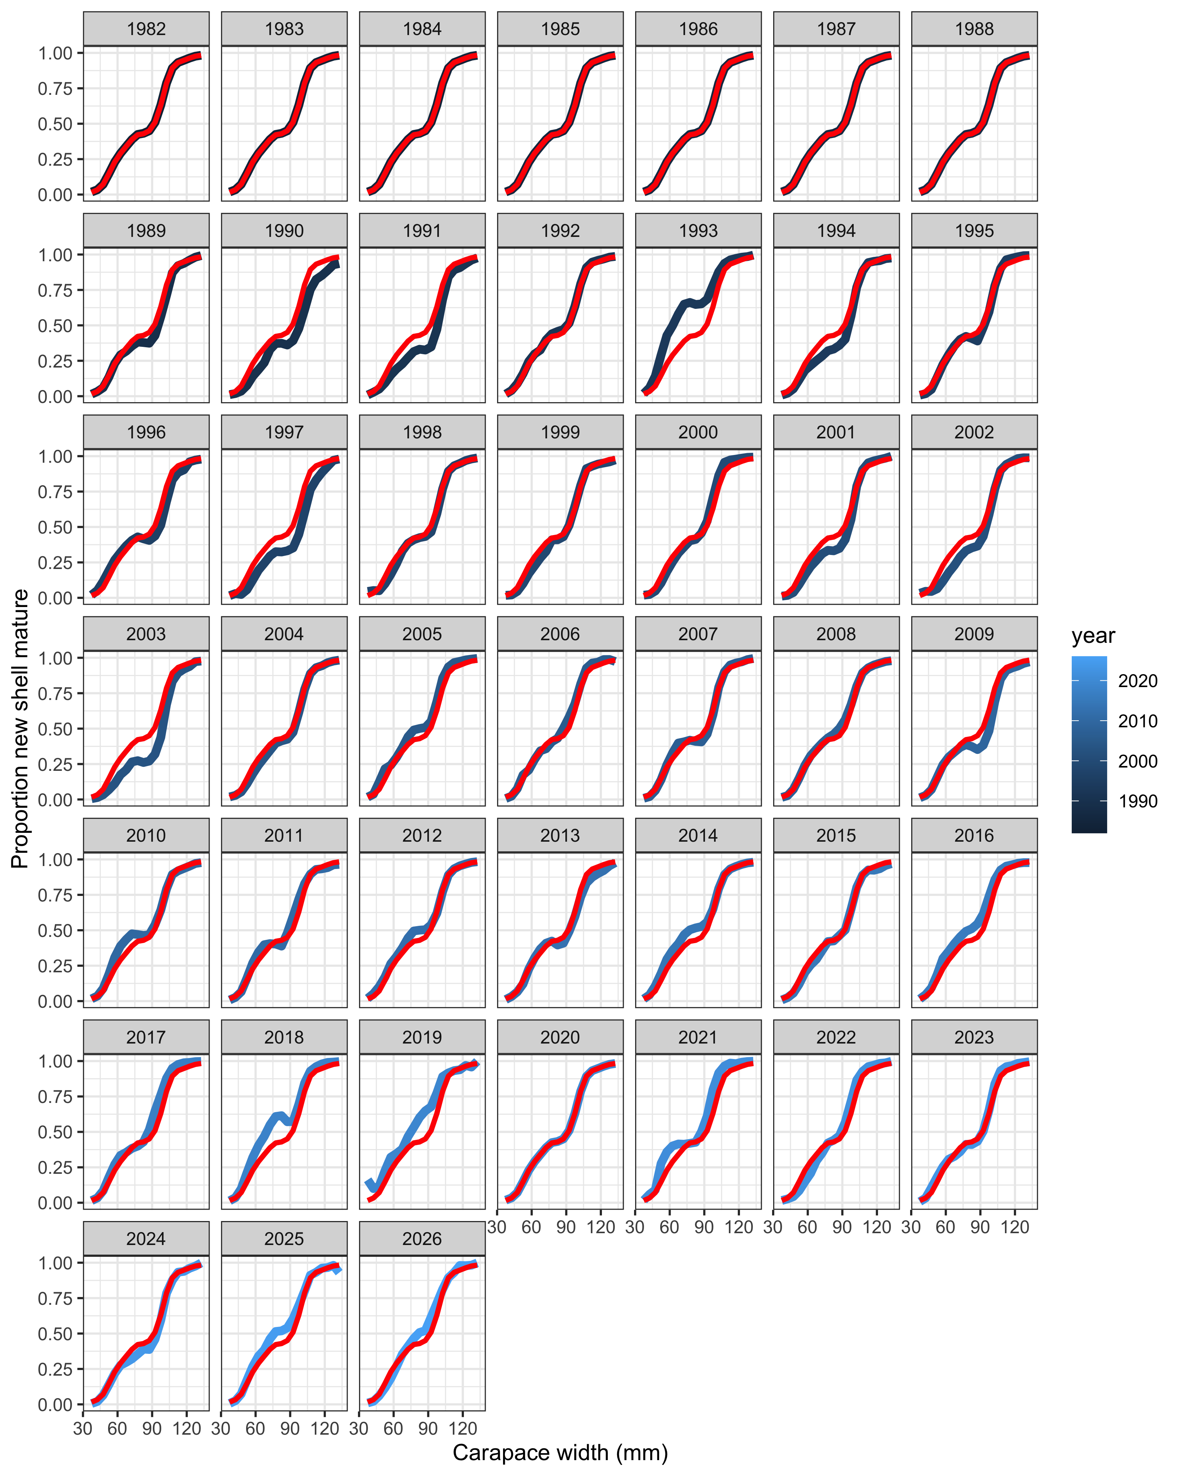
Why the definition matters
Morphometric maturity: males with a large claw relative to carapace width; many mature at sizes the fishery does not retain
Reference points on morphometric biomass can permit removing essentially all large males while the large-male trend is negative
CPT recommended >= 95 mm (2024, Sept 2025); the SSC found region-specific information insufficient for a change and kept morphometric maturity as the basis
We follow the SSC's direction and report the >= 95 mm and > 101 mm definitions alongside every recommendation
For scale: the recommended OFL of 16.98 kt is 74% of observed large-male biomass and 107% of observed preferred-male biomass in 2026
Observed probability of terminal molt at size (chela height); red = median.
U.S. Department of Commerce | National Oceanic and Atmospheric Administration | National Marine Fisheries Service
EBS snow crab | September 2026 CPT | 19
Notes:
OFL/large-male = 16.98/23.0 = 74%; OFL/preferred = 16.98/15.88 = 107%.

Slide 20
Tier 4 quantities under each definition
Definition | BMSY | B current | Status | FOFL | OFL | OFL (flat) | OFL (linear)
Morphometric | 146.29 | 109.30 | 0.747 | 0.194 | 16.98 | 22.80 | 21.22
Large males (>= 95 mm) | 85.20 | 23.53 | 0.276 | 0.053 | 1.06 | 4.91 | 1.24
Preferred males (> 101 mm) | 64.43 | 16.31 | 0.253 | 0.046 | 0.64 | 3.40 | 0.75
The same rule on the large-male definitions gives OFLs an order of magnitude lower: both sit just above the closure threshold, where the ramp pushes FOFL toward zero
The definition changes the OFL 26-fold; that dominates every other source of uncertainty in the Tier 4 calculation
U.S. Department of Commerce | National Oceanic and Atmospheric Administration | National Marine Fisheries Service
EBS snow crab | September 2026 CPT | 20
Notes:
All rows verified against Table 11 of the Sept 13 knit; linear-eqn column is the ramped-F linear OFL.

Slide 21
Tier 4 assessment
The basis of the 2026/27 specification

Slide 22
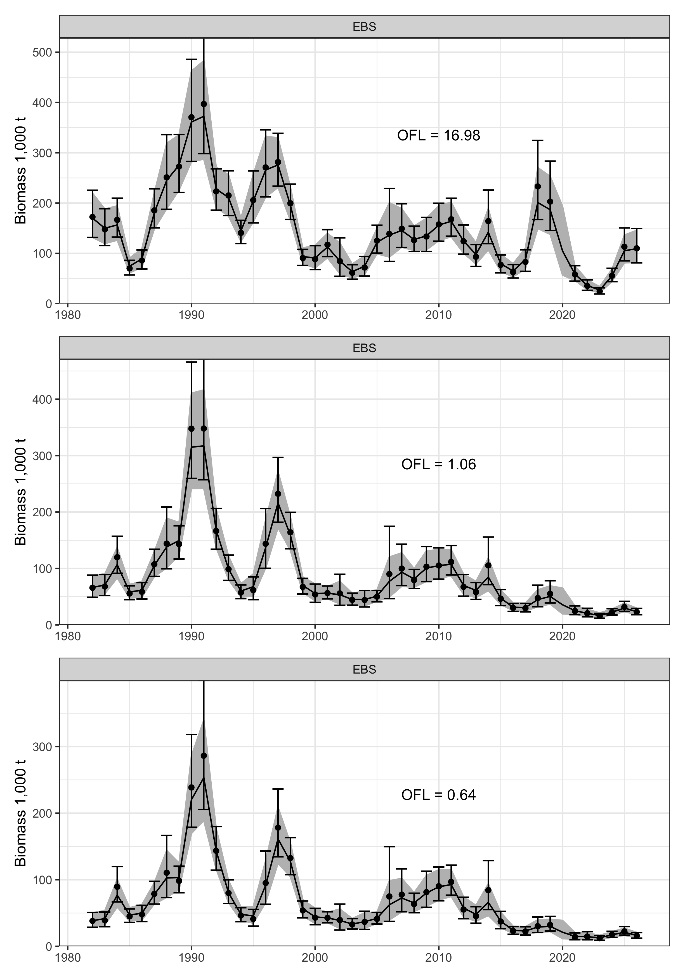
REMA model on the survey series
Random-effects (REMA) smooth of observed survey biomass, fit separately to each maturity definition
Terminal smoothed value is the biomass the control rule acts on: 109.30 kt (95% CI 81.9 to 145.9; CV 14.8%)
BMSY proxy = mean of the smoothed series over the full window 1982 to 2026: 146.29 kt
Smoothed series supplies a value for 2020, when the survey was cancelled
Window extended from 1982-2024 (Sept 2025) to the full series; effect on proxy and OFL ~1%
REMA fits by maturity definition; points are survey observations.
U.S. Department of Commerce | National Oceanic and Atmospheric Administration | National Marine Fisheries Service
EBS snow crab | September 2026 CPT | 22

Slide 23
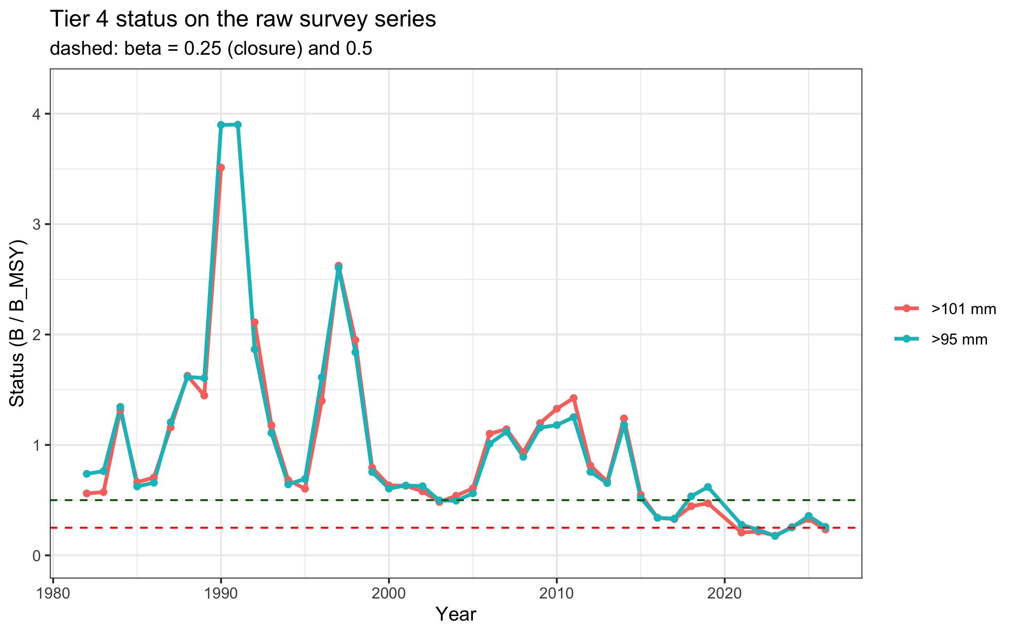
Harvest control rule and catch equation
Ramped crab-FMP Tier 4 rule: FOFL = M at or above the BMSY proxy, declining below it (alpha = 0.10, beta = 0.25)
At status 0.747: FOFL = 0.194 (below M = 0.27)
Baranov catch equation, changed this cycle from the linear form: yield is the fishing fraction of total mortality Z = F + M
The linear form F x B biases the OFL high; the bias is large here because FOFL is near M
Same rule the SSC adopted for 2025/26 after identifying the flat rate as an incomplete implementation
Tier 4 status on the raw series for the large-male definitions; red = closure threshold.
U.S. Department of Commerce | National Oceanic and Atmospheric Administration | National Marine Fisheries Service
EBS snow crab | September 2026 CPT | 23

Slide 24
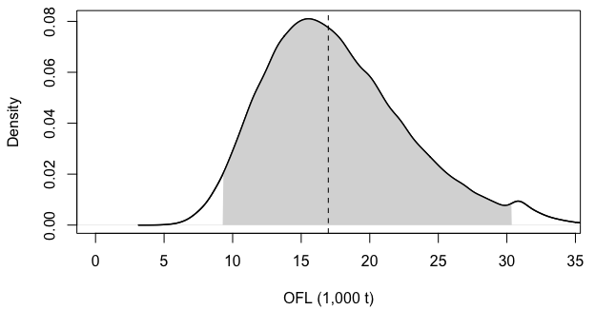
2026/27 specification and OFL uncertainty
16.98 kt
13.58 kt
OFL (median)
ABC (20% buffer)
9.27-30.36
0.194 / yr
OFL 95% CI (kt)
FOFL under the ramp
Distribution from propagating the REMA CI through the control rule and catch equation
Kink in the upper tail where biomass crosses the BMSY proxy and the rule caps FOFL at M
OFL down 16% from the 20.11 kt specified for 2025/26; ABC up 13% given the buffer change from 40% to 20%
OFL probability distribution; dashed = recommended OFL, band = 95% CI.
U.S. Department of Commerce | National Oceanic and Atmospheric Administration | National Marine Fisheries Service
EBS snow crab | September 2026 CPT | 24

Slide 25
Tier 3 models
6 models documenting progress on the convergence problems

Slide 26
The model set
Model | Description | Data end | Purpose
25.3 | 2025 accepted model, rolled forward (GMACS 2.20.22, as fitted) | 2024 | Continuity reference
26.1 | 25.3 + GMACS 2.20.34, comp fix, expanded plus group, new maturity workflow (May accepted) | 2024 | May baseline
26.1a | 26.1 + bin convention and growth transcription fixes | 2024 | Isolate data corrections
26.1b | 26.1a + 2025/26 fishery and 2026 survey (corrected). Author-preferred | 2025 | Current data
26.1c | 26.1b truncated to 2019 | 2019 | Test post-collapse influence
26.2 | 26.1b male-only (females removed; 412 to 234 parameters) | 2025 | Simplification direction
None proposed for specification. Fits for the 4 jittered models are the best of 100 jitter starts; 25.3 and 26.1a are as originally fitted
U.S. Department of Commerce | National Oceanic and Atmospheric Administration | National Marine Fisheries Service
EBS snow crab | September 2026 CPT | 26

Slide 27
Management quantities across models
Model | BMSY | Status | OFL (total) | MMB terminal | Peculiarity
25.3 | 180.06 | 0.88 | 44.29 | 137.46 | As fitted in 2025
26.1 | 172.67 | 0.96 | 43.83 | 123.09 | Jitter moved OFL 50.27 to 43.83
26.1a | 158.70 | 0.81 | 53.70 | 106.65 | Data fixes alone
26.1b | 144.06 | 1.29 | 82.46 | 137.44 | Status above 1
26.1c | 161.29 | 1.05 | 147.28 | 86.90 | OFL not comparable (2019 data)
26.2 | 130.47 | 1.20 | 74.03 | 112.33 | Male-only
Tier 3 OFLs range 43.8 to 147.3 kt across the set, against a Tier 4 OFL of 16.98 kt
The extra year of data, not structure, moves 26.1b above status 1
U.S. Department of Commerce | National Oceanic and Atmospheric Administration | National Marine Fisheries Service
EBS snow crab | September 2026 CPT | 27
Notes:
All rows verified against Table 23 of the Sept 13 knit. 25.3/26.1/26.1a are pre-correction by design.

Slide 28
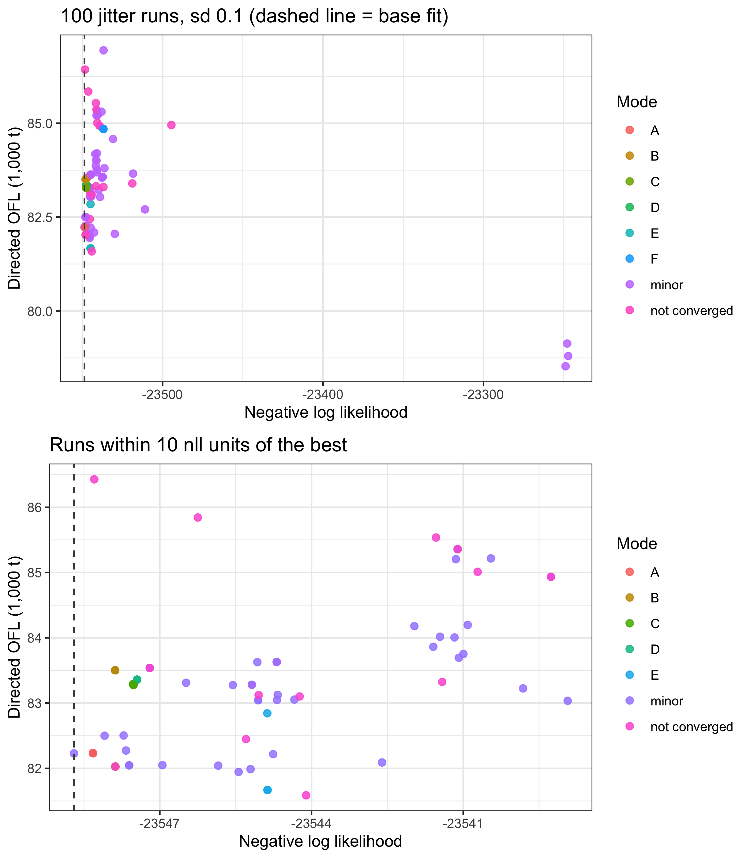
Convergence: what jittering shows
100 jitter starts per model; accepted fit = best likelihood found
Model 26.1b: 6 distinct minima; only 1 of 78 converged runs reaches the best fit
Likelihood separation is small, but management quantities differ materially across minima
Practical cost in Model 26.1: a solution 1.27 units better moved the total OFL from 50.27 to 43.83 kt
Model 26.2 (male-only): 15.2% of runs reach the minimum; the most promising direction this cycle
Directed OFL across 100 jitter runs of Model 26.1b.
U.S. Department of Commerce | National Oceanic and Atmospheric Administration | National Marine Fisheries Service
EBS snow crab | September 2026 CPT | 28

Slide 29
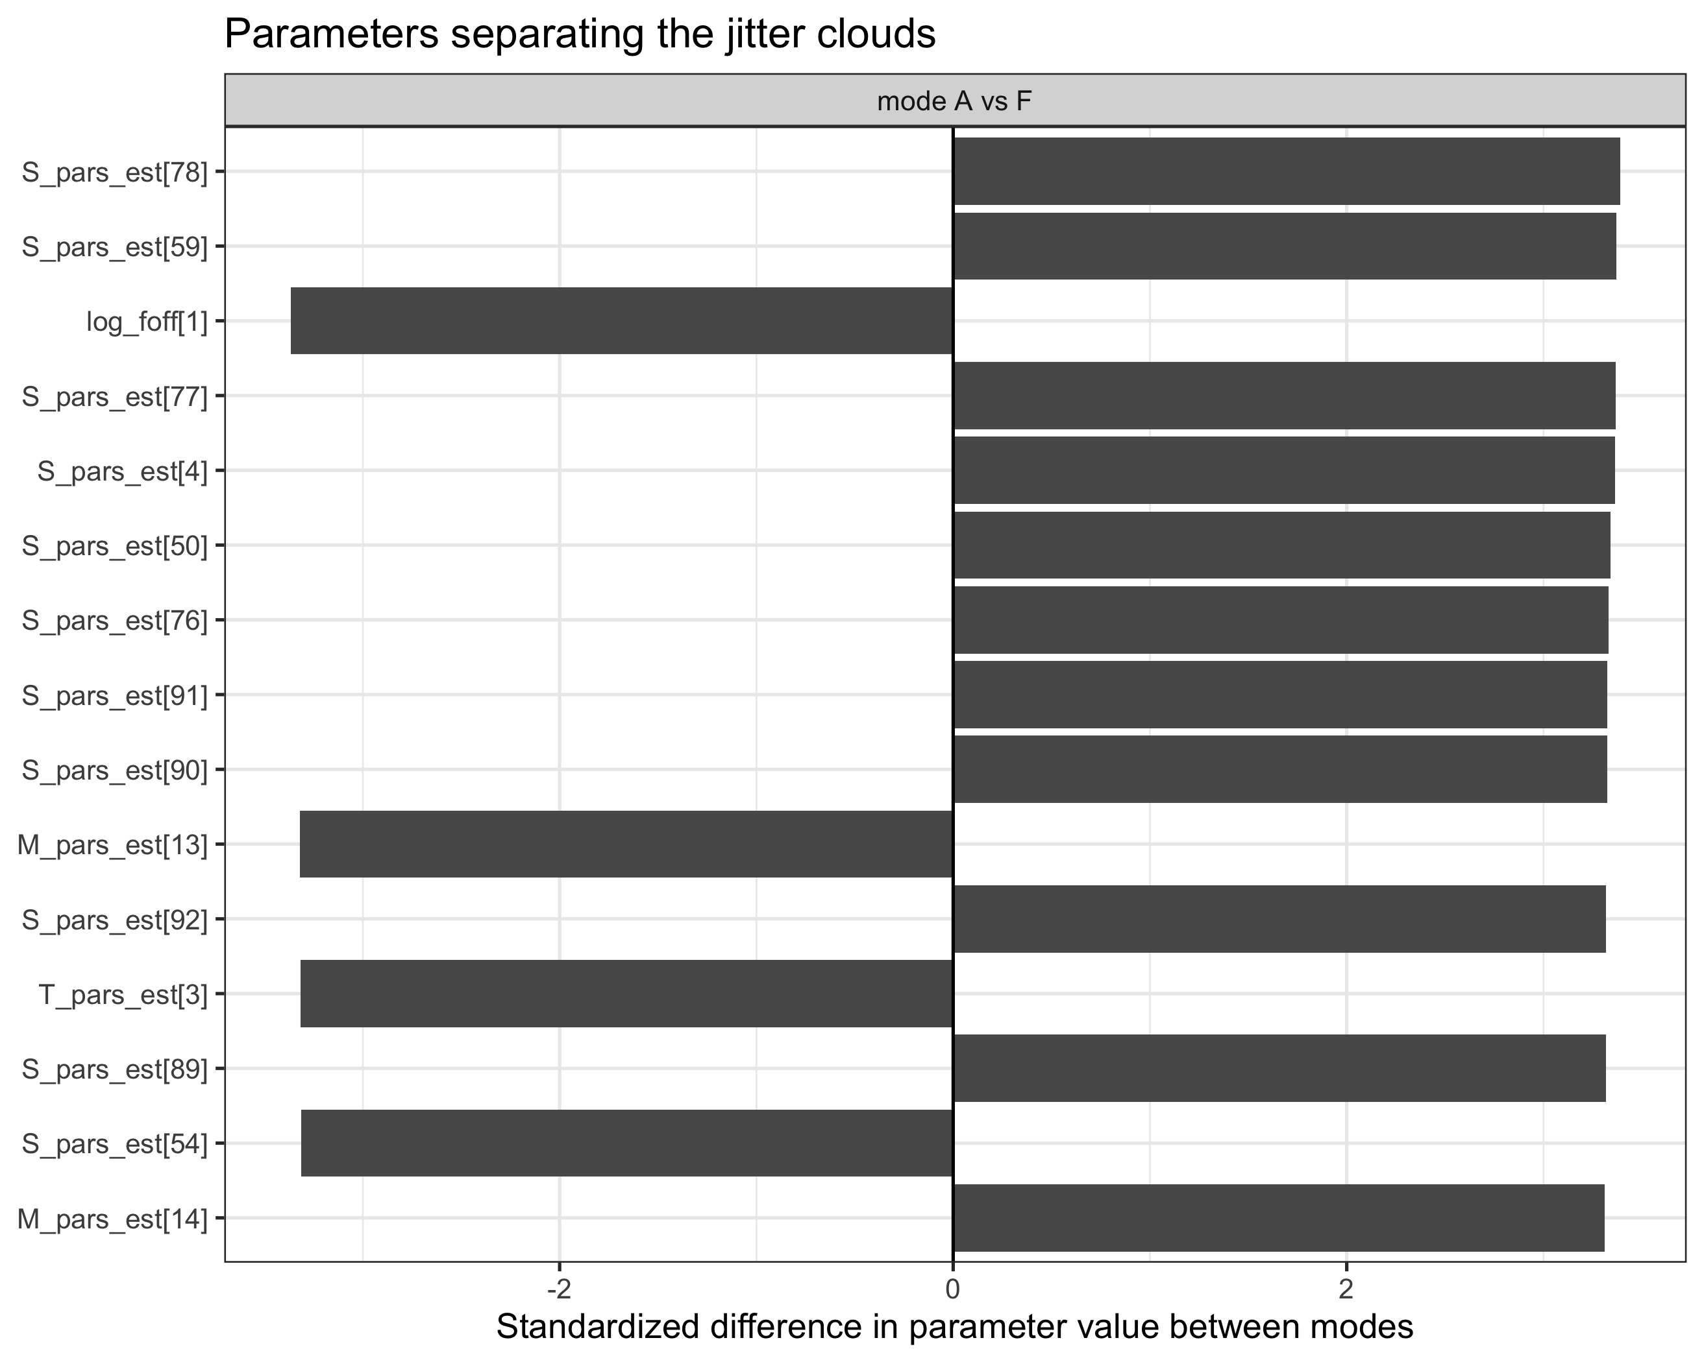
Which parameters separate the minima
Parameter attribution ranks the standardized differences between minima
Leaders this cycle: selectivity (11 of the top 15), natural mortality, fishing mortality offset, recruitment scale; the sex allocation led pre-correction but is no longer in the top 15
The sex allocation and female-linked parameters account for most of the movement, consistent with the male-only model converging far better
The 2019 immature-female M deviation is not identified from a cold start; identifiability is a question for the Plan Team
Parameters that most separate the jitter minima.
U.S. Department of Commerce | National Oceanic and Atmospheric Administration | National Marine Fisheries Service
EBS snow crab | September 2026 CPT | 29
Notes:
This is the focused convergence analysis the June 2026 SSC requested.

Slide 30
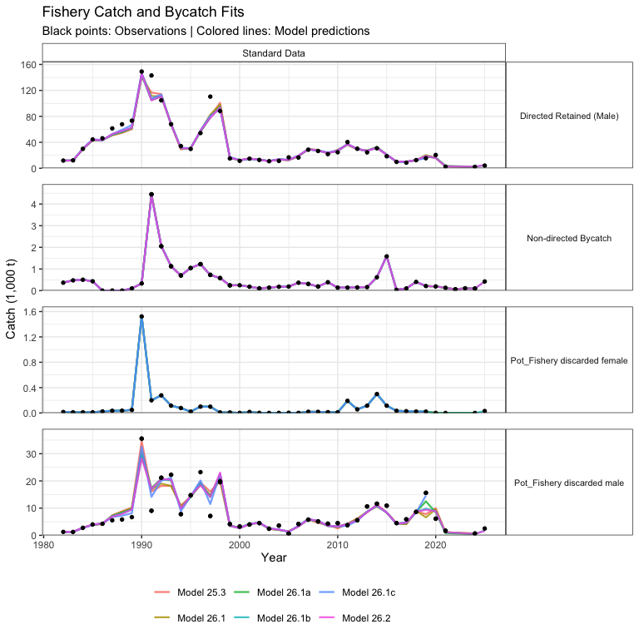
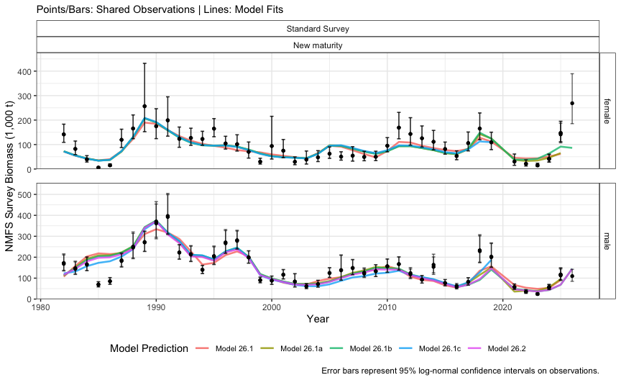
Model fits
Fits to mature biomass at survey.
Fits to catch data.
U.S. Department of Commerce | National Oceanic and Atmospheric Administration | National Marine Fisheries Service
EBS snow crab | September 2026 CPT | 30
Notes:
Fits broadly similar across models; largest misfits in non-directed fishery comps.

Slide 31
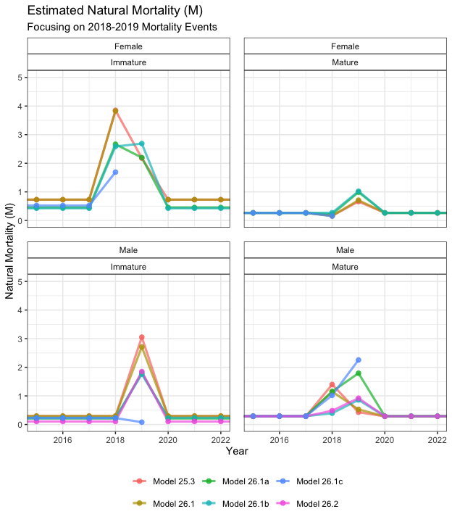
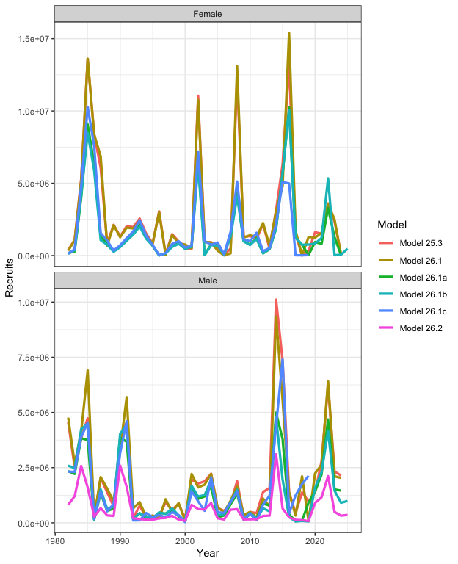
Estimated processes
Natural mortality by sex and maturity state; 2018-19 event estimated.
Recruitment by sex, all models.
U.S. Department of Commerce | National Oceanic and Atmospheric Administration | National Marine Fisheries Service
EBS snow crab | September 2026 CPT | 31

Slide 32
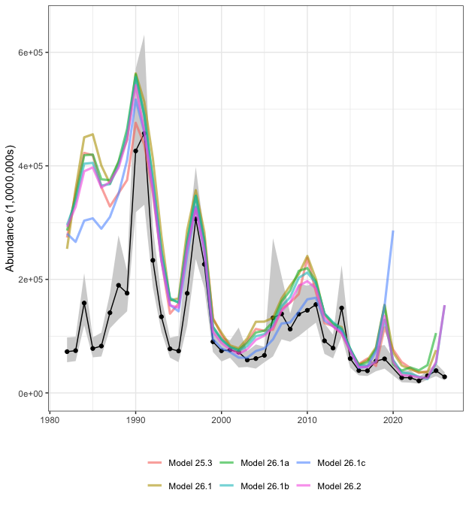
Preferred-male abundance: models vs survey
All models agree recent preferred-male abundance is the lowest in the series
Early years, when survey selectivity differed, are the most variable across models
Abundance of males >101 mm: survey (black) vs models (colored).
U.S. Department of Commerce | National Oceanic and Atmospheric Administration | National Marine Fisheries Service
EBS snow crab | September 2026 CPT | 32

Slide 33
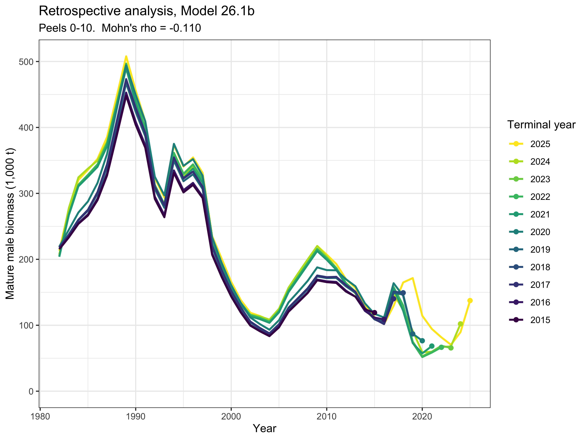
Retrospective analyses (Model 26.1b)
10 peels, terminal years 2024 back to 2015; standard sweep and a terminal-survey-dropped sweep
Mature male biomass: Mohn's rho = -0.11 (standard), -0.11 (survey dropped); inside Hurtado-Ferro bounds for every model
Peels sit below the full model: terminal biomass tends to be revised upward as data accumulate
Male recruitment: rho = 8.1; terminal recruitment unreliable in every configuration
GMACS does not recompute reference points per peel, so the retrospective characterizes biomass and recruitment only
Standard retrospective, mature male biomass.
U.S. Department of Commerce | National Oceanic and Atmospheric Administration | National Marine Fisheries Service
EBS snow crab | September 2026 CPT | 33

Slide 34
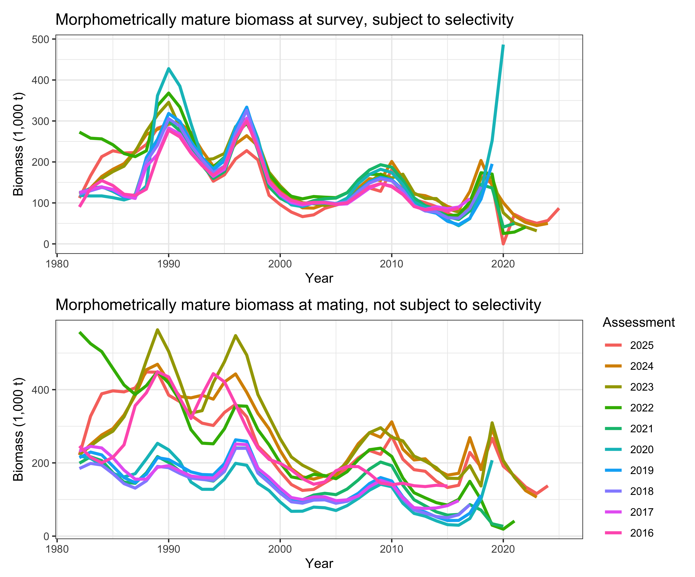
Historical analysis: revisions across assessments
Revisions across accepted assessments dwarf the within-model pattern
2020 biomass: 486.5 kt (2020 assessment), 40.95 kt (2021), 19.1 kt at mating (2022), 205.4 kt (2023)
Main drivers: treatment of terminal molt and BSFRF selectivity priors, the maturity definition used, and no 2020 survey
MMB as seen by each accepted Tier 3 assessment, 2016-2025.
U.S. Department of Commerce | National Oceanic and Atmospheric Administration | National Marine Fisheries Service
EBS snow crab | September 2026 CPT | 34

Slide 35
The male-only direction (Model 26.2)
Removes the female population entirely: 412 to 234 parameters
15.2% of jitter runs recover the accepted fit vs ~1% for the two-sex model; Hessian much better conditioned
Retrospective pattern comparable; recruitment rho drops from ~8 to ~0.7
Caveat: immature-male M offset pinned at its bound; implied mortality should not enter a specification model without examination
Appendix B: 4 structural experiments (26.d1 stability, 26.d3 eqmdevs, 26.d4 combined, 26.d5 male-only + eqmdevs); the male-only reconfigurations work, the two-sex ones do not
15.2%
1.3%
Jitter runs recovering the best fit (26.2)
Same rate, two-sex Model 26.1b
234
~0.7
Estimated parameters (vs 412)
Recruitment Mohn's rho (vs 8.1)
Full jitter diagnostics for the male-only model are in the backup slides and Appendix B.
U.S. Department of Commerce | National Oceanic and Atmospheric Administration | National Marine Fisheries Service
EBS snow crab | September 2026 CPT | 35
Notes:
Main-text depth per plan; Appendix B backup slides available if the CPT wants the experiment detail.

Slide 36
ABC buffer and risk table

Slide 37
ABC buffer: 20%
Year | SSC buffer (% of OFL)
2021 | 25%
2022 | 25%
2023 | 50%
2024 | 65%
2025 | 40%
OFL 95% CI spans 9.27 to 30.36 kt; the alternative-definition OFLs fall outside it
We do not consider a larger buffer necessary: the ESP indicates favorable juvenile conditions, and the Tier 4 OFL of 16.98 kt sits well below the Tier 3 range (43.8 to 147.3 kt)
5-assessment buffer history mean: 41% (June 2026 SSC supported reporting this)
Discussion point: preferred males are at their 4th lowest and the biomass CI sits entirely below the BMSY proxy; does that argue for a larger buffer?
U.S. Department of Commerce | National Oceanic and Atmospheric Administration | National Marine Fisheries Service
EBS snow crab | September 2026 CPT | 37
Notes:
Buck raised the buffer as the CPT-side response to the correction. Our position: 20%; open to discussion.

Slide 38
Risk table
Category | Long-term / persistent | Current year
Assessment-related | Level 2: multimodality has persisted across cycles; drove the move to Tier 4 | Level 1: Tier 4 terminal biomass CV 14.8%
Population dynamics | Level 2: considerable uncertainty in M, recruitment retrospective bias, declining size at maturity | Level 2: preferred males 4th lowest in 44 years; female-skewed sex ratio
Ecosystem | Not scored | Level 1: cold pool and sea ice favorable; offshelf spring transport a caveat
Fishery-informed | Not scored | Level 1: fleet behavior driven by weather, sorting, fuel, TAC
U.S. Department of Commerce | National Oceanic and Atmospheric Administration | National Marine Fisheries Service
EBS snow crab | September 2026 CPT | 38
Notes:
Current-year popdyn raised to Level 2 by the authors; the ESP/ESR summary scored it Level 1. Ecosystem/fishery cells from the Sept 2026 ESP-ESR summary.

Slide 39
Rebuilding and path forward

Slide 40
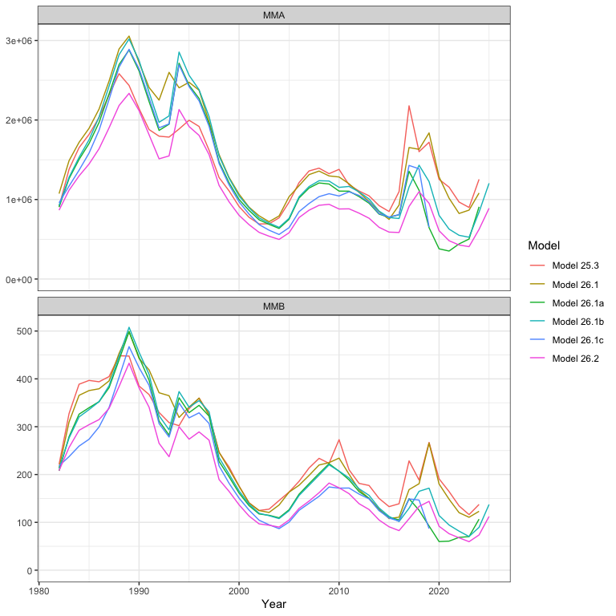
Rebuilding status
Under the Amendment 53 rebuilding plan; Tmin 6 years, Tmax 10 (rebuilt when MMB reaches the BMSY proxy)
Median projections: rebuilt by 2029 under no fishing, bycatch only, and the State harvest strategy; 2030 fishing at the ABC
With 2018-19-type mortality events recurring ~1 year in 7, rebuilding extends to 2034 or beyond
Main driver is recruitment and the ecosystem conditions permitting it, not fishing mortality
Recruitment (Model 26.1b): collapsed to 0.06-0.09 billion in 2018-19; 1.6-4.2 billion 2020-2022; ~1.0 billion 2024-25. Treat terminal estimates with caution (rho = 8.1)
Model-predicted mature male abundance and biomass.
U.S. Department of Commerce | National Oceanic and Atmospheric Administration | National Marine Fisheries Service
EBS snow crab | September 2026 CPT | 40

Slide 41
Research priorities and the January 2027 workshop
Convergence work starts from the male-only model: staged simplification, re-adding complexity while testing convergence at each step
Likelihood profiles once a stable model exists
Resolve identifiability of the immature-female mortality deviation
Maturity: continue evaluating region-specific reproductive information; old-vs-new workflow comparisons
Survey selectivity: awaiting additional BSFRF data
Growth data audit; actual composition sample sizes; discard mortality handled inside GMACS
U.S. Department of Commerce | National Oceanic and Atmospheric Administration | National Marine Fisheries Service
EBS snow crab | September 2026 CPT | 41

Slide 42
Summary and requests to the CPT
Recommended 2026/27 specification (Tier 4, morphometric MMB, ramped rule + Baranov): OFL 16.98 kt, ABC 13.58 kt (20% buffer)
Status 0.747; not overfished, no overfishing; rebuilding continues
Net-mensuration correction incorporated throughout the models fit to current data
Tier 3 models document real progress; male-only is the path to a stable model for 2027
Requests:
  Feedback on the 20% buffer given the correction and the preferred-male situation
  Guidance on the staged simplification plan for the January 2027 workshop
  Endorsement of the maturity-definition reporting approach
U.S. Department of Commerce | National Oceanic and Atmospheric Administration | National Marine Fisheries Service
EBS snow crab | September 2026 CPT | 42

Slide 43
Backup slides

Slide 44
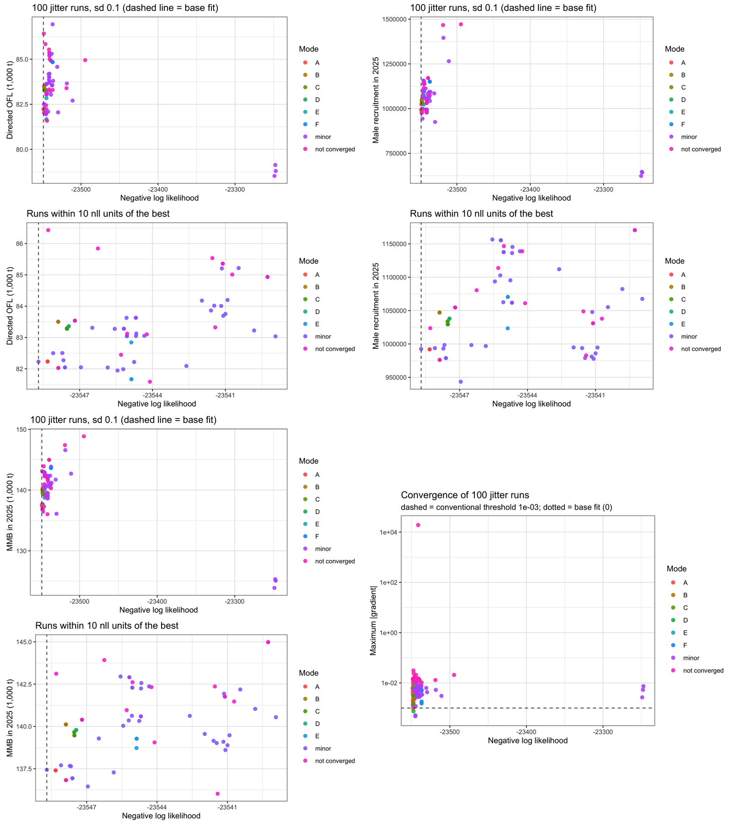
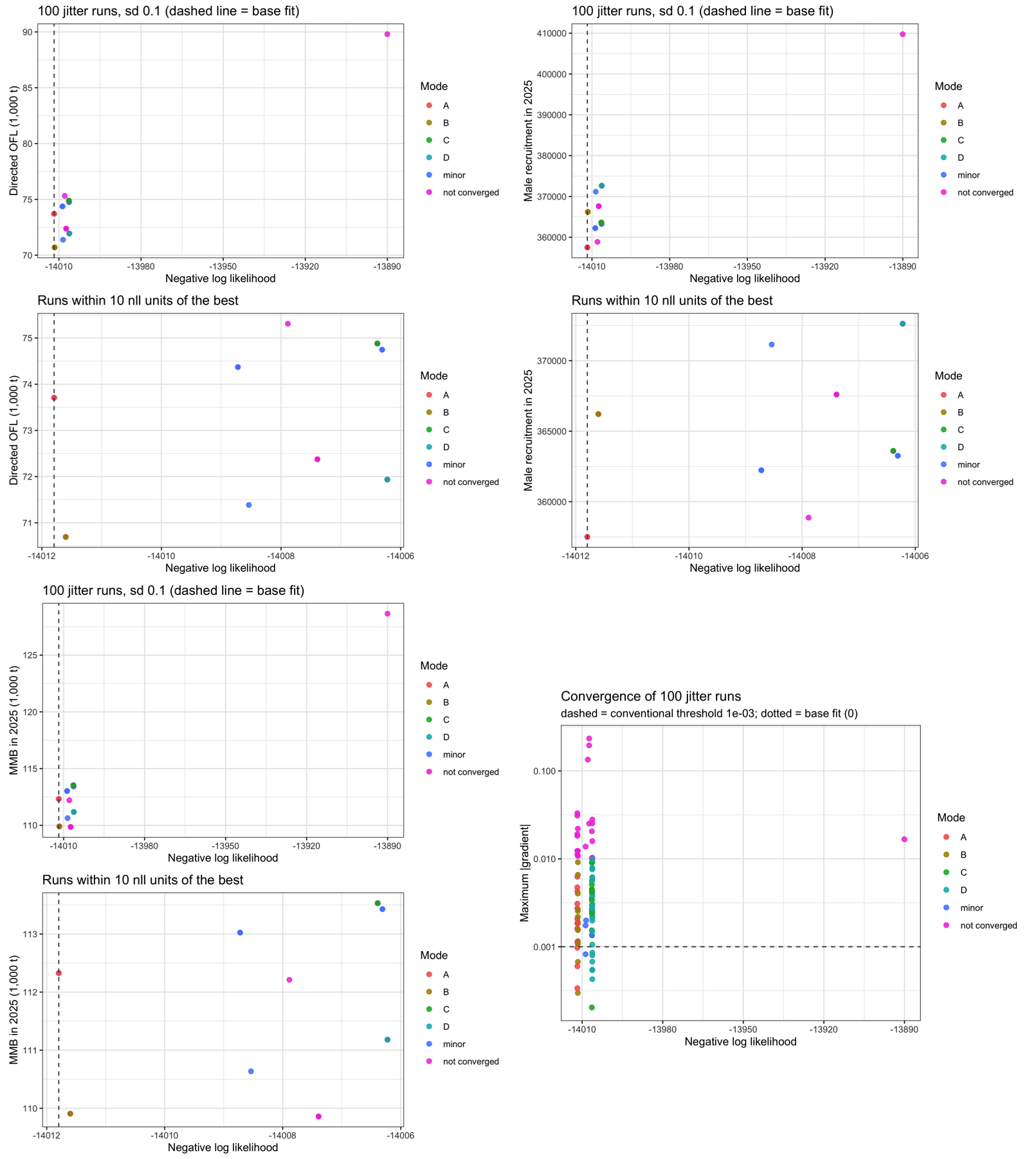
Backup: full jitter diagnostics, accepted and male-only models
Jitter diagnostics, Model 26.1b (accepted).
Jitter diagnostics, Model 26.2 (male-only).
U.S. Department of Commerce | National Oceanic and Atmospheric Administration | National Marine Fisheries Service
EBS snow crab | September 2026 CPT | 44

Slide 45
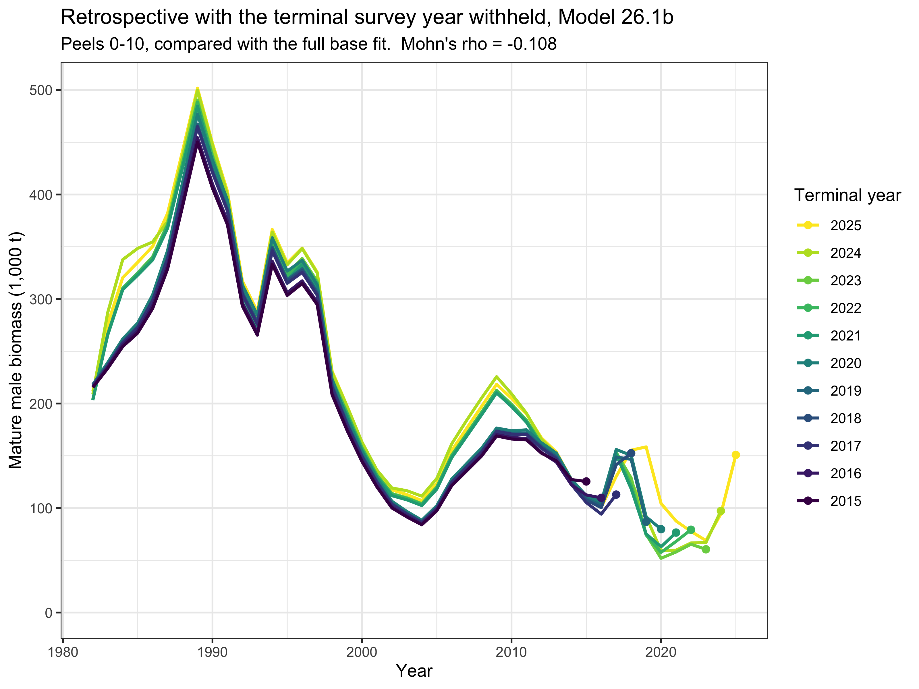
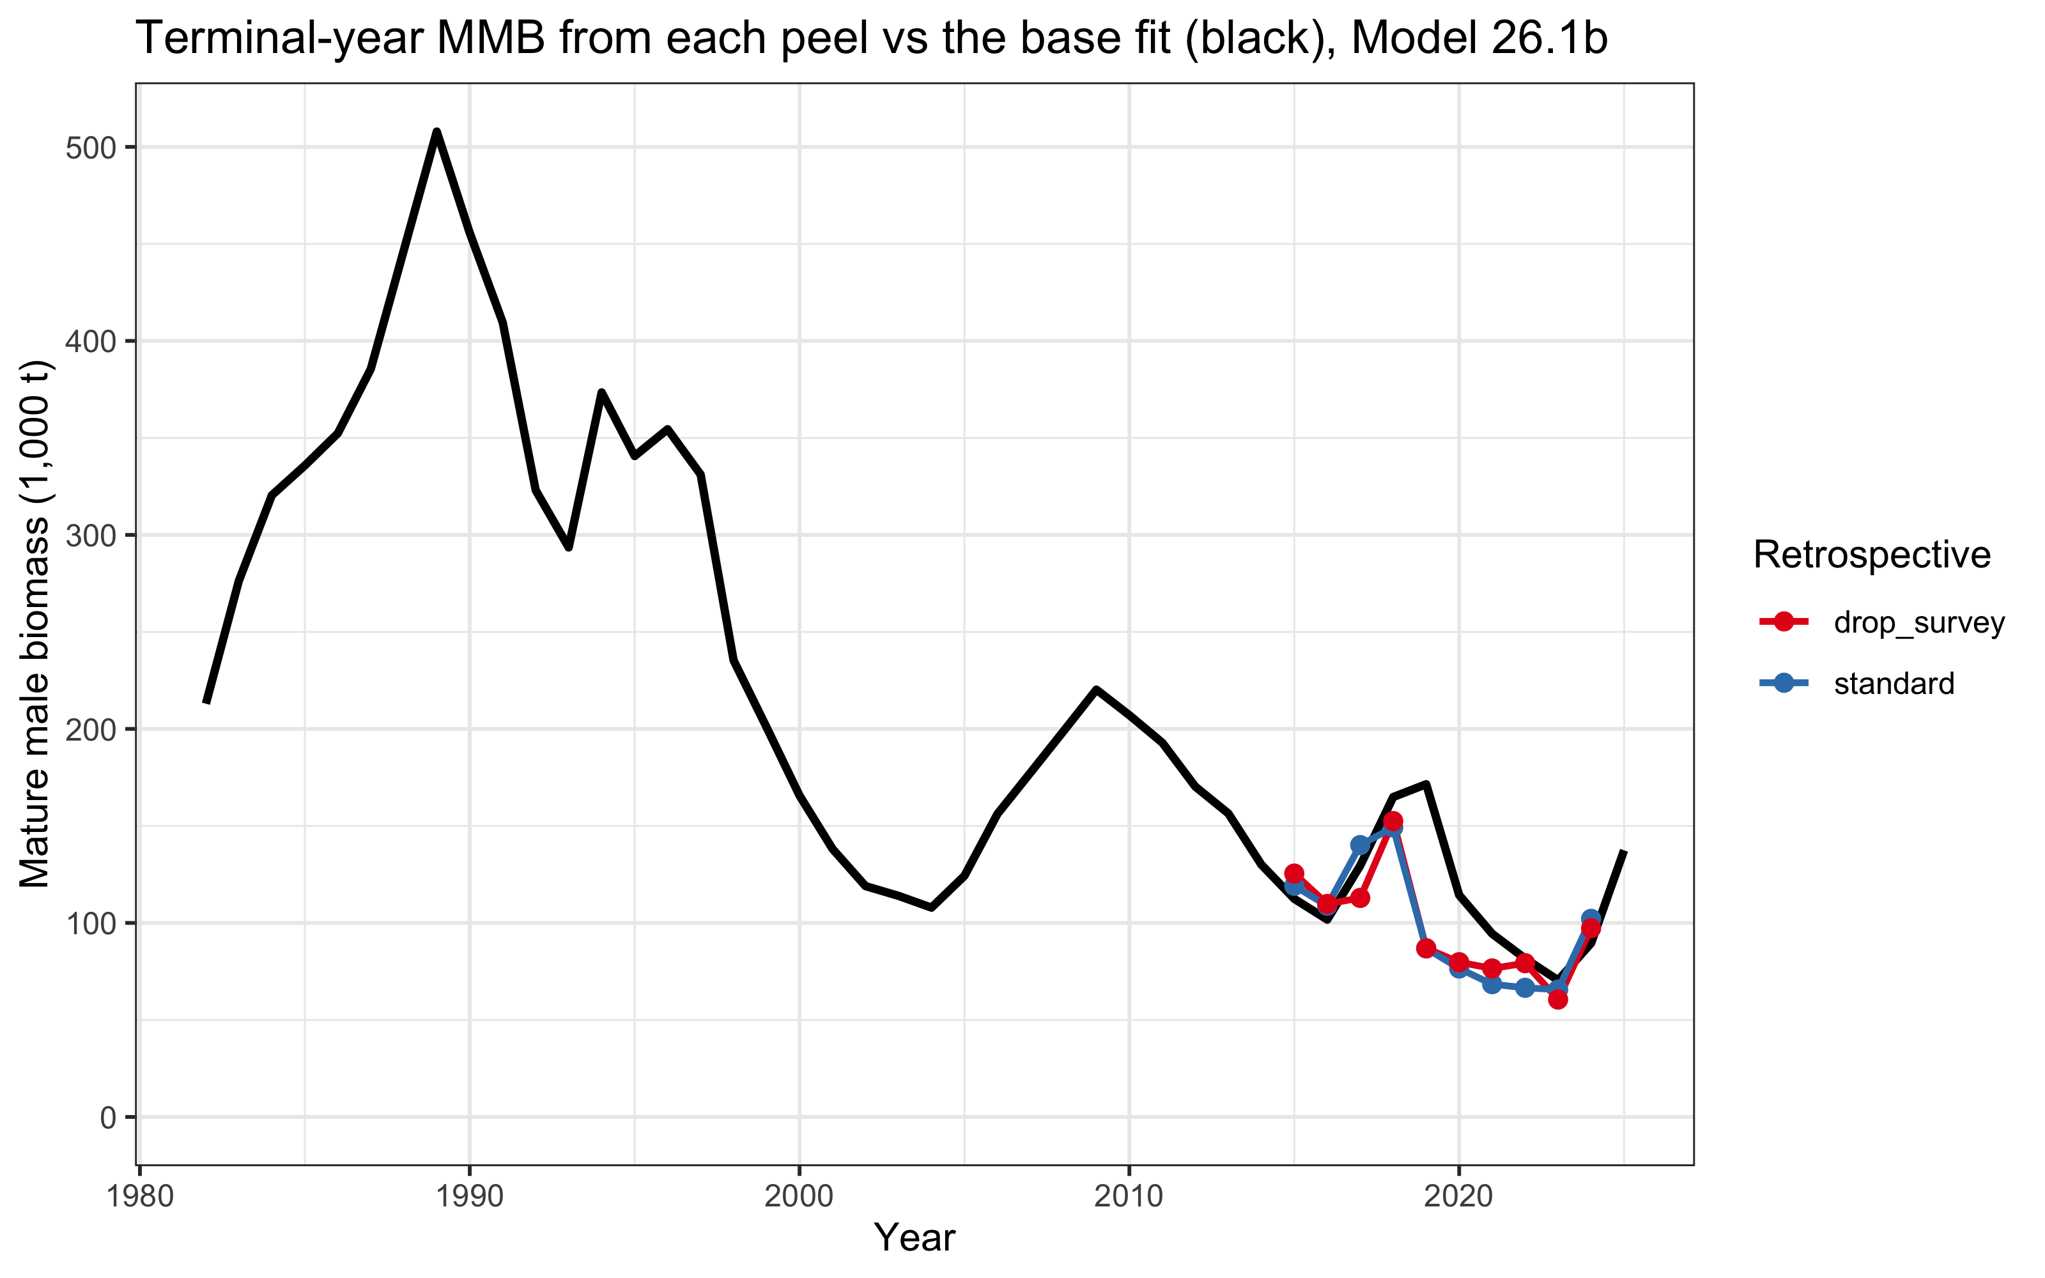
Backup: retrospective variants
Terminal-year estimates by peel vs full model.
Terminal-survey-dropped retrospective.
U.S. Department of Commerce | National Oceanic and Atmospheric Administration | National Marine Fisheries Service
EBS snow crab | September 2026 CPT | 45

Slide 46
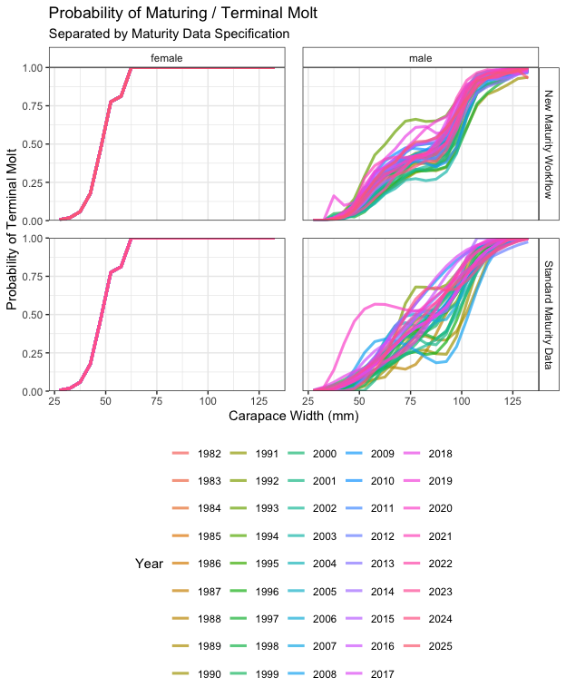
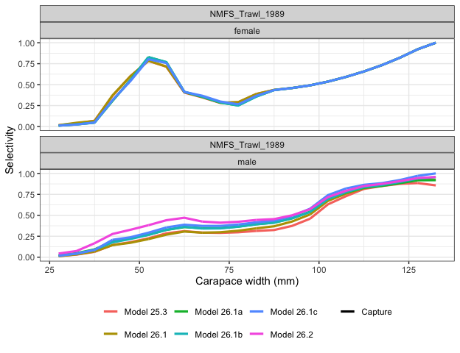
Backup: selectivity and maturity inputs
Survey selectivity with BSFRF-derived priors.
Probability of maturing: estimated vs specified.
U.S. Department of Commerce | National Oceanic and Atmospheric Administration | National Marine Fisheries Service
EBS snow crab | September 2026 CPT | 46

Slide 47
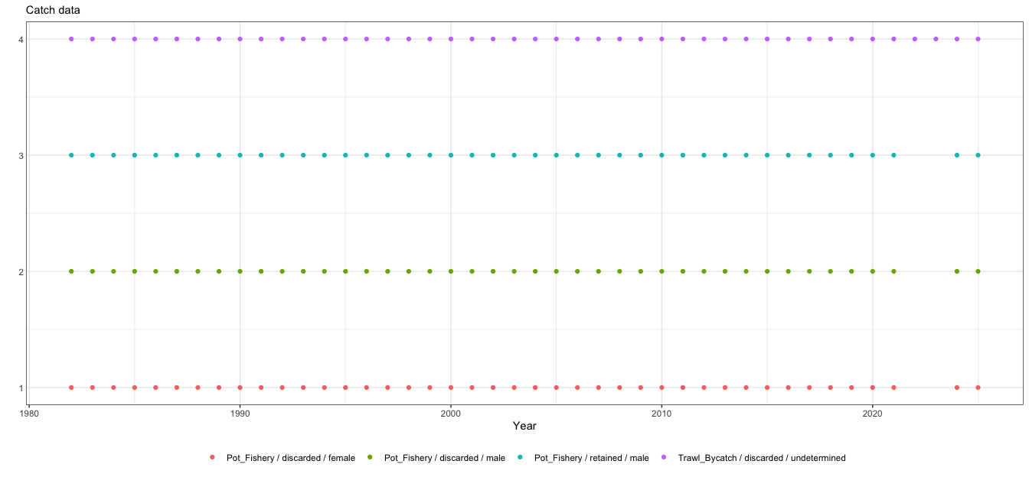
Backup: catch data series
Catch time series used in the assessment.
U.S. Department of Commerce | National Oceanic and Atmospheric Administration | National Marine Fisheries Service
EBS snow crab | September 2026 CPT | 47

