Slide 1
Eastern Bering Sea Snow Crab
September 2026 assessment: Tier 4 is the basis for 2026/27 specifications
Per SSC direction, only the Tier 4 (REMA) assessment is brought forward for harvest advice. Six Tier 3 models document progress on convergence only.
18.45 kt
14.76 kt
0.78
73.3 kt
Recommended OFL
95% CI 10.11 to 31.73 kt
Recommended ABC
20 percent buffer
Stock status (B/BMSY proxy)
MMB 113.9 kt vs proxy 146.6 kt
MSST
biomass CI entirely above it
Status determinations: not overfished · no overfishing (catch 7.10 kt vs 20.11 kt OFL) · rebuilding under Amendment 53, not yet rebuilt
G. Adams and C. Szuwalski · AFSC leadership briefing · September 1, 2026

Slide 2
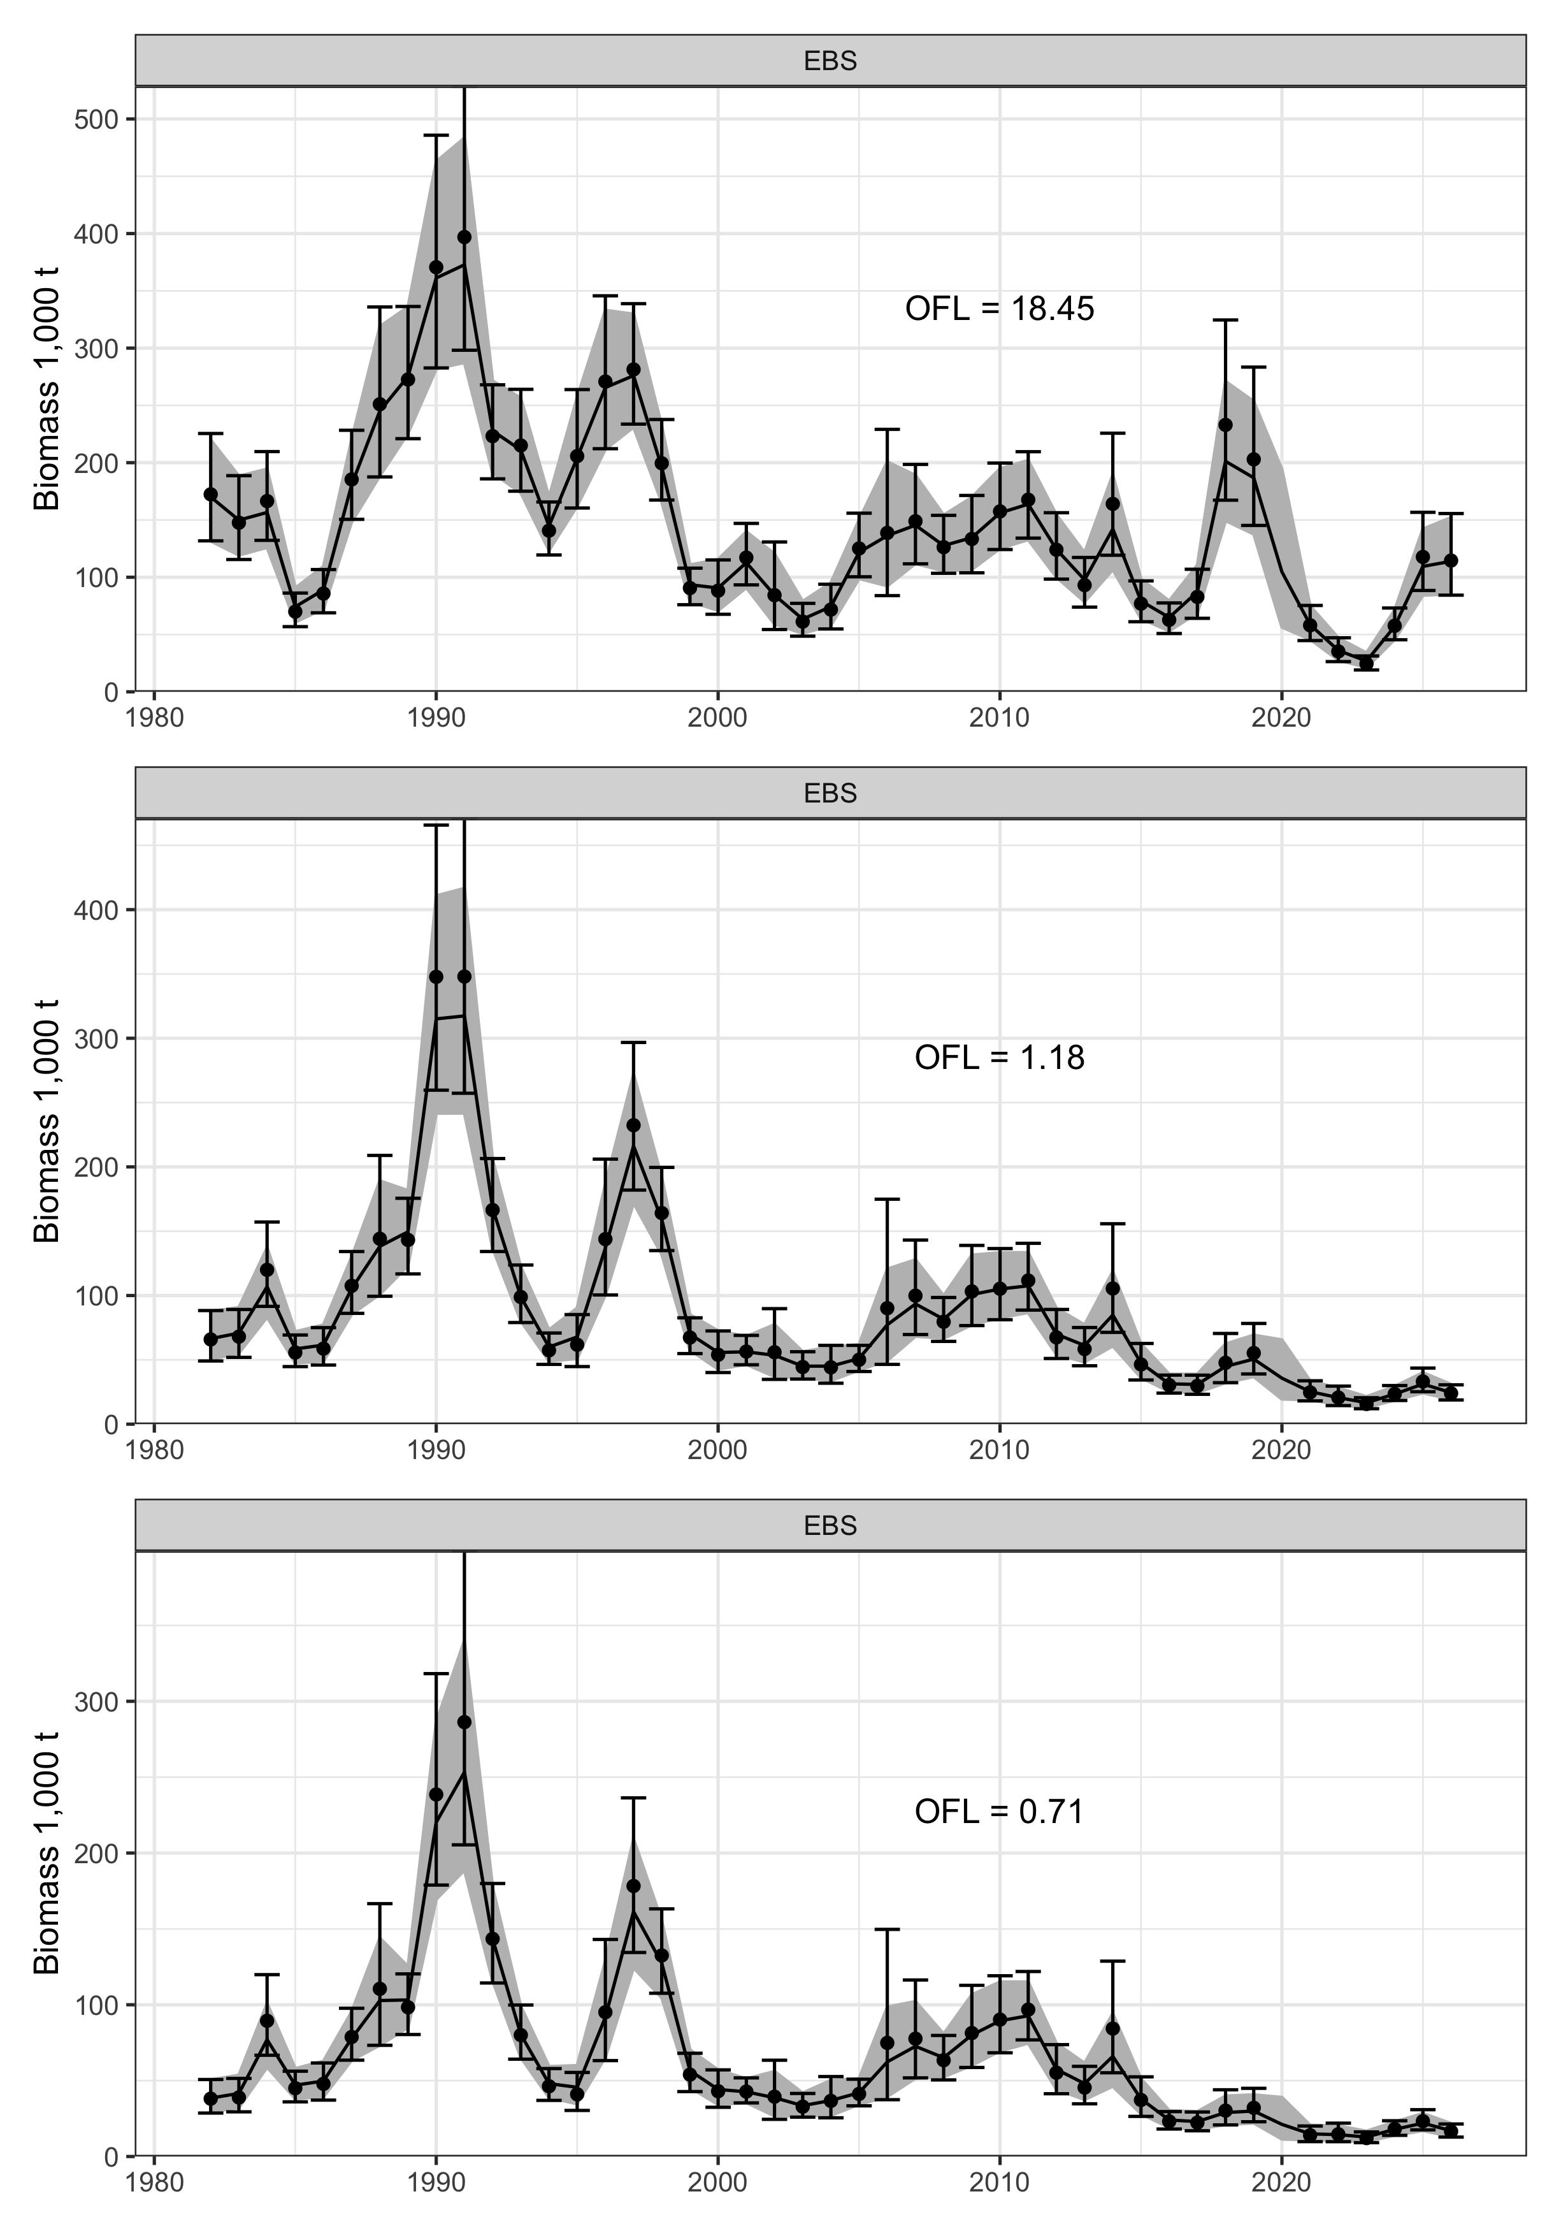
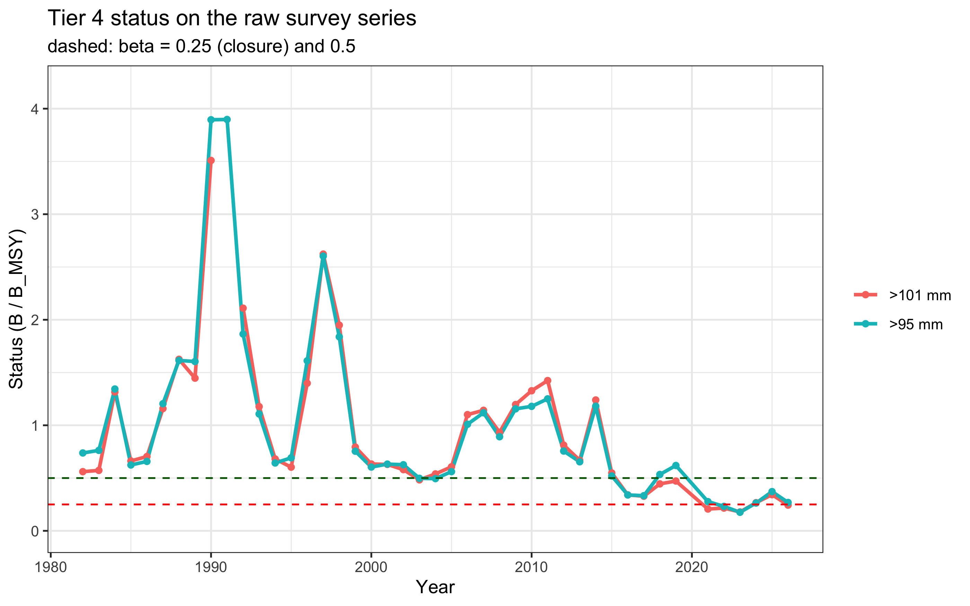
The currency decision drives the OFL
REMA fits by currency (OFL annotated)
Morphometric MMB (the SSC-directed currency): nearly unchanged from 2025.
Industry-preferred males (>101 mm): down 29 percent from the 2025 survey, 4th lowest in 44 years.
Currency moves the OFL 26-fold: 18.45 kt (morphometric), 1.18 kt (≥95 mm), 0.71 kt (>101 mm).
The recommended OFL exceeds the observed preferred-male biomass (16.6 kt).
Position: keep morphometric per the SSC; warn that fishing at the OFL could remove a considerable proportion of preferred males.
Large-male status has been near the closure threshold (red dashed) since 2015

Slide 3
2026/27 specifications vs 2025/26
Control rule: the same sloped FMP rule the SSC used for 2025/26. FOFL = 0.20.
Catch equation: now Baranov. The linear form biases the OFL high (~29 percent) and is not recommended.
Buffer: 20 percent recommended vs 40 percent applied last year. ABC rises 22 percent while the OFL falls 8 percent; the rise is entirely the buffer.
Rationale: OFL uncertainty is wide (10.1 to 31.7 kt), but the ESP shows favorable juvenile conditions and the Tier 4 OFL is far below all Tier 3 OFLs (43.8 to 147.3 kt).

Slide 4
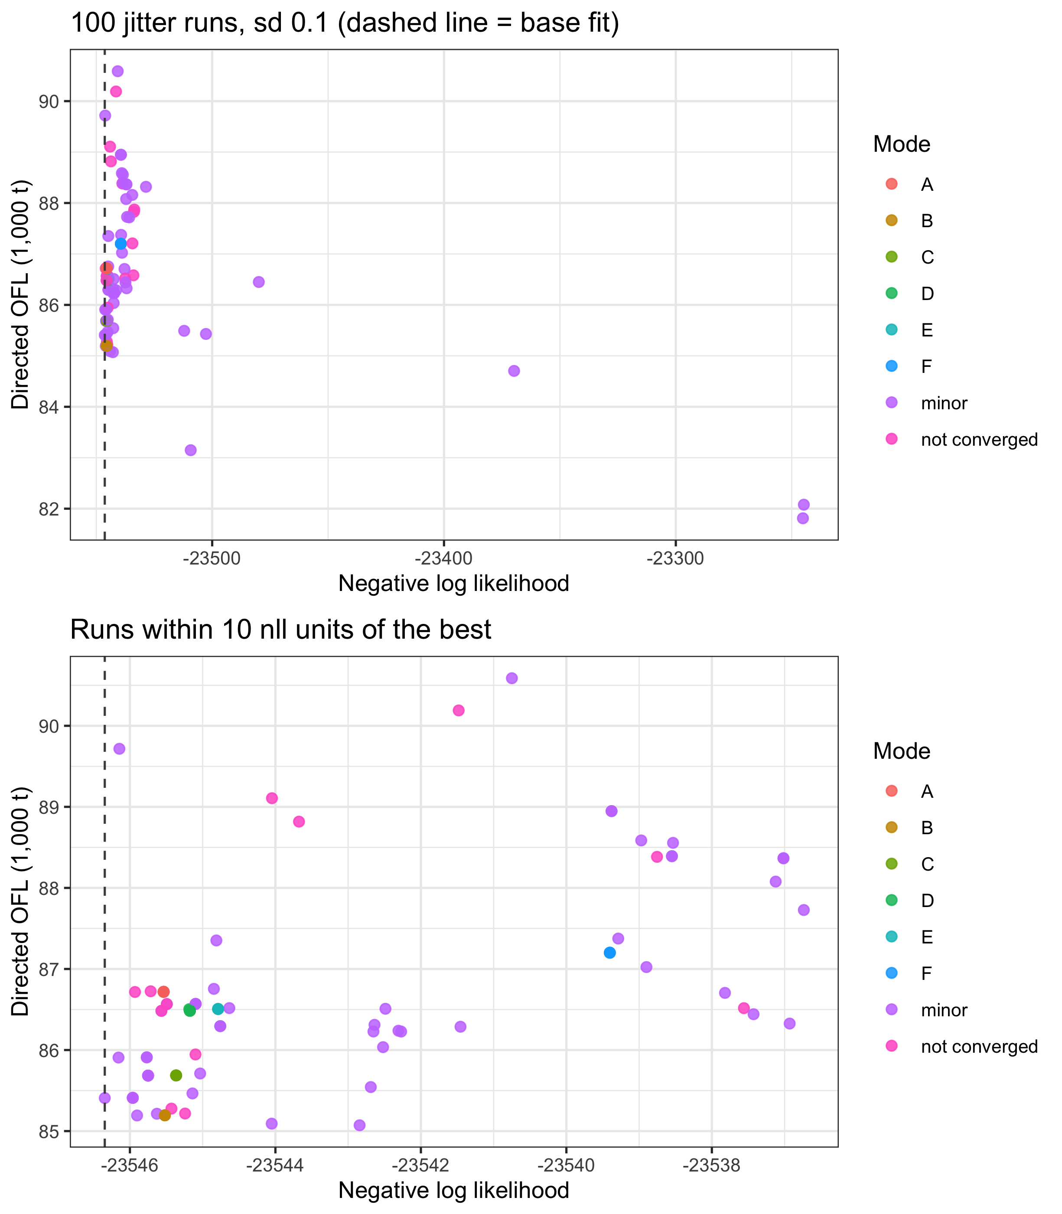
Tier 3: multiple minima persist; a path forward
Directed OFL across 100 jitter runs, Model 26.1b
Jittering Model 26.1b found six minima; only 1 of 79 converged runs reached the best fit.
Likelihood differences are small; management quantities differ materially.
Male recruitment Mohn's ρ ≈ 7.9: terminal recruitment is unreliable.
Male-only Model 26.2 is the most promising direction: 25.3 percent of runs recover its best fit, with better conditioning and smaller retrospectives.
Plan: build a simplified male-only model at the January 2027 modeling workshop; yield-per-recruit and MSE next cycle.

Slide 5
Likely NPFMC discussion points
1 · Currency of management
2 · ABC buffer
Morphometric (per SSC) vs the ≥95 mm definition the CPT has twice recommended. The OFL differs 26-fold and exceeds the observed preferred-male biomass.
20 percent vs 40 percent last year: the ABC rises 22 percent in a year when preferred males fell 29 percent. Long-term assessment and population-dynamics risk scored Level 2.
3 · Baranov catch equation
4 · Rebuilding and hybrids
New this cycle. Lowers the OFL and ABC, and departs from the other BSAI crab Tier 4 assessments, which keep the linear form.
Not rebuilt on the point estimate; the biomass CI reaches the rebuilt threshold. No reliable projection exists, so approach to overfished is unknown. Hybrids stay out of the models; their uncertainty goes in the buffer.
Full details: 2026 EBS snow crab SAFE (draft) · Adams and Szuwalski

