Slide 1

The 2026 assessment for
eastern Bering Sea snow crab
Grant Adams and Cody Szuwalski | Alaska Fisheries Science Center
Crab Plan Team | September 2026
Notes:
2-hour slot. Doc: 2026 SAFE draft. Values match the Sept 13 knit (post net-mensuration correction).

Slide 2

Tier 4 | Not overfished | No overfishing | Not Rebuilt
Model summary
Model: Tier 4 random-effects (REMA) model fit to morphometrically mature male biomass, ramped crab-FMP control rule, Baranov catch equation
Alternatives: 6 Tier 3 GMACS models (25.3, 26.1, 26.1a, 26.1b, 26.1c, 26.2) presented to document convergence progress. None proposed for specification
New data
Catch: 2025/26 directed fishery (4.13 kt retained) and bycatch
Survey: 2026 NMFS summer trawl survey, net-mensuration corrected
Notes
Preferred males (>101 mm) 4th lowest in 44-year series. Current-year population dynamics scored Level 2
Rebuilding plan (Amendment 53) in place. Not overfished, no overfishing, not rebuilt
16.98 kt
13.58 kt
Recommended OFL (2026/27)
Recommended ABC (20% buffer)
0.747
109.30 kt
Stock status (B / BMSY proxy)
Mature male biomass, 2026
-16%
+13%
OFL vs 2025/26 (20.11 kt)
ABC vs 2025/26 (12.07 kt)
U.S. Department of Commerce | National Oceanic and Atmospheric Administration | National Marine Fisheries Service
EBS snow crab | September 2026 CPT | 2
Notes:
Leadership summary in the SAFE-summary-slides format. Risk scores: assessment 1, popdyn 2 (low preferred males), ecosystem 1, fishery 1. ABC rises despite lower OFL because the buffer moved 40% to 20%.

Slide 3
Outline
Management context and 2025/26 performance (10 min)
Responses to SSC and CPT comments (10 min)
Data: 2026 survey, net-mensuration correction, input corrections (15 min)
Management currency (10 min)
Tier 4 assessment and 2026/27 specification (20 min)
Tier 3 models: convergence, retrospectives, male-only updates (30 min)
ABC buffer and risk table (10 min)
Rebuilding status and next steps for the January 2027 workshop (10 min)
U.S. Department of Commerce | National Oceanic and Atmospheric Administration | National Marine Fisheries Service
EBS snow crab | September 2026 CPT | 3
Notes:
Time allocations leave ~15 min for discussion.

Slide 4

Management context
Status, 2025/26 performance, and what changed this cycle

Slide 5
Stock status at a glance
Question | Answer | Basis
Is the stock subject to overfishing? | No | 2025/26 total catch 7.10 kt vs OFL 20.11 kt
Is the stock overfished? | No | MMB 109.30 kt above MSST 73.14 kt across the whole 95% CI
Is it approaching an overfished condition? | Unknown | No reliable projection: Tier 3 unstable, Tier 4 produces none
Rebuilt? | No | Below the BMSY proxy of 146.3 kt. Remains under the Amendment 53 rebuilding plan
Declared overfished October 2021. Directed fishery closed for 2022/23 and 2023/24
Small fishery in 2024/25 (2.15 kt retained), larger in 2025/26 (4.13 kt)
U.S. Department of Commerce | National Oceanic and Atmospheric Administration | National Marine Fisheries Service
EBS snow crab | September 2026 CPT | 5
Notes:
Overfished determination for 2024/25 was made in Oct 2025 under Tier 4.

Slide 6
Management performance, last 5 crab years
 |  | Stock status for that crab year |  |  |  | Specification set the October before |  |  | Catch as reported
Crab year | Tier | MSST | BMSY | MMB | MMB/BMSY | OFL | ABC | TAC | Retained | Total
2021/22 | 3 | 91.60 | 183.10 | 41.20* | 0.225 | 7.50 | 5.60 | 2.50 | 2.50 | 3.60
2022/23 | 3 | 77.95 | 155.91 | 92.40 | 0.593 | 10.32 | 7.70 | 0.00 | 0.00 | 0.05
2023/24 | 3 | 95.90 | 191.81 | 106.52 | 0.555 | 15.44 | 7.72 | 0.00 | 0.00 | 0.07
2024/25 | 3 | 71.40 | 142.79 | 60.08* | 0.421 | 19.60 | 6.86 | 2.10 | 2.10 | 2.81
2025/26 | 4 | 73.14 | 146.29 | 109.30 | 0.747 | 20.11 | 12.07 | 4.22 | 4.13 | 7.10
2026/27 | 4 | - | - | - | - | 16.98 | 13.58 | - | - | -
* Determined overfished: MMB below MSST (MMB/BMSY below 0.5)
Status uses the BMSY proxy of the assessment that made the determination, so MSST is half the BMSY on the same row. The May 2026 CPT text pairs the previous assessment’s proxy with current MMB, giving 0.765 for 2025/26, which changes neither determination
Total catch (retained + discarded + bycatch) was below the OFL in all 5 completed years
Tier is the tier the stock was assessed under for that crab year’s specification, matching slide 7. For 2024/25 that is Tier 3, while the MSST and MMB shown come from the Tier 4 assessment of October 2025, as the SSC report footnotes on the same row
1,000 t. Values as adopted by the SSC, except the 2026/27 row, which is this assessment as proposed (TAC set by the State later)
U.S. Department of Commerce | National Oceanic and Atmospheric Administration | National Marine Fisheries Service
EBS snow crab | September 2026 CPT | 6
Notes:
Catches are the SSC-reported values; our ADF&G data give 2.15 kt for 2024/25 vs 2.10 in the SSC table.

Slide 7
Basis for the OFL and ABC, last 5 assessments
 |  | Basis for the OFL as estimated in that assessment |  |  |  |  |  | Specification For the next crab year
Assessment | Tier | M | BMSY | BMSY years | MMB | MMB/BMSY | FOFL | OFL | Buffer | ABC
Sept 2022 | 3b | 0.29 | 183.10 | 1982-2021 | 55.00 | 0.300 | 0.32 | 10.32 | 25% | 7.70
Sept 2023 | 3b | 0.29 | 155.91 | 1982-2022 | 65.77 | 0.422 | 14.96 | 15.44 | 50% | 7.72
Sept 2024 | 3b | 0.28 | 191.81 | 1984-2023 | 96.77 | 0.505 | 25.07 | 19.60 | 65% | 6.86
Sept 2025 | 4b | 0.27 | 142.79 | 1982-2024 | 105.21 | 0.737 | 0.19 | 20.11 | 40% | 12.07
Sept 2026 | 4b | 0.27 | 146.29 | 1982-2026 | 109.30 | 0.747 | 0.19 | 16.98 | 20% | 13.58
MMB is the value that assessment used to set the OFL: under Tier 3 it is projected to the time of mating in the specification year, under Tier 4 it is the REMA survey-time estimate and is not projected
FOFL is the directed fishing mortality rate under the Tier 3 ramp, a fraction of F35%. F35% itself moved from 1.50 in the Sept 2022 assessment to 49.63 in Sept 2024, so the column is not comparable across rows. A large value is not a large removal: at FOFL 25.07 the OFL was still only 20% of MMB. The Tier 4 rows scale F to M instead
Buffer is the ABC buffer the SSC applied, as a percentage of the OFL (mean 41%). The proposed 20% for 2026/27 would be the smallest in the 5 years shown
Moved to Tier 4 for 2025/26 after the October 2025 SSC found Tier 3 convergence too severe for advice. 1,000 t, adopted values except the proposed 2026/27 row
U.S. Department of Commerce | National Oceanic and Atmospheric Administration | National Marine Fisheries Service
EBS snow crab | September 2026 CPT | 7

Slide 8
Responses to SSC and CPT comments
June 2026 and October 2025 SSC, May 2026 and September 2025 CPT, grouped by theme

Slide 9
SSC comments: model scope and convergence
Request | Response
Bring only the Tier 4 model forward in October (June 2026 SSC) | Done. OFL and ABC are calculated under Tier 4. 6 Tier 3 models shown only to document progress
Strip the model to a minimal parameter set, then add complexity back (June 2026 SSC) | Started. Model 26.2 (male-only) cuts parameters 412 to 234. Staged simplification is the next step
Immature survey index is not a convergence fix by itself (June 2026 SSC + CPT) | Agreed. Not included in any model presented
Focused convergence section identifying which parameters separate minima (June 2026 SSC) | Partially addressed. Selectivity dominates jitter spread (11 of the top 15): it is confounded with growth and M, producing near-flat likelihood with separate minima. By parameter type: female and sex-allocation parameters account for 64% of movement (sex allocation alone 24%), so the minima disagree about the female population rather than the males the assessment manages.
U.S. Department of Commerce | National Oceanic and Atmospheric Administration | National Marine Fisheries Service
EBS snow crab | September 2026 CPT | 9
Notes:
Categorized responses; full text in Section B of the document.

Slide 10
SSC comments: data and model inputs
Request | Response
Bring forward the composition correction and expanded plus group (June 2026 SSC) | Included in every model from Model 26.1 onward
Evaluate hybrid Chionoecetes data (May 2026 CPT) | Evaluated in May and excluded from all models per CPT and SSC advice. Tracked in the risk table
Use likelihood profiles to describe uncertainty (Oct 2025 SSC) | Deferred until a stable, converged model exists. Jitter analysis stands in
Explore male-female recruitment differences vs molt-increment fit (Oct 2025 SSC) | Not undertaken. Recruitment is one total split by an estimated sex allocation, so the series are not independent
U.S. Department of Commerce | National Oceanic and Atmospheric Administration | National Marine Fisheries Service
EBS snow crab | September 2026 CPT | 10

Slide 11
SSC comments: maturity definition and Tier 4
Request | Response
Retain morphometric maturity as the basis (Oct 2025 SSC, reaffirming 2024) | Followed. Morphometric MMB is the recommended definition, with >=95 mm and >101 mm reported alongside. Caveated for scale: the OFL is 107% and the ABC 86% of the 2026 preferred-male (>101 mm) survey biomass of 15.88 kt
Full Tier 4 implementation requires a harvest control rule (Oct 2025 SSC) | Done. The ramped crab-FMP rule is applied, with the Baranov catch equation. The flat rule is shown as a sensitivity
Report a stock-specific history of ABC buffers (June 2026 SSC) | Done. 5-year buffer history tabulated.
Report uncertainty in the biomass the control rule acts on (guidelines) | Done. REMA 95% CI on terminal biomass: 81.9 to 145.9 kt (CV 14.8%)
U.S. Department of Commerce | National Oceanic and Atmospheric Administration | National Marine Fisheries Service
EBS snow crab | September 2026 CPT | 11
Notes:
The morphometric direction is the most consequential; we keep the preferred-male caution visible throughout.

Slide 12
Data
2026 survey, the net-mensuration correction, and input corrections

Slide 13
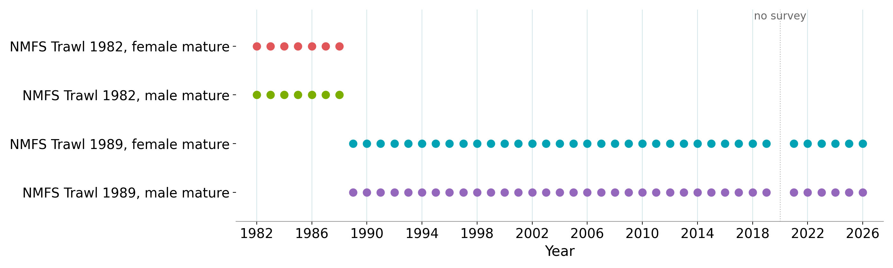
New data this cycle
2026 NMFS summer trawl survey (indices and size compositions), 2025/26 directed fishery catch and compositions (ADF&G), and bycatch from NORPAC
Corrected survey specimen data came directly from the Shellfish Assessment Program. The crabpack package did not yet include the correction
Maturity ogives regenerated from the corrected specimen data (Kodiak workflow)
Index data used in the assessment.
U.S. Department of Commerce | National Oceanic and Atmospheric Administration | National Marine Fisheries Service
EBS snow crab | September 2026 CPT | 13

Slide 14
Net-mensuration correction (September 10)
Tanner crab CIE review found average net spread in the 2024-2025 surveys well below earlier years
Cause: the 2013 correction factor reconciling analog Marport to legacy Netmind sensors is inappropriate for the next-generation Marport sensors used since early 2024
Fix: correction factor removed and net spread recalculated for all hauls, 2024 to 2026 EBS surveys and 2025 NBS survey
Effect: spread values ~4% higher, so biomass and abundance ~4% lower in those years. Earlier years unchanged
Which models include it:
  Corrected: Tier 4 model, Model 26.1b, Model 26.2, Appendix B experiments
  As used in May (uncorrected): Model 25.3, Model 26.1, Model 26.1a, whose data end in 2024
  The 26.1a to 26.1b step includes the correction
U.S. Department of Commerce | National Oceanic and Atmospheric Administration | National Marine Fisheries Service
EBS snow crab | September 2026 CPT | 14
Notes:
Data arrived Sep 11-12; full model set, jitters and retrospectives rerun on the corrected series.

Slide 15
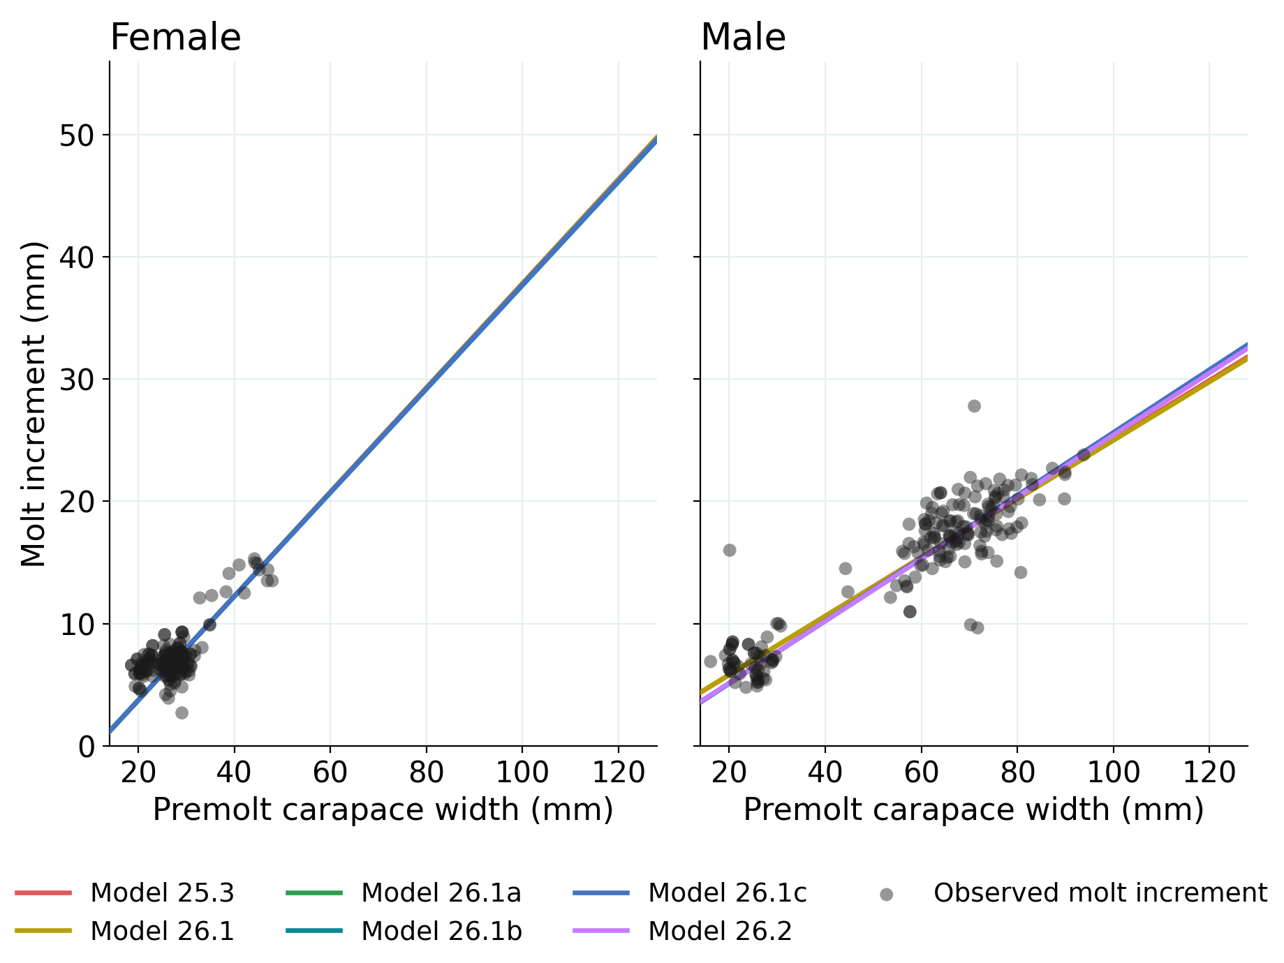
Author corrections to input data (4)
Total-male size composition corrected: resolves a discrepancy between the September 2025 file and the ADF&G processing script
Plus group expanded to include all crab >135 mm carapace width, previously excluded
Size-composition bin convention (ADF&G fishery comps): crab exactly on a 5 mm cutoff now assigned to the upper bin, matching the survey and maturity data
Growth transcription error corrected: a 26.3 mm crab's molt increment recorded as 73 mm instead of 7.3 mm
Excluded the hybrid data and the immature survey index
Model fits (lines) to the observed molt increments (points), by sex.
U.S. Department of Commerce | National Oceanic and Atmospheric Administration | National Marine Fisheries Service
EBS snow crab | September 2026 CPT | 15

Slide 16
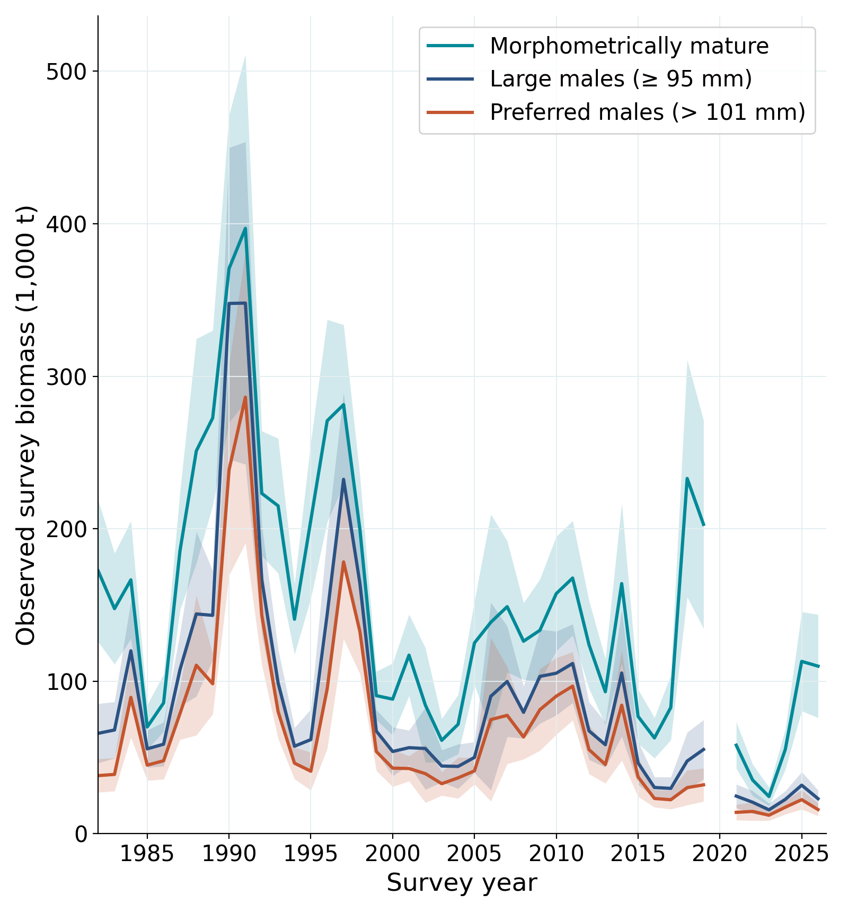
Survey trends by maturity definition
Maturity definition | 2025 | 2026 | Change (%)
Morphometrically mature males | 113.04 | 109.91 | -2.8
Large males (>= 95 mm) | 31.85 | 23.00 | -27.8
Preferred males (> 101 mm) | 22.36 | 15.88 | -29.0
Observed survey biomass (1,000 t), not model output
Preferred males: 15.88 kt
  4th lowest in the 44-year series
Morphometrically mature biomass nearly unchanged: the choice of currency, not the survey, decides whether the stock looks stable or declining
  Maturity-at-size lower in 2026
Observed survey biomass by maturity definition, with 95% CI shading.
U.S. Department of Commerce | National Oceanic and Atmospheric Administration | National Marine Fisheries Service
EBS snow crab | September 2026 CPT | 16
Notes:
This asymmetry is the heart of the buffer and risk-table discussion later.

Slide 17
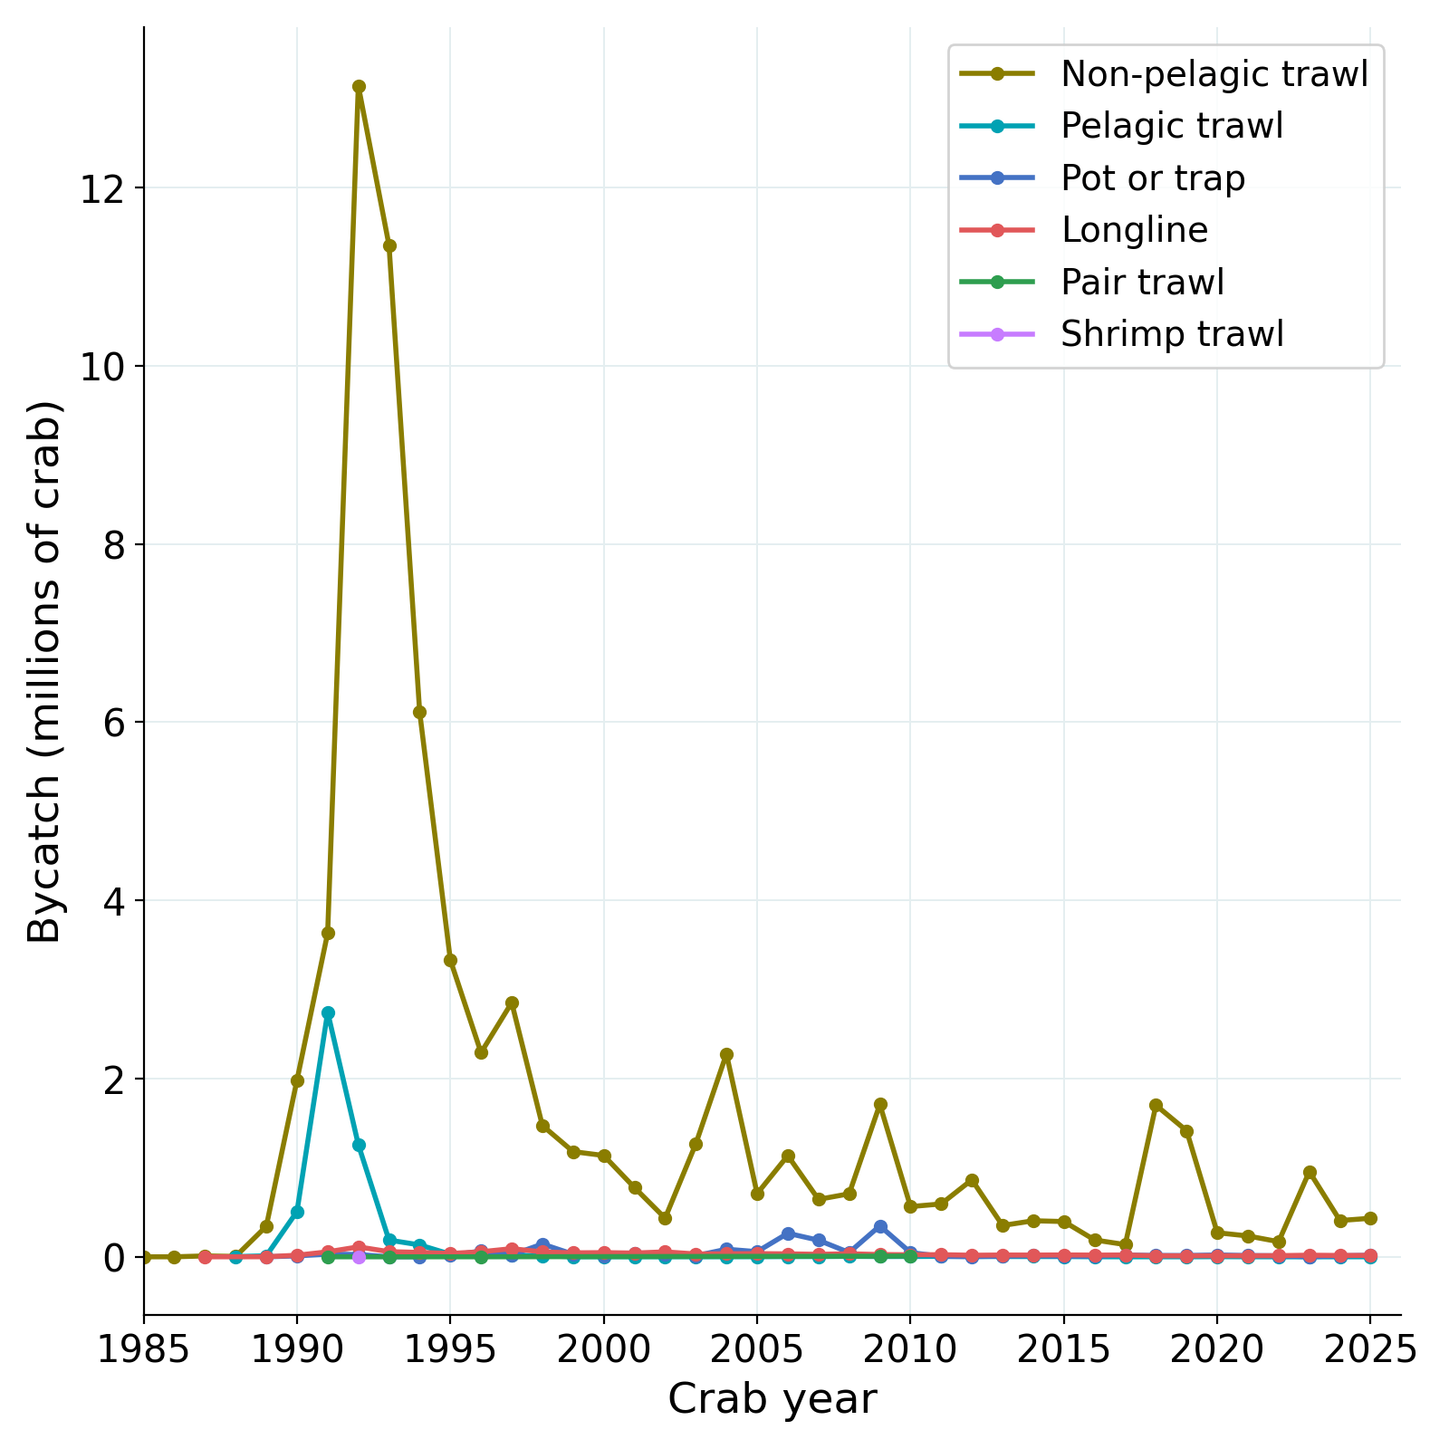
Bycatch and other removals
Total non-directed bycatch remains very small:
  0.09 kt in 2024/25
  0.42 kt in 2025/26 (0.04 kt groundfish trawl, 0.38 kt other crab fisheries)
Discard mortality 30% in the directed pot fishery.
Trawl bycatch is assumed to be 100%
Female discards very low, not a significant mortality source
Non-directed bycatch by gear, numbers of crab.
U.S. Department of Commerce | National Oceanic and Atmospheric Administration | National Marine Fisheries Service
EBS snow crab | September 2026 CPT | 17

Slide 18
The maturity question
Morphometric maturity vs large-male definitions

Slide 19
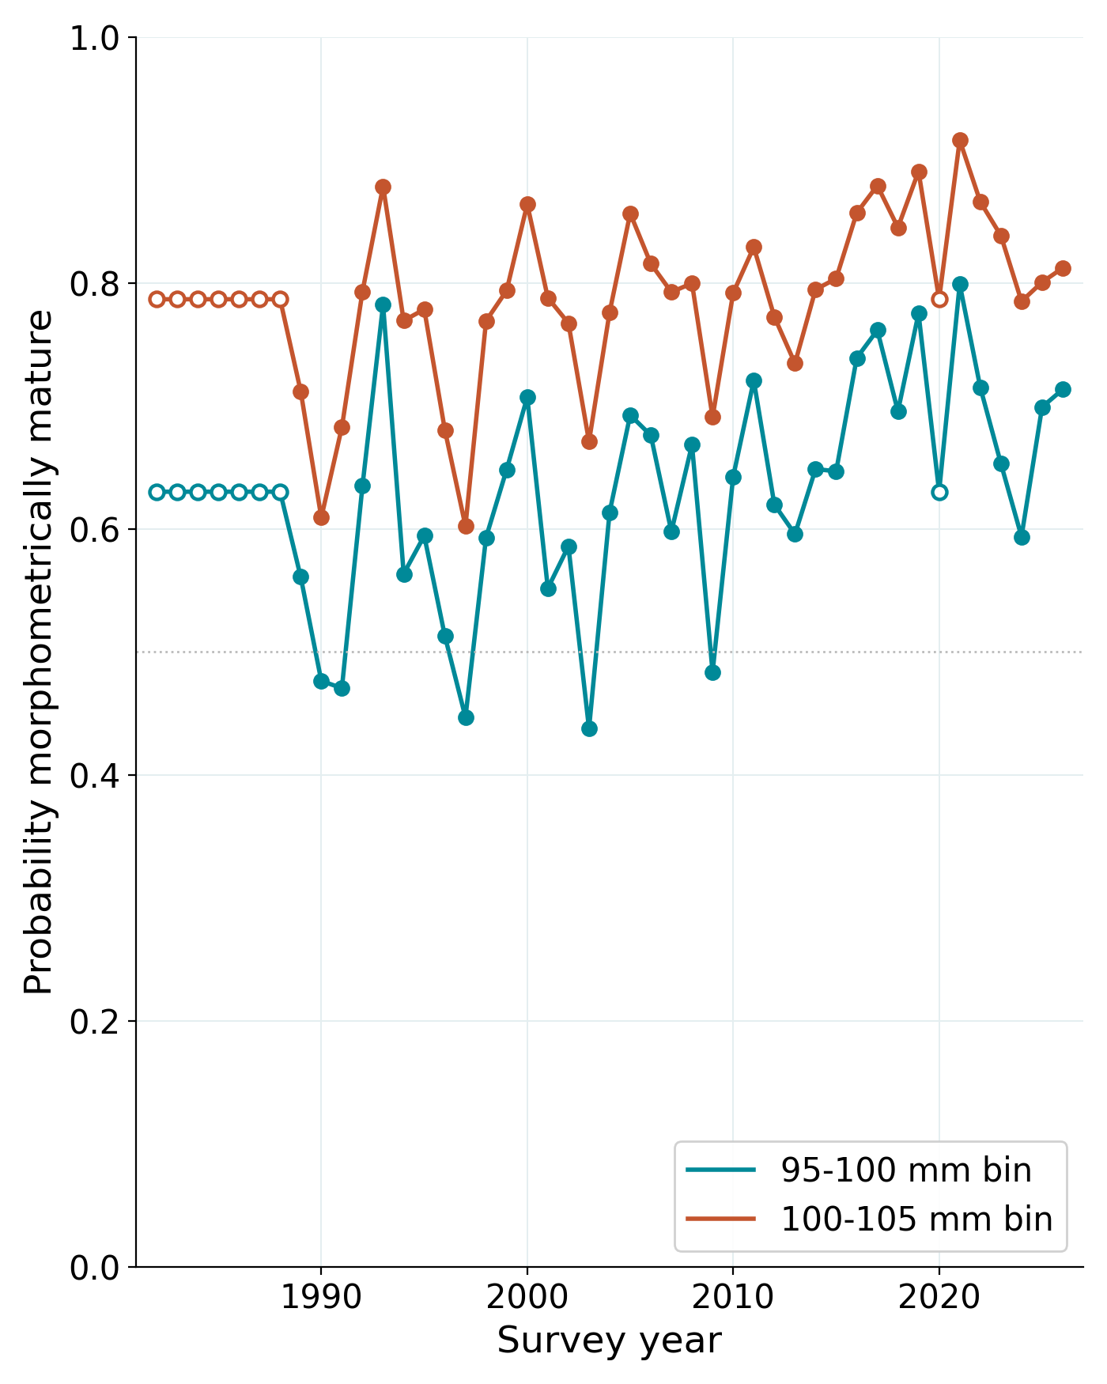
Where the currency matters
Morphometric maturity: males with a large claw relative to carapace width.
  Many mature at sizes the fishery does not retain
Reference points on morphometric biomass can permit removing essentially all large males while the large-male trend is negative
CPT recommended >= 95 mm (2024, Sept 2025). The SSC found region-specific information insufficient for a change and kept morphometric maturity as the basis
We follow the SSC's direction and report the >= 95 mm and > 101 mm definitions alongside every recommendation
For reference: the recommended OFL of 16.98 kt is 74% of observed large-male biomass and 107% of observed preferred-male biomass in 2026
Estimated probability of morphometric maturity over time for the 5 mm bins spanning 95 and 101 mm. Open circles are years without maturity data, which use the pooled ogive.
U.S. Department of Commerce | National Oceanic and Atmospheric Administration | National Marine Fisheries Service
EBS snow crab | September 2026 CPT | 19
Notes:
OFL/large-male = 16.98/23.0 = 74%; OFL/preferred = 16.98/15.88 = 107%.

Slide 20
Tier 4 quantities under each definition
Definition | BMSY | B current | Status | FOFL | OFL | OFL (flat) | OFL (linear)
Morphometric | 146.29 | 109.30 | 0.747 | 0.194 | 16.98 | 22.80 | 21.22
Large males (>= 95 mm) | 85.20 | 23.53 | 0.276 | 0.053 | 1.06 | 4.91 | 1.24
Preferred males (> 101 mm) | 64.43 | 16.31 | 0.253 | 0.046 | 0.64 | 3.40 | 0.75
Both alternative currencies give OFLs an order of magnitude lower: both sit just above the closure threshold, where the ramp pushes FOFL toward zero
The definition changes the OFL 26-fold. That dominates every other source of uncertainty in the Tier 4 calculation
Biomass and OFL in 1,000 t, FOFL per year
U.S. Department of Commerce | National Oceanic and Atmospheric Administration | National Marine Fisheries Service
EBS snow crab | September 2026 CPT | 20
Notes:
All rows verified against Table 11 of the Sept 13 knit; linear-eqn column is the ramped-F linear OFL.

Slide 21
Tier 4 assessment
The basis of the 2026/27 specification

Slide 22
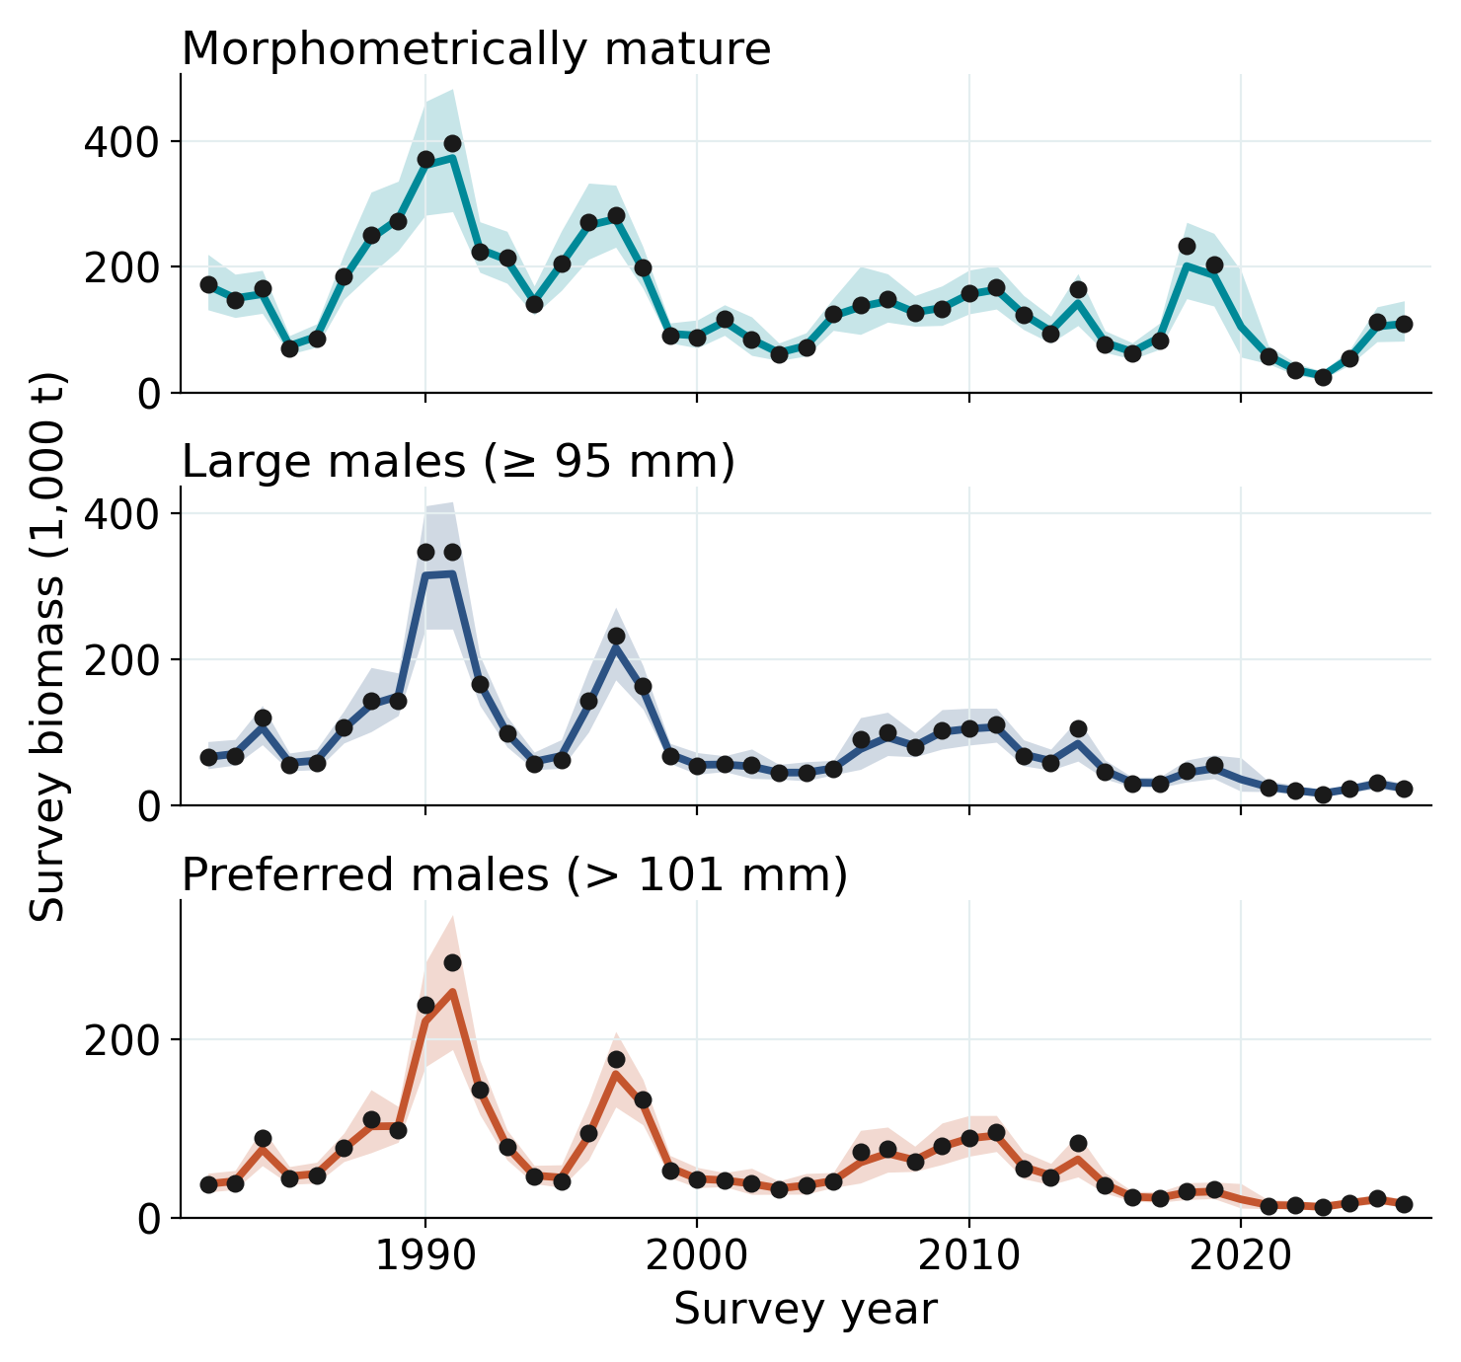
REMA model on the survey series
Random-effects (REMA) smooth of observed survey biomass, fit separately to each maturity definition
The control rule uses the terminal smoothed biomass estimate: 109.30 kt (95% CI 81.9 to 145.9, CV 14.8%)
BMSY proxy = mean of the smoothed series from 1982 to 2026: 146.29 kt
Smoothed series interpolates a value for 2020, when the survey was cancelled. Should we exclude that from the BMSY proxy?
BMSY proxy and OFL change ~1% from Sept 2025
REMA smoothed biomass with 95% prediction intervals, by maturity definition. Points are survey observations.
U.S. Department of Commerce | National Oceanic and Atmospheric Administration | National Marine Fisheries Service
EBS snow crab | September 2026 CPT | 22

Slide 23
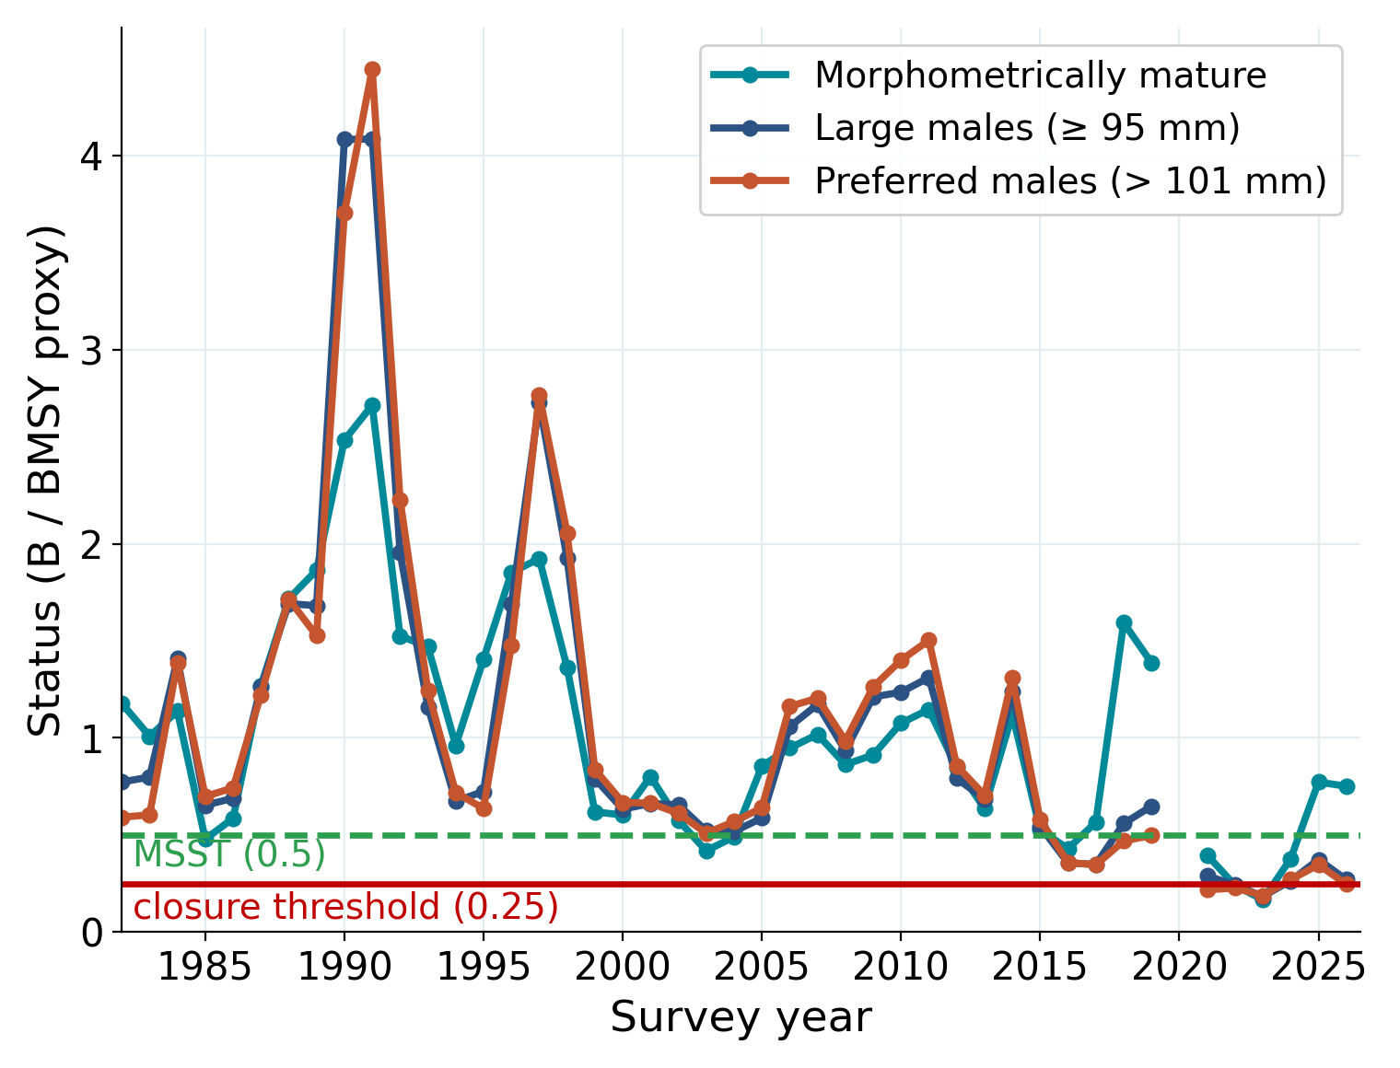
Harvest control rule
Ramped crab-FMP Tier 4 rule:
  FOFL = M (B/BMSY − alpha) / (1 − alpha)
  alpha = 0.10
  M = 0.27
Status (0.747) is between the closure threshold (0.25) and BMSY proxy
At current status FOFL = 0.194
Baranov catch equation, changed this cycle from the linear form.
Same rule the SSC adopted for 2025/26, after finding that a Tier 4 specification with no control rule was an incomplete implementation
Tier 4 status on the raw survey series by maturity definition, each against its own BMSY proxy.
U.S. Department of Commerce | National Oceanic and Atmospheric Administration | National Marine Fisheries Service
EBS snow crab | September 2026 CPT | 23

Slide 24
Catch equation: Baranov replaces the linear form
Previous basis (linear):
OFL = FOFL × B
This cycle (Baranov):
OFL = B × FOFL / (FOFL + M) × (1 − exp(−(FOFL + M)))
FOFL is an instantaneous rate and M removes crab over the same year. The catch is the fishing share of total mortality Z = FOFL + M, not FOFL applied to the starting biomass
The linear form is the first-order approximation and always biases the OFL high.
Holding FOFL = M so only the equation changes: the linear form gives 29.51 kt against 22.80 kt from the Baranov. Using the recommended HCR the 2 forms give 21.22 (linear) and 16.98 kt (Baranov)
The 2025/26 specification used the sloped rule with the linear equation, so the catch equation is the only change from last year
Linear values stay in Table 11 because the other BSAI crab Tier 4 assessments use that form, which keeps the cross-stock comparison. Its use is not recommended given the bias
U.S. Department of Commerce | National Oceanic and Atmospheric Administration | National Marine Fisheries Service
EBS snow crab | September 2026 CPT | 24

Slide 25
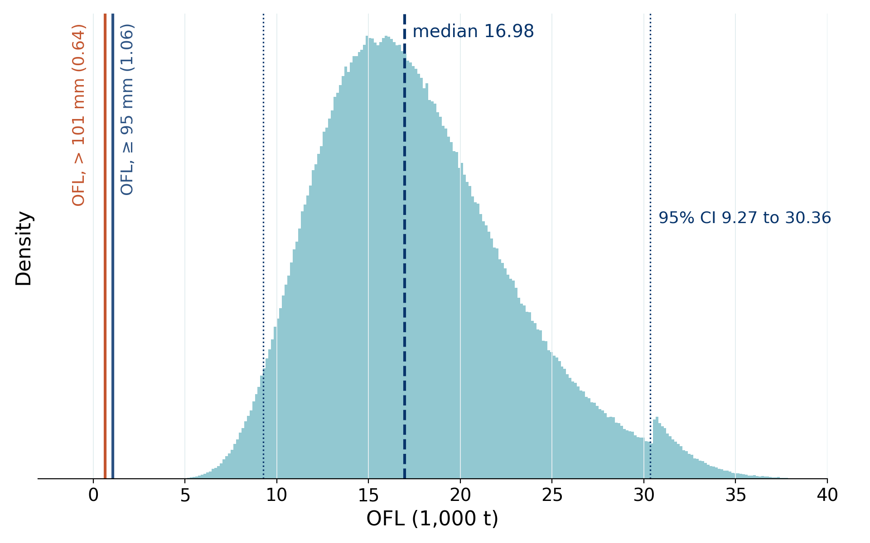
2026/27 specification and OFL uncertainty
16.98 kt
13.58 kt
OFL (median)
ABC (20% buffer)
9.27-30.36
0.194 / yr
OFL 95% CI (kt)
FOFL under the ramp
Distribution from propagating the REMA CI through the control rule and catch equation
Kink in the upper tail where biomass crosses the BMSY proxy and the rule caps FOFL at M
OFL down 16% from the 20.11 kt specified for 2025/26. ABC up 13% given the buffer change from 40% to 20%
OFL distribution under the recommended basis. Vertical lines mark the point OFLs under the large-male definitions, far outside the distribution.
U.S. Department of Commerce | National Oceanic and Atmospheric Administration | National Marine Fisheries Service
EBS snow crab | September 2026 CPT | 25

Slide 26
Tier 3 models
6 models documenting progress on the convergence problems

Slide 27
Tier 3 model set
Model | Description | Data end | Purpose
25.3 | 2025 accepted model, rolled forward (GMACS 2.20.22, as fitted) | 2024 | Continuity reference
26.1 | 25.3 + GMACS 2.20.34, comp fix, expanded plus group, new maturity workflow (May accepted) | 2024 | May baseline
26.1a | 26.1 + bin convention and growth transcription fixes | 2024 | Isolate data corrections
26.1b | 26.1a + 2025/26 fishery and 2026 survey (corrected). Author-preferred | 2025 | Current data
26.1c | 26.1b truncated to 2019 | 2019 | Test post-collapse influence
26.2 | 26.1b male-only (females removed, 412 to 234 parameters) | 2025 | Simplification direction
None proposed for specification. Fits for the 4 jittered models (bold) are the best of 100 jitter starts. Model 25.3 is as originally fit in September 2025 under GMACS 2.20.22, which cannot be re-run. Model 26.1a was fit this cycle without a jitter run.
U.S. Department of Commerce | National Oceanic and Atmospheric Administration | National Marine Fisheries Service
EBS snow crab | September 2026 CPT | 27

Slide 28
Management quantities across models
Model | BMSY | Status | OFL (total) | MMB terminal | Notes
25.3 | 180.06 | 0.88 | 44.29 | 137.46 | 2025 model
26.1 | 172.67 | 0.96 | 43.83 | 123.09 | May baseline. Jitter moved OFL 50.27 to 43.83
26.1a | 158.70 | 0.81 | 53.70 | 106.65 | Data fixes alone
26.1b | 144.06 | 1.29 | 82.46 | 137.44 | New data
26.1c | 161.29 | 1.05 | 147.28 | 86.90 | OFL not comparable (2019 data)
26.2 | 130.47 | 1.20 | 74.03 | 112.33 | Male-only
Tier 3 OFLs range 43.8 to 147.3 kt across the set, compared to a Tier 4 OFL of 16.98 kt
The extra year of data, not structure, moves 26.1b above status 1
U.S. Department of Commerce | National Oceanic and Atmospheric Administration | National Marine Fisheries Service
EBS snow crab | September 2026 CPT | 28
Notes:
All rows verified against Table 23 of the Sept 13 knit. 25.3/26.1/26.1a are pre-correction by design.

Slide 29
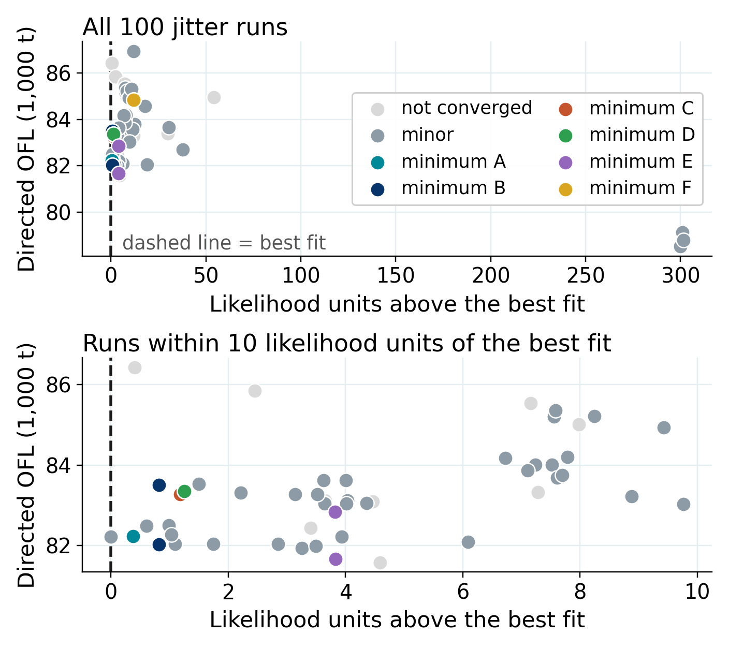
Convergence: what jittering shows
100 jitters. A run counts as converged when its maximum gradient falls below 0.01, which 78 of the 100 runs met for Model 26.1b
Converged runs were clustered based on their likelihood (cut at 0.01). A cluster of 3 or more runs was considered a distinct minimum and was labeled A to F from the best fit to the worst
Run in a cluster of 1 or 2 were considered “minor”, so a single stray run cannot pass as a minimum.
Model 26.1b: 6 minima across 28 runs, 50 converged runs were minor and 22 did not converge. Only 1 of the 78 converged runs reached the best fit
Likelihood separation is small, but management quantities differ materially across minima
For example, in Model 26.1 a solution 1.27 units better moved the OFL from 50.27 to 43.83 kt
Model 26.2 (male-only): 15.2% of runs reach the minimum, the most promising direction this cycle
Directed OFL across 100 jitter runs of Model 26.1b.
U.S. Department of Commerce | National Oceanic and Atmospheric Administration | National Marine Fisheries Service
EBS snow crab | September 2026 CPT | 29

Slide 30
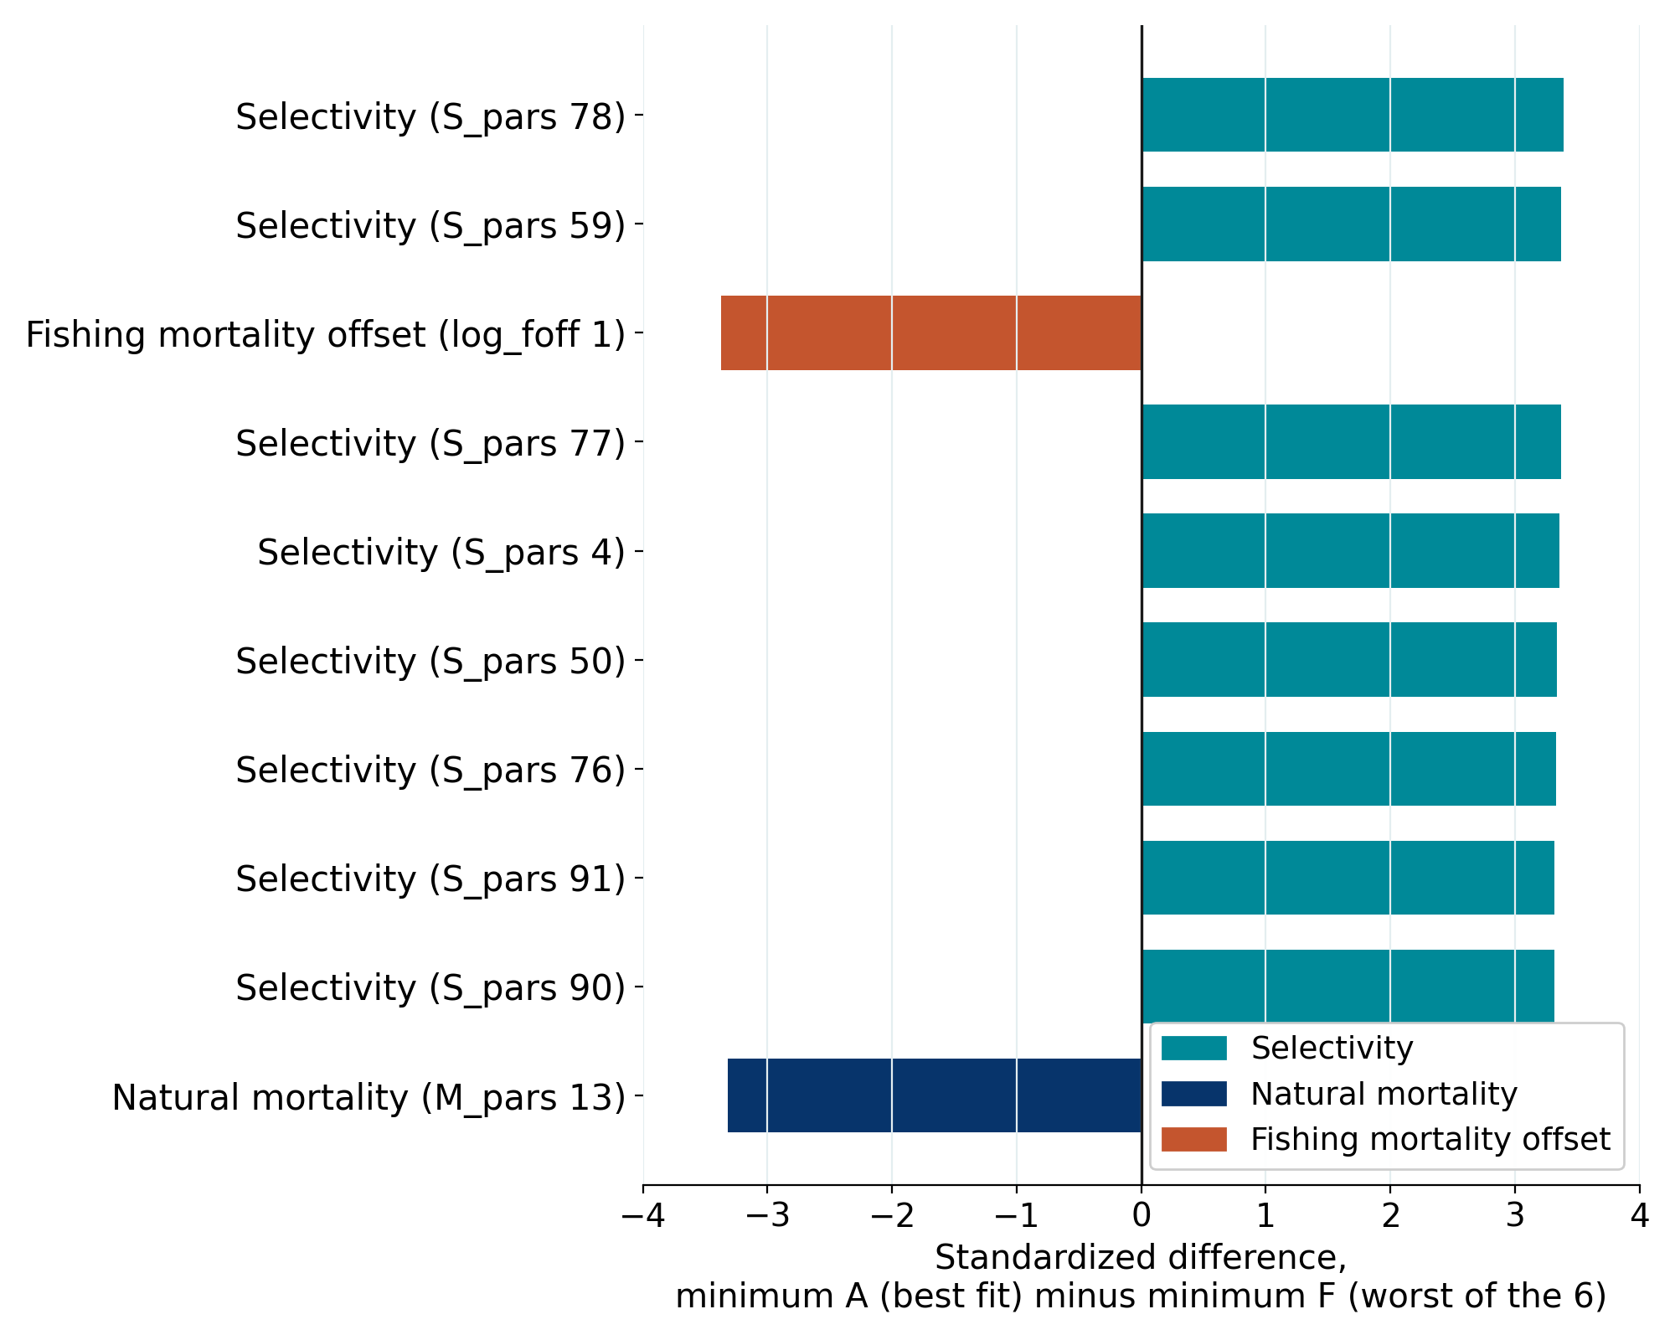
Which parameters separate the minima
Jitter runs cluster into 6 minima, labeled A to F from the best fit to the worst. The figure compares A against F, the 2 ends of that range
Standardized difference = (mean parameter value in A minus the mean in F) divided by that parameter’s SD across all 100 runs. Z-scaled, so parameters of different magnitudes can be compared
Selectivity dominates: 11 of the 15 largest differences are selectivity parameters. The rest are natural mortality, a fishing mortality offset and the recruitment scale
Movement is the range across the 31 runs within 2 likelihood units of the best fit, summed by parameter type. Female and sex-allocation parameters account for 64% of it, which is why removing the females improves convergence.
The 2019 immature-female M deviation is not identifiable
Parameters that most separate the jitter minima.
U.S. Department of Commerce | National Oceanic and Atmospheric Administration | National Marine Fisheries Service
EBS snow crab | September 2026 CPT | 30
Notes:
This is the focused convergence analysis the June 2026 SSC requested.

Slide 31
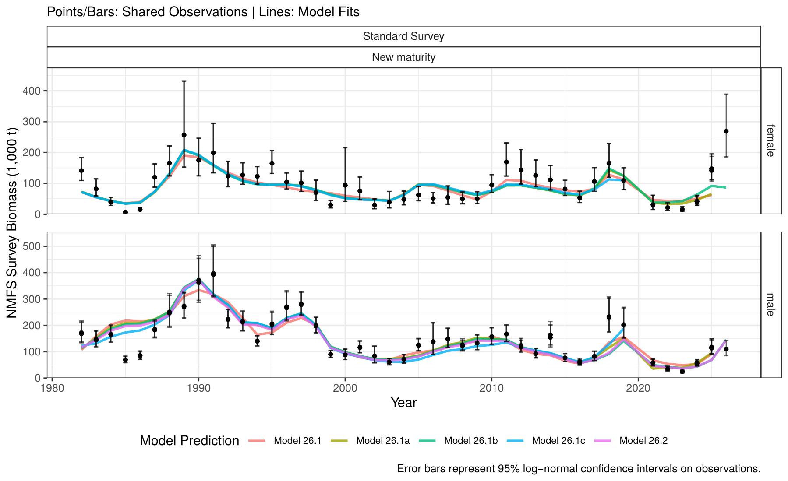
Model fits to survey biomass
Model fits to observed mature biomass at survey (1,000 t), for the 5 models fitted under GMACS 2.20.34.
U.S. Department of Commerce | National Oceanic and Atmospheric Administration | National Marine Fisheries Service
EBS snow crab | September 2026 CPT | 31
Notes:
Fits broadly similar across models; largest misfits in non-directed fishery comps.

Slide 32
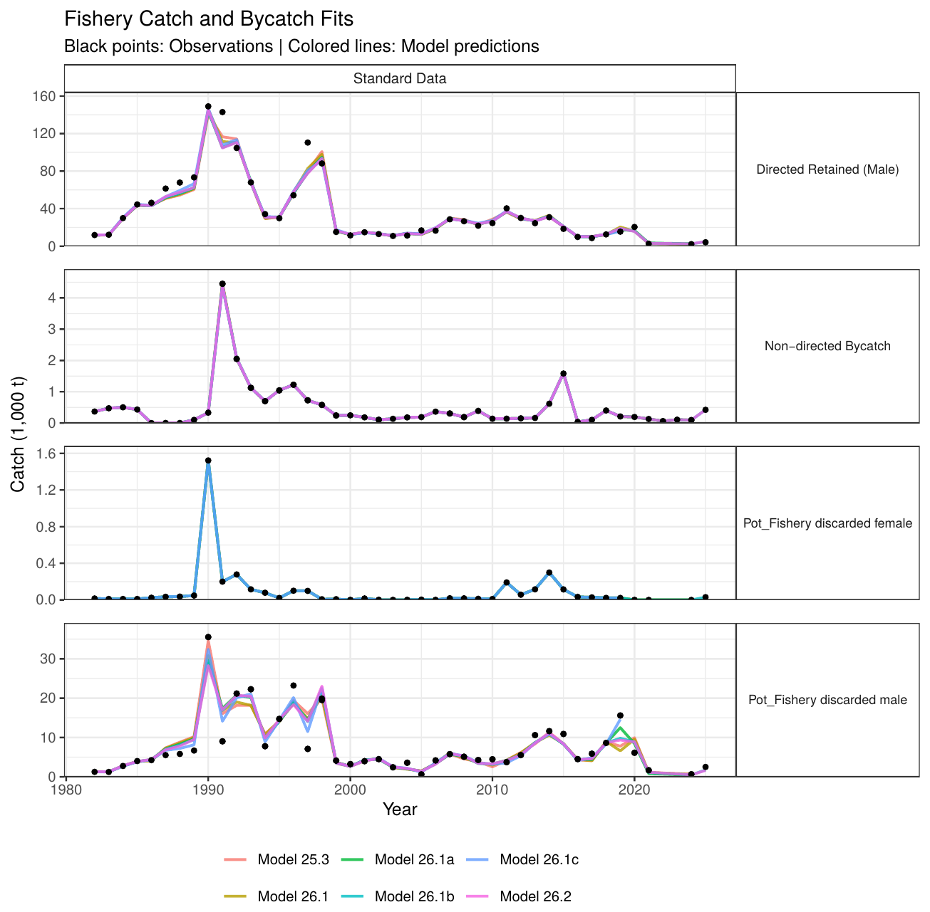
Model fits to catch
Model fits to catch data (1,000 t), for all models presented.
U.S. Department of Commerce | National Oceanic and Atmospheric Administration | National Marine Fisheries Service
EBS snow crab | September 2026 CPT | 32

Slide 33
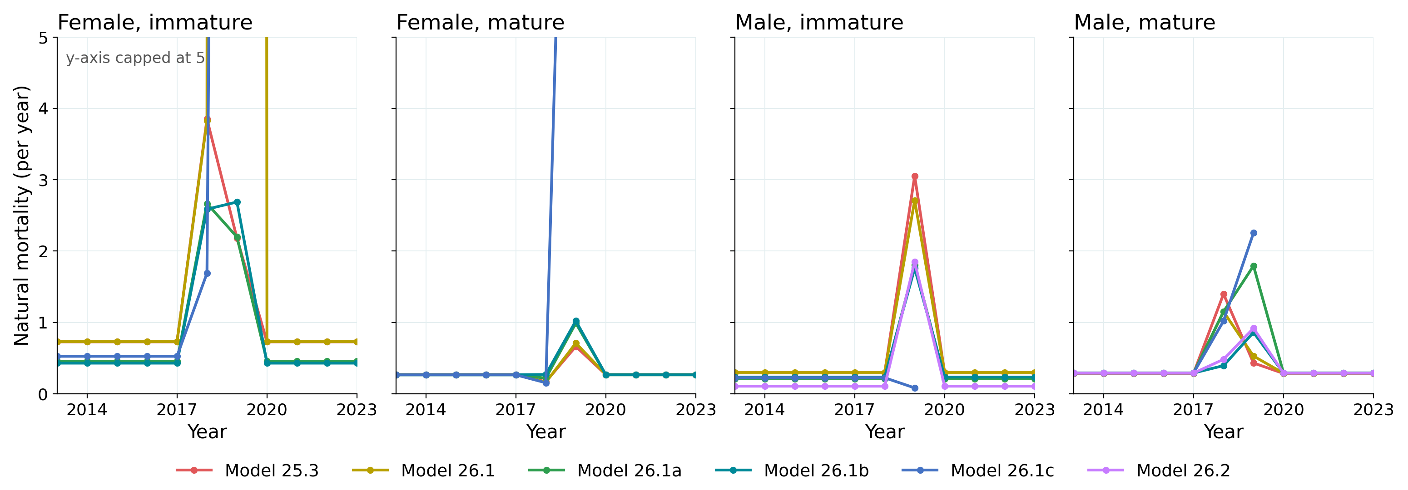
Estimated natural mortality
Estimated natural mortality (per year) by sex and maturity state. Years before 2018 and after 2019 are held at the estimated 2017 value. The y-axis is capped at 5.
U.S. Department of Commerce | National Oceanic and Atmospheric Administration | National Marine Fisheries Service
EBS snow crab | September 2026 CPT | 33

Slide 34
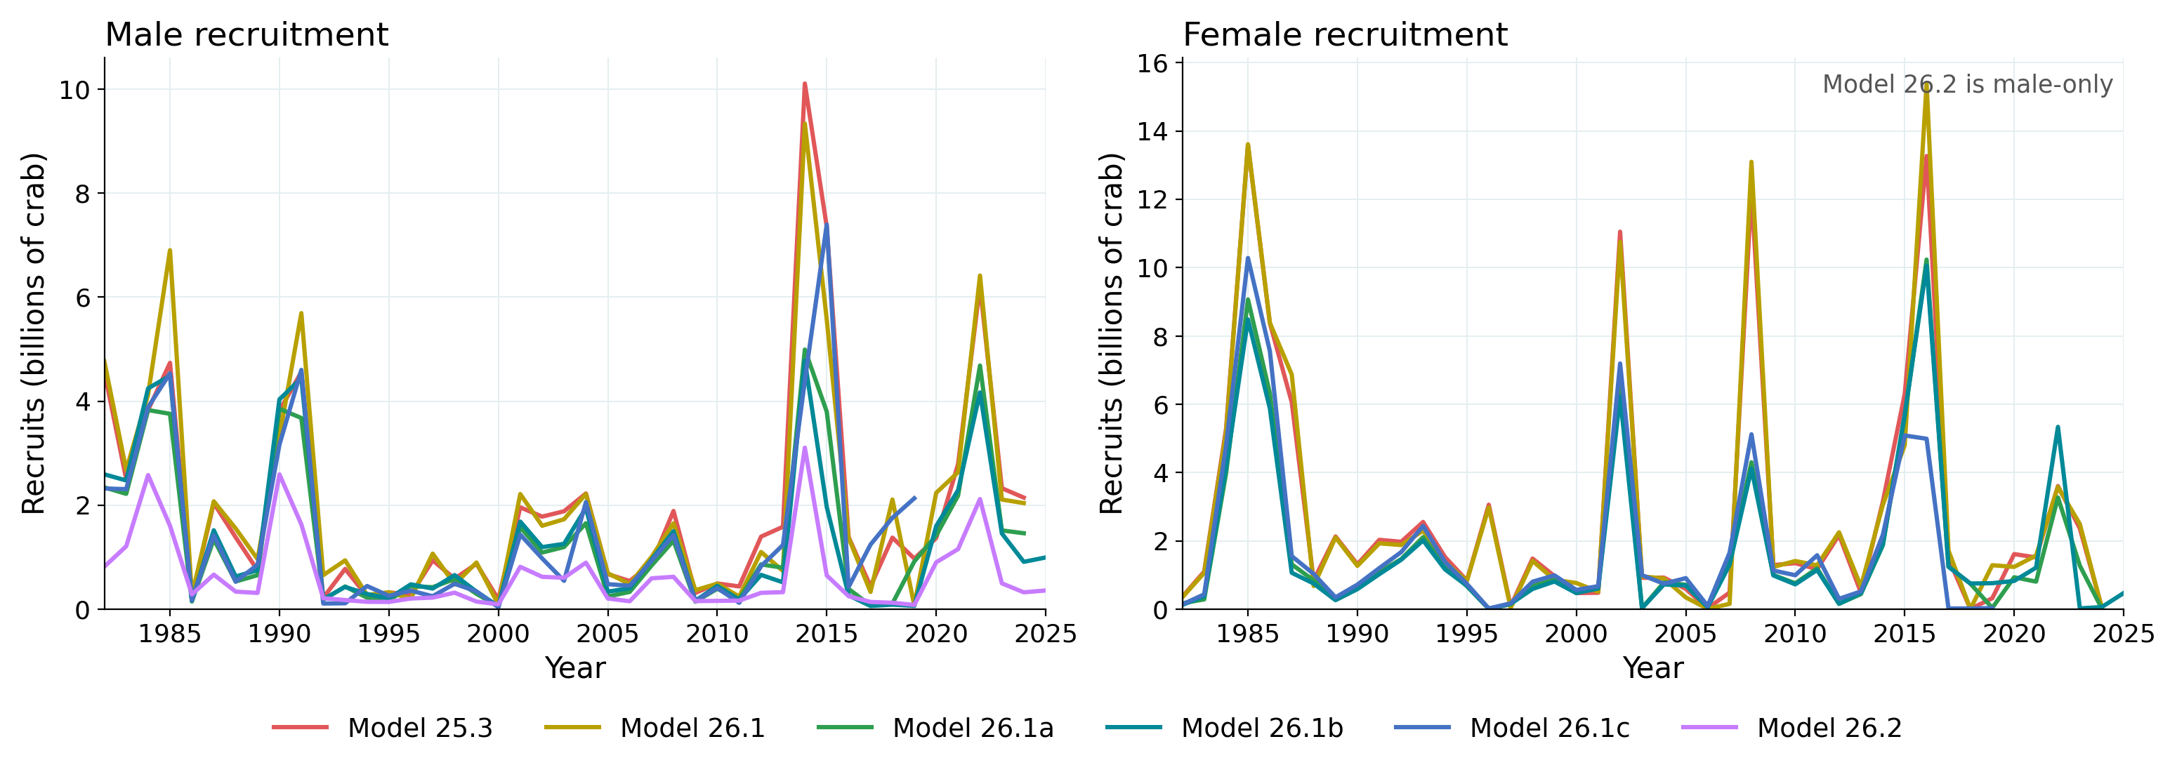
Estimated recruitment
Estimated recruitment by sex (billions of crab), for all models presented.
U.S. Department of Commerce | National Oceanic and Atmospheric Administration | National Marine Fisheries Service
EBS snow crab | September 2026 CPT | 34

Slide 35
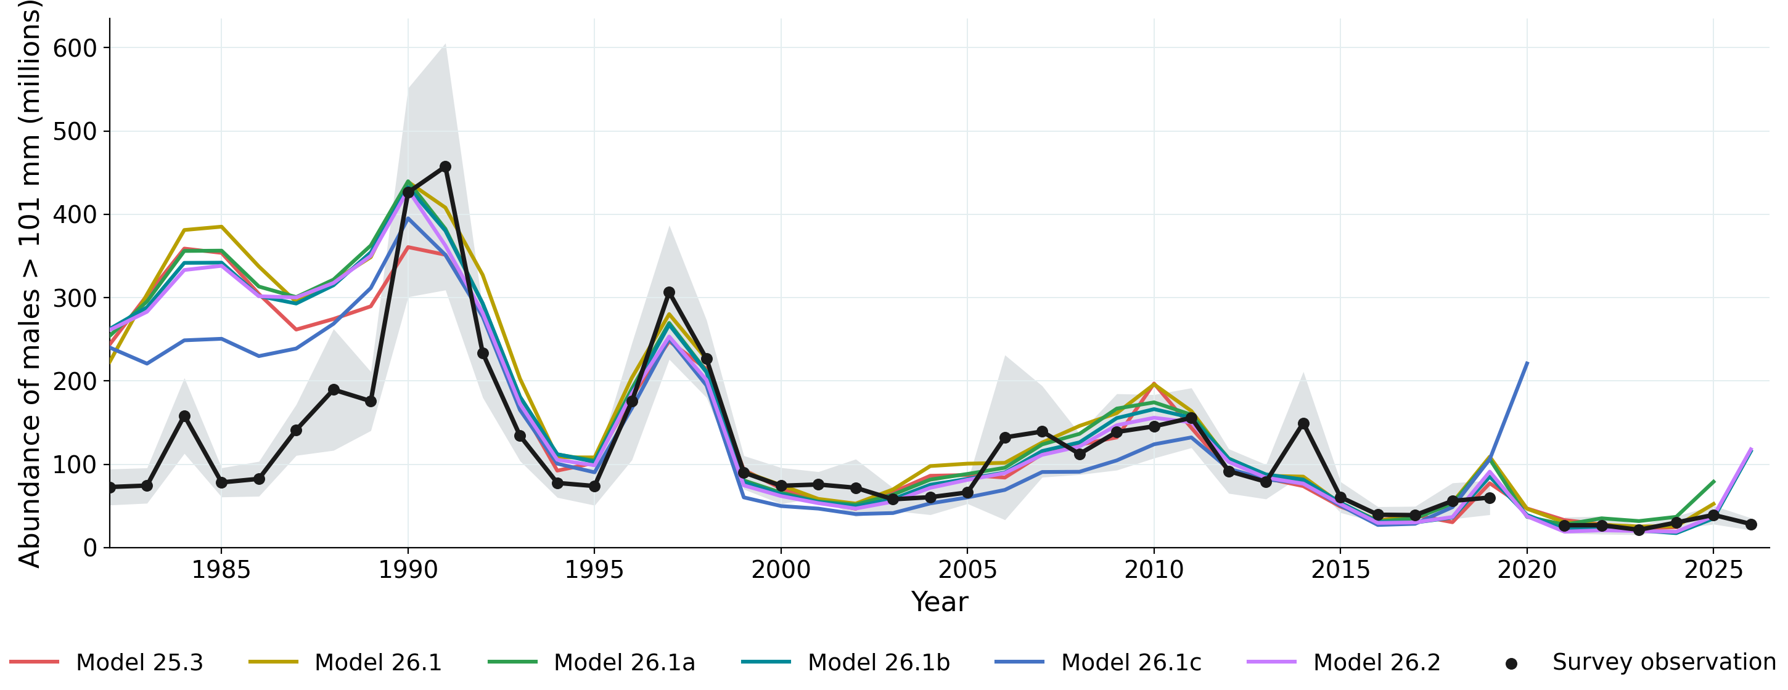
Preferred-male abundance: models vs survey
All models agree recent preferred-male abundance is the lowest in the series
Early years, when survey selectivity differed, are the most variable across models
Abundance of males > 101 mm: survey observations (black, with 95% CI) against each model.
U.S. Department of Commerce | National Oceanic and Atmospheric Administration | National Marine Fisheries Service
EBS snow crab | September 2026 CPT | 35

Slide 36
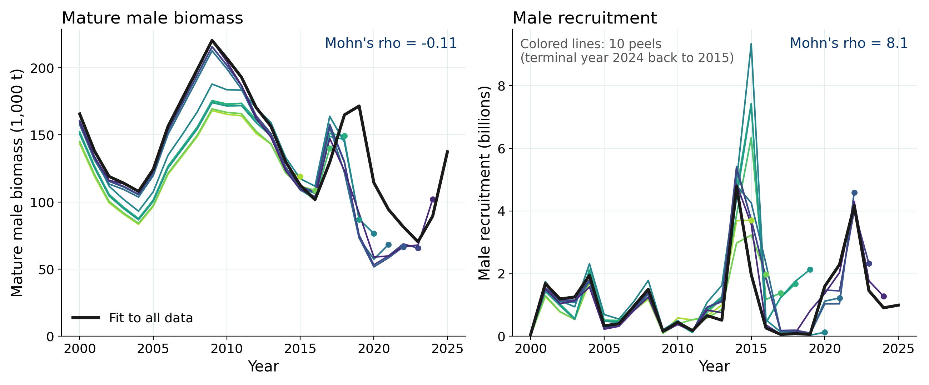
Retrospective analyses (Model 26.1b)
10 peels, terminal years 2024 back to 2015. Mature male biomass rho = -0.11 (-0.11 with the terminal survey dropped),
Peels sit below the full model, so terminal biomass tends to be revised upward with new years of data.
Male recruitment rho = 8.1 so terminal recruitment is unreliable.
U.S. Department of Commerce | National Oceanic and Atmospheric Administration | National Marine Fisheries Service
EBS snow crab | September 2026 CPT | 36

Slide 37
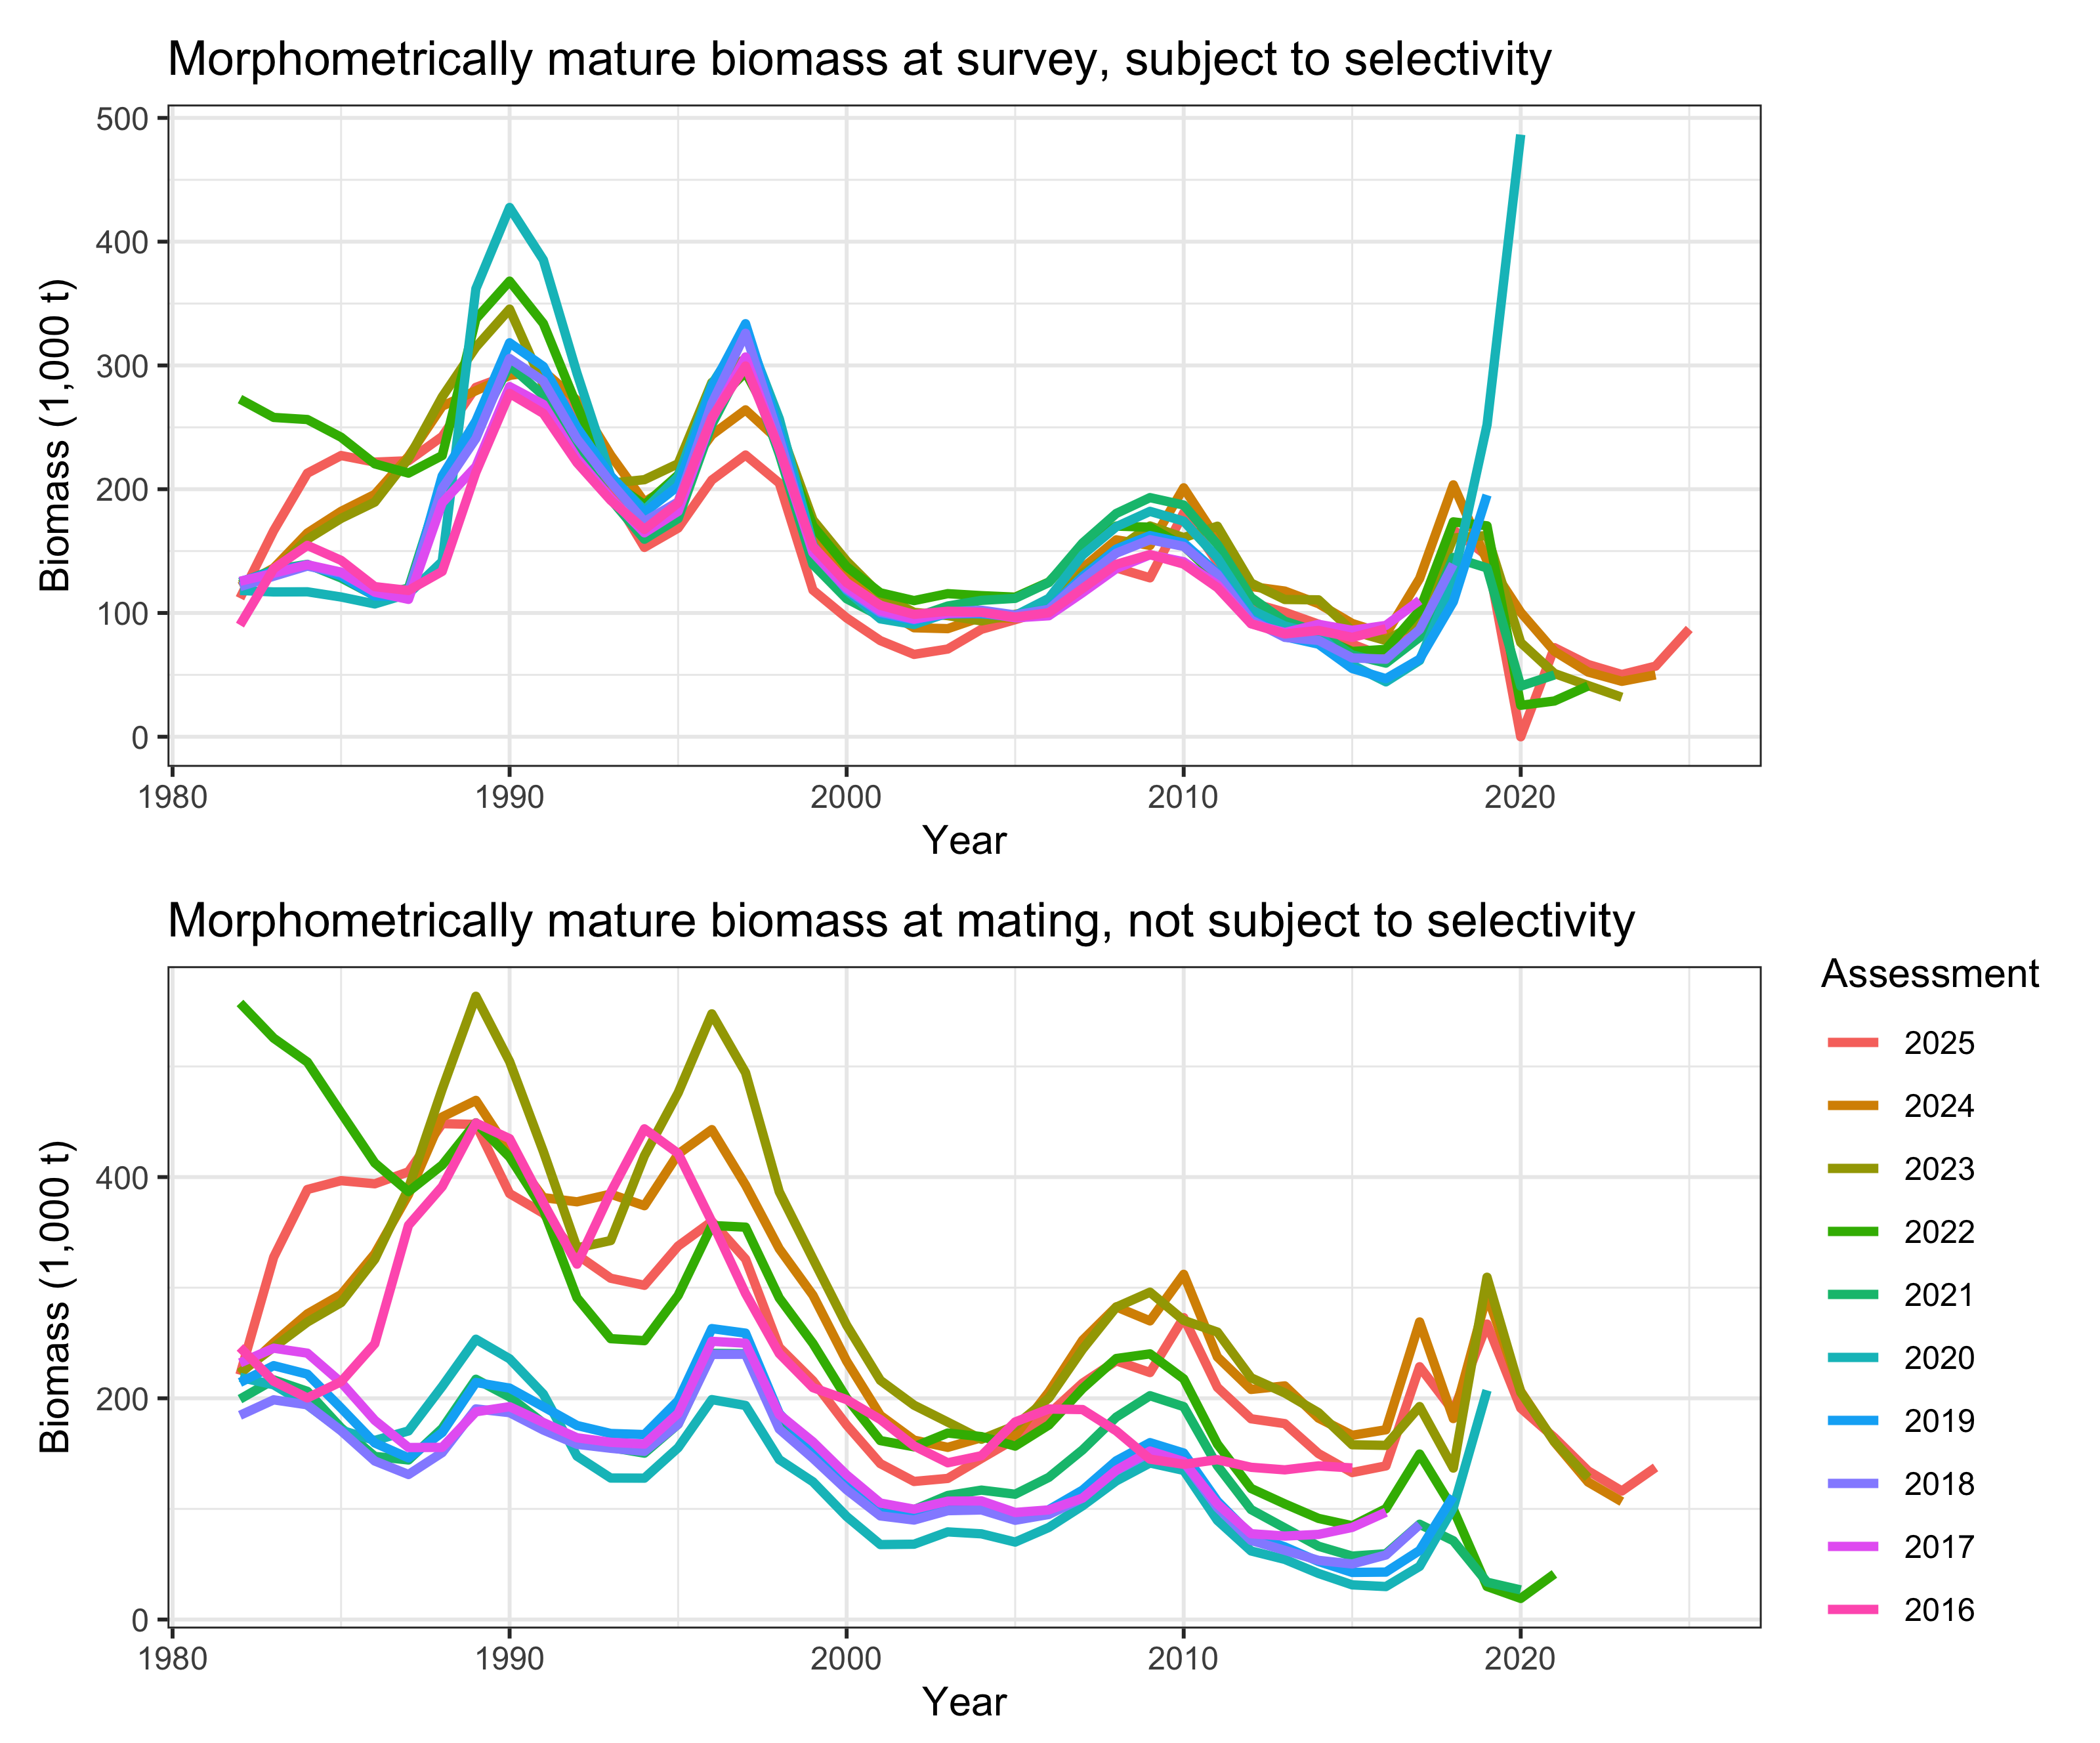
Historical analysis: revisions across assessments
Revisions across accepted assessments dwarf the within-model pattern
2020 biomass: 486.5 kt (2020 assessment), 40.95 kt (2021), 19.1 kt at mating (2022), 205.4 kt (2023)
2018 shows the same pattern without a collapse: mature male biomass at mating was 111.4 kt in the 2019 assessment, 71.2 kt in 2021 and 188.5 kt in 2025
Main suspects: treatment of terminal molt and BSFRF selectivity priors, maturity definition used, and no 2020 survey
MMB as seen by each accepted Tier 3 assessment, 2016-2025.
U.S. Department of Commerce | National Oceanic and Atmospheric Administration | National Marine Fisheries Service
EBS snow crab | September 2026 CPT | 37

Slide 38
The 2019-truncated model (Model 26.1c)
Model 26.1b truncated to 2019, the diagnostic the CPT requested to test whether the post-collapse data and the missing 2020 survey drive the convergence problems
Truncating did not resolve the problem. The 2019 model converges more often (89 of 100 runs, 12 meeting the conventional 0.001 gradient) but settles into 10 distinct minima instead of 6
Only 1.1% of its converged runs recover the best fit, against 1.3% for the full model. The absence of the 2020 survey is not the source of the multimodality
Retrospective pattern differs in sign rather than size: MMB rho is +0.06 against -0.11 for 26.1b, so terminal biomass is revised down as data accumulate. Recruitment rho is 4.6 against 8.1
With 386 parameters against 412, it also shows the multimodality is not driven by parameter count alone: fewer parameters, more minima
+0.06
4.6
MMB Mohn's rho (26.1b: -0.11)
Male recruitment rho (26.1b: 8.1)
89%
1.1%
Runs converged of 100 (26.1b: 78%)
Converged runs at the best fit (26.1b: 1.3%)
Full jitter diagnostics for Model 26.1c are in Appendix B. Its reference points span a different period, so its OFL is not comparable with the other models.
U.S. Department of Commerce | National Oceanic and Atmospheric Administration | National Marine Fisheries Service
EBS snow crab | September 2026 CPT | 39

Slide 39
The male-only model (Model 26.2)
Removes the female population entirely: 412 to 234 parameters
15.2% of jitter runs recover the accepted fit against 1.3% for the two-sex model, and the Hessian is much better conditioned
Male recruitment rho drops from 8.1 to 0.76
Caveat: immature-male M offset at its bound. The implied mortality should not enter a specification model without examination
Appendix B tests 3 pathologies found in the accepted model: a non-identified 2019 immature-female M deviation, a weakly penalized recruitment sex ratio, and an unpenalized level for the 1982 initial numbers at length. Fixing the first 2 (26.d1), replacing the third with an equilibrium backbone (26.d3), and doing all 3 at once (26.d4) left the multimodality in place. Applying the equilibrium backbone to the male-only model (26.d5) helped.
-0.09
0.76
MMB Mohn's rho (26.1b: -0.11)
Male recruitment rho (26.1b: 8.1)
79%
15.2%
Runs converged of 100 (26.1b: 78%)
Converged runs at the best fit (26.1b: 1.3%)
Full jitter diagnostics for the male-only model are in the backup slides and Appendix B.
U.S. Department of Commerce | National Oceanic and Atmospheric Administration | National Marine Fisheries Service
EBS snow crab | September 2026 CPT | 38
Notes:
Main-text depth per plan; Appendix B backup slides available if the CPT wants the experiment detail.

Slide 40
ABC buffer and risk table

Slide 41
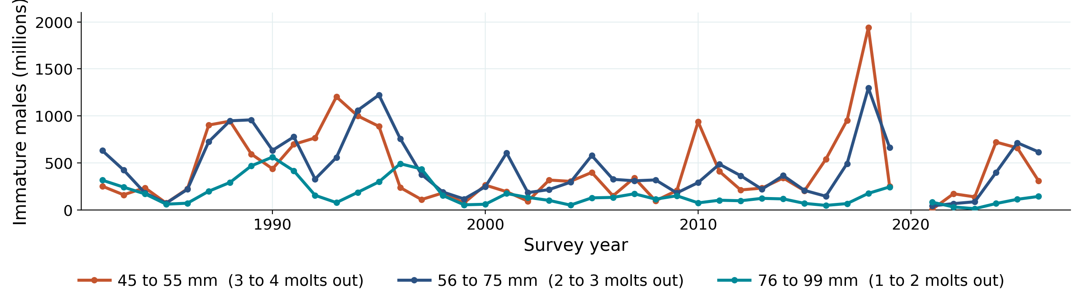
ABC buffer: 20%
Year | SSC buffer
2021 | 25%
2022 | 25%
2023 | 50%
2024 | 65%
2025 | 40%
OFL 95% CI spans 9.27 to 30.36 kt. The alternative-definition OFLs fall outside it
We do not consider a larger buffer necessary: the ESP indicates favorable juvenile conditions, the immature 56 to 75 mm males that recruit over the next 2 to 3 years are 36% above their long-term mean, and the Tier 4 OFL of 16.98 kt sits well below the Tier 3 range (43.8 to 147.3 kt)
5-assessment buffer history mean of 41% (June 2026 SSC supported reporting this)
Discussion point: preferred males are at their 4th lowest and the biomass CI sits entirely below the BMSY proxy. Does that argue for a larger buffer?
Immature male abundance by pre-recruit size window, NMFS summer trawl survey, weighted by the assessment maturity ogive. Terminally molted crab are excluded because they never grow again. No 2020 survey.
U.S. Department of Commerce | National Oceanic and Atmospheric Administration | National Marine Fisheries Service
EBS snow crab | September 2026 CPT | 41
Notes:
Buck raised the buffer as the CPT-side response to the correction. Our position: 20%; open to discussion. 2026 ogive, 47% of males at 77.5 mm and 71% at 97.5 mm are already terminally molted. Abundance does not account for selectivity/availability.

Slide 42
Risk table
Category | Long-term / persistent | Current year
Assessment-related | Level 2: multimodality has persisted across cycles and drove the move to Tier 4 | Level 1: Tier 4 terminal biomass CV 14.8%
Population dynamics | Level 2: considerable uncertainty in M, recruitment retrospective bias, declining size at maturity | Level 2: preferred males 4th lowest in 44 years, with a female-skewed sex ratio
Ecosystem | Not scored | Level 1: cold pool and sea ice favorable, with offshelf spring transport a caveat
Fishery-informed | Not scored | Level 1: fleet behavior driven by weather, sorting, fuel, TAC
U.S. Department of Commerce | National Oceanic and Atmospheric Administration | National Marine Fisheries Service
EBS snow crab | September 2026 CPT | 42
Notes:
Current-year popdyn raised to Level 2 by the authors; the ESP/ESR summary scored it Level 1. Ecosystem/fishery cells from the Sept 2026 ESP-ESR summary.

Slide 43
Rebuilding and next steps

Slide 44
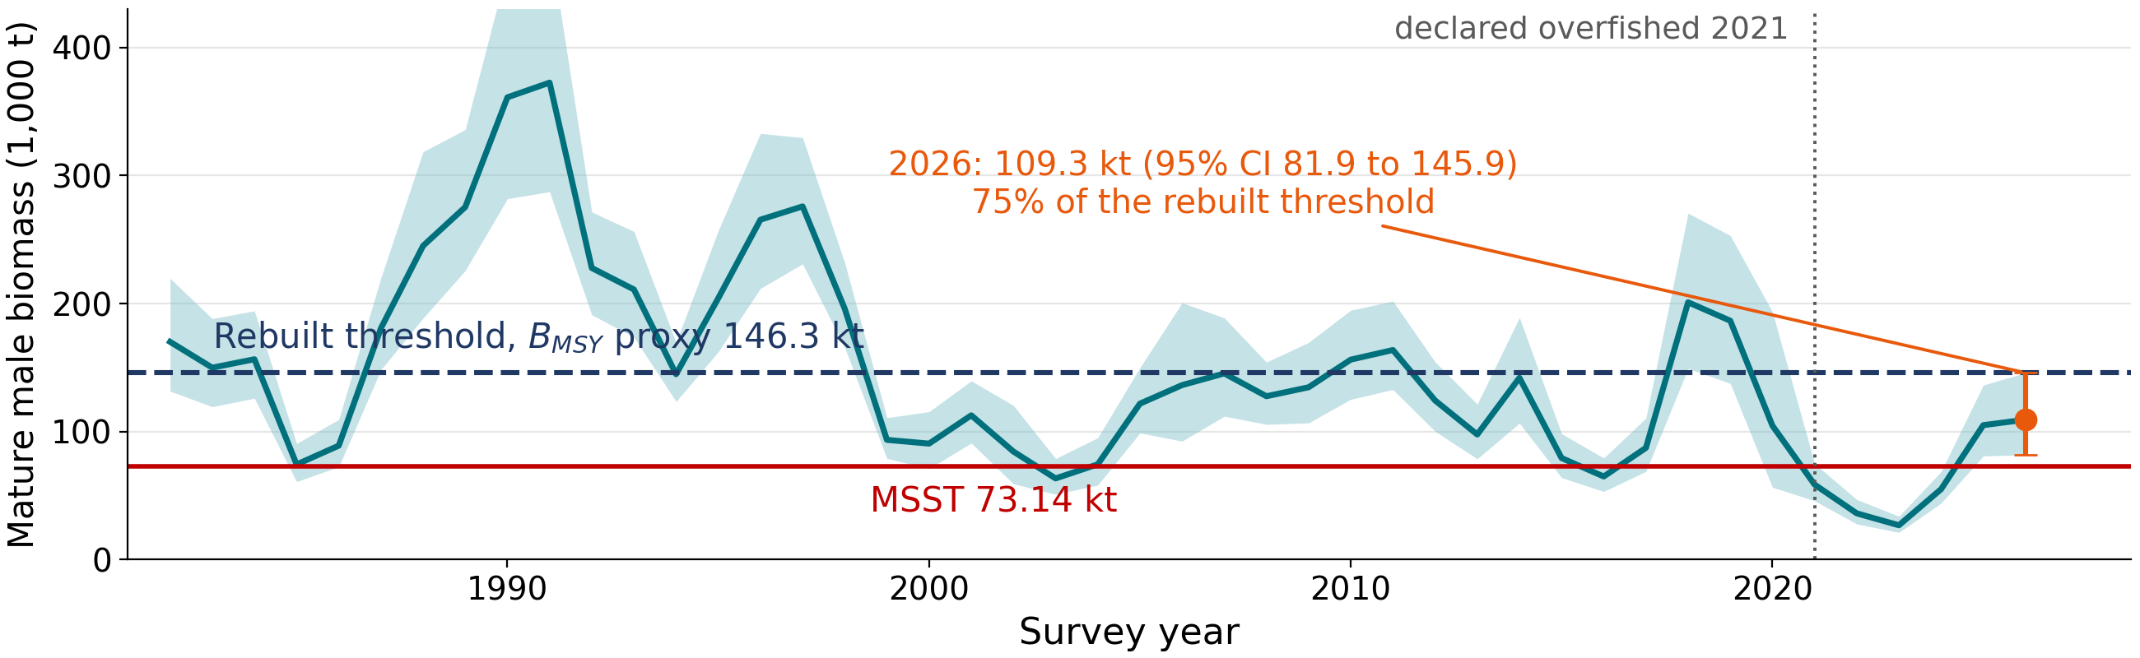
Rebuilding status
Amendment 53 rebuilding plan: Tmin, the minimum time to rebuild with no fishing, is 6 years, which sets Tmax, the longest period National Standard 1 allows, at 10 years. Rebuilt when MMB reaches the BMSY proxy
Median projections (rebuilt by 2029 under no fishing, bycatch only, and the State harvest strategy, and by 2030 fishing at the ABC) come from the rebuilding analysis in the Amendment 53 final EA (NPFMC and NMFS 2023), not from this assessment. No model run this cycle produces a projection
With 2018-19-type mortality events recurring ~1 year in 7, rebuilding extends to 2034 or beyond
Main driver is recruitment and the ecosystem conditions permitting it, not fishing mortality. Model 26.1b recruitment collapsed to 0.06-0.09 billion in 2018-19, recovered to 1.6-4.2 billion over 2020-2022 and ~1.0 billion in 2024-25 (terminal estimates uncertain, rho = 8.1)
REMA smoothed mature male biomass with its 95% prediction interval, against the rebuilt threshold and the MSST.
U.S. Department of Commerce | National Oceanic and Atmospheric Administration | National Marine Fisheries Service
EBS snow crab | September 2026 CPT | 44

Slide 45
Research priorities for the January 2027 workshop
Convergence work with male-only model: staged simplification, re-adding complexity while testing convergence at each step
Likelihood profiles once a stable model exists
Match survey data processing to Tanner?
Growth data audit, actual composition sample sizes, and discard mortality handled inside GMACS
U.S. Department of Commerce | National Oceanic and Atmospheric Administration | National Marine Fisheries Service
EBS snow crab | September 2026 CPT | 45

Slide 46
Summary and requests to the CPT
Recommended 2026/27 specification (Tier 4, morphometric MMB, ramped rule + Baranov): OFL 16.98 kt, ABC 13.58 kt (20% buffer)
Status 0.747. Not overfished, no overfishing, rebuilding continues
Net-mensuration correction incorporated throughout the models fit to current data
Tier 3 models document real progress. Male-only is the suggested path to a stable model for 2027
Requests:
  Feedback on the 20% buffer given the correction and the preferred-male situation
  Guidance on model simplification for the January 2027 workshop (ask Andre…)
  Endorsement of the maturity reporting approach: the specification is set on morphometric MMB, with the >= 95 mm and > 101 mm results shown alongside it in every table
U.S. Department of Commerce | National Oceanic and Atmospheric Administration | National Marine Fisheries Service
EBS snow crab | September 2026 CPT | 46

Slide 47
Backup slides

Slide 48
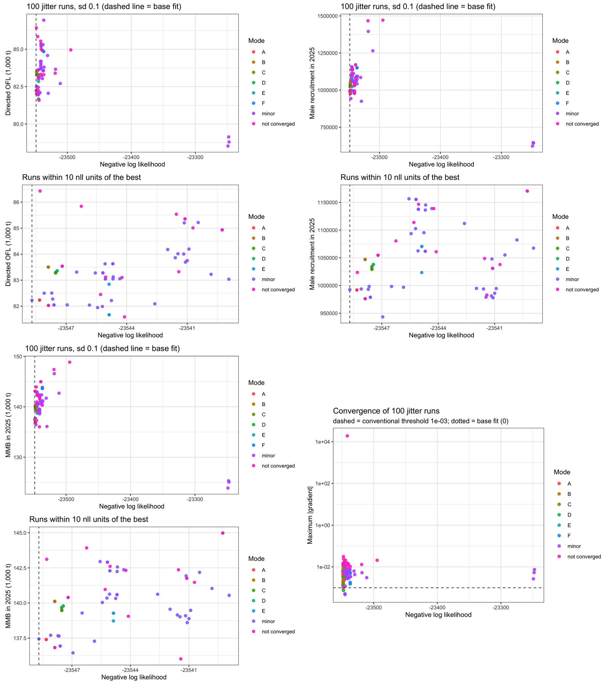
Backup: jitter diagnostics, Model 26.1b
Jitter diagnostics, Model 26.1b (accepted).
U.S. Department of Commerce | National Oceanic and Atmospheric Administration | National Marine Fisheries Service
EBS snow crab | September 2026 CPT | 48

Slide 49
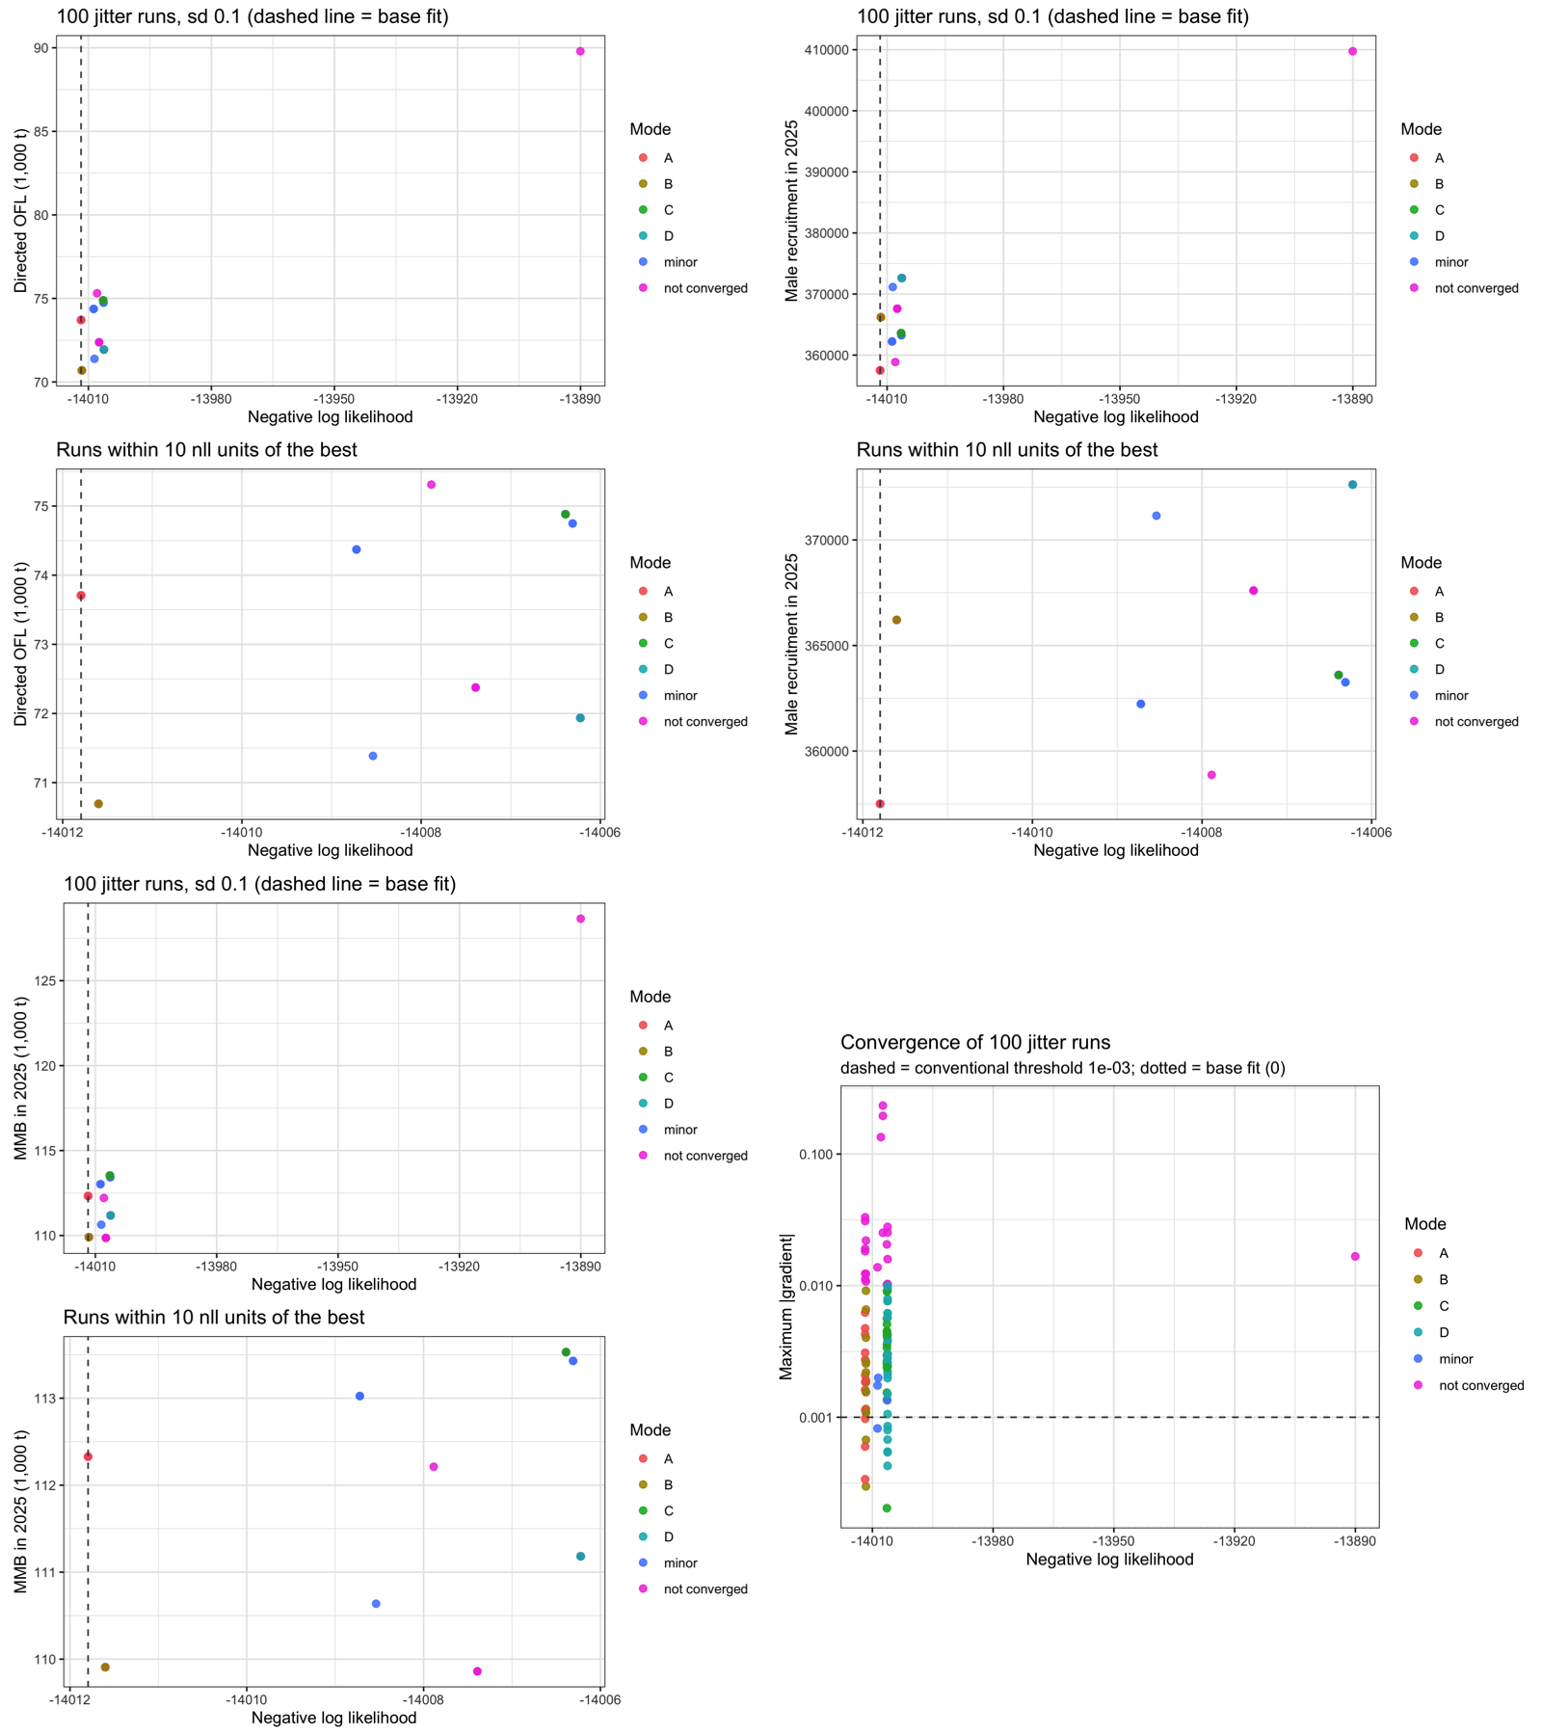
Backup: jitter diagnostics, Model 26.2 (male-only)
Jitter diagnostics, Model 26.2 (male-only).
U.S. Department of Commerce | National Oceanic and Atmospheric Administration | National Marine Fisheries Service
EBS snow crab | September 2026 CPT | 49

Slide 50
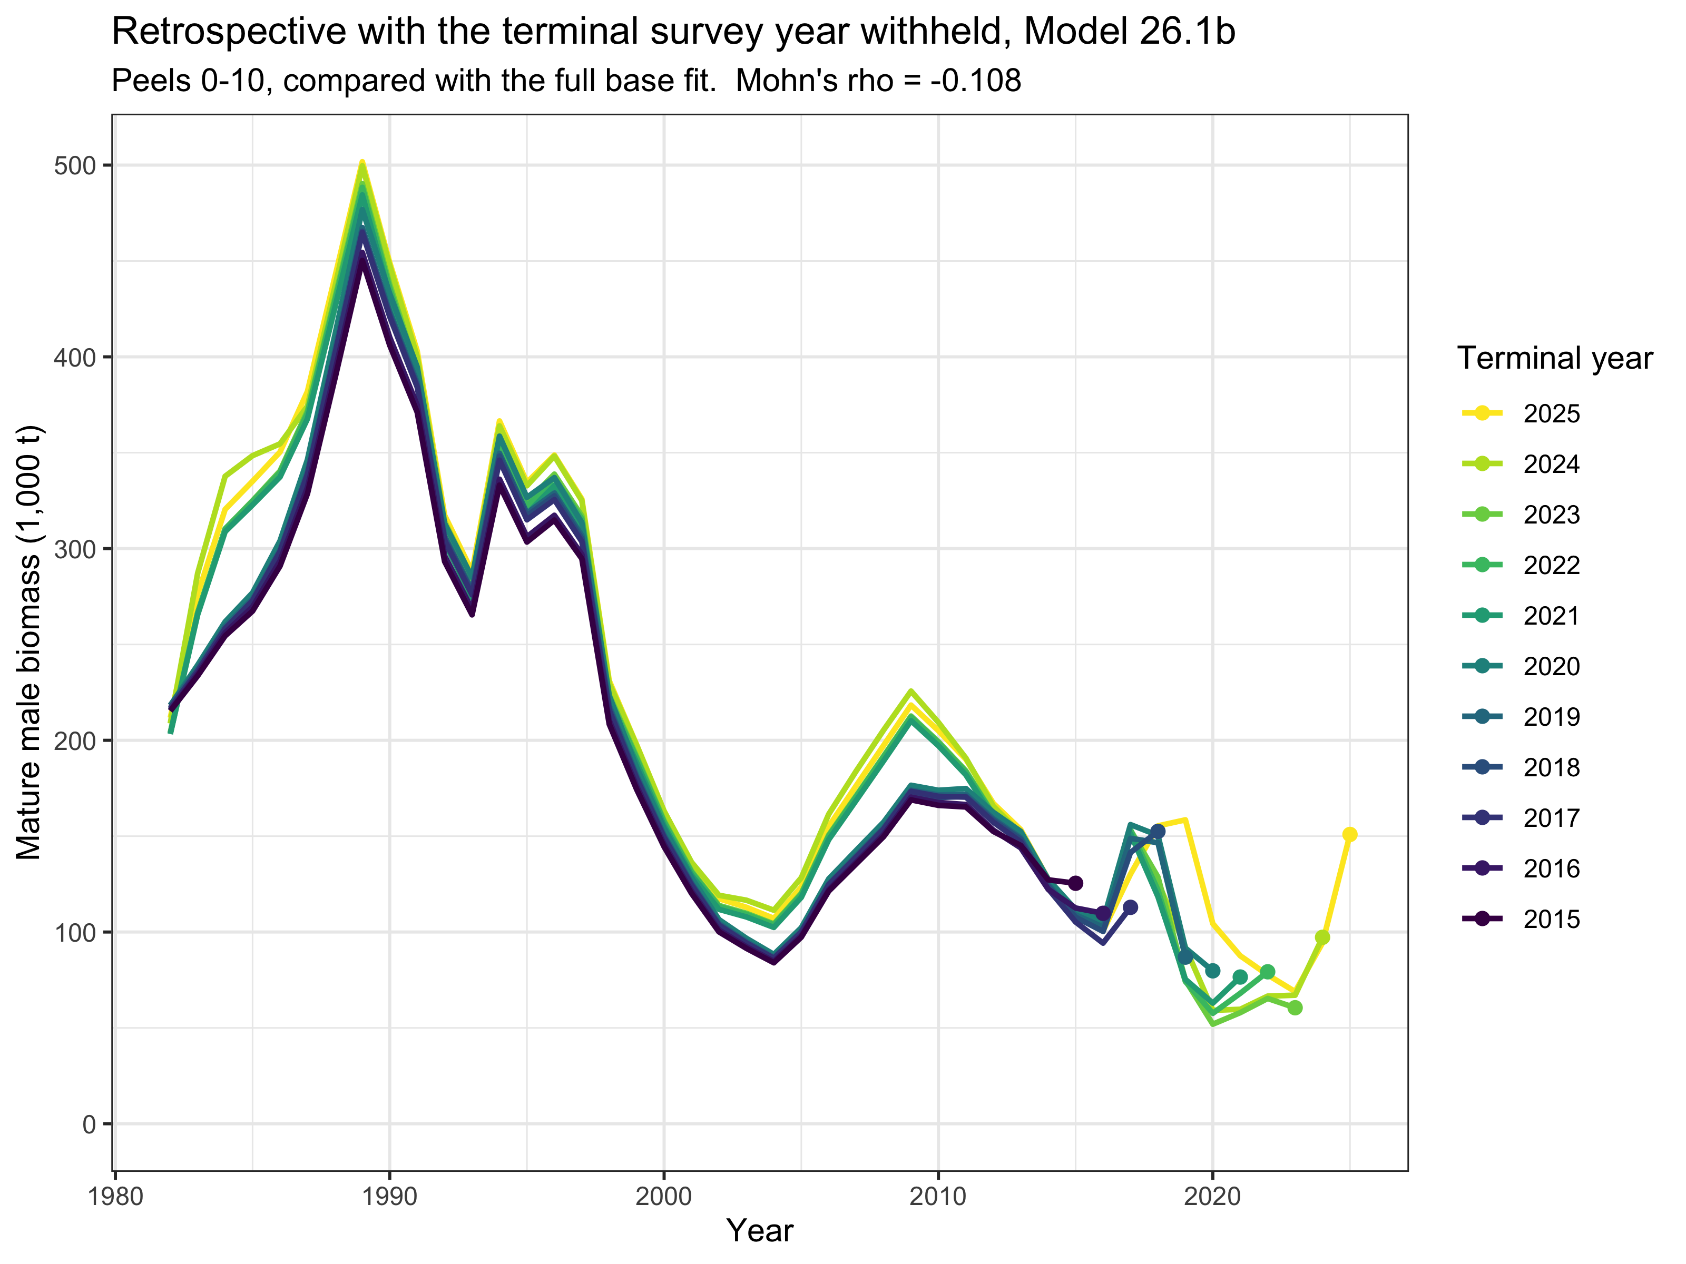
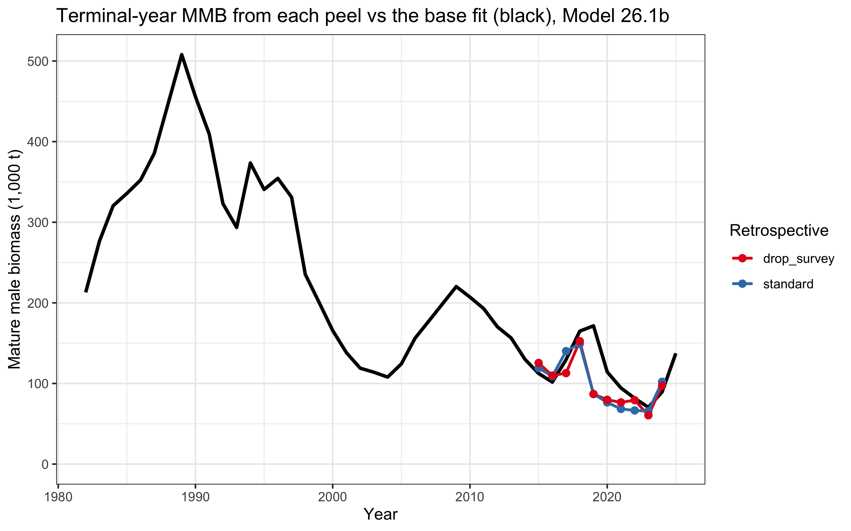
Backup: retrospective variants
Terminal-year estimates by peel vs full model.
Terminal-survey-dropped retrospective.
U.S. Department of Commerce | National Oceanic and Atmospheric Administration | National Marine Fisheries Service
EBS snow crab | September 2026 CPT | 50

Slide 51
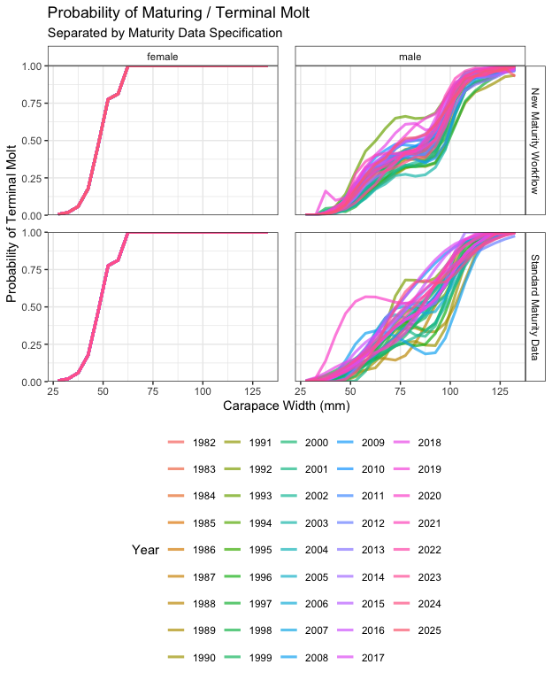
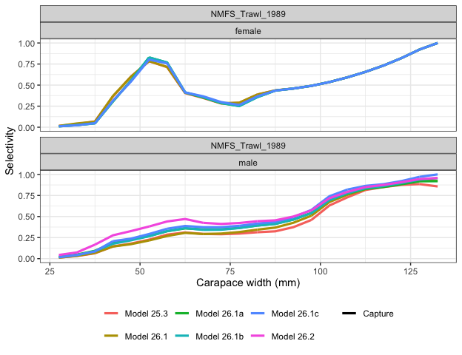
Backup: selectivity and maturity inputs
Survey selectivity with BSFRF-derived priors.
Probability of maturing: estimated vs specified.
U.S. Department of Commerce | National Oceanic and Atmospheric Administration | National Marine Fisheries Service
EBS snow crab | September 2026 CPT | 51

Slide 52
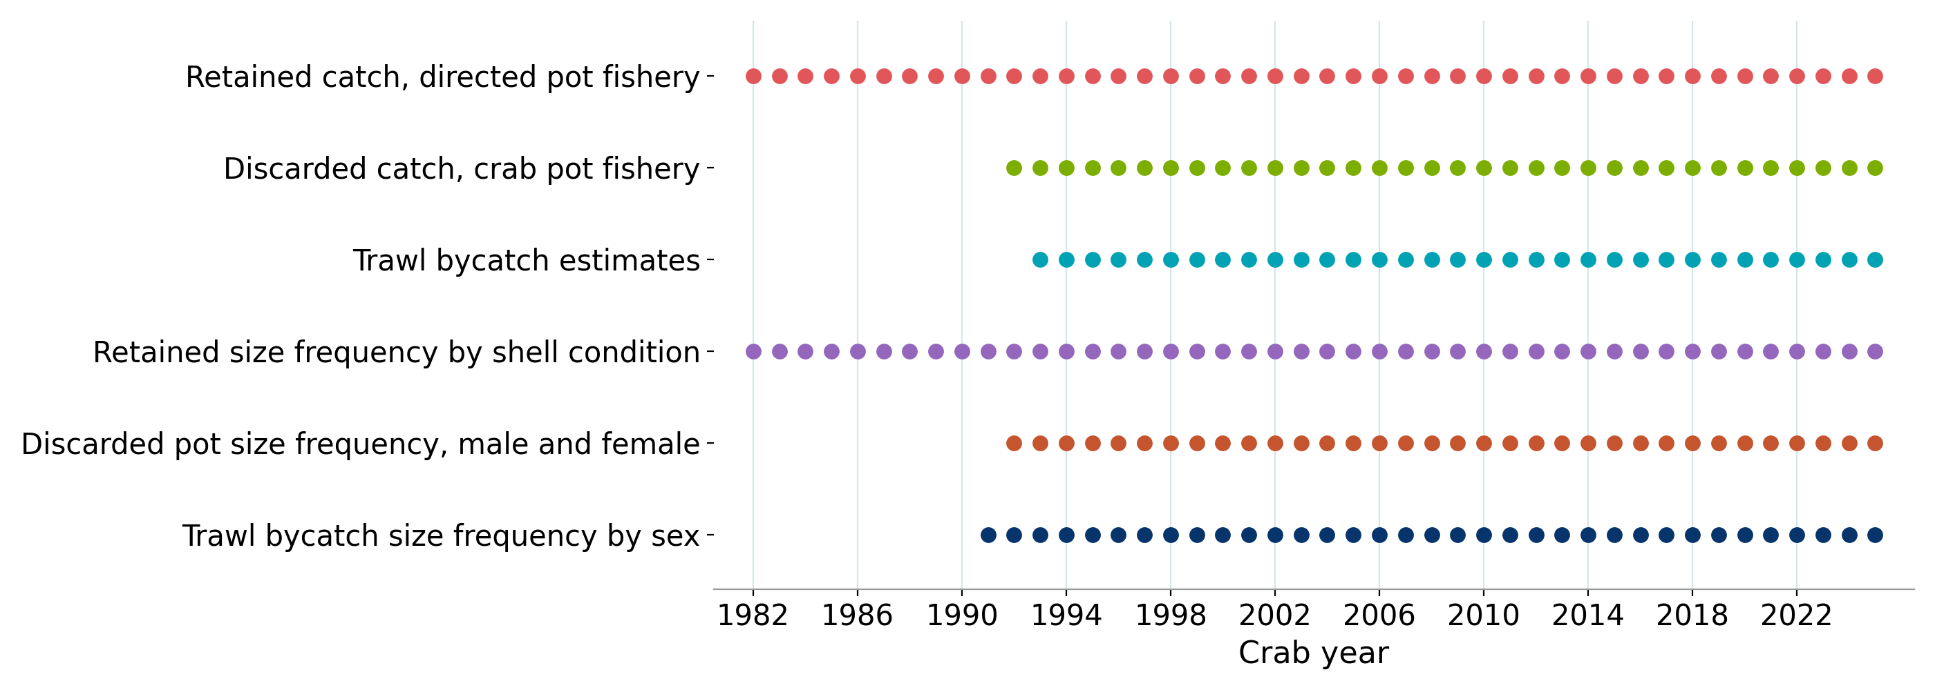
Backup: catch data series
Catch and fishery composition series used in the assessment, and the crab years each spans.
U.S. Department of Commerce | National Oceanic and Atmospheric Administration | National Marine Fisheries Service
EBS snow crab | September 2026 CPT | 52

